Slide 1


Advanced LIGO computing requirements
Stephen Fairhurst
& Paul Hopkins

Slide 2



Accelerating Mass produces
Gravitational Waves

Slide 3
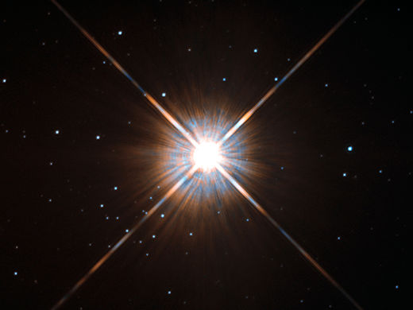
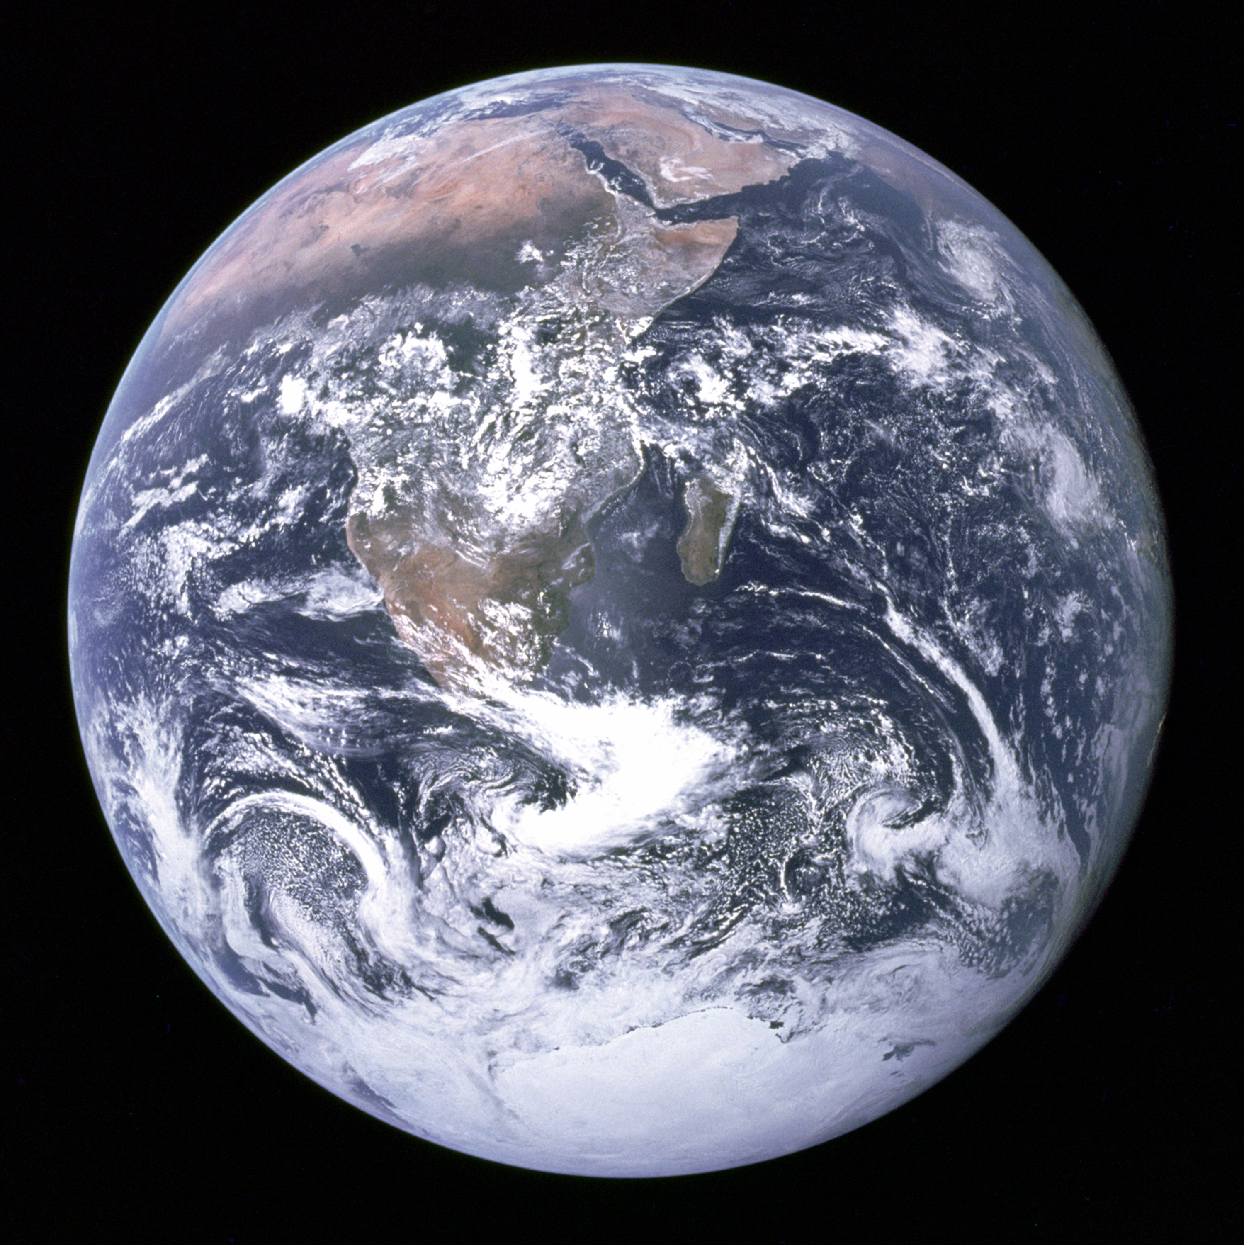
Proxima Centauri
4 light years
40 trillion km =
40,000,000,000,000 km

Slide 4
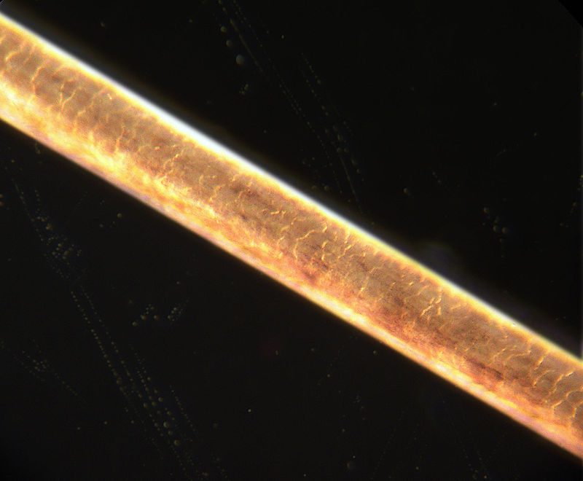
Proxima Centauri
Human hair
4 light years
40 trillion km =
40,000,000,000,000 km
WARNING: Not to scale!

Slide 5
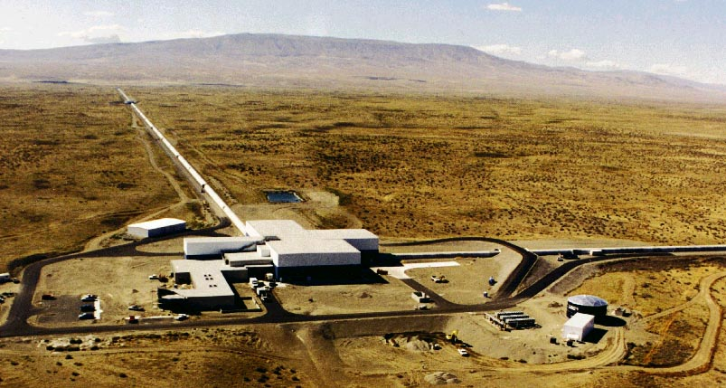
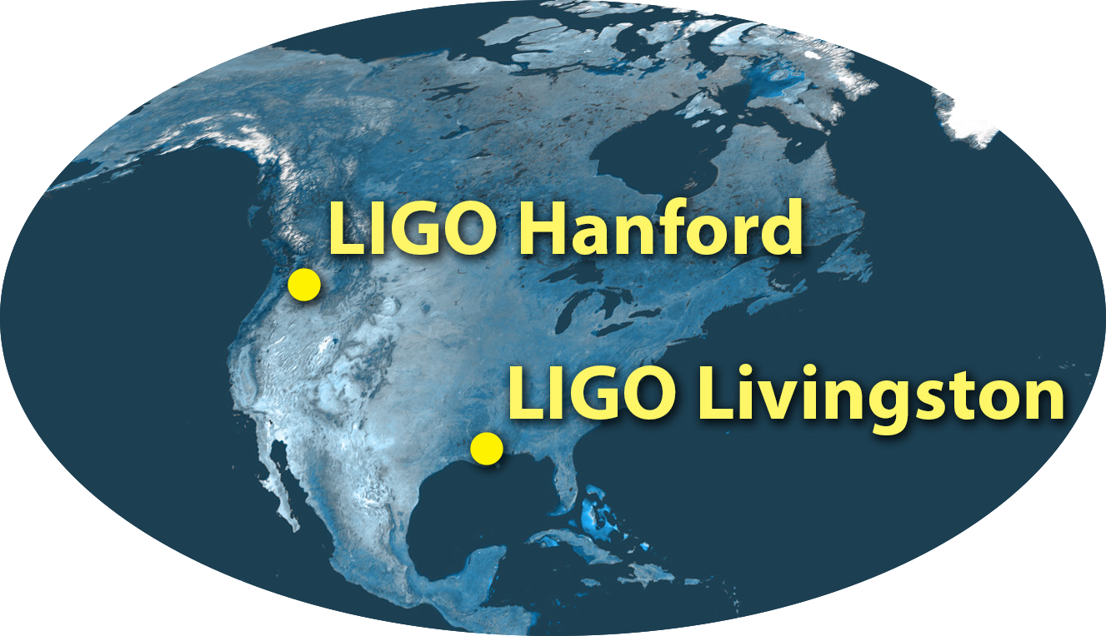
LIGO Hanford Observatory

Slide 6
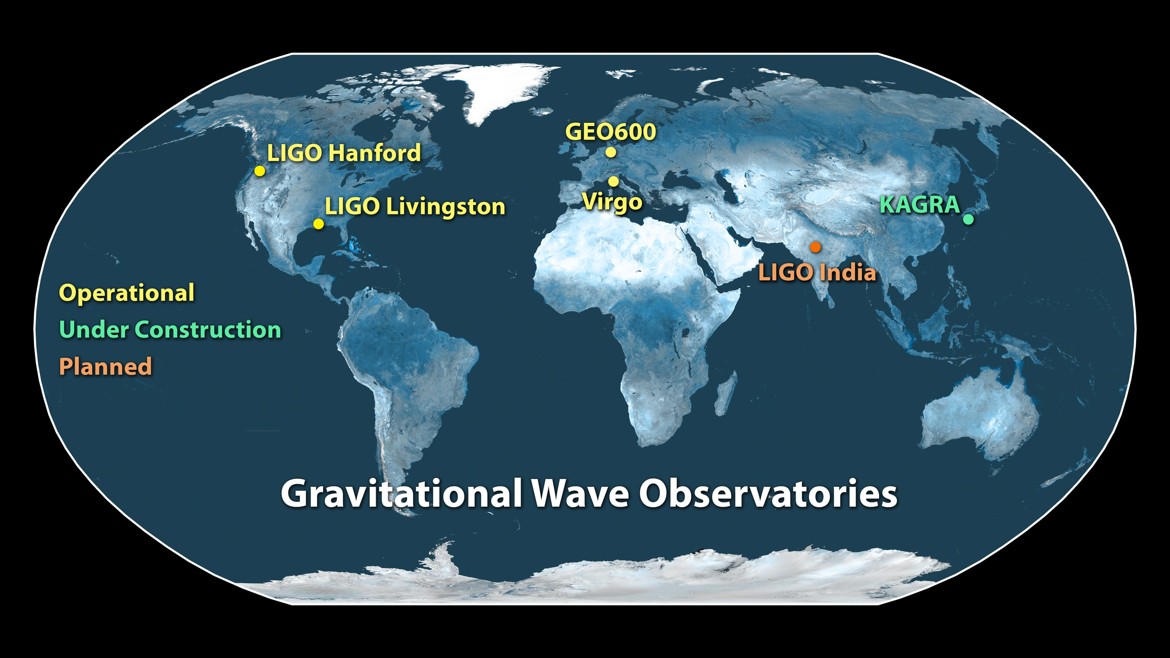

Slide 7
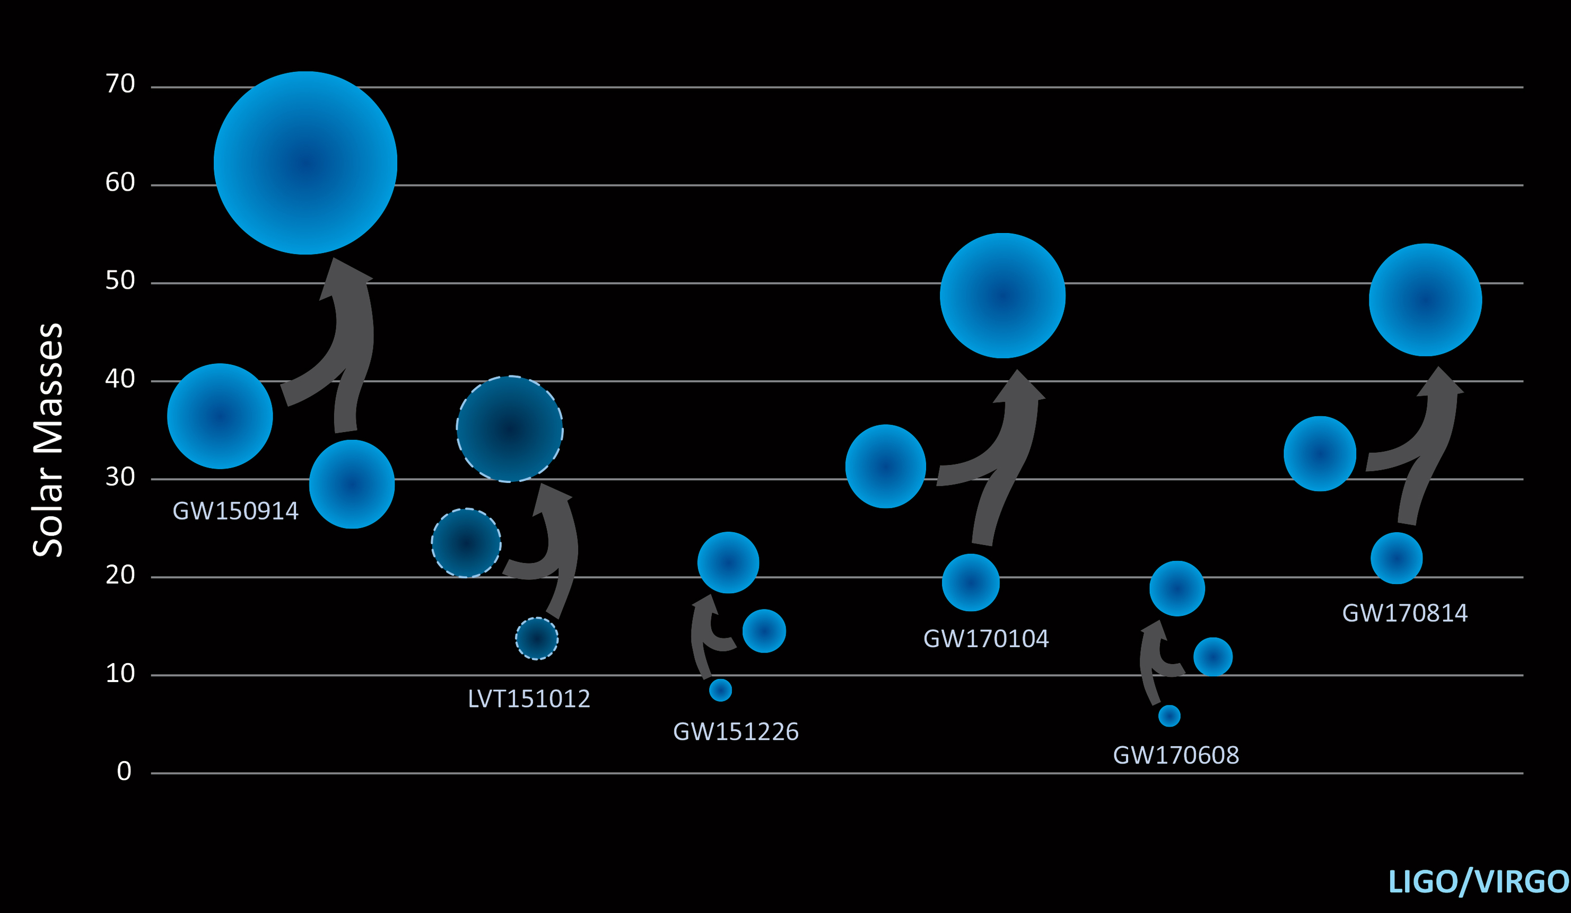

Slide 8
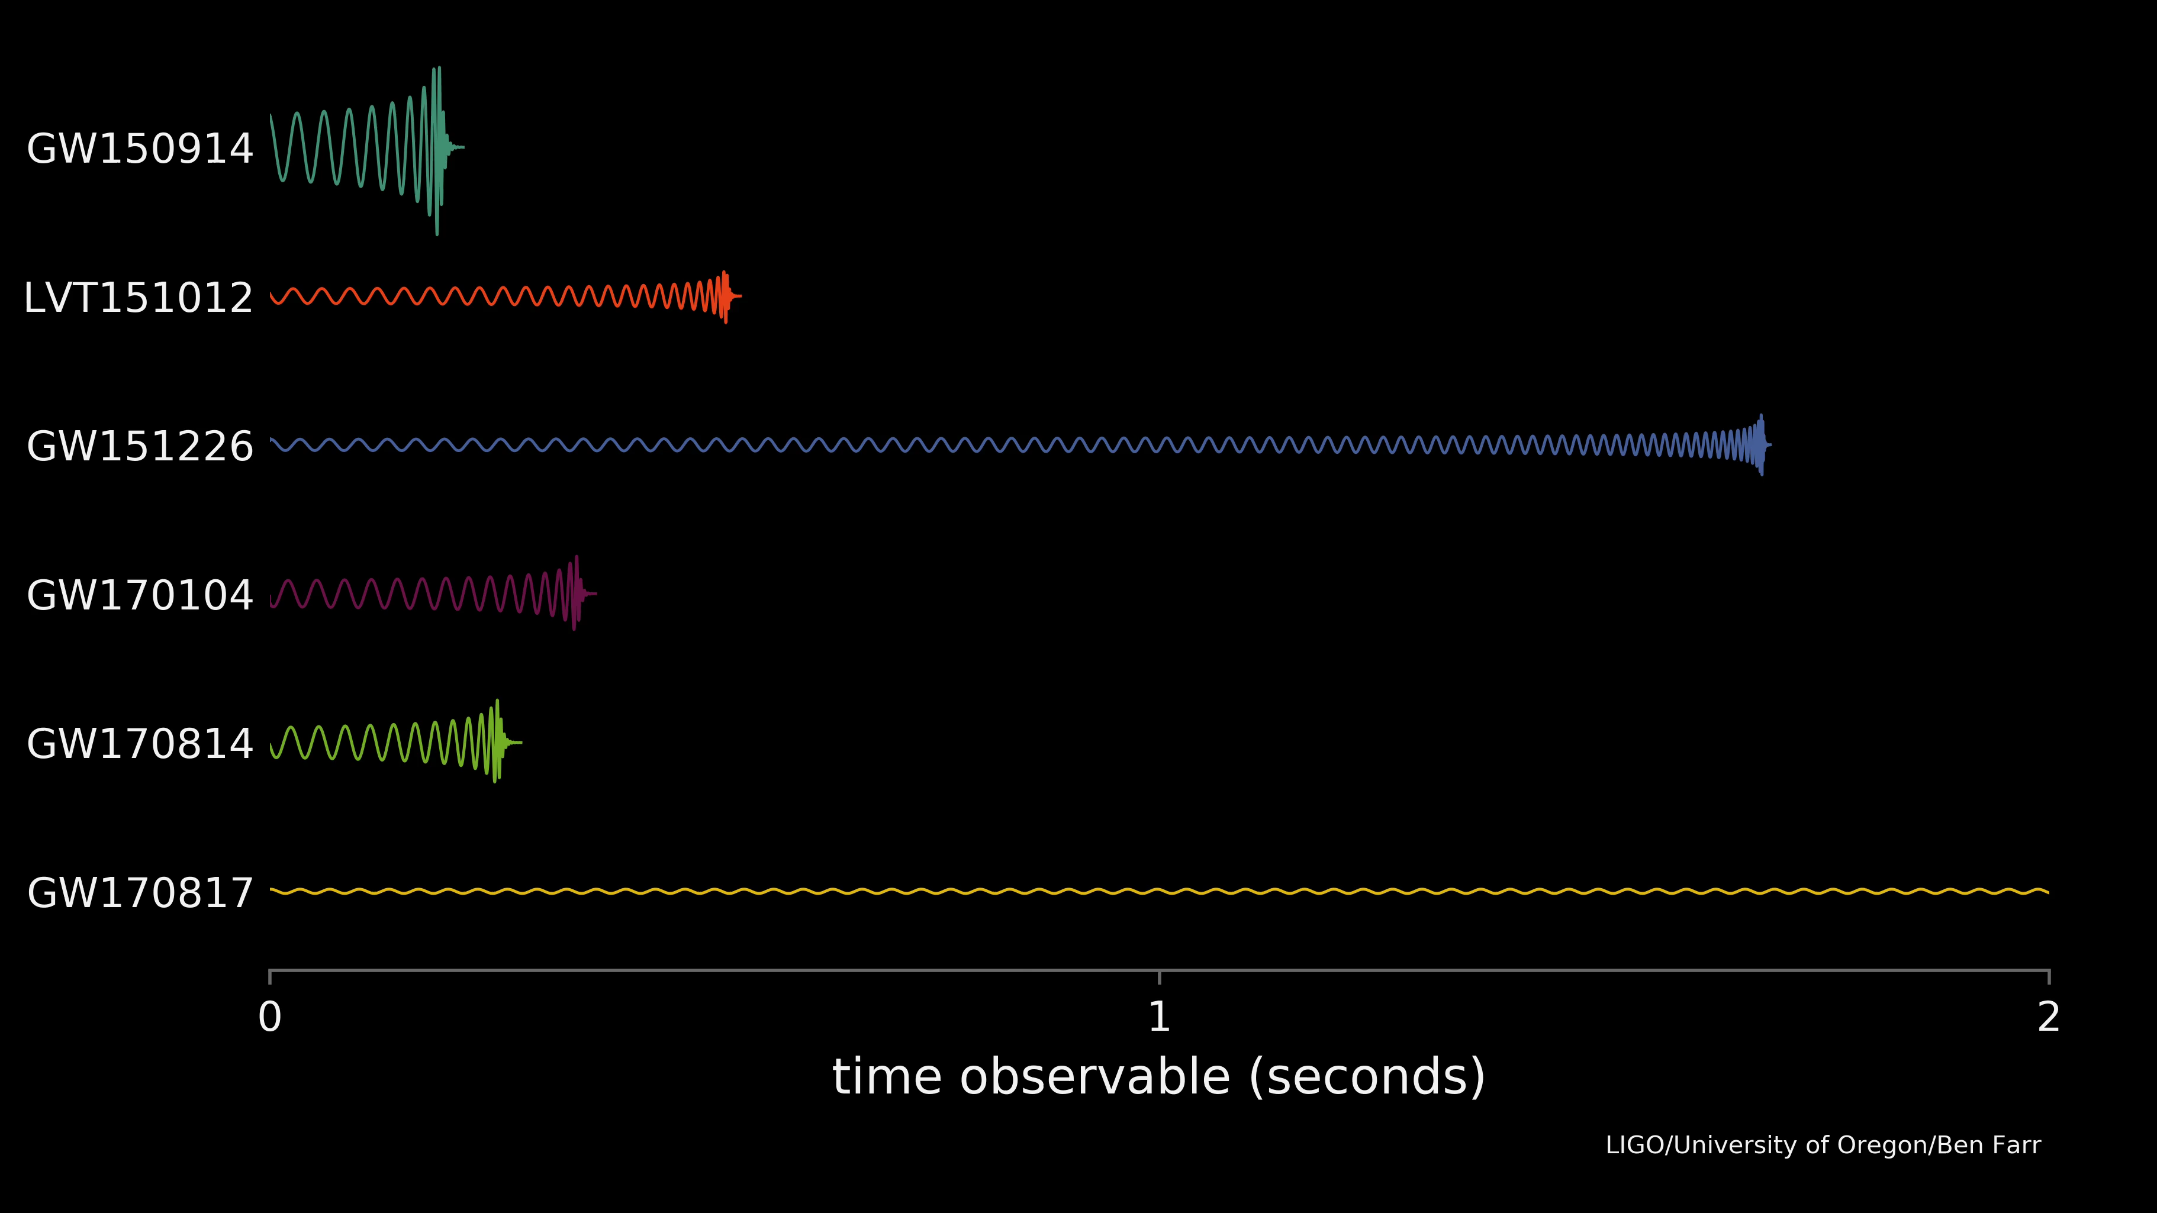

Slide 10
Computational Challenges

Slide 11
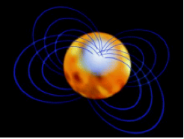

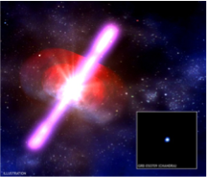
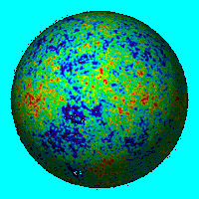
Gravitational Wave Sources/Searches
Continuous Waves:
Spinning Neutron
Stars
Coalescing Binaries:
Merging black holes
and neutron stars
Short Bursts:
Supernovae,
Gamma Ray Bursts
Stochastic Background: GW from the Big Bang or Astrophysical sources

Slide 12
Gravitational Wave Sources/Searches
Continuous Waves:
Spinning Neutron
Stars
Coalescing Binaries:
Merging black holes
and neutron stars
Known waveform: matched filter
Short Bursts:
Supernovae,
Gamma Ray Bursts
Stochastic Background: GW from the Big Bang or Astrophysical sources
Unknown waveform: cross correlate data

Slide 13
Computational challenges
(Mostly) ‘embarrassingly parallel’ high throughput computing, ~ 1 Petaflop
Einstein@home project for Continuous Waves all sky search; ~ 2.5 Petaflops
Dominant use on LIGO/Virgo resource:
  binary search using 300,000 templates. Number and length of templates increases with sensitivity.
  parameter estimation on events. Scales with number of observed events. Repeat with various waveform models and physical effects incorporated.
  results in low latency required for electromagnetic followup

Slide 14
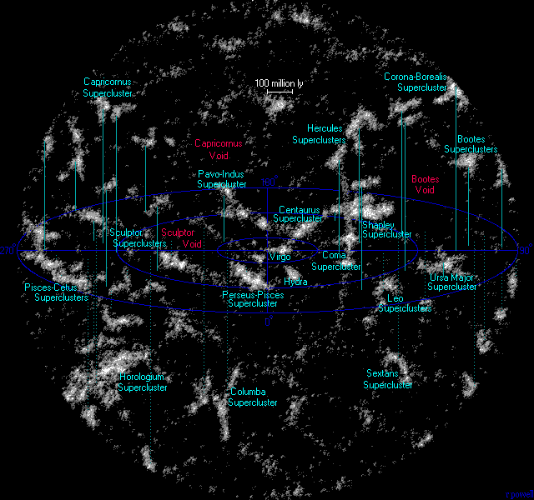
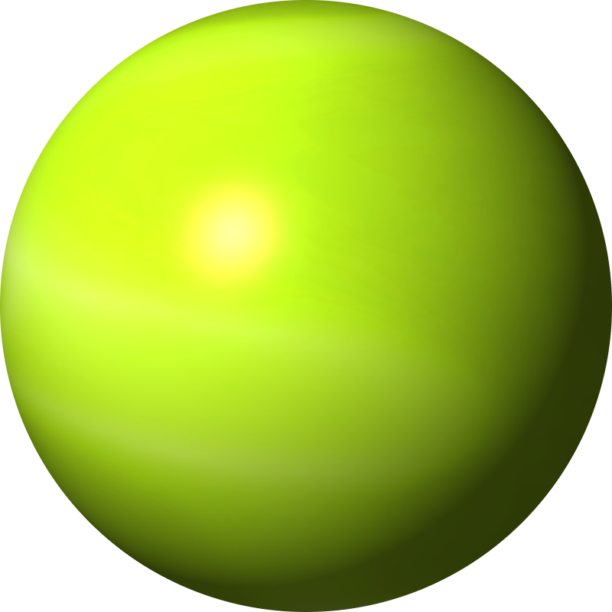
2017
Images: R. Powell, The Atlas of The Universe,

Slide 15
2020
Images: R. Powell, The Atlas of The Universe,

Slide 16
Production computing environments
Current Baseline: Dedicated/committed LIGO clusters, and Einstein@Home
Increasing use of other resources:
  US Open Science Grid
  European Virgo clusters
  UK GridPP Tier 0
Multiple pipelines adapted to take advantage of GPUs
  Some LSC clusters have a large number of GPUs, e.g.
  2400 at Max Planck Institute
Containerization – light-weight virtualization
Federated access to resources, including computational clusters, but also e.g. data, web pages, services etc.

Slide 17
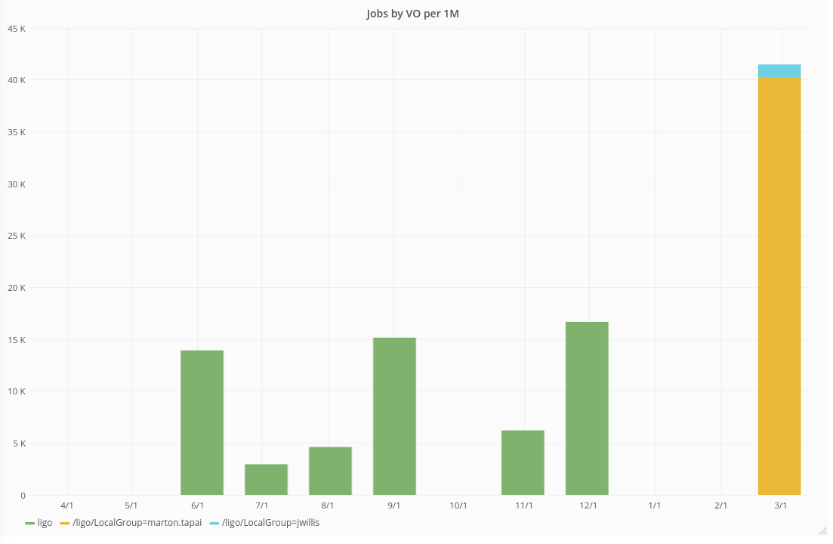
LIGO Jobs running at RAL

Slide 18
LIGO Computing Resources
Resources are distributed around the world and inhomogeneous:
Lab and LSC committed clusters
  Standard operating system
  dependencies and software installed on system
  condor scheduler
LSC general purpose clusters and Virgo clusters
  Shared with university or other organization
  Variety of OS and schedulers
  Challenges managing software and dependencies
  Extra hurdles in obtaining accounts and accessing resources

Slide 19
Data rates
Data Type | File Rate | Data Rate (After Compression)
Raw | 492,750 files/yr | 10.00 MB/s
Second-Trend | 52,560 files/yr | 1.10 MB/s
Minute-Trend | 8,760 files/yr | 0.08 MB/s
RDS | 123,188 files/yr | 2.00 MB/s
Calibrated Strain | 123,188 files/yr | 0.12 MB/s
SFTs | 17,520 files/yr | 0.02 MB/s
Single Interferometer Total: | 818000 files/yr | 13.32 MB/s
Both LIGO Interferometers: | 1.6M files/yr | 800 TB/yr
Notes:
Emphasize aLIGO; go over first 3 in detail, quickly cover last 3

Slide 20
aLIGO UK upgrade
Cardiff Supercomputer
Local pilot factory to still allow non-grid jobs.
LIGO / Virgo data
Private Headnode:
LIGO + Virgo access
Direct access to cluster
HTCondor Scheduler
Webserver
JupyterHub
Compute Nodes
Traditional HPC cluster
Slurm (Currently PBSPro)
NFS Home, 500GB quota
Lustre /scratch filesystem
LIGO/Virgo data on private Gluster storage and most recent 20TB on /scratch
Dedicated Headnode with HTCondor and local pilots
Local pilot factory
Compute
Element
Slurm
Overflow via flocking for grid jobs
UCSD, USA
Opportunistic grid jobs
RAL, UK
Open Science Grid
Manchester, UK
SU,
USA
Nikhef, NL
Caltech,
USA

Slide 21
aLIGO UK upgrade
Cardiff Supercomputer
Local pilot factory to still allow non-grid jobs.
LIGO / Virgo data
Private Headnode:
LIGO + Virgo access
Direct access to cluster
HTCondor Scheduler
Webserver
JupyterHub
Compute Nodes
Retain local pilot factory
Use cvmfs for data paths utilising locally stored data
Add a local compute element to accept jobs from OSG
Overflow grid jobs to OSG via flocking
Encourage users to grid enable their workflows
Aim to remove local pilot factory?
Local pilot factory
Compute
Element
Slurm
Overflow via flocking for grid jobs
UCSD, USA
Opportunistic grid jobs
RAL, UK
Open Science Grid
Manchester, UK
SU,
USA
Nikhef, NL
Caltech,
USA

