Slide 1
AAI for a National eInfra and making use of
AAAI Pathfinder
Jens Jensen, STFC
Ides of March 2018
Coseners, Abingdon

Slide 2
Requirements: AAI
Federated (MUST)
  make use of institutional Ids for users who have them
  Typically “homeless” IdPs for users who don’t
Yesterweek proposed to use EGI CheckIn
  This week, agreement
  And writeup

Slide 3
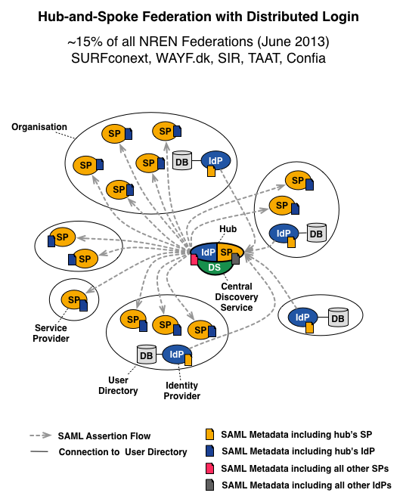
Implement
Hub&Spoke
Fed’n

Slide 4
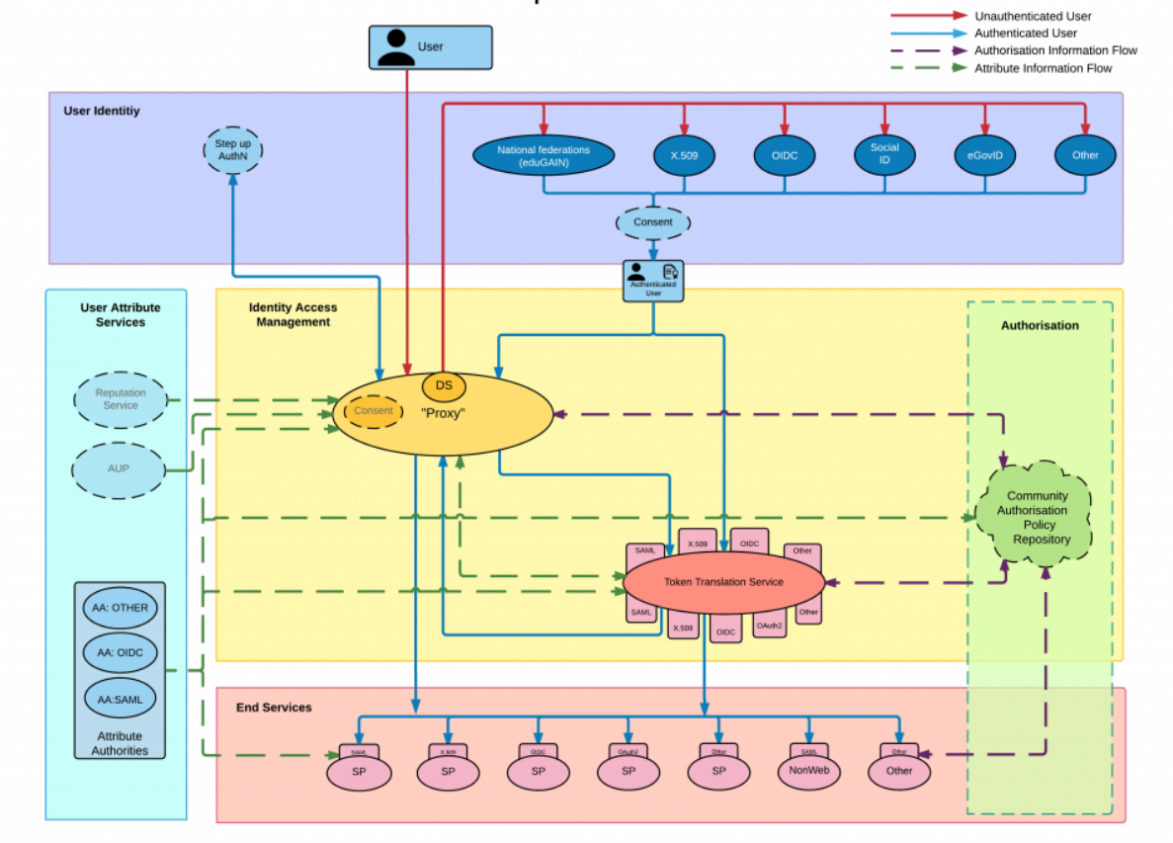
AARChitecture

Slide 5

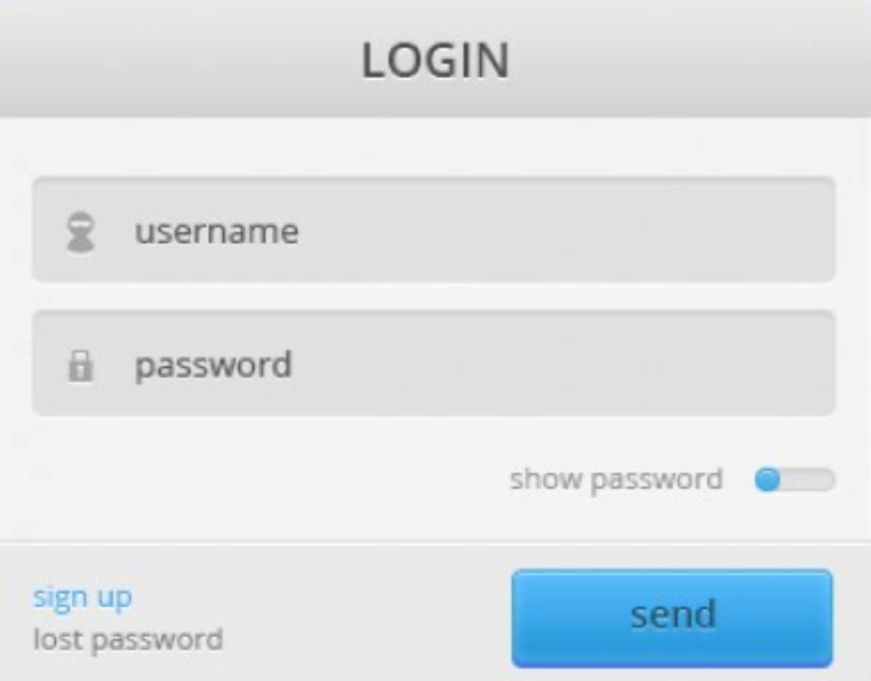






Turtles all the way down … and up!
…
Credit: David Groep, NIKHEF

Slide 6
Requirements - LoA
Provide useful LoA and attrs (MUST)
Support multi-LoA (SHOULD)
  Step-up
  MFA (Multi-Factor Authentication)
  “Guest” identities (social, gov’t, etc.)
Delegation
  In the GSI/K5 sense (cf. RFC 3820) (MUST)
  In the OAuth2 sense (MUST)
  In the authorisation sense (COULD)
Non-web(e.g. TTS)

Slide 7
Requirements – Stds.
Use SIRTFI, R&S (for SAML-based fed.)
Attribute validator
eduPerson schema
Useful LoAs, not random useless stuff
  Compare RAF, NIST 800-63v3, IGTF, Kantara, eIDAS
Transparency (= GDPR)

Slide 8
Recommendation
AARC(2) project (H2020)
  Grant agreement 730941
  Project runs until April ‘19
Lots of AARC policy/guidance
  And REFEDS (refeds.org)
  And IGTF (www.igtf.net)
Both policy and technical
AARC is open to collaborations…
  Specific community engagement
  Also FIM4R

Slide 9
AAAI Pathfinder
Building on the results of

Slide 10

AAAI Pathfinder
PRACE
EGI, EUDAT, Indigo DC
GridPP
DiRAC, ARCHER
VOMS
X.509
SAFE
ssh
Command line
JISC
ASSENT
IdP

Slide 11
sshd
SCARF
Reg’n portal
User
DB
STFC/Facilities
Portal
HSM
Pathfinder T3.2
Public
Online CA
DB
Authn
VOMS
MyProxy
GridPP, EGI, PRACE, EUDAT, GlobusConnect(?)

Slide 12
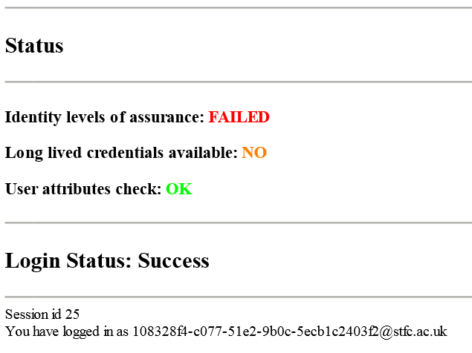

Slide 13
AAAI Pathfinder + EGI
Assent ∫ into Check-In (see next slide)
  Authenticate to Check-In from Assent
  Use Pathfinder→SAML→Check-In
  Or adapt Pathfinder CA portal for CheckIn
Offer EGI Pathfinder as a BIRCH CA
  They currently reach only DOGWOOD through RCauth
Collaborate on REFEDS attr implementation

Slide 14
X.509
OIDC
SAML
RC
auth
Check-In
COmanage
PERUN
VOMS
X.509
OIDC
SAML

Slide 15
X.509
OIDC
SAML
Assent
CA
RC
auth
Check-In
COmanage
PERUN
VOMS
X.509
OIDC
SAML
Assent

Slide 16
AAAI Pathfinder + Assent
Ensure Assent carries useful attrs.
  Guidance from AARC, REFEDS
BIRCH CA
  Replace UK eScience CA for user certs
  Online CA, immediate issuance
e-Infrastructure credential store
  MyProxy
Notify on loss of traceability

Slide 17
Success!
Luck you!
Working Assent infrastructure
AARC/REFEDS guidance on
LoA attributes
in SAML

Slide 18
Initial TODO (→ workplan)
Assent
  Implement Useful and Interoperable Attrs. + Validator
  Notification on loss of traceability
Pathfinder
  Get IGTF to finalise approval (BIRCH)
  Implement SAML IdP to connect to CheckIn
  Implement SAML SP for CheckIn to connect
  Revocations for long term certs
  Credentials store ∫ (MyProxy)
  Production certs (HSM)
UKT0
  VO
  Connect EGI CheckIn to resources

Slide 19
Thanks…

