Slide 1
UKT0 Policy Options
Andrew Sansum
15/3/18

Slide 2

What the Site Admin Thinks

Slide 3
Why we Need Policy
“Policy and Standard Operating Procedures (SOPs) are two key components of the glue that turns a bunch of sites into an e-Infrastructure”
Policy must be guided by pragmatic need. It needs to support and make feasible the productive operation of an e-Infrastructure – not make it impossible.
E-Infrastructure Policy is an enabler that supports a admin in convincing a site security officer to allow deviation from standard site policy.
Common policy gives our partners confidence that our actions will be appropriate.
Formal policy supports the evolution of common shared cultural values.

Slide 4
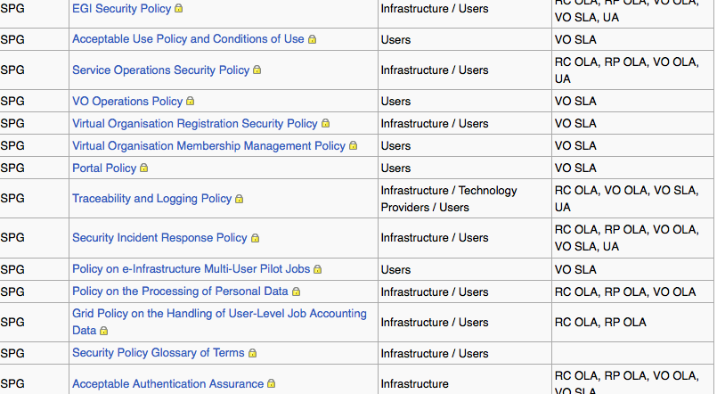
EGI Policies

Slide 5
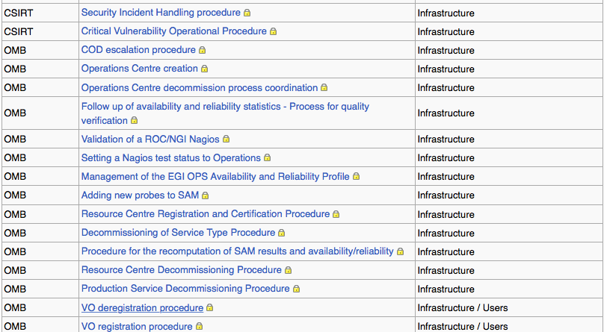
EGI Procedures

Slide 6
Policy Creation needs Effort
EGI Policy Groups
Service and Solution Board (SSB) (ToR)
Operations Management Board (OMB) (ToR)
Operations Tools Advisory Group (OTAG) (ToR)
Security Vulnerability Group (SVG) (ToR)
UMD Release Team (URT) (ToR)
Technical Coordination Board (TCB) (ToR)
Security Policy Group (SPG) (ToR)
Security Coordination Group (SCG) (ToR)
Computer Security Incident Response Team (CSIRT) (ToR)
User Community Board (UCB) (ToR)

Slide 7
Options
Do nothing – don’t bother about policy – hope problem will go away.
  Prey for security incidents/reputation damage.
Take advantage of existing e-Infrastructure policy framework – EGI for example.
  Probably not acceptable for whole UKRI community
Create our own UKT0 policy framework (adopt existing stuff).
  Hard to maintain, not our core business. But policy will match our needs
Push for policy creation to be at the heart of UKRI eInfrastructure development.
  Good option if we can ensure we get something pragmatic

