Slide 1


FCC week 2018
Block-coil 16T Design
for the FCC
The European Circular Energy-Frontier Collider Study (EuroCirCol) project has received funding from the European Union's Horizon 2020 research and innovation programme under grant No 654305. The information herein only reflects the views of its authors and the European Commission is not responsible for any use that may be made of the information.
E. Rochepault, M. Segreti,
on behalf of C. Pes, M. Durante, C. Lorin
With contributions of the EuroCirCol collaboration
10/04/2018

Slide 2
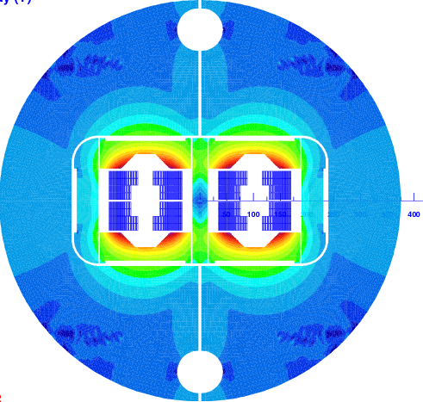
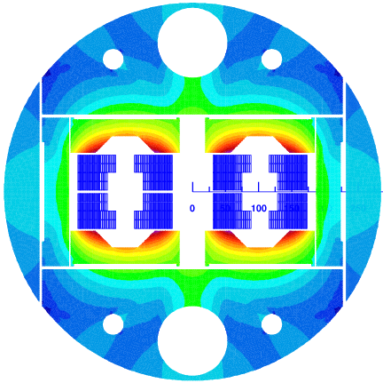


Evolution of the Design
FCC week 2017:
204 mm interbeam
750 yoke diameter
63 mm Al shell
Review Oct. 2017:
194 mm interbeam
570 mm yoke diameter
100 mm Al shell
Today:
204 mm interbeam
570 yoke diameter
67 mm Al shell +
20 mm SS shell
v1ari204
MT2017
v5ari204
C. Lorin, “Block-coil electromagnetic design”, ECC review 2017
C. Lorin, “Electromagnetic design of the block coil option”, FCC week 2017

Slide 3
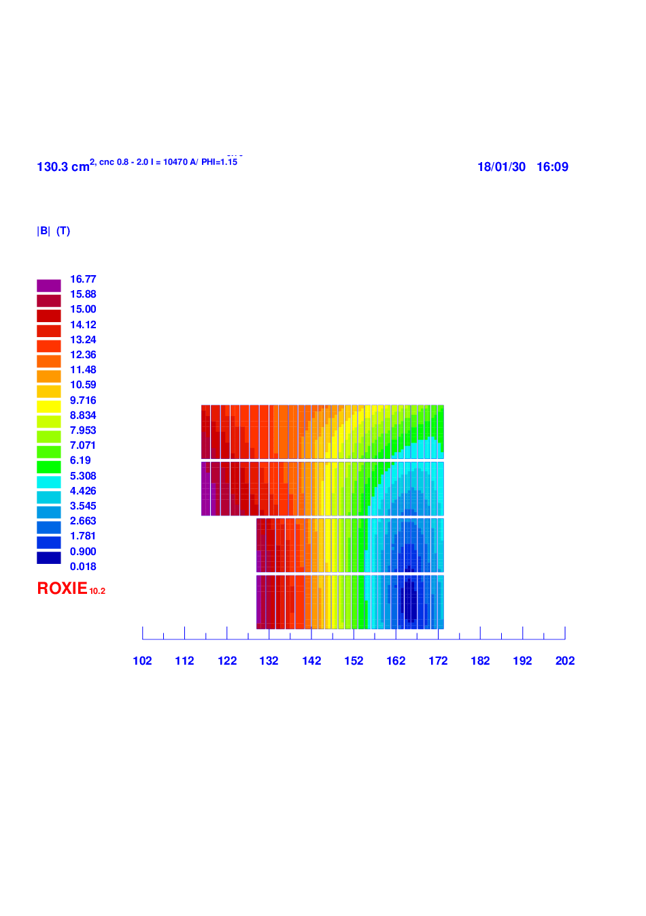
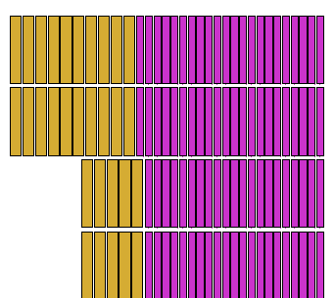
2D Magnetic Design – main parameters
Parameter | Value | Unit
Inom | 10.123 | kA
Nturns | 5+10+21+22 | -
Bore thickness | 1.9 (1.4 + 0.5) | mm
Mid-plane shim | 2.28 | mm
Conductor area | 138 | cm²
Estimated weight* | 7.90 | kt
Yoke diameter | 570 | mm
Bcenter | 16.00 | T
Bpeak | 16.75 | T
Load-line margin | 13.75 | %
Diff. inductance | 49.1 | mH/m
High Field “HF” cables
Low Field “LF” cables
10
22
10
22
5
21
5
21
*Area x 4668 dipoles x 14.1m x 8.7 t/m³

Slide 4
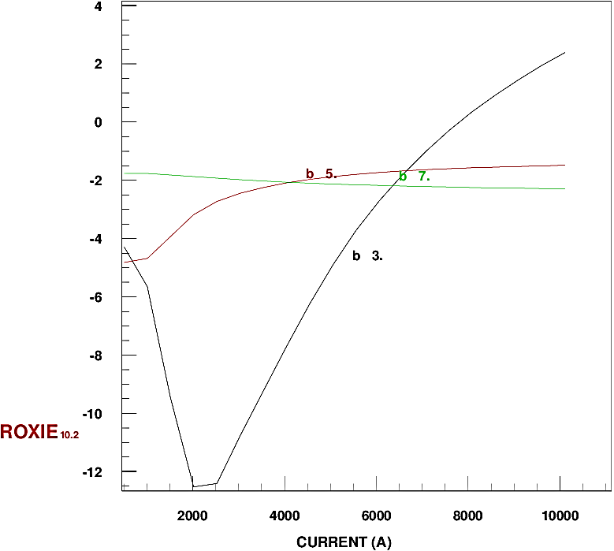
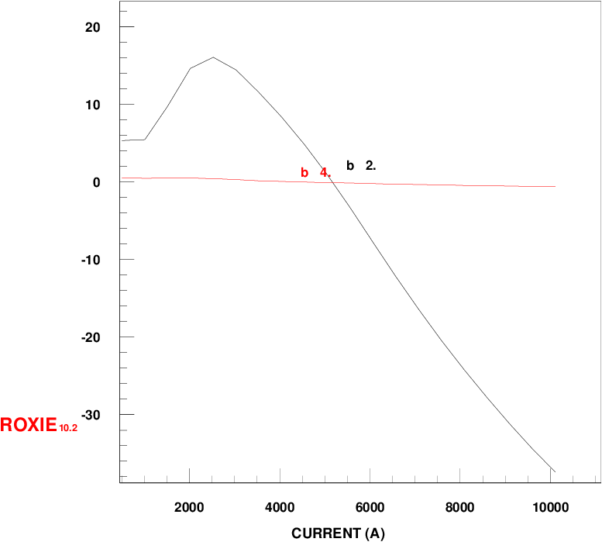
2D Magnetic Design – Harmonics
Without persistent currents (geometric + saturation):
Persistent currents P.C.:
Operation | Case | b2 | b3 | b5 | b7 | b9¹
Injection (3.3 TeV) | without P. C. | 5.2 | -3.2 | -4.9 | -1.7
 | P. C. only | 0 | -25.5 | -2.1 | -5.7 | -2.5
 | with P. C. | 5.2 | -28.9 | -7.0 | -7.4
 | Max. target² | - | 60 | - | - | -
Collision | negligible P. C. | -37.48 | 0.49 | -1.96 | -2.43 | -1.59
 | Max. target² | 50 | 4 | 3 | 3 | 3
S. Izquierdo Bermudez, “Field Quality Table Update for EuroCirCol 16 T designs”, FCC-hh magnet-beam dynamics coordination meeting 03, 2017
¹Other harmonics <1 unit
²Absolute value

Slide 5
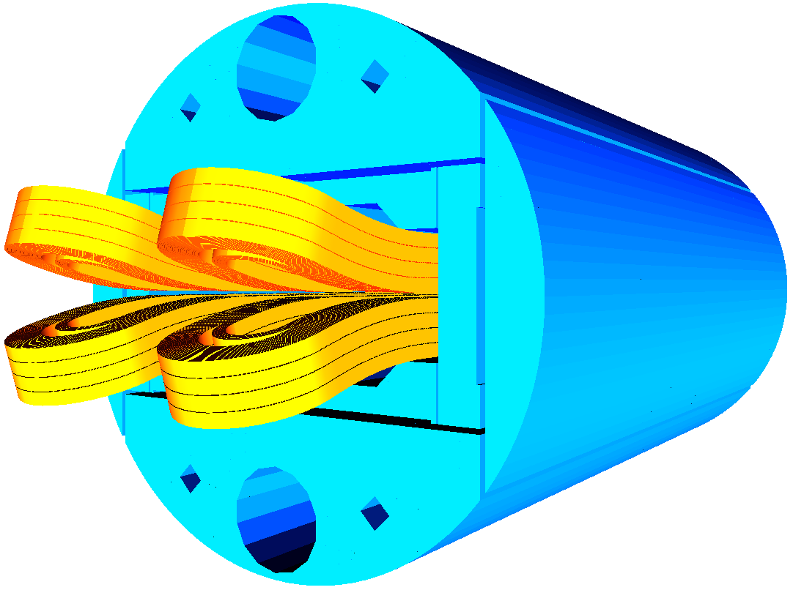
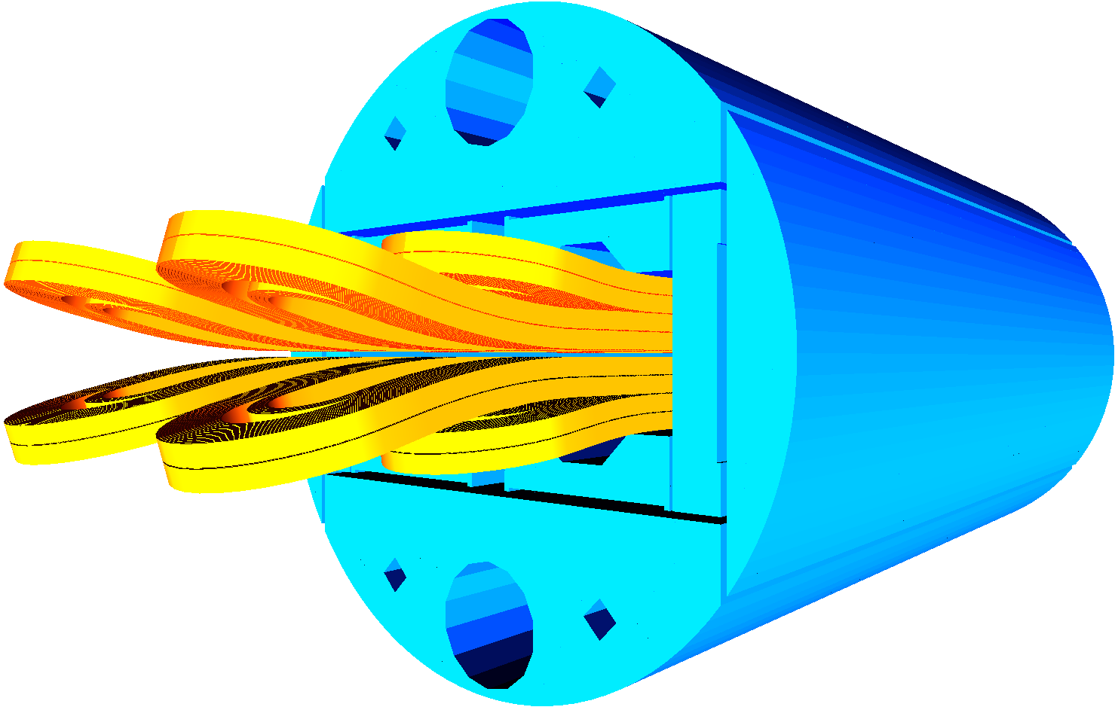
3D Magnetic Design – 2 options
Compact:
Coil ends to the shortest
Room in the spacers for internal joints
Long:
Extension of coil ends
Compensation of the b3 in the ends
L_{straight section} = L_{iron}
Minimum conductor length
Are the harmonics still within spec?
Is the peak field still in the straight section ?
What impact on the lengths? (conductor, coil ends)
What impact on the peak field?

Slide 6
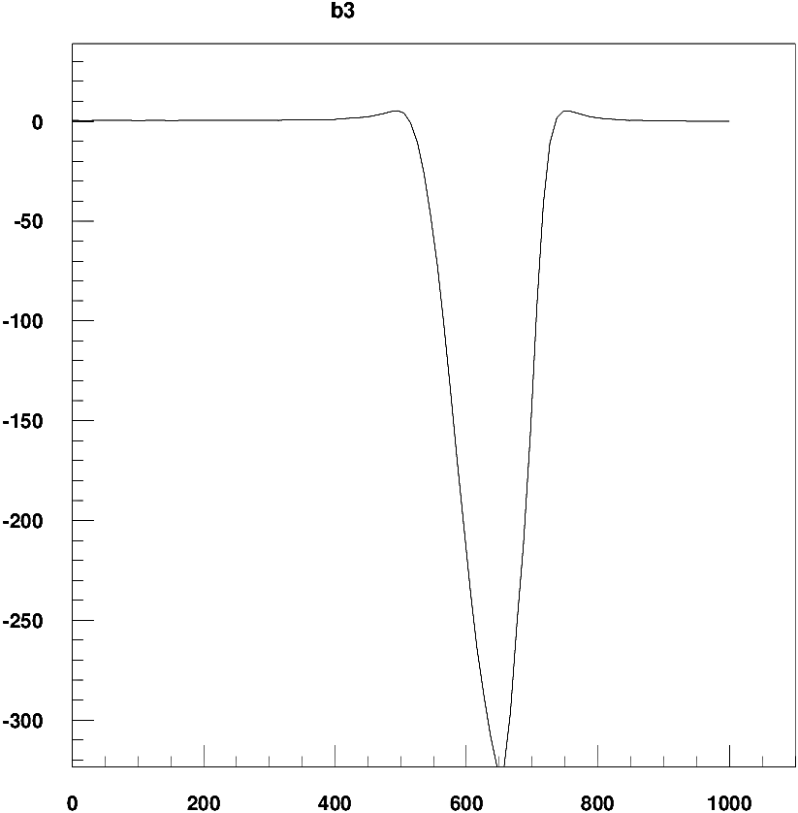
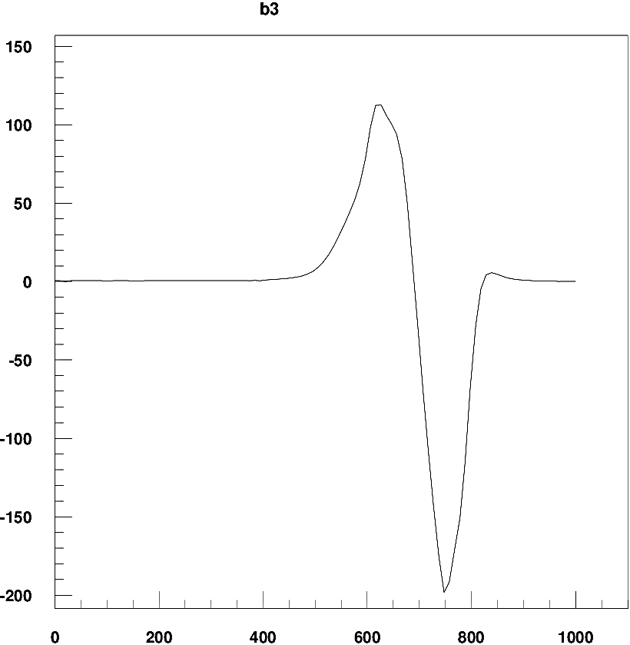
3D Magnetic Design – Harmonics
Compact:
Long:
Design | b2 | b3 | b5 | b7 | b9
2D | -37.48 | 0.49 | -1.96 | -2.43 | -1.59
3D, Compact ends | -39.03 | -4.59 | -2.37 | -2.47 | -1.58
3D, Long ends | -39.41 | 0.08 | -2.41 | -2.51 | -1.58
3D compact + compensation | -38.95 | -2.70 | -1.90 | -2.29 | -1.57
2D compensation | -37.40 | 2.39 | -1.48 | -2.43 | -1.59
At collision
Magnetic length 14 m

Slide 7
Compensation of b₃ in 2d
Midplane shim 2.35 mm → 2.28 mm
b₃ in the straight section (2d): 0.49 units → 2.39 units
b₃ integrated -4.59 units → -2.70 units
Slightly lower other harmonics
Slightly higher margin
v5ari204
2.28 mm

Slide 8
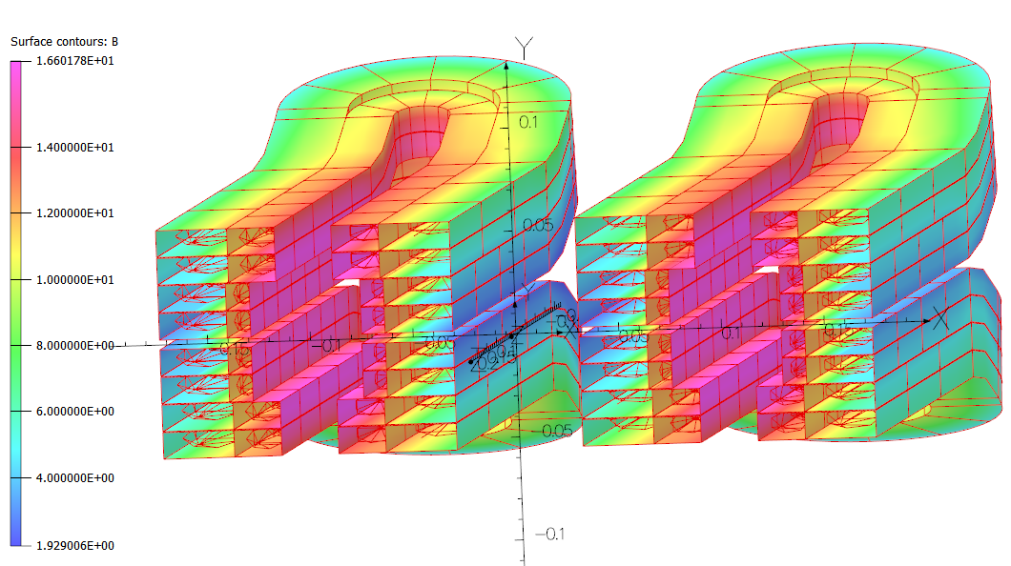
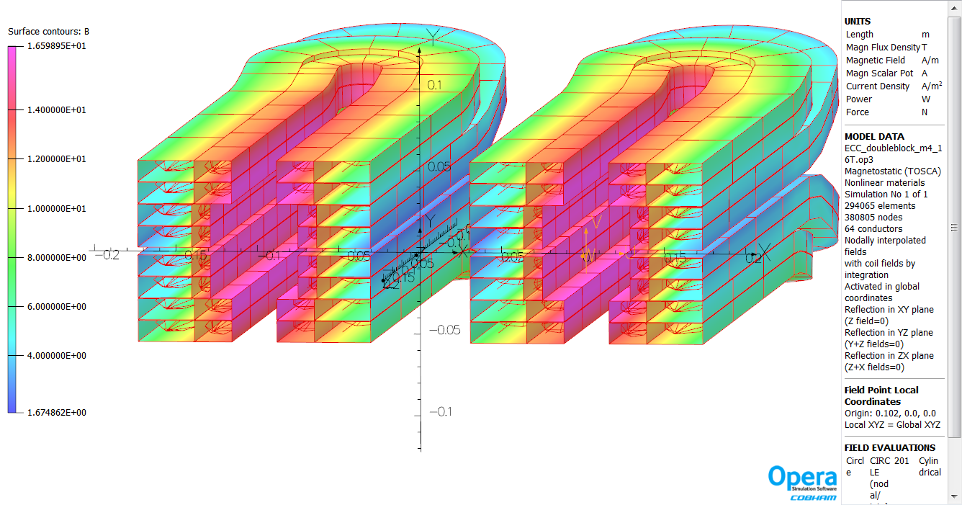
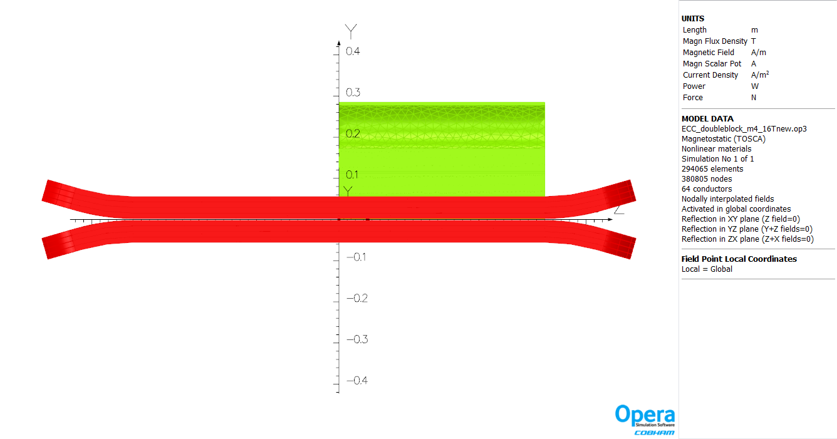
3D Magnetic Design – Peak Field
Compact:
Long:
3.
3.
2.
2.
1.
1.
Peak field in the center (z = 0) = 16.6 T for both cases
at the beginning of the coil ends ~16 T
Peak field in the pole tip ~15 T
With L_{ss} = L_{iron} = 1 m
B_{peak center} – B_{peak ends} = ΔB_{peak} > 0.6 T
Additional operational margin in the ends
L_{ss}
L_{coil}
L_{mag}
L_{coil end}

Slide 9
3D Magnetic Design – Summary
Parameter | Compact | Compact compensated | Long | Unit
b3 integrated | -4.59 | -2.70 | 0.08 | units
B_{peak1}, z=0 | 16.6 | 16.6 | 16.6 | T
B_{peak2}, bend | 15.9 | 15.9 | 16.0 | T
B_{peak3}, tip | 15.0 | 15.0 | 15.2 | T
L_{straight section} | 500 | 500 | 500 | mm (half length)
L_{iron} | 500 | 500 | 500 | mm (half length)
L_{coil} | 722 | 722 | 813 | mm (half length)
L_{mag} | 642 | 642 | 678 | mm (half length)
L_{coil end} = L_{coil} - L_{mag} | 80 | 80 | 135 | mm (per end)
3.
2.
1.
L_{ss}
Nominal:
Short ends
Low harmonics
Margin (ΔB_{peak} > 0.6 T)
L_{coil}
L_{mag}
L_{coil end}

Slide 10
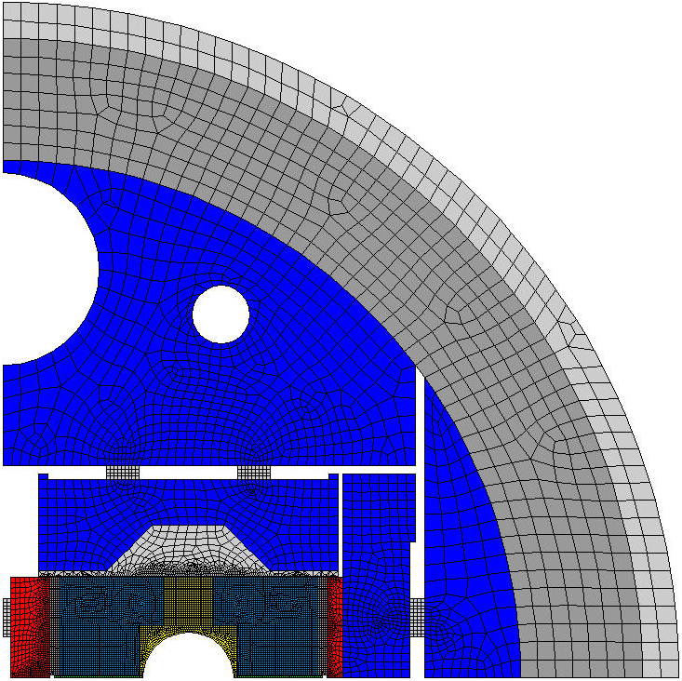
2D Mechanical Design – Model
Geometry:
  Interbeam distance = 204 mm
  Outer yoke Ø = 570 mm
  67 mm Al shell + 20 mm SS shell
ECC Coil properties (293K/4.2K):
  Ex = 25 GPa / 27.5 GPa
  Ey = 30 GPa / 33 GPa
Pre-load:
  Bladders without SS shell
  2 Horizontal + 2 Vertical keys
  Imposed displacement on SS shell bottom = -0.2 mm (260 MPa tension)
Contacts:
  Bonded: inside the coils, with the poles
  Separation allowed with 0.2 friction: between the coils, with the structure
40 MPa
0.10 mm
59 MPa
2x0.72 mm
Yoke
Al Shell
SS Shell

Slide 11
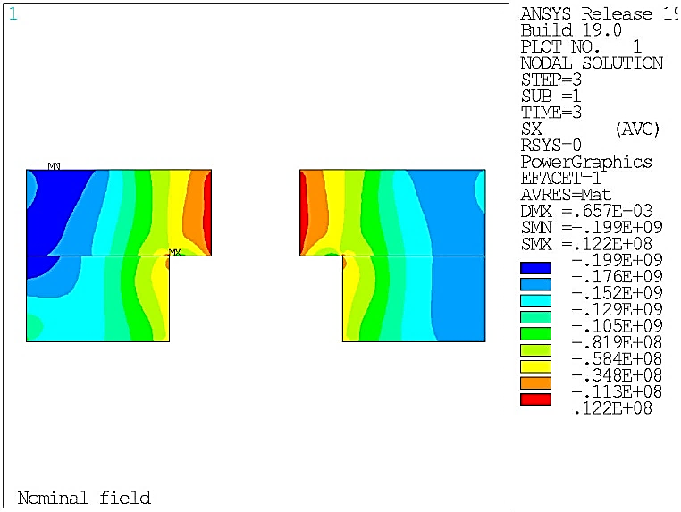
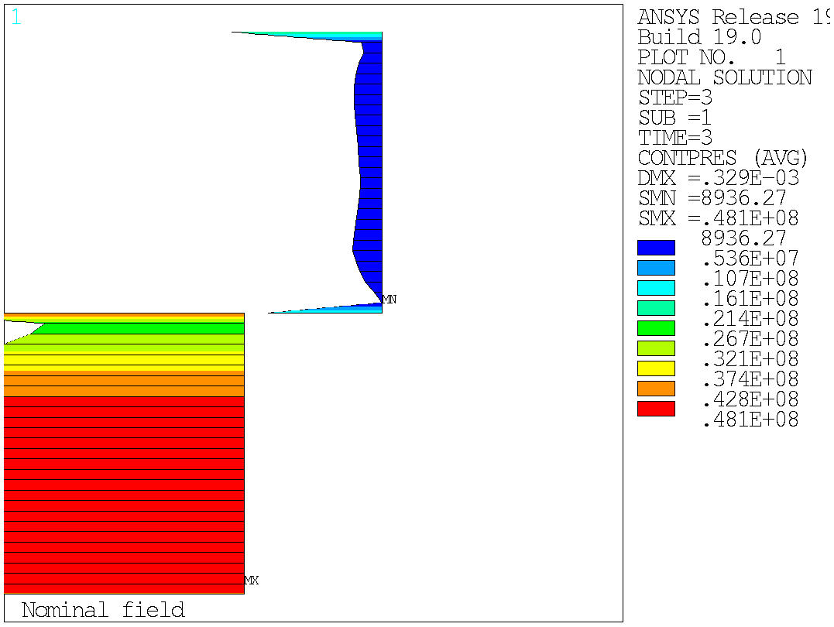
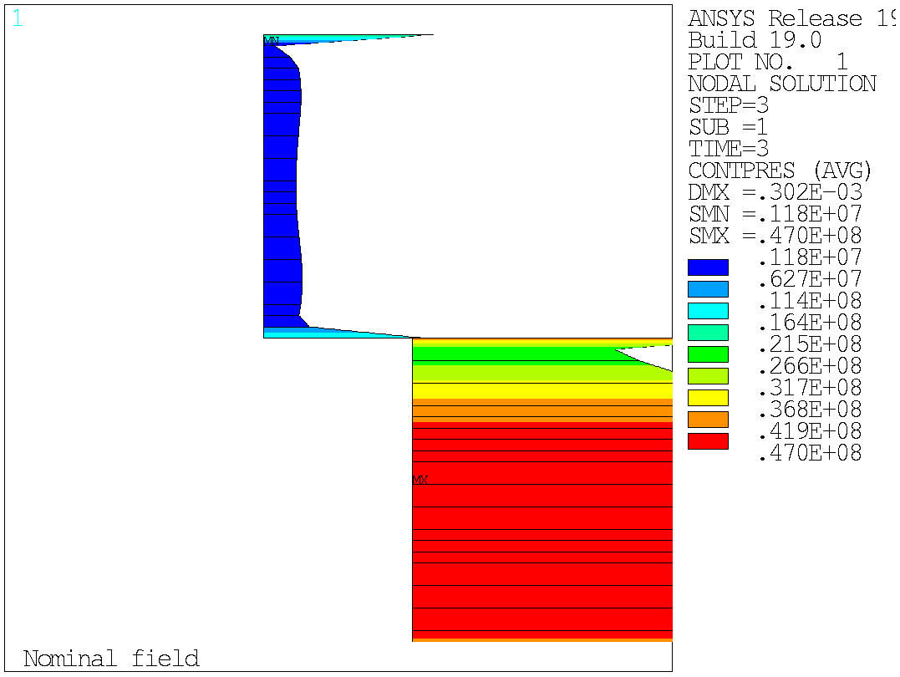

2D Mechanical Design – Coil-Pole contact
Pre-load: interference tuned
Operation at 16 T: contact pressure >0
LEFT coil
RIGHT coil
0 MPa
0 MPa

Slide 12
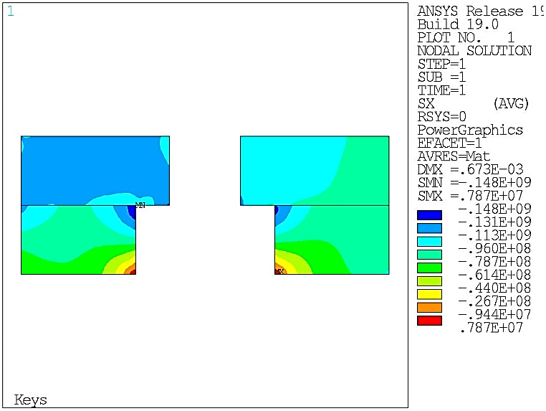
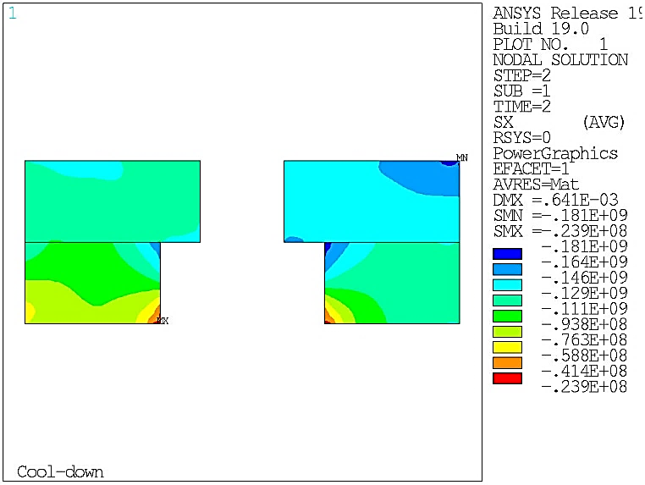
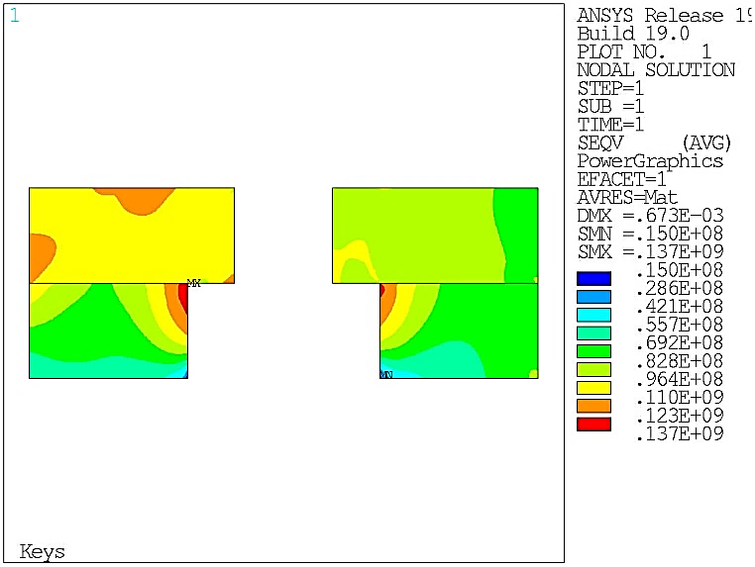
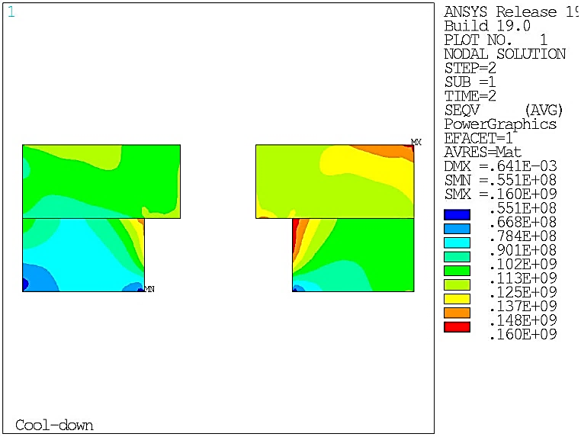
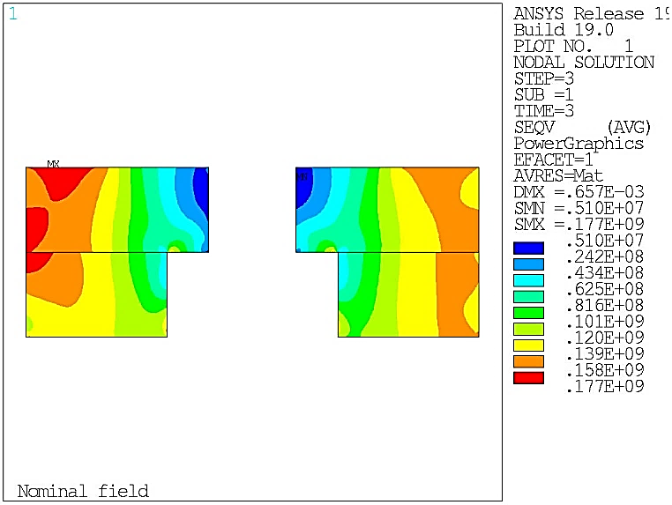
2D Mechanical Design – Coil Peak Stress
Room-temperature pre-load
Cool-down to 1.9K
Operation at 16 T
σ_{X}
-148 MPa
-181 MPa
-199 MPa
σ Von Mises
137 MPa
160 MPa
177 MPa
Criteria:
<150 MPa
<200 MPa
<200 MPa

Slide 13
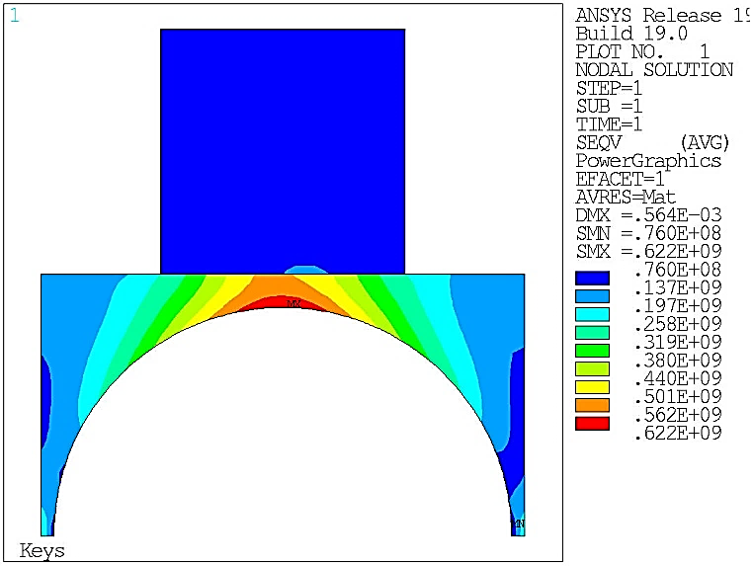
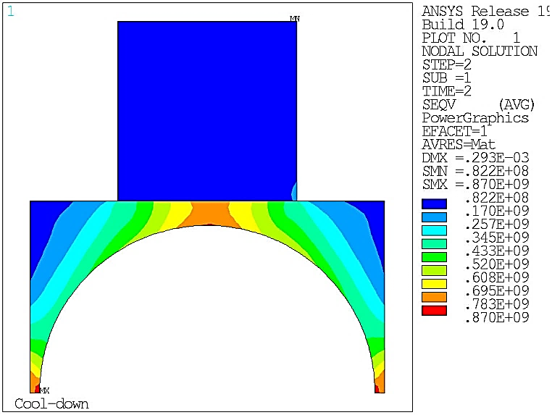
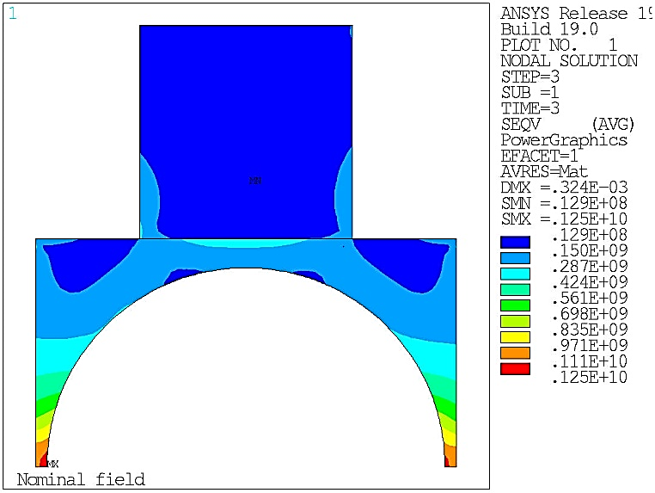
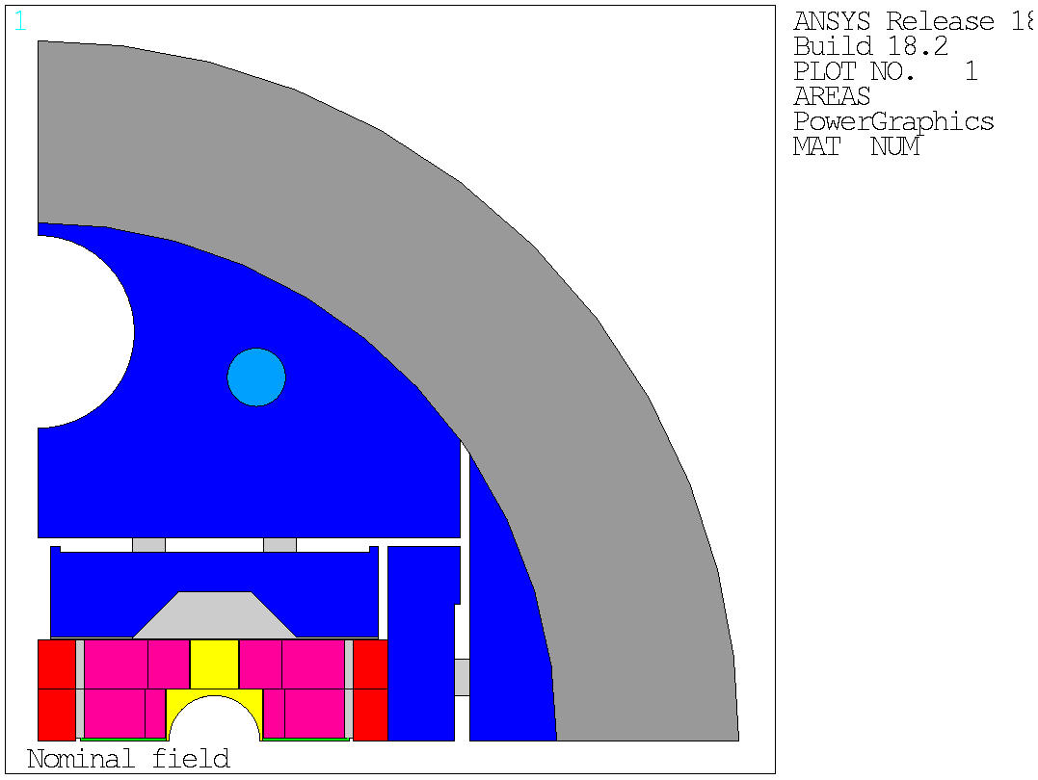
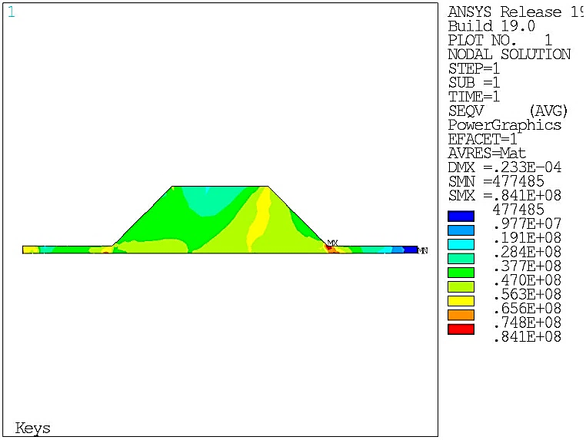
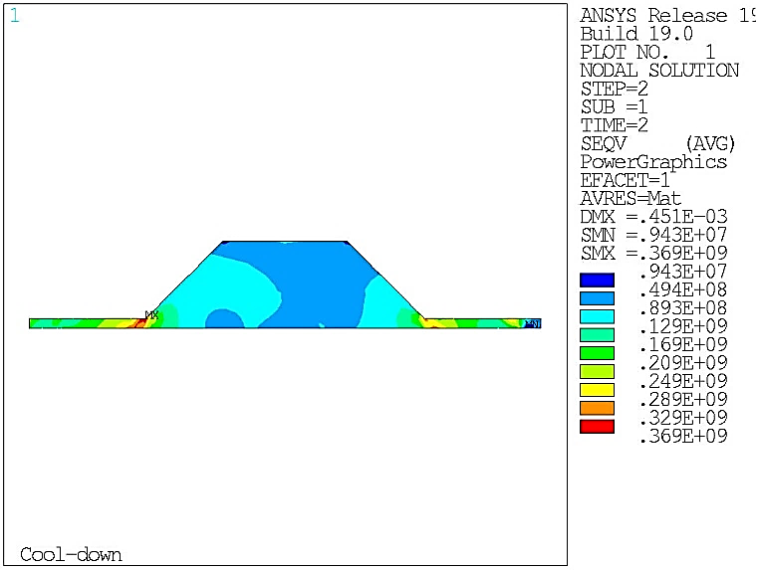
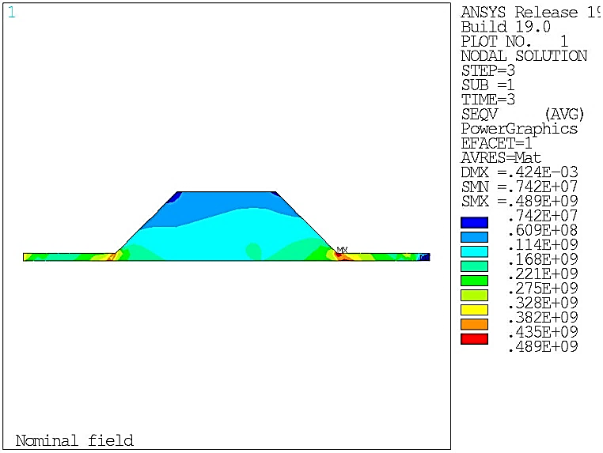
2D Mechanical Design – Structure
Room-temperature pre-load
Cool-down to 1.9K
Operation at 16 T
Ti Poles
σ Von Mises
622 MPa
870 MPa
1125 MPa
Criteria:
<800 MPa
<1650 MPa
<1650 MPa
Stainless steel Y-pusher
σ Von Mises
84 MPa
369 MPa
489 MPa
Criteria:
<350 MPa
<1050 MPa
<1050 MPa

Slide 14
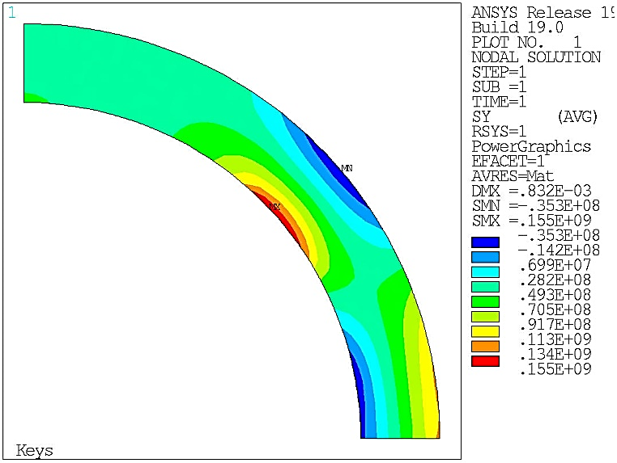
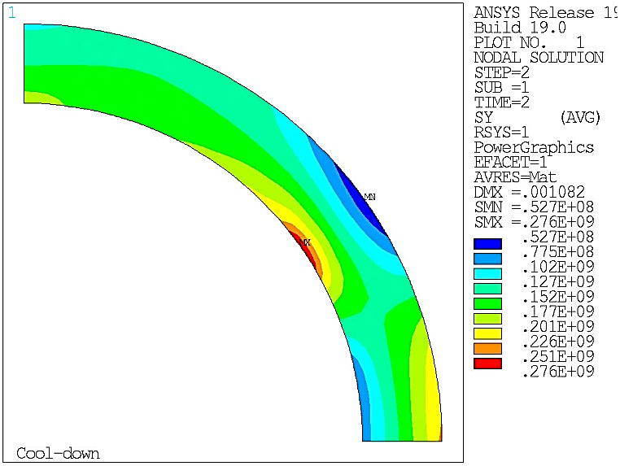
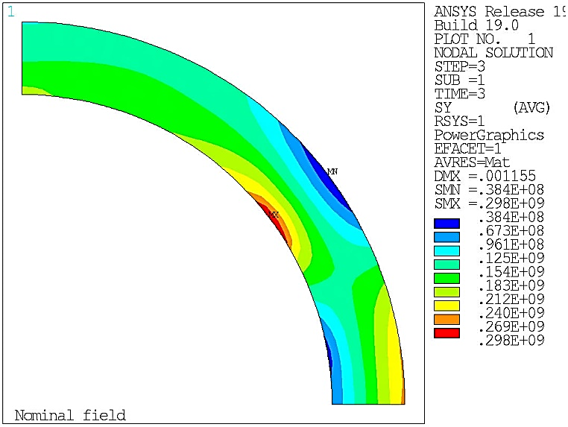
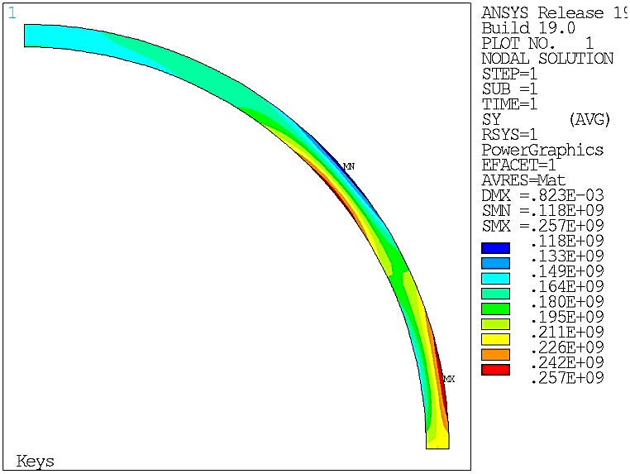
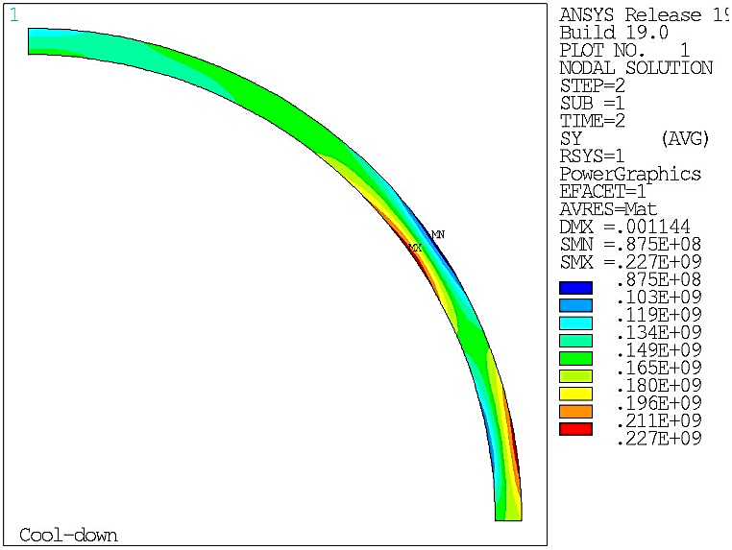
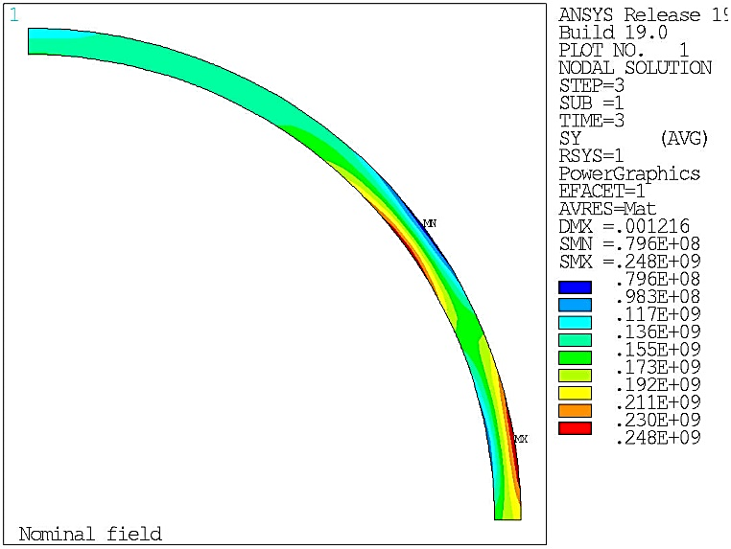
2D Mechanical Design – Structure
Stress distribution
Stress distribution
Room-temperature pre-load
Cool-down to 1.9K
Operation at 16 T
Al Shell
σ_{θ}
155 MPa
276 MPa
298 MPa
Criteria:
<480 MPa
<690 MPa
<690 MPa
Stainless steel shell
σ_{θ}
257 MPa
227 MPa
248 MPa
Criteria:
<350 MPa
<1050 MPa
<1050 MPa

Slide 15
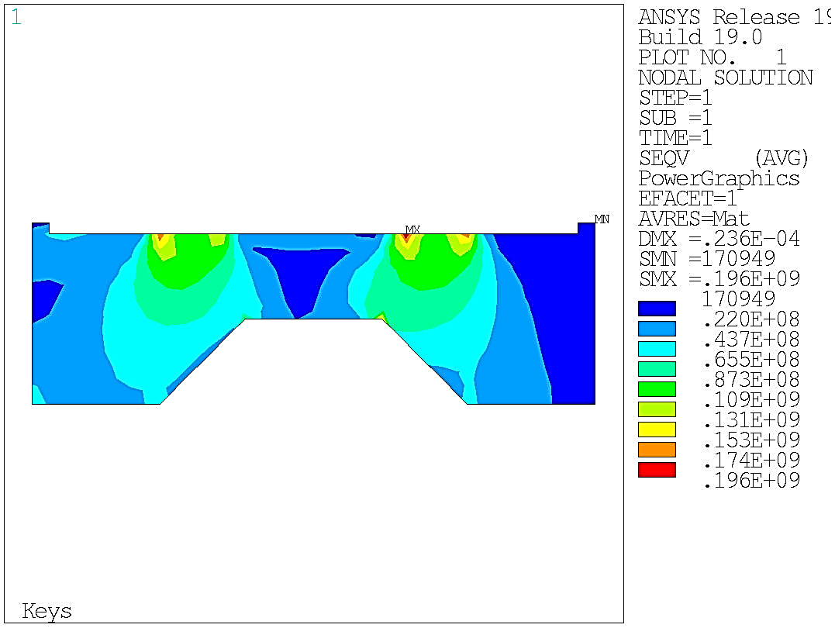
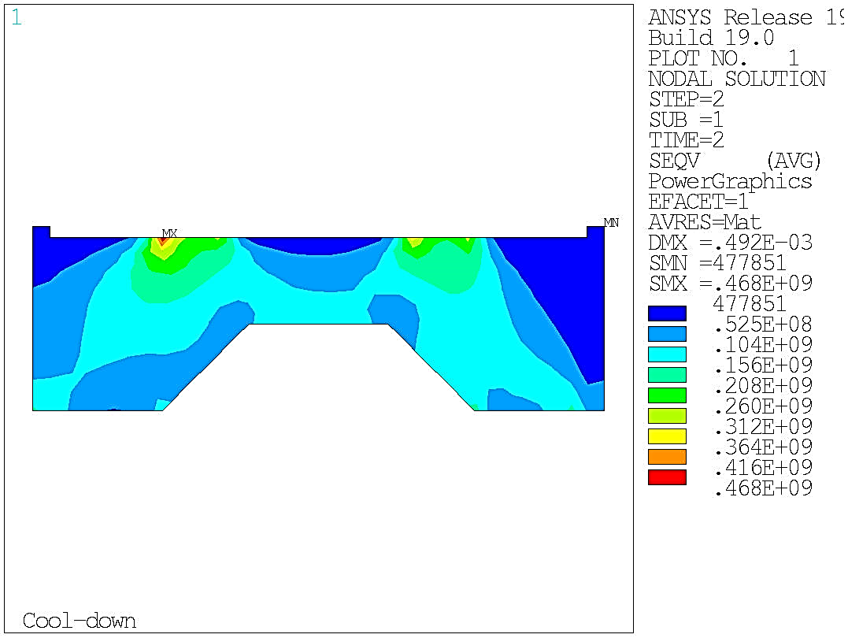
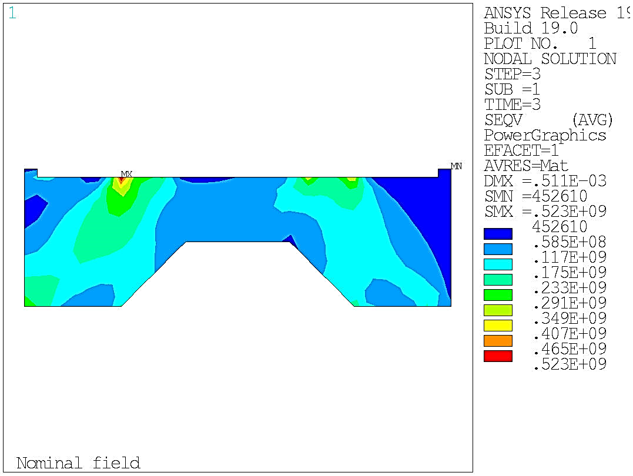
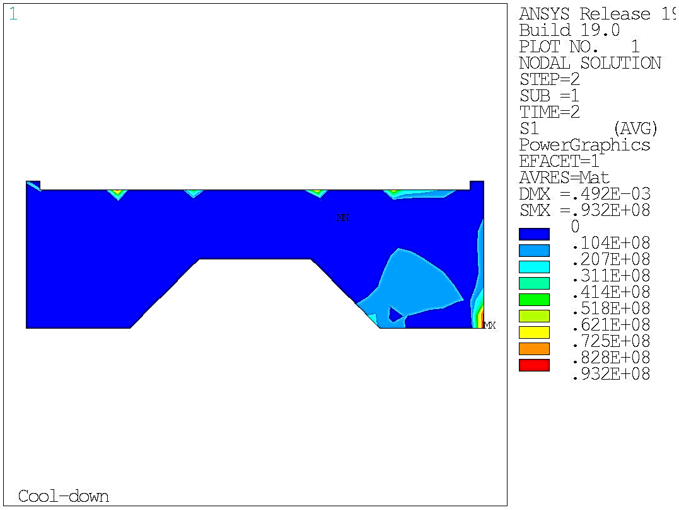
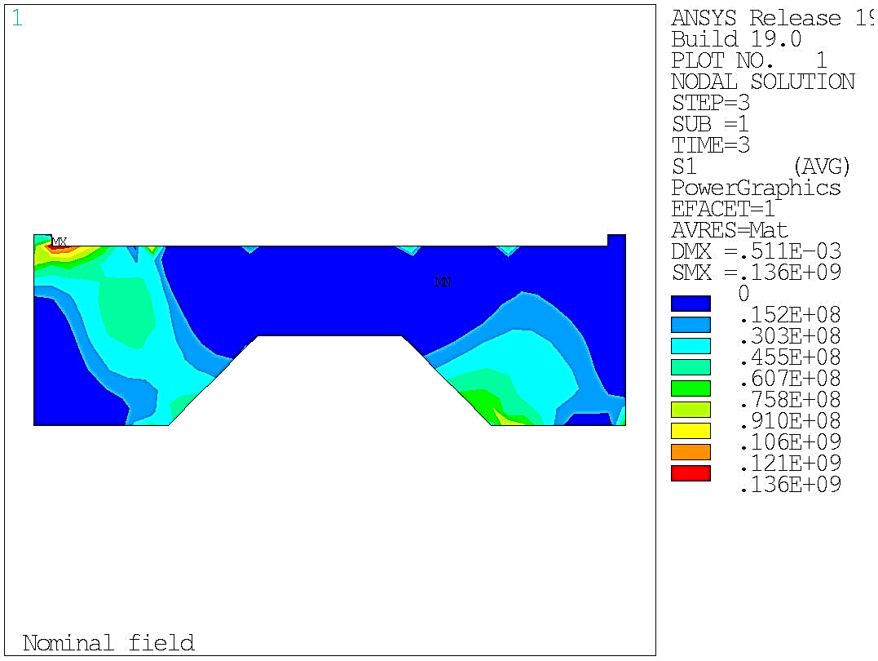
2D Mechanical Design – Structure
Room-temperature pre-load
Cool-down to 1.9K
Operation at 16 T
Iron Y-pad
σ Von Mises
196 MPa
468 MPa
523 MPa
Criteria:
<230 MPa
<720 MPa
<720 MPa
Sigma I:
pure tension
93 MPa
136 MPa
93 MPa
136 MPa
<380 MPa
<380 MPa

Slide 16
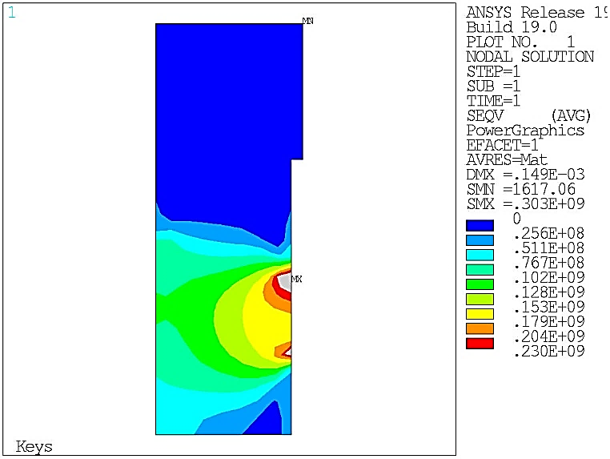
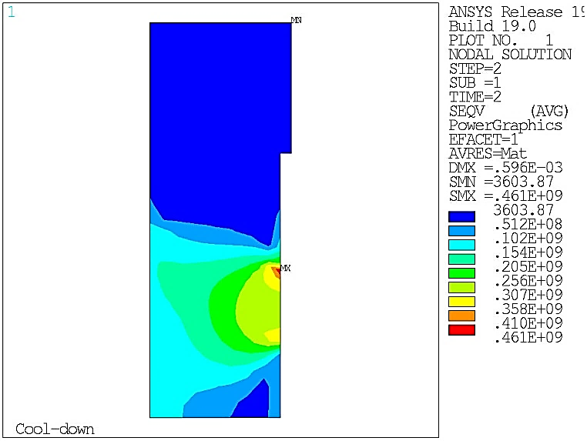
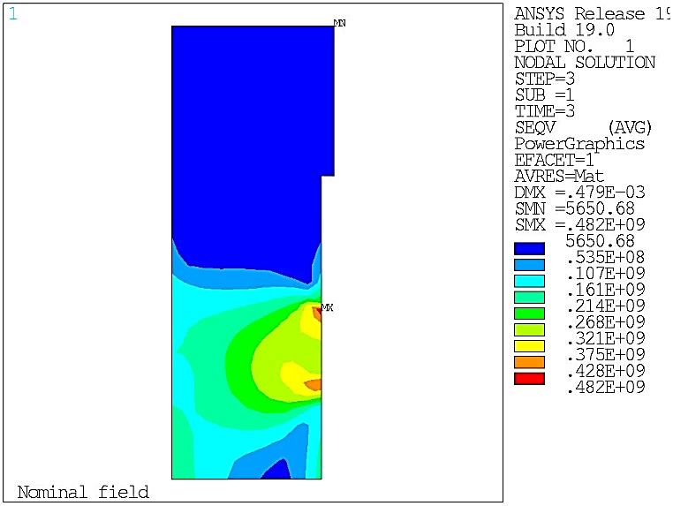

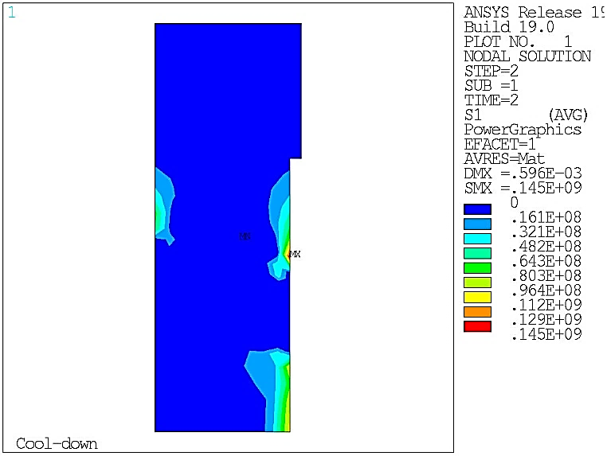
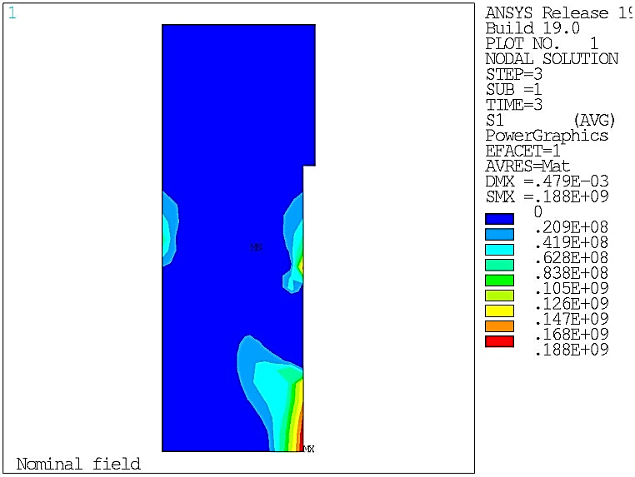
2D Mechanical Design – Structure
Stress distribution
Room-temperature pre-load
Cool-down to 1.9K
Operation at 16 T
Iron X-pad
σ Von Mises
303 MPa locally
461 MPa
482 MPa
Criteria:
<230 MPa
<720 MPa
<720 MPa
Sigma I:
pure tension
145 MPa
188 MPa
<380 MPa
<380 MPa

Slide 17
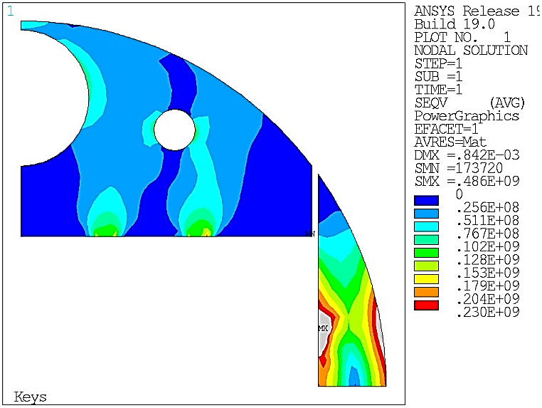
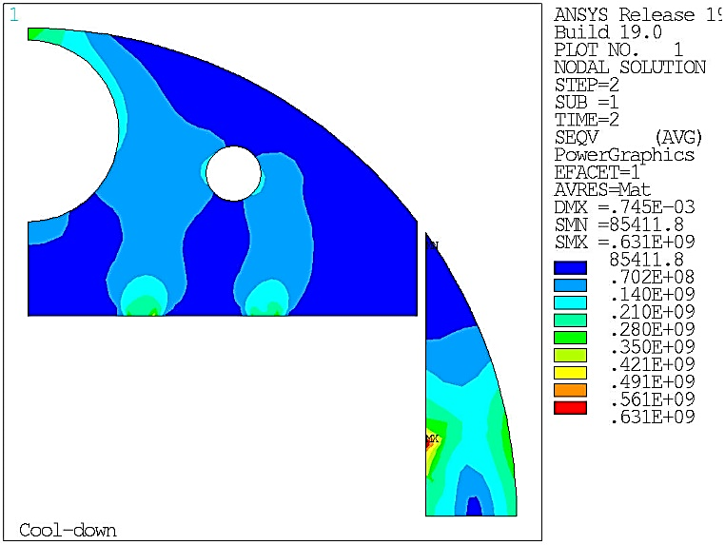
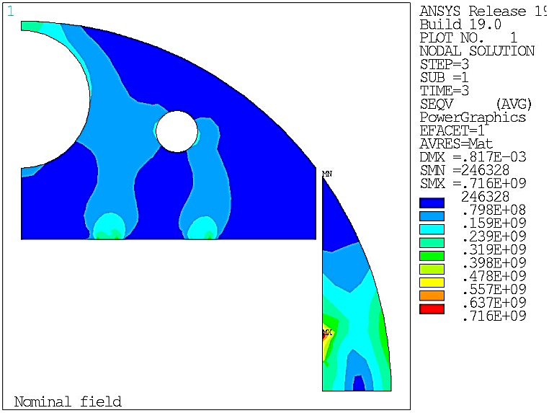
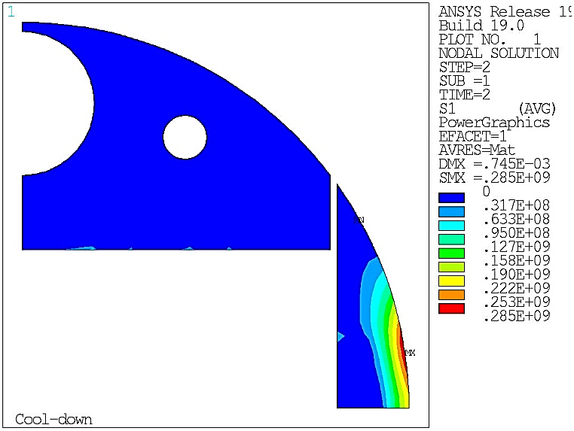

2D Mechanical Design – Structure
Stress distribution
Stress distribution
Room-temperature pre-load
Cool-down to 1.9K
Operation at 16 T
Iron Y-pad
σ Von Mises
486 MPa
631 MPa
716 MPa
Criteria:
<230 MPa
<720 MPa
<720 MPa
Sigma I:
pure tension
285 MPa
344 MPa
<380 MPa
<380 MPa

Slide 18
Conclusion
2d magnetic design:
  16 T at 14 % of LL margin at 1.9 K
  At collision: b3 and higher orders < 3 units (absolute value)
  b2 ~ -40 units
  At injection: b3 ~ -30 units
  → block-coil more favorable than other designs
  b5 and higher orders < 10 units
3d magnetic design:
  Compact ends
  Similar values for integrated harmonics
  Additional margin in coil ends (ΔB_{peak} > 0.6 T)
2d mechanical design:
  Coil stress < criteria
  Iron X-Pad + Yoke: locally > criterion at warm
  Other components: stress < criteria

Slide 19
Outlooks
Short-term future (2018-2019)
Coil end design to be validated by a 3D mechanical study
  Compact ends favorable for:
    Limited number of parts
    Easier pre-load because of aligned blocks
    EM Forces more balanced between the blocks
Protection:
  To be updated by protection team
  → should stay below the limits (minor modifications wrt previous designs)
Mid-term future (~2022)
F2D2: a block-coil short model dipole toward FCC
→ See presentation « The CEA 16T model for the FCC », E. Rochepault

Slide 20
Backup Slides

Slide 21
Conductor parameters
Parameter | Values |  | Unit
Strand diameter | 1.1 | 0.7 | mm
Number of strands | 21 | 34 | adim
Unreacted width | 12.47 | 12.47 | mm
Unreacted thickness | 1.94 | 1.23 | mm
Reacted width | 12.6 | 12.6 | mm
Reacted thickness | 2.00 | 1.27 | mm
Copper/non-Copper ratio | 0.8 | 2.0 | adim
Insulation thickness | 0.15 | 0.15 | mm
Bare cable compaction | 11.8 | 12.0 | %
Packing factor | 85.4 | 88.2 | %
Transposition pitch | 93 | 93 | mm
C. Lorin,
Oct 17 review
J. Fleiter: Rutherford cable design approach and experience at CERN (here)

Slide 22
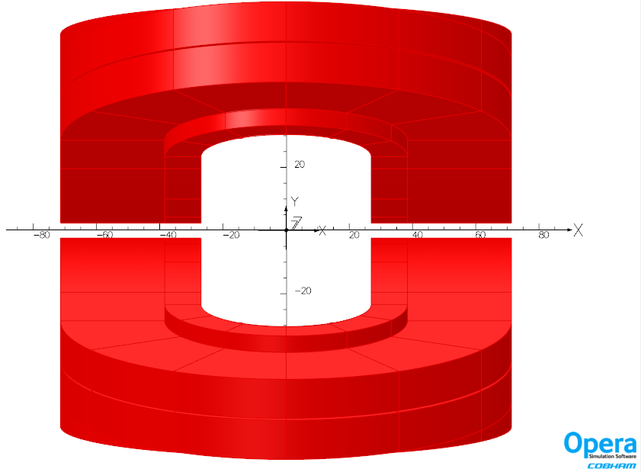


3D magnetic design
Assumptions:
  Return ends – 1000 mm straight section
  Hardway bend : Rmin = 450 mm in upper layer (w = 12.6 mm)
    Strain 13.8 mm/m (HD2: 30.6 mm/m HD3: 12.4 mm/m Fresca2: 15.3 mm/m)
  Coil-to-aperture y-direction: 5 mm
  Double pancake end
5 mm
Fresca2 : w ~ 21 mm
R ~ 700 mm
LHC MB : w ~ 16 mm

Slide 23
3D Harmonics
$$Ib_{n}=\frac{\int{B_{n}\left(z\right)dz}}{\int{B_{1}\left(z\right)dz}}=\frac{\int{B_{n}\left(z\right)dz}}{L_{mag}.B_{ref}}=\frac{\int{b_{n}\left(z\right)dz}}{L_{mag} }$$
$$Ib_{n,short}= \frac{\int_{short}{b_{n}\left(z\right)dz}}{L_{mag,short} }$$
$$Ib_{n}=\frac{\int_{short}{b_{n}\left(z\right)dz}+b_{n}\left(0\right).(L_{mag}−L_{mag,short})}{L_{mag} }$$
$$Ib_{n}=\frac{Ib_{n,short}.L_{mag,short}+b_{n}\left(0\right).(L_{mag}−L_{mag,short})}{L_{mag} }$$
Ex: -10 units on a short length
Ib₃ = [ -10 units x 0.68x2 -0.8 units x (14.069-0.68x2) ] / 14.069
= -1.69 units

Slide 24


2D Mechanical designs
v3ari204
v4ari204
v4ari204
Interbeam distance = 204 mm
Ø_{ext} iron yoke = 570 mm
Total Ø_{ext} = 740 mm
65 + 20 mm thick shells
→ 2 x 0.67 mm ←
Interbeam distance = 204 mm
Ø_{ext} iron yoke = 570 mm
Total Ø_{ext} = 740 mm
65 + 20 mm thick shells
1.51mm ←
Interbeam distance = 204 mm
Ø_{ext} iron yoke = 570 mm
Total Ø_{ext} = 744 mm
67 + 20 mm thick shells
→ 2 x 0.72 mm ←
 | σ_{X} max | σ Von Mises max
Keys + SS shell | -170 | 149
Cool-down | -205 | 188
Energization 16 T | -188 | 178
 | σ_{X} max | σ Von Mises max
Keys + SS shell | -135 | 123
Cool-down | -184 | 170
Energization 16 T | -214 | 186
 | σ_{X} max | σ Von Mises max
Keys + SS shell | -148 | 137
Cool-down | -181 | 160
Energization 16 T | -199 | 177

Slide 25
Material properties (Davide 3rd FCC week)
  Coil maximum stress
    @ 4.2 K: 200 MPa
    @ 300 K: 150 MPa
Material | E [GPa] |  | pr | (L_{4.3K}-L_{293K})/L_{293K}
 | 293 K | 4.3 K | 293K/4.3K | 293 K -> 4.3K
Coil | EX = 25 EY = 30 GXY = 21 | EX = 27.5 EY = 33 GXY = 21 | 0.3 | X = 3.36e-3 Y = 3.08e-3
StSt | 193 | 210 | 0.28 | 2.84e-3
Iron | 213 | 224 | 0.28 | 1.97e-3
Aluminum | 70 | 79 | 0.34 | 4.2e-3
Titanium | 115 | 126.5 | 0.3 | 1.74e-3
Nitronic 40 | 210 | 225 | 0.28 | 2.6e-3
Material | R_{p 0.2} [MPa]
 | 293 K | 4.3 K
Al 7075 | 480 | 690
SS 316 LN | 350 | 1050
NITRONIC 40 | 350 | 1240
Ferromagnetic iron | 230 | 720*
Ti 6Al 4V | 800 | 1650
*Ferromagnetic iron @ 4.2 K stress < 380 MPa in tension (1st principal stress)

Slide 26
2D Mechanical Design – Structure
Component | Material | Pre-load | 1.9 K | 16 T | Crit. 293K | Crit 1.9 K
Poles | Ti6Al4V | 622 | 870 | 1125 | 800 | 1650
Y-Pusher | Stainless steel | 84 | 369 | 489 | 350 | 1050
Y-Pad | Iron | 196 | 468 | 423 | 230 | 720
X-Pad | Iron | 303 | 461 | 482 | 230 | 720
Yokes | Iron | 486 | 631 | 716 | 230 | 720
Al shell | Al | 155 | 275 | 289 | 480 | 690
SS shell | Stainless steel | 260 | 230 | 250 | 350 | 1050
Von Mises [MPa]
Within spec
At spec or localized
Outside spec

