Slide 1

Thoughts on 3D Mechanical Design
B. Auchmann (CERN/PSI), L. Brouwer (LBNL), S. Caspi (LBNL), R. Felder (PSI), J. Gao (PSI),
G. Montenero (PSI), M. Negrazus (PSI), G. Rolando (CERN), S. Sanfilippo (PSI), S. Sidorov (PSI)
17.04.2018, EuroCirCol Meeting 36, CERN.
Work supported by the Swiss State Secretariat for Education, Research and Innovation SERI.

Slide 2
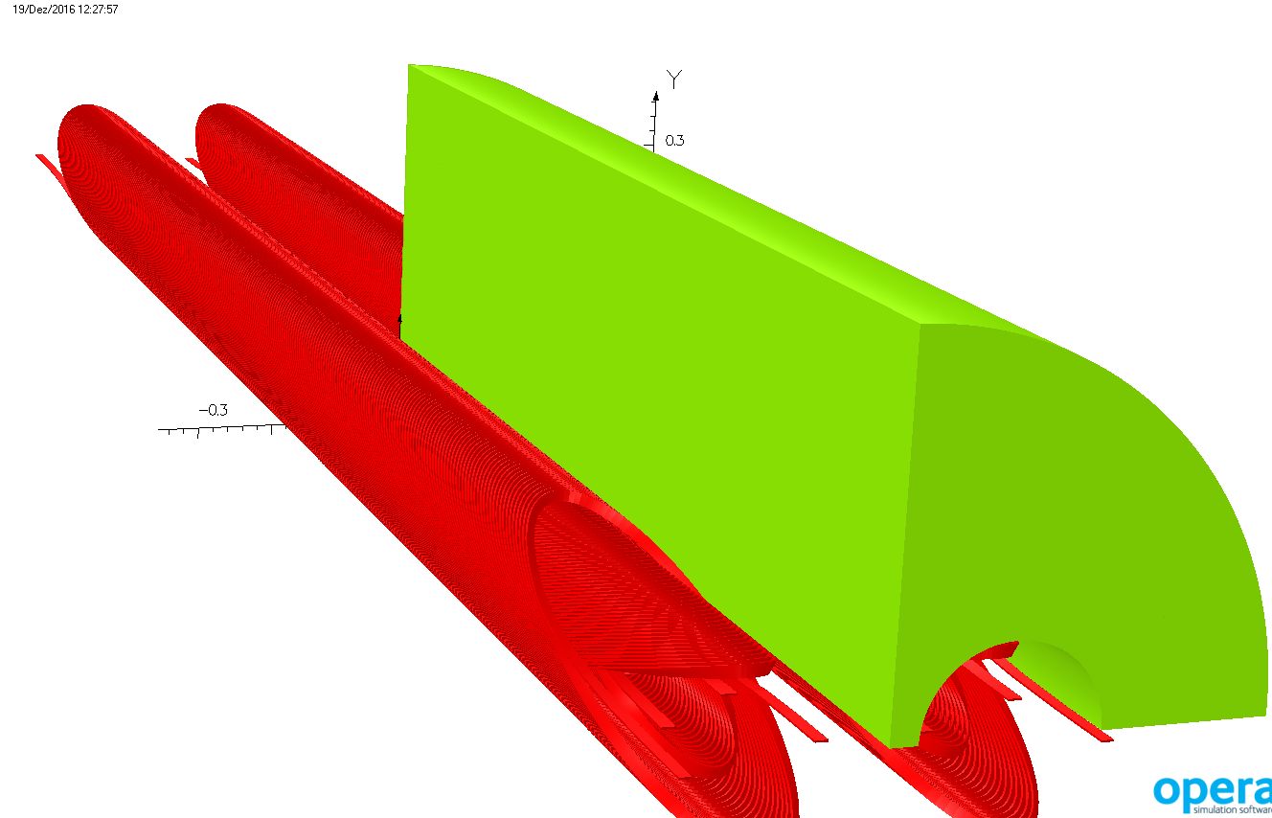
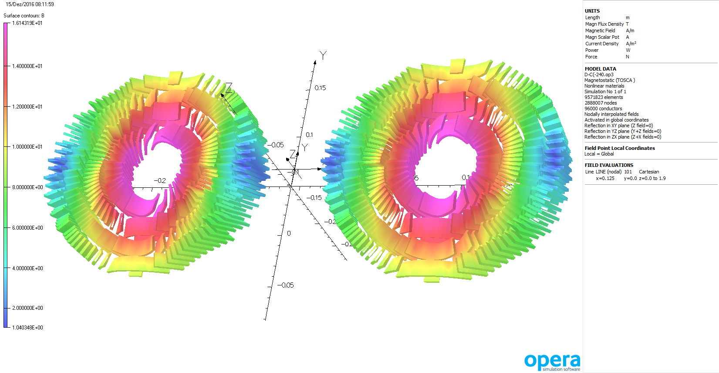
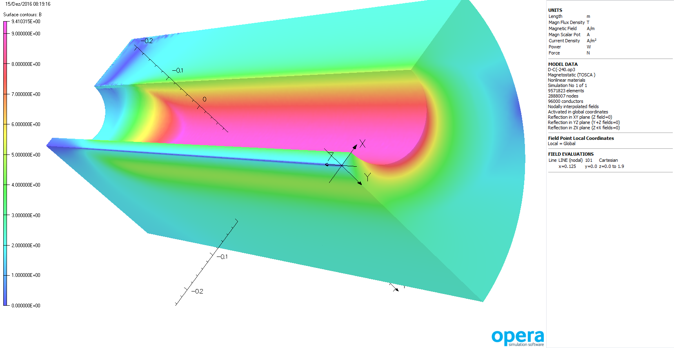
Use 3D Opera Lorentz Force Data
Export Lorentz forces via comi script in barycenters of ANSYS coil mesh.
Courtesy M. Negrazus

Slide 3
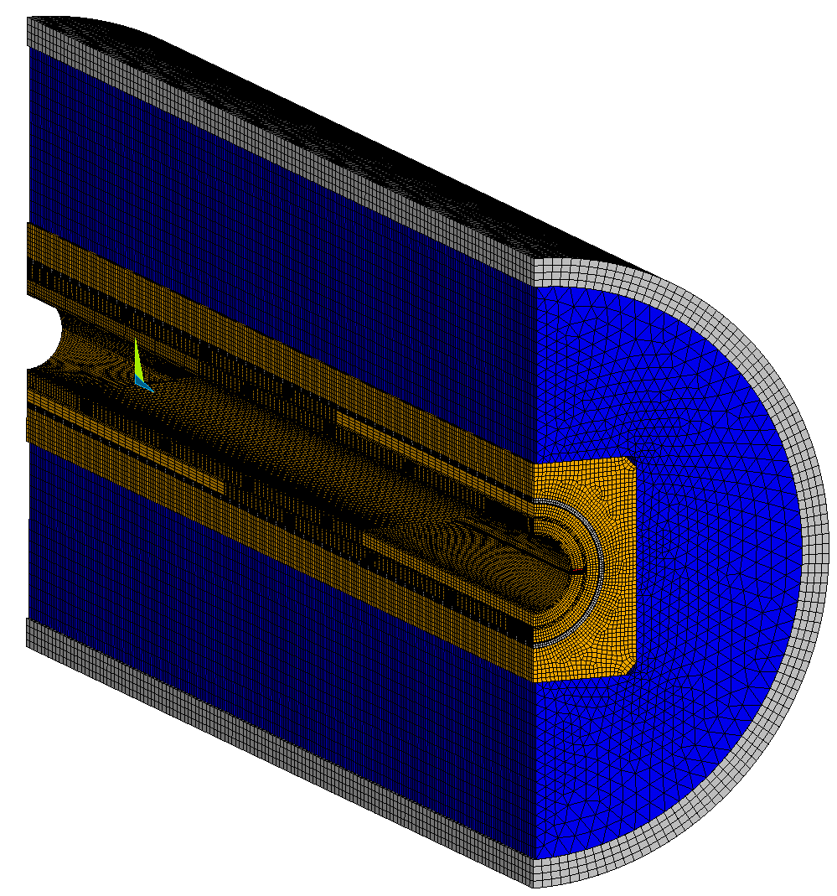
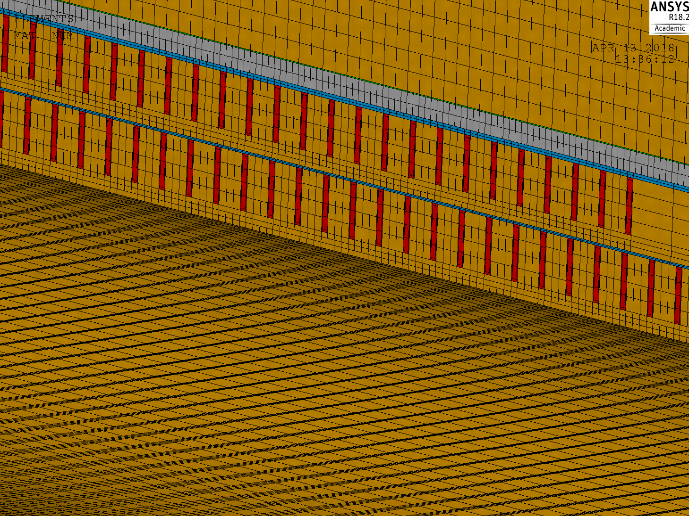
Status 3D Mechanical Calculations for CD1
3D coil and former model generated by L. Brouwer (LBNL).
3D mechanical structure added at PSI.

Slide 4
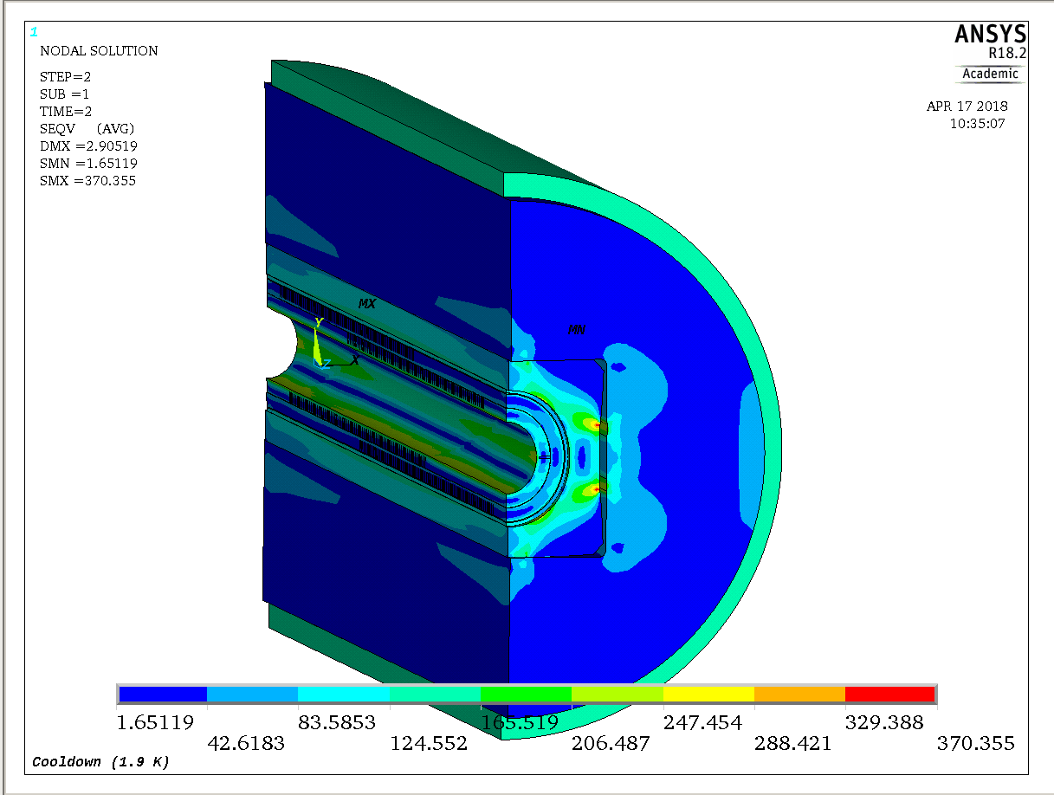
Simulation results
Simulations under way on new work station.
  Room-temperature and cool-down steps converged.

Slide 5
FCC 4-Layer CCT Design Criteria
Former stresses.
Cable axial strain.
Cable transverse stress.
Working assumption: coils do not require axial pre-load due to turn-by-turn transfer of Lorentz forces to former.

Slide 6
END

