Slide 1
CompactLight
WP5 Normal Conducting Undulators: task overview
Notes:
Slide 2: Title of the Presentation
Before you start editing the slides of your talk change to the Master Slide view:
Microsoft Office :Menu: View > Slide Master;
Macintosh – View > Master > Slide Master
Edit the following items:
On the Slide Master (first master slide) – lower area
a) On the left Delete the text and write the title of the event/Conference, Location
b) On the right delete the text and write the name and surname of the speaker and the date (day, month , year)
Close Master View
To start adding slides insert a new slide and select a Layout:
For Title & Subtitle
For text with bullet points
For Text
For Picture, graphs, visuals
Two columns
Blank

Slide 2
1st deliverable Undulator Technology Survey, is 1.5 years from now, for several reasons (team building, provide quantitative arguments, etc...) better meet and exchange information soon and often.
Structure, index of the report
A. Bernhard and F. Nguyen released a similar document on behalf of the EuPRAXIA

Slide 3
Normal Conducting Undulators’ mailing list (from Federico): PSI <thomas.schmidt@psi.ch> ANSTO <rohan.dowd@synchrotron.org.au> AU-IAT <Avni.Aksoy@cern.ch> ALBA <francis@cells.es> ENEA <alberto.petralia@enea.it> Added: Marco Calvi (PSI) marco.calvi@psi.ch Zafer Nergiz (AU-IAT) zafer.nergiz@cern.ch Jordi Marcos (ALBA) jmarcos@cells.es Who else? Send me and email raffaella.geometrante@kyma-undulators.eu

Slide 4
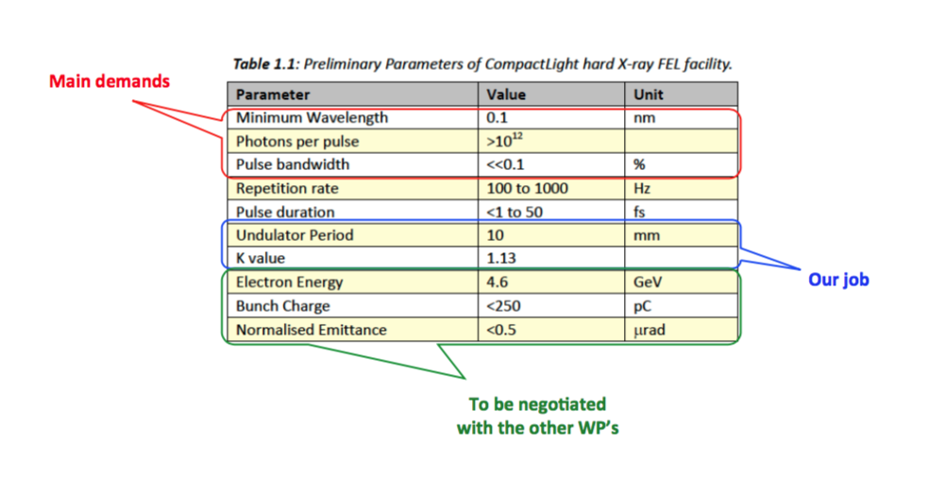

Slide 5
Normal Conducting Undulators: Normal conducting electromagnets PPM undulators …

Slide 6
SWOT analysis
This should help us to identifies NCU’s existing Strengths and Weakness, its emerging Opportunities, and the worrisome Threats.

Slide 7
STRENGTH
WEAKNESS
Low cost
Low energy consumption
Simple infrastructure
Well-known technology
Automated assembly procedure
For soft x-ray with full polarization and (with the APPLE X) gradient control
…
Magnets demagnetization - with small gap, possible heating form the beam with risks of local demagnetization
Limited field strength (but still with expansion options by new materials i.e. Tb diffusion especially for short period in-vacuum undulators)
When gap and phase very small -> multipolar terms
…

Slide 8
OPPORTUNITIES
THREATS
Verify the lowest period achievable with NC technology
Study of PPM magnet-holder new assembly techniques (soldering, gluing etc.)
Development of automated procedure for serial production
Well established cryo undulator technology for higher fields and fewer demagnetization risks but eventually we can look to cryo undulators in the surrounding of kryo-cooled sc undulators
Achievement of the parameters required by CompactLight
…

Slide 9
Next steps
Agree on required specs for the ID (L=10mm, K=1.13, total length of the undulators, etc.).
Assessment of NC technology range of application (smallest periods achievable with certain gaps).
Look for two or three alternatives, each one developed by different partners.

