Slide 1
Linear vs non-linear beam-beam kick
Dima El Khechen
Acknowledgements: K. Oide

Slide 2
OUTLINE
→ Reminder
Trials and failures: Correction of residual dispersion/xy coupling
Artificial damping/excitation
Non-linear beam-beam kick (Ohmi san,s code) vs linear kick

Slide 3
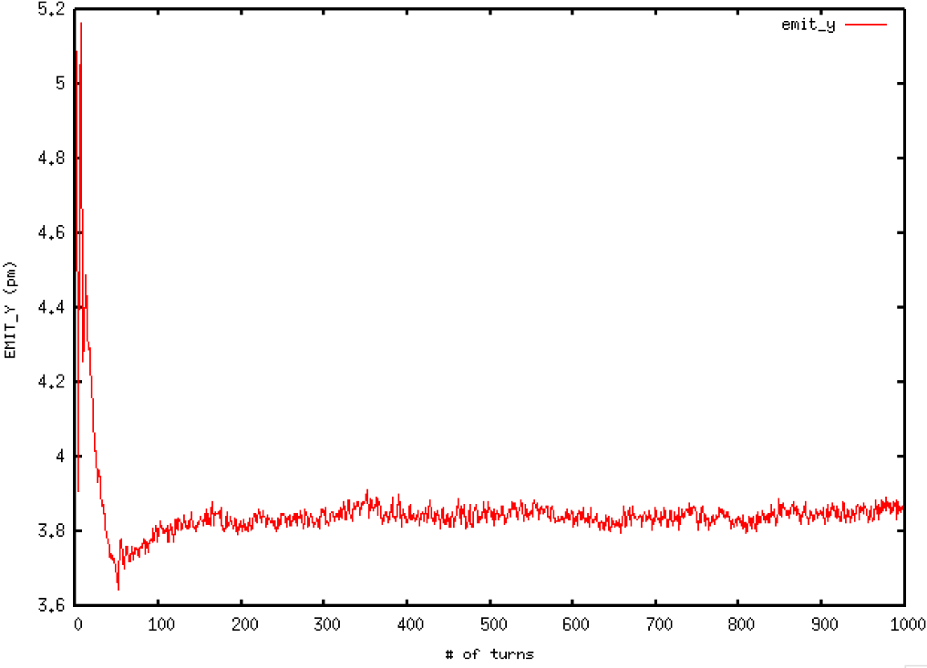
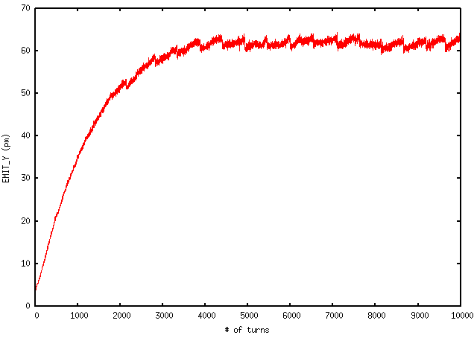
Reminder
Beamstrahlung simulations done in SAD with beam-beam element at IP
XY coupling established by vertical misalignments of sextupoles
Beam-beam simulations: larger emittance than design values
No beam-beam: A blow-up of emittance from 2.7 pm to 5 pm
Why? : Residual dispersions/xy couplings
175 GeV
45.6 GeV

Slide 4
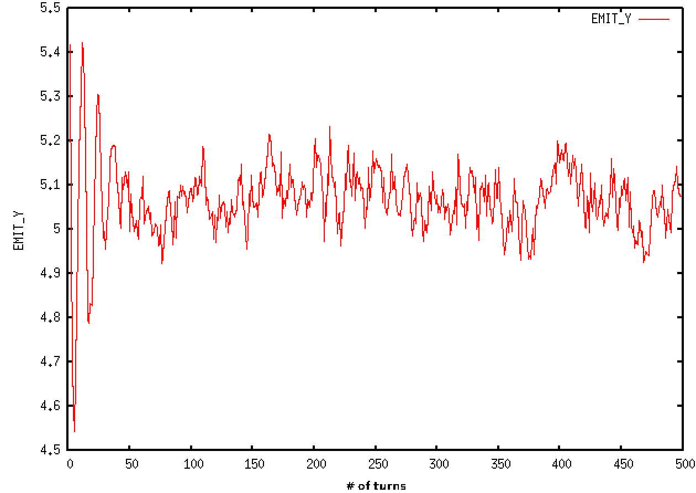
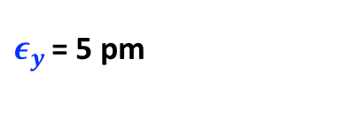
Reminder
Beamstrahlung simulations done in SAD with beam-beam element at IP
XY coupling established by vertical misalignments of sextupoles
Beam-beam simulations: larger emittance than design values
No beam-beam: A blow-up of emittance from 2.7 pm to 5 pm
Why? : Residual dispersions/xy couplings
$ε_{y }$= 5 pm

Slide 5
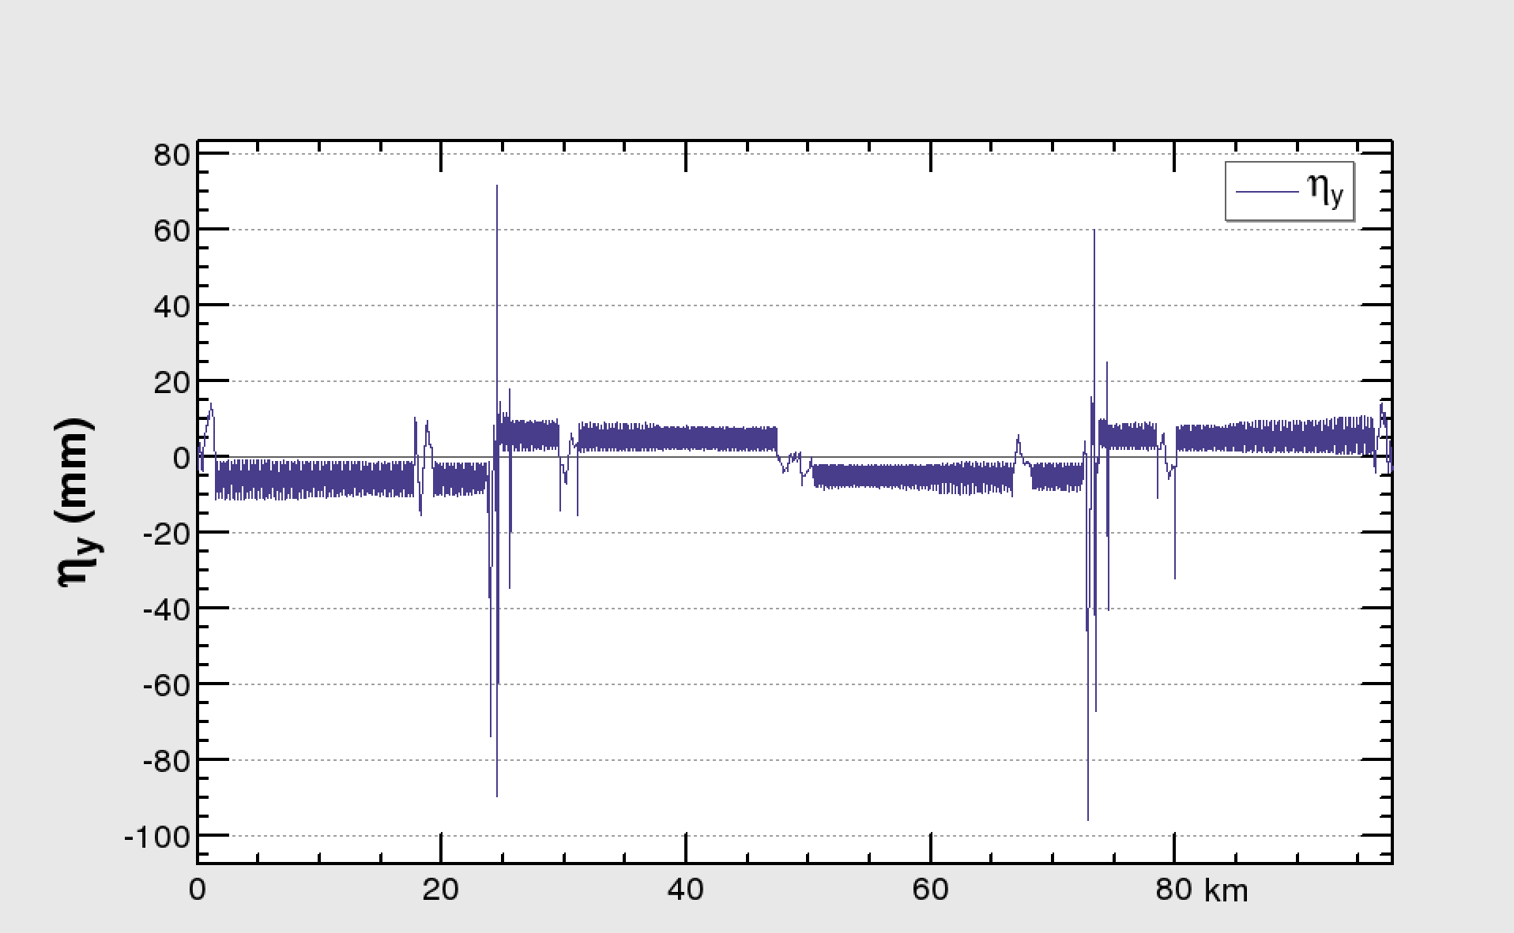
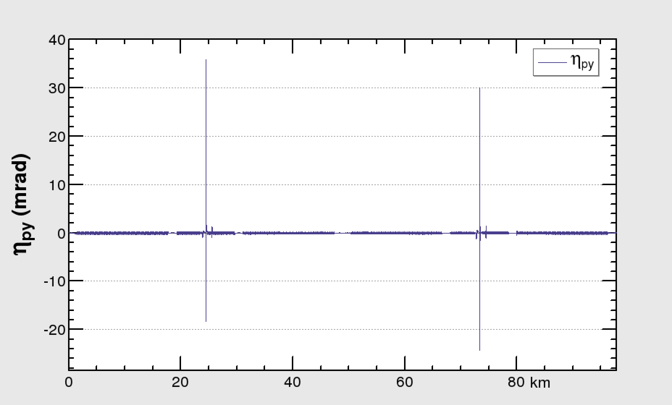
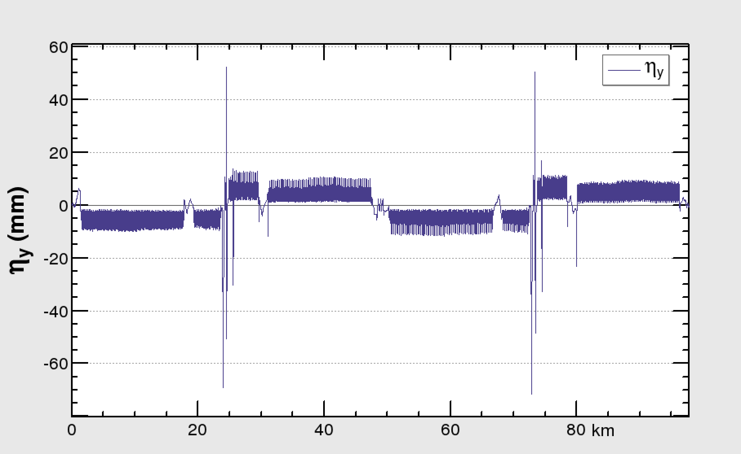
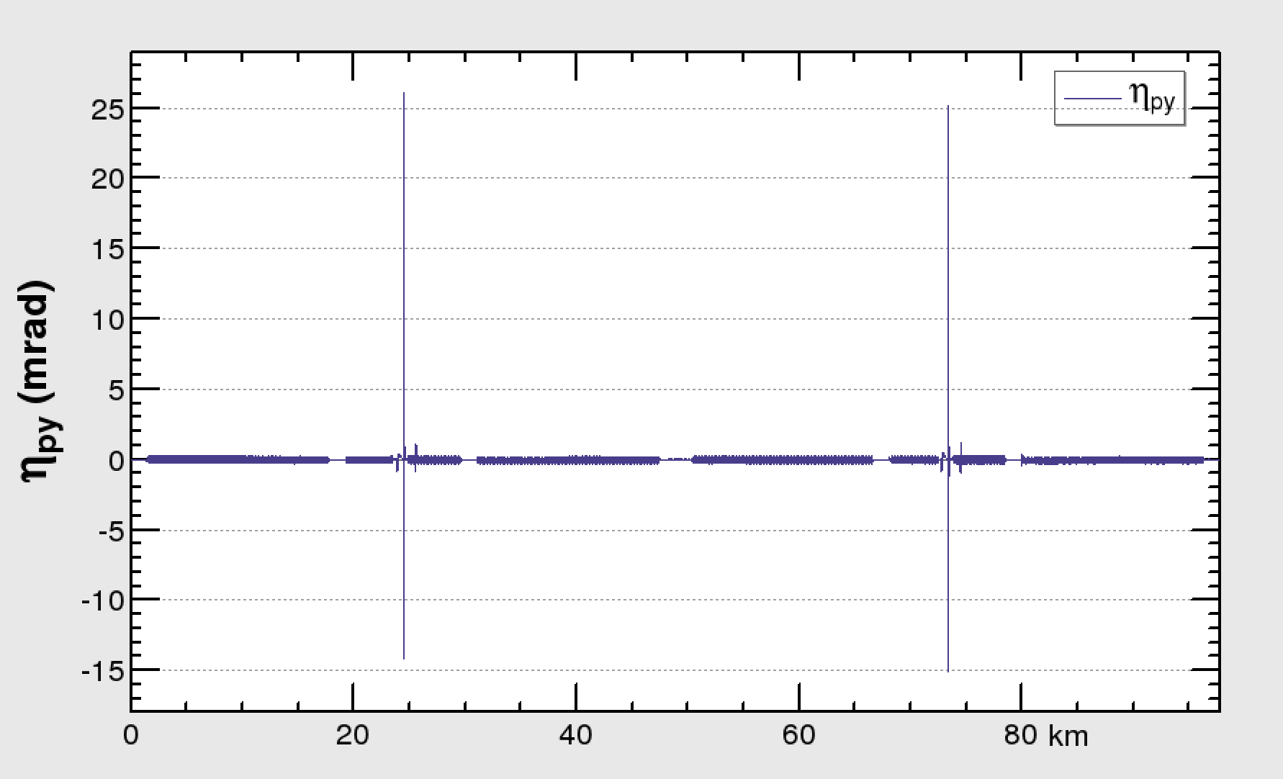
Corrections
Corrections done locally
Variation of skew quadrupole components of few sextupoles upstream/downstream of the location to be corrected
IP
FRF
IP
FRF
IP
FRF
IP
FRF

Slide 6
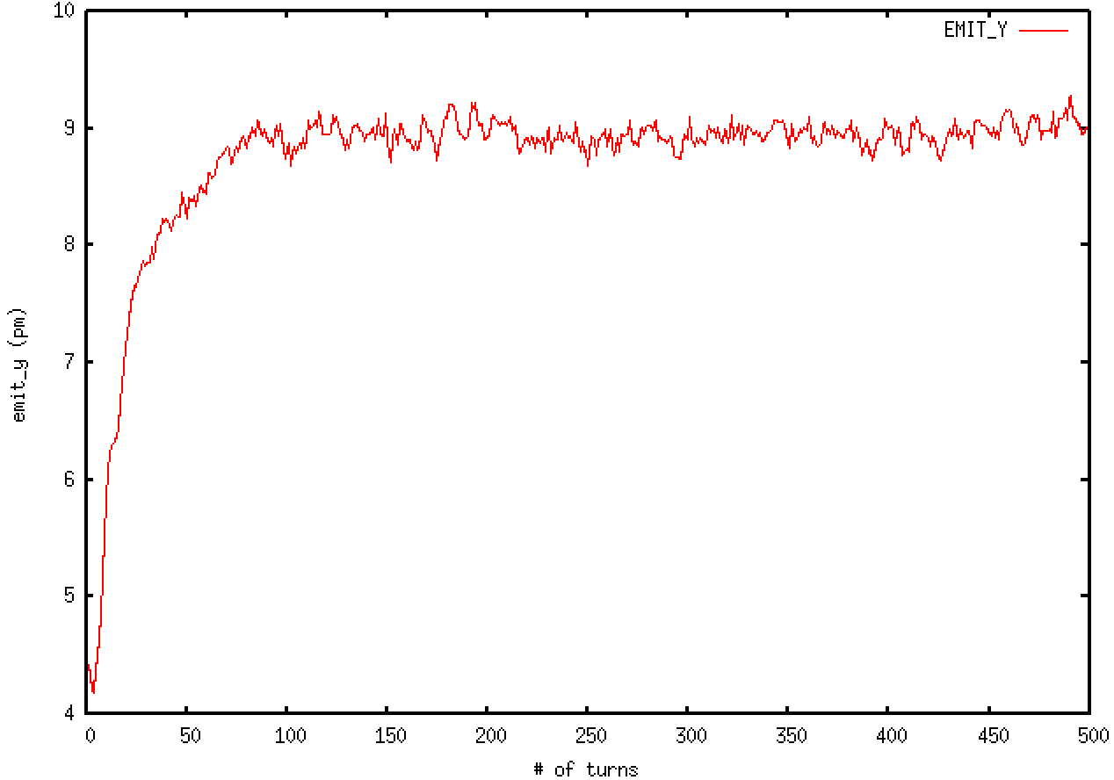
Corrections
Corrections done locally
Variation of skew quadrupole components of few sextupoles upstream/downstream of the location to be corrected

Slide 7
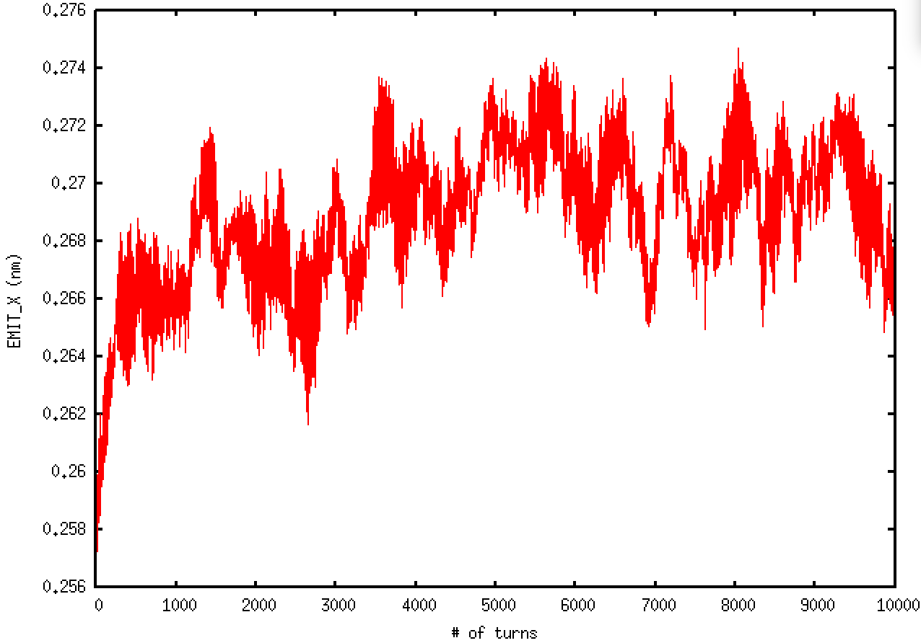
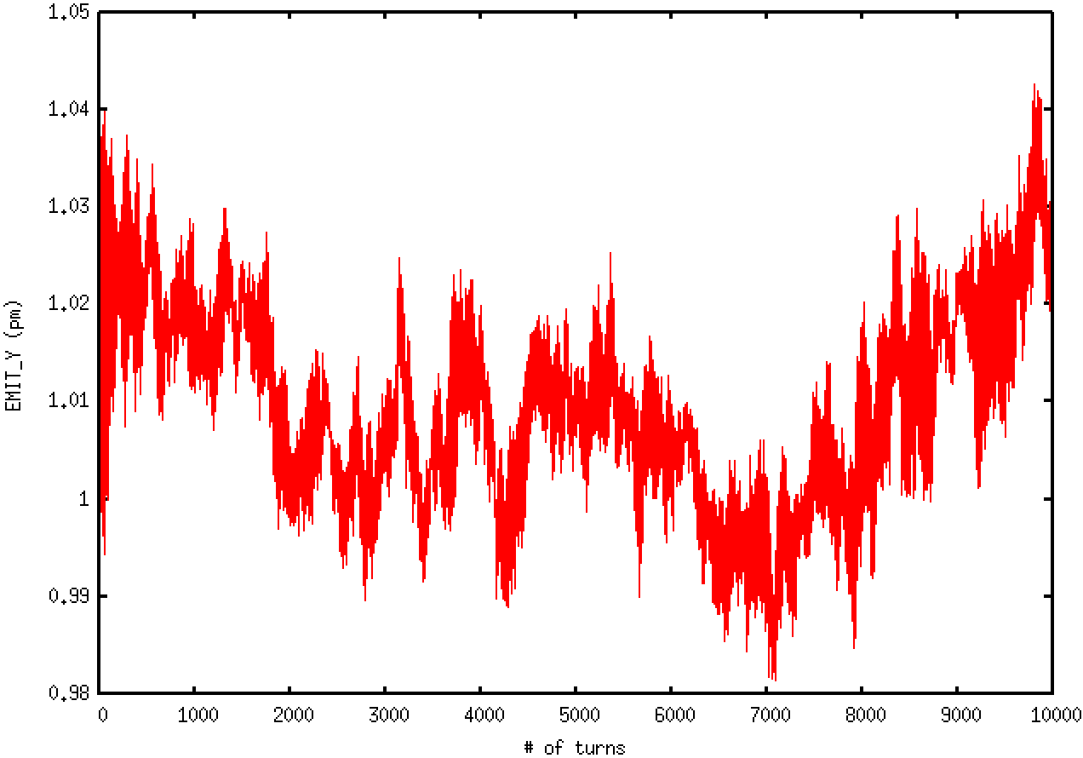
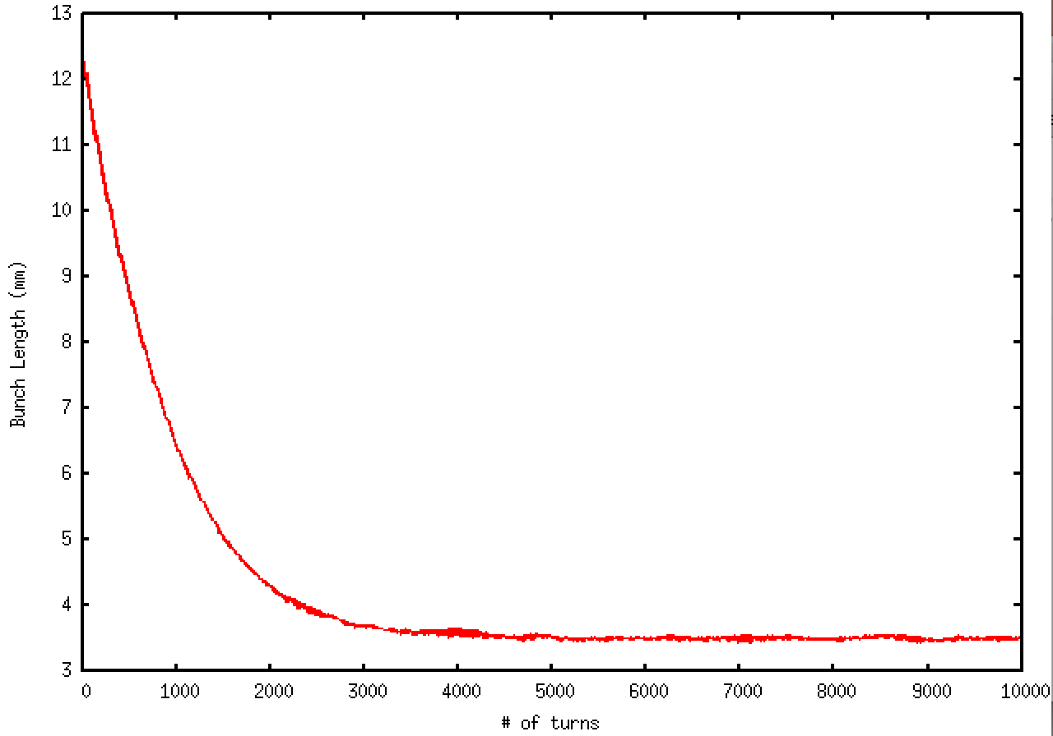
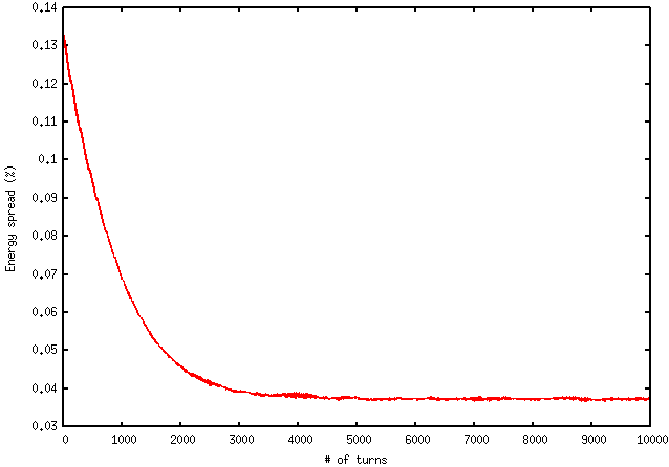



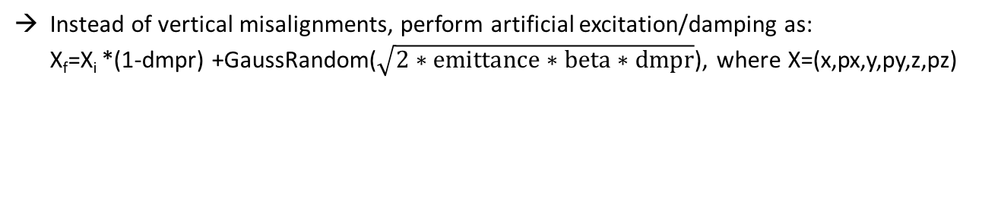
Artificial excitation/damping
Instead of vertical misalignments, perform artificial excitation/damping as: X_{f}=X_{i} *(1-dmpr) +GaussRandom($\sqrt{2∗emittance∗beta∗dmpr}$), where X=(x,px,y,py,z,pz)
$$ε_{x}$$
$$ε_{y}$$
NO beam-beam element
@ 45.6 GeV
$$σ_{z}$$
Energy spread

Slide 8
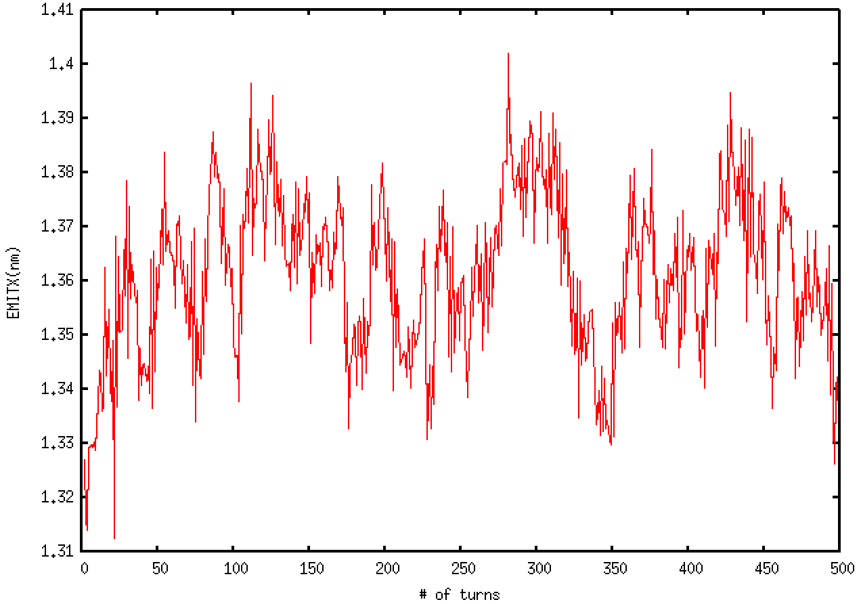
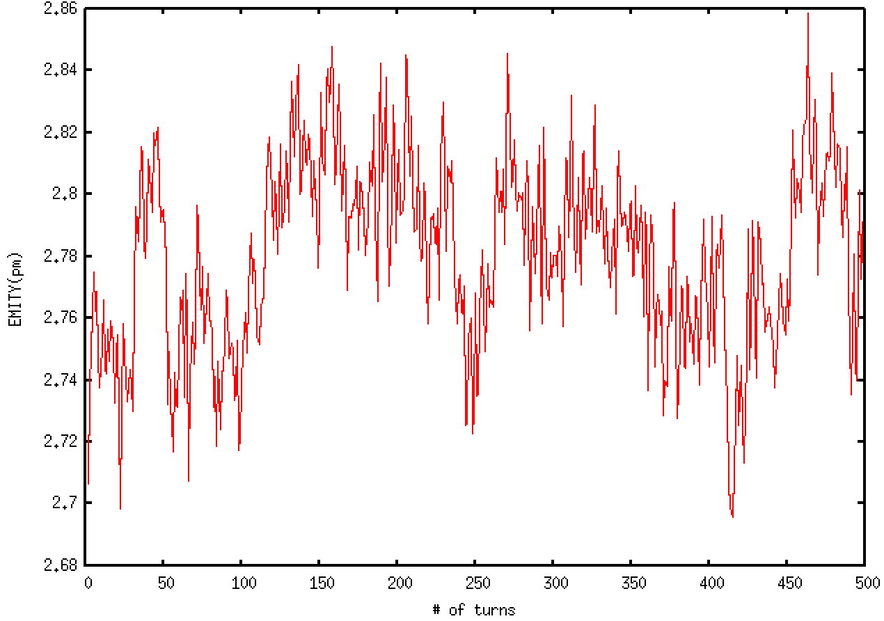
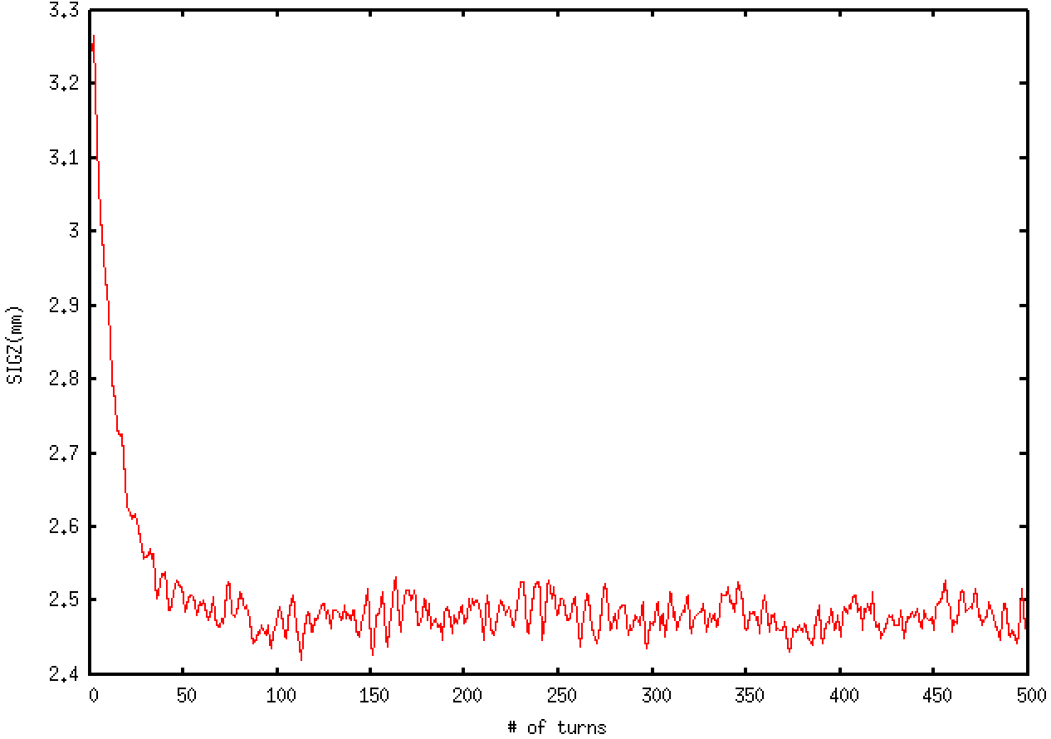
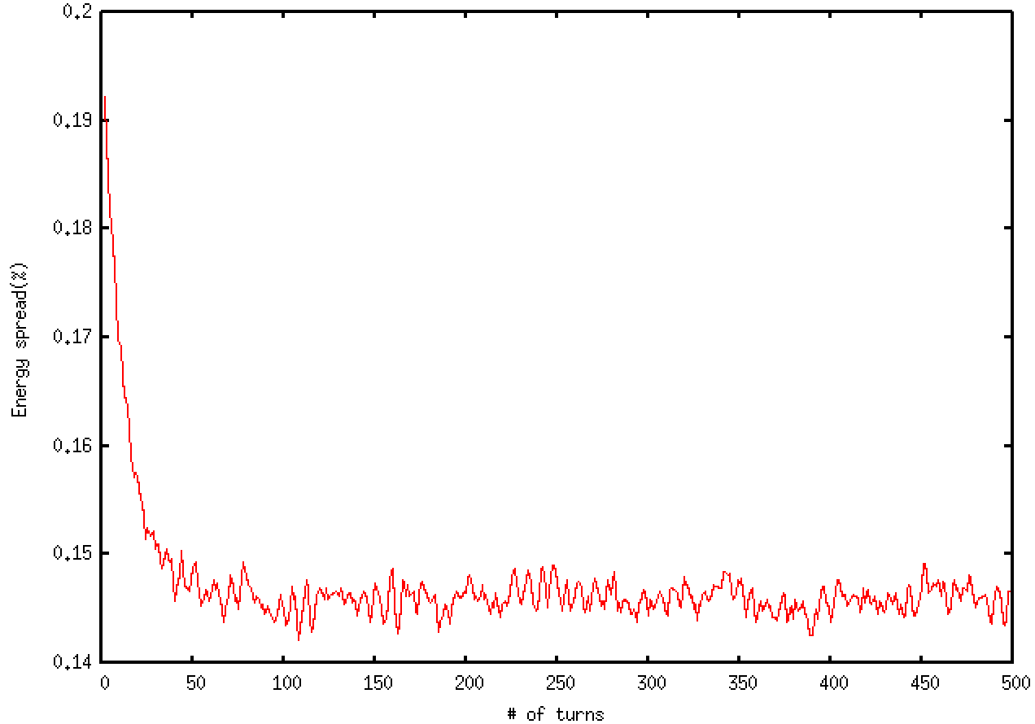



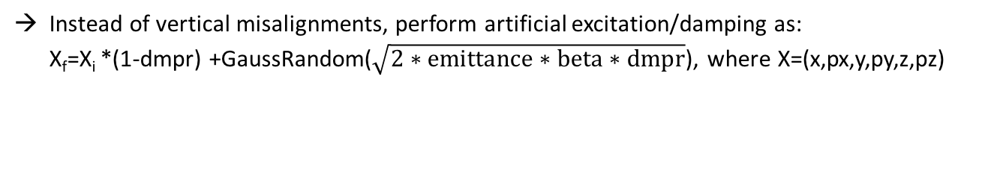
Artificial excitation/damping
Instead of vertical misalignments, perform artificial excitation/damping as: X_{f}=X_{i} *(1-dmpr) +GaussRandom($\sqrt{2∗emittance∗beta∗dmpr}$), where X=(x,px,y,py,z,pz)
$$ε_{x}$$
$$ε_{y}$$
NO beam-beam element
@ 175 GeV
$$σ_{z}$$
Energy spread

Slide 9
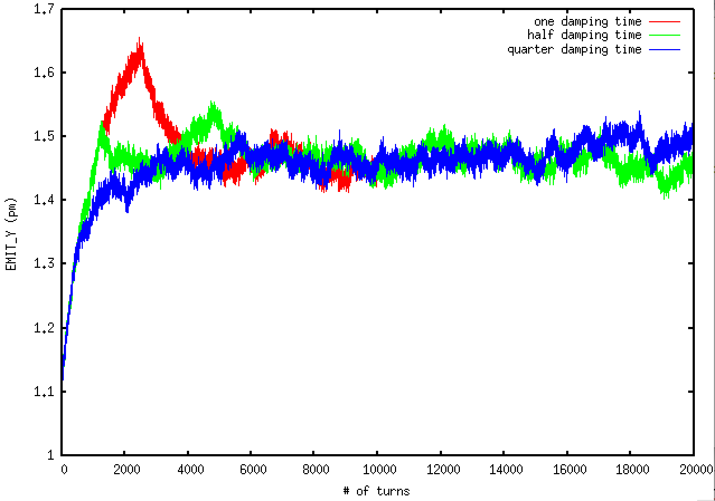
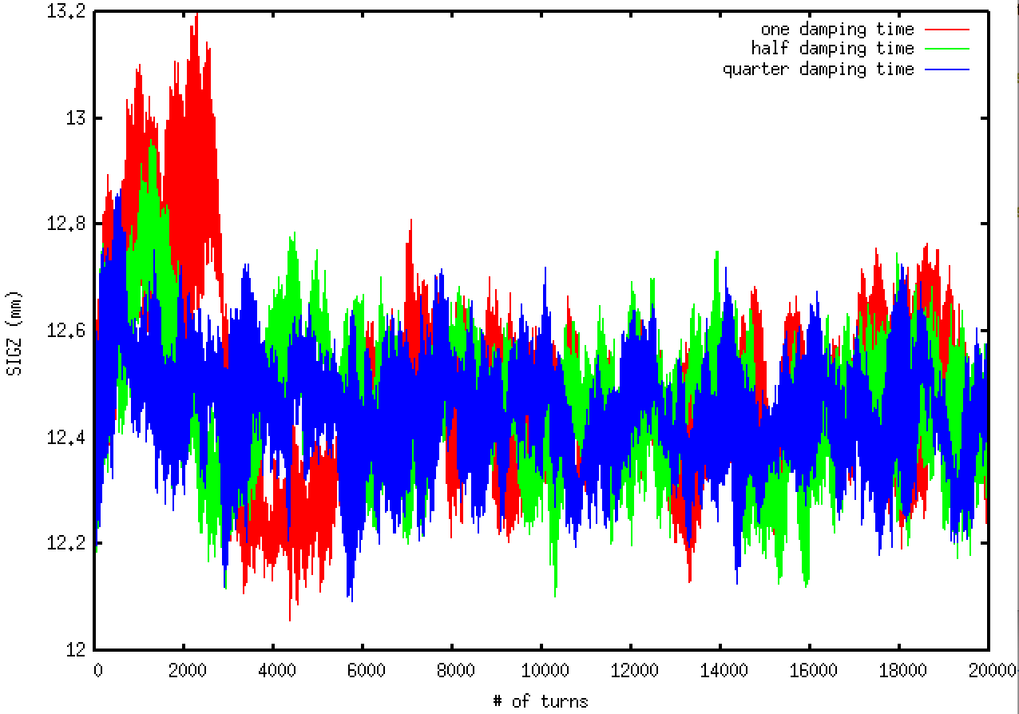
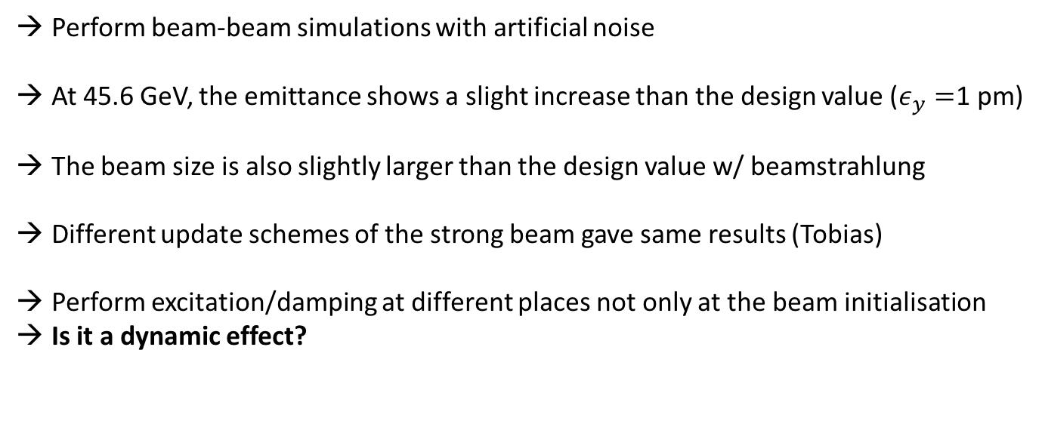
Beam-beam w/ beamstrahlung
Perform beam-beam simulations with artificial noise
At 45.6 GeV, the emittance shows a slight increase than the design value ($ε_{y}=$1 pm)
The beam size is also slightly larger than the design value w/ beamstrahlung
Different update schemes of the strong beam gave same results (Tobias)
Perform excitation/damping at different places not only at the beam initialisation
Is it a dynamic effect?

Slide 10
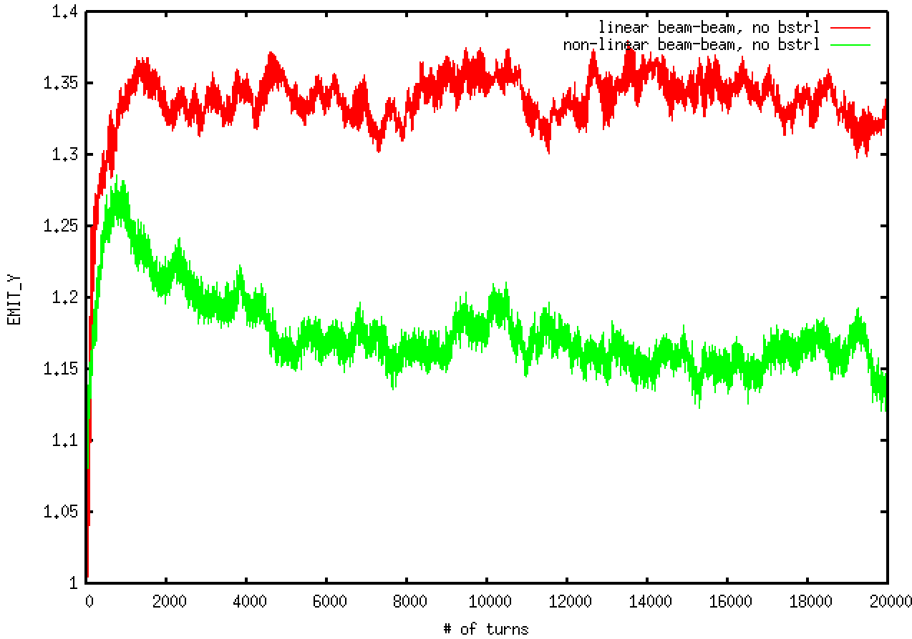
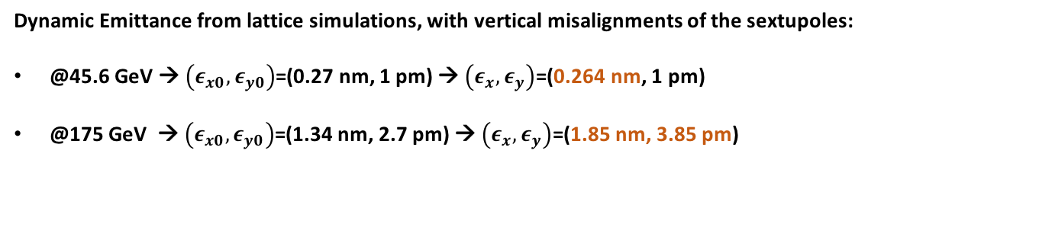
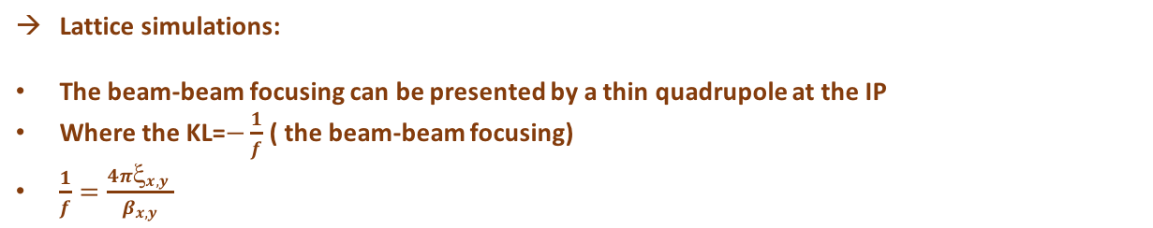
Dynamic effects
Lattice simulations:
The beam-beam focusing can be presented by a thin quadrupole at the IP
Where the KL=$−\frac{1}{f}$ ( the beam-beam focusing)
$\frac{1}{f}=\frac{4πξ_{x,y }}{β_{x,y}}$
Dynamic Emittance from lattice simulations, with vertical misalignments of the sextupoles:
@45.6 GeV → $\left(ε_{x0},ε_{y0}\right)$=(0.27 nm, 1 pm) → $\left(ε_{x},ε_{y}\right)$=(0.264 nm, 1 pm)
@175 GeV → $\left(ε_{x0},ε_{y0}\right)$=(1.34 nm, 2.7 pm) → $\left(ε_{x},ε_{y}\right)$=(1.85 nm, 3.85 pm)
Tracking in the presence of a thin quadrupole shows a dynamics emittance effect
Beamstrahlung seems to have an effect on the vertical emittance
@ 45.6 GeV

Slide 11
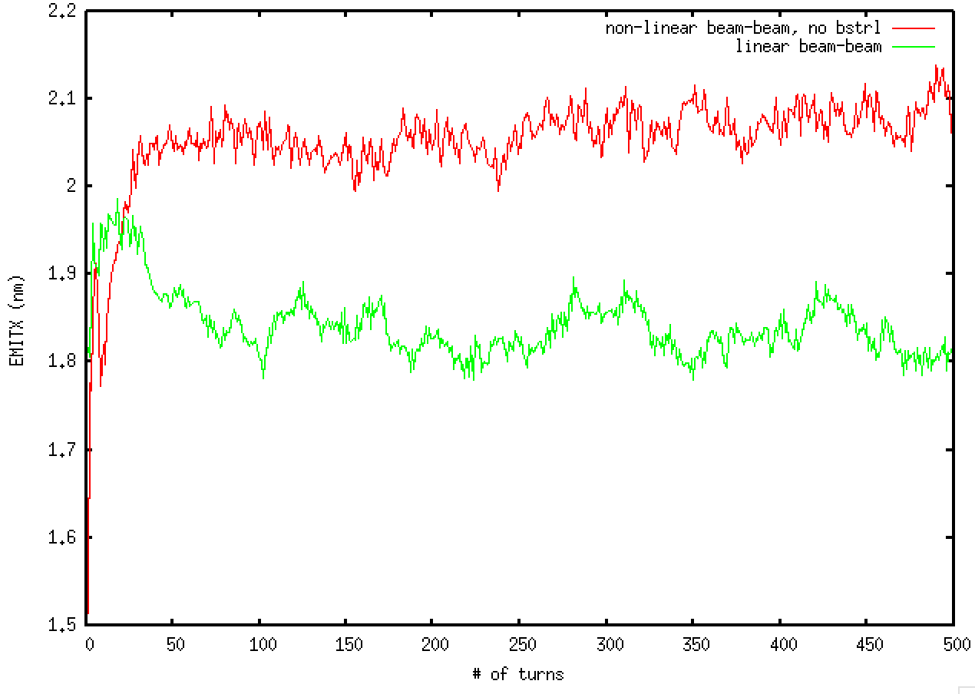
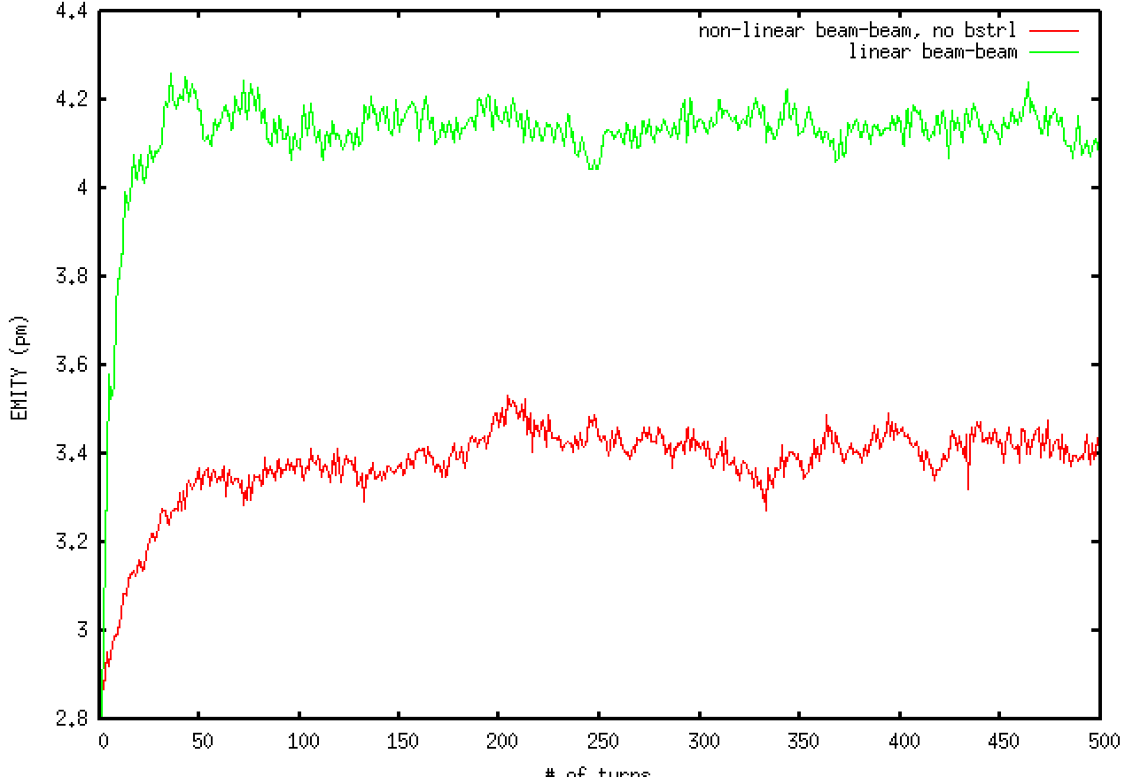
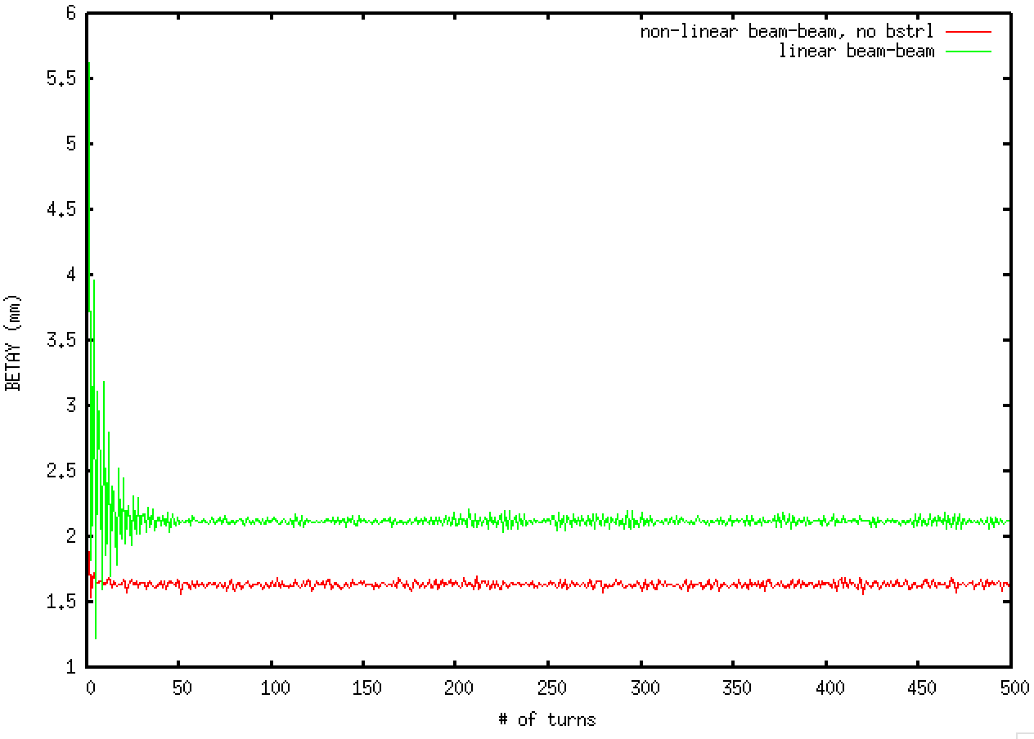
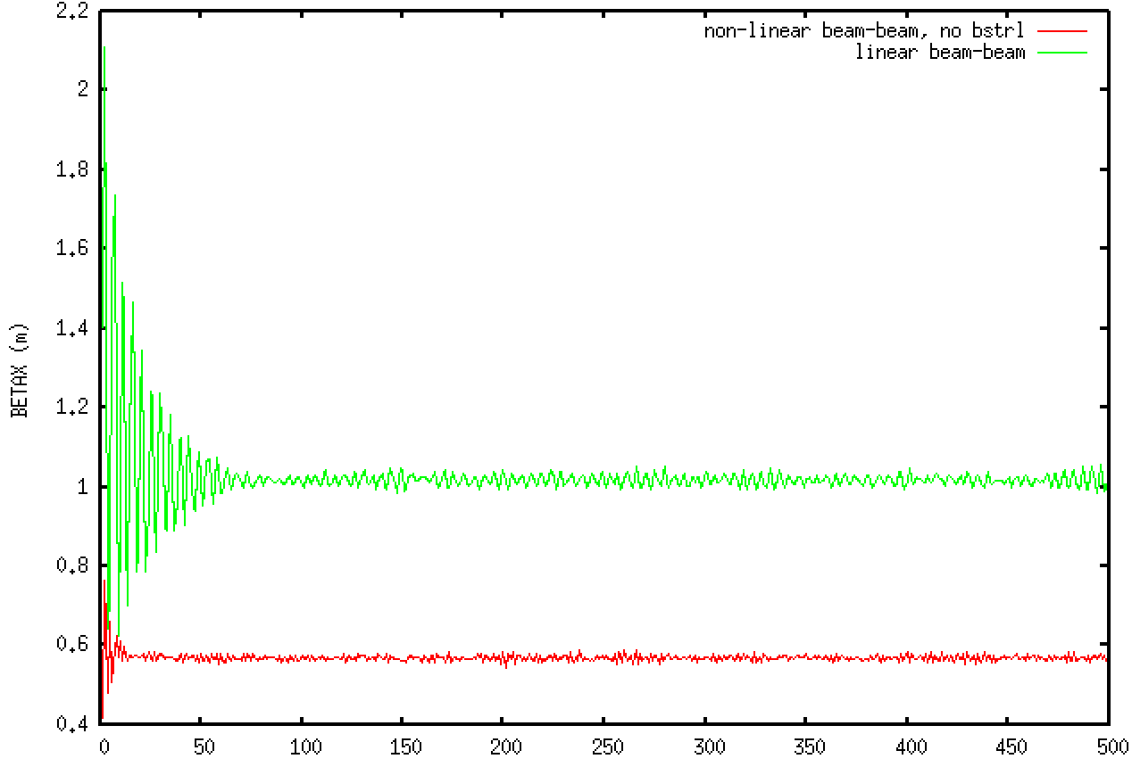
Dynamic effects @ 175 GeV

Slide 12
Conclusions
Sextupole misalignments are not corrected yet
Simulations with artificial excitation/damping were performed
Linear and non-linear beam beam kicks were compared
Dynamic effects seem to exist.
Corrections need to be done and simulations should be verified with corrected dispersions and xy couplings

Slide 13
BACK UP

Slide 14
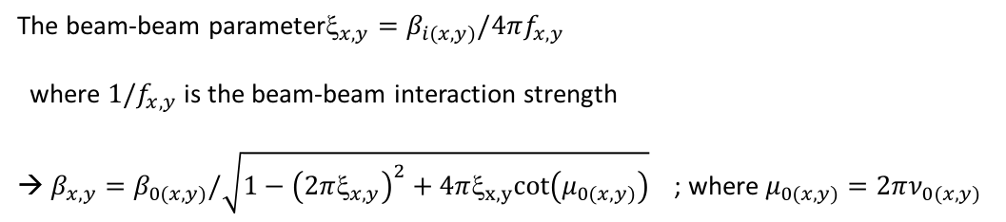
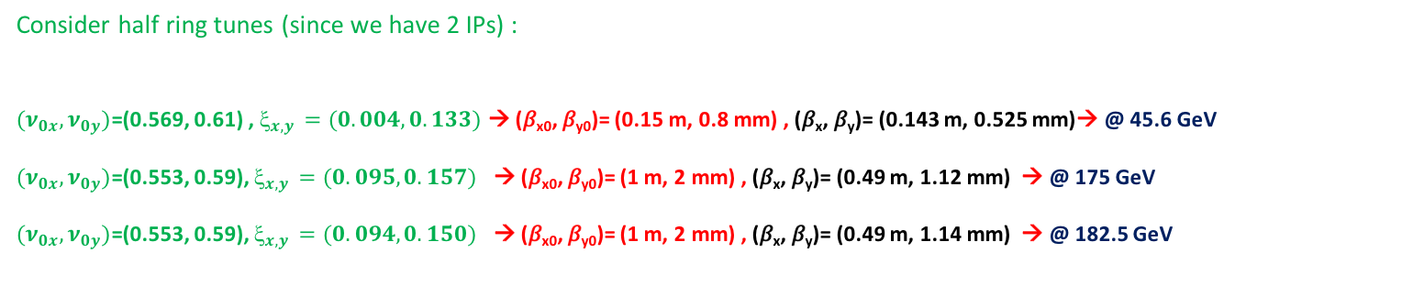
The beam-beam parameter$_{x,y}=β_{i\left(x,y\right)}/4πf_{x,y}$
where ${1/f}_{x,y}$ is the beam-beam interaction strength
→ $β_{x,y}=β_{0\left(x,y\right)}/\sqrt{1−{\left(2πξ_{x,y}\right)}^{2}+4πξ_{x,y}cot\left(μ_{0\left(x,y\right)}\right)}$ ; where $μ_{0\left(x,y\right)}=2πν_{0\left(x,y\right)}$
Consider half ring tunes (since we have 2 IPs) :
${(ν}_{0x},ν_{0y})$=(0.569, 0.61) , $_{x,y }=(0.004,0.133)$ → (𝛽_{x0}, 𝛽_{y0})= (0.15 m, 0.8 mm) , (𝛽_{x}, 𝛽_{y})= (0.143 m, 0.525 mm)→ @ 45.6 GeV
${(ν}_{0x},ν_{0y})$=(0.553, 0.59), $_{x,y }=(0.095,0.157)$ → (𝛽_{x0}, 𝛽_{y0})= (1 m, 2 mm) , (𝛽_{x}, 𝛽_{y})= (0.49 m, 1.12 mm) → @ 175 GeV
${(ν}_{0x},ν_{0y})$=(0.553, 0.59), $_{x,y }=(0.094,0.150)$ → (𝛽_{x0}, 𝛽_{y0})= (1 m, 2 mm) , (𝛽_{x}, 𝛽_{y})= (0.49 m, 1.14 mm) → @ 182.5 GeV

