Slide 1
PS status 19 April 2018
Frank Tecker, Denis Cotte, on behalf of PS operations and supervisor team

Slide 2
Status of beams
Fixed target beams | Status | Comment
EAST Irrad/North with nTOF Parasitic | Operational | Issue on ZT10.QDE01 (T10 momentum reduced from 6 to 5 Gev/c)
MTE | Operational | to SPS ~8∙10¹² ppp (tested 1.8∙10¹³)
TOF | Operational | Up to ~8∙10¹² ppp
AD | Operational | ~1.0∙10¹³ ppp sent to AD (tested 1.4∙10¹³)
LHC-type beams | Status | Comment
LHCPROBE, LHCINDIV | Operational
LHC25 (12b, 72b) | Operational
LHC25 BCMS (12b, 48b) | Operational

Slide 3
ZT10.QDE01 issue
Wednesday evening: T10 users ask to restart it. It did but quickly tripped again
First Line (called @ 22:44) found a magnet temperature fault.
Magnet piquet and RP piquet were called
=> Access from 9am Thursday with 3 hours of cool down
(7h20 without beam for T10 only)
EAST primary zone access until 18:40 (12h40 without beam for EAST AREA)
A thermal scan of the magnet was performed, water filters exchanged
No solution unless decreasing the water temperature or the CCV current, as there is no spare and the radiation level is too high to fix the magnet on site.
=> maximum 500A, run at 445A corresponding to 5 Gev/c (instead of 6 GeV/c)
Another access yesterday confirmed the present limit.
Lau Gatignon informed us that T10 will run like this for the rest of 2018

Slide 4
Other PS Complex Issues
EAST AREA:
  Radiation monitor PAXP502 around alarm level A (reported by RP)
  mainly due to high intensity beam on EAST1 (around 6∙10¹¹)
  Intensity was reduced to ~4.5∙10¹¹
Faults
  Timing repeater failure delayed the startup after dedicated MD on Wednesday by ~3 hours
    Difficult to diagnose: Beam loss, consequence of MD suspected, Internal dump found blocking, transition problems, extraction bump not pulsing
  Several problems from the Booster, temperature interlock on quadrupole, now solved

Slide 5
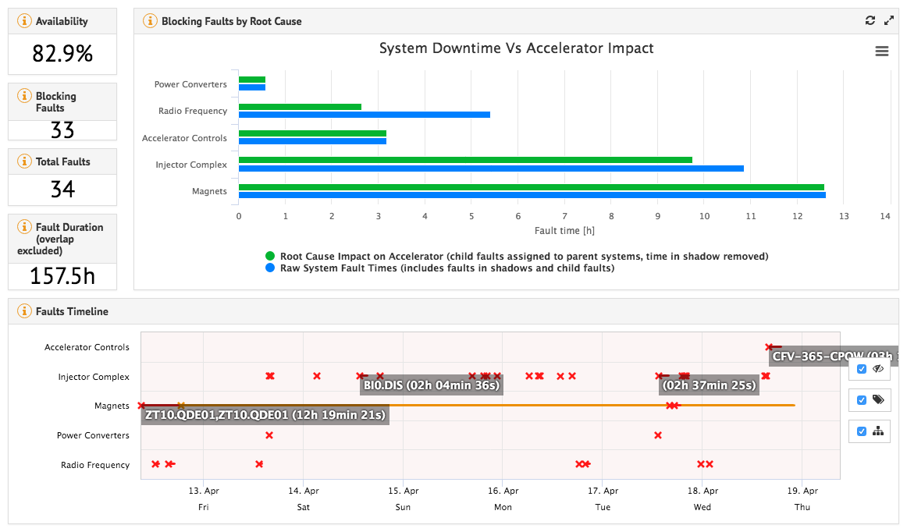

Slide 6
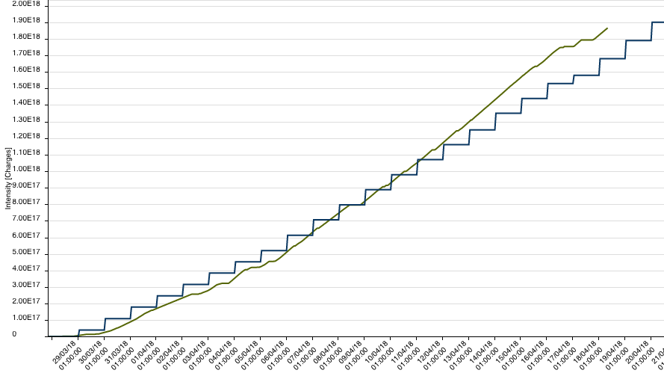
NTOF integrated intensity
1.87x10¹⁸ pot delivered up to now
This is 8.6% of the total intensity forecasted of 2.17x10¹⁹ pot
Beam position on target to be checked

