Slide 1
EP-DT Engineering Office
Section Meeting March 14th , 2018.
C. Bault, A. Catinaccio
https://indico.cern.ch/event/714258/
1

Slide 2
Agenda
News from EP and DT (Andrea)
Automatic synchronization tool for CDD released drawings: what to do with not synchronized drawings (failure of automatic tool)?
Tour de Table
AOB
2

Slide 3
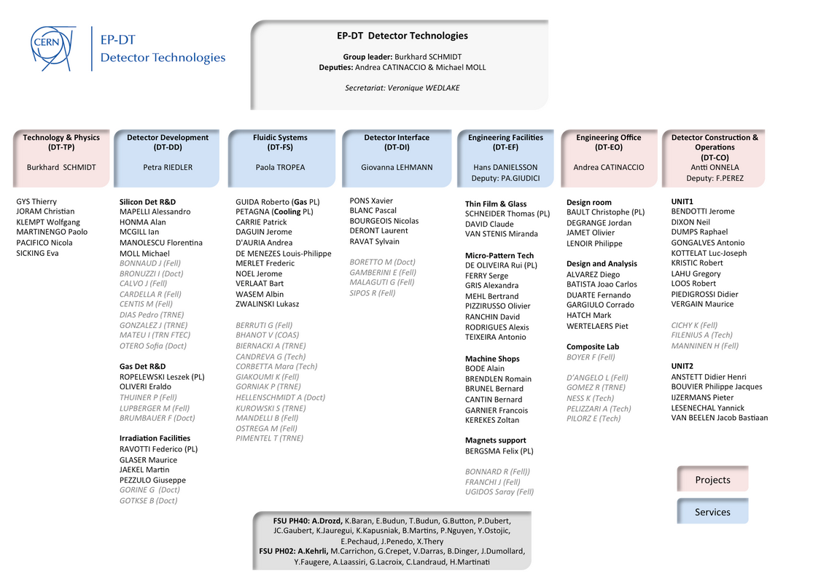
DT Structure
3

Slide 4
EO Personnel today
Christophe appointed Deputy SL since this year
New fellow, Jaakko Johannes Esala, joining the team from April
4

Slide 5
Main EO Activities
  Atlas: Upgrade ITk Pixel Outer Barrel (Diego PE) , High Granularity Timing Detector
  Neutrino LBNF: Follow up tests & qualifications – modifications introduced / calculations
  CMS: Tracker Upgrade
  LHCb: upgrade UT detector, LHCb TC and Integration
  NA62: Straw detector support, GTK integration and micro-cooling support
  LCD: support Test beam Telescope, FCAL test beam support
  Cooling: Support to the Cooling Project (EP-DT-FS)
  Alice: ITS upgrade, ITS, TPC, installation LS2, TC, integration
  Composite lab: Tools and infrastructures, prototype activities for several experiments – setting up production for Upgrades

Slide 6
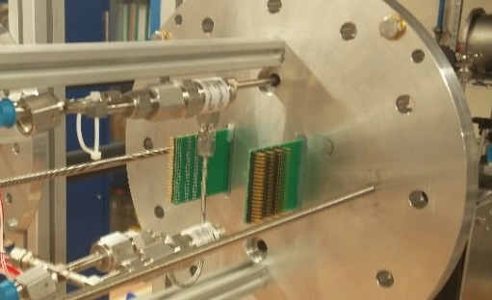
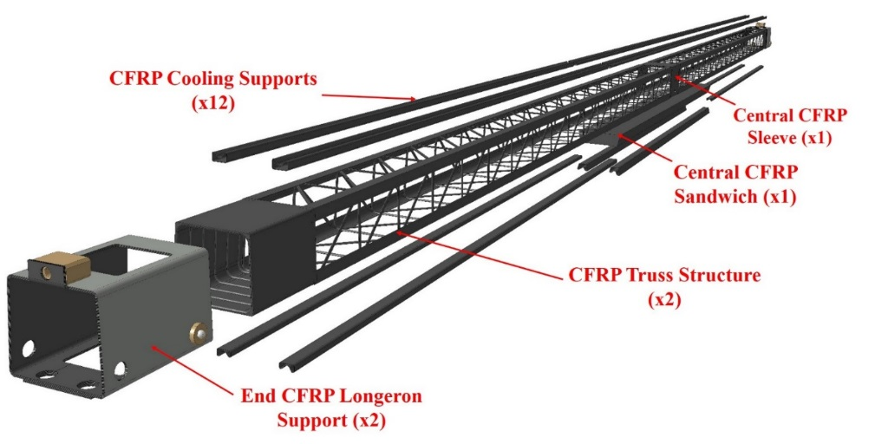
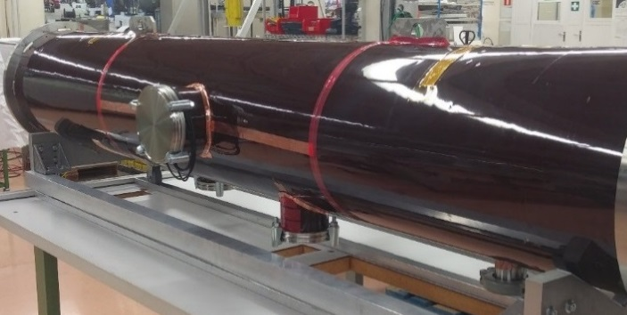
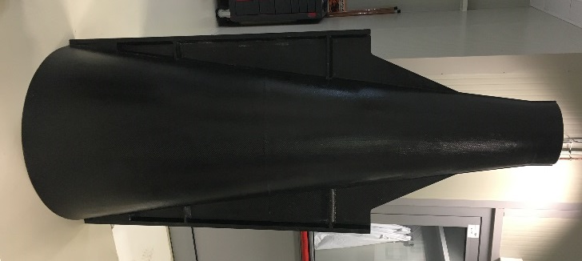
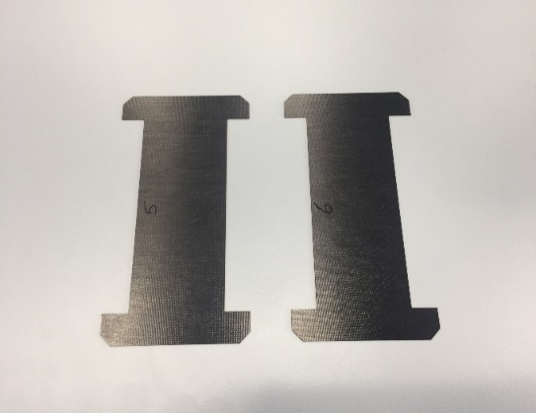
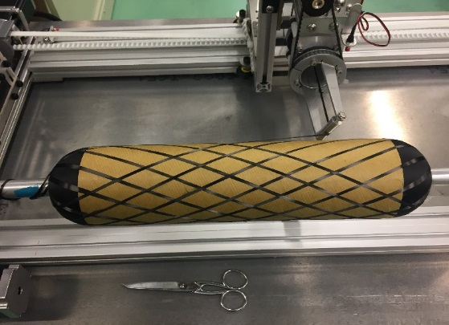
EP-DT-EO – Project driven R&D
  Ultra Light Carbon Composites Structures (ie Atlas, CMS, Alice, LHCb, LCD, NA62)
  On detector Thermal management solutions (Cooling & Advanced Materials)
  Additive manufacturing technologies
Filament winding of Pixel carbon fibres staves
Carbon parts for CMS PS modules
Thermal management Materials characterisation
Example of filament winding with dry carbon fibres
ITS Inner Barrel Structure

Slide 7
EP-DT-EO – R&D Composite Materials
Composite characterization:
  Ultra light Structures in Composite Material
  Development of high thermal conductive composites for on-detector thermal management
Composite processing
  Filament winding techniques, RTM (Resin Transfer Molding) techniques
  Additive manufacturing: production of special molds (cost and time advantageous); CF part production by additive techniques.
Monitoring techniques
  Composites on line health monitoring with embedded sensors: integration of sensors directly in composite parts in order to record data and control integrity of the carbon parts under load
  Composite failure: propagation of fracture in composite and bonded joints
  Failure Mechanisms, Quality control methods, DT and NDT techniques.
DT Composite Lab unique at CERN

Slide 8
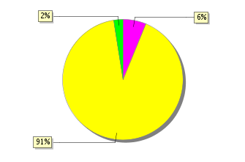

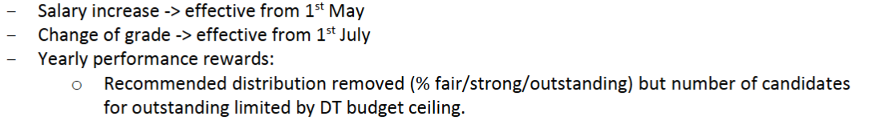
MERIT exercise
STATUS
MERIT Interviews 1/12 - 01/03
Performance proposals submitted on 06/03
Many thanks for your efforts to be on time!
Status as of today

Slide 9
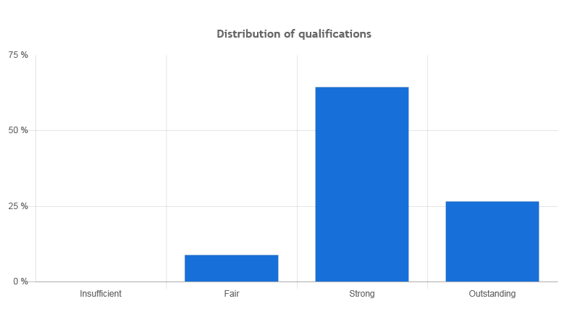
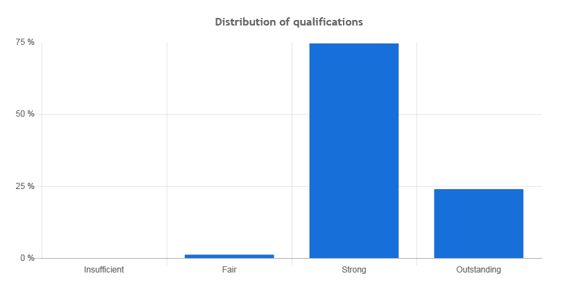
MERIT exercise 2017/2018
2017
2018
Many thanks to Section leaders for their input
Despite the tight situation, the proposals allow us to be in our quota
Note that the above (and the following) are preliminary
Proposals submitted latest by March 6

Slide 10
DT News: Promotions
Outcome of CAB 1 for promotions
Although no formal quota exists, there are informal ceilings which are respected.
Promotions not granted are related to staff who are still below the midpoint of 100% in their present grade.
Similar situation to last year.

Slide 11
Upcoming LDs and TTE committee
Laboratory Technical Engineer (to support activities in the DSF etc.)
  VN published : EP-DT-DD-2018-19-LD (open until 20/03/2018)
Applied physicist (Expert in QA for Silicon Detectors)
  VN published : EP-DT-DD-2018-20-LD (open until 20/03/2018)
Beyond the first part of 2018:
Engineer to support the activities of the composite lab
TTE program:
Submit project and request for the next committee (April) – agreed shared position with Antti (CO)
FTEC program: Urgent to proceed x new candidate

Slide 12
DT Training Seminars
12th April CLOUD by Hanna Manninen (organized by Antti)
14th or 28th June: Group meeting followed by a BBQ
      Problem with the 2nd date (28th of June) due to Forum
20th September: Open for suggestions
29th November: Open for suggestions
Ruben to present Cooling Simulation and Test Studies for Pixel: suggested date (April) ?
EO Internal DT Seminars

Slide 13
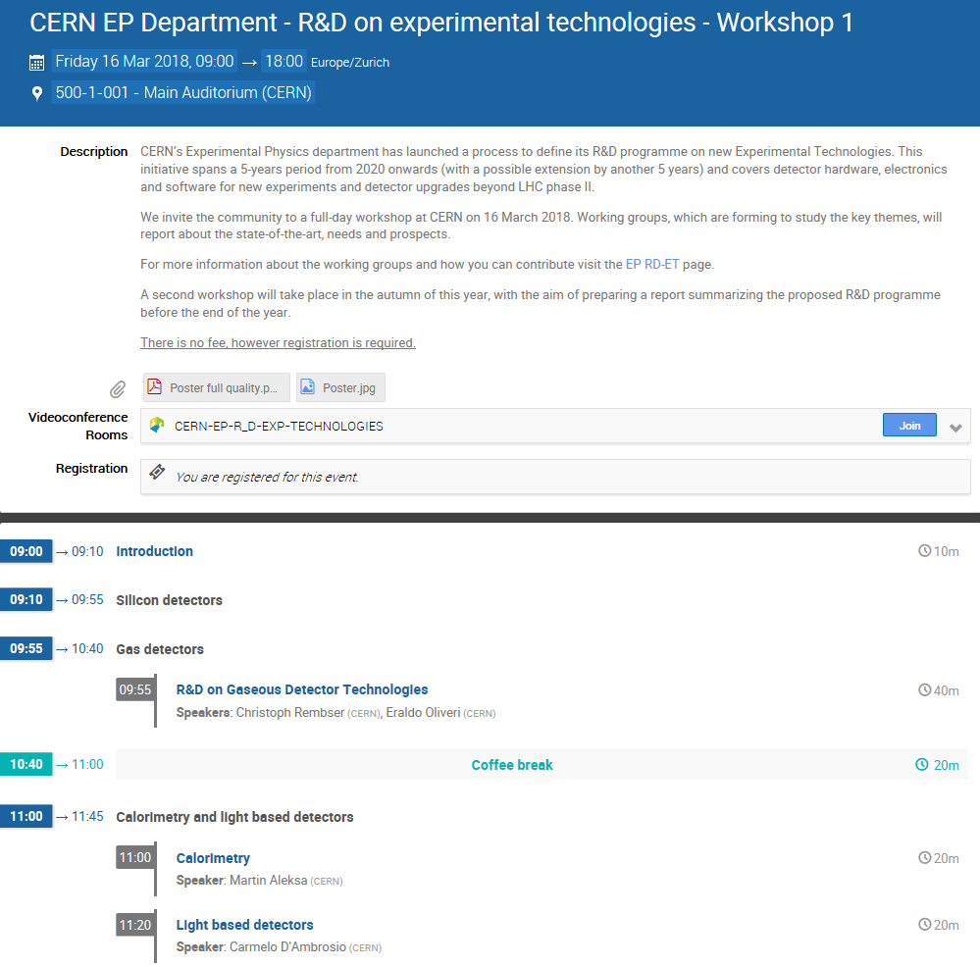
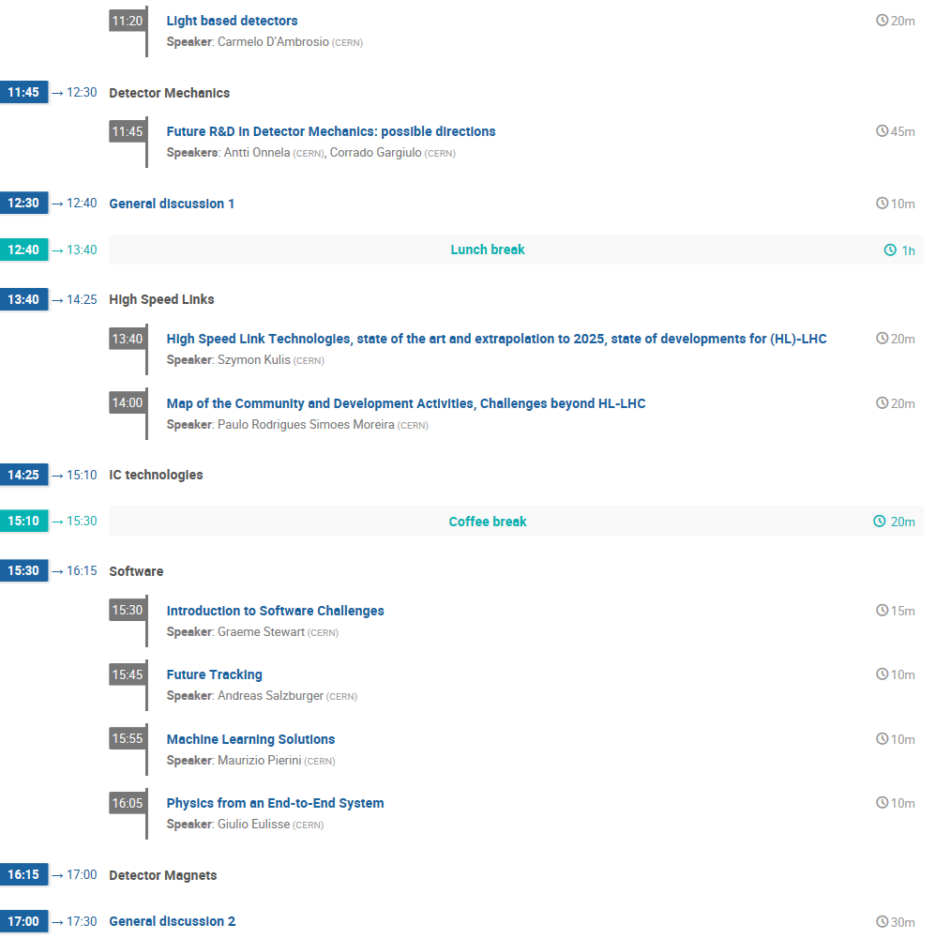
R&D on Experimental Technologies

Slide 14
Space and ongoing Renovations
Move from b. 102 to b. 107 proceeds well
Preparation of cooling zone in b. 153 slightly behind
Preparation of composite lab zone in b. 153 starting
Work for removal of asbestos in b. 166 on schedule
Clean-up 169-S-026 is now urgent
  Met yesterday with the people concerned
Office Space: to be looked into with Veronique

Slide 15
Reminder: Safety in DT
Isabelle Mardirossian has been asked to hand over her role as safety link person to someone from DT; we are looking for a replacement.
Her tasks included:
  Conformity of the EP-DT machines
    At present we have 96% conformity
  Conformity of DT labs
    This only started (specific methodology for different labs)
  Implementation of safety aspects when purchasing new machines
  Support to TSO related safety aspects of DT
  Logistics aspects for lead collection in the department in close collaboration with the RP group
Andrea would also like to hand over his duties as safety responsible for the group. We have to find a replacement and ensure a smooth transition
BS proposed to form a small group (which will include Isabelle and Andrea), to prepare the safety reorganization and the transition.
We will start this exercise in April

Slide 16
News from Enlarge Directorate (extract)
Microsoft license (F. Hemmer)
  Microsoft denies in future CERN’s status as an academic institution corresponding to a prize increase from 600 k per year to 7.5 M.
  Discussion on possible CERN-wide strategy to gradually eliminate the dependence on Microsoft products. Critical and expensive are the large number of licenses for server-based products rather than Windows and Office.
Priorities for 2018 (F. Gianotti)
  Top-five priorities:
  Successful completion of LHC run 2 and the rest of the scientific programme before LS2
  Preparation for LS2 and LHC upgrades
  Finalise input from design studies (CLIC, FCC, PBC, etc.) for the European Strategy for Particle Physics
  Secure additional contributions from NMS to HL-LHC and make progress on special contributions from France and Switzerland
  Raise the funds for the Science Gateway building

Slide 17
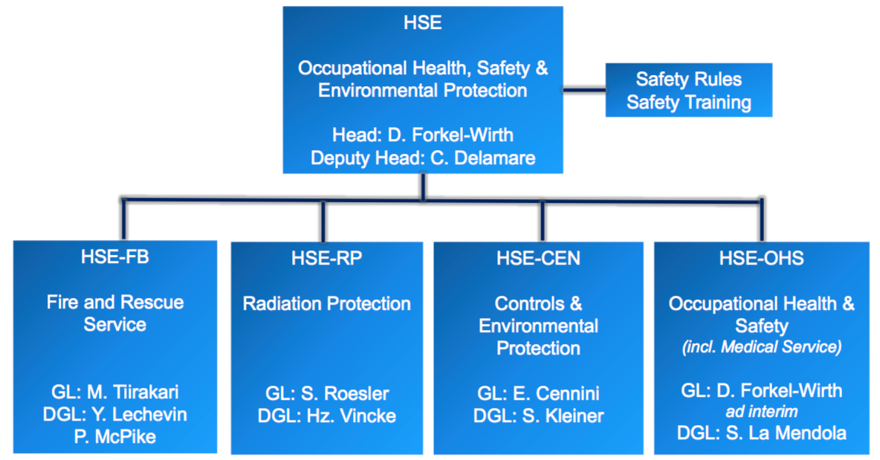
News from Enlarge Directorate (extract)
HR matters(J. Purvis):
  - Promotion Parameters
  - Change in Recruitment Software
  eRT phase out, last staff post publication April 2, offline April 30
  Smartrecruiters (SR) start May 2
  Staff post published after April 2 will require 2 publications and manual handling
HSE matters (D. Forkel-Wirth)
  New HSE Organisation
  since January 1st, 2018
17

Slide 18
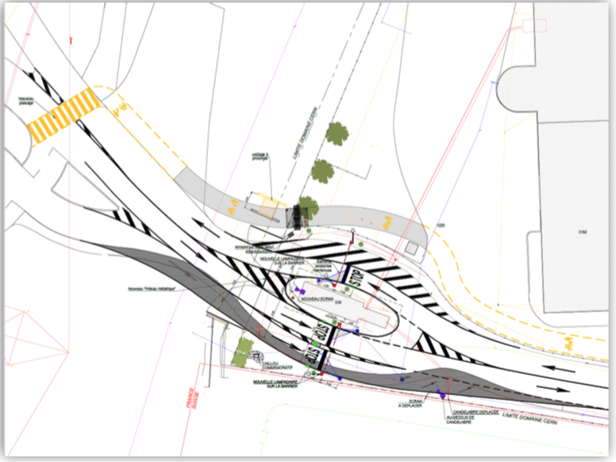
News from Enlarge Directorate (extract)
SMB matters (Ll. Miralles):
  Plan for 2018 on site security: more cameras, new pedestrian gate also for disabled people gate B (left side) and gate Jura, Gate E double lane and bicycle/pedestrian entrance
Web re-development Project:
  Migration from Drupal 7 to Drupal 8 (137 webpages in EP)
  Instruction for migration: https://entice.web.cern.ch/drupal8pilotInfo
  Migrated Drupal 8 websites only accessible within CERN until summer, then they become default and Drupal 7 websites will be frozen.
18
18

Slide 19
EO Upcoming
Annual report: - Just after the MERIT exercise - Aim for having a draft end of March - should be shorter than previous reports
→ editors EO
Review of EO commitments LBNF and Pixel Upgrade OB
Proposals x Investments from DT budget (be ready with list)
Negotiation for DT R&D budget allocation for EO (so far classified as project unit)
Define future allocations from EP R&D Initiative for Mechanics

Slide 20
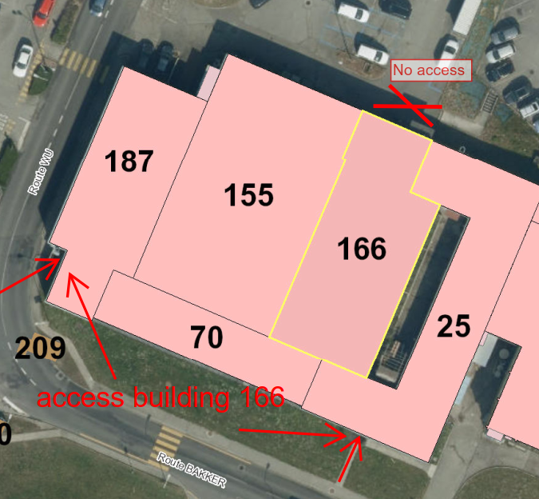
EO Upcoming
Discussion needed with cooling team: no space or plants foreseen for on-detector cooling in DT (153 lab)
New UE call for Additive Manufacturing (Jan 2019) (CERN wide participation with EU office and KT)
Project for ‘children of personnel’. Deadline is 23rd March 2018
  Office work, b) Light or heavy manual work, c) Electronical, d) Electrical, e) Mechanical, f) Technical drawing, g) Computing, h) Office computing work
166/25 asbestos removal: main entrance door of 166/25 condemned from next Monday 19th March 2018 to April/May 2018.

