Slide 1
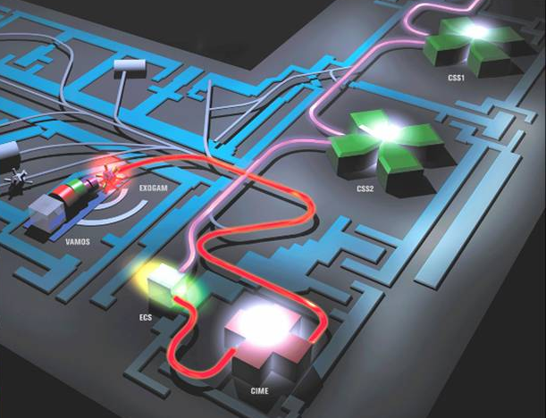
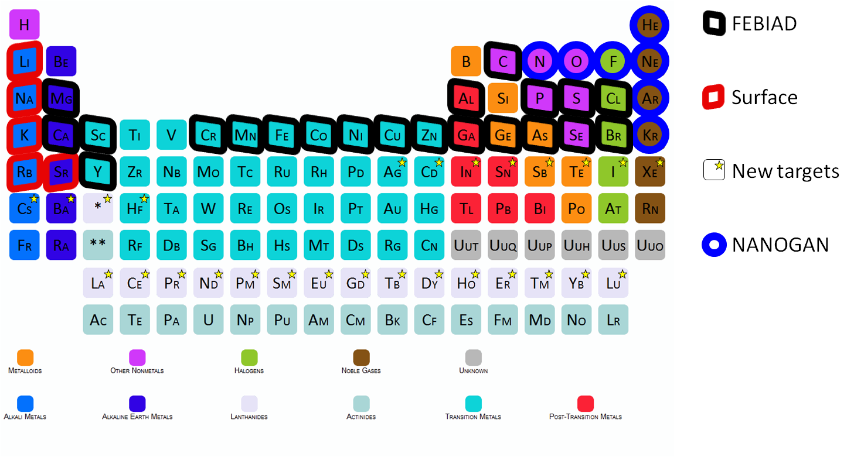

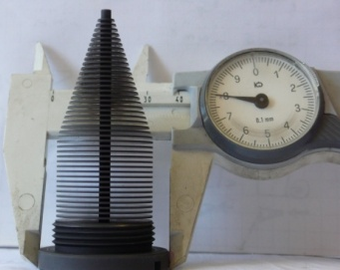








Radioactive ion beam R&D with SPIRAL 1
SPIRAL 1 Upgrade
P. Delahaye for the Upgrade SPIRAL 1 team
Beamlab meeting, ISOLDE
3rd of April 2018

Slide 2
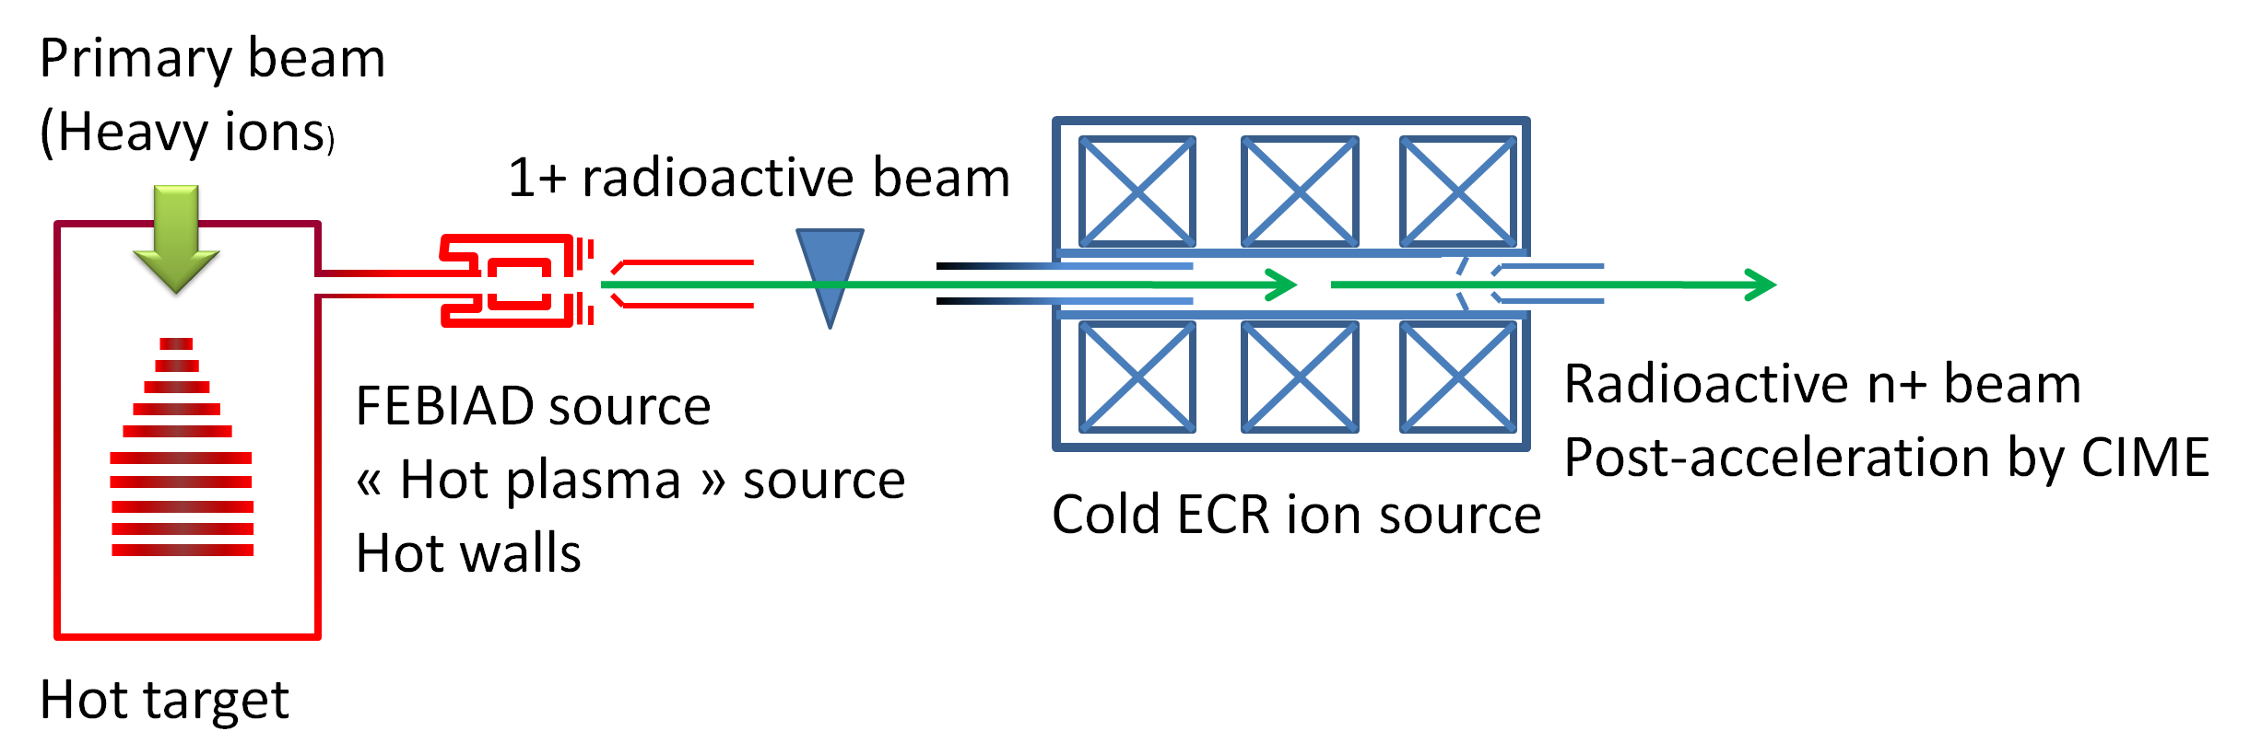
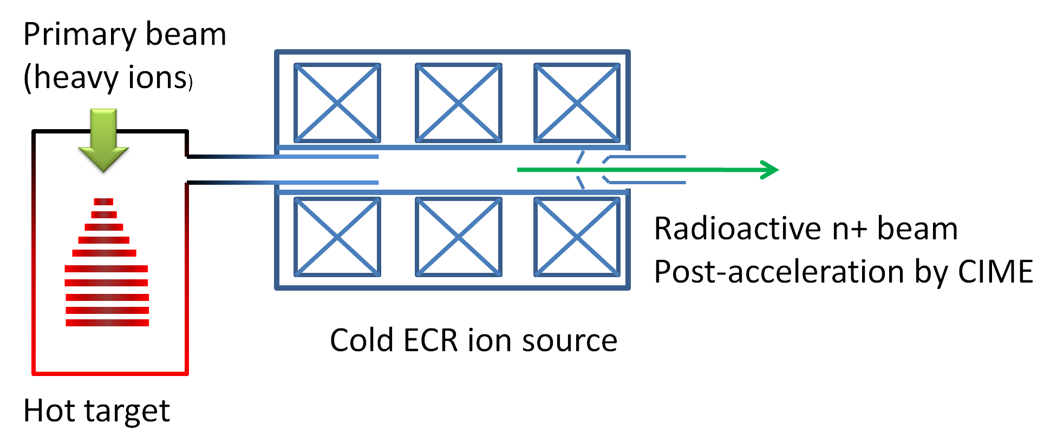
SPIRAL upgrade in a nutshell
Extending the number of elements produced by the ISOL method at SPIRAL
1+ ionisation: VADIS from ISOLDE
  1+ beams from metallic elements with T_{fusion} <2000°C
Conversion from 1+ to n+: Phoenix booster
  Almost chemistry independant, charge breeding times from 10 to ~200ms

Slide 3
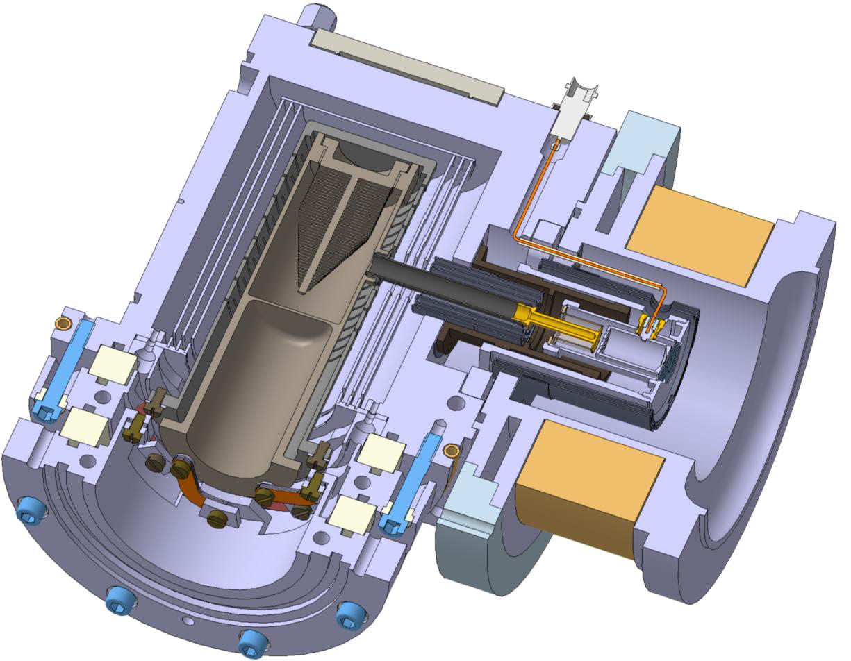
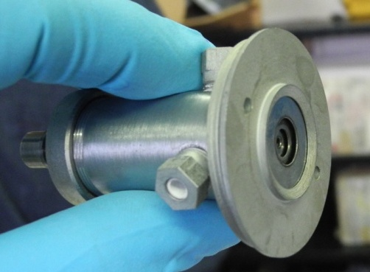
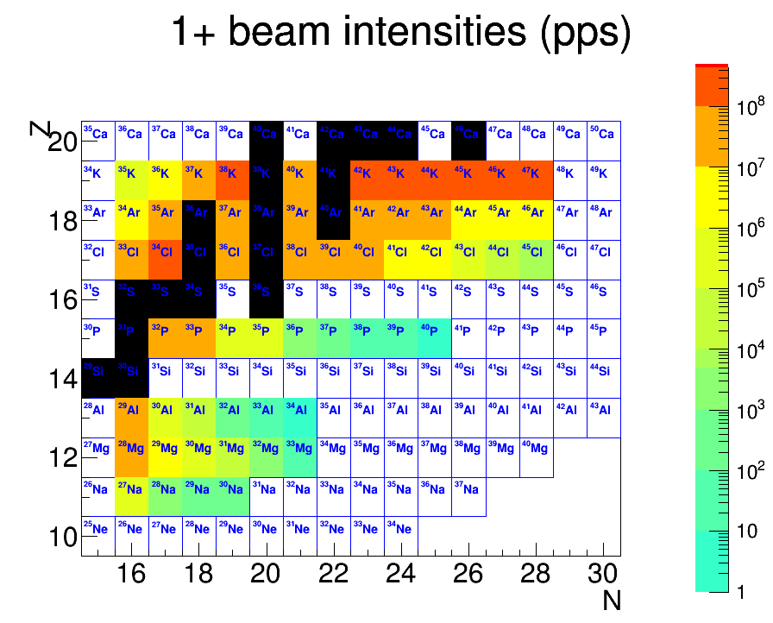
FEBIAD source
ISOLDE VADIS
2011 -2013 - Different tests at SIRA and SPIRAL 1
Coupling of the SPIRAL 1 targets with the VADIS
Dilatation problems are fixed
Ion source sliding against its axis
oven attached to container
Record temperature of 2400°C attained
1+ beams from metallic
elements with T_{fusion} <2000°C
Dec. 2013: tests at nominal power at SPIRAL 1
O. Bajeat et al, NIM B 317(2013)411
P. Chauveau et al, NIM B 376(2016)35
Day 1 beams from FEBIAD TIS test results with ³⁶Ar@95AMeV at nominal power at SPIRAL 1
Already 7 new elements
Na, Mg, Al, P, Cl, Cu, Fe
+ many more to come
2014- 2015: reliability tests
Failing BeO insulators exchanged
High voltage discharges at extraction fixed
More than 3 weeks running with stable efficiencies
Notes:
Fonctionnement pendant plus de 3 semaines avec efficacités stables

Slide 4
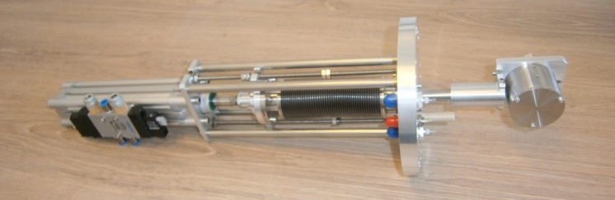
FEBIAD source - status
2 ion target ion sources
1 in assembly
1 conditioned on the SPIRAL 1 test bench
Ionisation efficiency measurements
Energy profile measurement
η%
With Xe injection
?
?
Latest @ GANIL
Simulations: M. Herbane, LPC Caen
He Ne Ar Kr Xe Rn
A
Ref: L. Penescu et al, Rev. Sci. Instrum. 81, P. Chauveau et al, NIM B 376, S. Essabaa et al NIM A 317
Using a calibrated leak with gas injection: η= I1+/Igaz
Intensity increase to be confirmed on long term
*Yield estimates use conservative efficiencies*
Charge breeding efficiency depends on δE
σ_{E}~1.5eV
Notes:
Interrogation sur les efficacités – eficcacité des taux cnservateurs – insister sur hors ligne, conditionnement

Slide 5
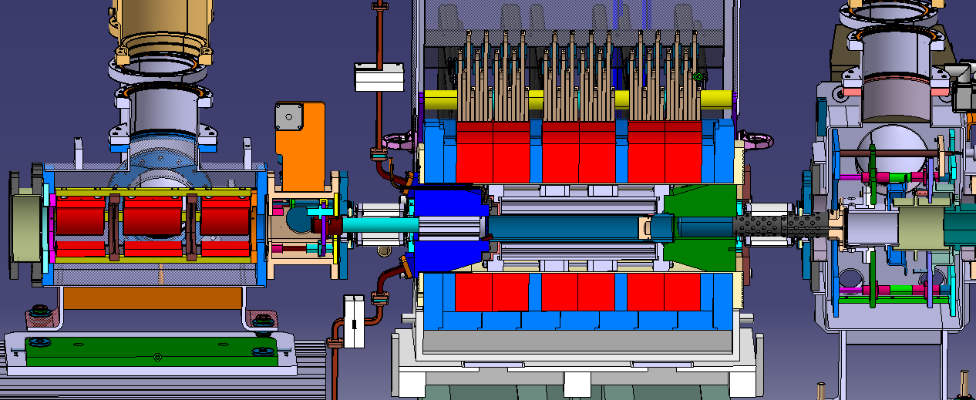
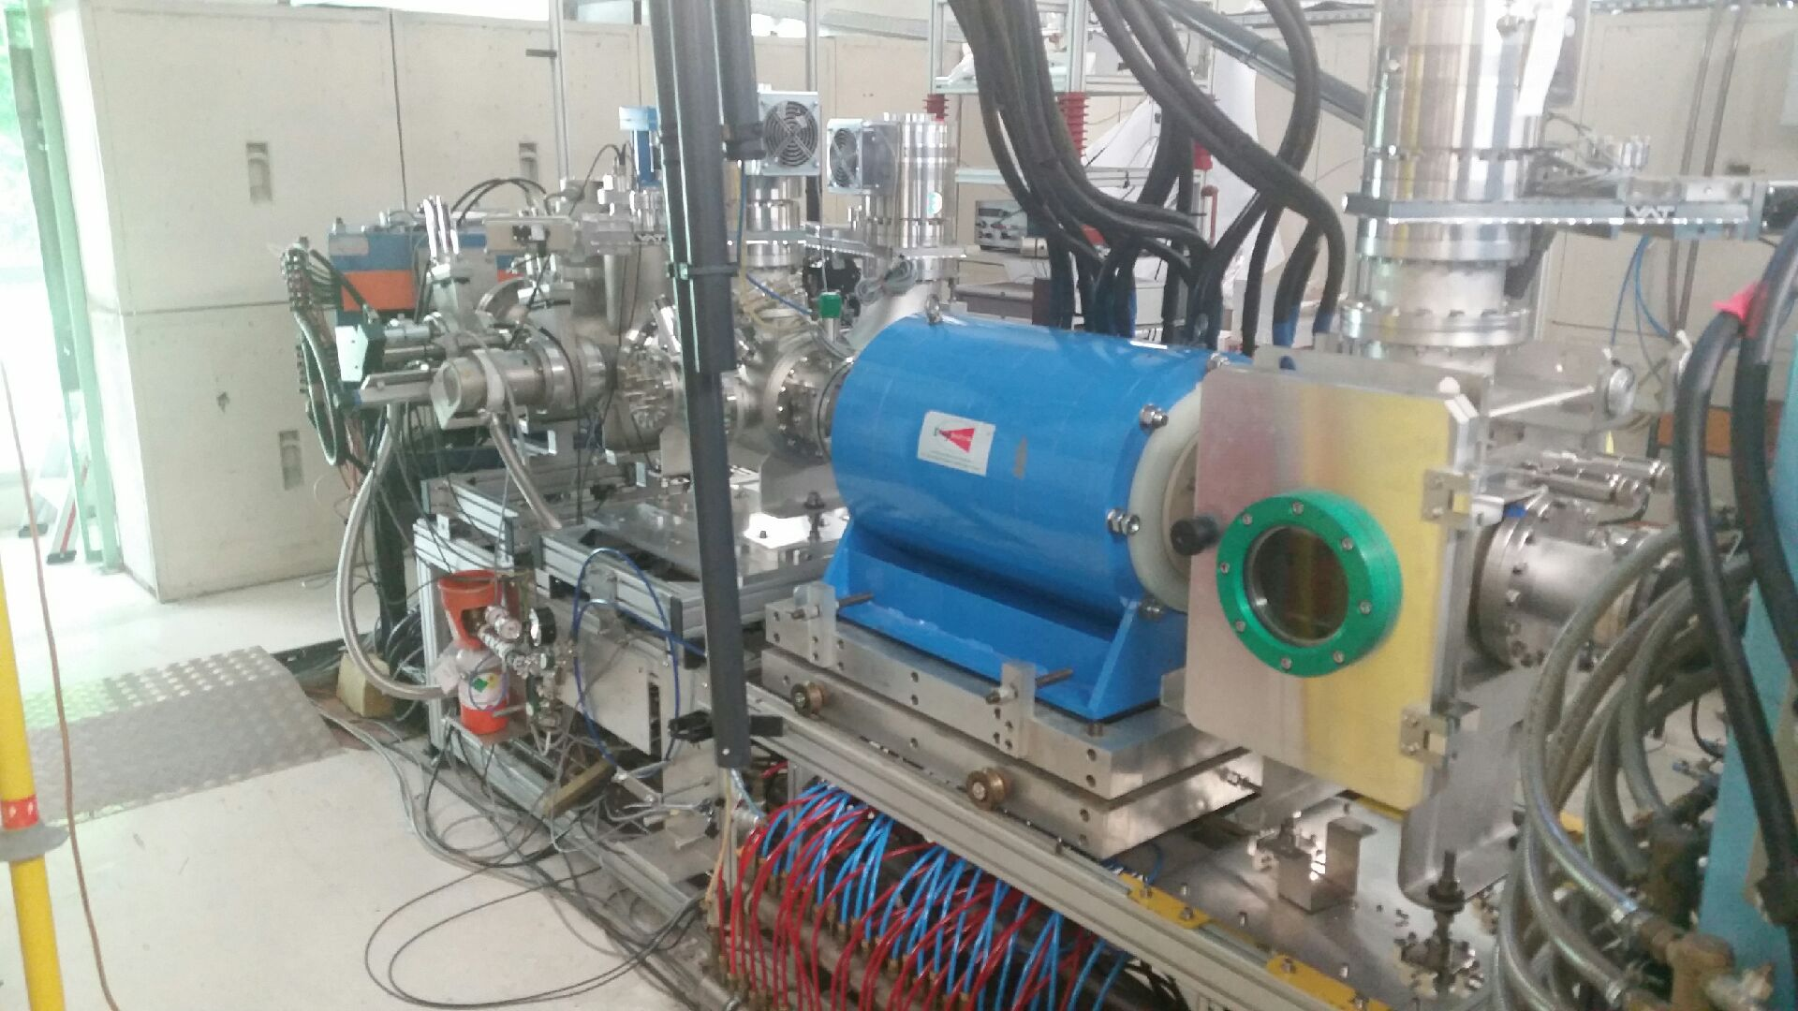
Phoenix ECR charge breeder
Former ISOLDE ECR charge breeder
Upgraded with new Al plasma chamber, UHV vacuum,2 RF ports and gas injection, injection triplet, mobile injection and puller electrodes
Tested at LPSC in summer 2015
1+
With contributions from
High efficiencies with stable beams
Rare gases and alkalis
L. Maunoury et al, Rev Sci Instrum. 87(2016)02B508

Slide 6
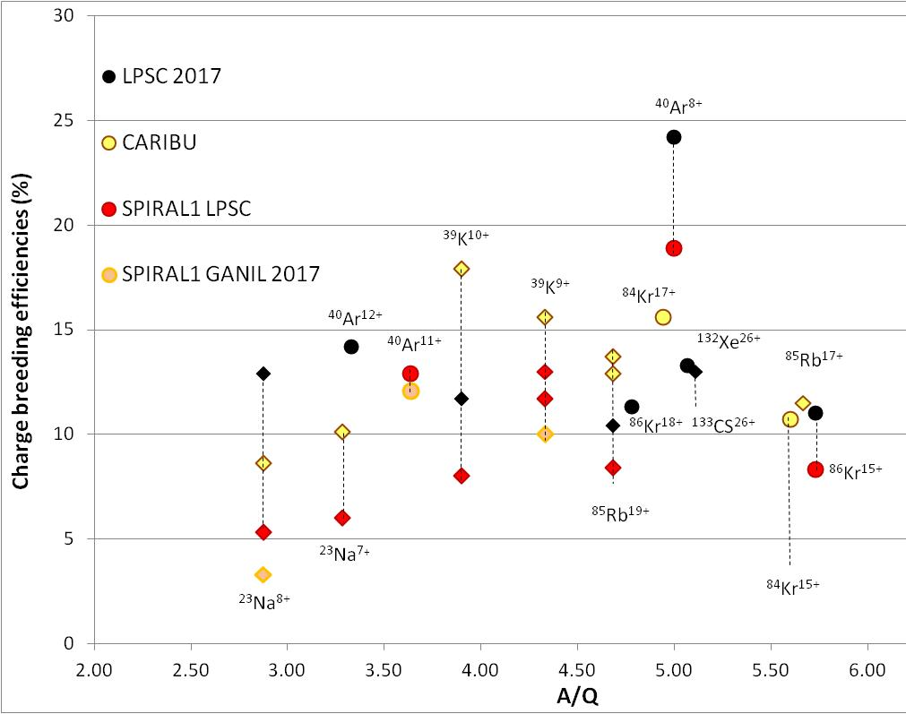
Phoenix ECR charge breeder
Noble gases
Alkaline elements
Back to efficiencies measured in 2015 at LPSC
Possible optimizations with higher B field at injection, as shown with LPSC CB are still possible
Notes:
Ronds et diamants

Slide 7
Upgraded magnetic field configuration: does not work for us!

Slide 8
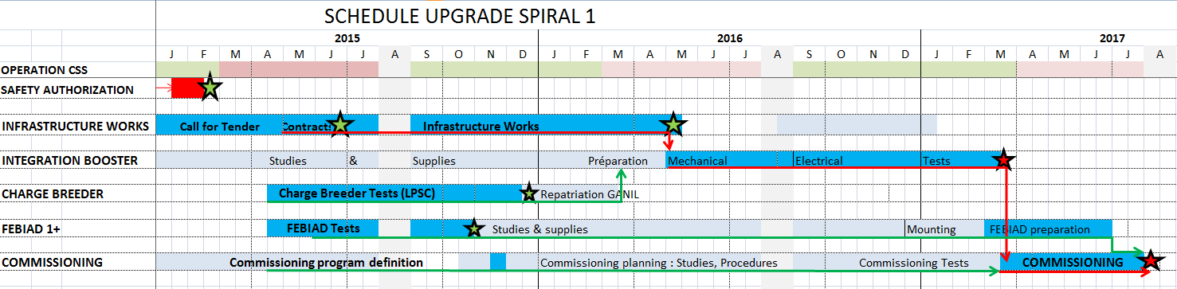
Overall schedule
SPIRAL 2 week 11/2016
Presentation M. Dubois
RIB second semester of 2017

Slide 9
Organisation of the target and ion source R&D
Different developments
Testing production with new primary beam on C target
New Target or … new ion source
Evaluation in
GANISOL
ISOL beams for GANIL
reviews after each PAC meeting
Direction + TISS developpers + 4 external physicists (T. Stora, M. Assié, B. Blank, N. Orr)
List of priorities - from Review 2016/07
Test of new beams with C targets
1) 30P and 25Al from 40Ca fragmentation
2) 56Ni, 48Cr from fragmentation of 58Ni. For 56Ni: 56Co contamination to evaluate.
3) Beams (79Se, 60Fe, 67As) from 86Kr fragmentation.
Development of new targets
1) Nb for production of high intensities for beams with 30<Z<40
1) ex aequo Fusion evaporation targets (N=Z nuclei)
All science driven (LoIs)

Slide 10
Radioactive ion beam commissioning
2018 – run 1
Accepted experiments:
Resonant proton elastic scattering on 17F and 2-proton emission from excited states in 18Ne, G. F. Grinyer et al (E750)
17F was observed as BeF molecule with dissociating BeO insulator
F atomic beams in principle well produced with FEBIAD sources
Optimization of ¹⁷F production from ²⁰Ne fragmentation using the FEBIAD, directly followed by the experiment
Direct isospin mixing measurement in Coulomb excitation of an ^{38m}K isomeric beam from SPIRAL1, G.De France et al (E737)
^{38m}K from ⁵⁸Ni fragmentation ok but not from transfer reaction with ³⁶Ar
Population of the isomeric state depends on the reaction mechanism!
Testing ^{38m}K from ⁴⁰Ca fragmentation
R&D for future beams - Beamlab activities:
- Priorities from GANISOL review 2016/7/4
Preparing the MUGAST campaign – 2019/2020
From ⁴⁰Ca fragmentation: test of of production of ²⁵Al and ³⁰P (LoI De Séréville et al)
  Trying the formation of hydride molecules
Test of production of ⁵⁶Ni from the fragmentation of ⁵⁸Ni (LoI Assié et al)
  Stripping to get rid of ⁵⁶Co and ⁵⁶Fe
Notes:
Tentative dates for the radioactive ion beam commissioning March 2018
First experiments could then be in the end of first semester 2018 maybe after the tests

Slide 11
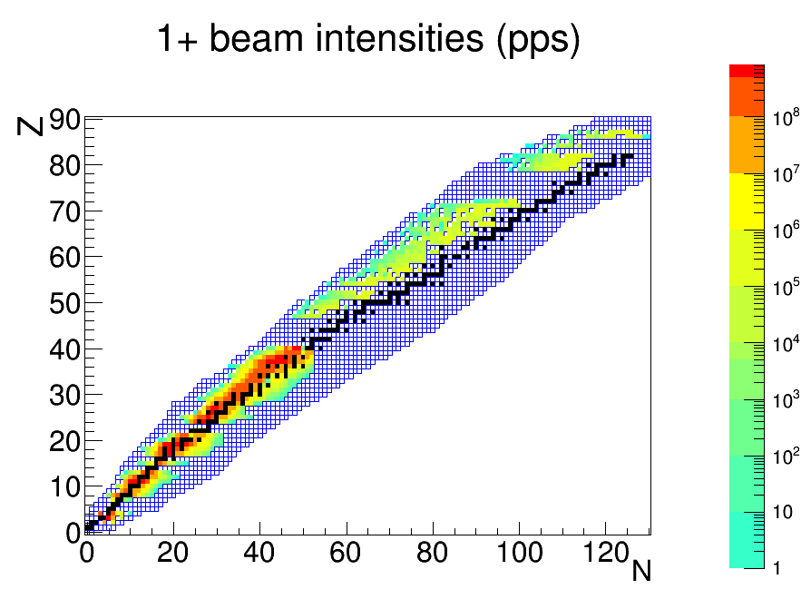
Beyond commissioning…
From day 1 beams…
To longer term: 2018-…
New targets:
Fragmentation targets
  Nb target design is ongoing
  Others under study (SiC, Al2O3, CaO…)
Fusion evaporation targets
  thin Ni target (PhD thesis V. Kuchi)
ISOLDE FEBIAD + Graphite targets
Fusion - evaporation targets
Fragmentation targets
+ ion source developments
Collaborations within EURISOL/Beamlab within ENSAR2
Notes:
For nuclear safety reasons (no Iodine filter at SPIRAL 1), the highest Z material that can be used for fragmentation is Nb.

Slide 12
Fusion evaporation targets
List of priorities from the GANISOL review 2016, July 4th
Ongoing developments
To be tested at SPIRAL at the earliest in 2020
Fusion evaporation target ion source development
neutron deficient isotopes such as ⁷⁴Rb, ¹¹⁴Cs, N=Z for DESIR
Offline test 2017-2018
Ionisation efficiency and rapidity measurement
Online test at ALTO earliest 2019
Online test at SPIRAL earliest 2020
Fusion evaporation
fragmentation
ECS fusion evaporation V. Kuchi, P. Jardin
Collaboration with IPN Orsay – first test possible in 2019 with the Tandem

Slide 13
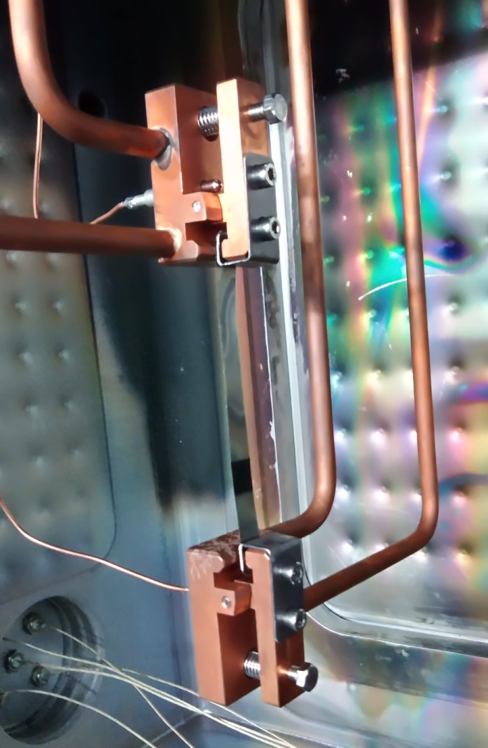
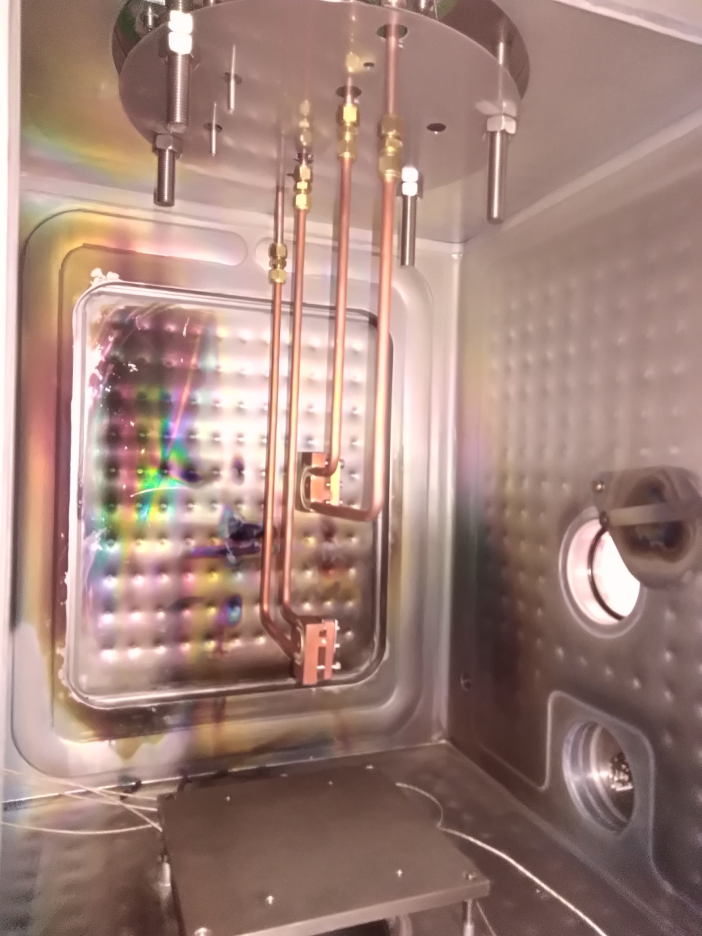
Fusion evaporation targets
List of priorities from the GANISOL review 2016, July 4th
Ongoing developments
To be tested at SPIRAL at the earliest in 2020
Fusion evaporation target ion source development
neutron deficient isotopes such as ⁷⁴Rb, ¹¹⁴Cs, N=Z for DESIR
Ongoing measurement of emissivity of target foils
ANR ‘TULIP’ (Target Ion Source for Short-Lived Ion Production) has been submitted
Offline test 2017-2018
Ionisation efficiency and rapidity measurement
Online test at ALTO earliest 2019
Online test at SPIRAL earliest 2020
Test setup
Measurement of emissivity
with a 2 wavelength pyrometer
Collaboration with IPN Orsay – first test possible in 2019 with the Tandem

Slide 14
Conclusion
SPIRAL 1 upgrade status
  The FEBIAD source has been thoroughly tested and is ready for on-line operation
    >3 weeks operation has been proven possible
    Stable efficiencies, some improvements possible (?)
  The SPIRAL 1 charge breeder has been installed in the beam lines and confirm performances shown in LPSC
    Efficiencies and charge breeding times are ok
    Optimized magnetic configuration gives higher efficiencies at LPSC, but not at GANIL
  Documentation for internal safety authorization is being prepared
    Should be completed these days!
  The RIB commissioning is planned in beginning of run 1
    Production test for accepted experiments: ¹⁷F, ^{38m}K
    Production tests for future experiments: ⁵⁶Ni, ²⁵Al and ³⁰P
    First experiment 17F@ACTAR
  Ongoing R&D for fusion evaporation target

Slide 15
SPIRAL upgrade team
GANISOL
ISOL beams for GANIL
O. Bajeat
M. Babo
P. Chauveau (now CSNSM)
C. Couratin (now IKS leuven)
M. Dubois (chef de projet)
P. Delahaye (resp. scientifique)
M. Fadil
R. Frigot
S. Hormigos
P. Jardin
P. Lecomte
N. Lecesne
L. Maunoury
B. Osmond
V. Toivanen (postdoc)
E. Traykov (now IPHC)
J. C. Thomas
…
T. Stora
C. Seiffert
F. Wenander
L. Penescu
E. Lienard
G. Ban
X. Fléchard
D. Durand
J. Angot
T. Lamy
R. Vondrasek
Acknowledgements to

Slide 16
