Slide 1


AWAKE++ PEPIC Exploratory Study
Christoph Hessler, CERN

Slide 2
A Plasma Electron Proton/Ion Collider, PEPIC
LHeC like collider based on AWAKE plasma wakefield acceleration scheme
400 GeV p beam from the SPS → minimum bending radius of the beam line is the one of the SPS (1100 m, limited by the achievable field in normal conducting magnets)
Electron beam with 100-150 GeV produced in 100 m (minimum length) to 200 m (maybe more realistic) long plasma cell(s) → LEP like beam, bending radius limited by synchrotron radiation losses. LEP radius (4300 m) as minimum bending radius is a safe assumption. Not a hard limit, synchrotron radiation losses could be compensated to a certain extend with a higher electron energy (and therefore longer plasma cell)
Intensity of electron beam 1e9 e-

Slide 3
Scope of the study
Location of plasma cell
Separation of proton and electron beam
Beam transport of electron beam to the LHC
Dumping of proton beam
List of elements (types and quantities (0 order estimate))
Civil engineering impact
Summarize outcome on a document
Limit of this study: Injection of electron beam into the LHC tunnel

Slide 4
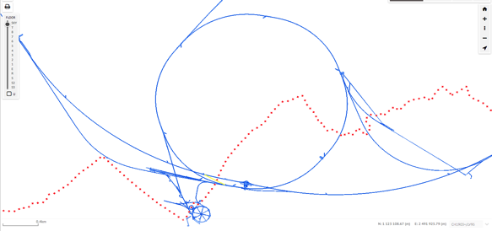
Possible locations for PEPIC plasma acceleration stage
Possible locations for pe- collider experiment would be either ALICE or LHCb.
Since p beam is produced in the SPS a natural location for the plasma cell(s) would be in one of the transfer tunnels from the SPS to the LHC:
TI 2 SPS -> LHC beam 1
TI 8 SPS -> LHC beam 2
TI 12 old e- TL from SPS to LEP
TI 18 old e+ TL from SPS to LEP
LHC needs to stay fully operational as pp collider
PEPIC equipment needs to share space with existing equipment in LHC/TI2/TI8
SPS
LHC
AWAKE
TI2
TI18
TI8
TI12

Slide 5
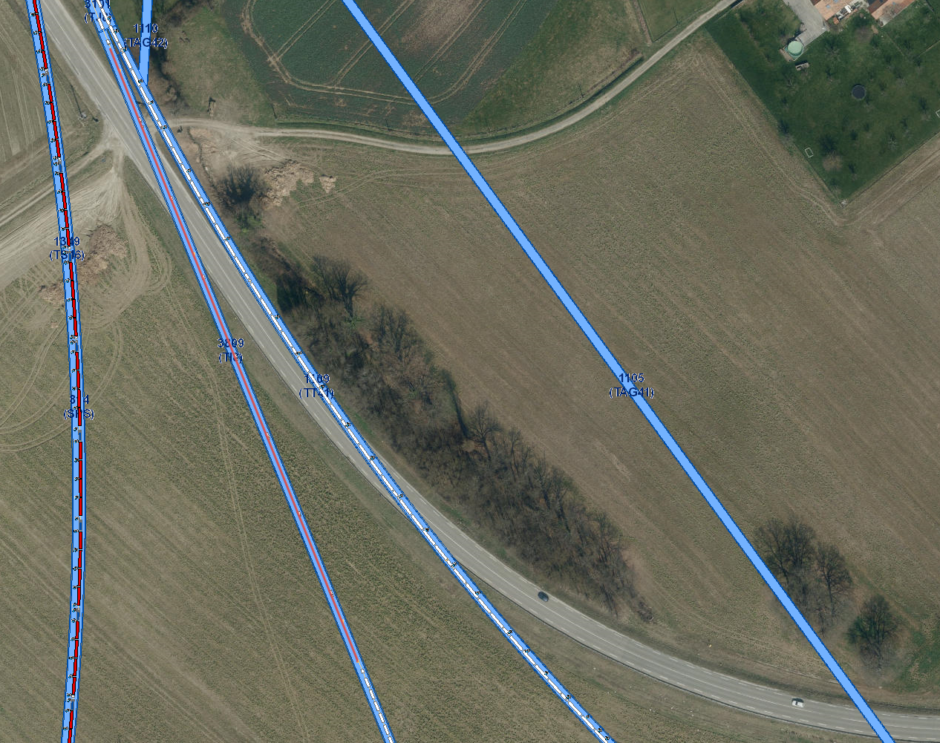
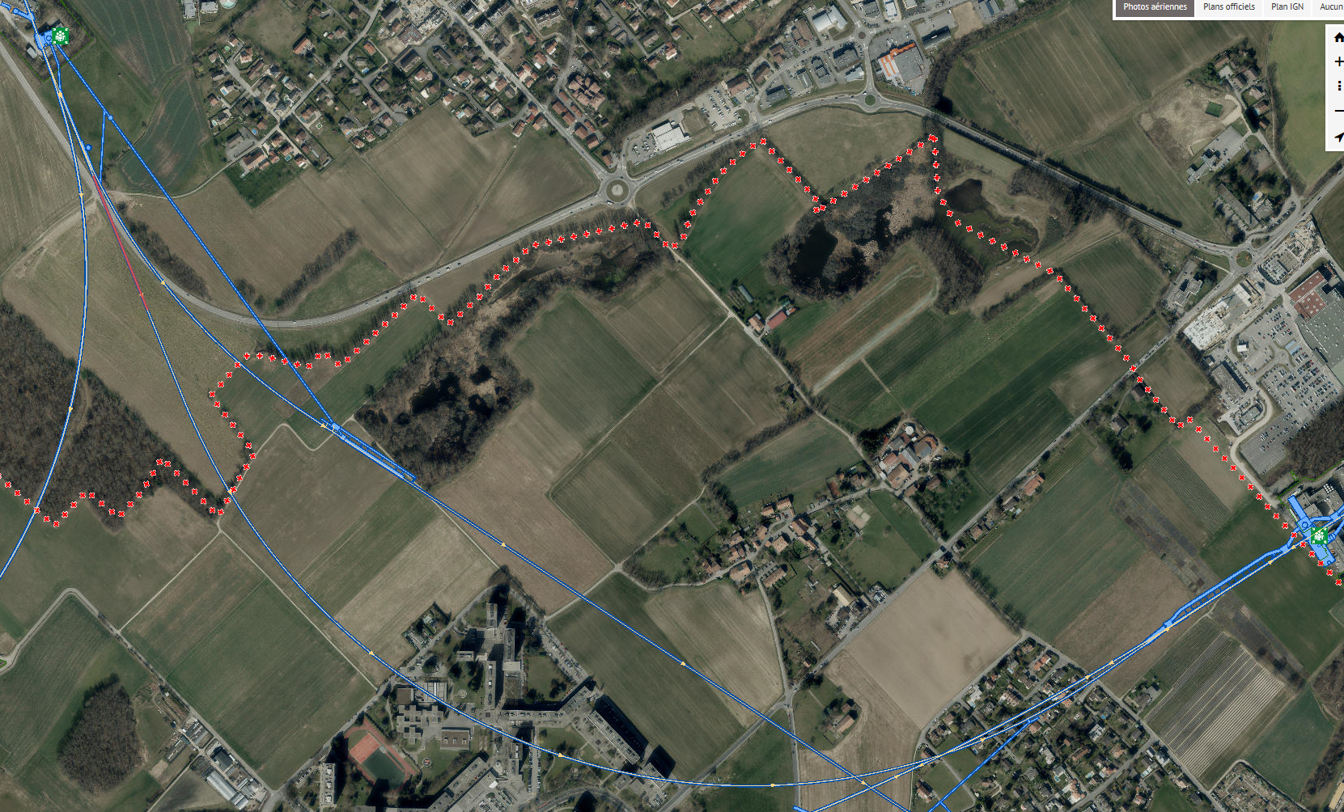
TI 8 transfer line
Fully packed with magnets, only at the start is a ~230 m long straight section (with quadrupoles).

Slide 6
TI 8 transfer line
Available space would be needed not only for plasma cell, but also for focussing optics for p beam, diagnostics, e- beam injection, laser beam injection, p/e- beam separation, etc.
Long electron beam transport with bending radius much below LEP radius.
Presumably high synchrotron radiation losses (to be verified).
Probably not a suitable place for the plasma cell.
Fully packed with magnets, only at the start is a ~230 m long straight section (with quadrupoles).

Slide 7
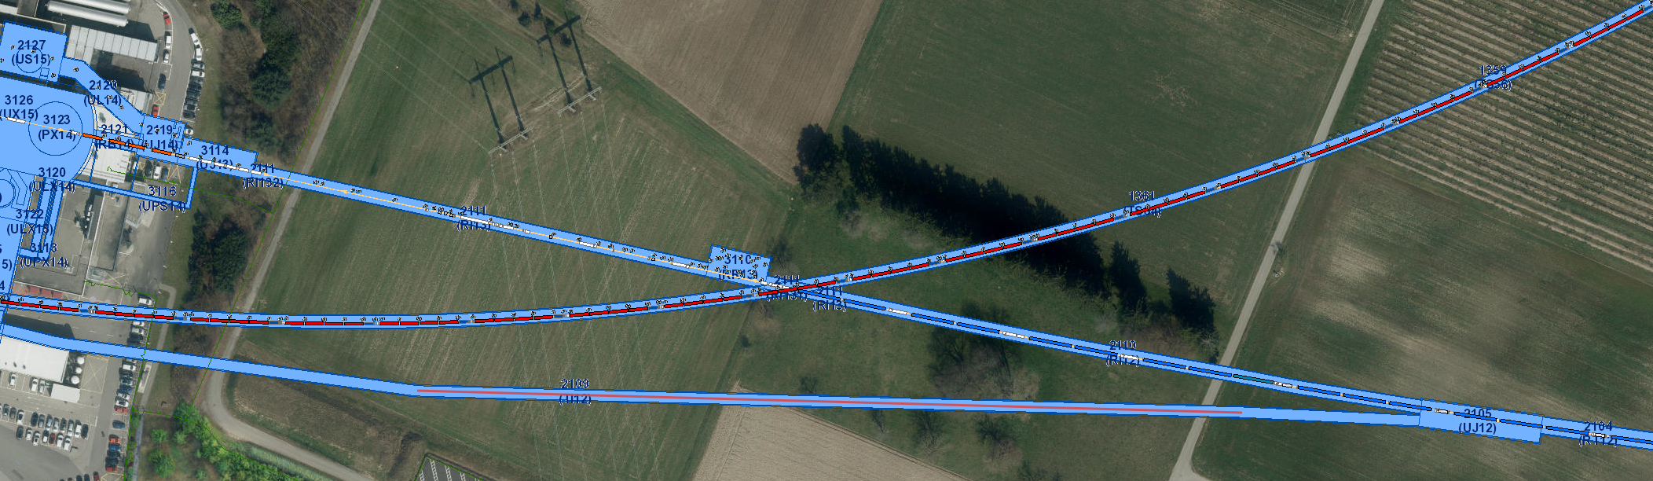
TI 12 transfer line tunnel
Tunnel currently not used for beams.
Contains a 275 m long straight section.
However, tunnel direction is opposite to the SPS beam direction.
Therefore, it cannot be used for PEPIC.

Slide 8
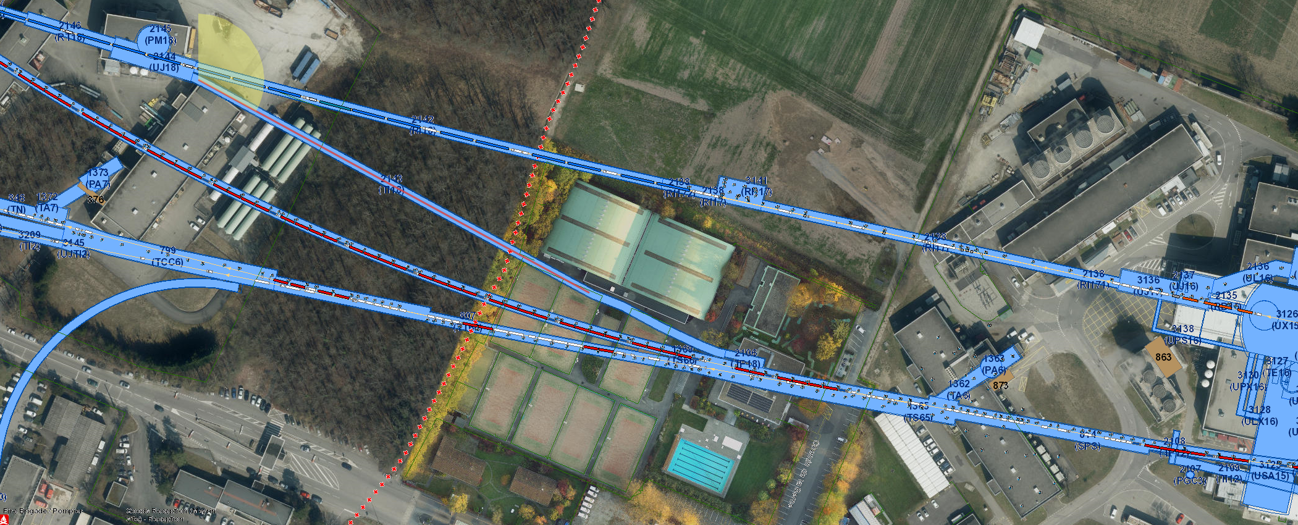
TI 18 transfer line tunnel
Tunnel currently not used for beams.
Contains a 190 m long straight section.
Tunnel direction is in the SPS beam direction.

Slide 9
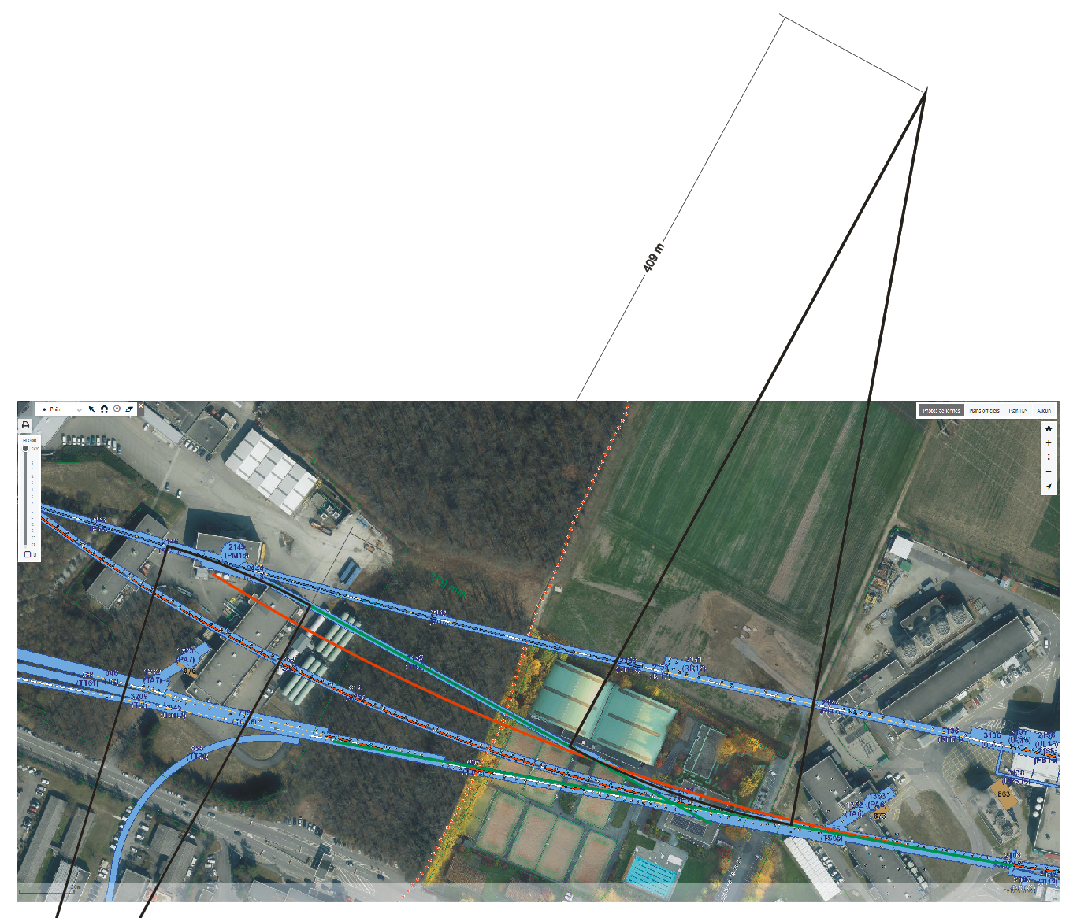
TI 18 transfer line tunnel
However, beam needs to be extracted to the inside of the SPS → smaller bending angle needed than in SPS!
To squeeze beam into existing tunnel (only horizontal plane considered!) a bending radius of 409 m is needed.
With 70% filling factor as in SPS 4.7 T magnets would be required.
A beam path with SPS radius would not fit into the tunnel.

Slide 10
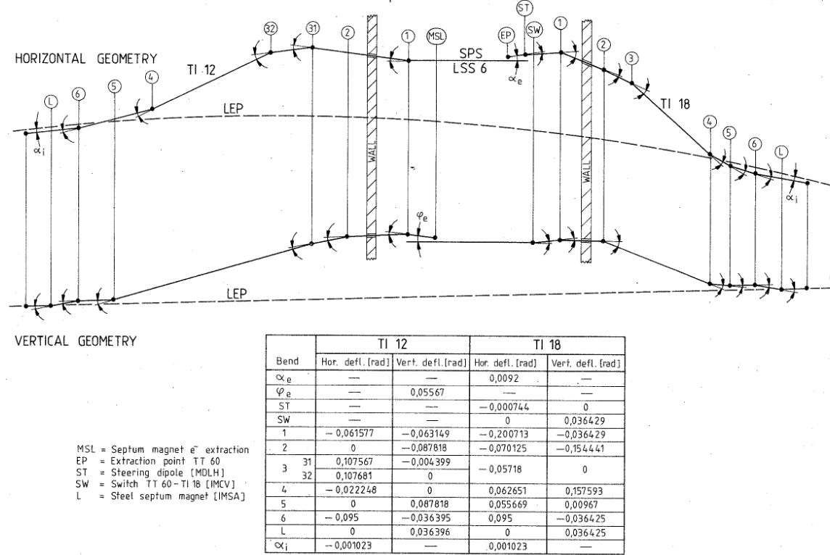
TI 18 transfer line tunnel
In addition a substantial height difference of ~40 m needs to be overcome in a short distance, which yields to a large tunnel slope of ~15%.
Additional 18 6.62 m long MBB type bending magnets would be needed to deflect the beam onto this slope and another 18 to deflect the beam back to horizontal plane.
LEP-ES-121090002

Slide 11
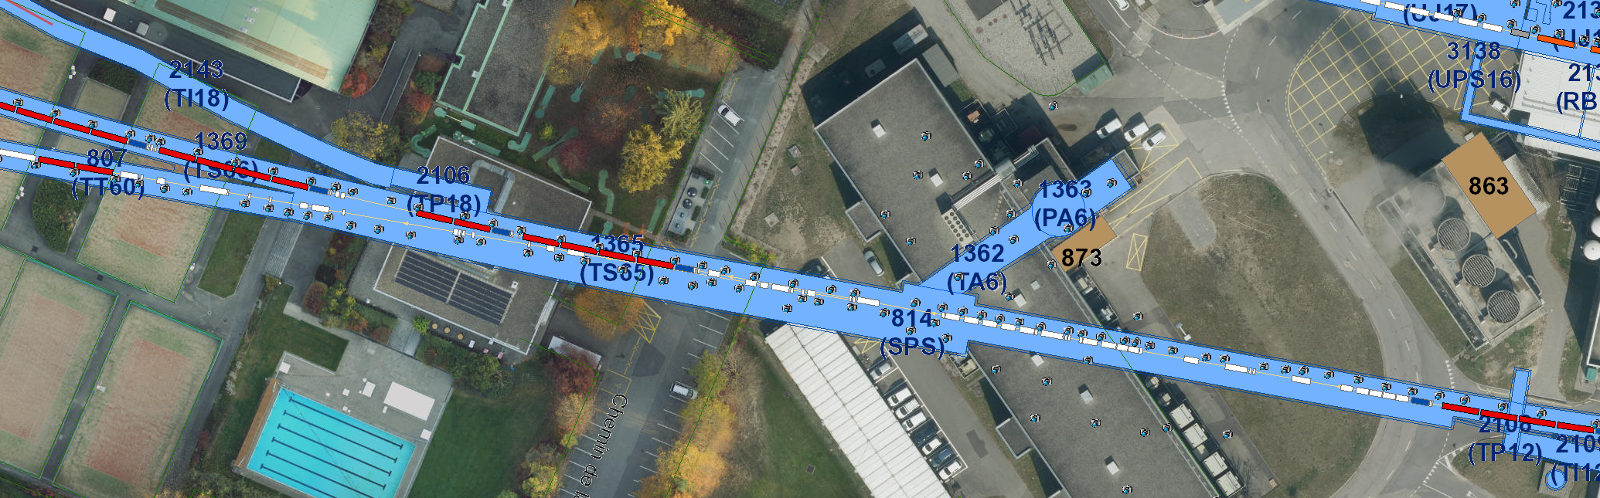
TI 18 transfer line tunnel
LSS6 in the SPS is already densely occupied by the extraction elements for the west extraction towards TI 2 and HiRadMat.
It is not obvious where the required extraction elements for PEPIC could be installed

Slide 12
TI 18 transfer line tunnel
Conclusion:
The usage of the TI 18 tunnel for installation of a plasma acceleration stage for PEPIC is excluded

Slide 13
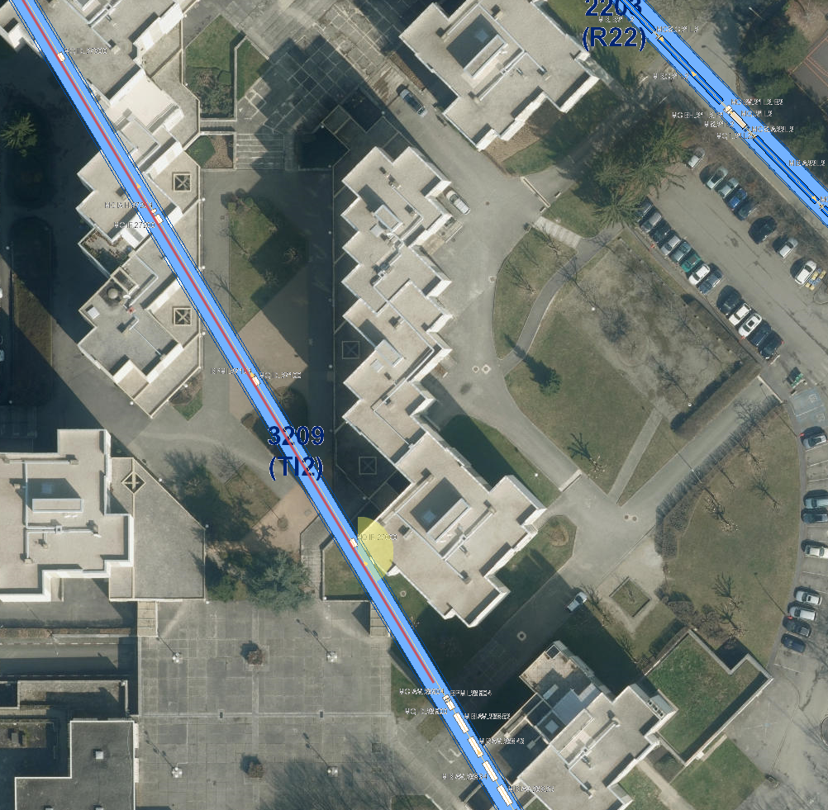
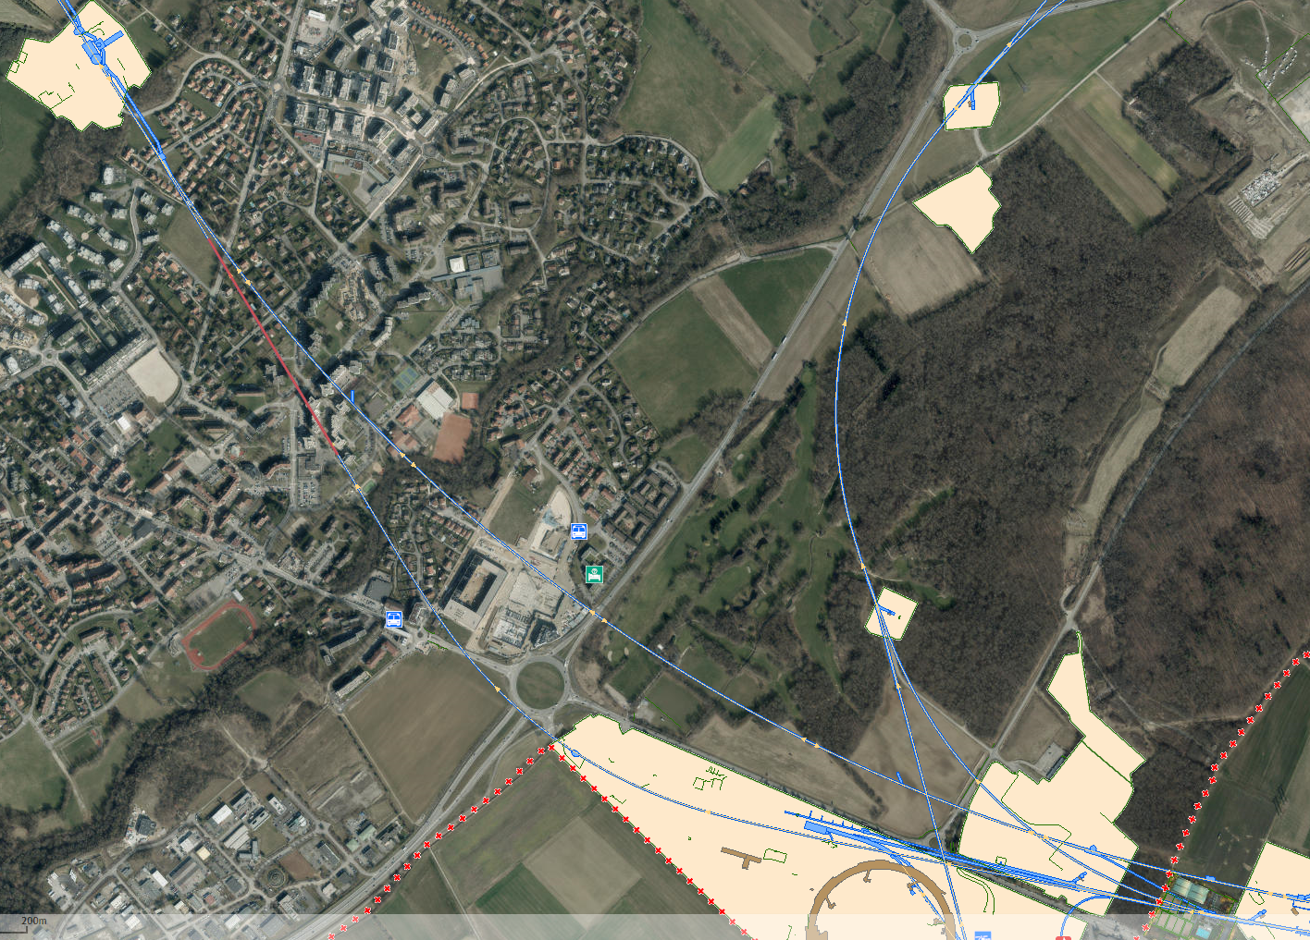
TI 2 transfer line
In contrast to TI 8 the TI 2 transfer line has a 540 m long straight section, close to its end.
This sections contains only quadrupoles, correctors and beam instrumentation elements in a regular FODO lattice with 30 m half cell length.

Slide 14
TI 2 transfer line
There are 18 empty half cells available.
25 m in each half cell could be used for installing plasma cells and other AWAKE equipment (focussing quadrupoles, electron/laser injection, diagnostics).
Downstream of the plasma cells the electron beam needs to be separated from the proton beam and transported in a own beam line, e.g. on top or on the side of the existing line.
The proton beam needs to be safely dumped, either in a new dedicated beam dump or downstream TED.
The aperture of TI 2 is rather small (diameter 29 mm)

Slide 15
TI 2 transfer line
Beam separation:
By single bending magnet (6 m)
Bending angle 0.011 rad, energy loss of e- beam 16%
Relative large deflection of the proton beam. -> Beam hits the magnet.
Energy of the synchrotron radiation pulse hitting the downstream TI 2 elements: 2.5 J (= 25 TW peak power in 100 fs pulse) Is this a problem?
quad
Bend 0.6 T
quad
p
50 mm
e-
216 mm
20 m

Slide 16
TI 2 transfer line
More magnets (20 m):
Bending angle 0.022 rad, energy loss of e- beam 9.5%
Same problem with the deflection of the proton beam.
Energy of the synchrotron radiation pulse hitting the downstream TI 2 elements: 1.5 J (= 15 TW peak power in 100 fs pulse)
Situation not significantly improved concerning single bend scheme.
quad
Bends 0.36 T each
quad
p
50 mm
e-
216 mm
10 m

Slide 17
TI 2 transfer line
Separation scheme over multiple half cells:
Focussing quad for p is defocussing for e-
Reduced energy loss for e- beam and reduced synchrotron radiation power.
Reduced deflection of p beam. It might be able to transport p beam to TED.
To be studied more in detail
QD
QF
QD
p
216 mm
Bending magnet
20 m
Electrostatic septum
Coil window
Magnetic septum
e-

Slide 18
Open questions and assumptions
Damaging effects of synchrotron radiation.
Does the energy loss due to synchrotron radiation increase (or decrease) energy spread?
List of elements.
Assumptions:
Lattice of e- beam line the same as p beam line.
Electron beam transport up to the LHC tunnel.
Only unpolarised electrons will be used.

Slide 19
Conclusion
The TI 2 transfer line tunnel seems to be the only solution for housing the plasma acceleration stage of PEPIC without building a new transfer line tunnel.
With this setup only dedicated PEPIC runs are possible, since the plasma cell needs to be moved out of the beam path or at least emptied for regular LHC operation.
Although this solution makes a maximum use of existing tunnels, further new, non-negligible underground buildings are required: Laser lab, tunnel for electron gun, technical gallery for equipment, tunnel for proton beam dump, etc.

