Slide 2

Optics experience with Q’’ knob
C. Bracco, R. Bruce, J. Coello de Portugal, R. De Maria, S. Fartoukh, E. Fol, M. Giovannozzi, K. Li, L. Malina, E. Métral, S. Redaelli,
R. Tomás, M. Schenk, J. Wenninger, LHC OP teams

Slide 3
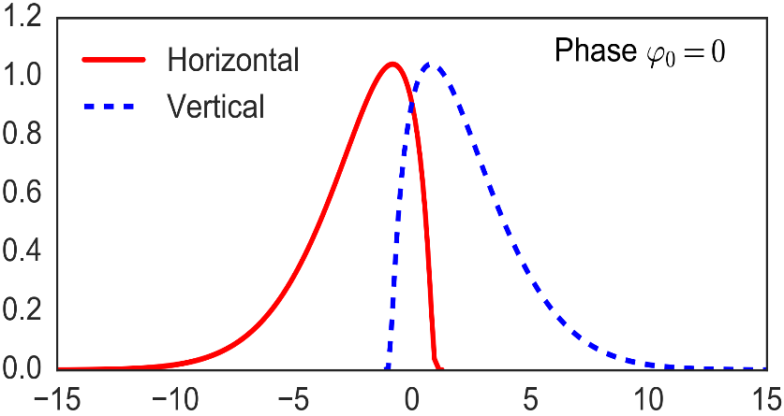
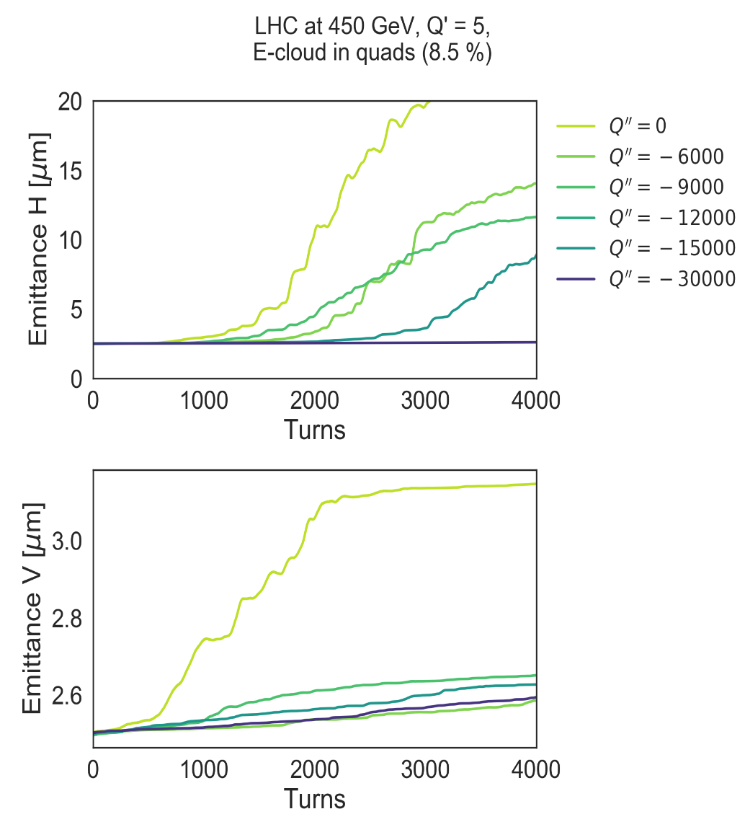

Motivation for negative Q’’
Landau damping from detuning with longitudinal amplitude ΔQ(J_{z})
Can be introduced by means of Q’’
Experimental study of rf quadrupole
Alternative to Landau octupoles?
MD1831: Single Bunch Instabilities with Q’’ and Non-Linear Corrections
Showed stabilisation of single bunches at 6.5 TeV using Q’’
Good agreement with simulations
=> Q’’ helps against impedance- driven instabilities
Can Q’’ help against e-cloud instabilities?
Q’’ < 0
Q’’ > 0
-Im(ΔQ_{c}) [a.u.]
unstable
unstable
stable
stable
Re(ΔQ_{c}) [a.u.]
PyECLOUD / PyHEADTAIL

Slide 4
Q’’ knob
Wish list
Negative Q’’ in both planes (only B1)
Transverse amplitude detuning ‘free’ knob
Minimum effect on Q’, (Q’’’)
‘Strong’, localised powering of 4 sextupole families
dKSF and dKSD produce negative Q’’_{x} and Q’’_{y} respectively
E.g. for Q’’_{x,y} = - 30’000, would need dKSF = 0.620 and dKSD = -0.685 (MAD-X)
Q’’_{x}: SF2.a12b1 + dKSF and SF2.a45b1 – dKSF
Q’’_{y}: SD2.a81b1 + dKSD and SD1.a56b1 – dKSD

Slide 5
Q’’ knob
Aim for two settings Q’’ = -30’000 and Q’’ = -45’000
Trims 4 families of sextupoles
~10 times stronger than nominal
Similar knob was tested in June ‘17 and distortion of linear optics was observed
~20% beta-beating and coupling ~0.002
Probably caused by feed-downs in misaligned sextupoles (~hundreds of μm)
=> Need for optics correction

Slide 6
Horizontal orbit bumps
Sextupoles belonging to a given family have π phase advances between them
Neglecting other (weaker families)
Not changing the orbit in IRs
Combination of several π-bumps of same amplitude for each of Q’’ knob’s sextupole families
“holes” in bumps – some sextupoles are replaced by octupoles

Slide 7
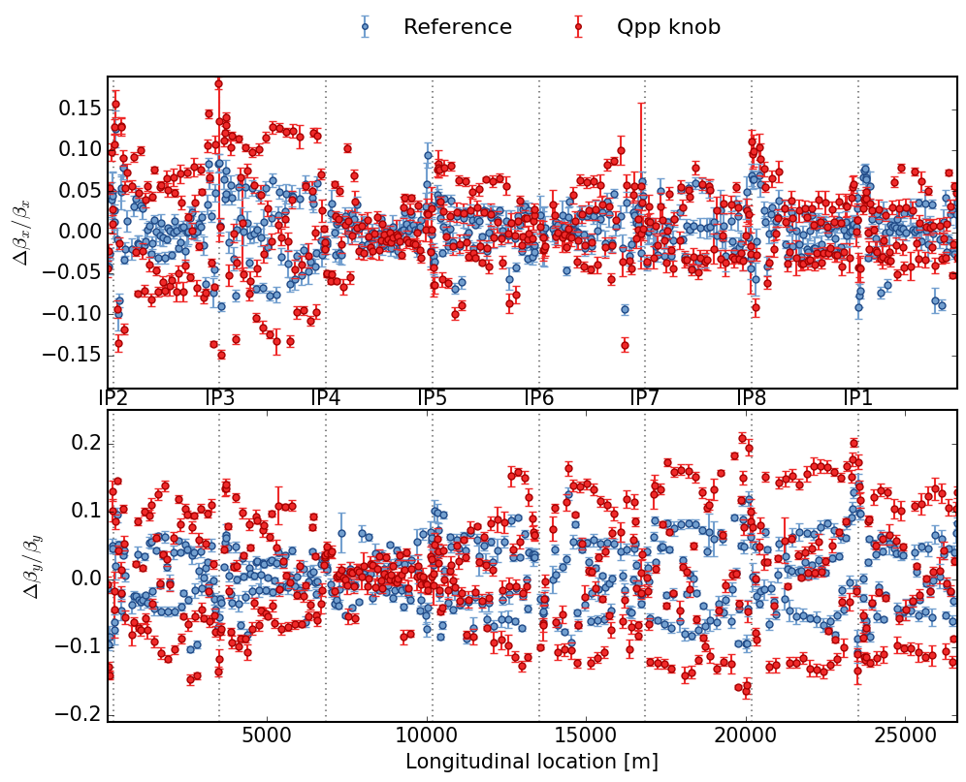
Optics in MD
Coupling change was small, well below 10⁻³
Want to correct only β-beating from Q’’ knob, not generally
Correction targets the reference measurement

Slide 8
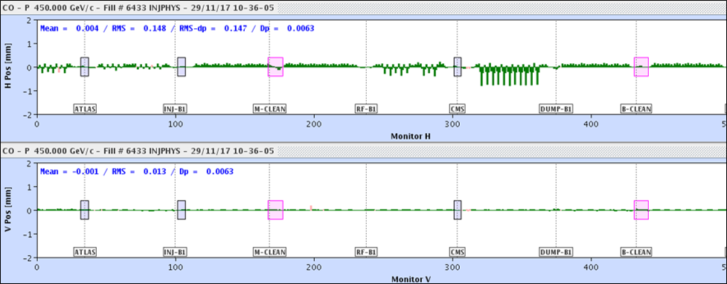
Horizontal orbit bumps in
Orbit bumps at sextupole families:
ksf2.a12: 0.2 mm ksf2.a45: 0.4 mm ksd1.a56: 0.25 mm ksd2.a81: 0.1 mm

Slide 9
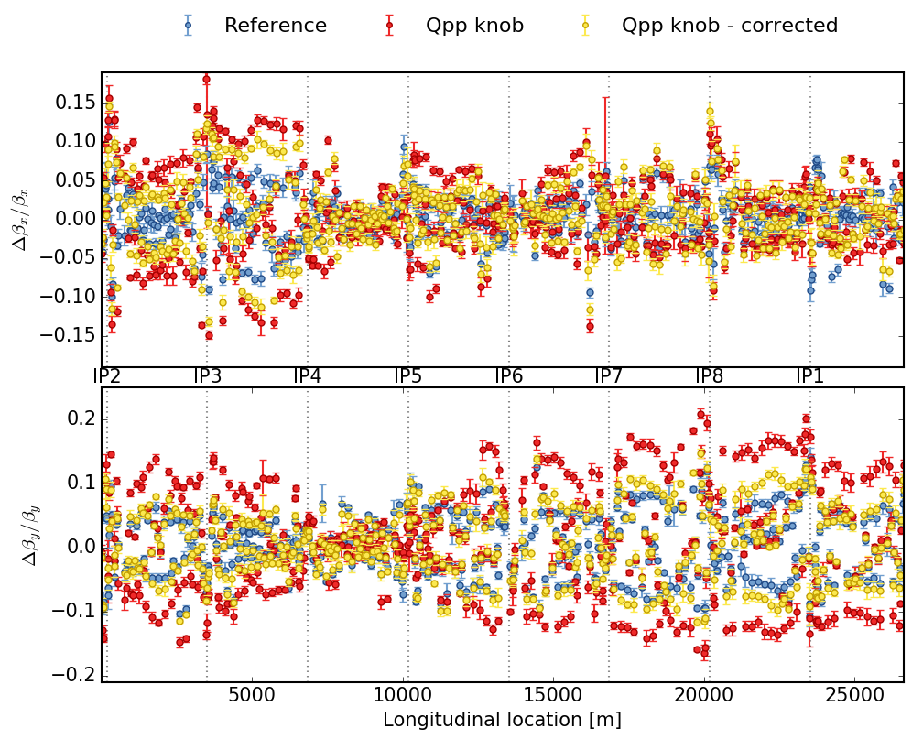
After correction
β-beating improved
Correction was a bit weaker
Other sextupole families are in the orbit bumps
Sextupoles do not have the same misalignments

Slide 10
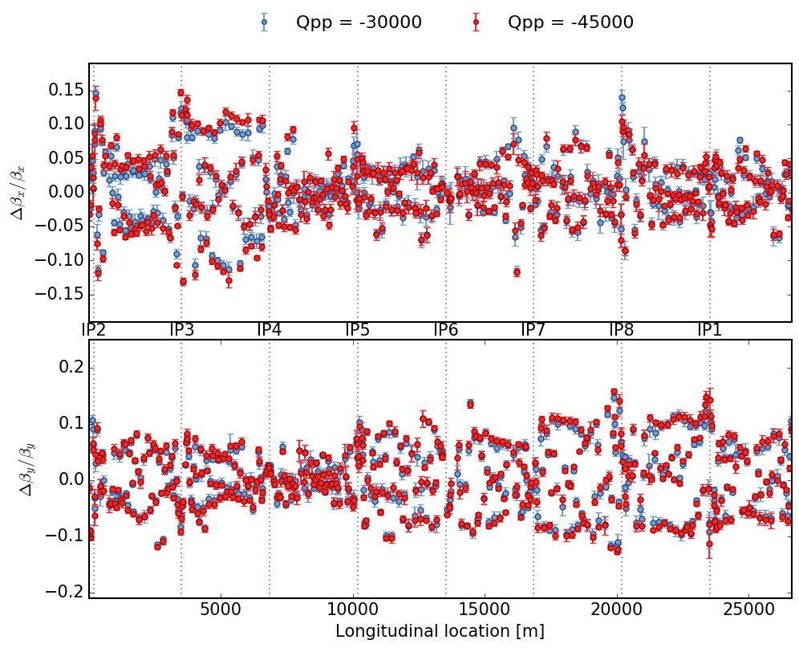
Correction validation
Two Q’’ knob settings
Very similar β-beating
validates orbit bumps
Few sextupoles were not in the bumps (IRs)

Slide 11
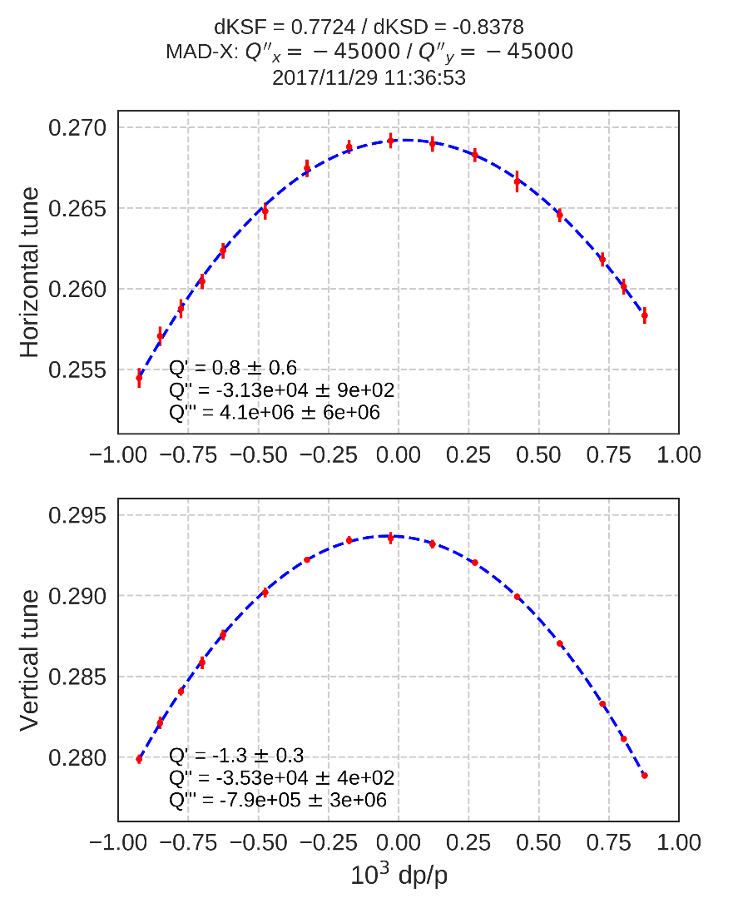
Measurement of Q’’
Measured Q vs. dp/p for expected Q’’_{x,y} = -4.5 × 10⁴
With |dp/p| up to 9×10⁻⁴
Q’’_{x} = (-3.13 ± 0.09)×10⁴ Q’’_{y} = (-3.53 ± 0.04)×10⁴
Agreement with MAD-X ok
Possible explanations for difference
Discrepancy of beta-function at sextupoles wrt. assumptions in the model (Q’’ produced in that scheme is proportional to β²)
Tunes are slightly off (0.27 / 0.295)
Other? (D²)

Slide 12
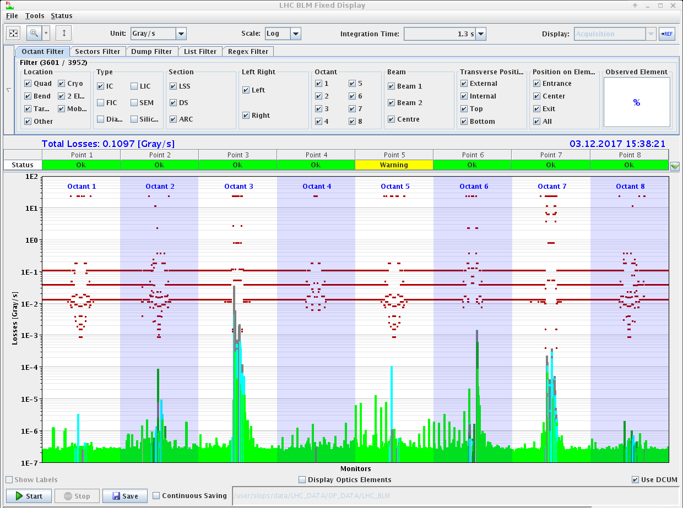
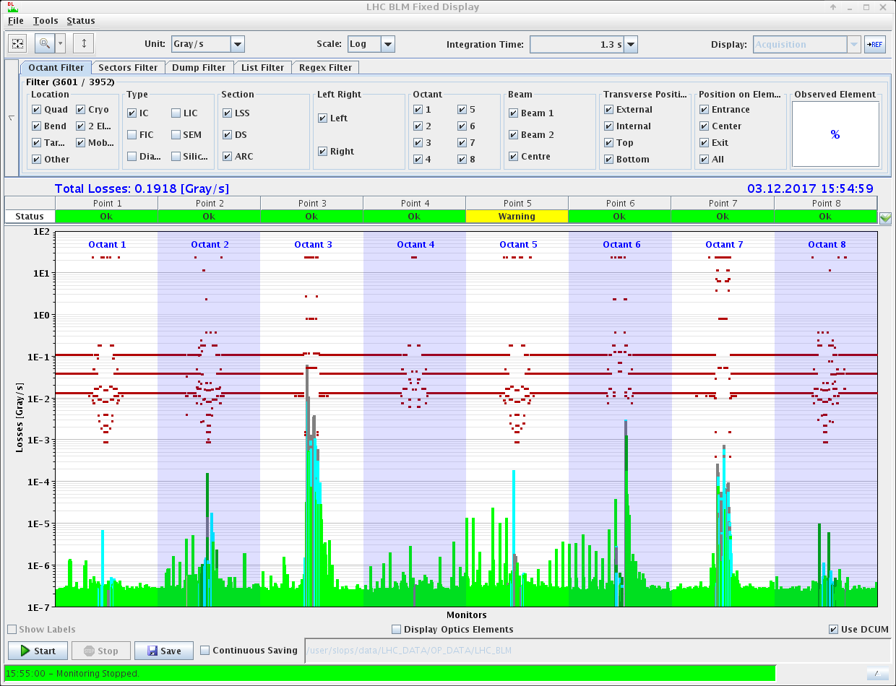
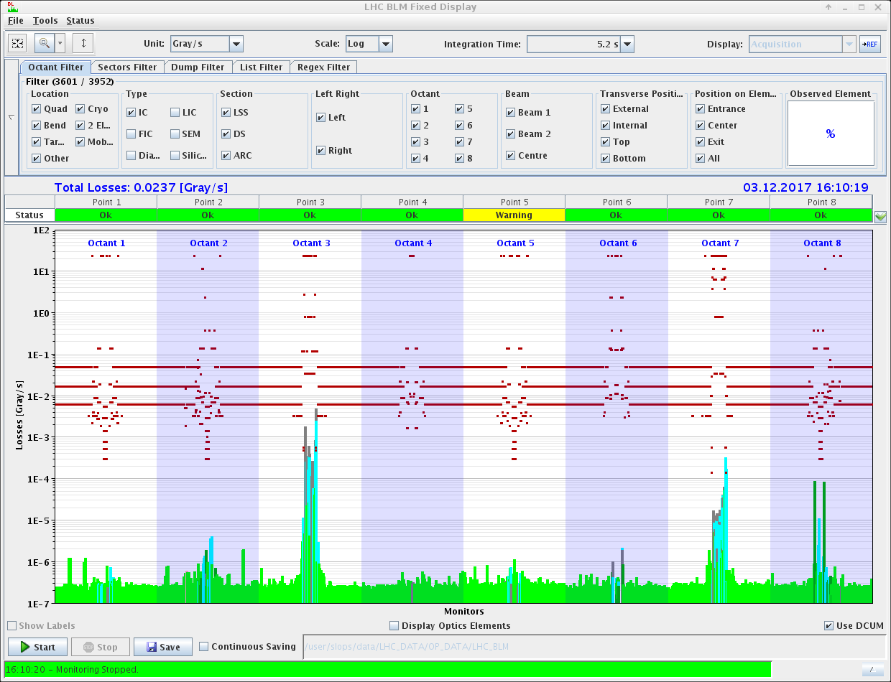
Off-momentum loss maps
Betatron loss maps are OK
Significant spikes on off-momentum loss maps (@dp/p = -0.004)
Not caused by orbit bumps, but by the strong sextupole families themselves
Unfortunately forbade injection of many bunches (600 b.) needed for e-cloud studies
Losses stem from off-momentum beta-beating enhanced to produce Q’’
Strong sextupoles & orbit bumps
Strong sextupoles, no orbit bumps
Nominal machine

Slide 13
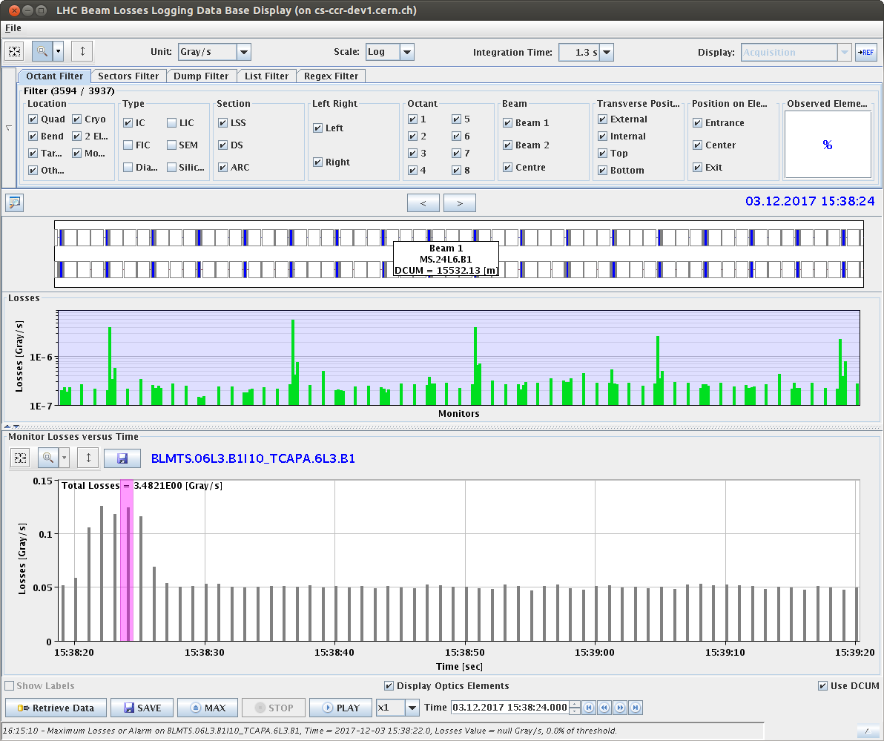
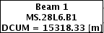
Off-momentum loss maps
Strong sextupoles from SD1.a56 family (e.g. 28L6, 24L6), separated by phase advance π give kick of off-momentum beta-beating which becomes largest at phase advance π/2
The loss maps show exactly this behaviour: Losses occur in between the strongly powered sextupoles at the place of the largest off-momentum beta-beating
π

Slide 14
Conclusions
Q’’ knob distorts linear optics via feed-downs
Beta-beating successfully corrected using π-bumps at Q’’ knob’s sextupole families
validated with stronger Q’’ knob
Only small change of coupling observed
not corrected
Measured Q’’ is negative as expected, but there is a discrepancy of about 20 - 30% wrt. MAD-X
Off-momentum beta-beating causes significant losses
Either lower |Q’’| or lower dp/p cut in IR3 collimators?

Slide 15
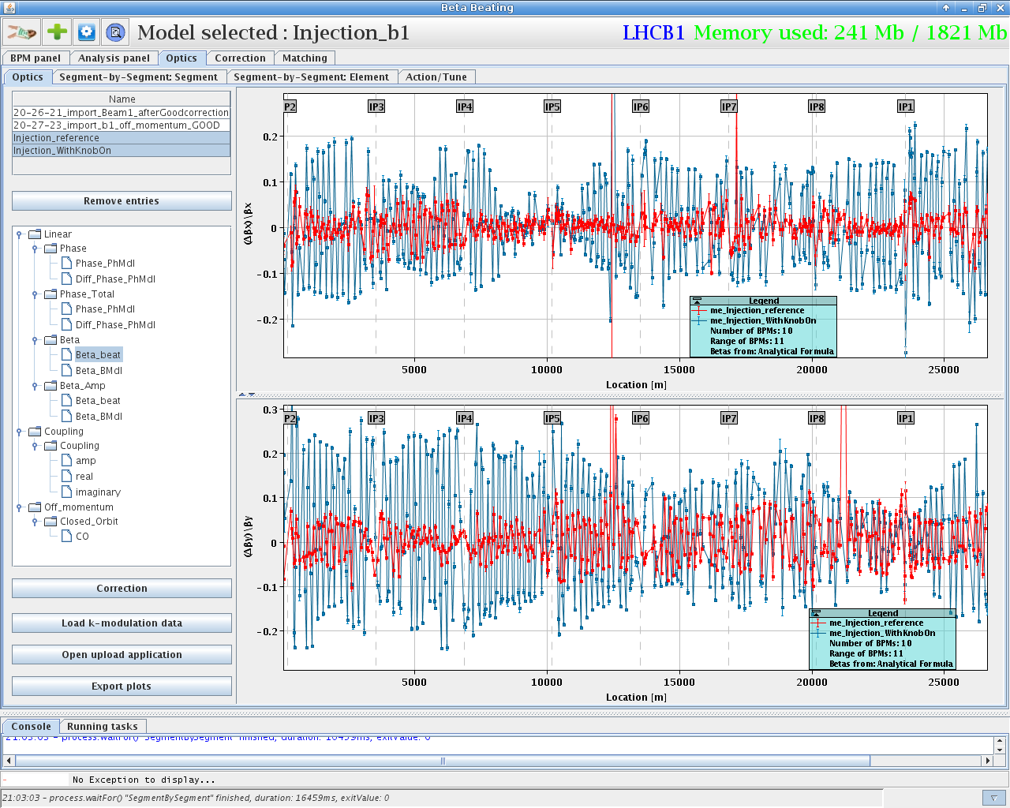
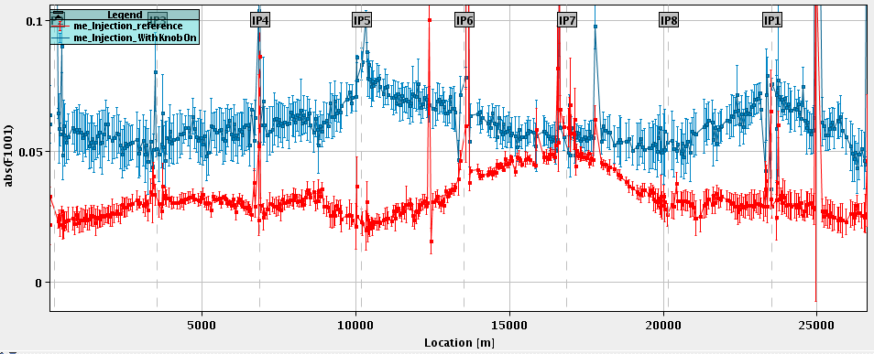
Previous MD – optics distortion

