Slide 1

LHC BLM system:
Summary of changes and re-commissioning after YETS
Christos Zamantzas on behalf of the BLM team.

Slide 2
Overview
Status of checks to be performed during:
  Hardware Commissioning
  Machine Checkout
  Beam Tests
Resolved issues
Long standing issues (reminder)
Future developments (preview)
Summary

Slide 3
Status of checks performed

Slide 4
Hardware and Machine Checkout
All Hardware Commissioning and Machine Checkout checks need to be completed successfully.
Those include:
  8 Hardware checks
  3 Machine Checkout checks
Majority of checks completed
  See attached xls file for some details (more info will be added) and
  MPS document LHC-OP-MPS-0009 v.3.4 for explanations on reasons and conditions
    New version in circulation with minor changes

Slide 5
Pending tasks
Exchange of one processing card
  surface SR6.R crate
  seems FPGA or backplane connection issue
LSA Settings database
  renaming of DUMP monitors
  new monitor at TCLVW.A5L1.B2
  changes need to propagate through MTF, Layout, LSA to electronics.
31L2 and 16L2 installations need grounding
  Human safety

Slide 6
Beam Tests

Slide 7
Injection Interlock Inhibit
Tests with pilot beam
  During commissioning of injection protection system
  Create losses above dump threshold
  Modify blindout time
  Record interlock input from blindable/non-blindable crates
  If losses above dump threshold cannot be reached, lower the monitor factor of blindable crates BLMs
Tests with trains
  288 b or what is being used for scrubbing
  Tighten TCDIs from 5 sig to 4.5 sig (likely settings for Hilumi)
  Tighten monitor factor
Criteria for successful test:
Functionality: detectors in blindable crates DO NOT interlock within given blindout time and losses above threshold
Redundancy: detectors in non-blindable crates DO interlock in case losses go above threshold on those, while blindable ones do not interlock
Inhibit time: get feeling for which blindout time is needed – not critical, can be adjusted later

Slide 8
Resolved Issues & new installations
Issues resolved to date

Slide 9
Corrective Actions during YETS
Multiple cards have been exchanged
  8 acquisition and 7 processing cards
  Mostly communication issues
Several connectors and cables replaced
Acquisition card reset through WorldFIP become operational for the ARCs
  Reduced significantly the number of interventions
  ExpertGUI under development by BI-SW
BST got an update and fixes regarding timestamps
LTIMs upgraded to FESA3
All concentrators moved to new server
Many applications re-delivered to get latest libraries

Slide 10
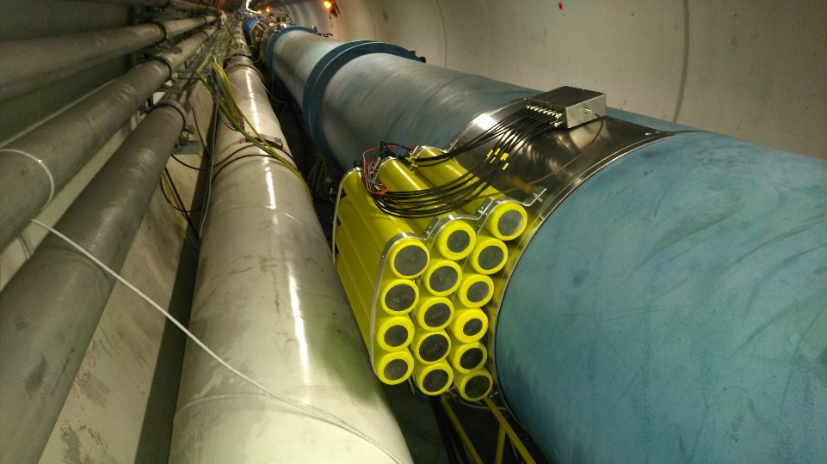
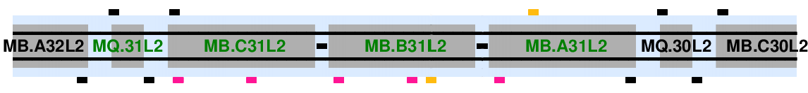
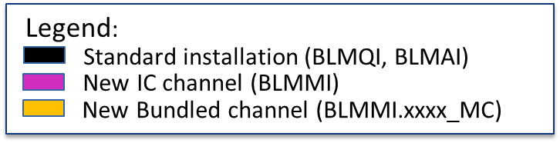
BLMs at 31L2
Installed:
  2 x Bundles of 15 ICs around the solenoid
  5 x ICs across the dipoles
  Modified support of IC above dipoles
  Mini-crate for acquisition connected to spare fibres at MQ.31L2
B1 (external)
BLMMI.31L2.B1E10_MC
mini-crate (below)
BLMMI.31L2.B2I15
BLMMI.31L2.B2I14
BLMMI.31L2.B2I13
BLMMI.31L2.B2I12
BLMMI.31L2.B2I10
B2 (internal)
BLMMI.31L2.B2I11_MC

Slide 11
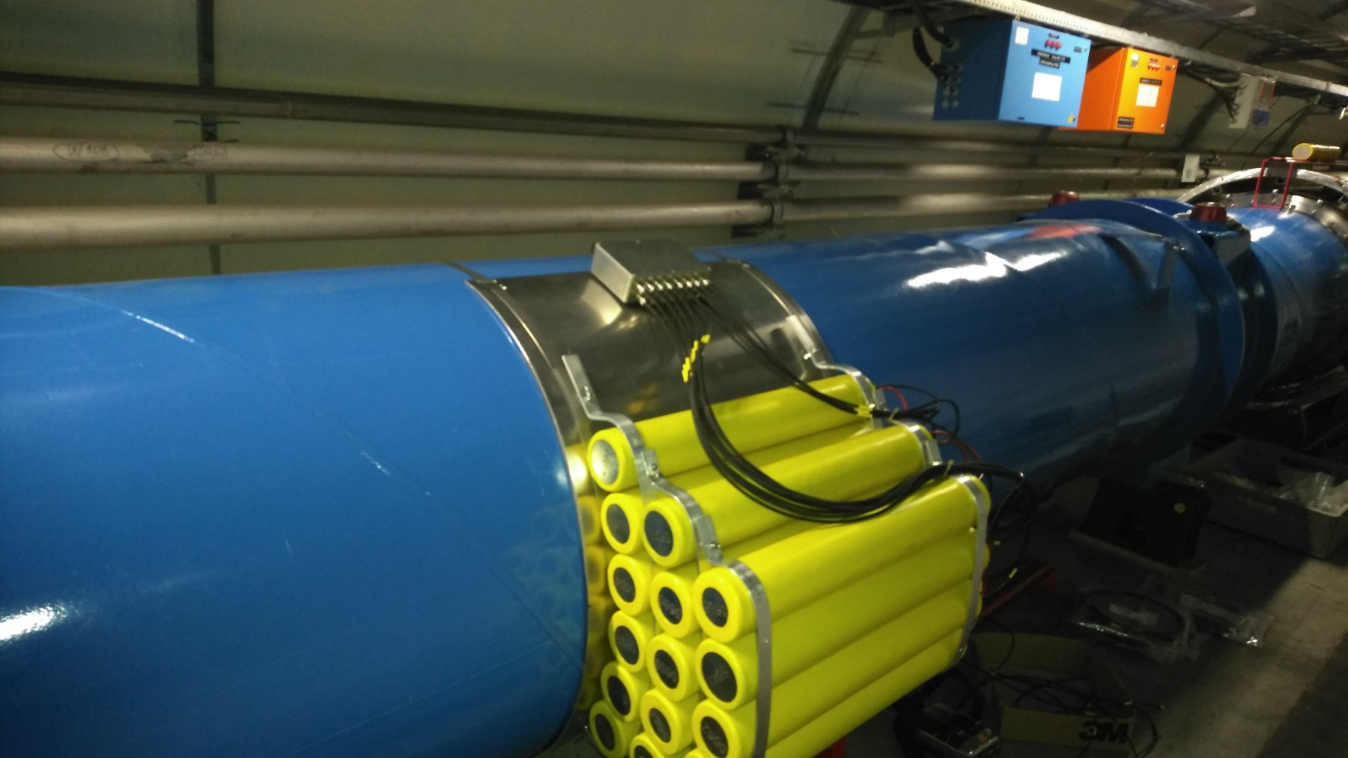
BLMs at 31L2
Bundle at internal position – Beam 2
New support to elevate dipole-dipole IC at 24 cm
New design for bundle support extends ~ 30 cm

Slide 12
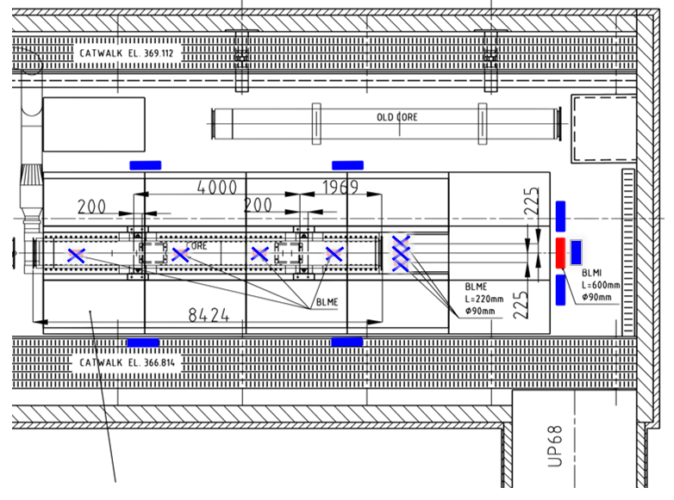
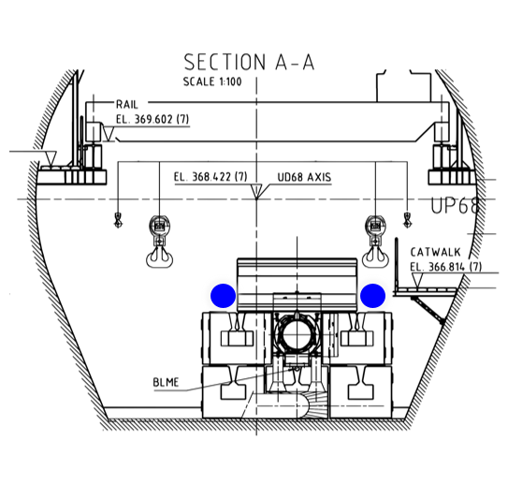
BLMs at the DUMPs
Solution consists of
  Adding six ICs and one LIC per DUMP
  using rad-tol cables (kapton insulation)
  Portable supports

Slide 13
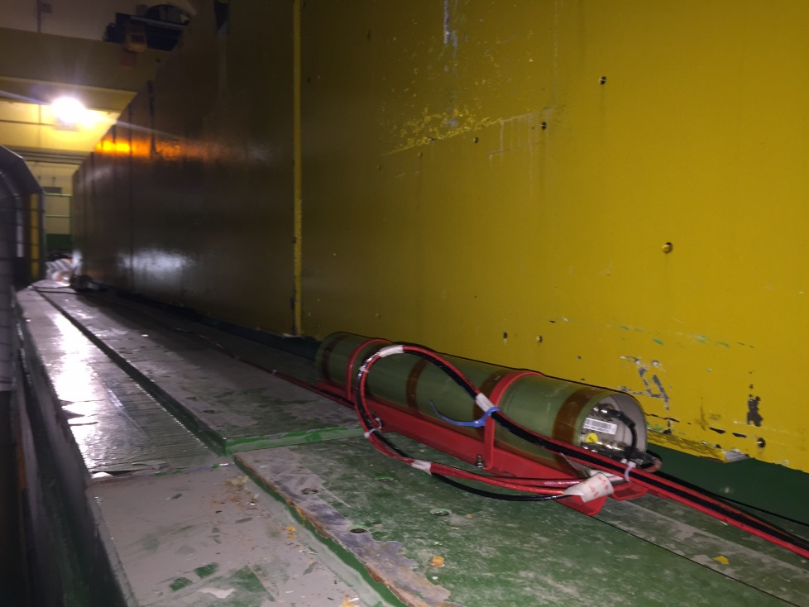
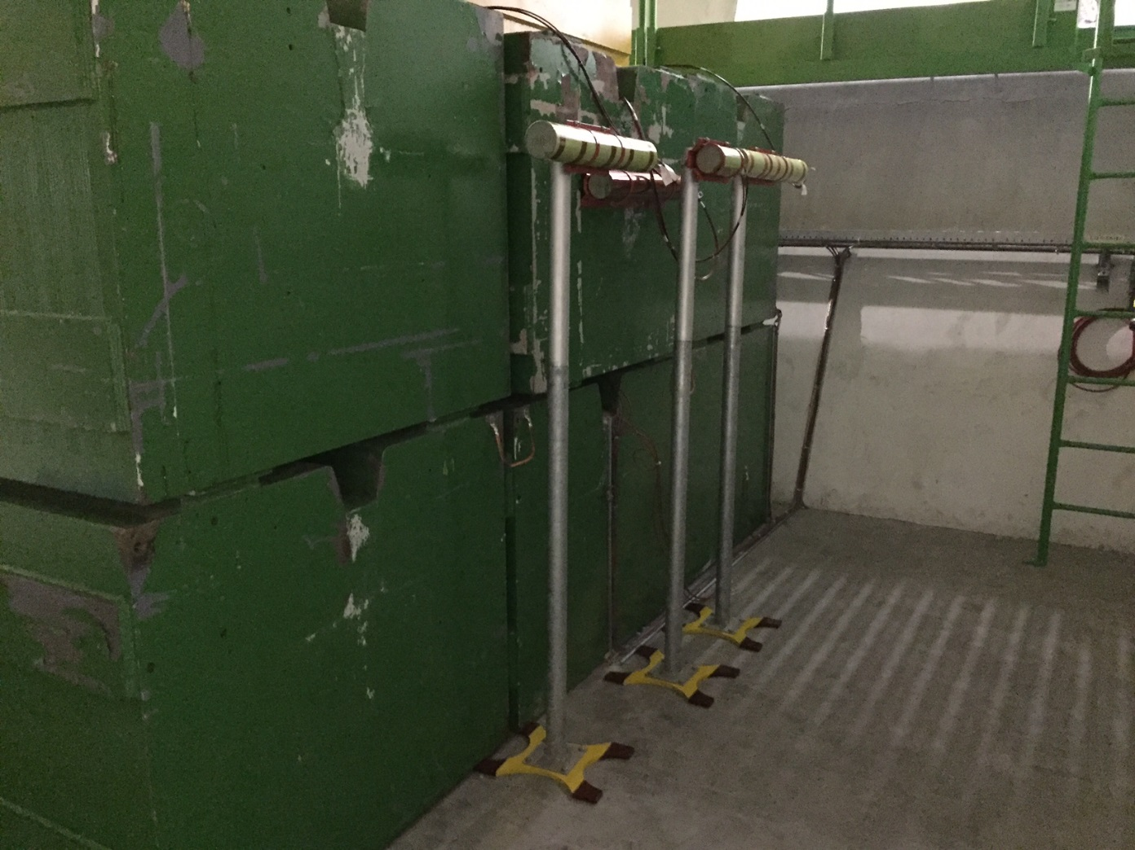
BLMs at the DUMPs

Slide 14
Outstanding issues

Slide 15
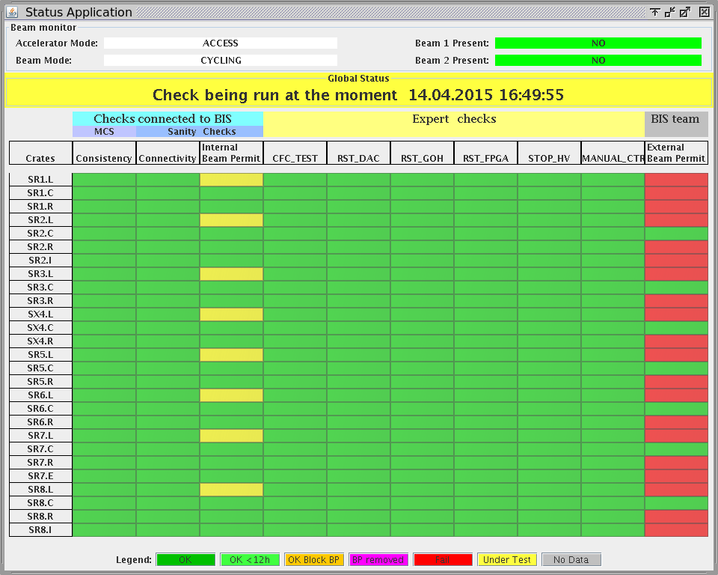
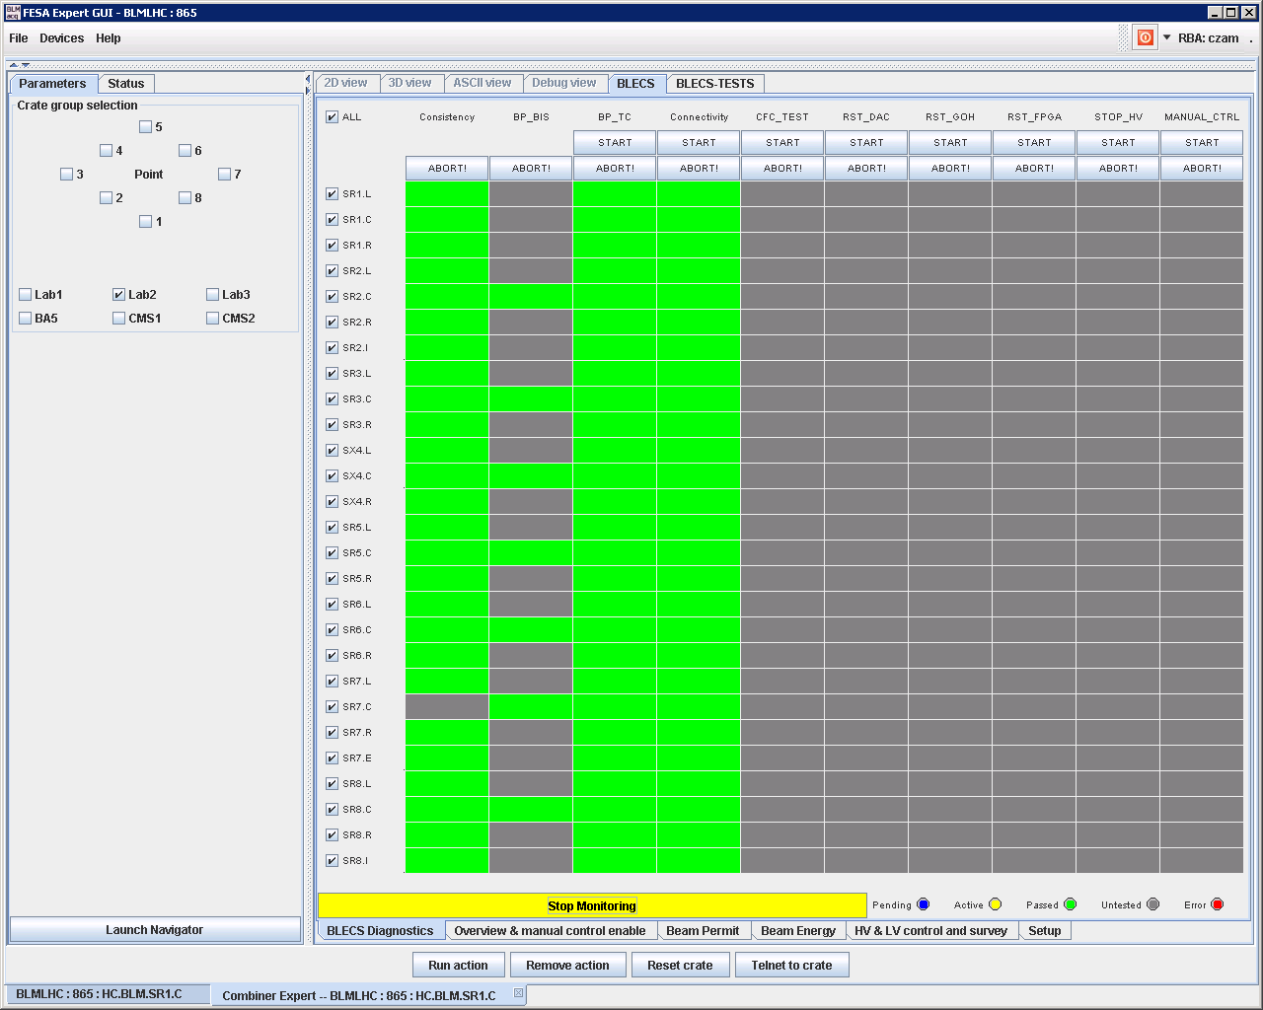
Sanity Checks
BIBML-937: Sanity Checks’ result in the Sequencer does not always gets registered in the BLECS
Several calls from the CCC that checks cannot complete
MCS Check had passed (thus the Sequencer showed as green, but the BLECS did not get the result as TRUE to release the permit). During the retries, MCS was being skipped.
Not yet sure what is the cause.
In the meantime, added a Status application to show the state of each crate
NEW: BI-SW has taken over the sequencer tasks.

Slide 16
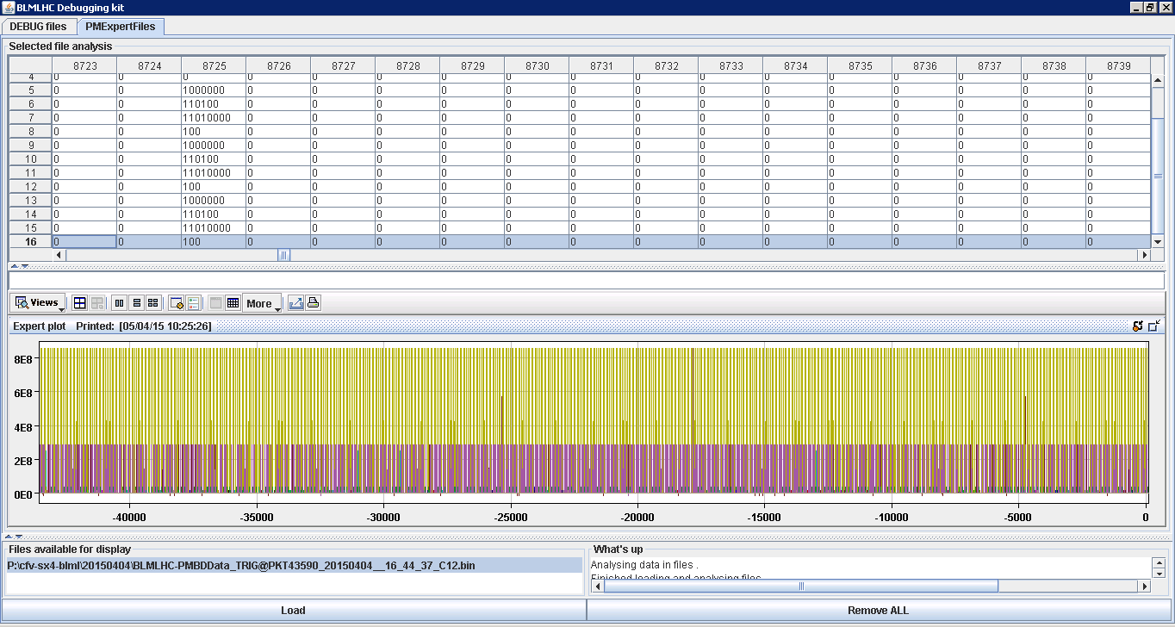
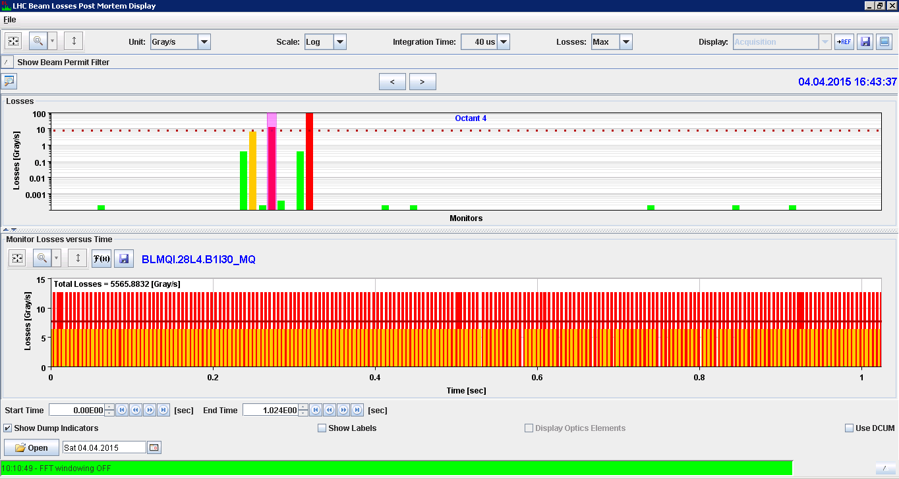
Post-Mortem Data 1/2
BIBML-881: In few cases the GPM Buffer is not working correctly
The issue is on the SRAM recording of the data.
The spikes seen are the markers between channels.
Cards has been exchanged (Note: had 5 similar cases in Run 1)
UPDATE: campaign end of last year to eradicate cards that shown this issue.

Slide 17
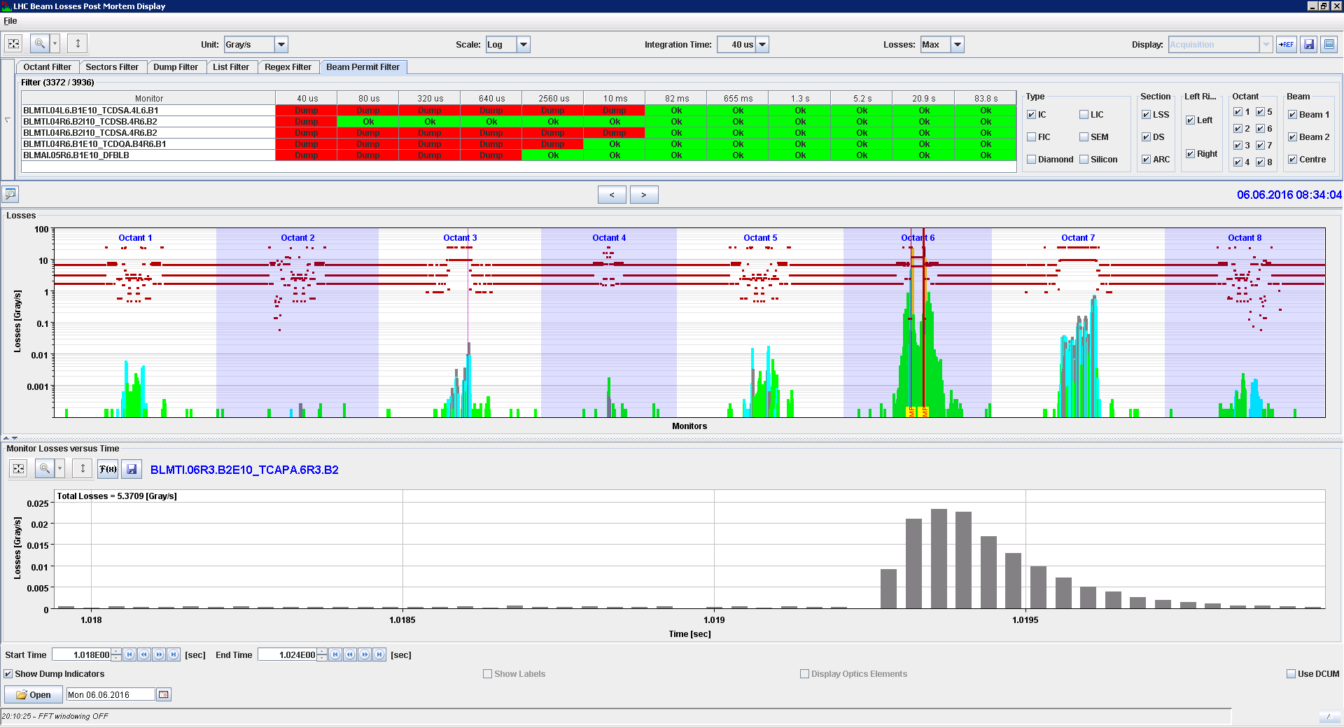
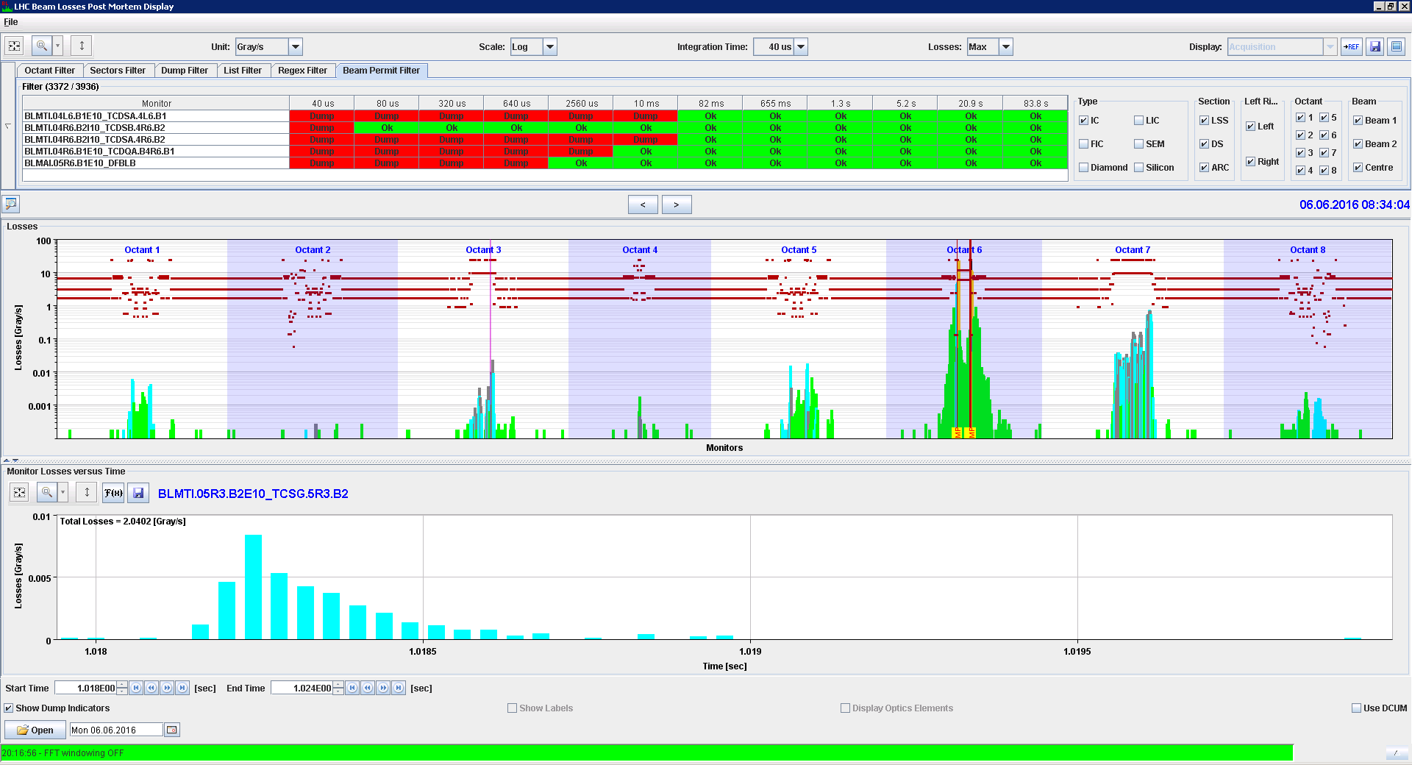
Post-Mortem Data 2/2
BIBML-1249:PM data sometimes not in sync between crates
  In few of the PM data recorded it is visible 1 ms misalignment
  A common factor on those observed events is that the BeamDumped1 & 2 events had a ms difference
One possible explanation is that the PM data for the misaligned crates have been readout from a different buffer than the rest
UPDATE: added debugging info to understand this issue and BST has been updated.

Slide 18
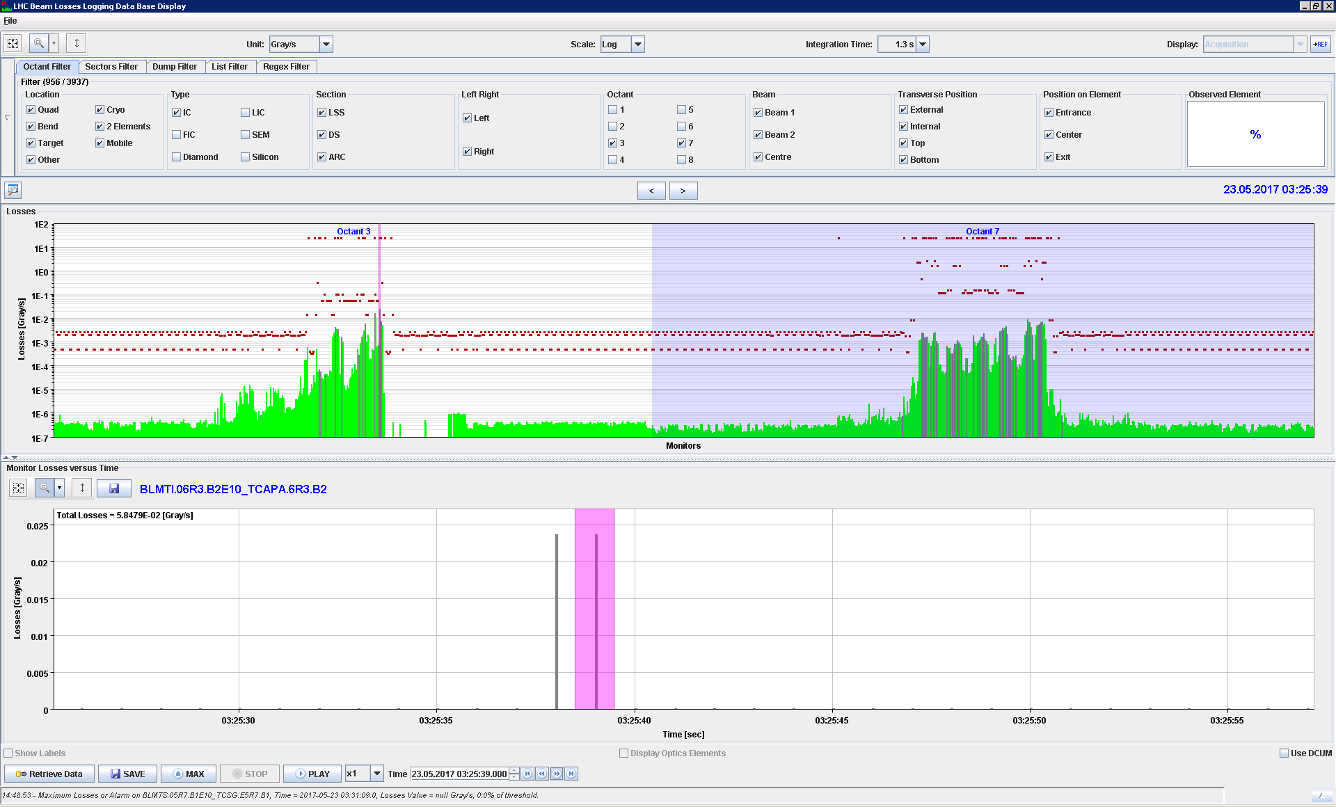
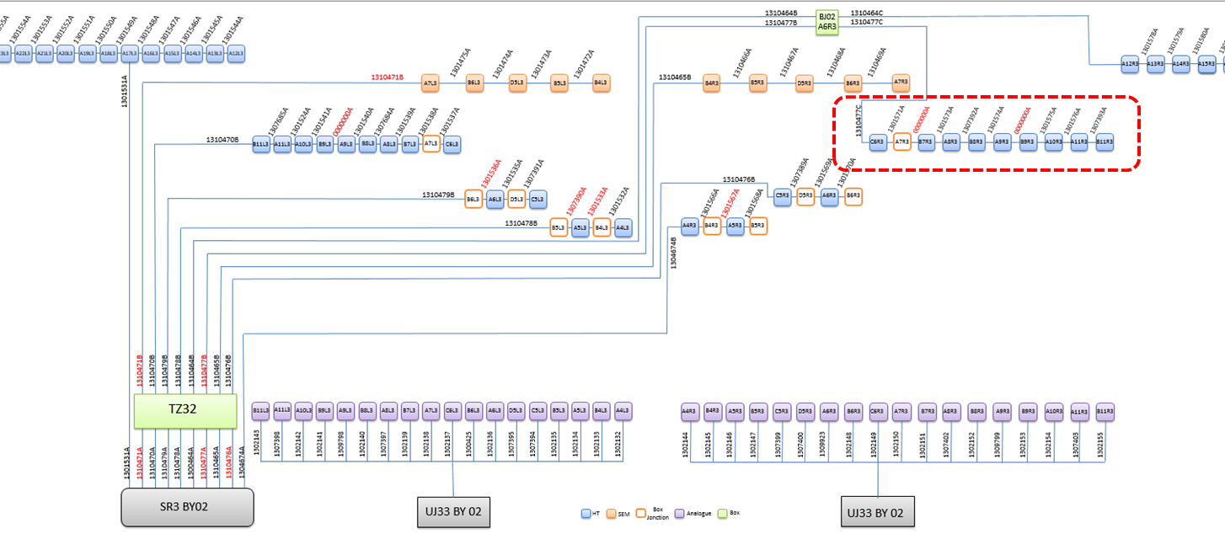
Signal Drop at IP3
During the Loss Maps Validation several BLM signals drop to zero at DS of R3
The issue has been reported twice in Run 2:
  BIBML-990 on 2015/05/05 & BIBML-1344 on 2017/05/23
Specificities of the location
  HV cable is ~ 3km (all other locations < 200m)
  Very long signal cables (~ 800m)
UPDATE: Objective and additional manpower set for 2018 to investigate and propose solutions

Slide 19
Work in Progress
& Future plans

Slide 20
NXCALS
BE-CO has been working to bring all LHC BLM data to the next Logging DB
  New schema has been agreed to optimise performance
  All metadata have been created
  Concentrator has been modified to push data to both DBs
  Old data is being prepared to be copied
To become fully operational after LS2

Slide 21
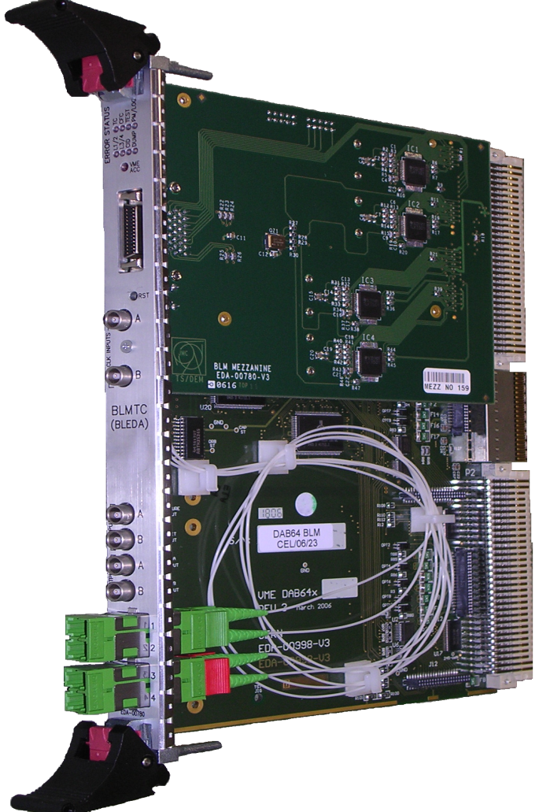
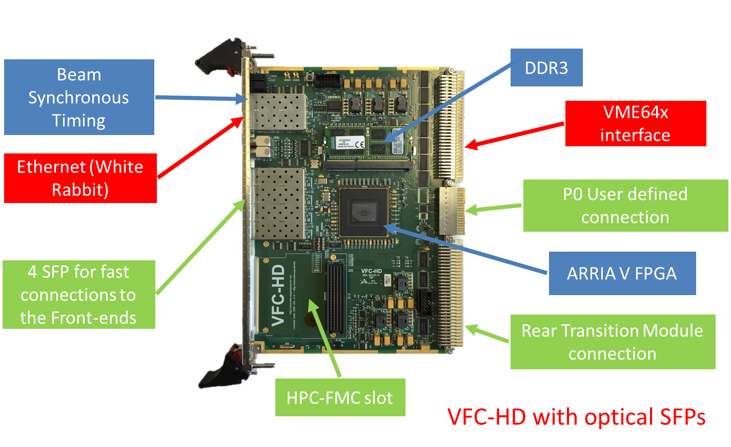
New Processing Module
1150 boards under production for BI
  ~ 700 for BLM systems
  Common board across accelerators
DAB64x + mezzanine

Slide 22
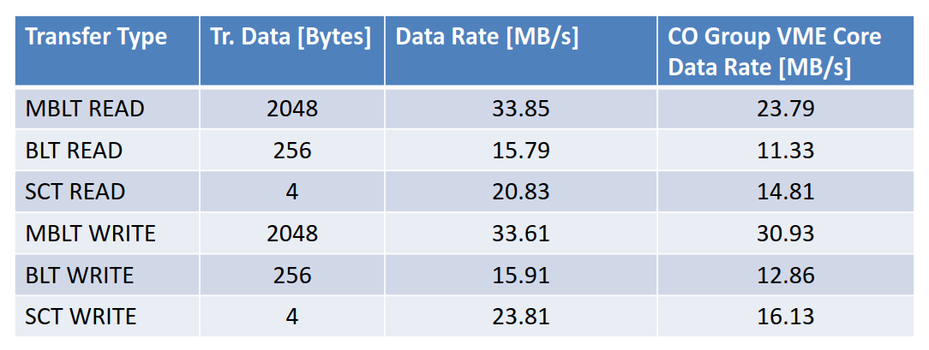
New VME core
With the addition of the new processing module and the optical links in SFP only bottleneck is the VME communication.
New faster VME core has been developed
  Operational at Injectors BLM using MBLT access mode
Current LHC BLM system at ~ 2MB/s and only SCT R/W

Slide 23
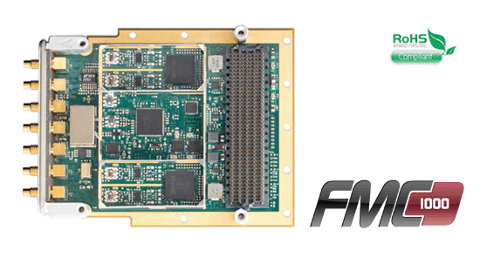
New Diamond Acquisition System
FMC-HPC module with
  2x1000 MSPS 14-bit ADCs,
  2x1000 MSPS DACs,
  DC coupled A/D & DACs
Diamond installations at SPS and LHC
  From 2018 all have the new acquisition system
  Parallel installation to the operational system
  Four new diamonds with all electronics deployed
Aim to start after LS2 with the new system only
  Already in very good state with most functionality available
  This year, additional features, data taking and optimisation

Slide 24
Summary
Commissioning:
Hardware and Machine checkout checks ongoing
  DBs and minor hardware issue to complete
Tests with beam to be planned
  For most of them good experience to achieve
  Test for the ‘blindable’ channels was not achieved last year
System Issues:
No known machine protection critical issues
Some work still needed to bring the system into operational mode

