Slide 1
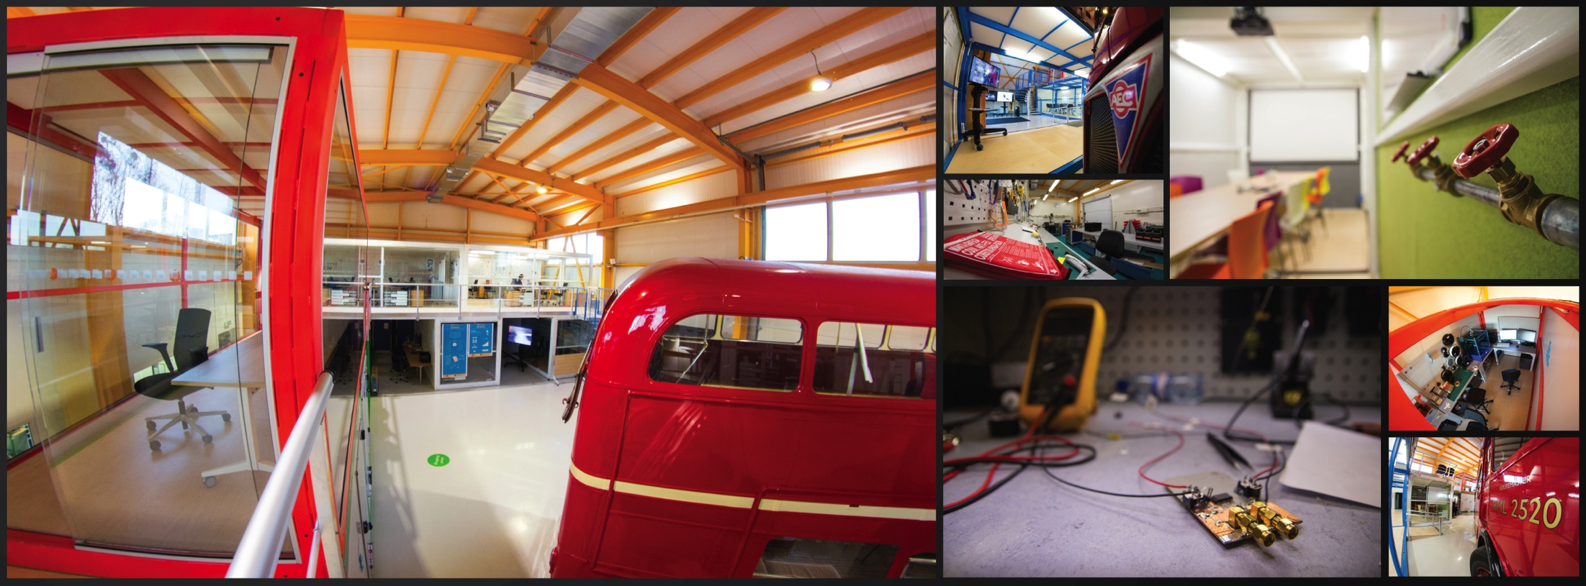
CERN Ideasquare
Harri Toivonen
CERN-Advatera, March 28th, 2018
INTRODUCTION

Slide 2

CERN »core business» is
Fundamental research
Notes:
CERN’s goal is FUNDEMENTAL research, not APPLIED research.
CERN is not to improve the way electricity is produced or rockets are launched.
CERN is to help answering questions and for a better understanding of the Universe.

Slide 3
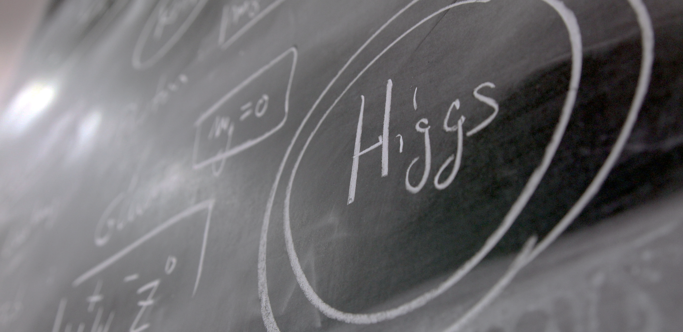
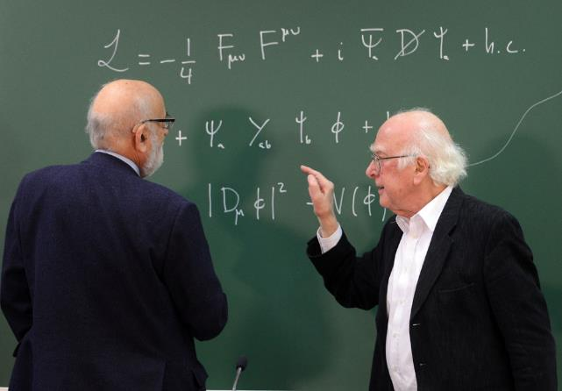
Answering questions…
Higgs ?
Notes:
CERN also helped proving certain theories like the existence of the «Higgs Boson».
This particle is responsible for giving its mass to all other particles. It is very important in the standard model.
It was predicted in 1964 by 2 Belgian physicists (François Englert and Robert Brout), then by the Scottish physicist (Peter Higgs) and others later.
If took 48 years to have the experiments (ATLAS and CMS) which proved its existence. The discovery was announced at CERN on 4th July 2012.
This discovery led François Englert and Peter Higgs (only surviving of the 3)to be rewarded by a Nobel Prize in 2013.

Slide 4
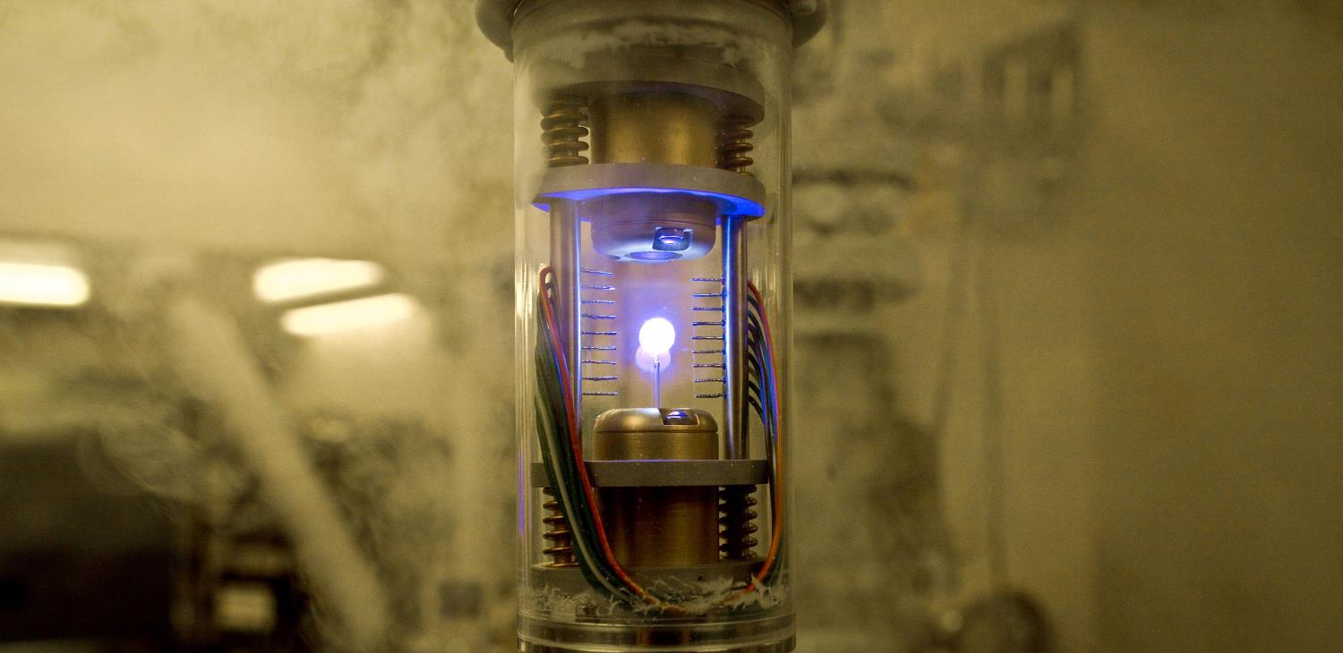
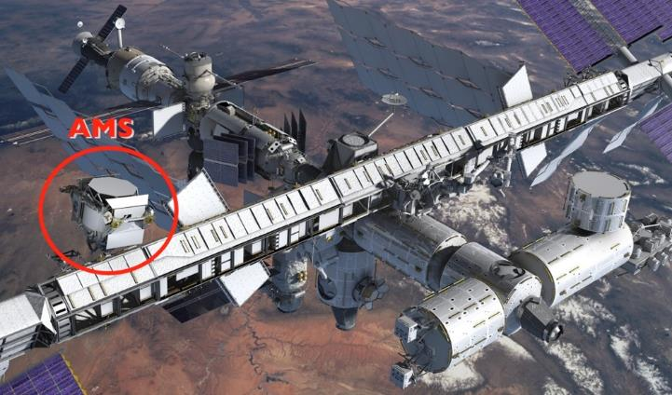
Answering questions…
Antimatter ?
Notes:
Theorists believe that at the moment of the Big Bang, a theory telling that all universe is an expansion of a tiny space of pure energy which was transformed into matter, as many particles than antiparticles were created. It is also believed that the first instants of the universe was a gigantic anihilation of partcles and their counter anti-particles which were just created. But it seems that out of 1 billion particle-antiparticle anihilation, 1 particle survived… And that what makes the current Universe… apparently made only of matter. Why matter has won over antimatter? Are we sure there is no antimatter left from the Big Bang?
CERN is looking at that question with various experiments amongst which:
AD (Antimatter Decelerator) creates anti atoms and slows them down to eventually trap them (the image here is the one from Angels and Demons movie, our trap is bigger, sexiers and consumes much more energy)
AMS is an experiment on the International Space Station which looks for traces of primordial antimatter from space. It needs to be there outside of the Earth’s atmosphere where many particle collisions occur and produce briefly anti-particles. The AMS Control Centre is located at CERN and receives signals from the experiment.

Slide 5

Answering questions…
Dark matter ?
Notes:
But we have many more questions unanswered.
For example when we look at galaxies far away, and at their rotation speed, the estimated mass of the visible matter (stars, planets, clouds of gas etc) is not sufficient to «keep it together». At the speed it rotates, this galaxy should split away.
And the worrying thing is that is seems we are missing 95% of the needed mass…
What is 95% of the universe’s mass made of? Dark matter? Dark energy? There are many theories again (Supersymetry amongst others). CERN may help finding out more about it.

Slide 6
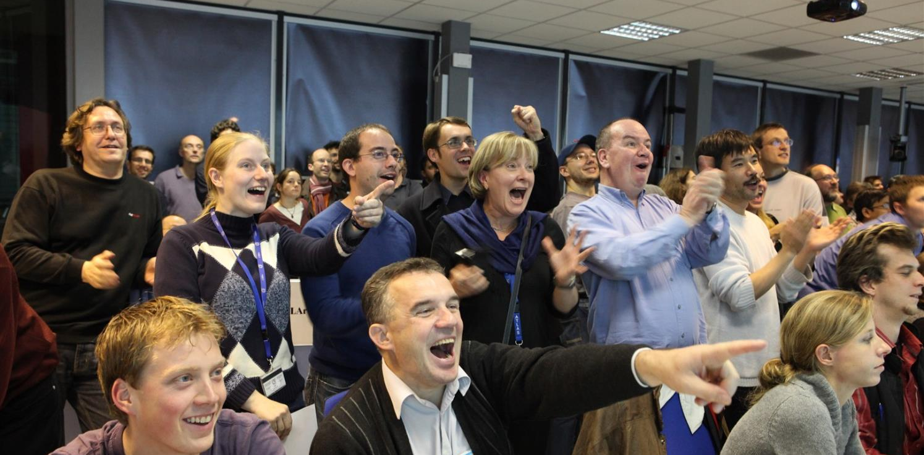
Collaborate
Notes:
In order to face all these questions and challenges, scientists need huge, complex and costly instruments.
Therefore international collaboration is the only way to answer these questions. CERN accounts for half of the world particle physicists.

Slide 7
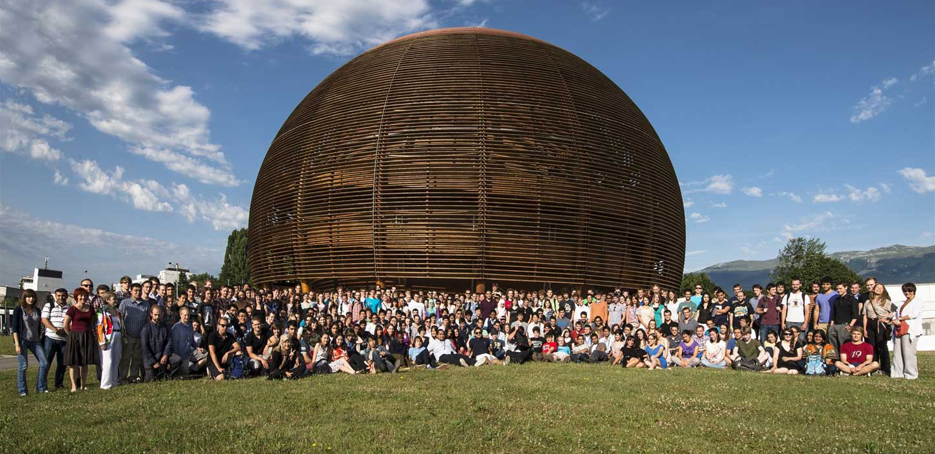
Educate
Notes:
A last goal of CERN is to educate: students of course by welcoming them at CERN for internships, but also the general public, by making its discoveries available and understandable. CERN is visited each year by 100’000 visitors on guided tours. And many more visit CERN’s permanent exhibitions. This presentation is part of CERN’s educational effort.

Slide 8
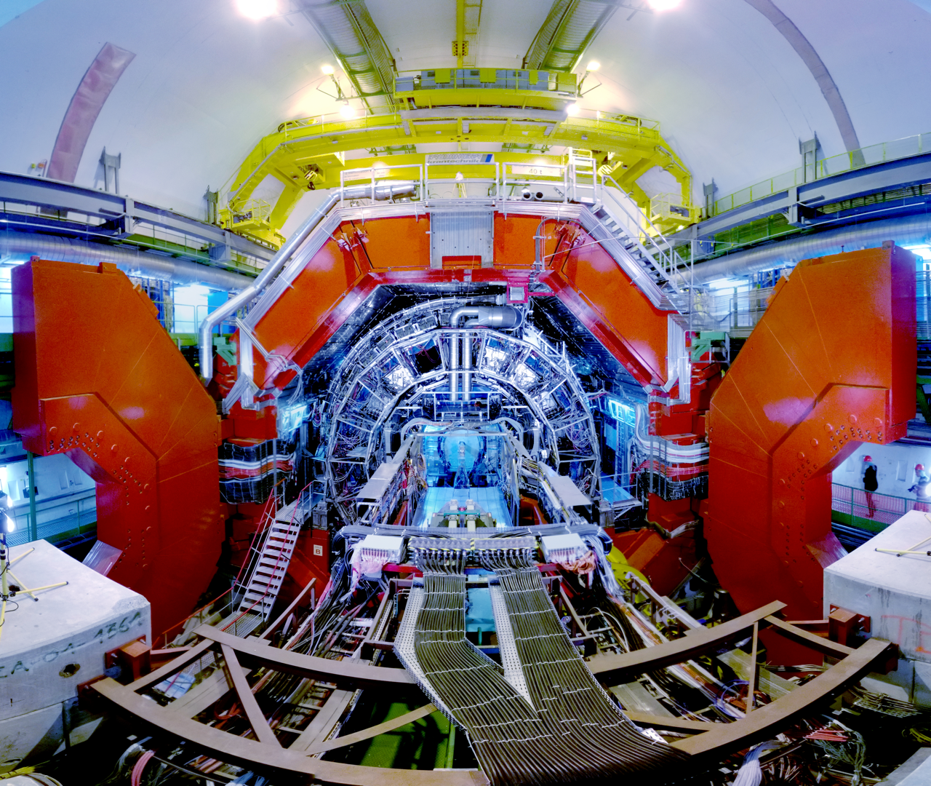
EUROPEAN RESEARCH INFRASTRUCTURE CHALLENGES
The ERI´s, CERN included, deal with engineering and innovation challenges stemming from scientific progress
Accumulated knowledge, capabilities and infrastructure aligned to drive advanced scientific field forward -> societal value and benefits are challenging to measure as the time from discovery to application is long
How might we accelerate societal value creation (new technology, products, services, jobs, startups, etc) from basic research?

Slide 9
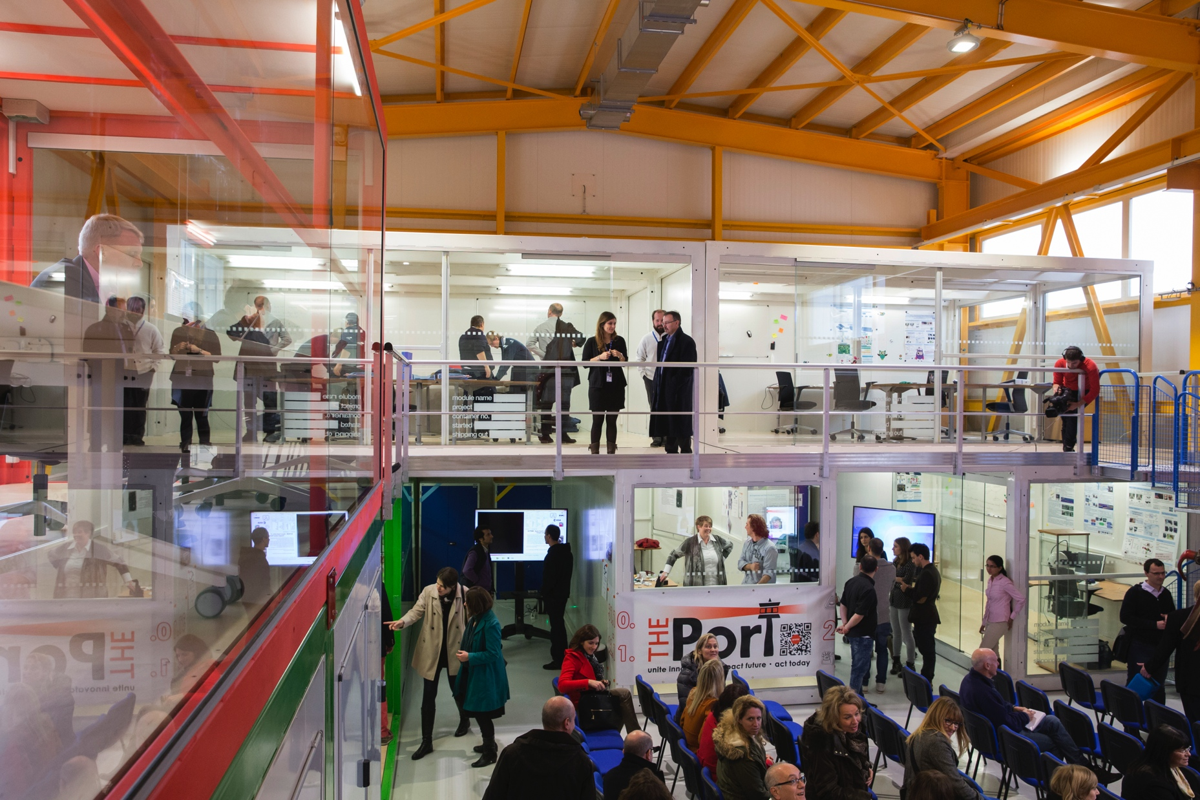
IDEASQUARE IN BRIEF
“Ideasquare is a pilot project that brings together physicists, engineers, industrial partners, early-stage researchers and cross-disciplinary teams of students to work together on detector upgrade R&D technologies. The purpose is to co-develop new technologies for research purposes, and at the same time, create a fruitful environment for socially and globally relevant new product ideas and innovation.”

Slide 10
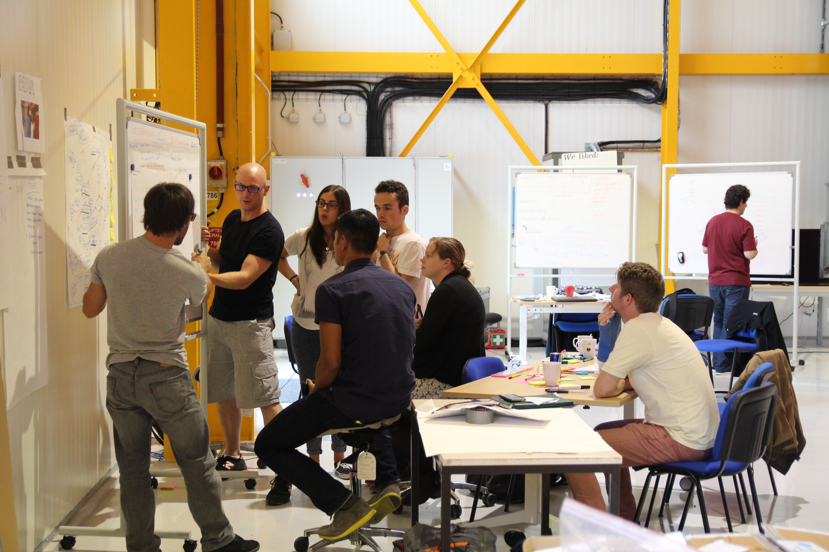

IDEASQUARE IS
Project with a dedicated building, hosting:
  EU-funded detector upgrade R&D projects
  Multidisciplinary master level student programs
  Innovation events, workshops, hackathons
...to prototype, test and iterate new forms of collaboration and co-creation in the areas or Research, Education and Technology - RET
Research
Education
Technology

Slide 11
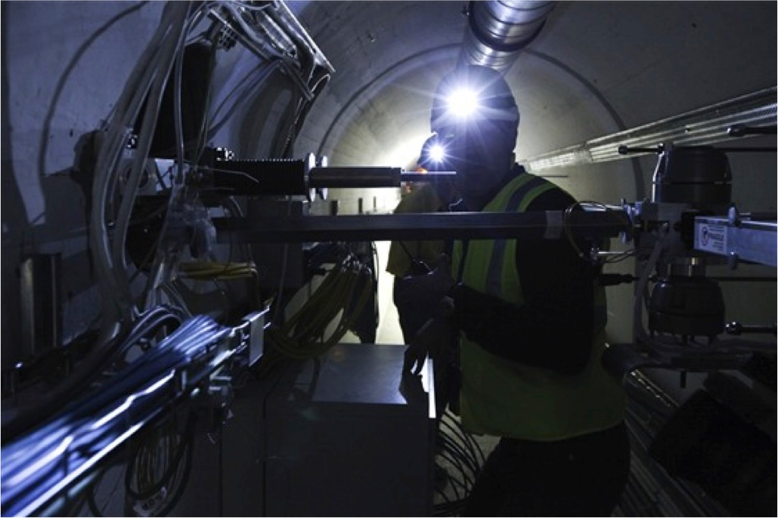

EXAMPLE: EU-FUNDED DETECTOR UPGRADE R&D PROJECT
EDUSAFE is a 4-year Marie Curie ITN project
Training for 10 Early Stage and 2 Experienced Researchers
Focuses on research into the use of Virtual Reality (VR) and Augmented Reality (AR) during planned and emergency maintenance in extreme environments
The result will be an integrated wearable VR/AR system (+control system) which can be implemented and tested as a prototype, using LHC at CERN as a test and demonstration platform

Slide 12
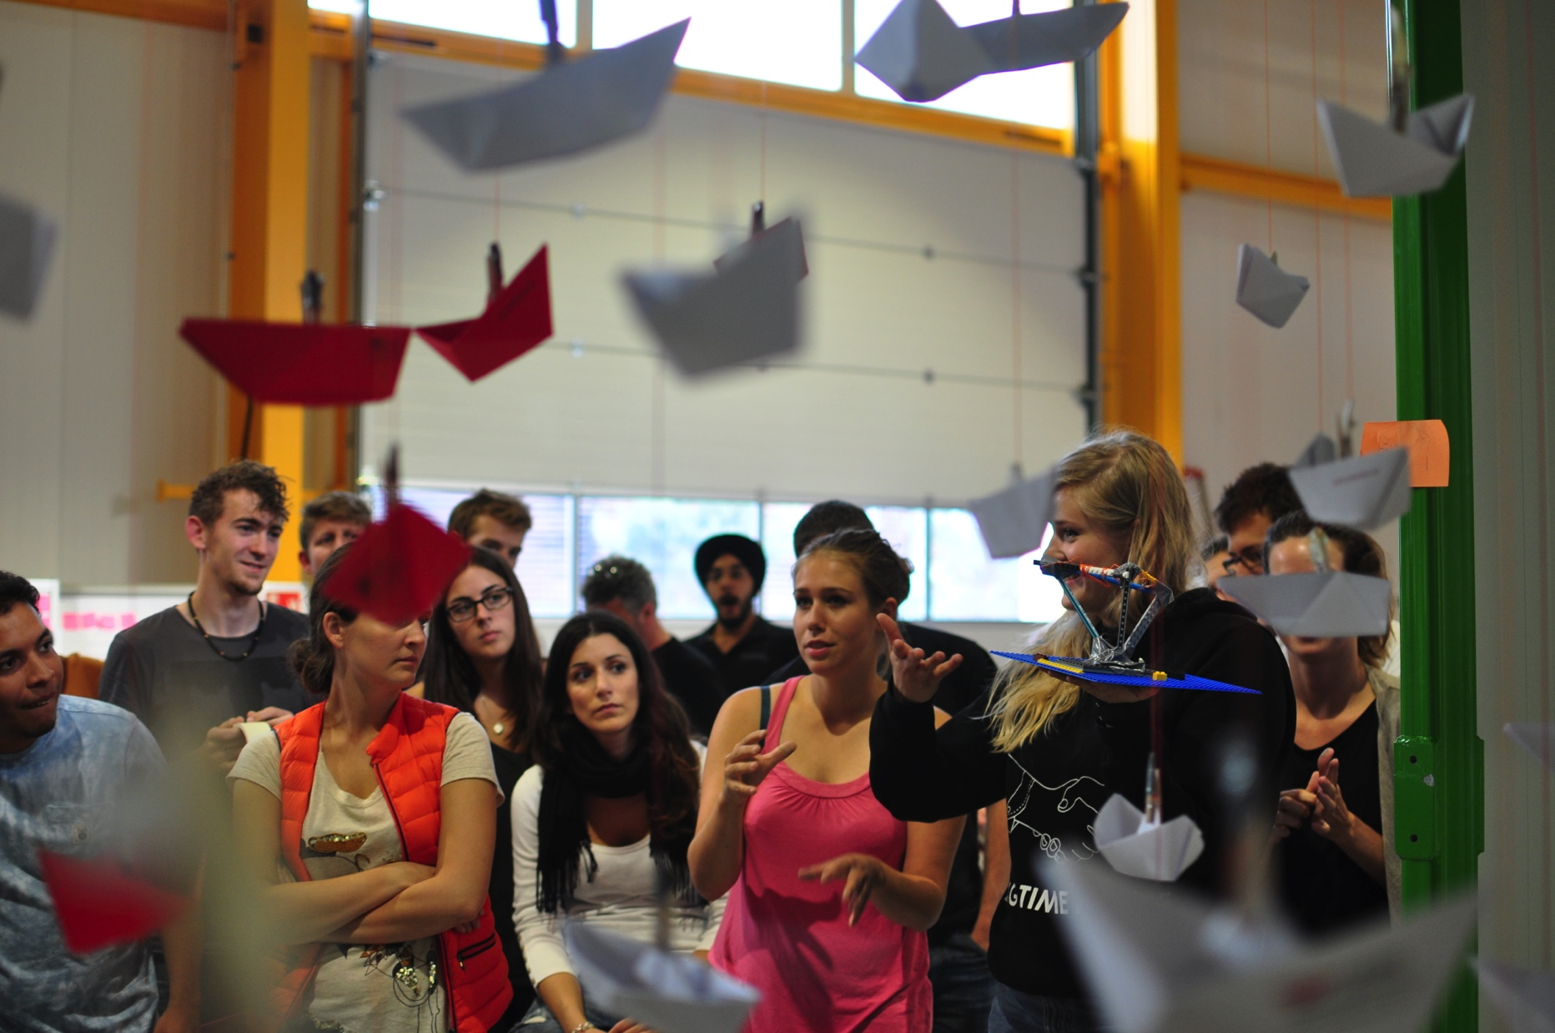

EXAMPLE: MASTER-LEVEL STUDENT COURSE
Challenge Based Innovation (CBI) is 4-6 month MSc-level specialization course for product and service development, run by participating universities from (currently) 8 countries around the world
Three pilot runs completed, 12 proof-of-concept prototypes produced
In the course, multidisciplinary student teams learn how to apply Design Thinking – process (PBL) for new product/service development; CERN researchers act as technological coaches in the process
“Work extremely hard, learn and have fun!”
“Fail fast and often to succeed sooner”

Slide 13

EXAMPLE: STUDENT PROJECT PROTOTYPE

Slide 14
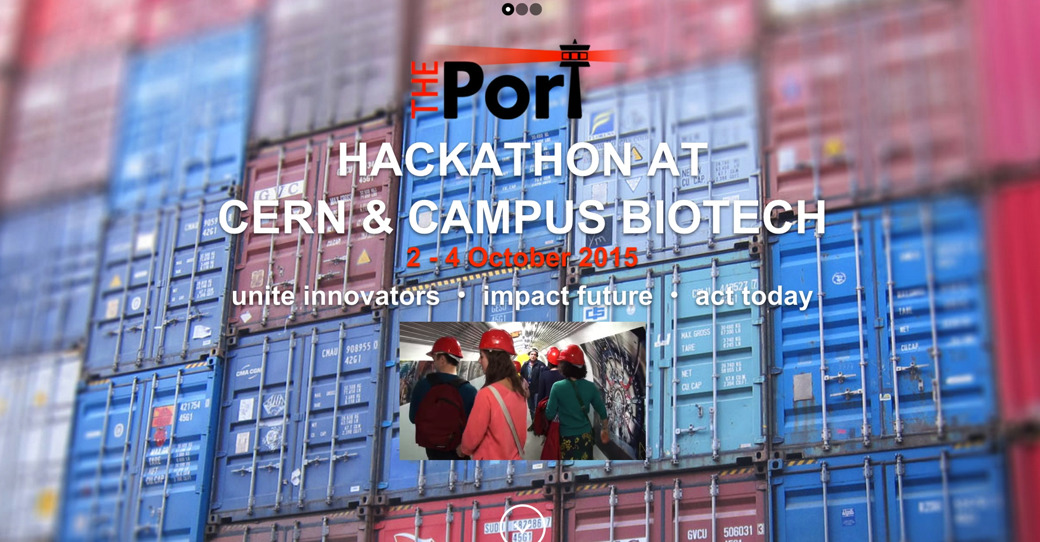

EXAMPLE: HACKATHON
Organised by THE Port Association, hosted by CERN Ideasquare and with partners from other non-governmental organisations, a three-day problem solving workshop hackathon with the theme “Science for Humanitarian Purposes”
Example prototypes produced included: open-source cosmic ray detector, an assistive electronics suit to help mine detection dogs, an inflatable fridge for vaccines, a terrain-mapping tool for refugee camps, etc.

Slide 15

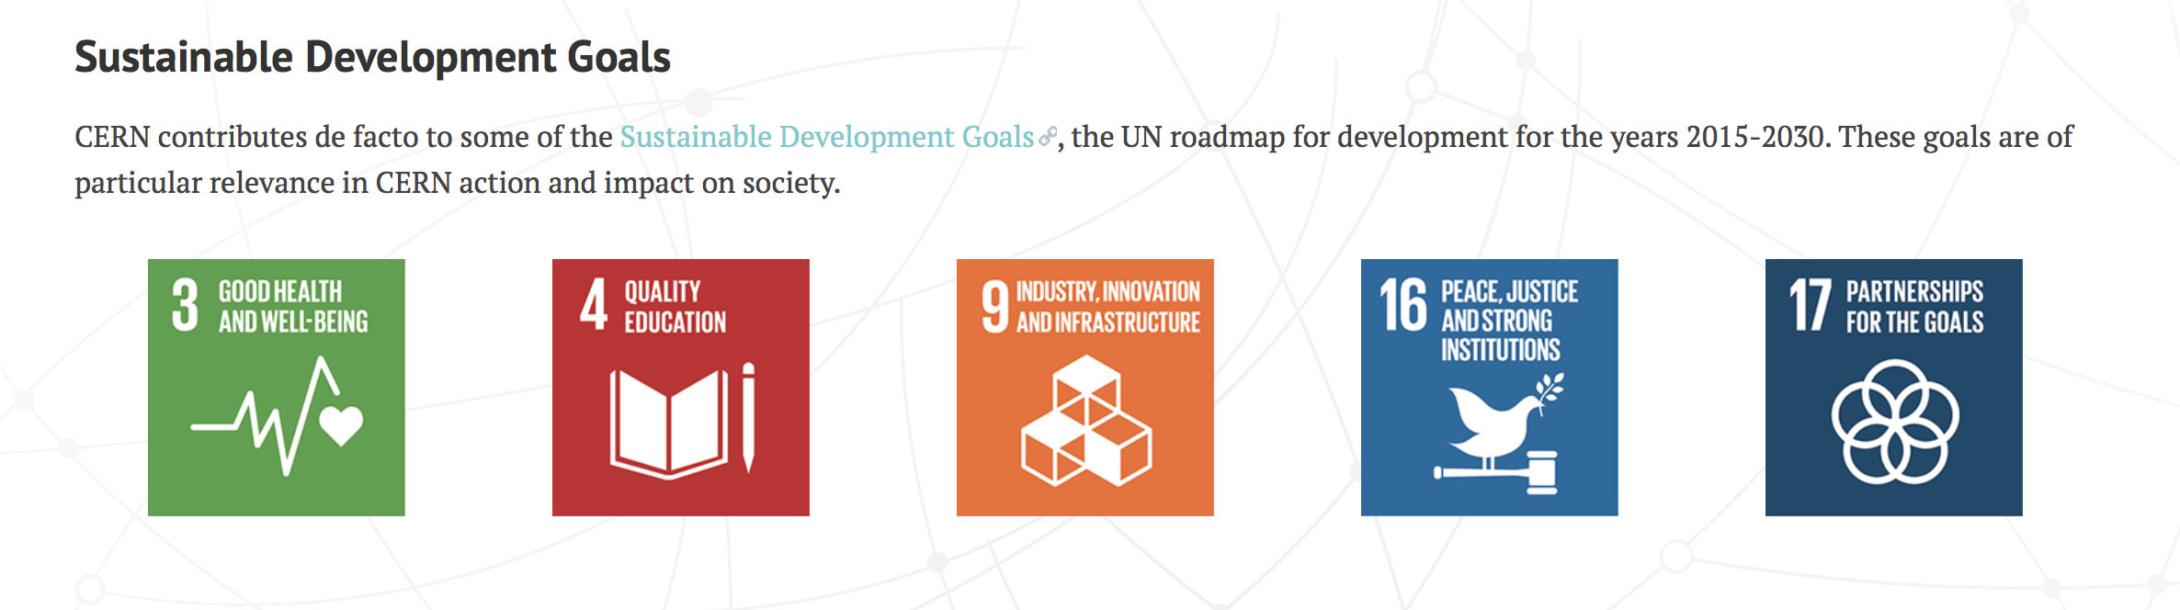
CERN connections to UN & Sustainable Development Goals

Slide 16
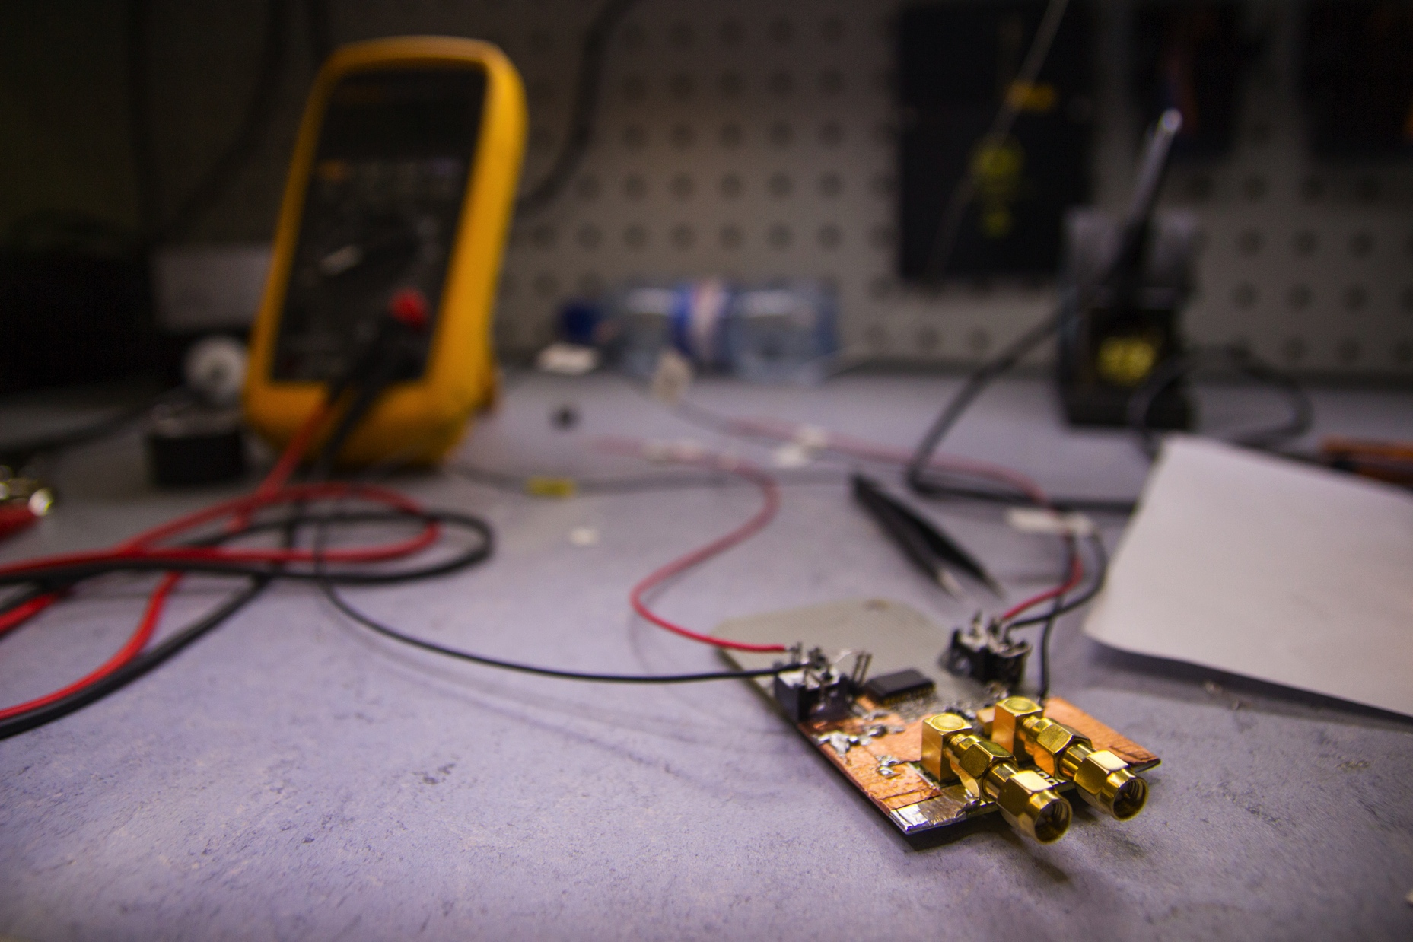
IDEASQUARE (EXPECTED) OUTPUT
Pilot project = outcomes and measures for them are in development with in-situ research
Communication, sharing ideas, spaces and resources improved in and between advanced technology development projects
The counter-intuitive, controlled addition of variation, diversity, connections, ideas that are realised as prototypes to accelerate technology development
Time span from discovery to application compacted
Societal value of basic research more visible and tangible
Education of future talent capable of working in basic research, commercial product & service development, or both
Demonstrator for ATTRACT

Slide 17
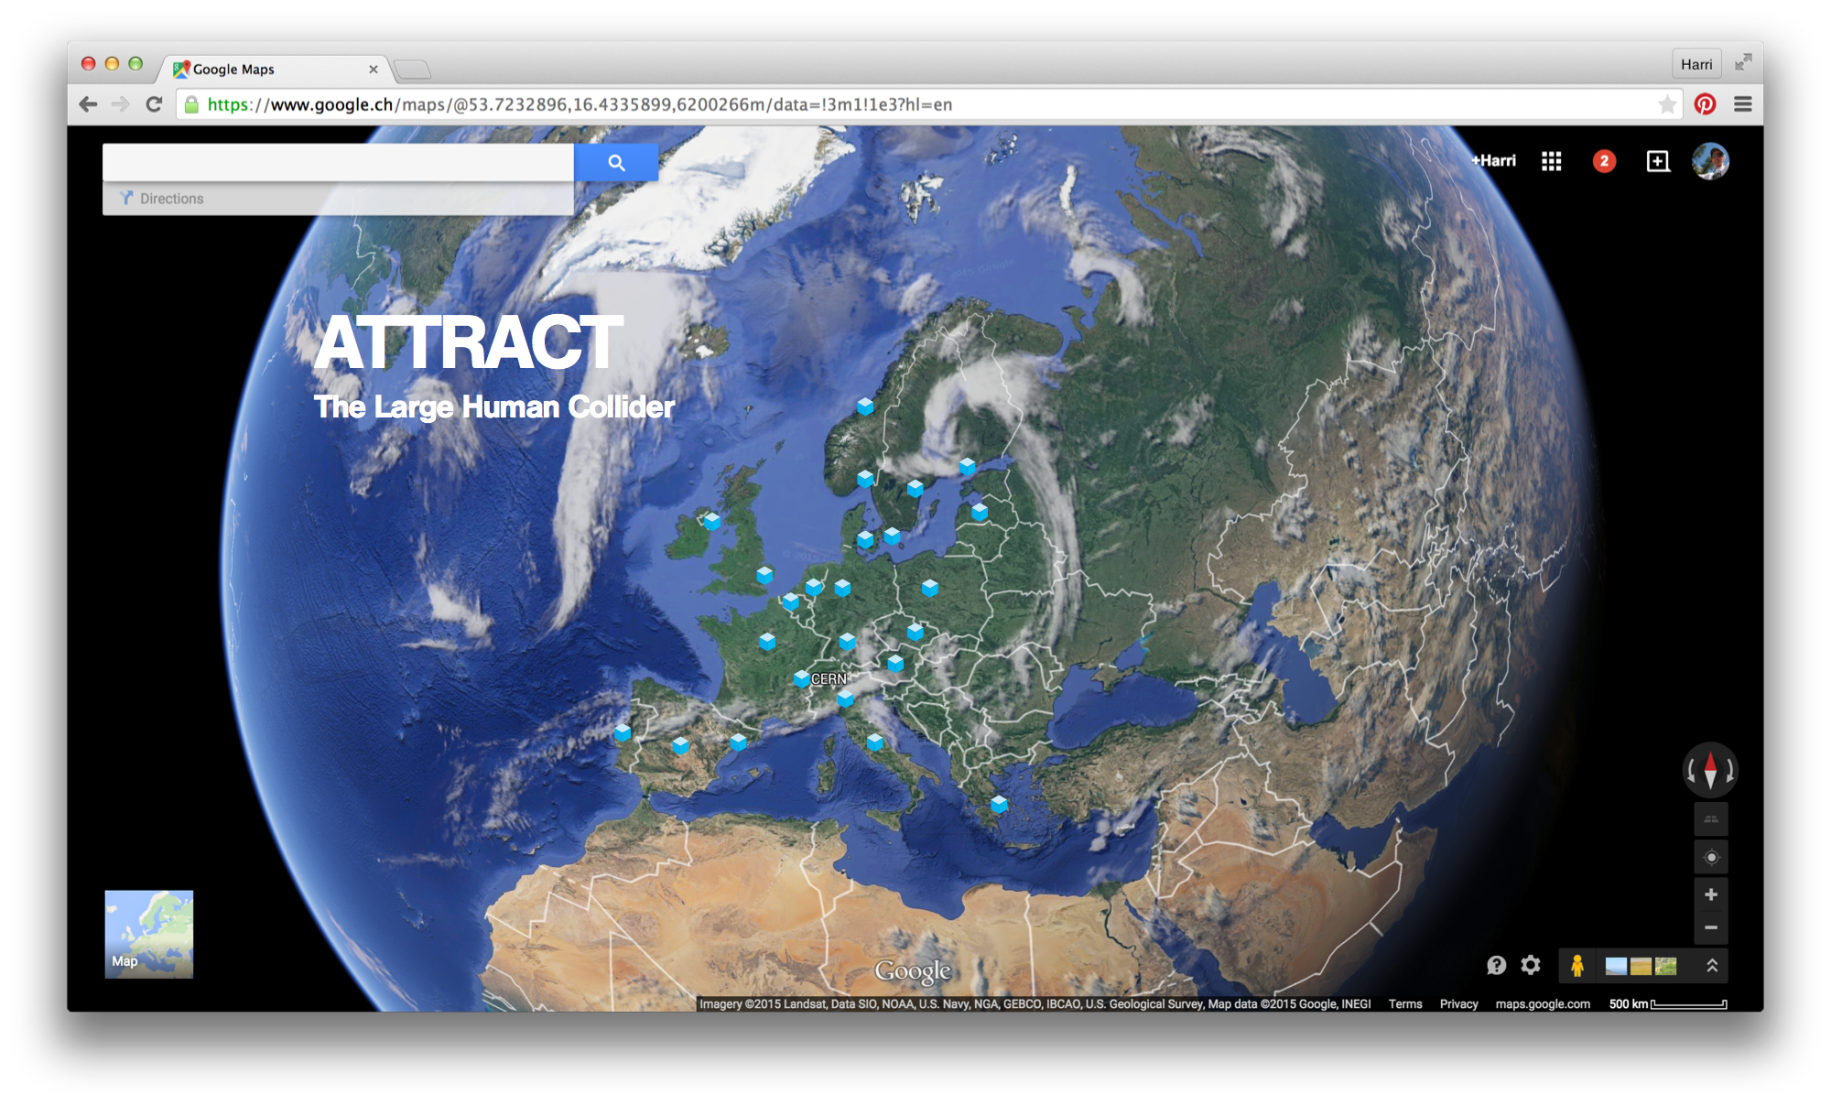

Slide 18


Questions? Comments?
Contact information:
Email: harri.toivonen@cern.ch
Skype: olavi-dude
Take care of the space, each other and your ideas! Remember to have fun!

