Slide 2
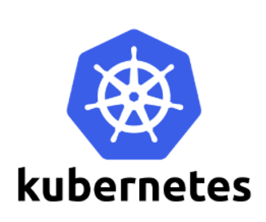
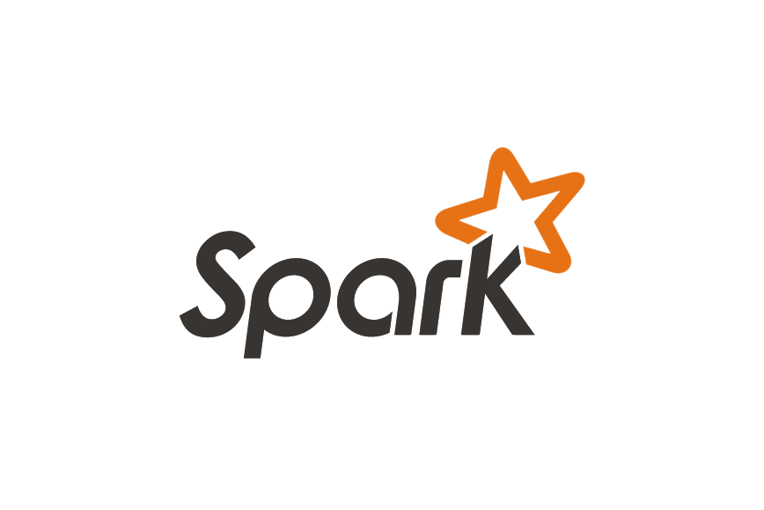
Spark Service on Kubernetes
Motivation, current status and objectives

Slide 3
Spark Service on Kubernetes
Current state of the art for Spark at CERN
Future demand outlook – LHC experiments and big data
Spark on Kubernetes
State of the art in industry
Current progress of Spark on Kubernetes
What next?

Slide 4
Current state of the art for Apache Spark at CERN
- Spark running on top of Hadoop/YARN (distributed filesystem for big data and cluster resource manager).
- Physical machines allocated – means no elasticity, no isolation, not cloud-ready model (Openstack)
- Stable workloads from monitoring, security, plus some other smaller communities
- Sometimes more busy due to high load from physics analysis

Slide 5
Spark Service on Kubernetes
Current state of the art for Spark at CERN
LHC Experiments and big data – future demand outlook
Spark on Kubernetes
State of the art in industry
Current progress of Spark on Kubernetes
What next?

Slide 6
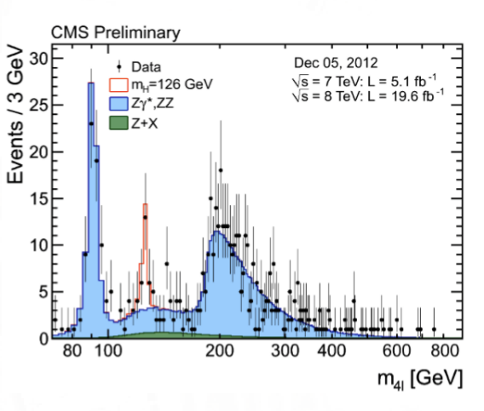
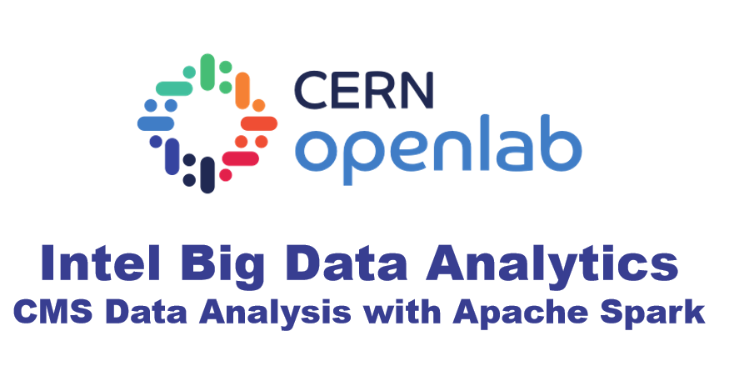
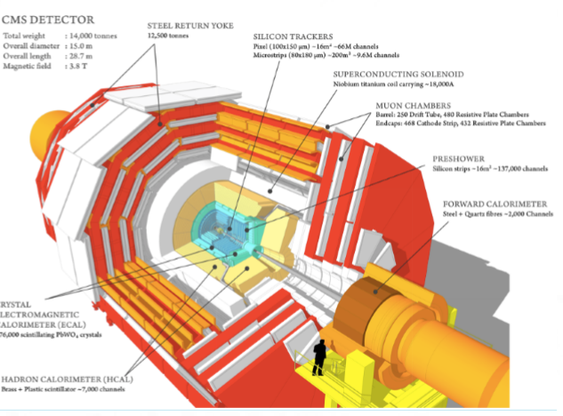
LHC Experiments and big data – future outlook
Detect particle interactions (data), compare with theory predictions (simulation)
Particle detection analysis
Large scale data reduction facility

Slide 7
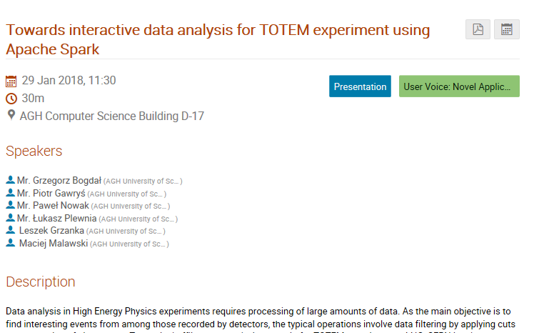
Experiments and big data – future outlook
100s of Root files for offline analysis

Slide 8
LHC Experiments and big data – future outlook
Data Intensive – lots of data to be processed and reduced
Data stored in external place – EOS with around 250 PB
Sporadically analyzed

Slide 9
How to achieve elasticity?
How to easily deploy applications?
How to make use of data stored on EOS and not HDFS ?
How to ensure that service can self-heal and recover from failures easier?

Slide 10
Spark Service on Kubernetes
Current state of the art for Spark at CERN
Future demand outlook – LHC experiments and big data
Spark on Kubernetes
State of the art in industry
Current progress of Spark on Kubernetes
What next?

Slide 11
Spark on Kubernetes – why for this use case?
Kubernetes is an open-source system for automating deployment, scaling, and management of containerized applications.
15 years of virtualization experience from Google
Scales horizontally. Self-healing system - restarts containers that fail, replaces and reschedules containers when nodes die or container not respond
Large and industry-grade community
Kubernetes already gets adopted at CERN.

Slide 12
Spark on Kubernetes – why for this use case?
In development by:
Bloomberg
Google
Haiwen
Hyperpilot
Intel
Palantir
Pepperdata
Red Hat
Spark runs as any other application in Kubernetes cluster
Spark on Kubernetes released this month in Spark 2.3 and in active development currently.
Get better understanding of the system for big data applications at CERN

Slide 13
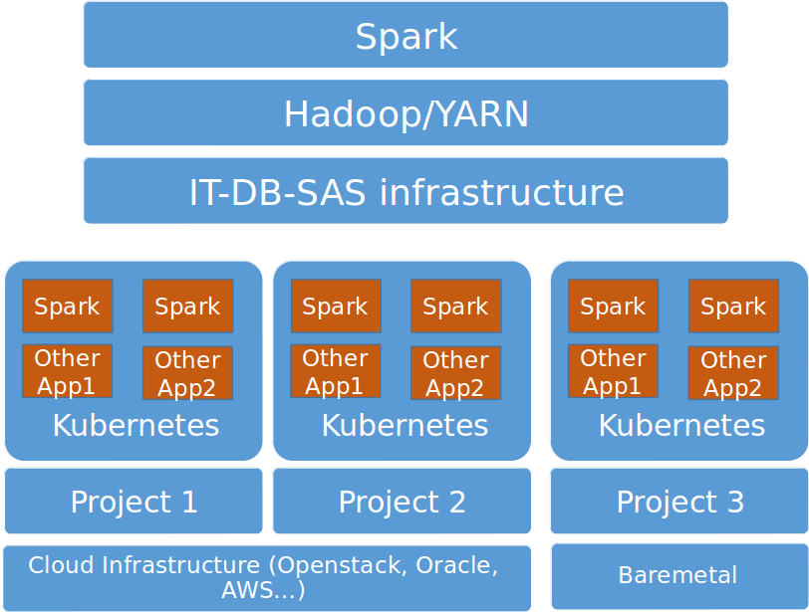
Spark on Kubernetes – Comparison to YARN
Spark on
Hadoop/YARN
Spark on
Kubernetes

Slide 14
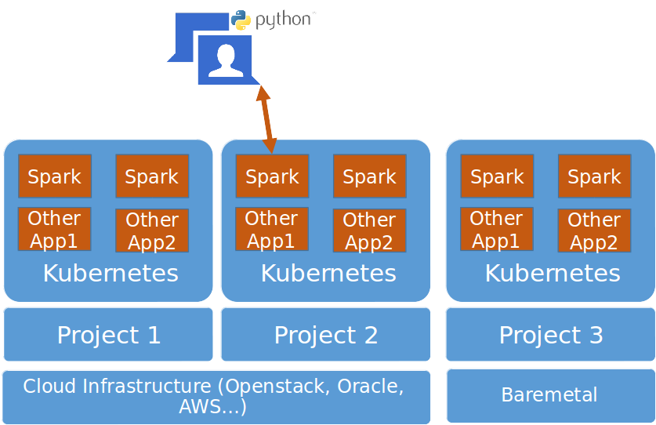
Spark on Kubernetes – How it works?
1. Create Kubernetes cluster and initialize its dependencies
3. Our docker images will deploy and run your Spark application
over Kubernetes as it was on Hadoop/YARN
2. Submit Spark jobs to Spark using cern-spark-submit python package installed with pip

Slide 15
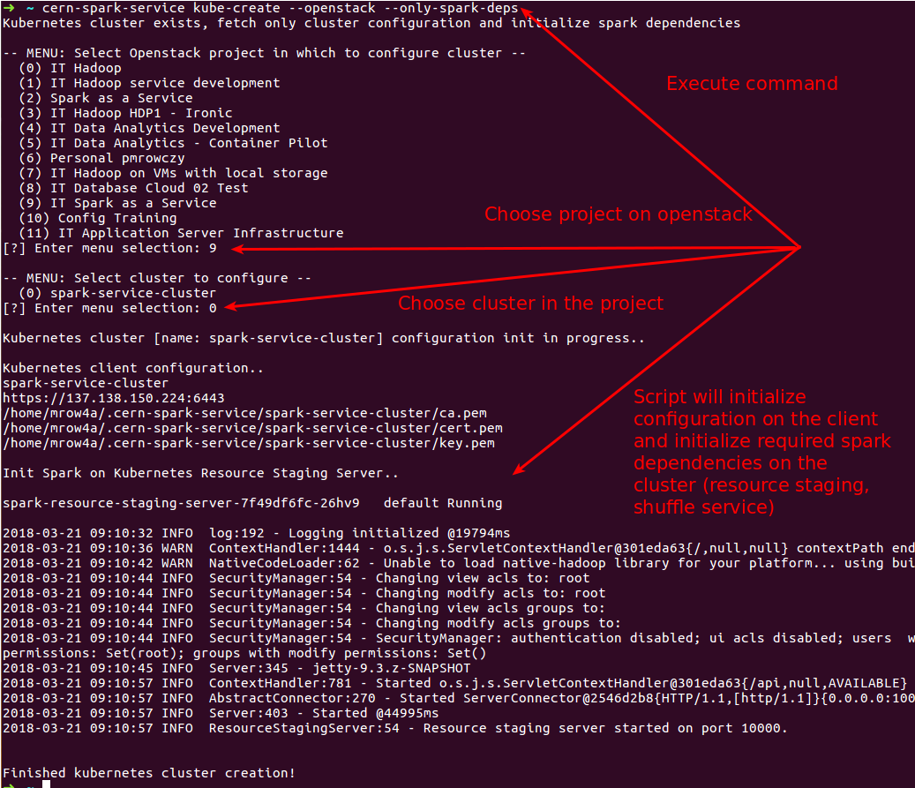

Slide 16
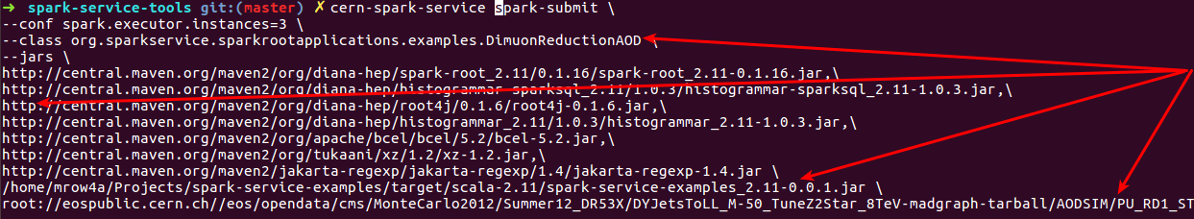

Slide 17
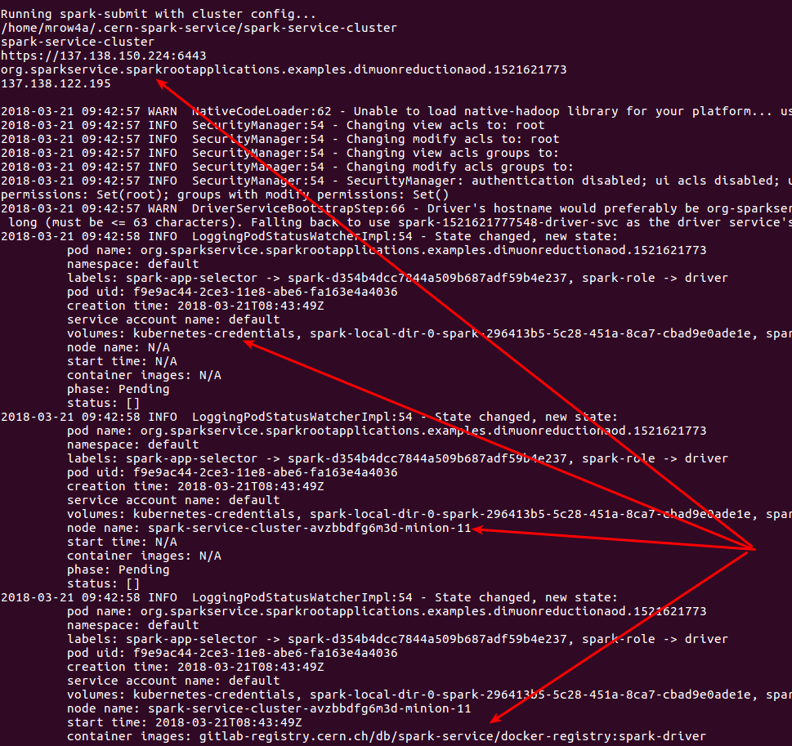

Slide 18
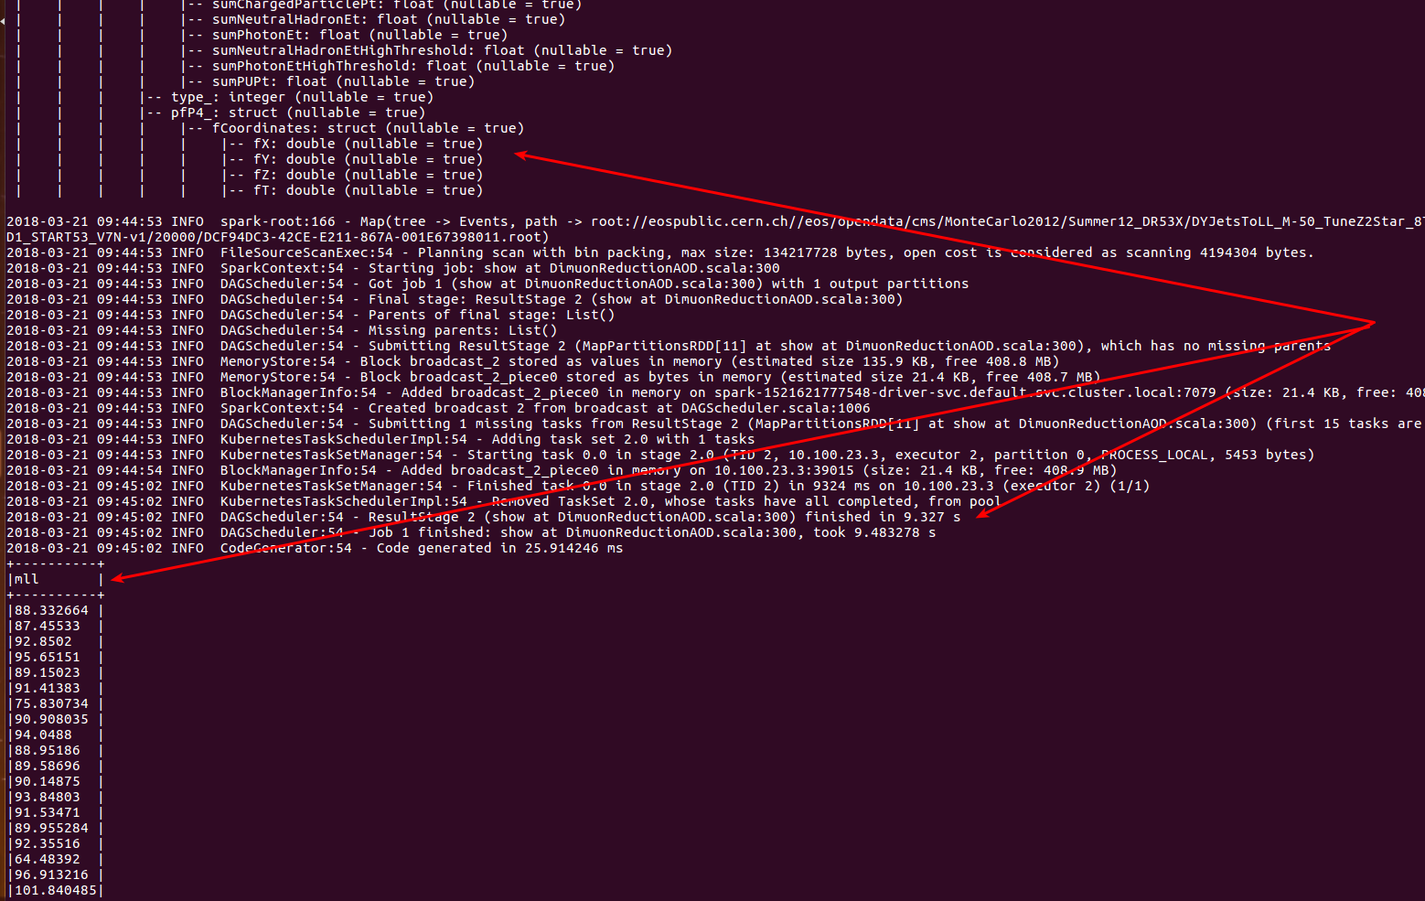

Slide 19
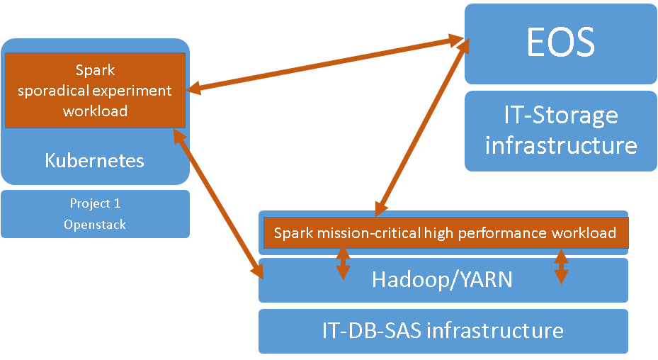
Spark on Kubernetes – why for this use case?

Slide 20
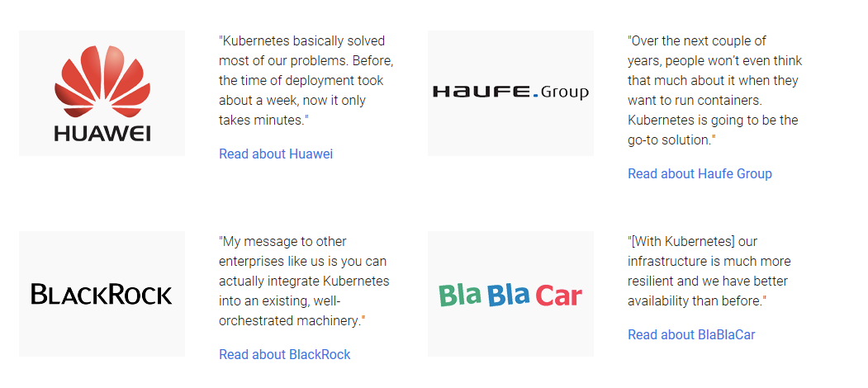
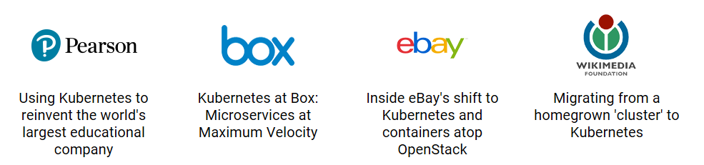
State of the art in the industry - Kubernetes

Slide 21




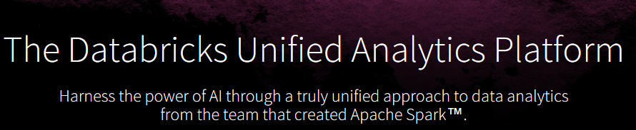
State of the art in the industry – Spark Service
Hops - Apache Spark and Tensorflow as a Service on YARN (Zeppelin and Notebooks integrated)

Slide 22
Spark on Kubernetes
Current state of the art for Spark at CERN
Future demand outlook – experiments and big data
Spark on Kubernetes
State of the art in industry
Current progress of Spark on Kubernetes
What next?

Slide 23
Current progress
Successfully deployed Spark on Kubernetes on OpenStack and built spark images and tooling
We prototyped and made a proof of concept. Able to run root file analysis on EOS
Work on the cern-spark-service package - https://pypi.python.org/pypi/cern-spark-service (installation with pip install --upgrade cern-spark-service)

Slide 24
Next Steps
April 2018 – Allow creation of spark-on-kub cluster on OpenStack and run spark workloads accessing EOS and HDFS (including necessary auth). Further improve usability of tooling.
May 2018 – Make spark-submission compatible with Kubernetes on baremetal / Helix Nebula test.
June 2018 – Benchmarks, fixes and adjustments to run large scale workloads
December 2018 – Multi tenancy on Spark-on-kub cluster
December 2018 – Integration of Spark as a Service with SWAN

Slide 25
Thank you!
Questions?
Current state of the art for Spark at CERN
Future demand outlook – LHC experiments and big data
Spark on Kubernetes
State of the art in industry
Current progress of Spark on Kubernetes
What next?

Slide 26
Spark on Kubernetes – Conclusions
Spark on Hadoop/YARN:
good for production, high-availability workloads
infrastructure, service and software stack maintaned by IT-DB-SAS
adding/removing physical machine is not that trivial
Spark on Kubernetes:
allows extreme scale and sporadical workloads on your own project resources (Openstack, Cloud, Baremetal).
shutdown and create on demand via Kubernetes over Openstack / Cloud
lacks in performance and reliability (assumption), not suitable for continuous workloads

