Slide 1
IR Layout and mechanical integration issues

Slide 3
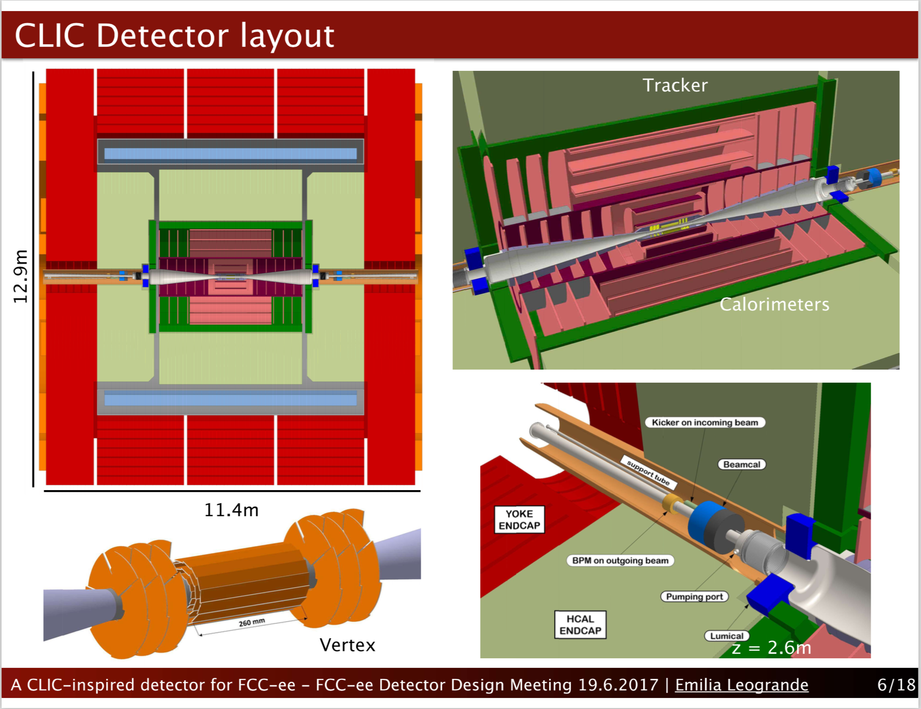

Slide 4
M. Sullivan, NEW updated IR Layout
from 2nd Mdi workshop (Jan.30-Feb.9, ’18)
https://indico.cern.ch/event/694811/

Slide 5
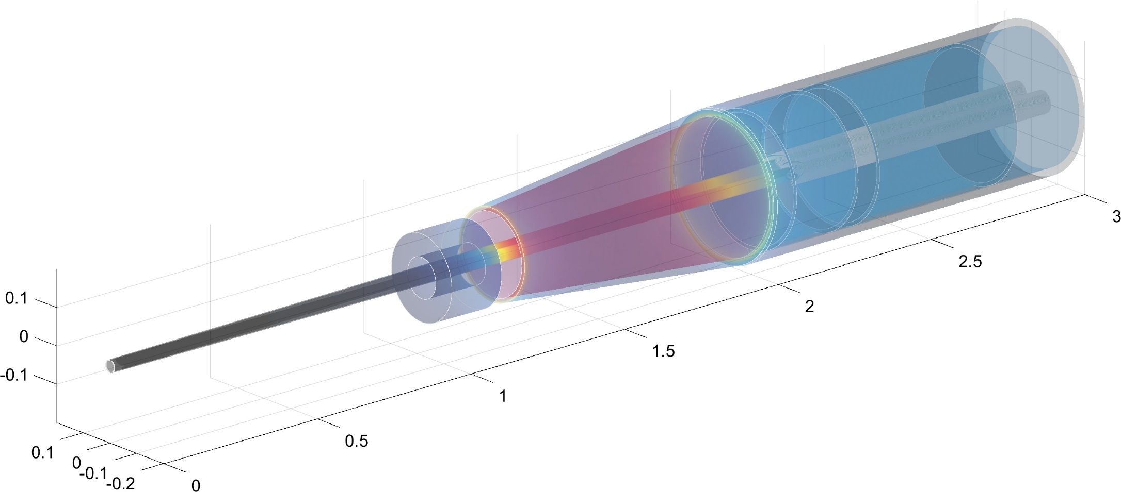
The IR 3d view with magnets and lumical
2st MDI workshop , Jan. 2018
radius 200 mm
screening solenoid
radius 122m
Final focus quads
Compensating solenoid
lumical
1.99
2.00
1.074
1.190
1.25
  detector solenoid dimensions 3.76m ( inner radius) (outer radius 3.818m) × 4m (half-length)
  drift chamber at z=2m with 150 mrad opening angle (IDEA design)

Slide 6
Layout
1st MDI workshop , Jan. 2017
1.2 m
Luminometer
QC1R1_1
QC1R1_2
1 m
Compensating
Solenoid
Screening
Solenoid
1.25 m
Defocusing
Quads
2.01 m
1.84 m
2.16 m
2.2 m
QC1R1_1: L= 0.7 m, K1=-75 / -75 T/m, R = 0.015 m
QC1R1_2: L= 1.4 m, K1=-173 / -166 T/m, R = 0.0175 m

