Slide 1
PS status
H. Damerau, A. Guerrero, F. Tecker on behalf of PS operations and supervisor team

Slide 2
Status of beams beams
Fixed target beams | Status | Comment
EAST Irrad/North | Operational | With parasitic TOF
MTE | Operational | Delivered to SPS at ~4.5 ∙ 10¹² ppp, tested up to ~1.8 ∙ 10¹³ ppp
TOF | Operational | Up to ~7 ∙ 10¹² ppp
AD | Ready in PS | ~1.4 ∙ 10¹³ ppp
LHC-type beams | Status | Comment
LHCPROBE, LHCINDIV | Operational | LHCINDIV tested up to ~4 ∙ 10¹¹ ppb
LHC25 (12b, 72b) | Operational | Nominal intensity only, 1.3 ∙ 10¹¹ ppb
LHC25 BCMS (12b, 48b) | Ready in PS | Nominal intensity only, 1.3 ∙ 10¹¹ ppb
First machine developments (BGI studies) restarted

Slide 3
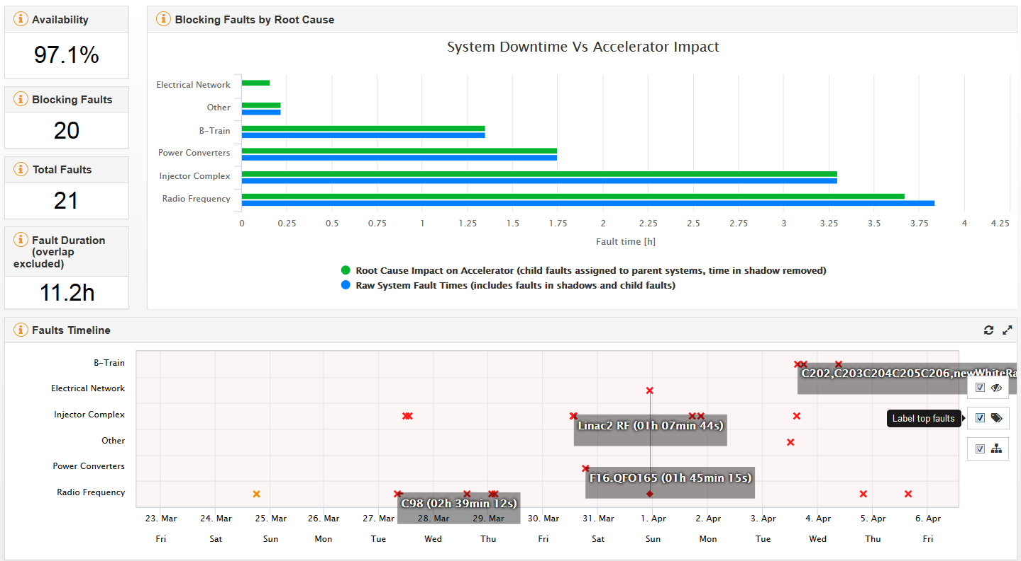
AFT, 23rd March – 6th April
6

Slide 4
PS status 23rd March – 6th April
Good week for the PS Complex with about 97% availability
Thursday, 30/03: Beam to TOF
Friday, 31/03: Beam on CHARM target
Linac2 ion pump
  1h15 downtime for all proton beams
Quadrupole power converter (F16.QFO165)
  1h45 downtime for all beams → reset of converter
Wrong field measurement intermittently stopping cycle execution
  ~1h downtime for all beams → reboot of field measurement

