Slide 1
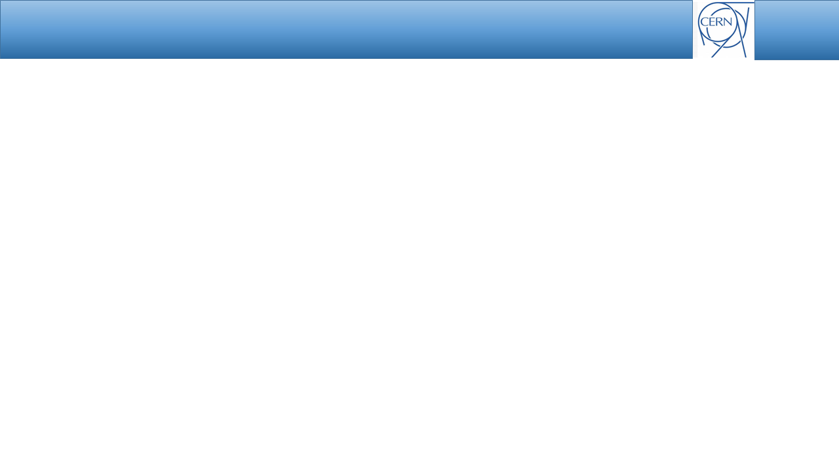
Parameters of the
quarter wavelength cavity
with on-axis tuner
for PS Landau system
Nasrin Esfahani
Many Thanks to : Heiko Damerau, Robyn Madrak (Fermi Lab), Cheng-Yang Tan (Fermi Lab), and William A Pellico (Fermi Lab)

Slide 2
Overview
Short survey of λ/4 cavities with on-axis tuner
Suitable RF (Q, R/Q) parameters
Design procedure
  TL (Transmission Line) based analysis
  CST Simulations
Selected Geometries and CST simulations
Vacuum related issues
Conclusions and Outlook

Slide 3
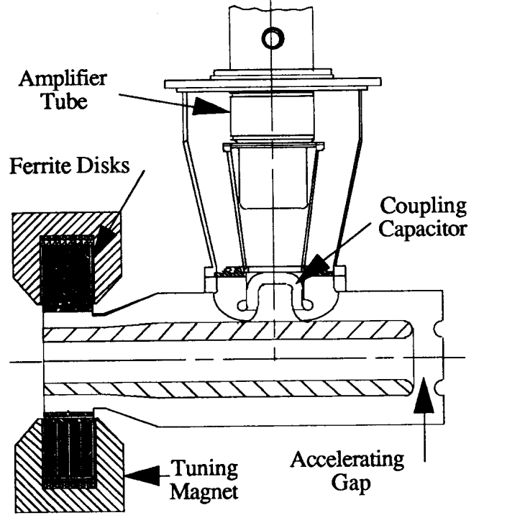
Short survey of λ/4 cavities with on-axis tuner(1)
Cavity | SSC LEB Cavity [1] | Fermi Lab 2nd Harmonic Cavity [2]
F (MHz) | 47-60 | 76-106
Vgap | 120 kV | 100 kV
Tuning range | 20% | 32%
R/Q | 32 | 32-42
Q | 5000 | 3200
Rshunt | 160 kΩ | 100 kΩ
L | 110 cm | 67 cm
P | 45 kW | <50 kW
μ -ratio | 1.5-4 | 1.5-3.5
[1] ieeexplore.ieee.org/document/164524/
[2] http://beamdocs.fnal.gov/AD-public/DocDB/ShowDocument?docid=6113

Slide 4
Short survey of λ/4 cavities with on-axis tuner(2)
Up to 50% of the effective cavity volume is filled with ferrite
Relatively large permittivity of ferrite miniaturize the cavity (up to λ/6 ) and
Removes the need for strong capacitive loading
Large volume of the ferrite provides large tuning ranges (20%-30%)

Slide 5
PS Landau Cavity
In contrast to the existing designs
Relatively small tunig range (5%) is not in favour of using Large volume of ferrite, therefore
Miniaturization (up to λ/8, if the 40 MHz options is considered¹ ) through capacitive loading is required
 | Landau 40 MHz
RF voltage | 50 kV_{p}
Frequency, f_{res} | 37.98…40.05 MHz
Tuning range | Ferrite tuner, 5%
Geometrical parmeter, R_{S}/Q₀ | 30 Ω
quality factor, Q_{u} | >2000
Total length | 1 m
1. In this presentation we will concentrate on 40 MHz option, the 30 MHz option will also be treated.

Slide 6
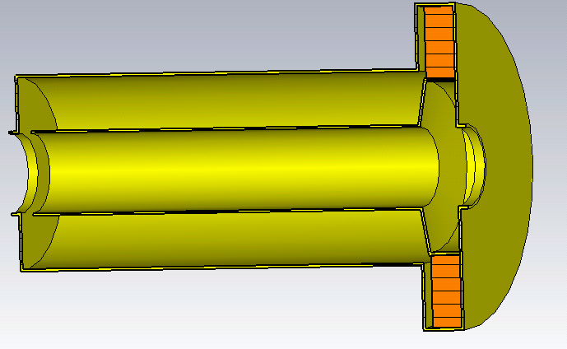
Design Procedure
Using TL analysis l to determine the required capacitive & ferrite loading
Simulations in CST to confirm the results of TL approach
Vacuum related considerations to modify the design
l_{v}
l_{f}
R_{of}
C_{g}
l_{v}
l_{f}
R_{ov}
R_{if}
R_{iv}
𝜀₀, μ₀, Z₀
𝜀_{r} , μ_{r} , Z_{f}

Slide 7
TL Analysis Results (1)
Scaled Fermi-Lab design+capacitive loading
Our design
Design Parameters | Scaled Fermi-Lab design+ capacitive loading | Our design
Lf (cm) | 11 | ₆
Lv (cm) | 77 | 88
Rif (cm) | 13.4 | 16
Rof (cm) | 34.6 | 30
Riv (cm) | 7.5 | 7.5
Rov (cm) | 16 | 18
RF Parameters | Scaled Fermi-Lab design
f (MHz) | 38-52
Tuning range | 31%
R/Q | 39
C_{g}
l_{v}
l_{f}
𝜀₀, μ₀, Z₀
𝜀_{r} , μ_{r} , Z_{f}

Slide 8
TL Analysis Results (2)
Scaled Fermi-Lab design+ capacitive loading
Our design
RF Parameters | Scaled Fermi-Lab design | Scaled Fermi-Lab design+Capacitive Loading | Our design
f (MHz) | 38-52 | 37.49-44.87 | 37.94-40.14
Tuning range | 31% | 18% | 5.7%
R/Q | 39 | 43 | 40

Slide 9
PS Landau Cavity vs. PS 40 MHz Cavity and Tunable Cavities
RF Parameters | SSC LEB Cavity [1] | Our Design | PS 40 MHz
f (MHz) | 47-60 | 37.94-40.14 | 40.053
Tuning range | 20% | 5.7% | Fixed Frequency
R (kΩ) | 160 | 256 | 330
R/Q | 32 | 40 | 33
Q | 5000 | 6400 | 10000
Vgap (kV) | 120 | 50 | 300
P (kW) | 45 | 5 | 140
[1] ieeexplore.ieee.org/document/164524/

Slide 10
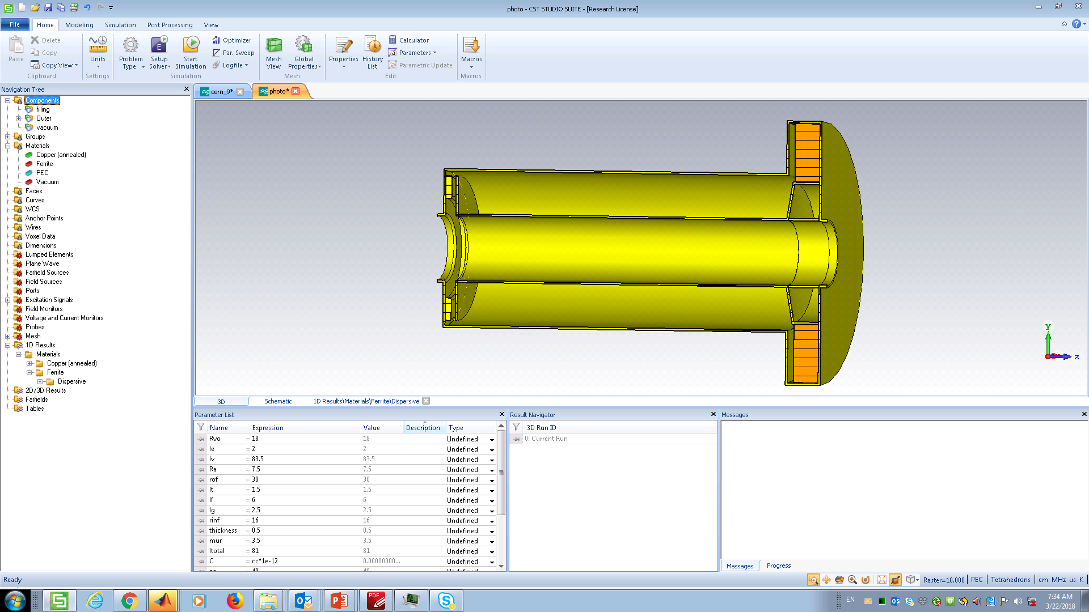
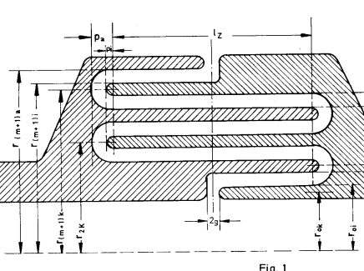
PS Landau Cavity; CST Model
Case 1: Gap : C<10pf
Case 2: C>10 pf
for C>60 pf we are limited by vacuum breakdown, if the simple structure of case (2) is used.
Using interdigital capacitances [1] can resolve this issue
Case 1 Case2
g
interdigital capacitance [1]
Case 1 Case 2
[1] The radio frequency system for the Positron –Intensity- Accumulator, internal DESY report-79/28

Slide 11
CST Model vs TL Analysis
RF Parameters | TL Analysis | CST Model
f (MHz) | 37.90-40.14 | 37.63-40.1
Tuning range | 5.7% | 6.3%
R/Q | 40 | 43
Q | 6600 | 6400
l_{v}
l_{f}
C_{g}
𝜀₀, μ₀, Z₀
𝜀_{r} , μ_{r} , Z_{f}
The CST model settings is in close correspondence with the CST model of FNAL colleagues.

Slide 12
Conclusions
Using TL approach dimensions and the required capacitive loading is calculated considering
  Tuning range of F=37.98-40.05 MHz
  L=1 m
  R/Q of around 30-40
Results of TL analysis is used to construct the CST model
Agreement between CST and TL approach (required tuning range can be realized)

Slide 13
Outlook
Risk of vacuum related issues will be resolved using interdigital capacitance
Effect of the power module will be added to the analysis
Practical consideration regarding the geometry of the Ferrite/Garnet

Slide 14
Thank you for your attention!

