Slide 2
Discussions with Fermilab and MD studies in view of Landau RF system
H. Damerau
PS Landau RF System Study Group
22/03/2018

Slide 3
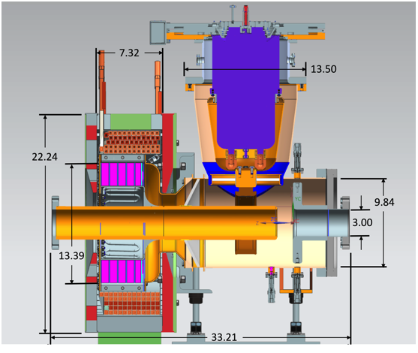
Discussions with Fermilab
λ/4 resonator with perpendicular ferrite biasing on axis
Skype chat with Robyn Madrak, Bill Pellico, Cheng-Yang Tan
  Push technical limits to achieve ~100 kV gap voltage, frequency range 75…106 MHz
  Garnet material: AL800 (National Magnetics Group, only vendor), μ ≈ 1.5…3.5, ring sectors
  HOM cavity to suppress higher-order line resonances
  No fast feedback around amplifier and no passive gap short-circuit
  Installation of 2nd prototype cavity in the FNAL Booster this year
FNAL Booster 2nd harmonic RF
Scaling simplified FNAL → PS design to ~46 MHz by R. Madrak using CST
  R_{shunt}: ~100 kΩ → ~180 kΩ
  R/Q: ~32 Ω → ~41 Ω
  Tuning range: ~30%
  Twice larger ferrite rings
Next Skype meeting with larger participation from CERN
C.Y. Tan et al, FNAL design document (link)

Slide 4
Status of cavity options
λ/4 resonator with on-axis tuner
  Nasrin working on simulations and modeling of cavity
Finemet-based cavity
  Ideas by Mauro: Use Finemet with ‘compensated’ capacitance
  Test with PSB cell: R_{shunt} ≈ 400 Ω per cell at 40 MHz, ~15…30 kV/m, bandwidth adjustable according to needs
Vaccum resonator with external tuners
  No estimates yet

Slide 5
Some initial questions
  Preference 30 MHz/40 MHz for LHC-type beams?
  Benefit of extending frequency range below transition?
  Worth including the options of h = 64?
  Tunable narrow-band cavity versus wide-band system?
  Basic cavity and amplifier parameters: R/Q, Q, amplifier coupling?
  Cavity types feasible in standard short straight section?
  Particularities of feedbacks compared to existing RF systems?
  Try to find answers without launching detailed simulations
    Estimates/scalings for beam dynamics questions
    Cavity/amplifier/feedback based on experience, literature, simple models (e.g, transmission line, lumped elements)
Cavity parameters usable for first beam dynamics estimates?
Also usable to start amplifier and feedback estimates?
Simulations started for λ/4 resonator with on-axis tuner

Slide 6
Input from MDs for RF system parameters
40 MHz cavity as Landau RF system
  Re-check capabilities with new anode power supplies
  Try quadrupole damping during the ramp
  Show damping during part of the ramp
Stabilization with 20 MHz, 40 MHz (and 80 MHz)
  Confirm beam stability from synchrotron frequency spread for different harmonic number ratios
  Relevant for choice 30 MHz or 40 MHz
Quadrupole coupled-bunch measurements with 21 bunches
  Full machine may give clearer idea of driving impedance
  No direct impact of Landau RF system parameters expected

Slide 7
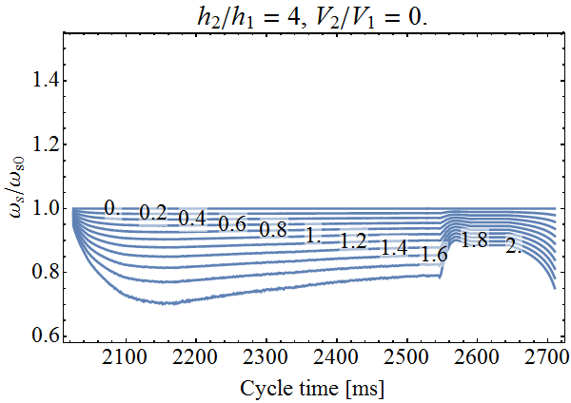
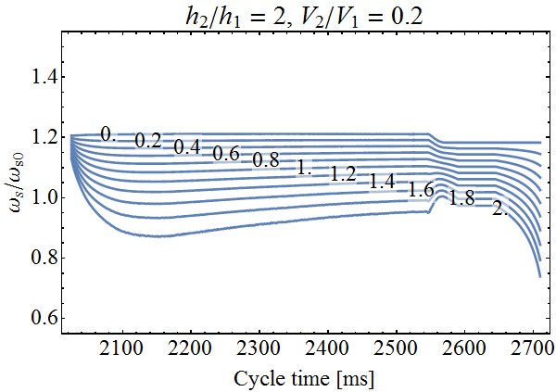
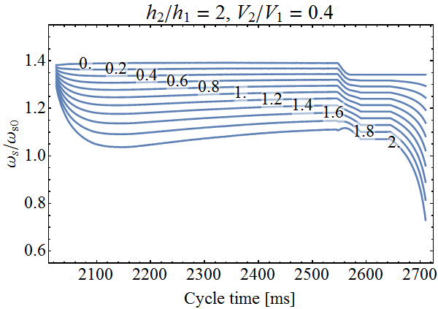
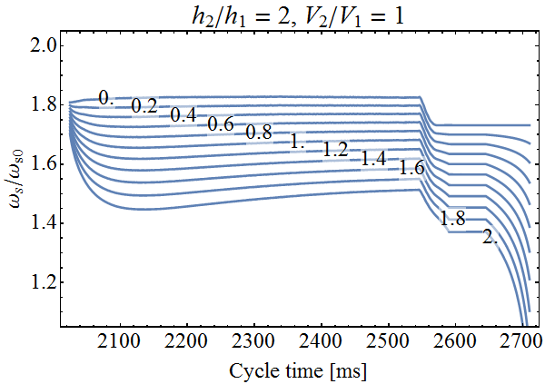
Tests with existing RF installations
  Synchrotron frequency spread versus emittance
Transition
Arrival at flat-top
  Stabilization with 10 MHz/20 MHz at large voltage ratios?
  Important input for 30 MHz or 40 MHz choice → MDs early

Slide 8
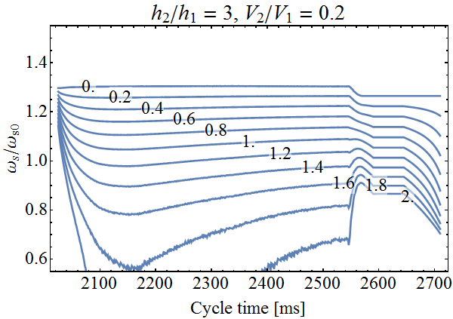
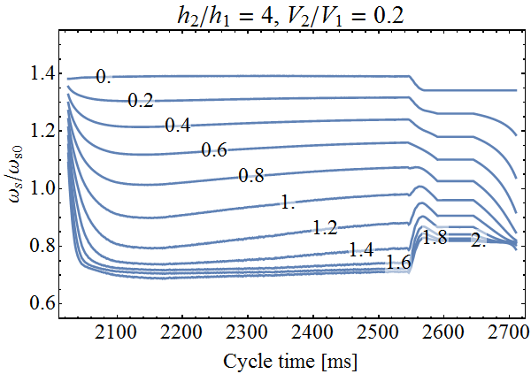
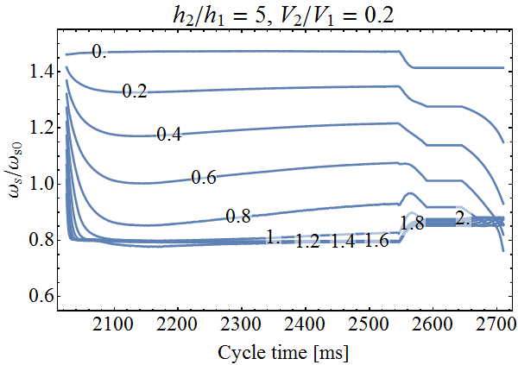
Possible harmonic number ratio
  Synchrotron frequency, f_{s}, spread versus emittance
Transition
Arrival at flat-top
  2nd harmonic too inefficient for significantly increase f_{s} spread
  Keep only 3rd (30 MHz) and 4th (40 MHz) options

Slide 9
References
  Collection of documents (please contribute) of existing systems, e.g., also including technical drawings of the LAMPFII cavity:
  \\cern.ch\dfs\Departments\AB\Groups\RF\Machines\PS\LIU\LandauRFSystem\Literature
  Detailed description of development at Fermilab:
  http://beamdocs.fnal.gov/AD-public/DocDB/ShowDocument?docid=6113

Slide 10

THANK YOU FOR YOUR ATTENTION!

