Slide 1
Technology challenges: Superconducting accelerator magnets
PART II/II
Daniel Schoerling
daniel.schoerling@cern.ch
2nd and 3rd of July 2018
Summer Student Lecture
Thanks to many colleagues, in particular Paolo Ferracin for the material they have given to me

Slide 2
Part II/II
Part I
Superconductivity
Electromagnetic coil design
Coil manufacture
Part II
Margins and quench protection
Structural design and assembly
Testing
Outlook, what brings the future?

Slide 3
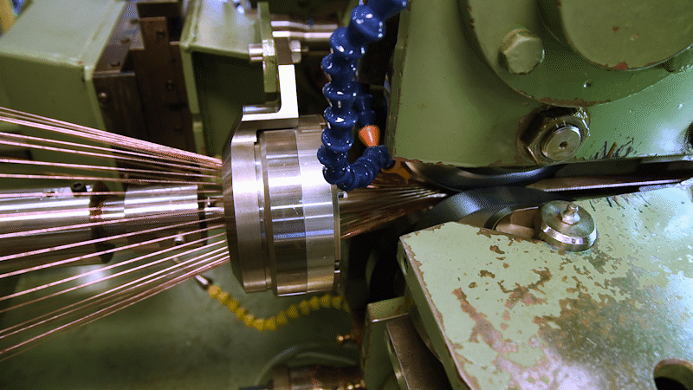
Recap from last lecture
Technical low-temperature superconductors (Nb-Ti, Nb₃Sn) are multifilamentary wires
Rutherford cables are made of typically out of ~30-40 wires
Insulation: polyimide (Nb-Ti), S2-glass/mica (Nb₃Sn)
Electromagnetic coil design to optimize the field quality
Courtesy of GL Sabbi
CERN machine: up to 40 strands, and up to ~5 m/min

Slide 4
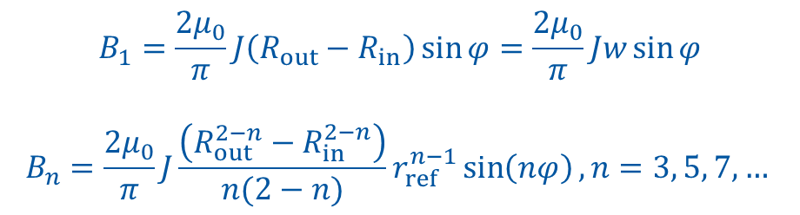
Recap Magnet design
The field can be expressed as (simple) series of coefficients
So, each coefficient corresponds to a “pure” multipolar field
Dipole
$$B_{1}=\frac{2μ_{0}}{π}J\left(R_{out}−R_{in}\right)\sin{φ}=\frac{2μ_{0}}{π}Jw\sin{φ}$$
$$B_{n}=\frac{2μ_{0}}{π}J\frac{\left(R_{out}^{2−n}−R_{in}^{2−n}\right)}{n(2−n)}r_{ref}^{n−1}\sin\left(nφ\right), n=3, 5, 7,…$$

Slide 5
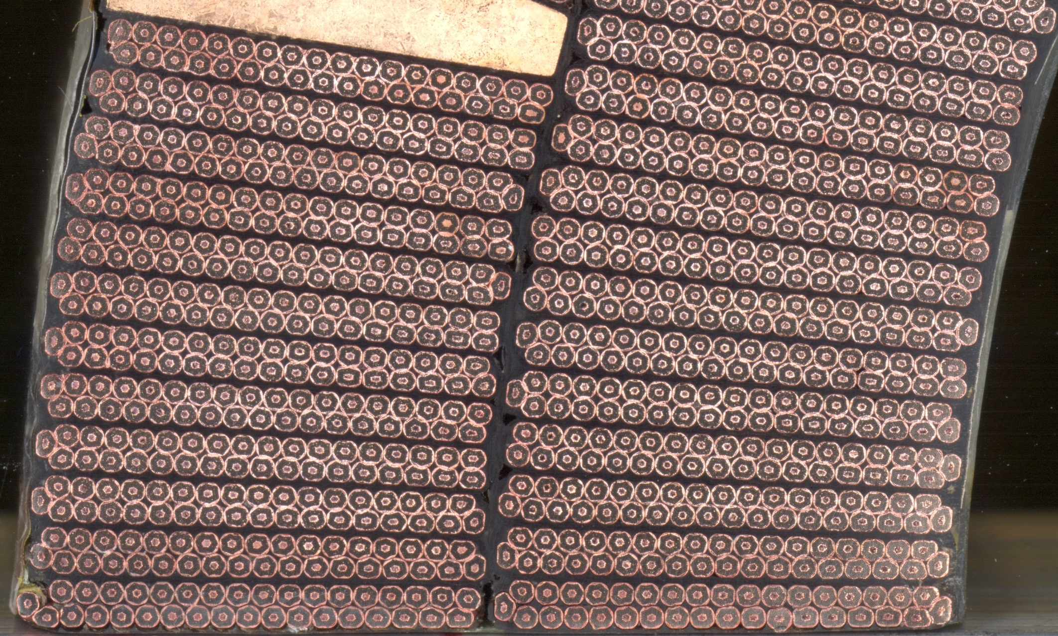
How much superconductor is in the cable?
Filling ratio: 0.25-0.3

Slide 6
How to select the J in the coil?
LHC main dipole at nominal operation:
B_{op} = 8.33 T, I_{op} = 11 850 A, J_{eng} = ~450 A/mm²

Slide 7
How to select the J in the coil?
Why margins?
Reach design field
Limit number of training quenches
Avoid quenches during operation
Margins:
Load line margin
Temperature margin
Current margin
How to select the margins? Typically, designs are done for load line margin (LHC & FCC: 14%)
How is it selected? Empirically: long discussions and many prototypes!

Slide 8
Margin on the load line

Slide 9
Temperature margin

Slide 10
Coil design
Question: A magnet shall reach a bore field of 16 T with a load line margin of 14% (example of FCC).
What is the field this magnet could potentially reach?

Slide 11
Circuit protection
LHC MBs are powered in 8 sectors, each with 154 MBs
The stored energy is 1.1 GJ:
→Corresponds to the kinetic energy of a fully loaded jumbo jet at start

Slide 12
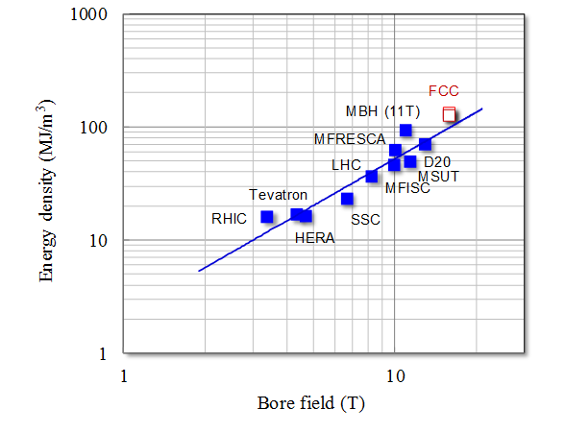
Magnet quench protection
In case a quench occurs, the stored energy does not allow to be extracted within the required time (few tens of ms): too large voltages (several kV-MV, depending on the circuit) would be required
U = LdI/dt (LHC MB: L = 98.7 mH/magnet, I =11.85 kA)
    →A discharge in 0.1 s would yields a voltage of ~12 kV
Alternative: stored energy is damped into the entire magnet by quenching it: upper theoretical limit can be calculated with adiabatic model

Slide 13
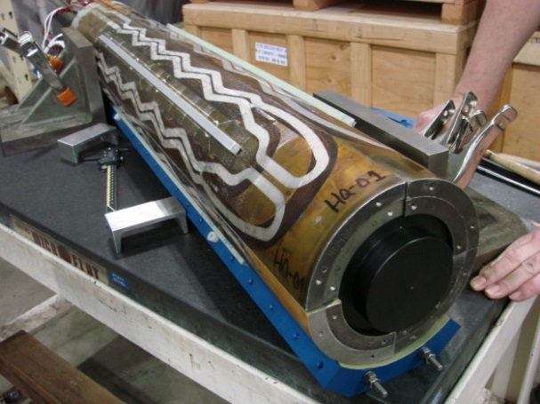
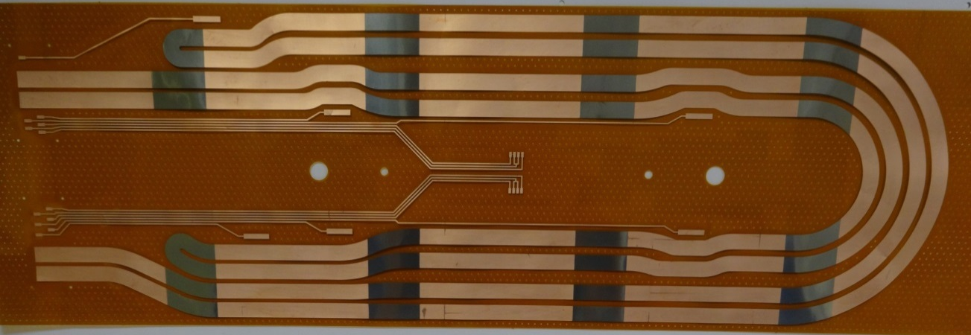
Quench heater
In case a quench is detected, the magnet will be quenched (brought to normal conducting) within ~40 ms everywhere
The final peak temperature for a given magnet depends on the time span to quench the magnet and the stored energy density

Slide 14
How to protect the magnets?
Which parameters determine the final temperature after quench of a magnet connected in series and operated at nominal field?

Slide 15

What is around the coils?
How do keep the coils in place despite the large forces?
How do we keep them cool?
How we ensure that they perform well in the tunnel: testing!

Slide 16
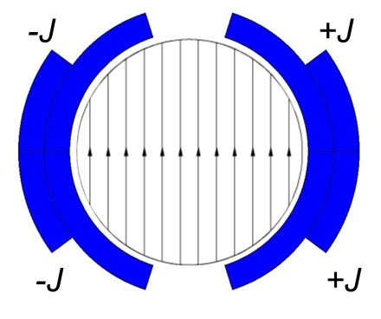
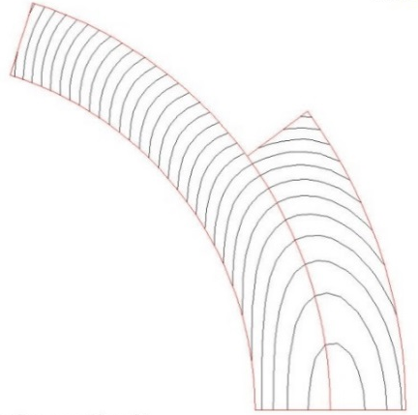
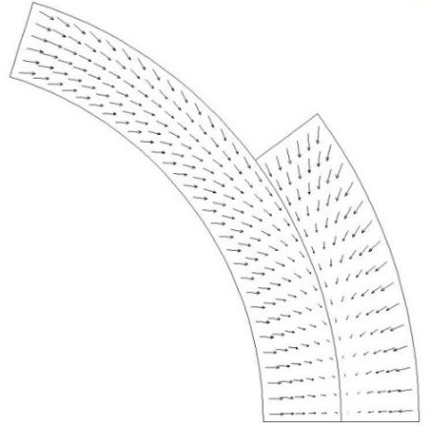
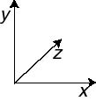

Mechanical structure
The e.m. forces in a dipole/quadrupole magnet tend to push the coil
Towards the mid plane in the vertical-azimuthal direction (F_{y} , F_{θ} < 0)
Outwards in the radial-horizontal direction (F_{x} , F_{r} > 0)
$$F∝B^{2}a$$

Slide 17
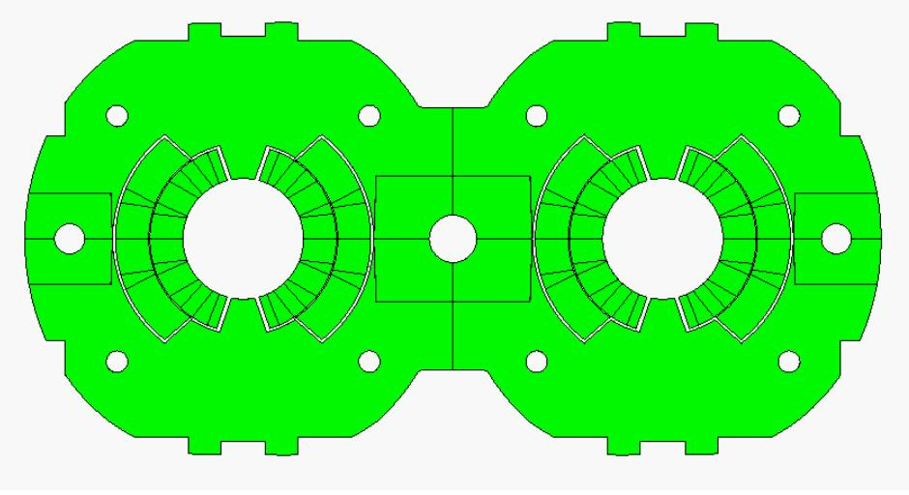
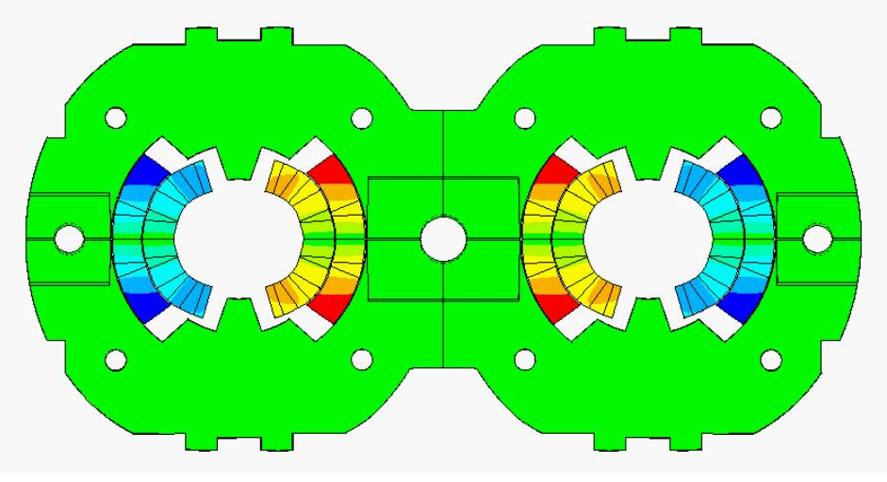
What to do to avoid movement and tensile stress?
Effect of e.m forces
change in coil shape: effect on field quality
a displacement of the conductor: potential release of frictional energy
Nb-Ti magnets: possible damage of polyimide insulation at~150-200 MPa.
Nb₃Sn magnets: possible conductor degradation at about 150-200 MPa.
All the components must be below stress limits.
LHC dipole at 0 T
LHC dipole at 9 T
Displacement scaling = 50

Slide 18
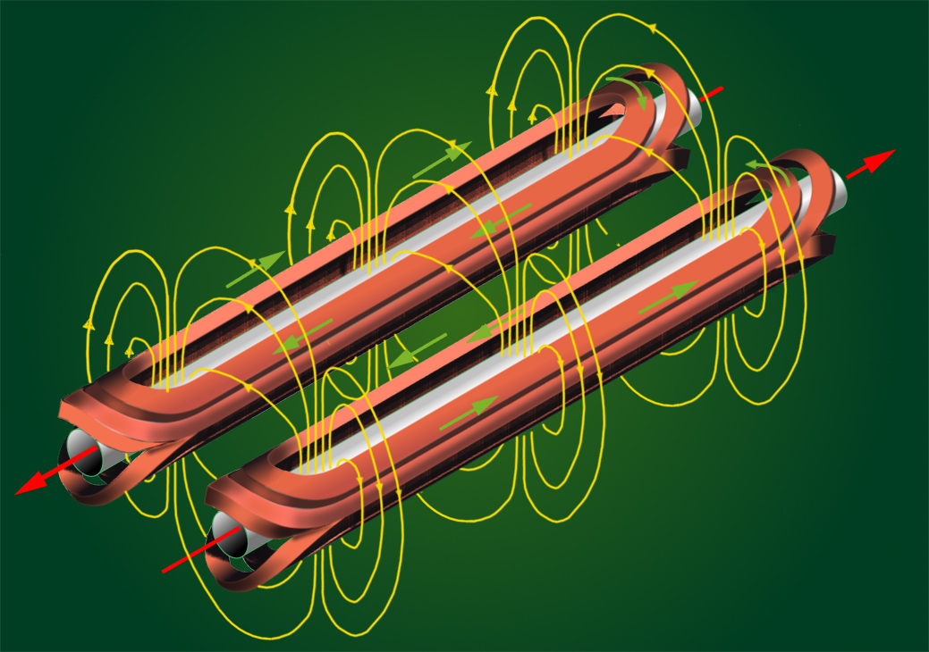
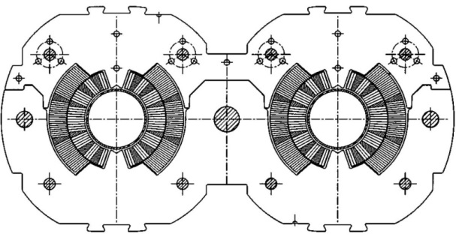
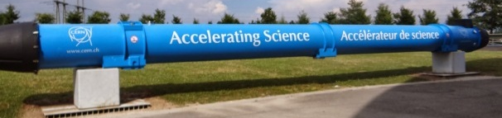
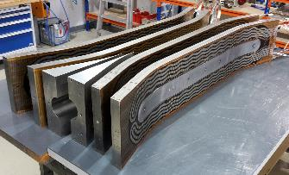
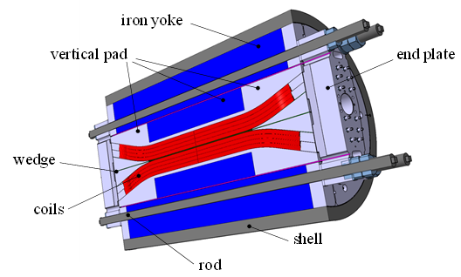
Mechanical structure: Examples
Nb-Ti LHC MB
Values for a central field of 8.33 T
F_{x} = 340 t per meter: ~300 compact cars/m
Precision of coil positioning: 20-50 μm
F_{z} = 27 t: ~weight of the cold mass
Nb₃Sn dipole (Fresca-2)
Values for a central field of 13 T
F_{x} = 770 t per meter and quadrant
F_{z} = 72 t/octant
These forces are applied to an objet with a
cross-section of 150x100 mm
and by the way, it is brittle

Slide 19

How to do to avoid movement and tensile stress?

Slide 20
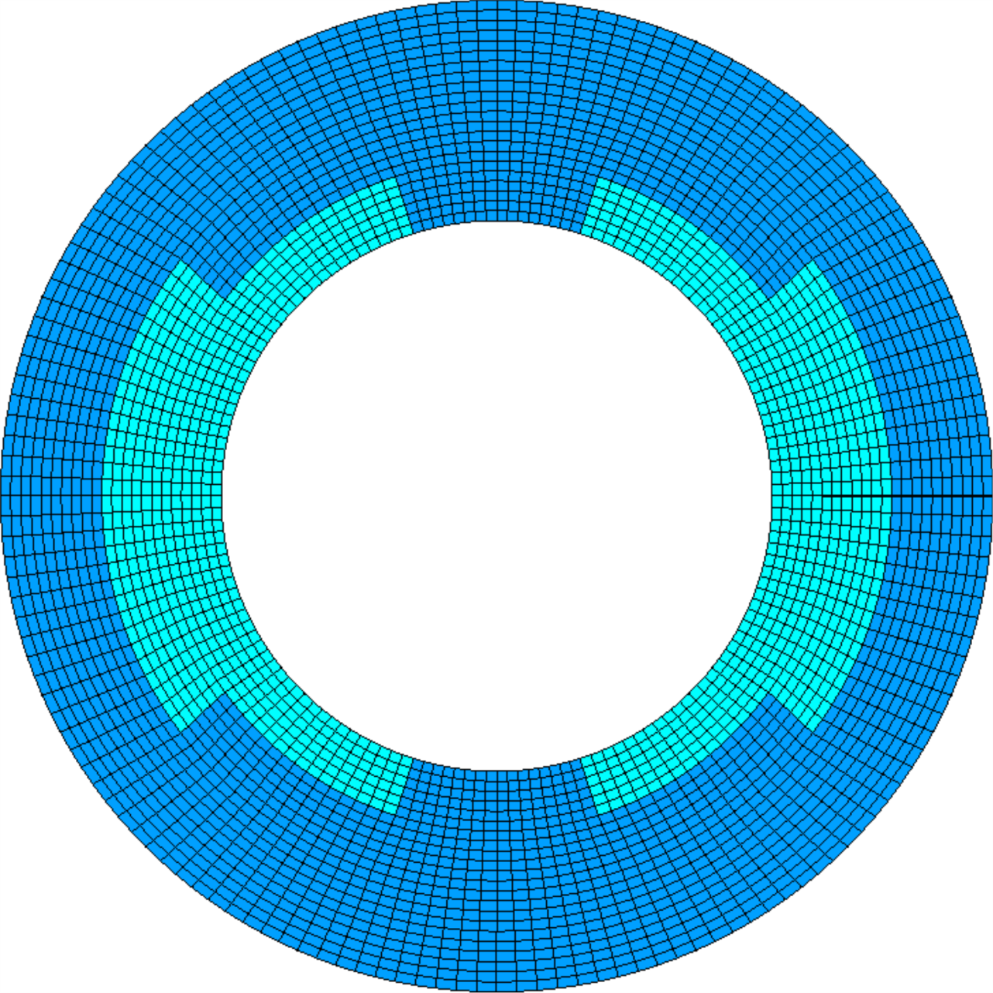
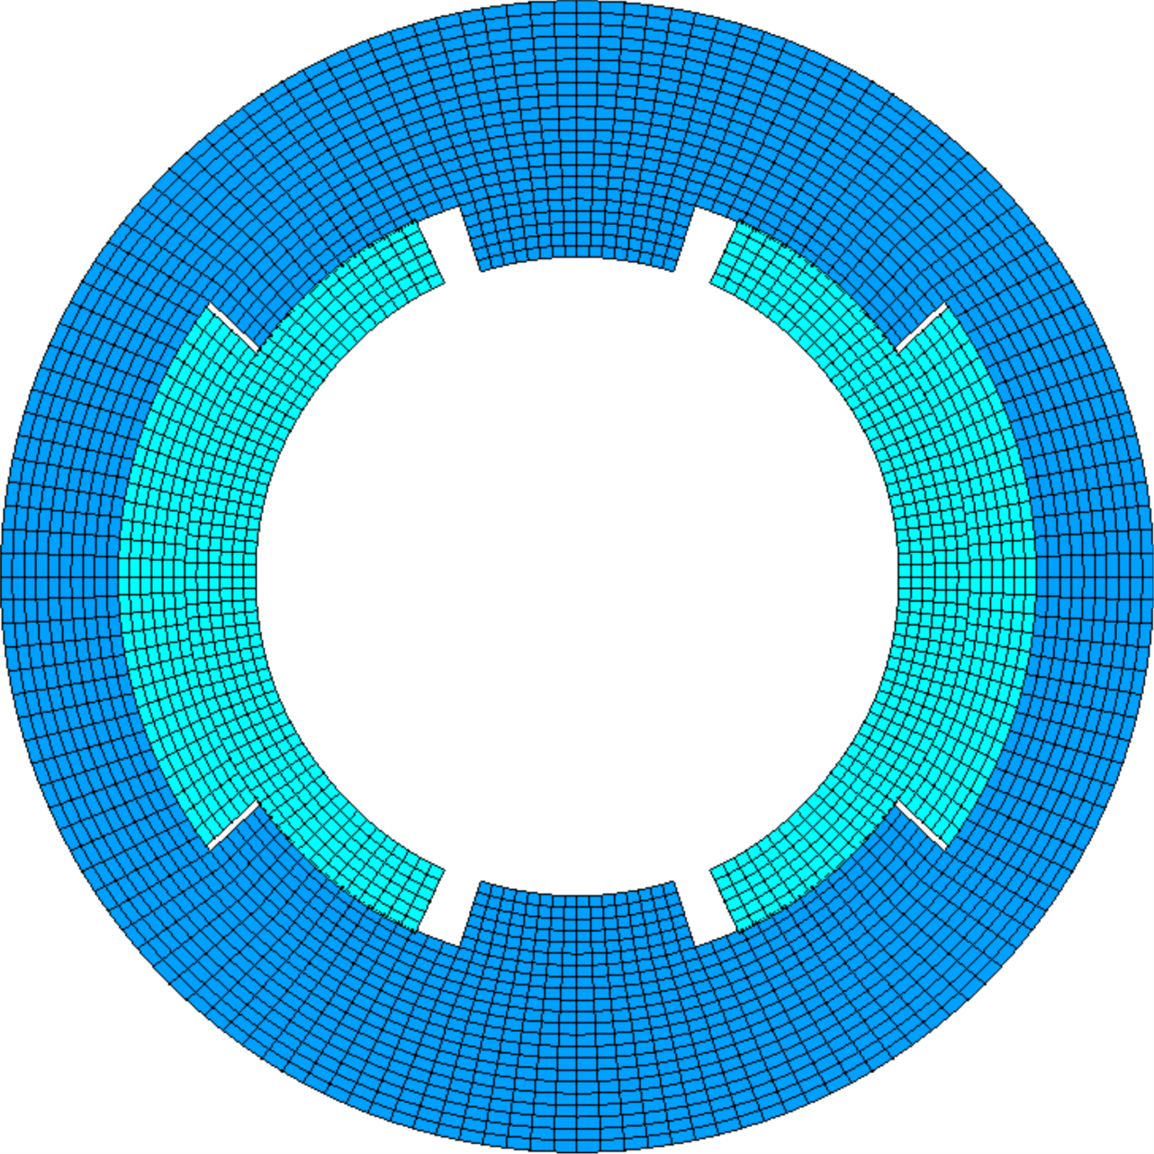
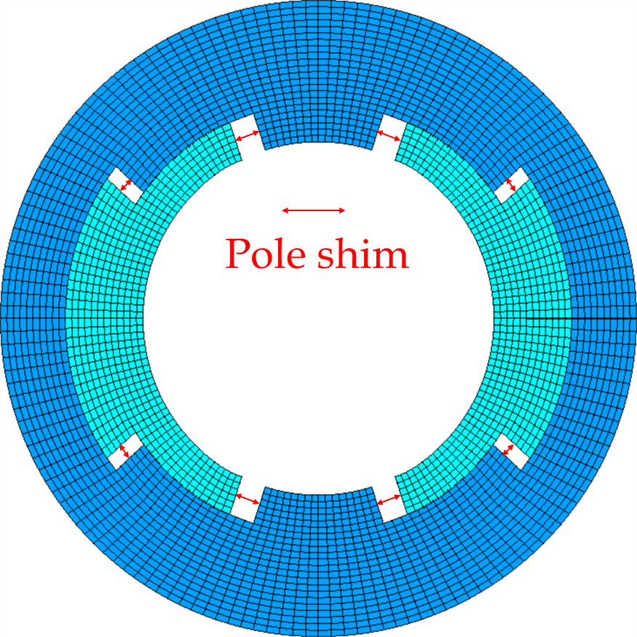
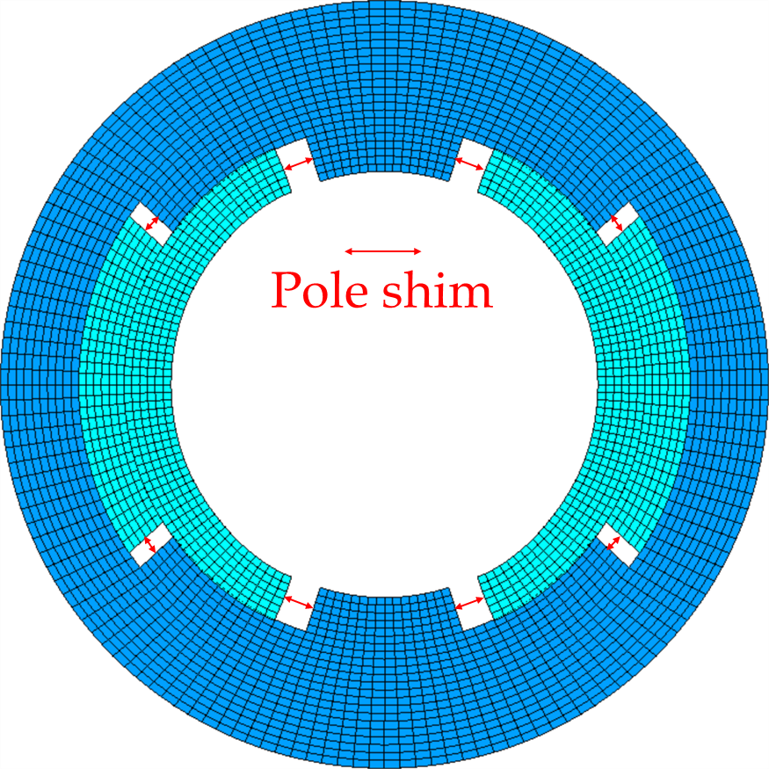
How to do to avoid movement and tensile stress?
No pre-stress
No e.m. force
No pre-stress
With e.m. force
Pre-stress
No e.m. force
Pre-stress
with e.m. force

Slide 21
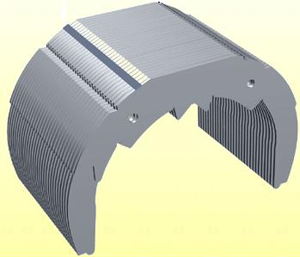
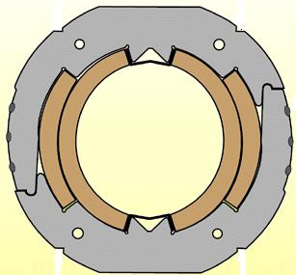
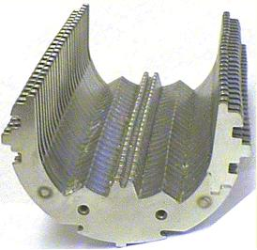
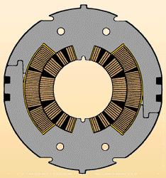
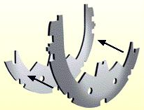
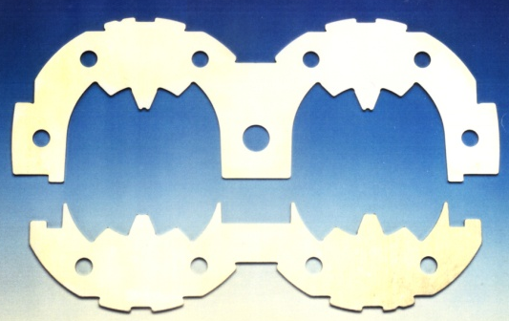
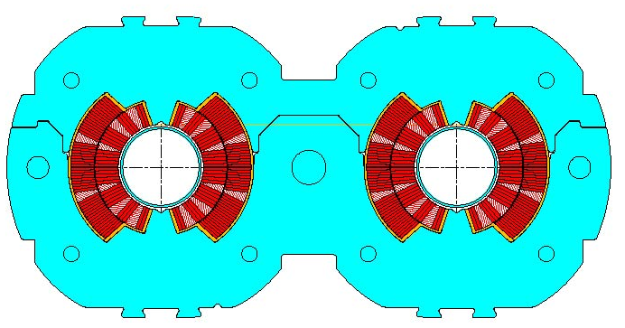
Mechanics of superconducting magnets: Collars
Tevatron
Implemented for the first time in Tevatron, since then, almost always used
Composed by stainless-steel or aluminium laminations few mm thick.
By clamping the coils, the collars provide
  coil pre-stressing;
  rigid support against e.m. forces
  precise cavity
SSC
LHC

Slide 22
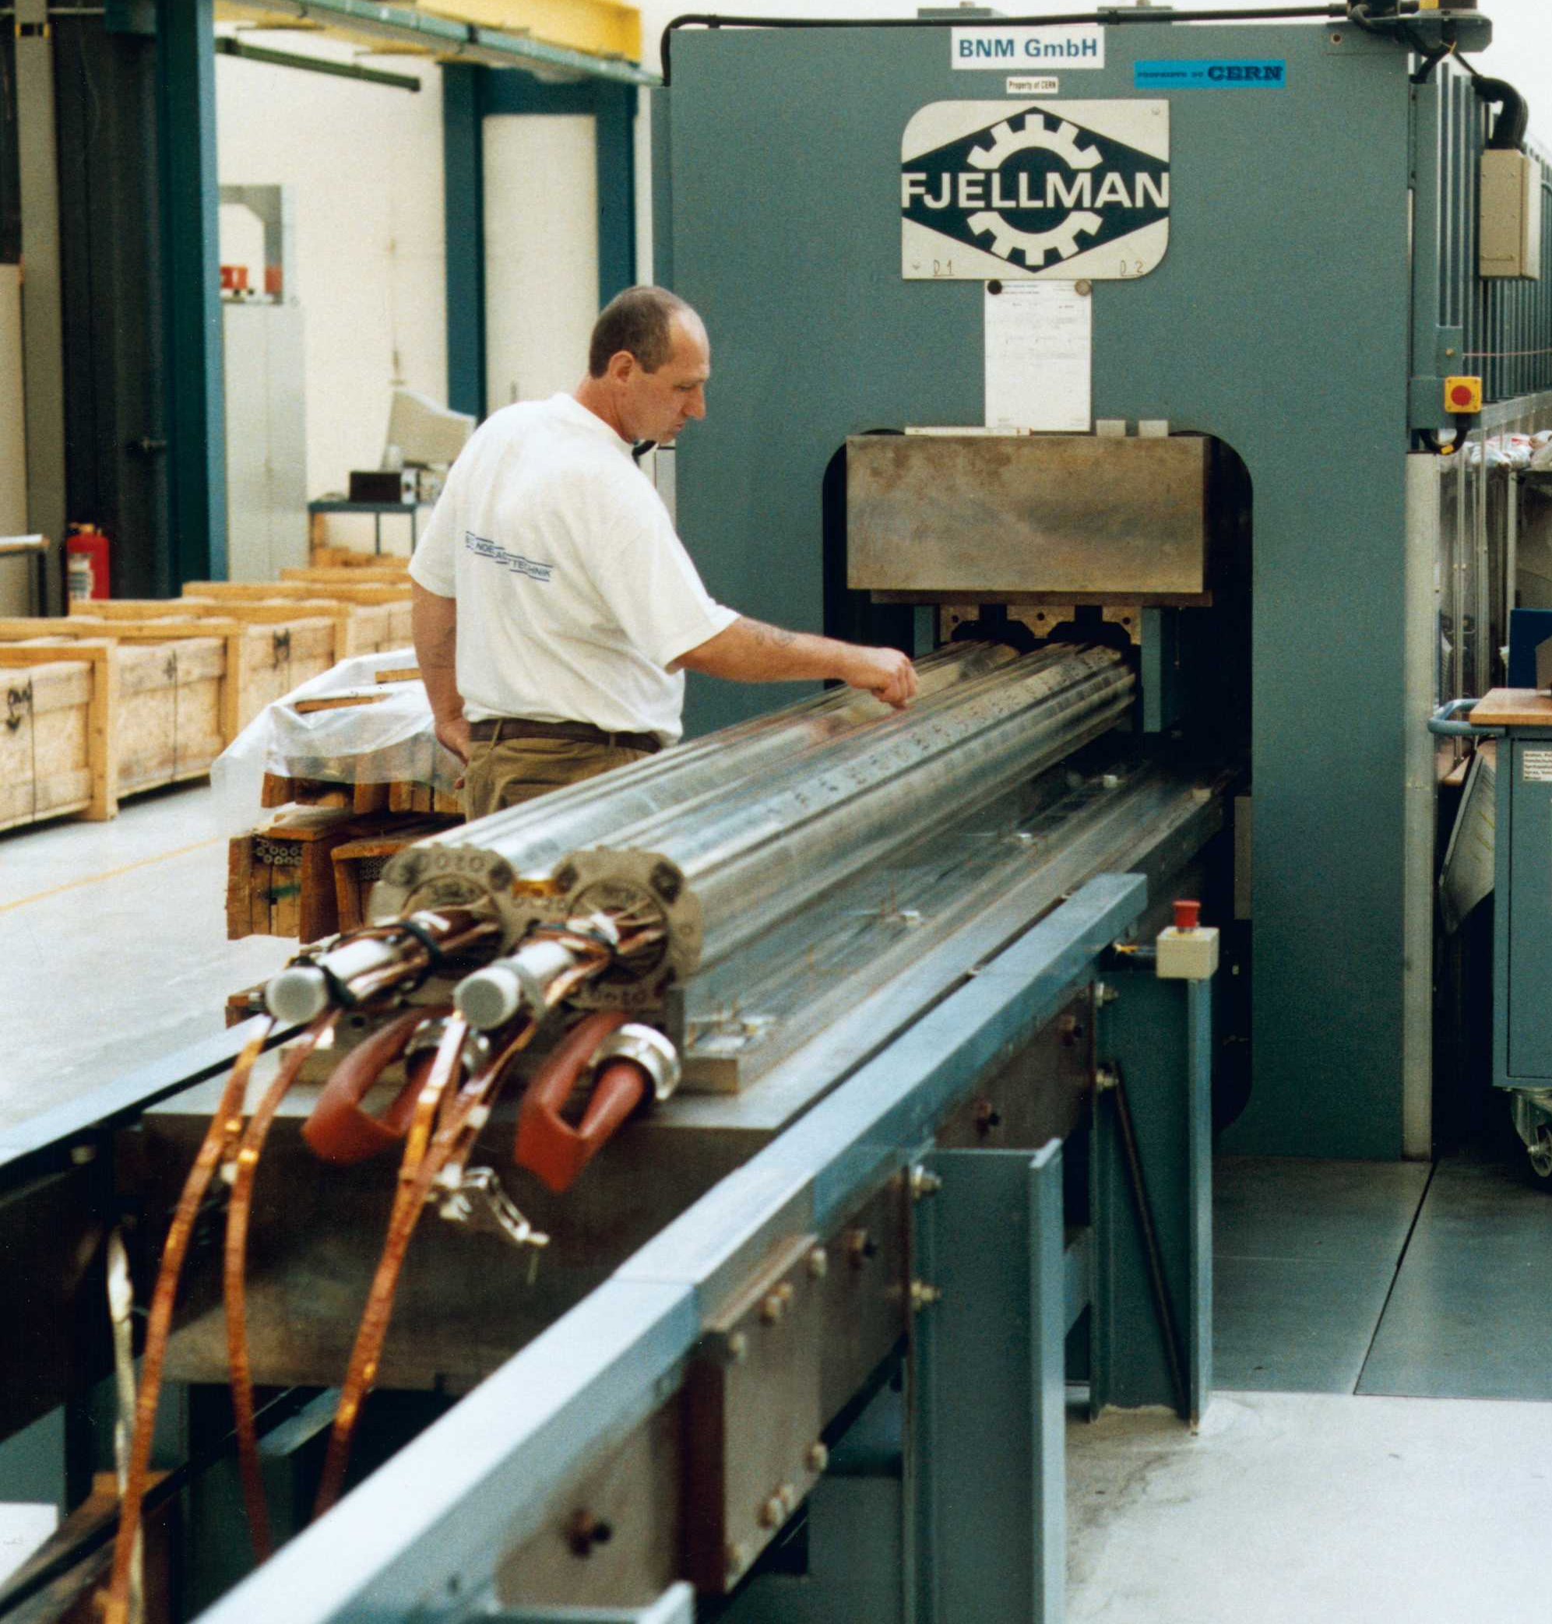
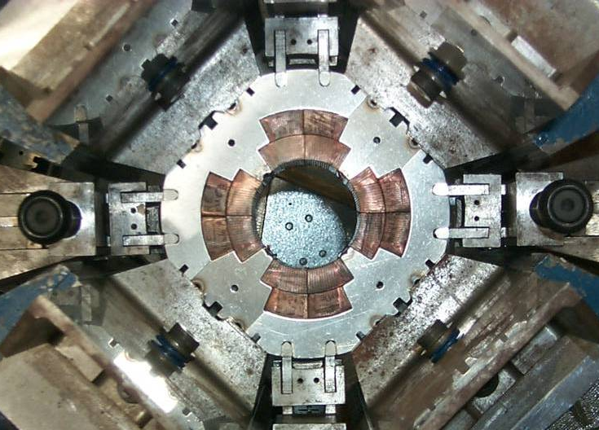
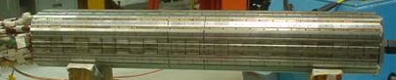
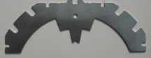
Mechanics of superconducting magnets: Collars
Collaring of a dipole magnet
Collaring of a quadrupole magnet

Slide 23
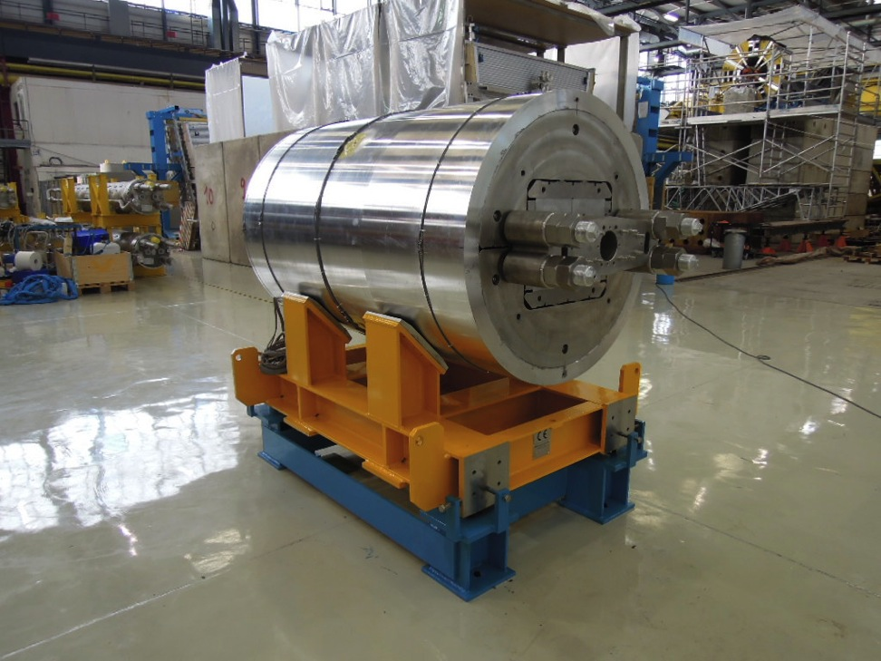
Mechanics of superconducting magnets: Shell structure
Alternative structure, principle is based on different contraction coefficients:
No large scale infrastructure required
Only part of pre-stress is applied at ambient temperature

Slide 24
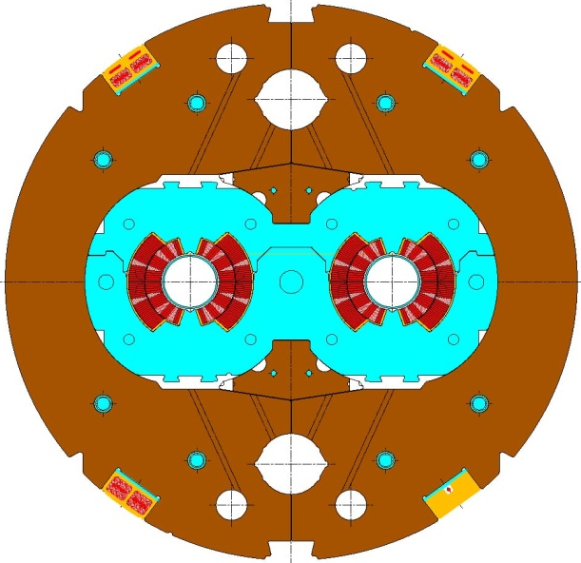
Mechanics of superconducting magnets: Iron yoke
Iron yoke are also made in laminations (several mm thick)
Magnetic function:
  contains and enhances the magnetic field.
Structural function
  tight contact with the collar
  it contributes to increase the rigidity of the coil support structure and limit radial displacement.
Holes are included in the yoke design for
  Correction of saturation effect
  Cooling channel
  Assembly features
  Electrical bus

Slide 25
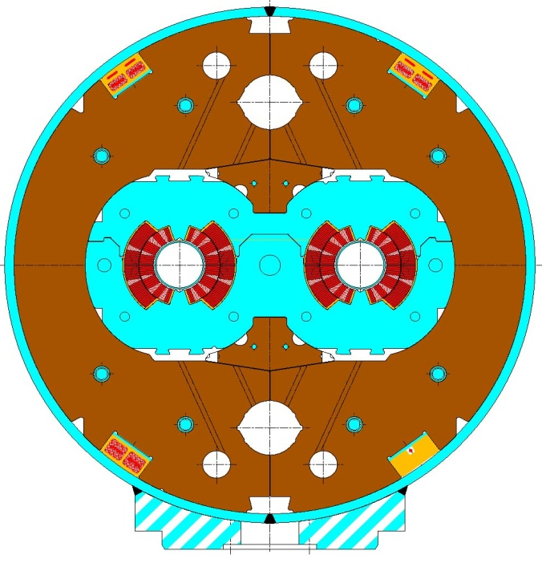
Cold mass
The shell constitutes a containment structure for the liquid Helium.
It is composed by two half shells of stainless steel welded around the yoke with high tension (about 150 MPa for the LHC dipole).
With the iron yoke, it contributes to create a rigid boundary to the collared coil.
If necessary, during the welding process, the welding press can impose the desired curvature on the cold mass
In the LHC dipole the nominal sagitta is of 9.14 mm over ~14.3 m

Slide 26
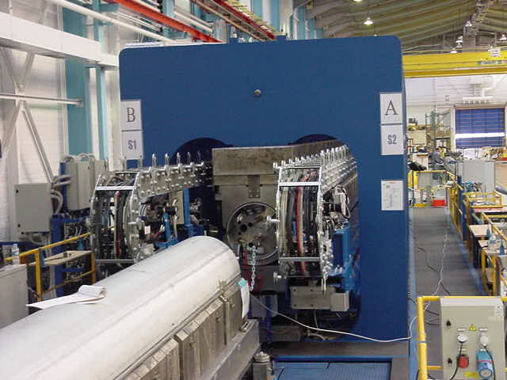
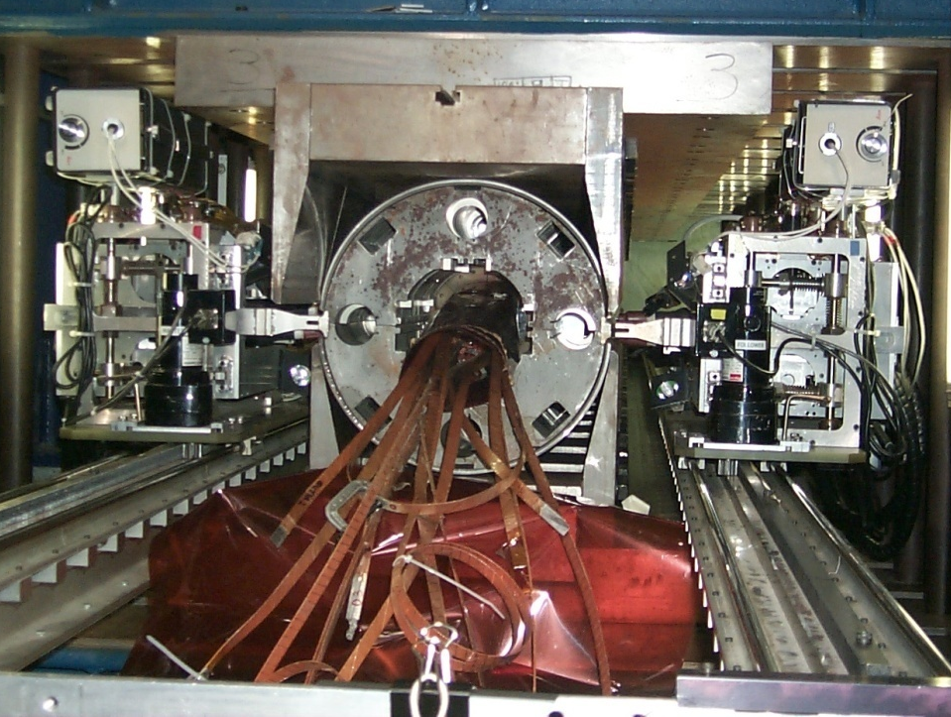
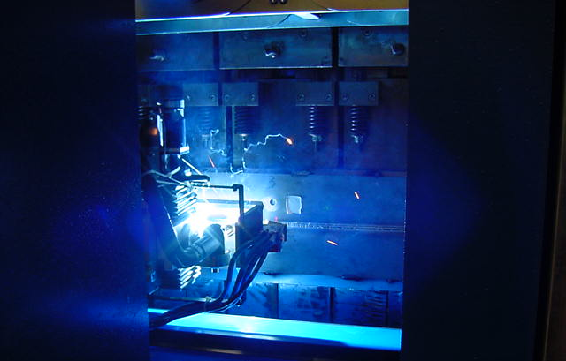
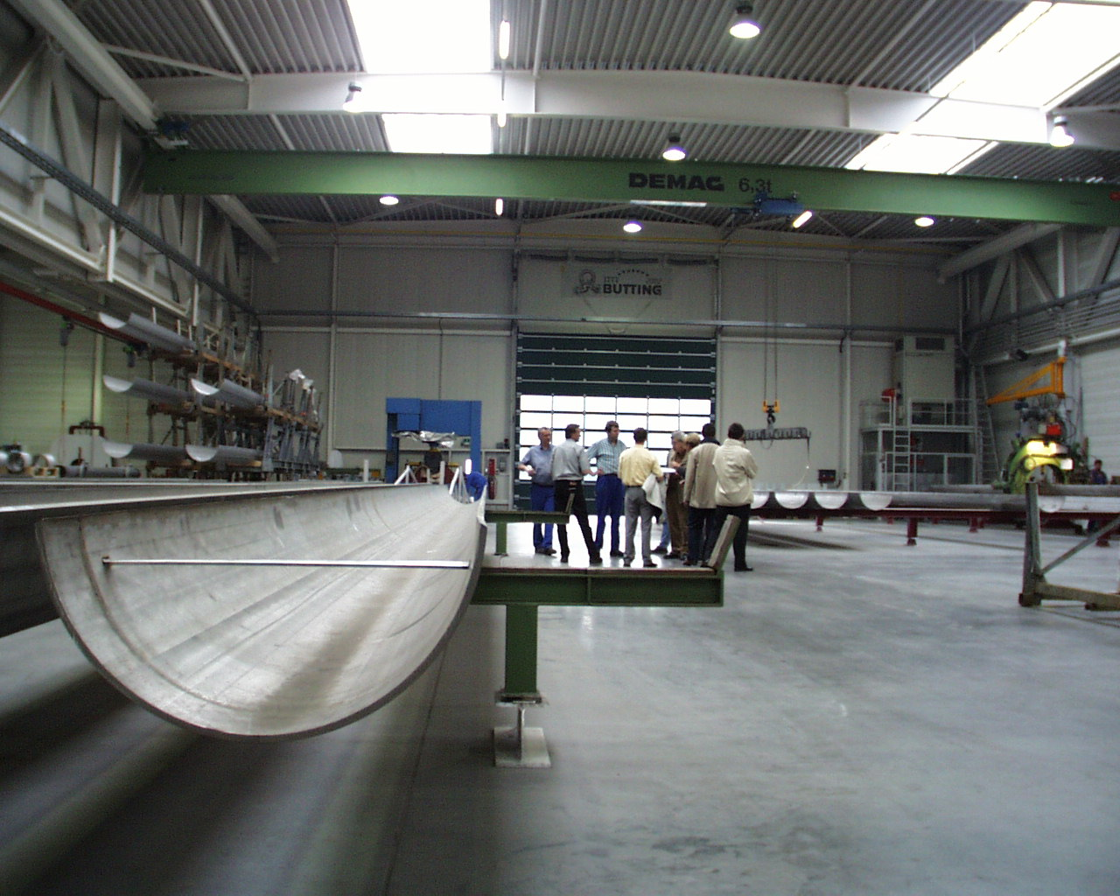
Cold mass

Slide 27
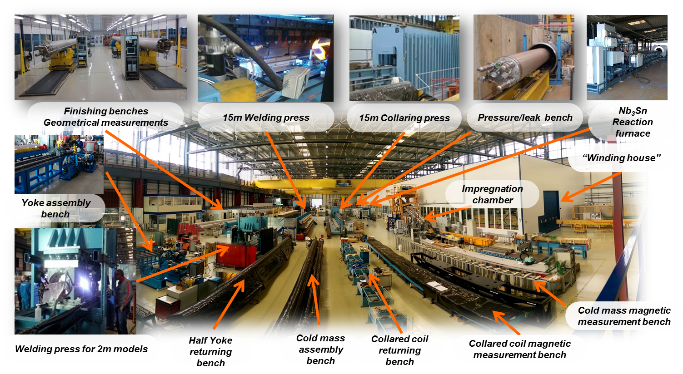
An overview of the infrastructure (bldg. 180)…

Slide 28
Cryo-magnets!

Slide 29
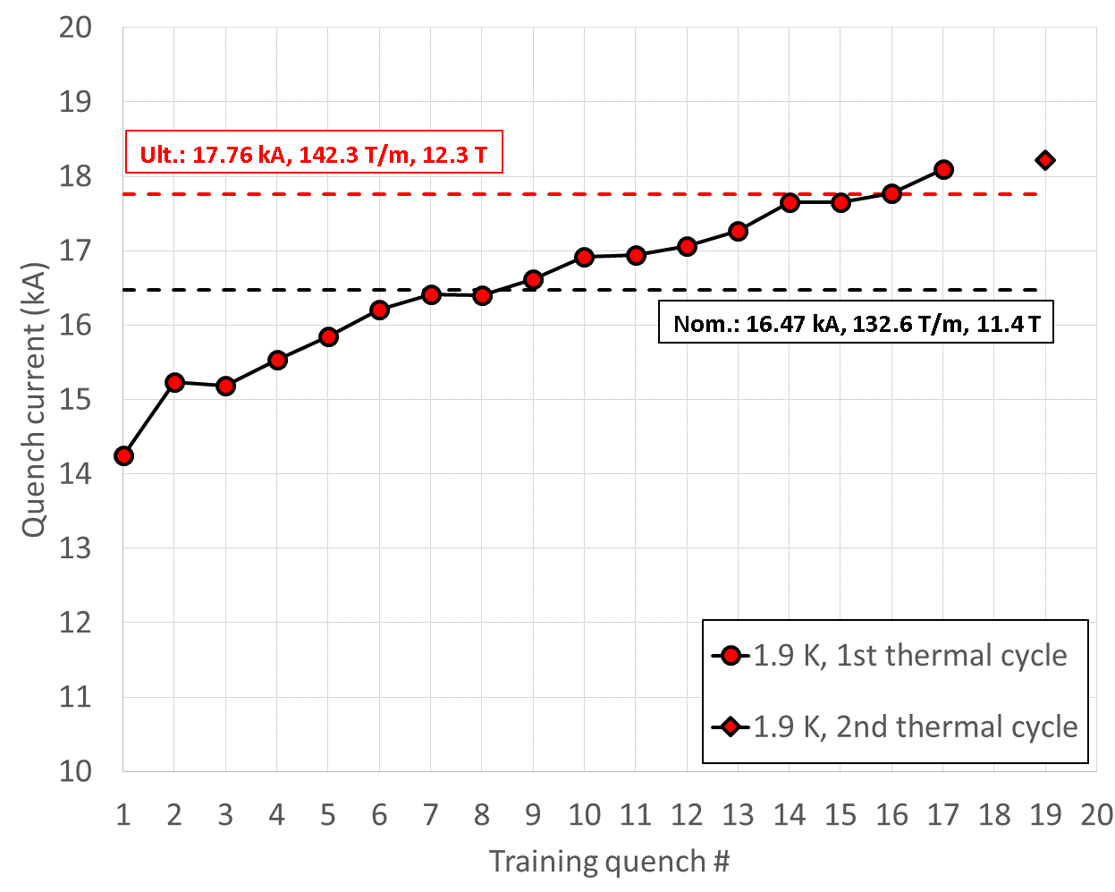
Testing
All magnets to be installed in a machine have to go through testing. A detailed test plan is elaborated. Main points:
Electrical integrity (test voltage 1-2 kV)
Performance (field, field quality): Reduce training!
Memory after thermal cycle: Keep memory!
MQXFS01 test
First test of HiLumi Nb3Sn IR quadrupole

Slide 30
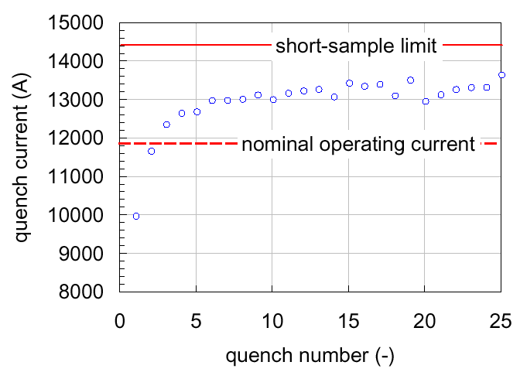
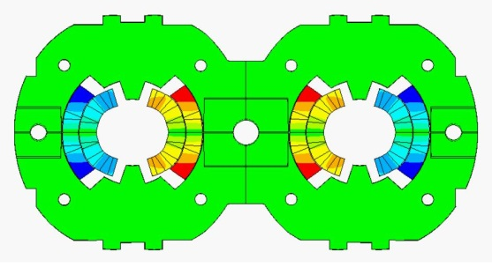
Training
Main causes
Frictional motion
  E.m. forces → motion → quench
  Coil locked by friction in a secure state
Epoxy failure
  E.m. forces → epoxy cracking → quench
  Once epoxy locally fractured, further cracking appears only when the e.m. stress is increased.
Magnets operate with margin: Nominal current reached with few quenches.
In general, very emotional process!

Slide 31
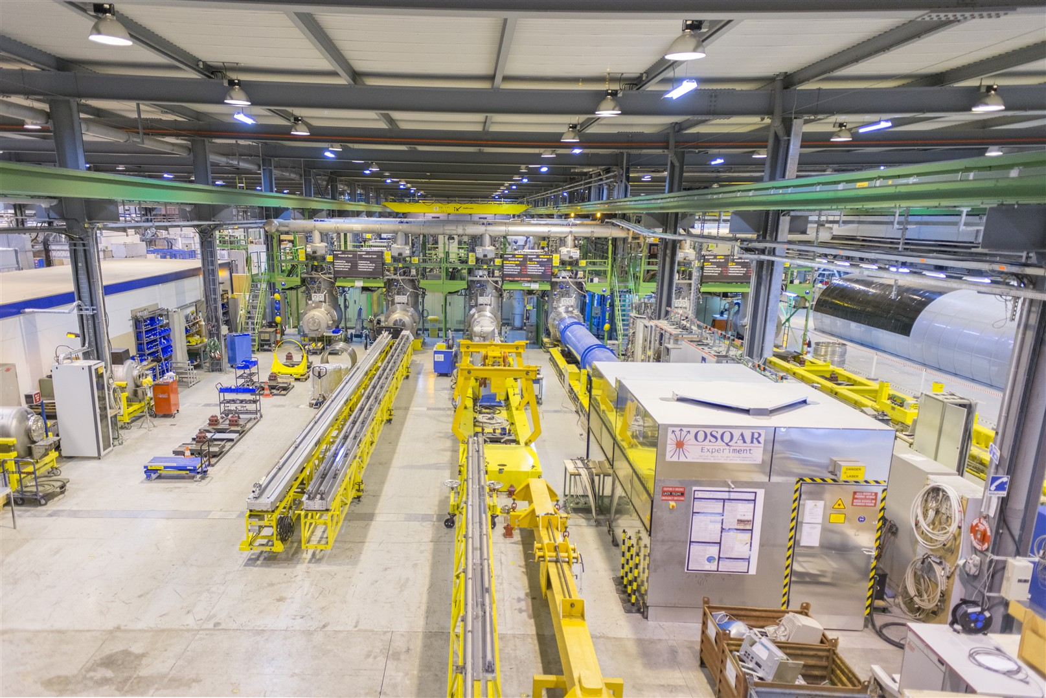
Testing of magnets: Horizontal test station

Slide 32
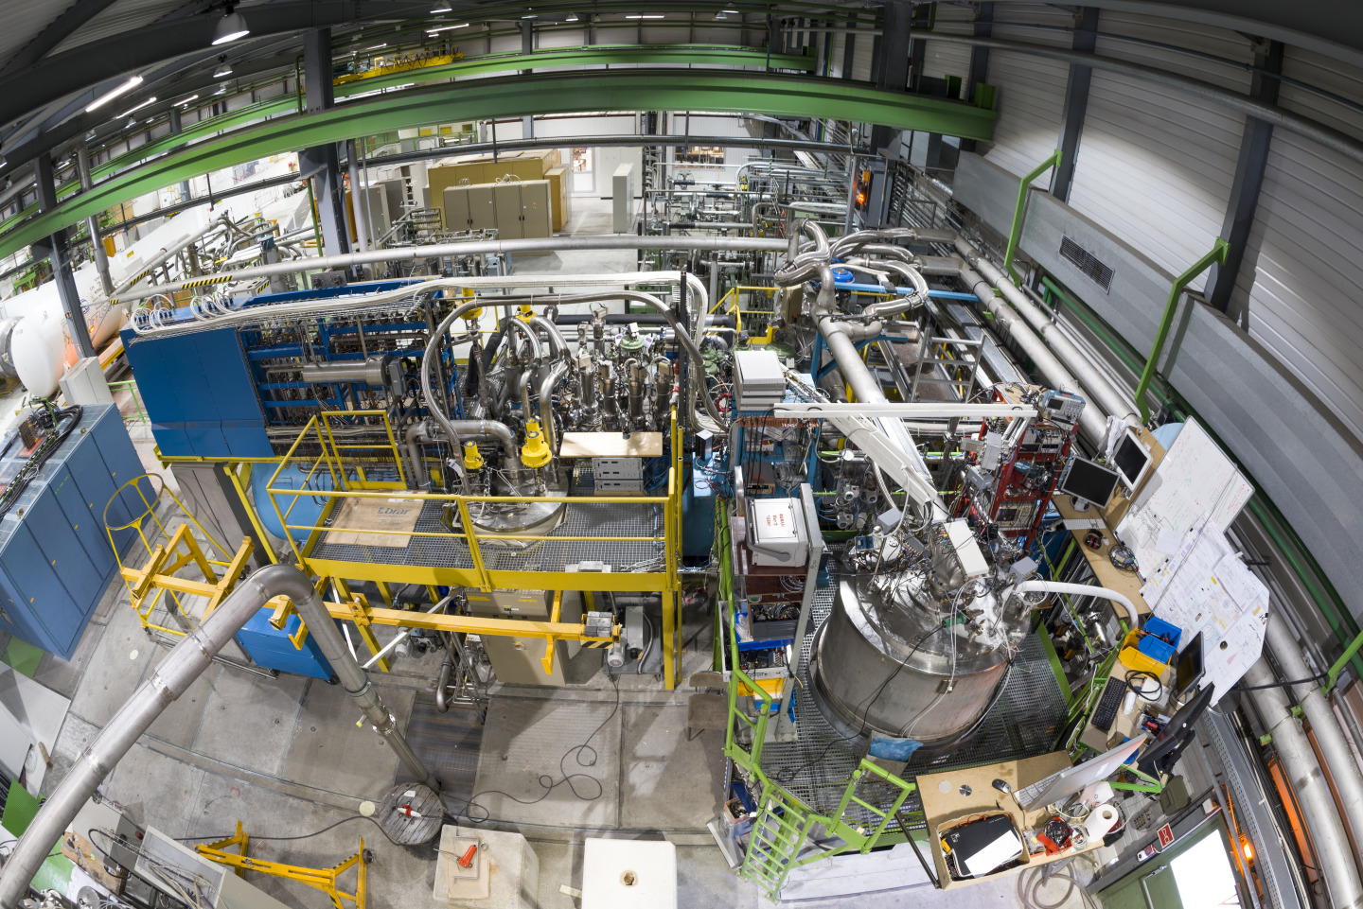
Testing of magnets: Vertical test station

Slide 33
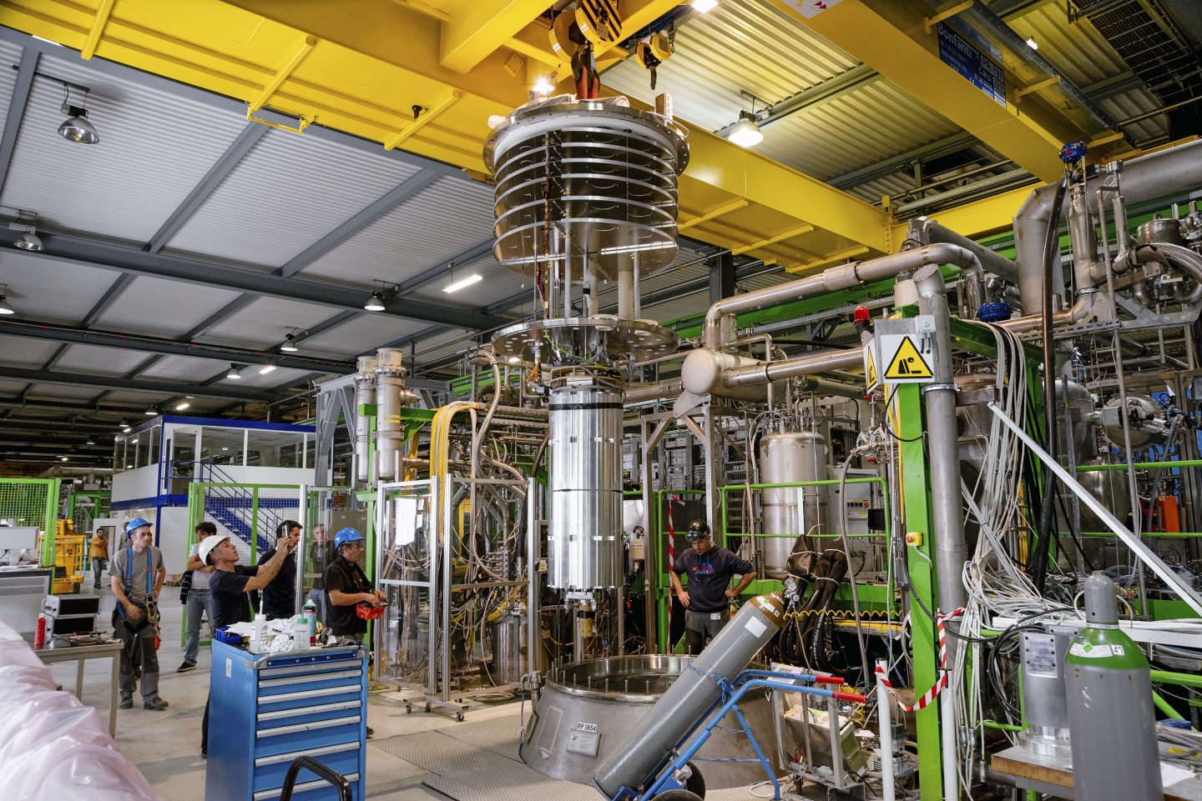
Testing of magnets: Vertical test station

Slide 34
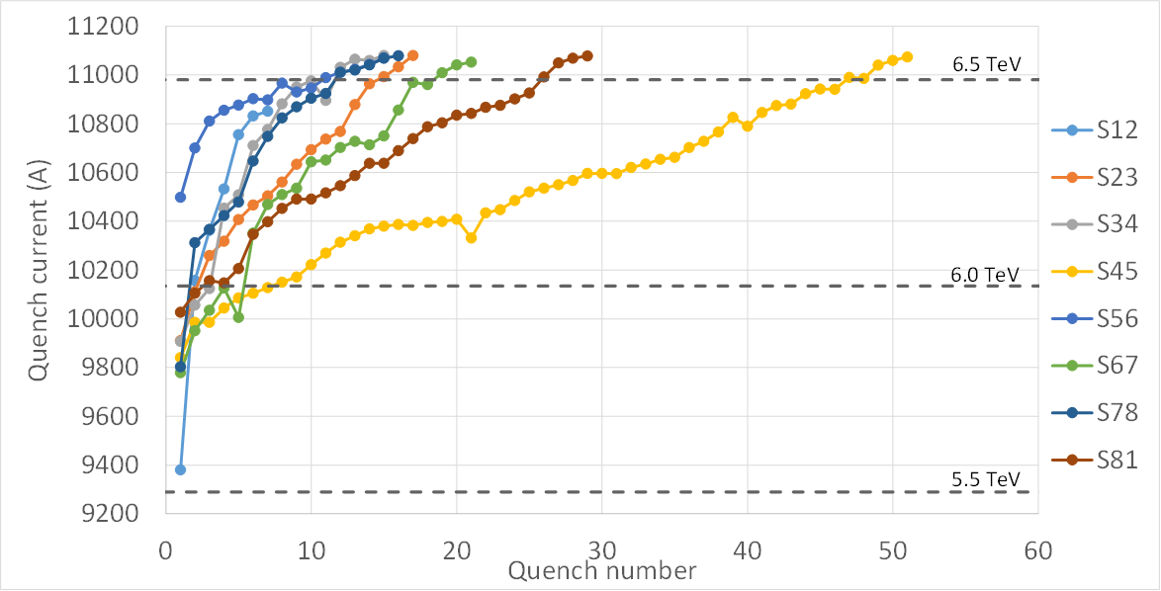
Memory

Slide 35
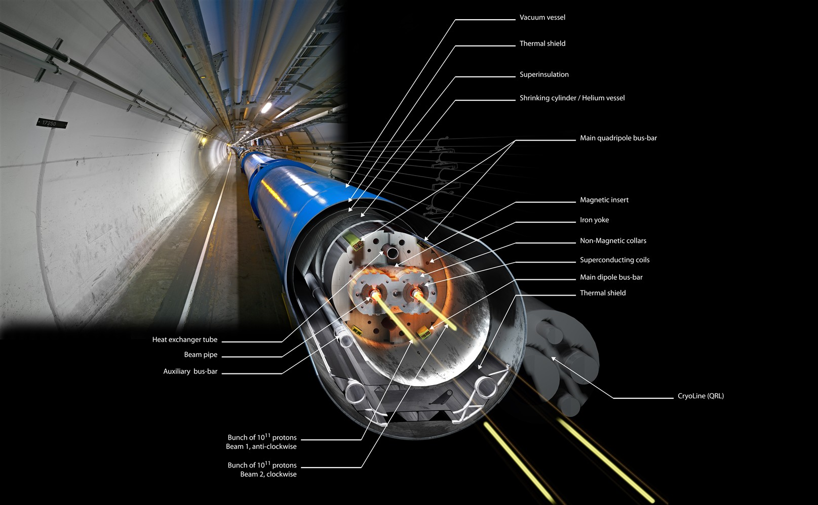
The LHC dipole magnet

Slide 36
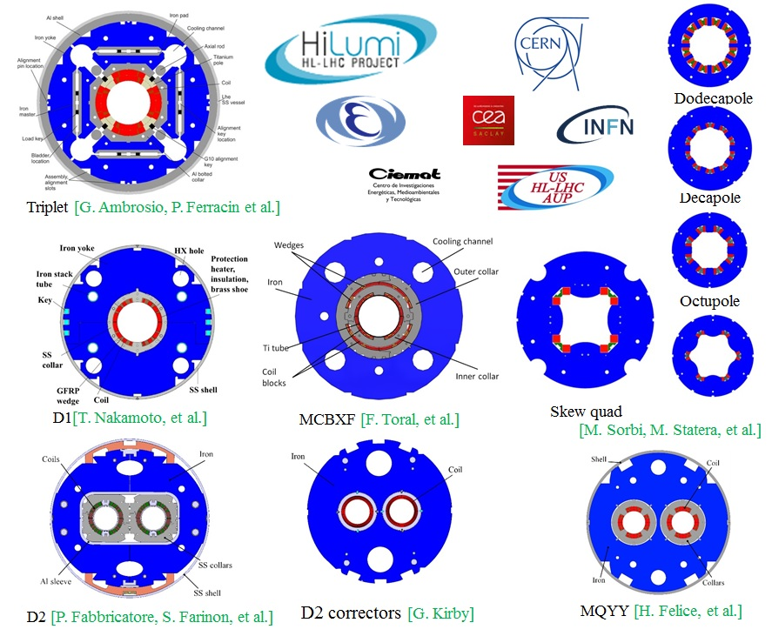
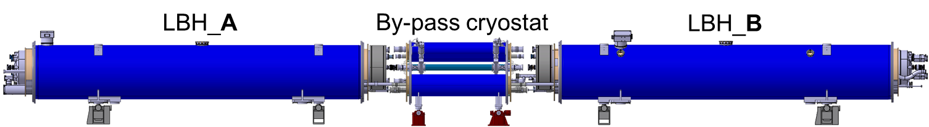
Hi-Lumi LHC at CERN
Achieve instantaneous luminosities a factor of five larger than the LHC nominal value
Enable the experiments to enlarge their data sample by one order of magnitude compared with the LHC baseline programme
11 T dipole

Slide 37

LHC, what next? FCC!
International FCC collaboration (CERN as host lab) to study:
80-100 km tunnel infrastructure
pp-collider (FCC-hh)
e⁺e⁻ collider (FCC-ee) as potential first step
p-e (FCC-he) option
HE-LHC with FCC-hh technology

Slide 38
FCC versus LHC dipole
Twice the magnetic field →
  2 x more Ampere turns
  4 x higher forces/m
  ~6 x more stored energy/m
4 x more magnets
Prototypes will be built.

Slide 39





Magnet Design Options: Future Circular Collider
800 mm 600 mm
Cosine-theta (baseline)
Magnet length 14.3 m
Free physical aperture 50 mm
Inter-beam distance 204 mm
Field amplitude 16 T
Margin on the load-line @ 1.9K 14 %
Block-type coils
Common-coils
2015 2017
CCT (PSI with LBNL and CERN)

Slide 40


High-Temperature Superconductors
High-temperature superconductor promise much higher fields
Technology is currently being developed
Main challenge: Reduce cost!

Slide 41


Other superconducting magnets in accelerators
Experimental magnets (large solenoids)
Insertion devices for reducing the beam emittance and creating synchrotron radiation: Very active field of R&D for storage rings and FELs (ESRF, Soleil, etc…. and European XFEL, SwissFel,…)
D. Schoerling et al.
David Attwood, Soft X-Rays and Extreme Ultraviolet Radiation: Principles and Applications

Slide 42
Concluding remarks
Superconducting magnet design and manufacture is a very diverse field. It starts with superconductors (materials, wires, cables, and their electric and thermal properties), continues with electromagnetic design, thermal calculations, mechanics, protection, stability, etc…
Cooling requires cryogenic, a field of applied science by its own
The manufacture requires cost modelling, industrialization, complex project management, etc.
We live in exciting times for superconducting accelerator magnets: First Nb₃Sn magnets to be installed in HL-LHC, new field record of 14.6 T achieved with Fresca-2, first 16 T magnets for FCC to be manufactured from now on, first HTS dipole to be tested in background field, HTS undulator to be build, …

Slide 43


Literature
Martin N. Wilson, Superconducting Magnets, 1983: The classical book! Excellent introduction to the engineering of superconducting magnets.
Stephan Russenschuck, Field computation, 2010: The book for all questions related to electromagnetic calculations!

Slide 44

Literature
Werner Buckel and Reinhold Kleiner, Superconductivity, 2015: Very accessible and comprehensive introduction to superconductivity!
Daniel Schoerling and Alexander Zlobin, Nb₃Sn accelerator magnets: Designs, technologies, and performance, 2018 (to be published): Review of all so far built Nb₃Sn dipole magnets.

Slide 45

Literature
Oliver Bruning, Lucio Rossi (editors), High Luminosity Large Hadron Collider, The New Machine For Illuminating The Mysteries Of Universe: Introduction to HL-LHC

Slide 46
The LHC dipole magnet

