Slide 1
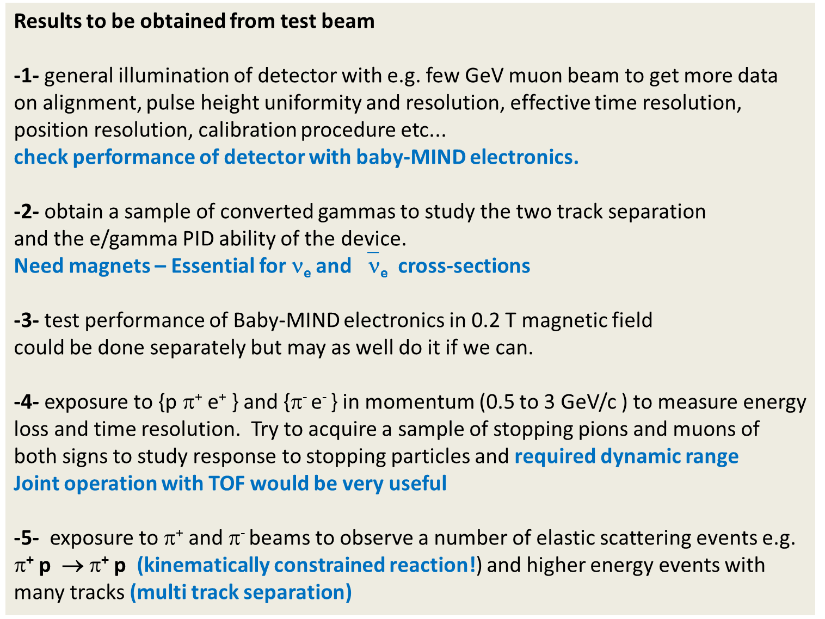
Results to be obtained from test beam
-1- general illumination of detector with e.g. few GeV muon beam to get more data on alignment, pulse height uniformity and resolution, effective time resolution, position resolution, calibration procedure etc...
check performance of detector with baby-MIND electronics.
-2- obtain a sample of converted gammas to study the two track separation
and the e/gamma PID ability of the device.
Need magnets – Essential for ν_{e} and ‾ν_{e} cross-sections
-3- test performance of Baby-MIND electronics in 0.2 T magnetic field
could be done separately but may as well do it if we can.
-4- exposure to {p $$⁺ e⁺ } and {$$⁻ e⁻ } in momentum (0.5 to 3 GeV/c ) to measure energy loss and time resolution. Try to acquire a sample of stopping pions and muons of both signs to study response to stopping particles and required dynamic range
Joint operation with TOF would be very useful
-5- exposure to $$⁺ and $$⁻ beams to observe a number of elastic scattering events e.g.
$$⁺ p → $$⁺ p (kinematically constrained reaction!) and higher energy events with many tracks (multi track separation)

Slide 2
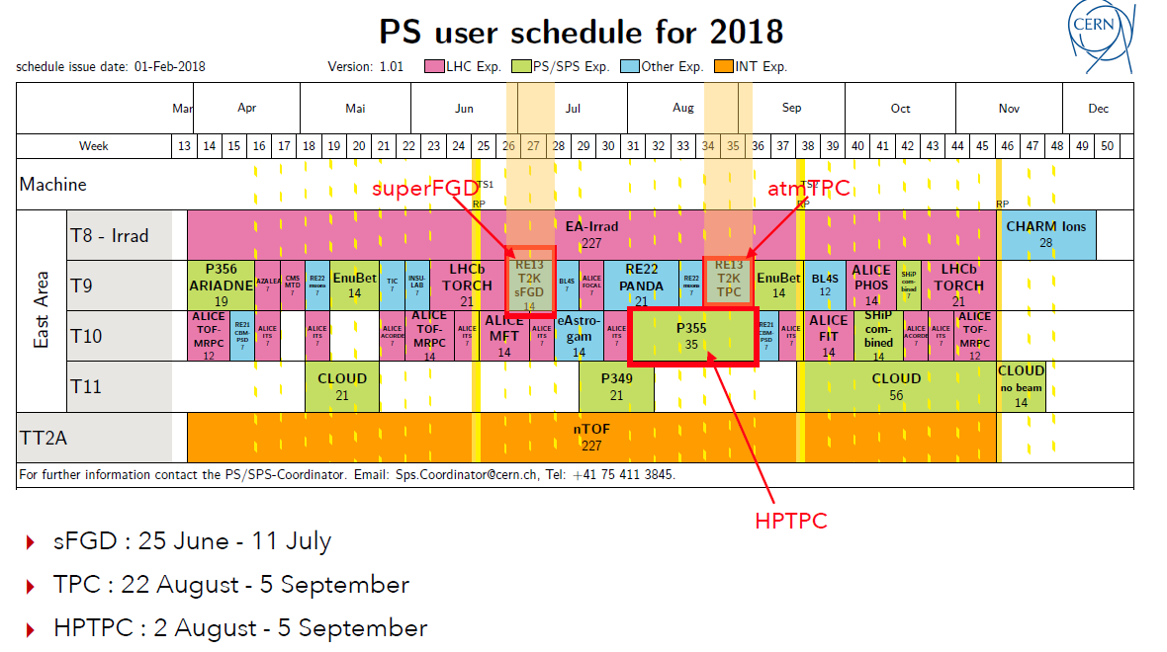
Aim is to make use of the June-July period.
possibility to run also in 22 August – 19 September
period parasitically to TPC and EnuBET

Slide 3
Possible layout
superFGD prototype:
52x22x8 cm³
MNP17 B=0.2-1T
MDX
beam Cherenkov
Helium or low pressure bag
(if possible)
dipole
magnet
superFGD
prototype
tracking chamber
do we have one?
converter
copper or lead
TOF
scintillator hodoscope

Slide 4
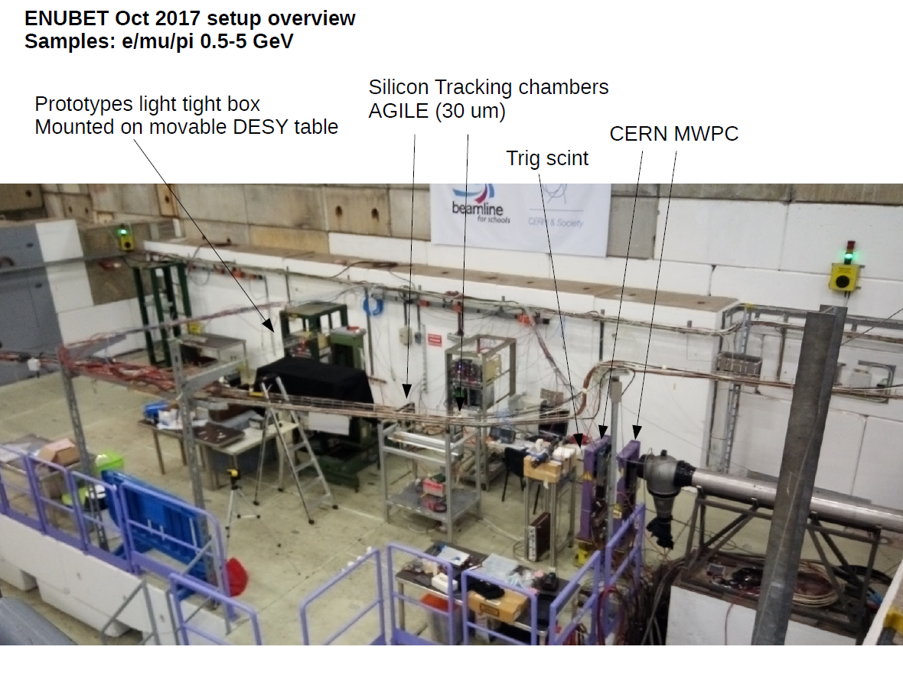
A. Longhin

Slide 5
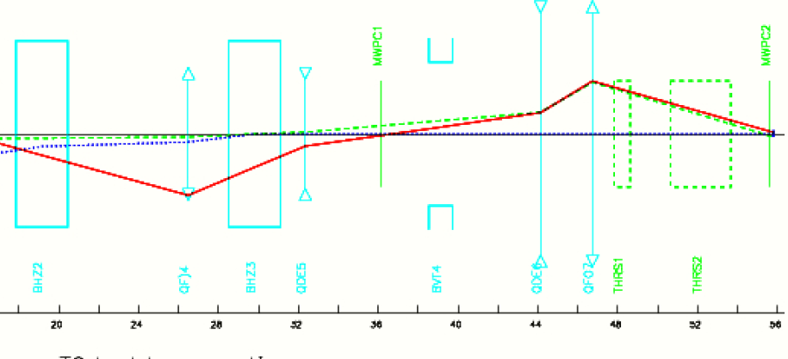
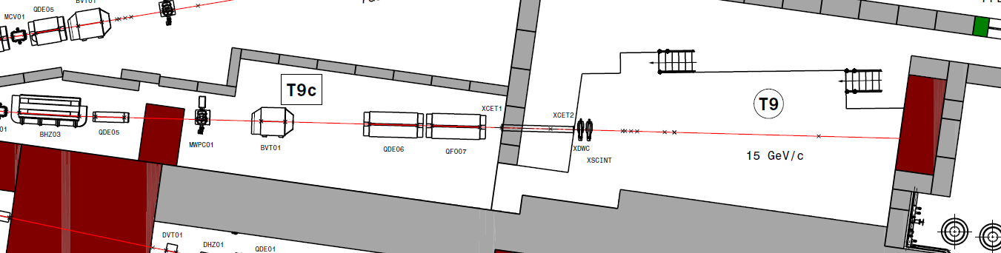
BHZ3 ~2.66 m long.
~14m

Slide 6
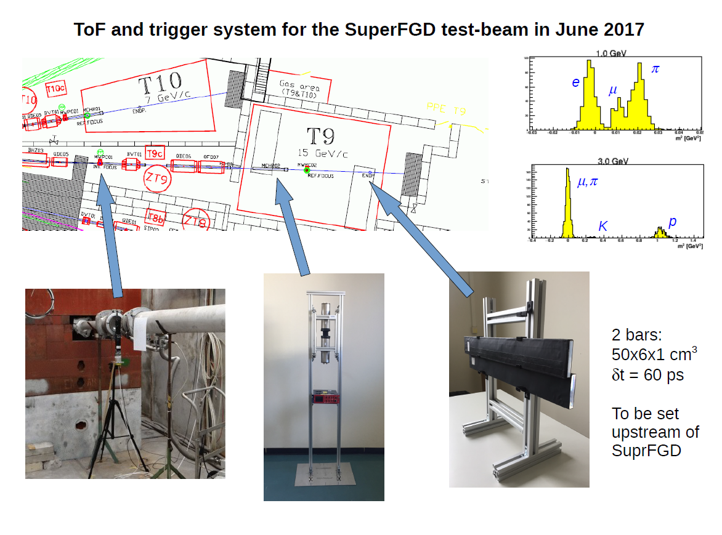
Alex Korzenev

Slide 7
we located two magnets
-- one MDX type for the production of the gamma beam (I explained that in my presentation at the workshop in November 2017). There are several of those available so it should not be a problem.
-- one for the immersion of the detector in magnetic field (0 to 0.96T) MNP17
The aperture height is 30 cm, the length 52 cm and the width is quite large. So it would work very well to immerse a prototype of e.g. 50x20x10cm (10k cubes and 1700 channels).
We have made the request to the SPS coordinator for the use of this magnet.
This would allow investigation of
-- momentum reconstruction and
-- e/gamma separation
vs magnetic field
It is urgent to check the availability of this magnet in June-July period!

Slide 8
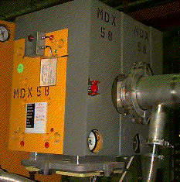
A Photon beam in T9 area
A. Blondel, L. Gatignon
Principle
e⁻ beam
Cu radiator
MDX magnet
0.51 T.m
γ beam
may need a position detector
best is probably
around 2 GeV/c e-
for 200-800 MeV
photons
(should be simulated)
hodoscope
(measures electron momentum
➔ photon energy)

Slide 9
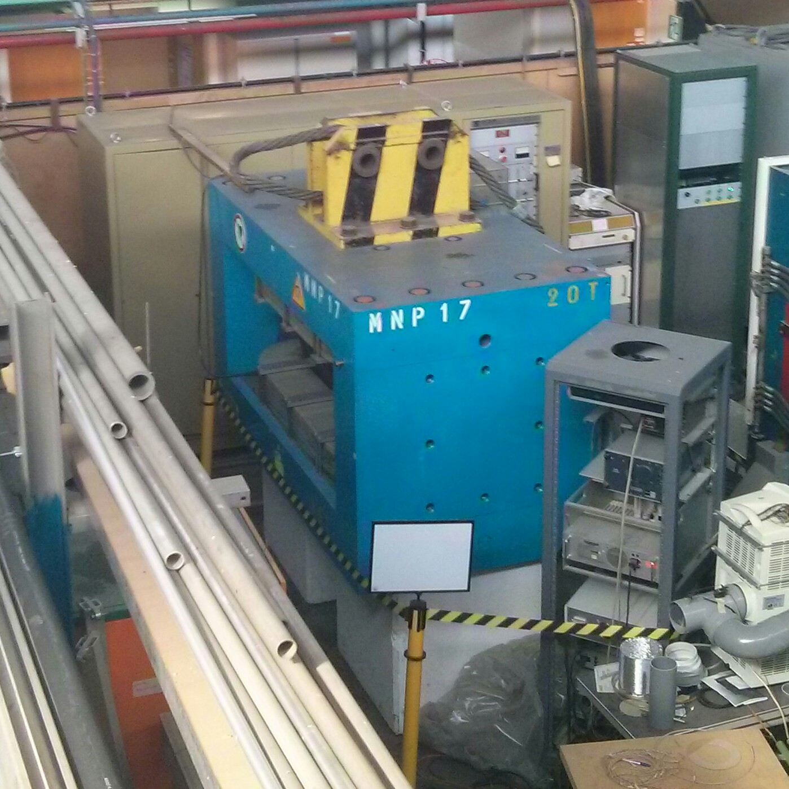

Slide 10
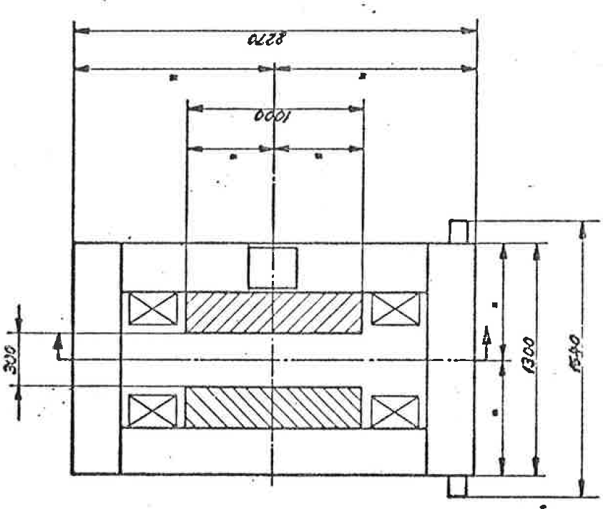
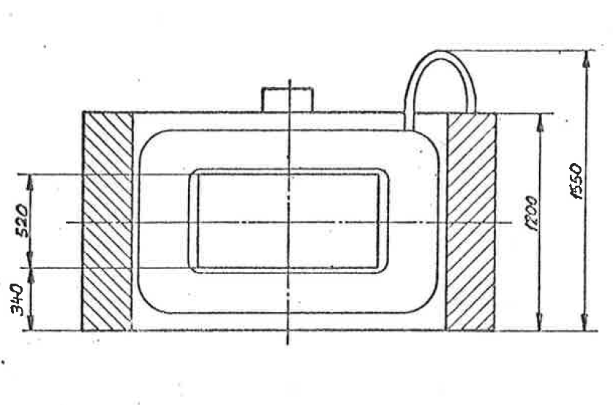
MNP17 magnet
(laid with B vertical normally
… horizontal possibility?)
x-y view
x-z view

Slide 11
MNP17 magnet
(laid with B vertical normally
… horizontal possibility?)
question is there a few bolting
holes on the surface of the magnet pole
or somewhere else on the magnet,
to design the support?
x-y view

Slide 12
Cables
Cables
SFGD
SFGD
Cables
Cables
SFGD
Cables
Cables
x-z view
electronics
electronics
electronics
electronics
electronics
electronics

Slide 13
x-z view
Cables
SFGD
Cables
Cables
SFGD
Cables
Cables
Cables
SFGD
Cables
Cables
Cables
Cables
Cables
Cables
electronics
electronics
electronics
electronics
electronics
electronics

Slide 14
x-z view

Slide 15
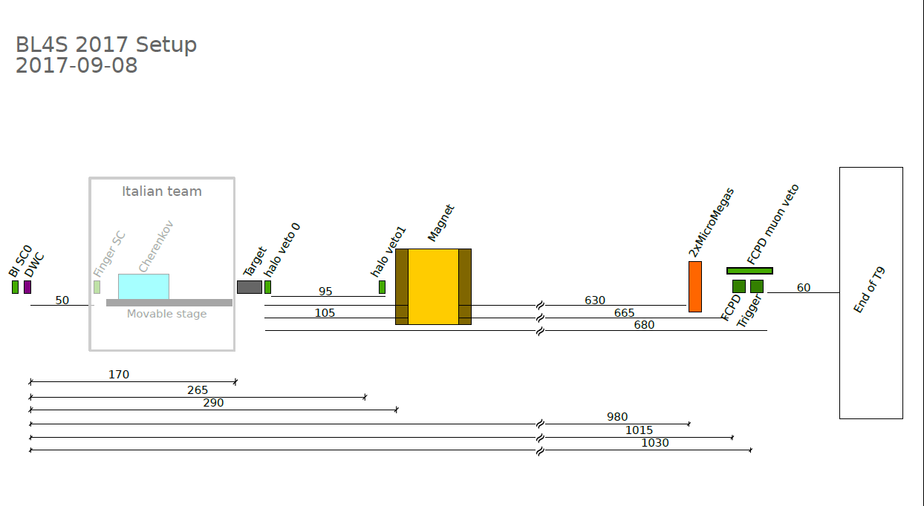
example of set-up from last year using a magnet,
and with another detector test upstream,
there is 2.9m free space in front of the magnet

Slide 16
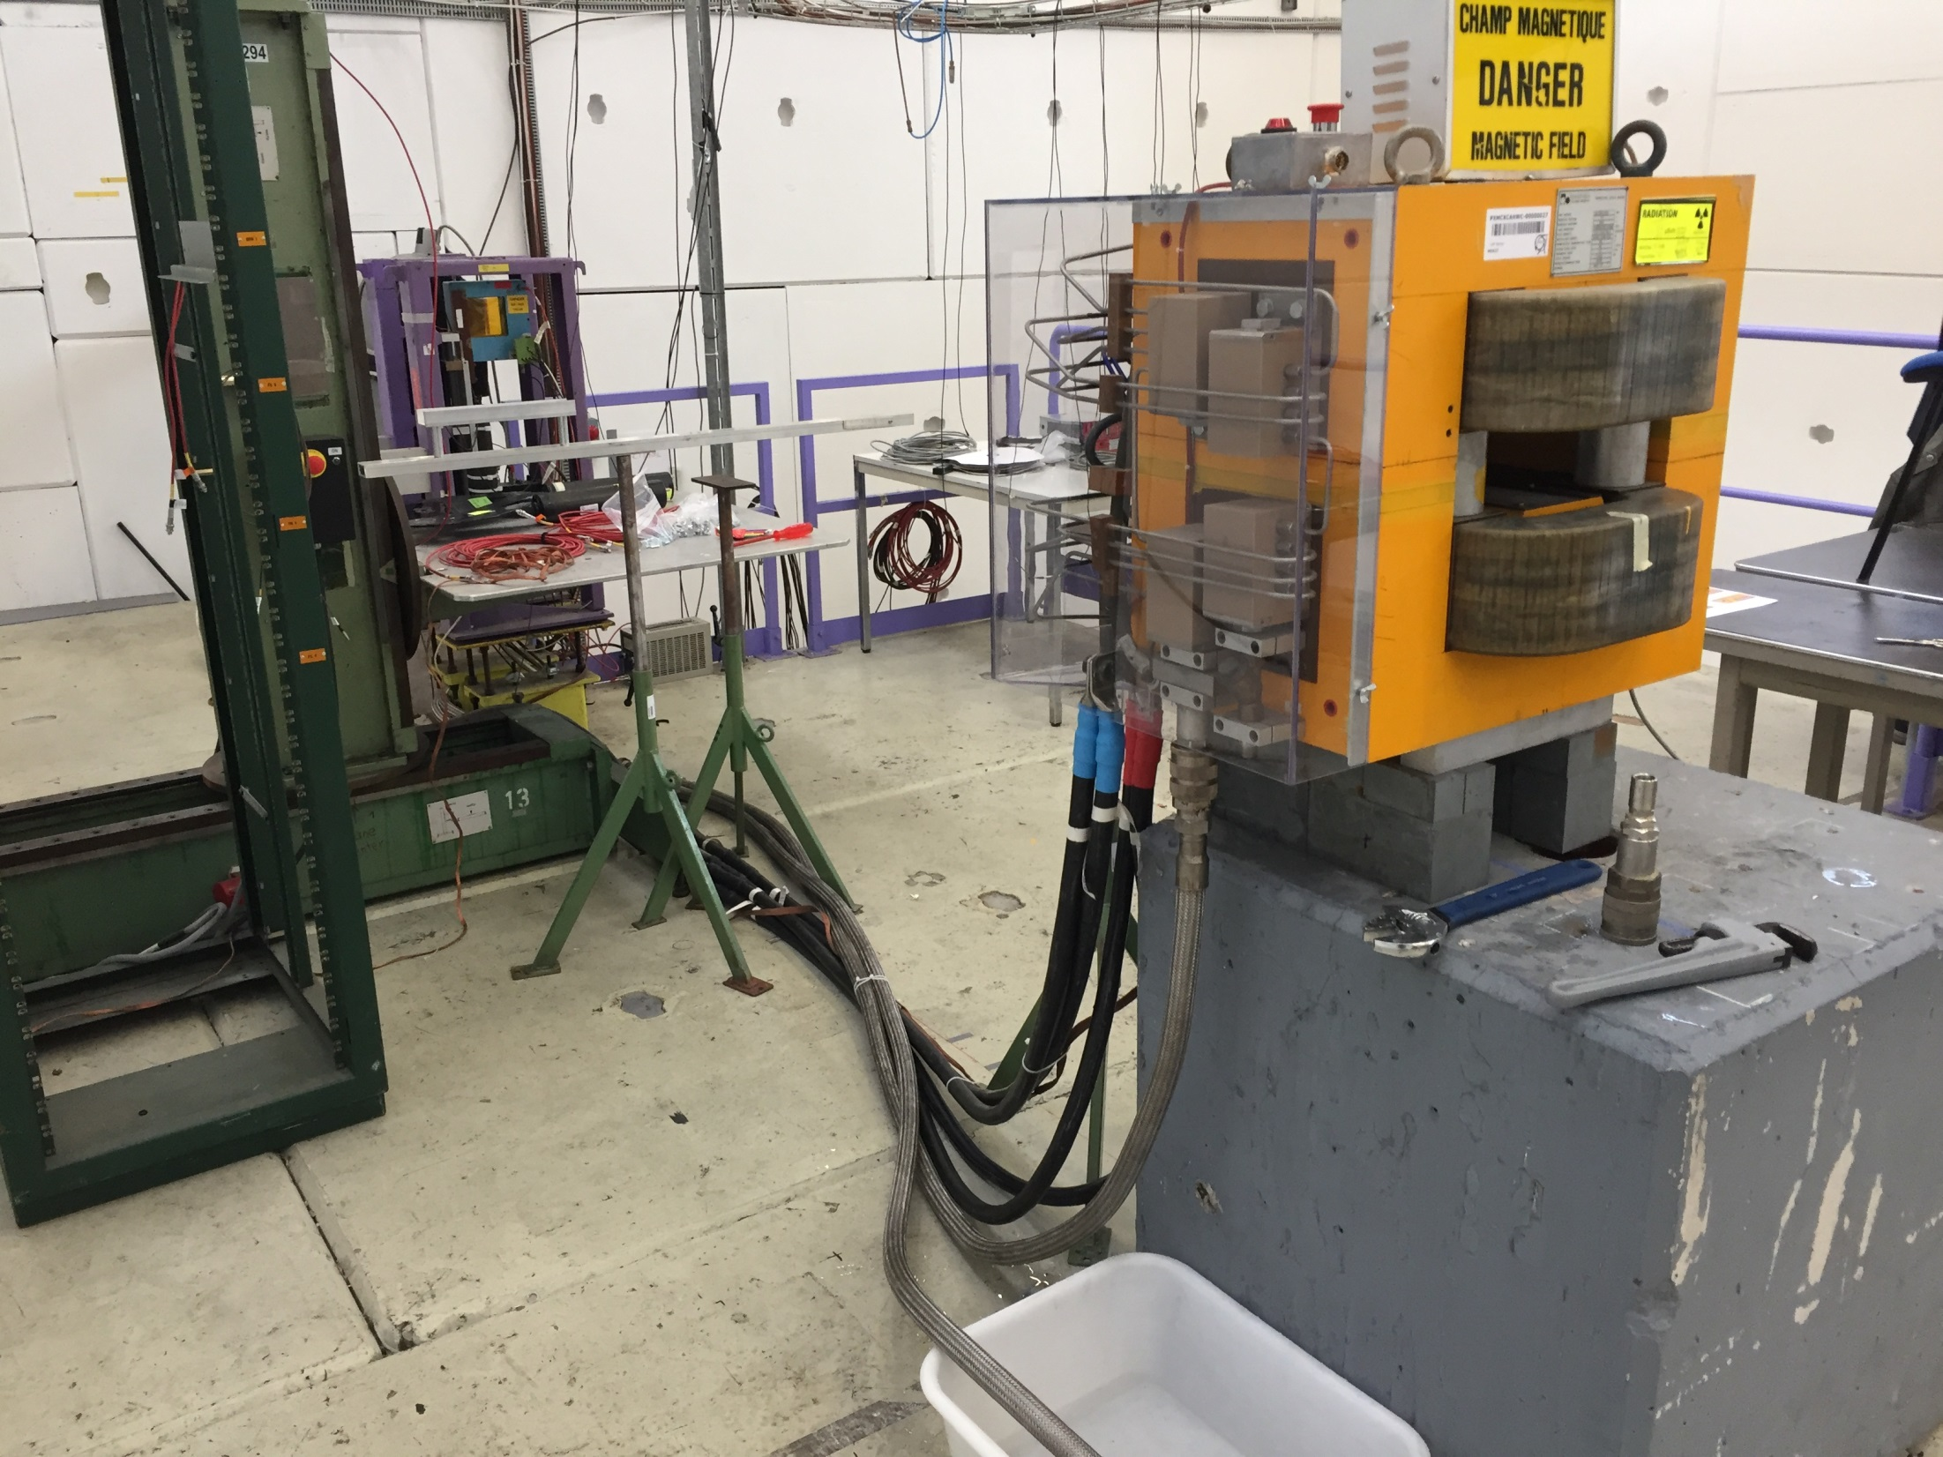

Slide 17
Detector shape
Especially for the photon conversions in magnetic field it is better to have a deeper
and thinner detector
beam
22
8
52

Slide 18
B
photon beam

Slide 19
B
electron beam

Slide 20
we can also get a nice sample of low energy protons from $$⁺ p → $$⁺ p
pion beam
π⁺
p
π⁺

Slide 21
Or simply study stopping protons for momenta 500-800 MeV/c
proton beam
π⁺

Slide 22
Range vs Momentum of protons in Polystyrene
https://physics.nist.gov/PhysRefData/Star/Text/PSTAR.html
Maximum energy deposition in a single cell: ~30-45 MeV (22 MIPs = 880 pixels)
Range of 500 MeV/c protons : 12cm
Range of 800 MeV/c protons : 50cm

Slide 23
Comments
Maximum energy deposition in a single cell: ~30-45 MeV (22 MIPs = 880 p.e.)
this means that the MPPCs need much more than 900 pixels. 1600 possibly OK
Because of scintillator saturation (Birk’s law) the single cell signal
might be further saturated (down to ~600 p.e.?) still 1600 pixels needed, as their might be
more than one evaporation proton at vertex.
This is not an effect that is well understood, test beam data will be very useful.
Range of 500 MeV/c protons : 11cm
Range of 800 MeV/c protons : 51cm
The lowest beam momentum of the beam is 500 MeV/c,
Thus we can essentially explore all the detector with settings from 500 to 800 MeV/c
However 500 MeV/c pions or muons will not stop in the detector unless they interact
Inelastic multi-prong interactions will also be interesting to collect.

Slide 24
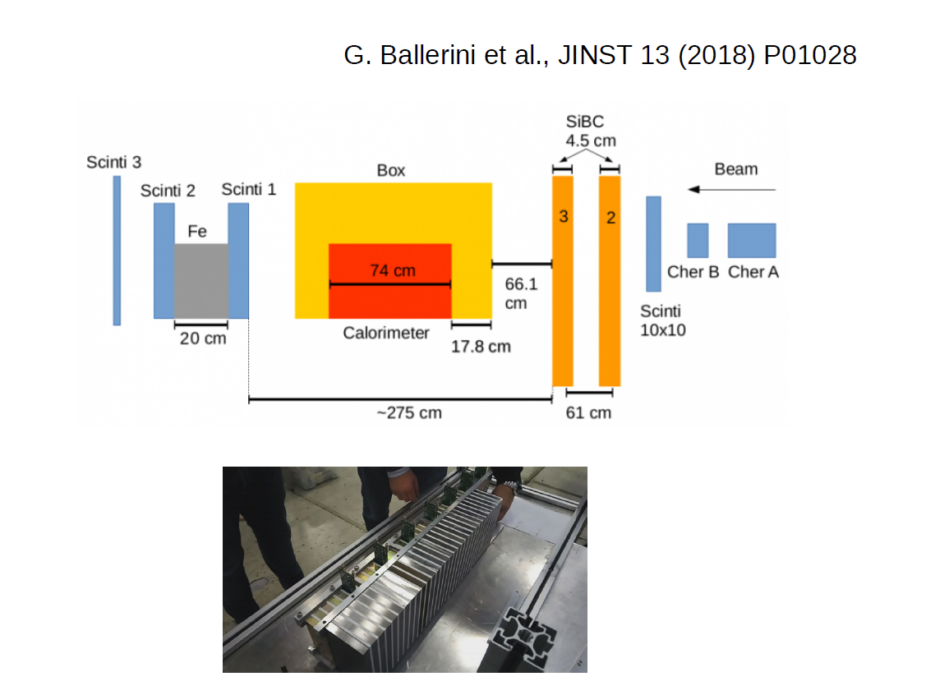
2017 EnuBET test set-up
The silicon beam chambers
provide 50 micron resolution
useful for TPC/SFGD?

Slide 25
From Baby-MIND electronics to SuperFGD electronics
For test beam in summer 2018
8x22x52 cubes (cm³) is being prepared @ INR →1736 channels. FANTASTIC!
we have begun production of 13 x 96 channels + 7x 96 spare channels from Baby-MIND
→ aim at full instrumentation of SuperFGD prototype for June-July test beam.
layout the electronics outside MNP17 magnet
Plan test of the effect of magnetic field and the timing resolution (see below)
DAQ will be that of Baby-MIND. Work already started to include TOF. (Korzenev)
Towards SuperFGD (a first look)
-- SuperFGD is inside the magnet surrounded by TPCs
material budget should small, avoid copper and cables
➔ try geometry of electronics directly set on detector surface.
➔ re-routing of (hopefully mostly) same electronics on different layout.
-- 2’000’000 cubes and 60’000 channels
➔ thermal issues and communication issues (getting data out)
-- mechanical design, cooling system and communication system must be integrated
-- 2kG magnetic field must be tested
-- may need to improve timing resolution (establish after summer test)
A few weeks will be necessary to define full set of questions and required extra manpower;
collaboration welcome; test beam results will be important!

