Slide 1
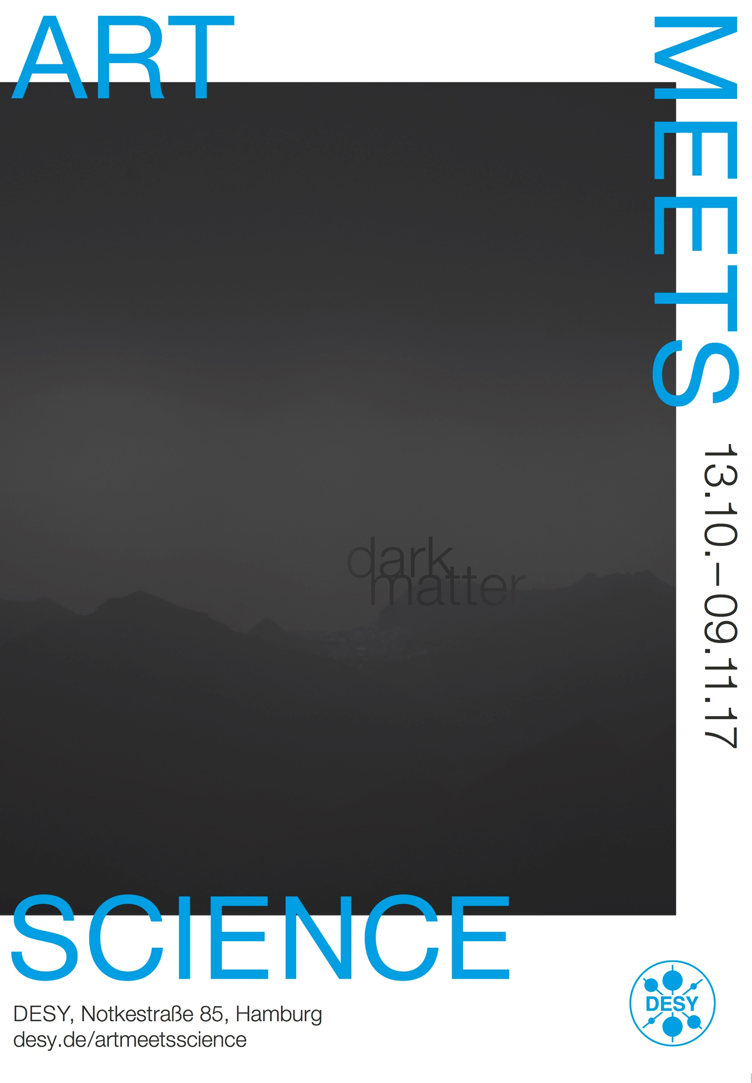

Dark Matter: when art met science
Creative collisions on the DESY campus
Christian Schwanenberger and Barbara Warmbein, DESY
19 March 2018

Slide 2
Summary
DESY’s first art-meets-science project
15 artists, 10 scientists
Topical artwork presented in a working laboratory
More than 2000 visitors, almost all new to campus, plus 20000 visitors during DESY DAY
some very exciting artwork and a lot of new fans
artmeetsscience.desy.de

Slide 3
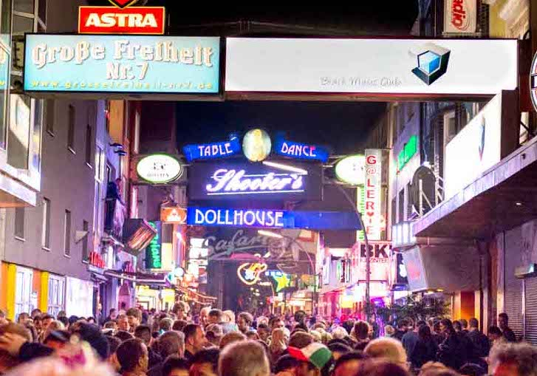
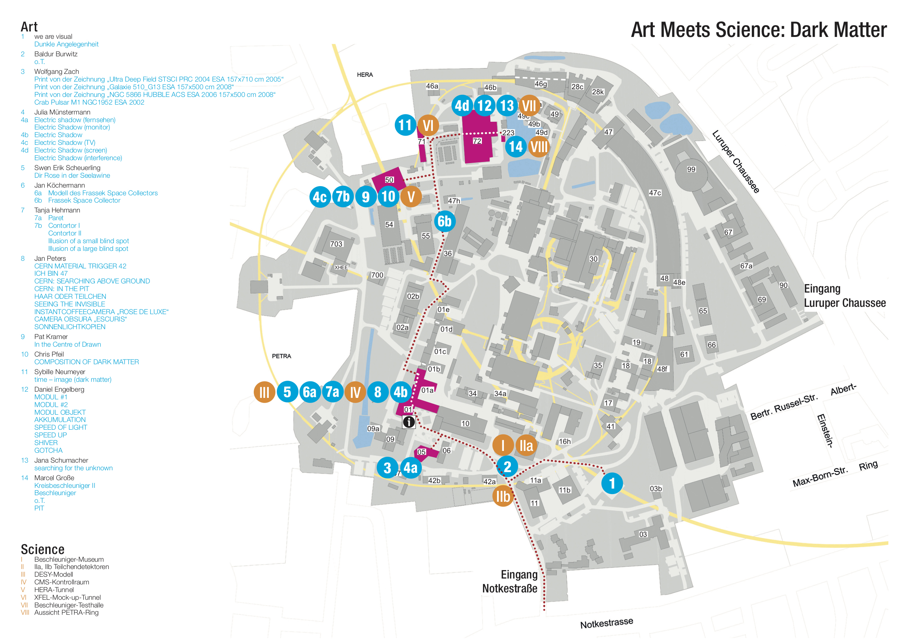
The idea
The idea – develops
Picture: Artur Gorski https://www.getyourguide.com/st-pauli-l3166/
  Initiators contact DESY PR; a project is born
  DESY PR decides to carry out the project as a test for a potential art-meets-science programme at DESY to conquer new target audiences
  DESY is chosen as location: attractive for artists, attractive for new target audience
  The project is designed to truly bring art and science into collision
  Official ok in May 2017
  Next steps:
    → Contact a variety of artists
    Scan possible locations on campus
    Check how to keep visitors safe
    Make sure visitors don’t get lost
    Find suitable partners
    Organise kick-off meeting
    Ensure balance between art and science
  A party in Hamburg
  One artist, one scientist…
  A brilliant idea: art and science are not different at all, on the contrary – let’s explore the similarities:
  Scientists and artists have similar approaches and methods to their work, searching for something not knowing exactly for what
  Dark matter is a particularly striking example

Slide 4
Who are the artists?
15 artists from all over Germany
Baldur Burwitz, Applause
Baldur Burwitz, Interventionen, Hamburg;
Marc Einsiedel und Felix Jung, we are visual, Installation, Hamburg;
Daniel Engelberg, Malerei, Objekte und Installation, München;
Marcel Große, Installation, Hamburg;
Tanja Hehmann, Malerei, Hamburg;
Jan Köchermann, begehbare Skulpturen, Hamburg;
Pat Kramer, Licht und Skulptur/Installation, Forbach
Julia Münstermann, Malerei, Berlin;
Sybille Neumeyer, Installation, Video, Berlin;
Prof. Jan Peters, Fotografie und Film, Kassel und Berlin;
Chris Pfeil, Sound Designer, Klanginstallation, Köln;
Swen-Erik Scheuerling, kinetische Objekte und Installation, Berlin;
Jana Schumacher, Grafik, Installation, Hamburg;
Wolfgang Zach, Computergrafiken, Bremen;
Kurzfilmprogramm der Kurzfilmagentur Hamburg
Wolfgang Zach, Crab Pulsar M1 NGC1952 ESA 2002"
Pat Kramer, Prozess zu „Dark Matter“
Jan Köchermann, Tunnelsystem 2
Swen Erik Scheuerling, Dir Rose in der Seelawine
Julia Münstermann, Electric Shadow
Marcel Große, Teilchenbeschleuniger

Slide 5



Coorperation partners
Hamburger Kreativ Gesellschaft
Hamburger Kreativ Gesellschaft cooperation partner for the project: “a municipal institution founded to promote Hamburg’s creative industries”
      Thematic cooperation, documentation of “dark matter” trough EU EFRE project
      Financial support
      Future cooperation planned
      http://kreativgesellschaft.org
KurzFilm Agentur Hamburg
      Series of short films called “dark matters” shown on Dark Matter Day and DESY Open Day
      http://agentur.shortfilm.com
Renowned art scientist Belinda Grace Gardner gave introductory talk putting the project in context with the history of art an science
All images by architecture photography expert Helge Mundt who followed the project from the kick-off

Slide 6
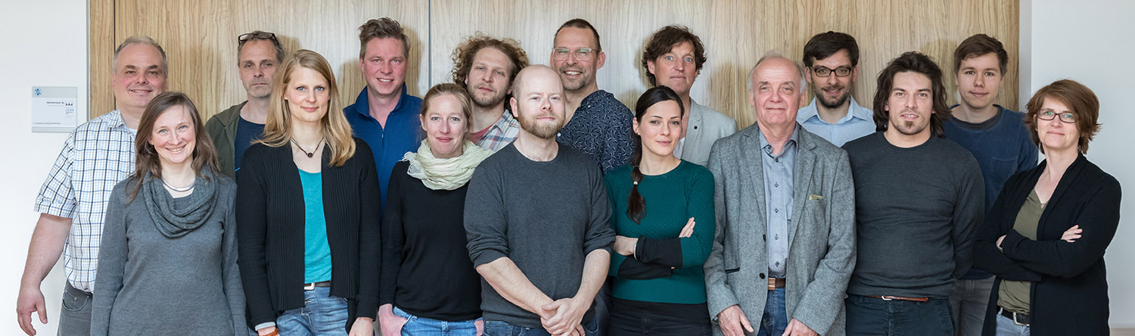
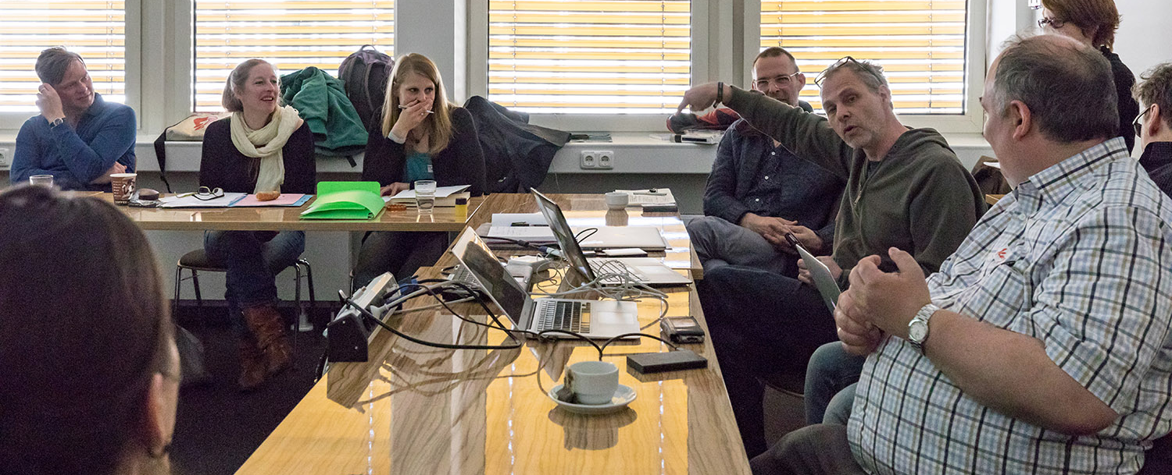
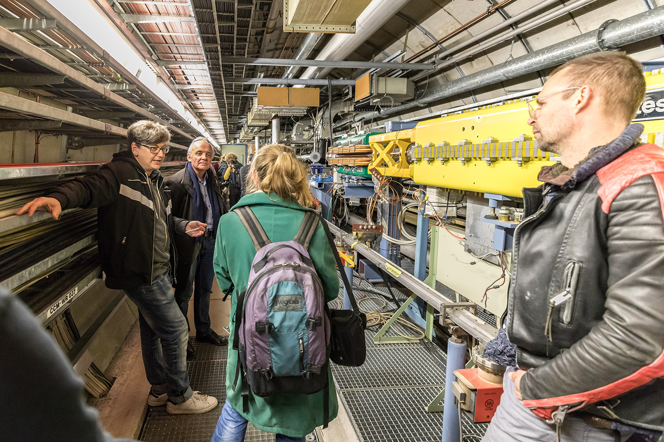
The Kick-Off, April 2017
Vital statistics: 2 days, 11 artists, 10 scientists, 18 talks, a lot of coffee…
Theory
Scientists presented the basics of dark matter:
  Why do we know it must be there?
  What could it be?
  How do we look for it?
  Why is it important?
Practice
Artists presented their previous work and initial ideas for art-meets-science art
First discussions about content and practibility
Tourism
DESY site visit for information and location-scouting
  Agenda: https://indico.desy.de/indico/event/17495/

Slide 7
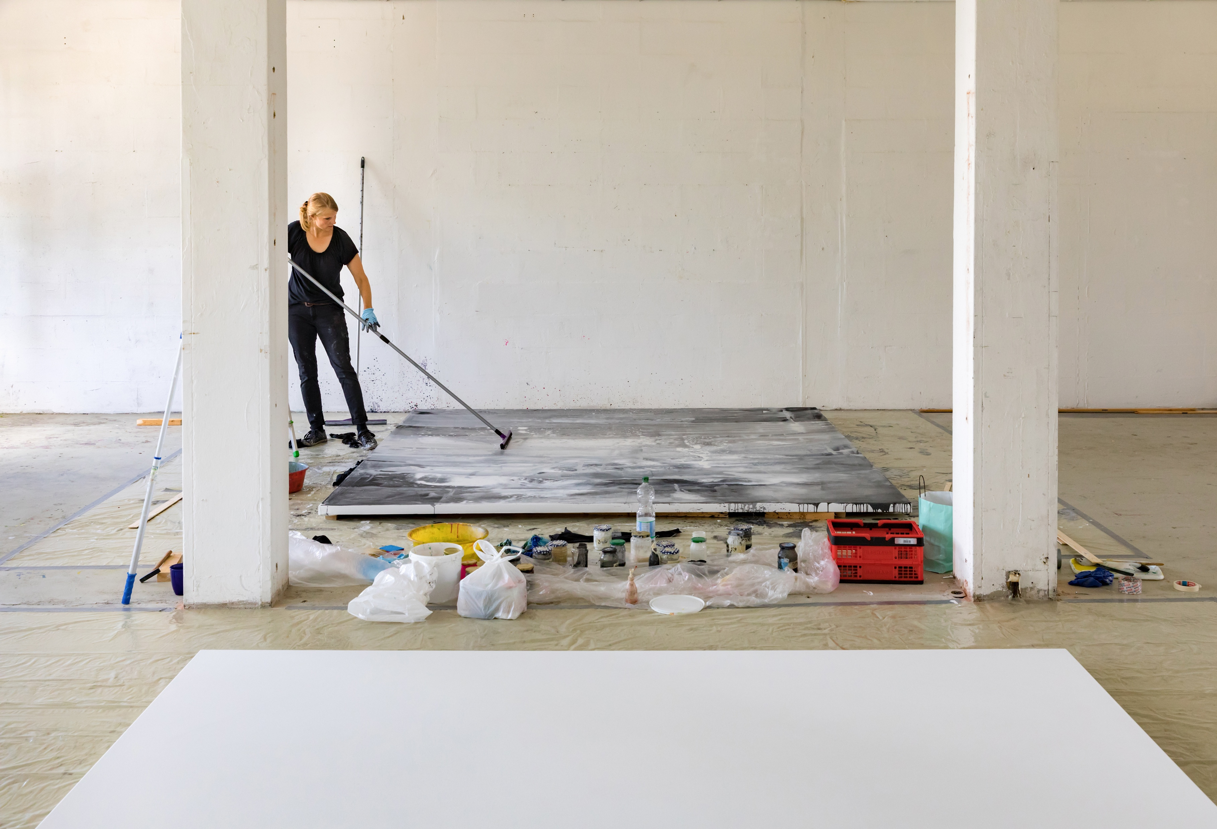
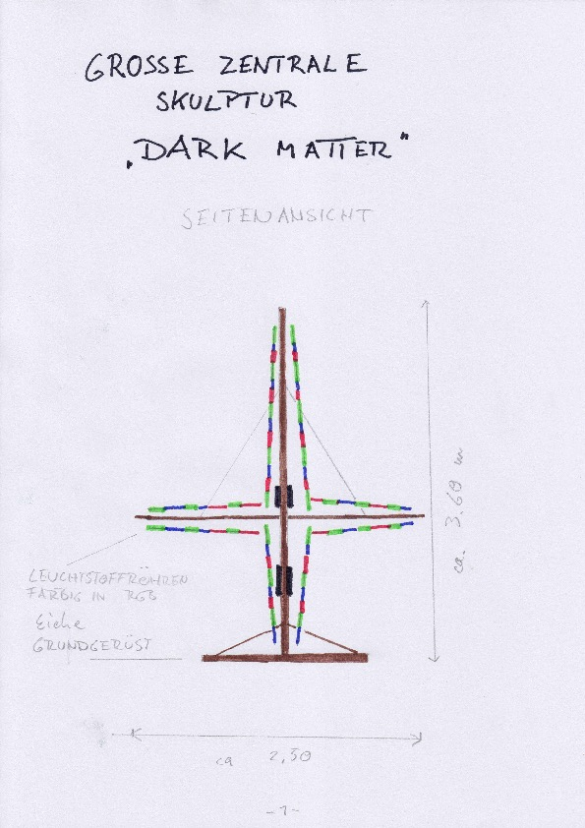
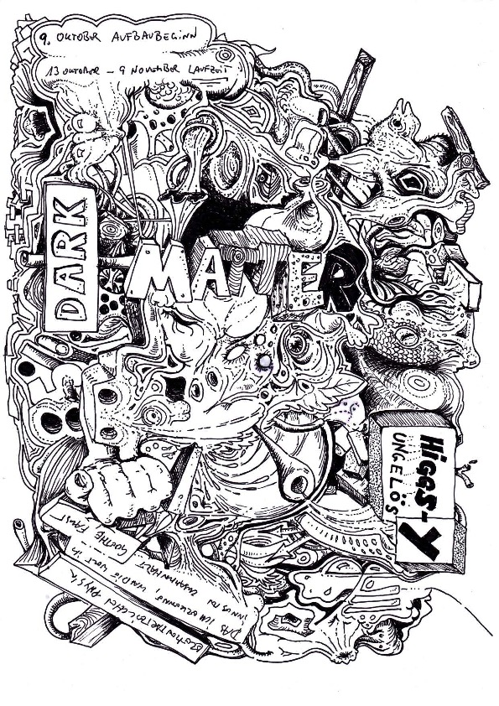
The creative phase – impressions
Tanja Hehmann in her studio; sketches by Baldur Burwitz and Pat Kramer

Slide 8
The creative phase – hurdles
How can we get our science across?
Can we hang huge canvases on tunnel shaft walls?
Where do we find a location at DESY that has enough wall space for all the two-dimensional artworks?
Art meets Science coincides with the DESY Open Day with 20000 expected visitors. How do we make sure the science exhibits and the art exhibits both have enough space?
What training do the artists need in order to be able to work in halls with cryogenics or other restrictions?
How do visitors find their way to the art that is scattered over various buildings on campus?
How do we take visitors to the HERA tunnel? It features a sound installation but access is restricted.
Where do we get the money from?
How do we reach the art crowd? And will they come?
How do we reimburse artists for their material costs?
Is it okay to stage a collision between two cars on the DESY roundabout?
Do we have a crane that can arrange shielding blocks into a safe walk-in construction?

Slide 9
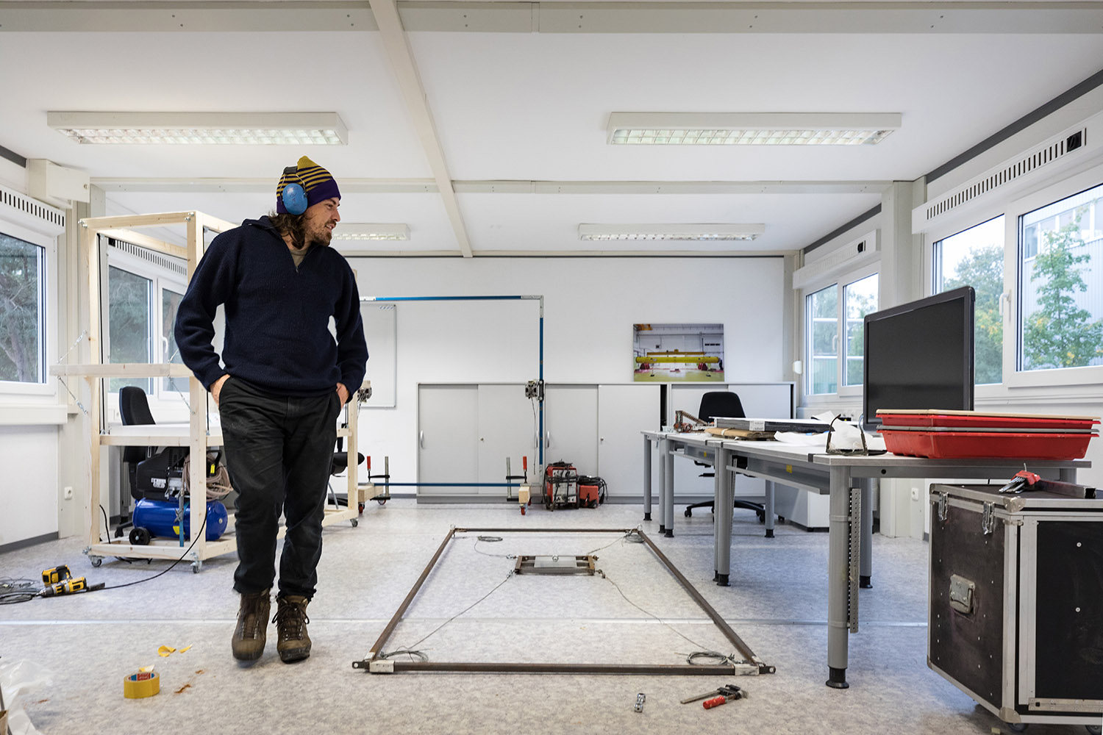
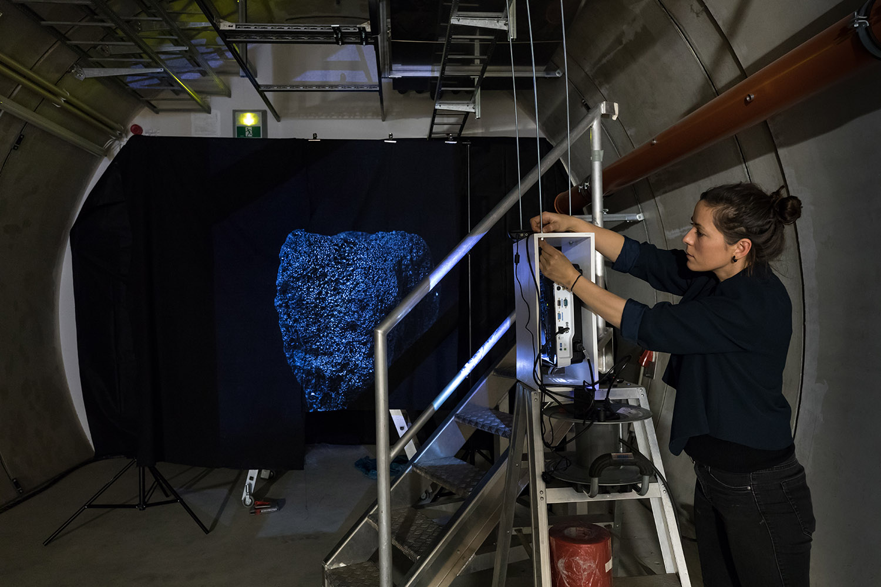
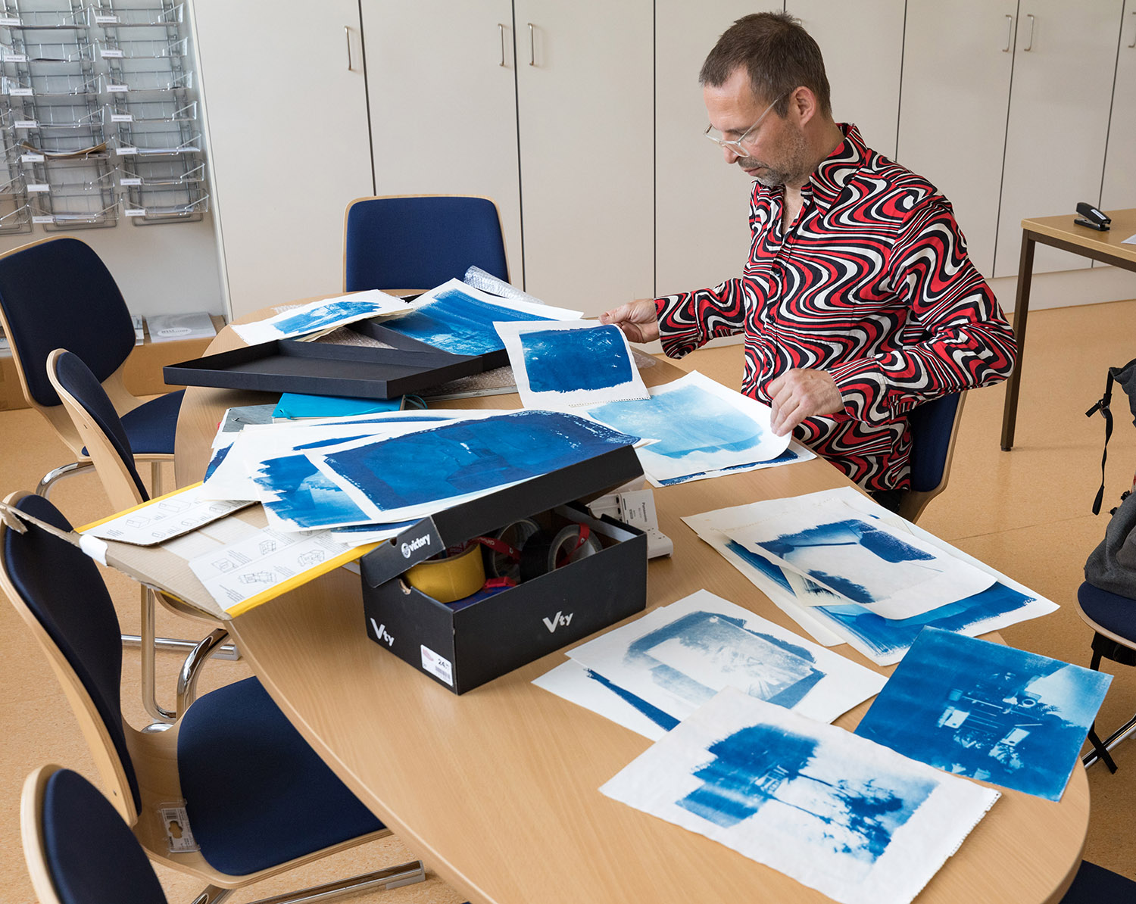
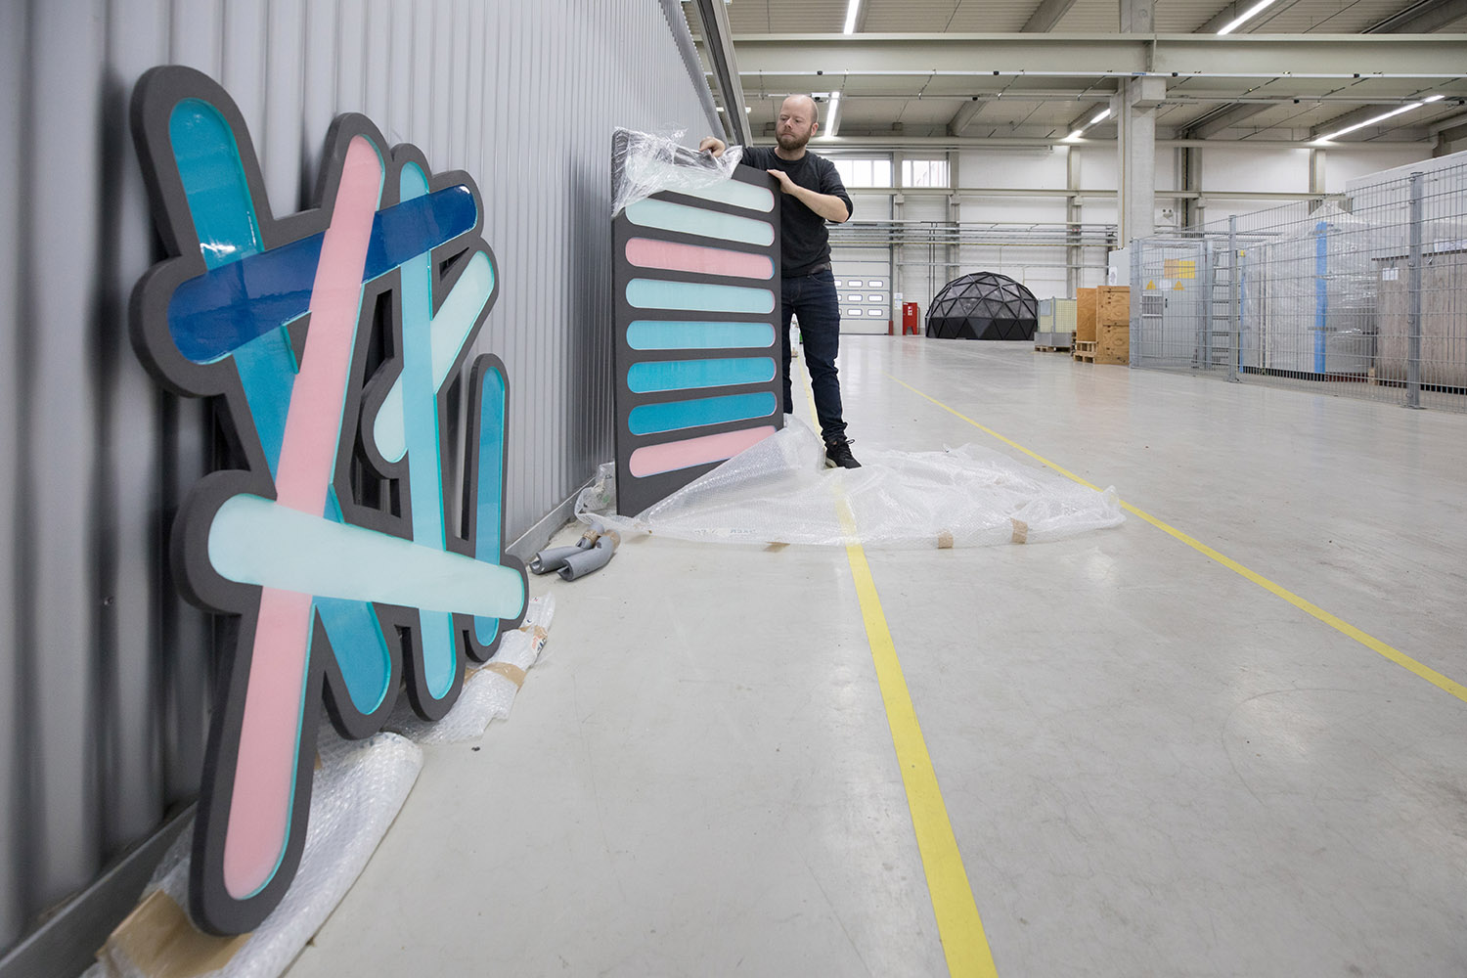
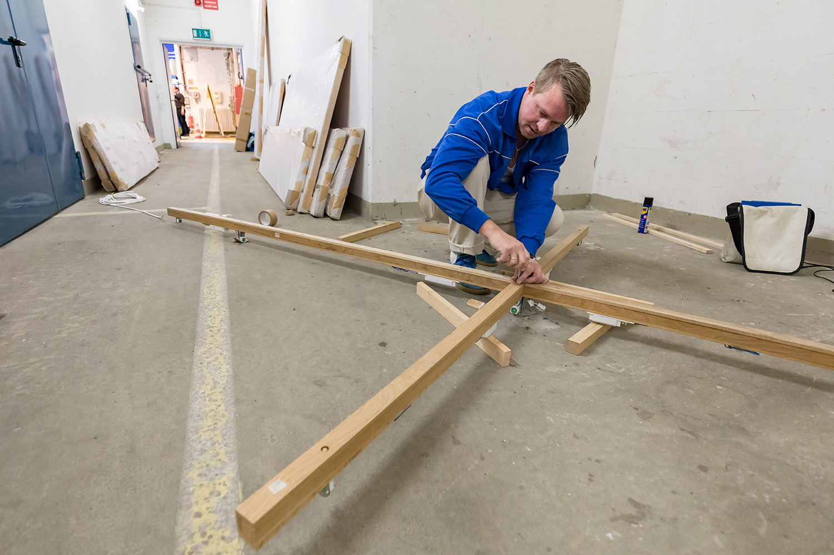
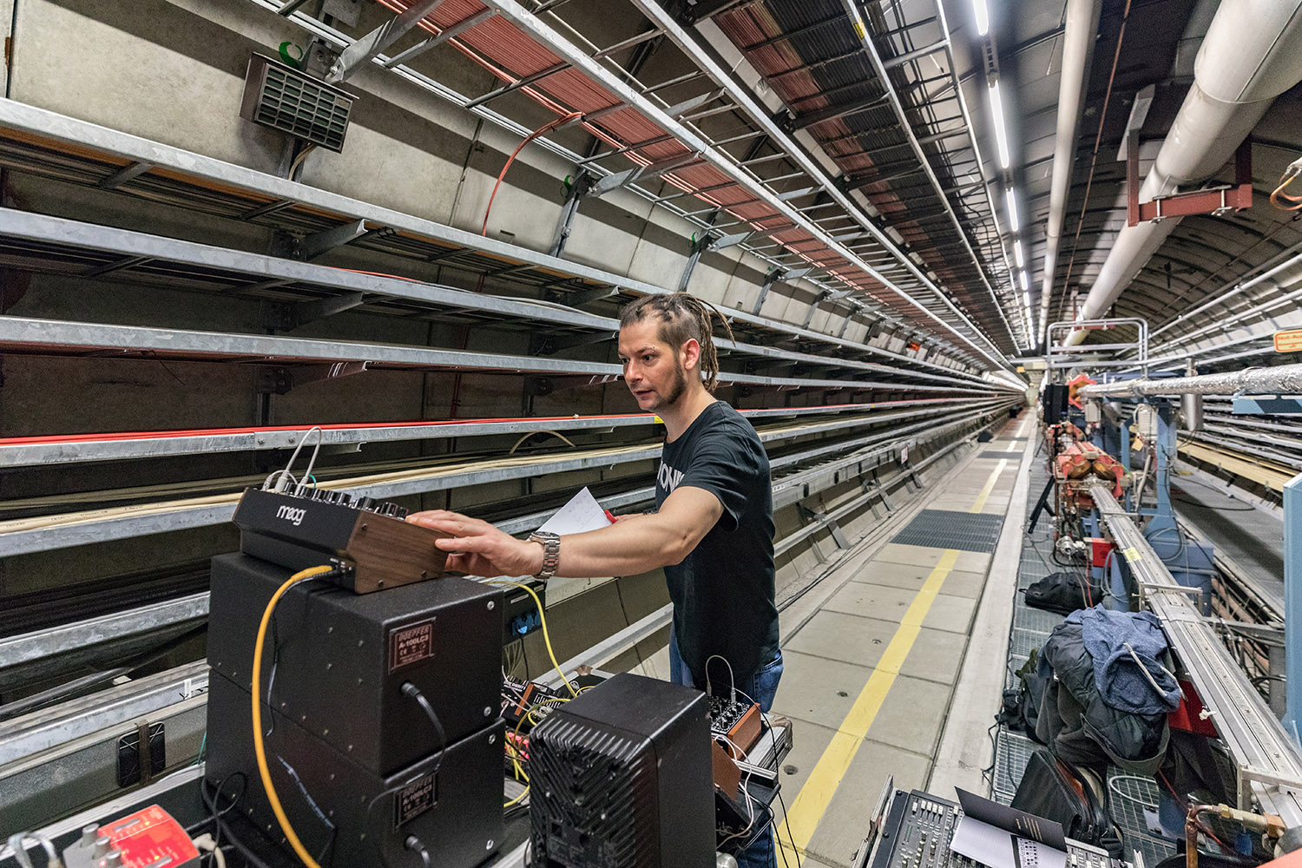
Setting up – impressions

Slide 10
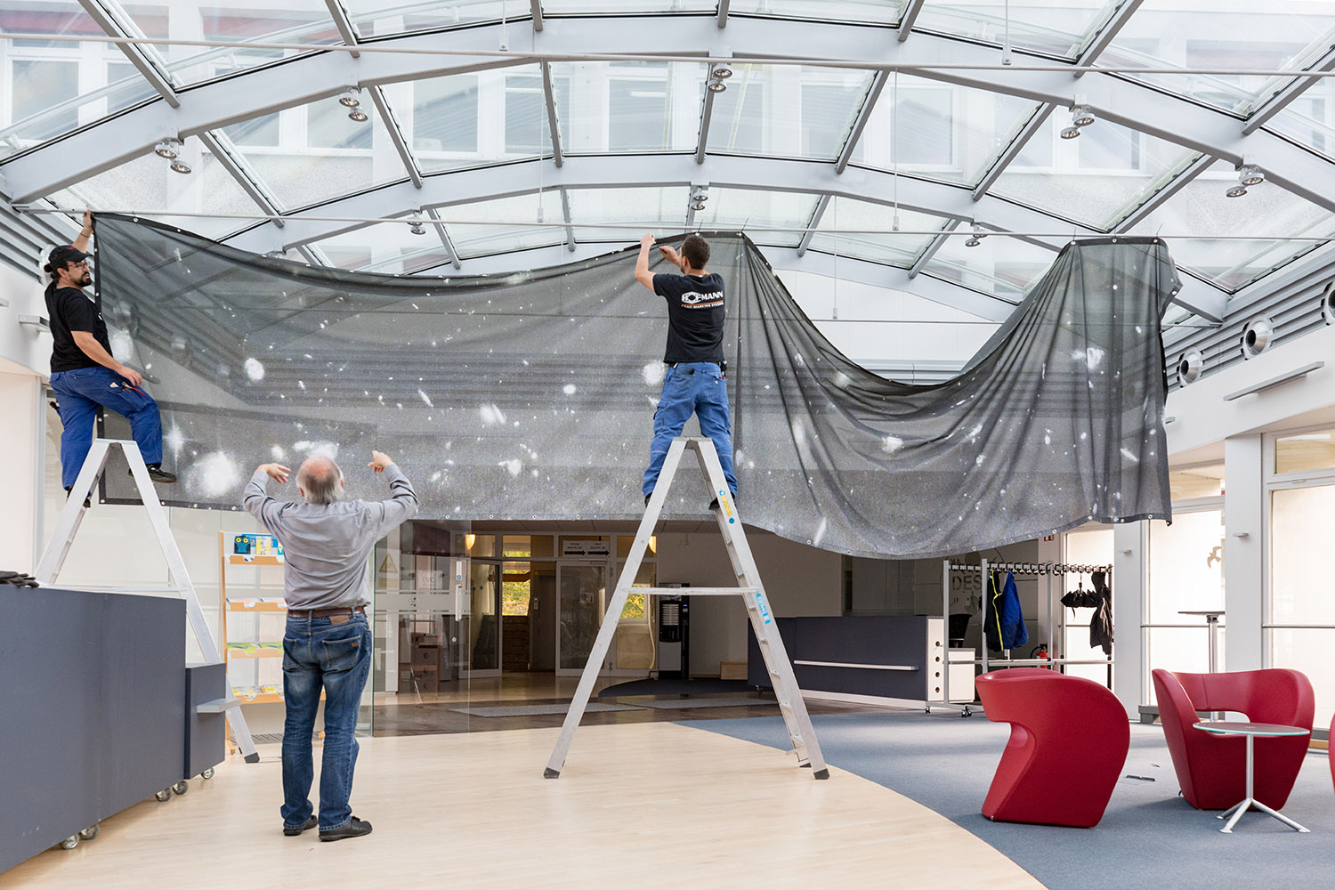

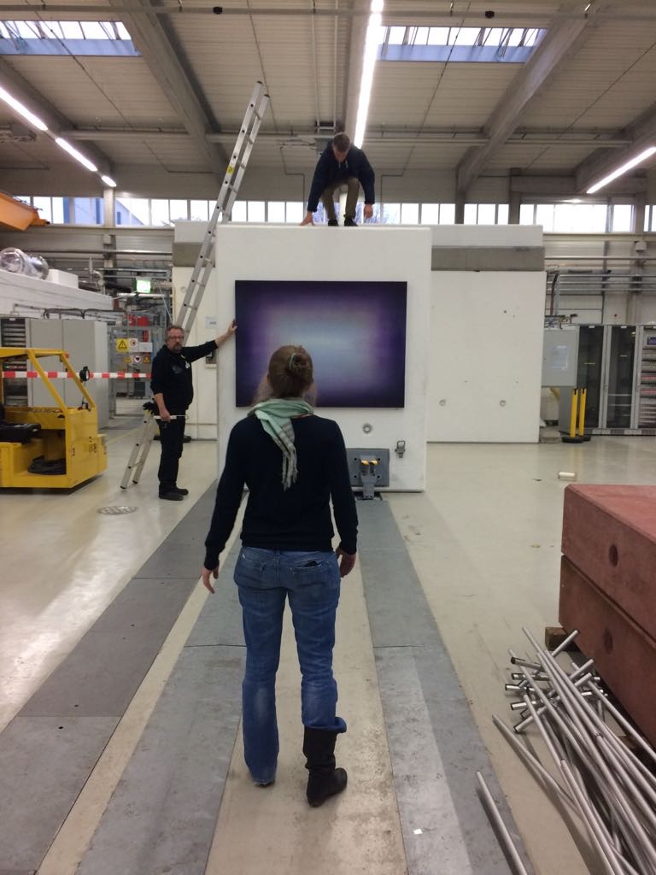
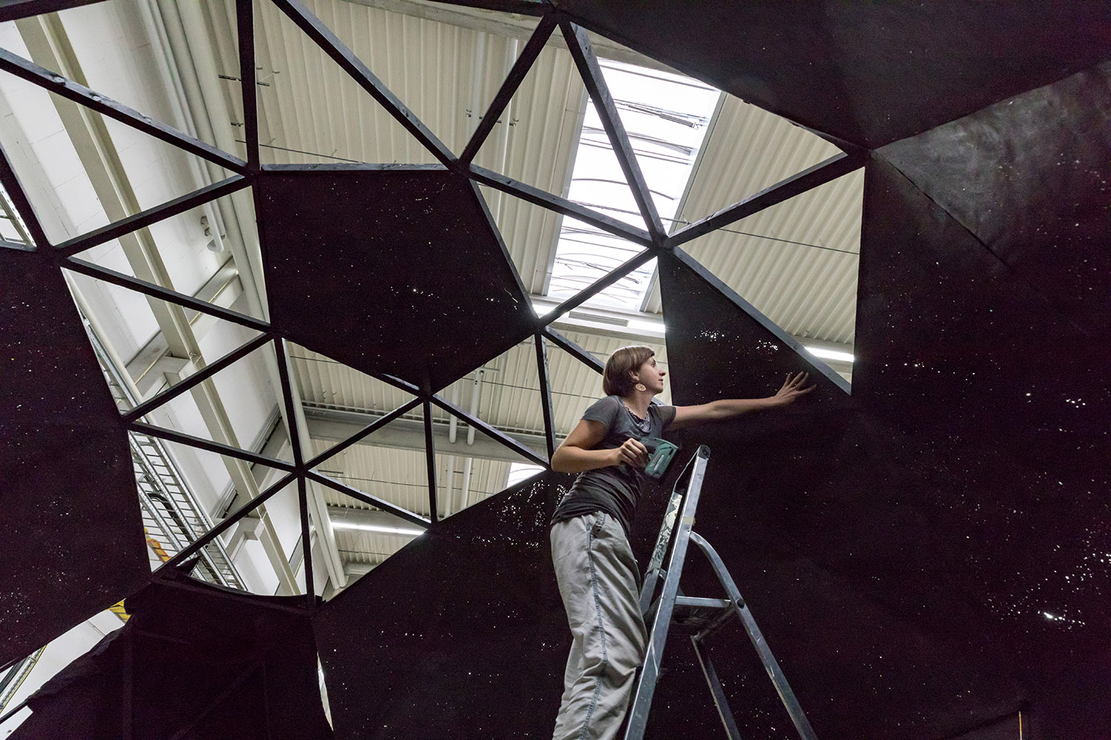
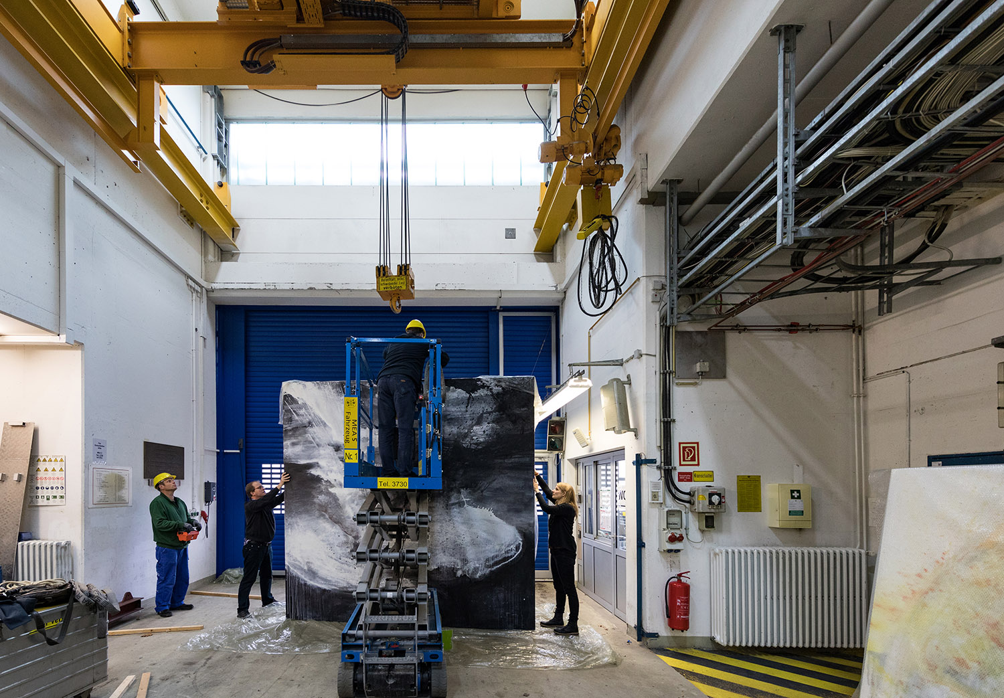
Setting up – impressions

Slide 11
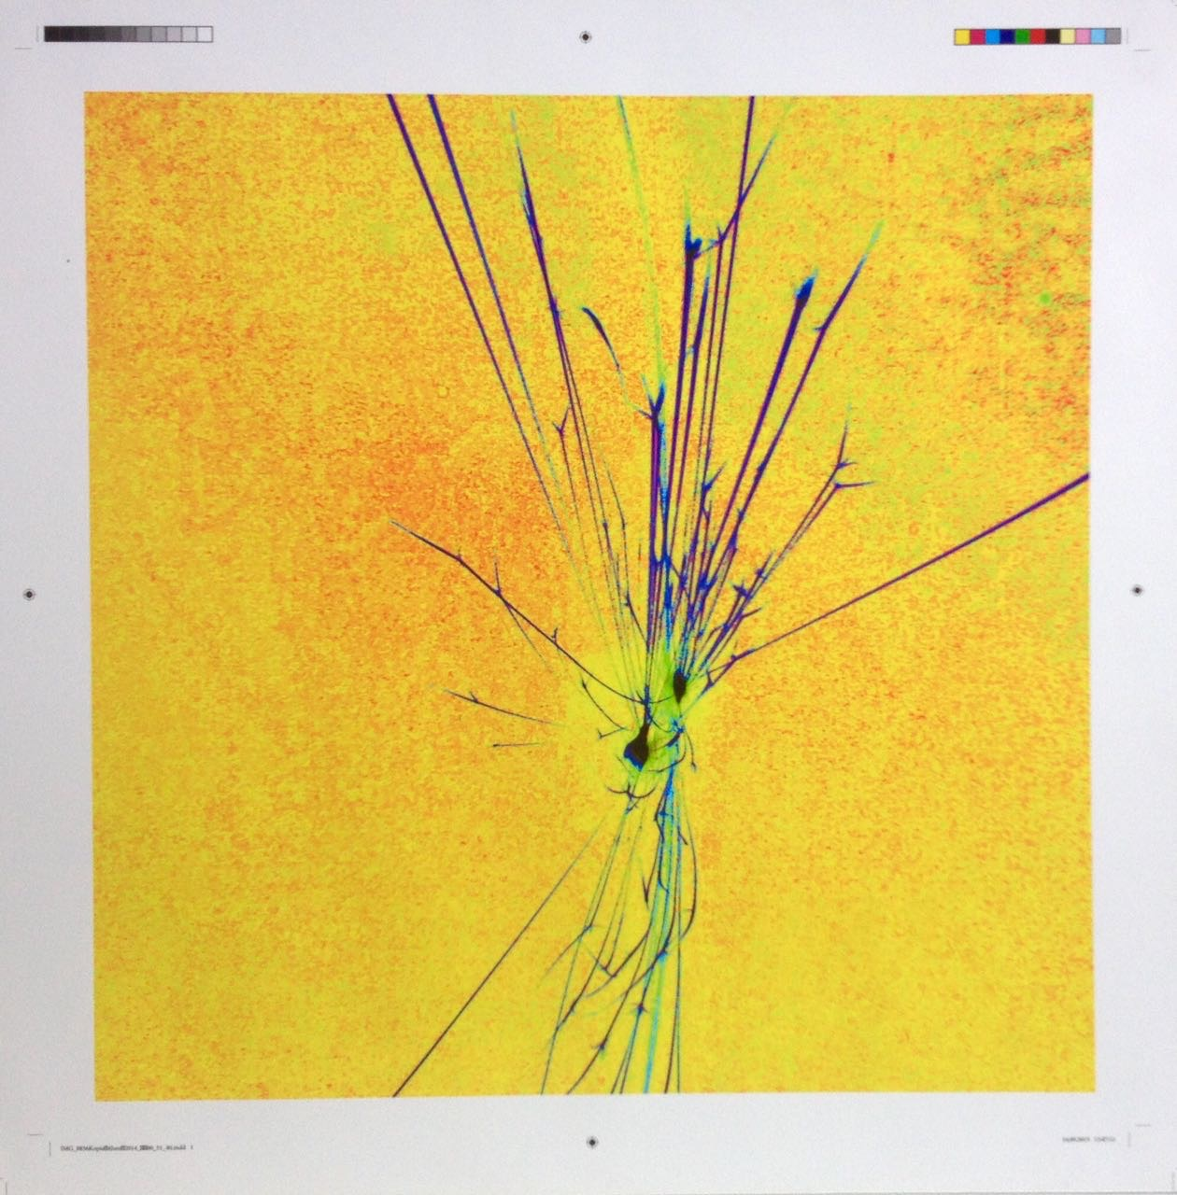
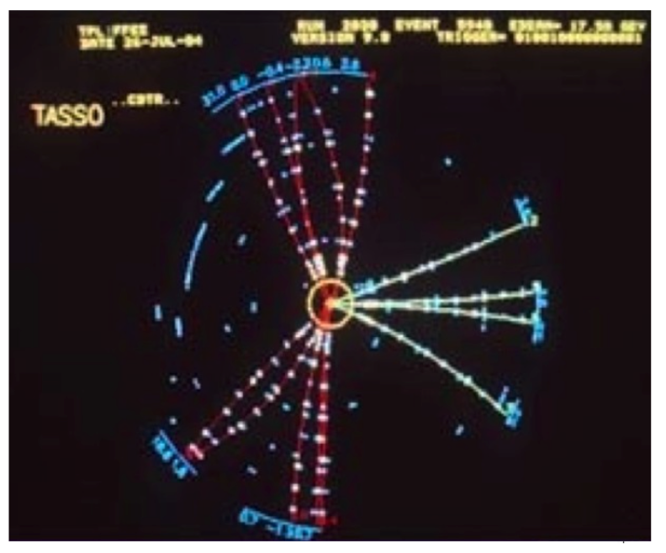
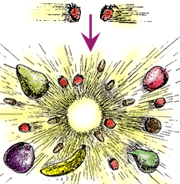
The collision
Science and art are everything but worlds apart
What we learned during the process:
Scientists and artists have very similar approaches to their work:
unbiased
flexible
driven by curiosity
limited by technology
inventive
Main challenge was to find a common language
How can science inspire art?
How can art inspire science? Can art become part of science?
We are still digesting the results.
Marcel Große

Slide 12
The exhibition
Dates: from 13 October to 9 November
13 October: Vernissage
18 October: Lecture Performance and Visit
25 October: Lecture, Discussion and Visit
31 October: Dark Matter Day
4 November: DESY open day
8 November: Lecture, Discussion and Visit
9 November: Finissage
500
250
350
500
20 000
300
200
70 % of visitors had never set foot on the DESY campus before

Slide 13
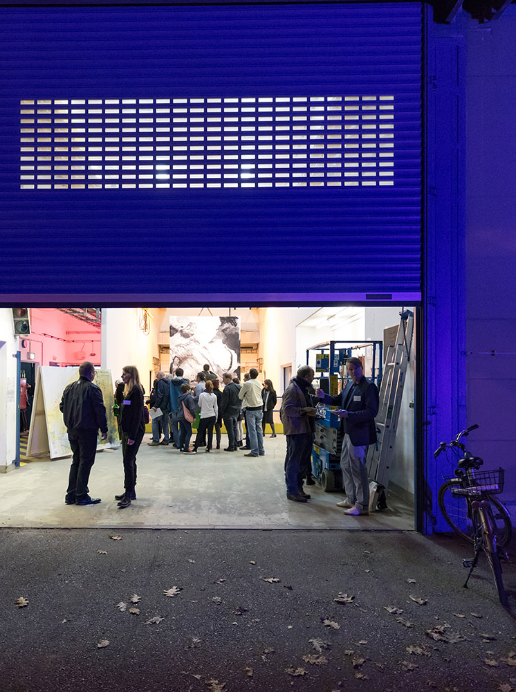
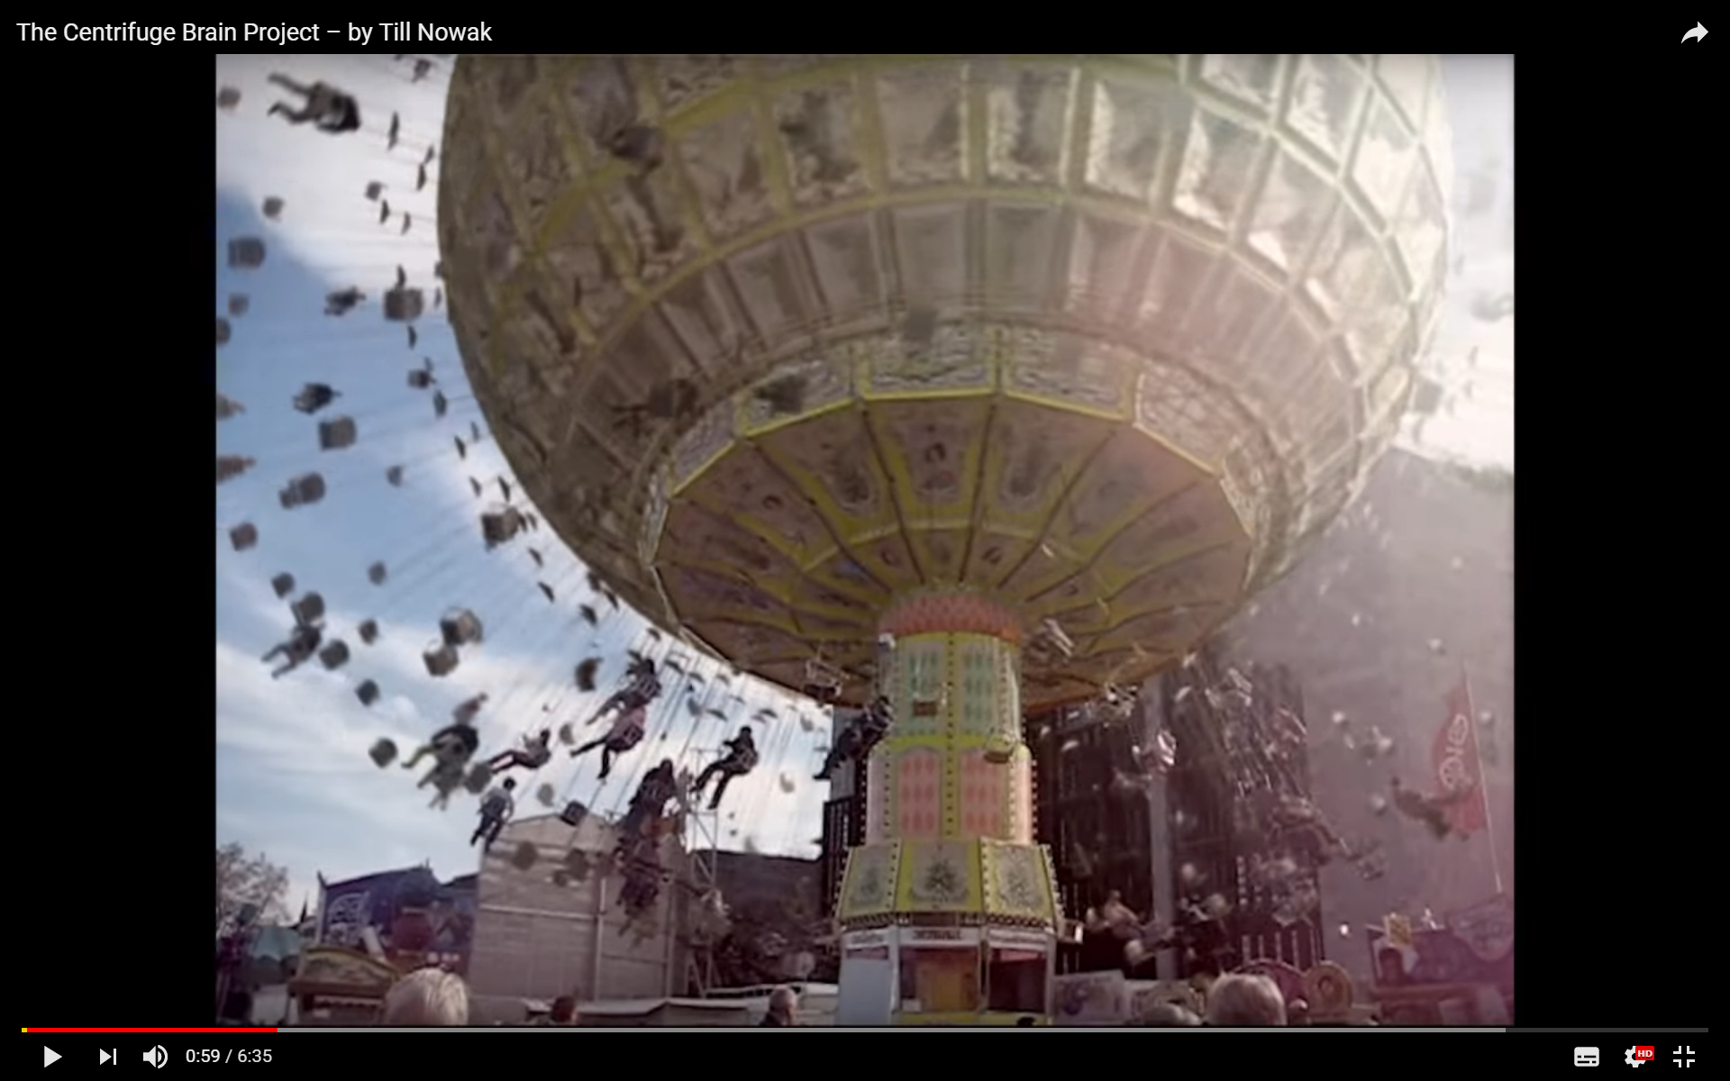
The exhibition - impressions
Scientific programme | Guided tours, talks, short films
Quelle: You Tube, Till Nowak – The Centrifuge Brain Project

Slide 14
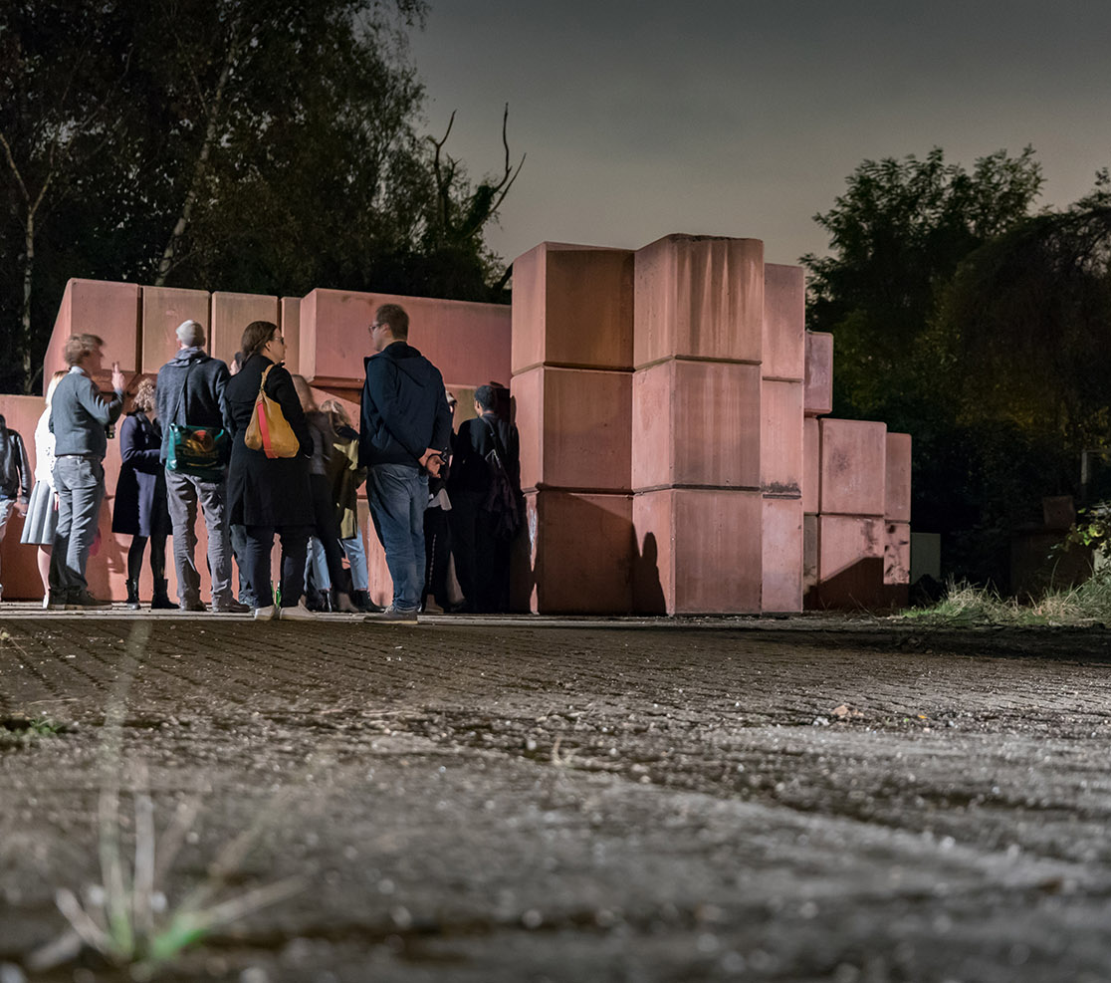
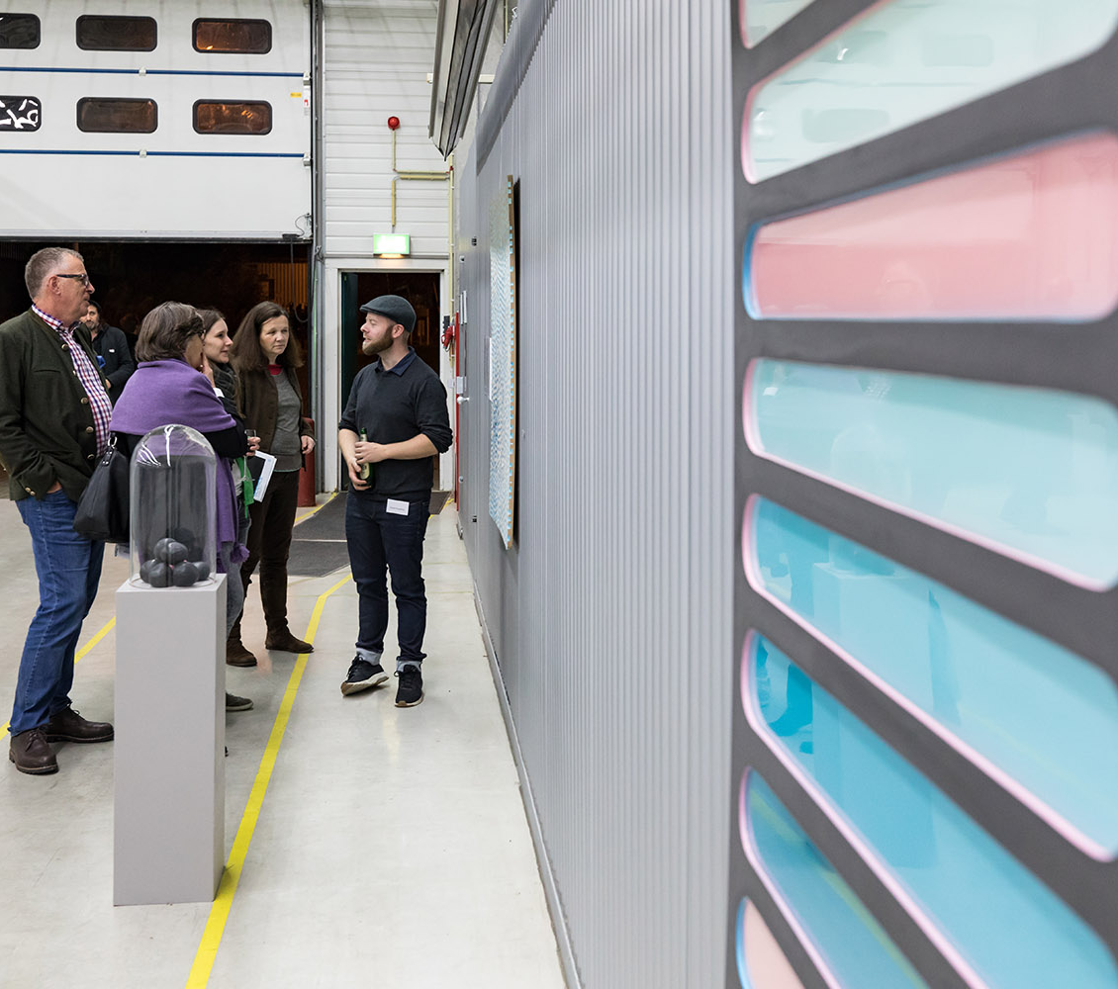
Dark Matter
The exhibition: impressions

Slide 15
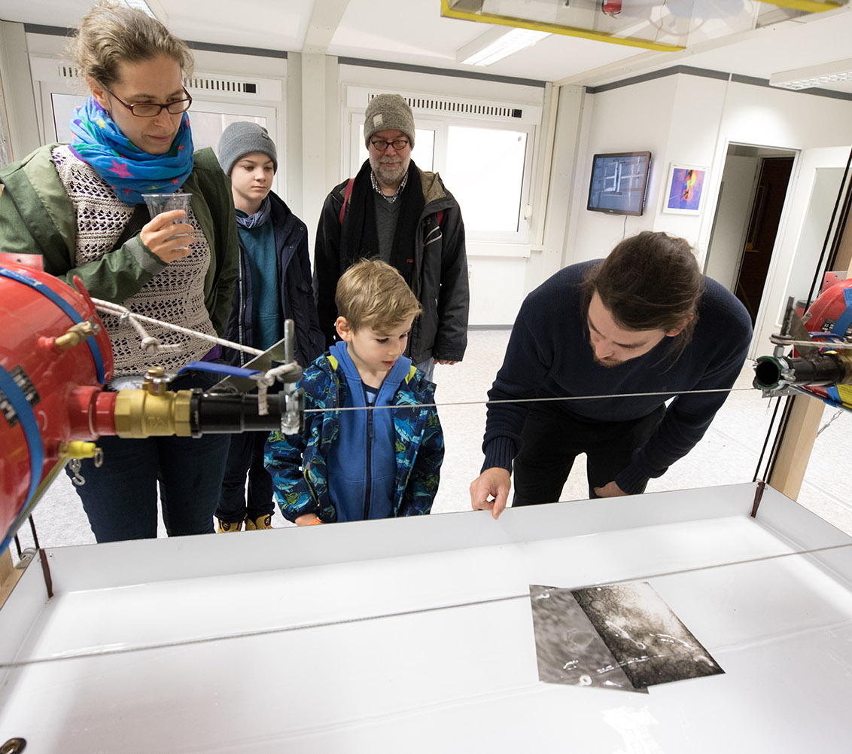
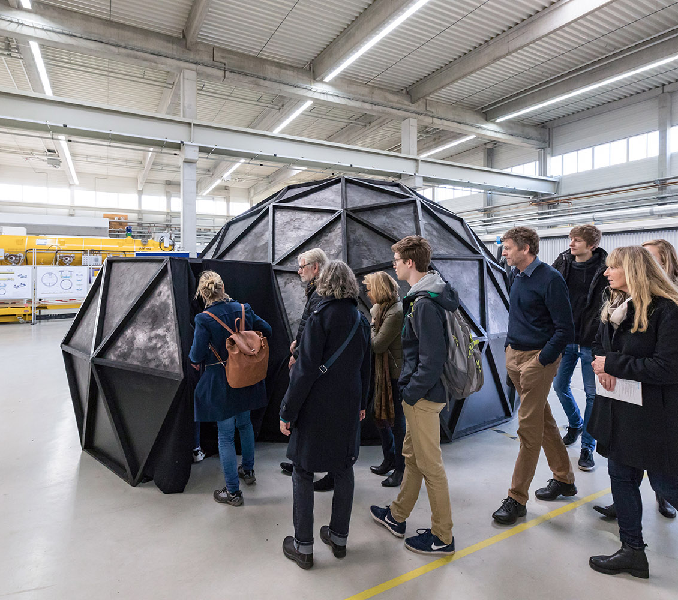
Dark Matter
The exhibition: impressions

Slide 16
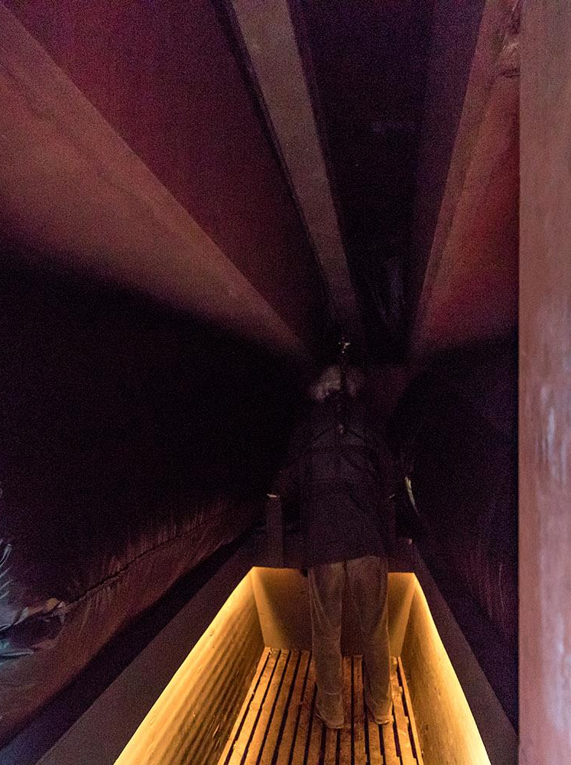
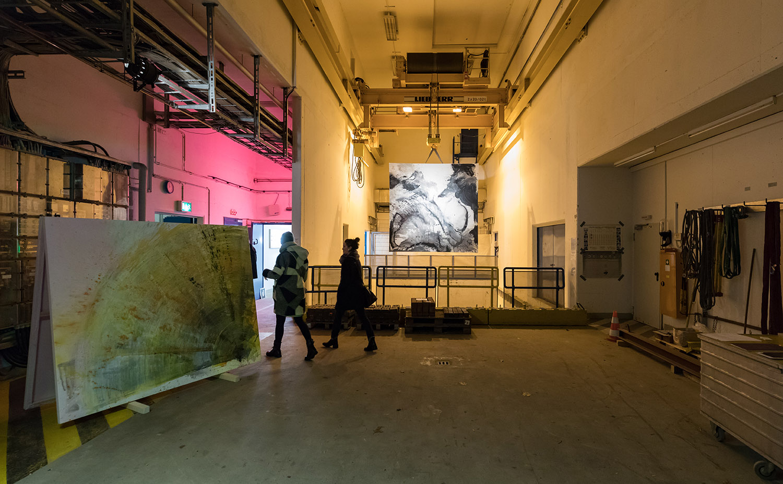
Dark Matter
The exhibition: impressions

Slide 17
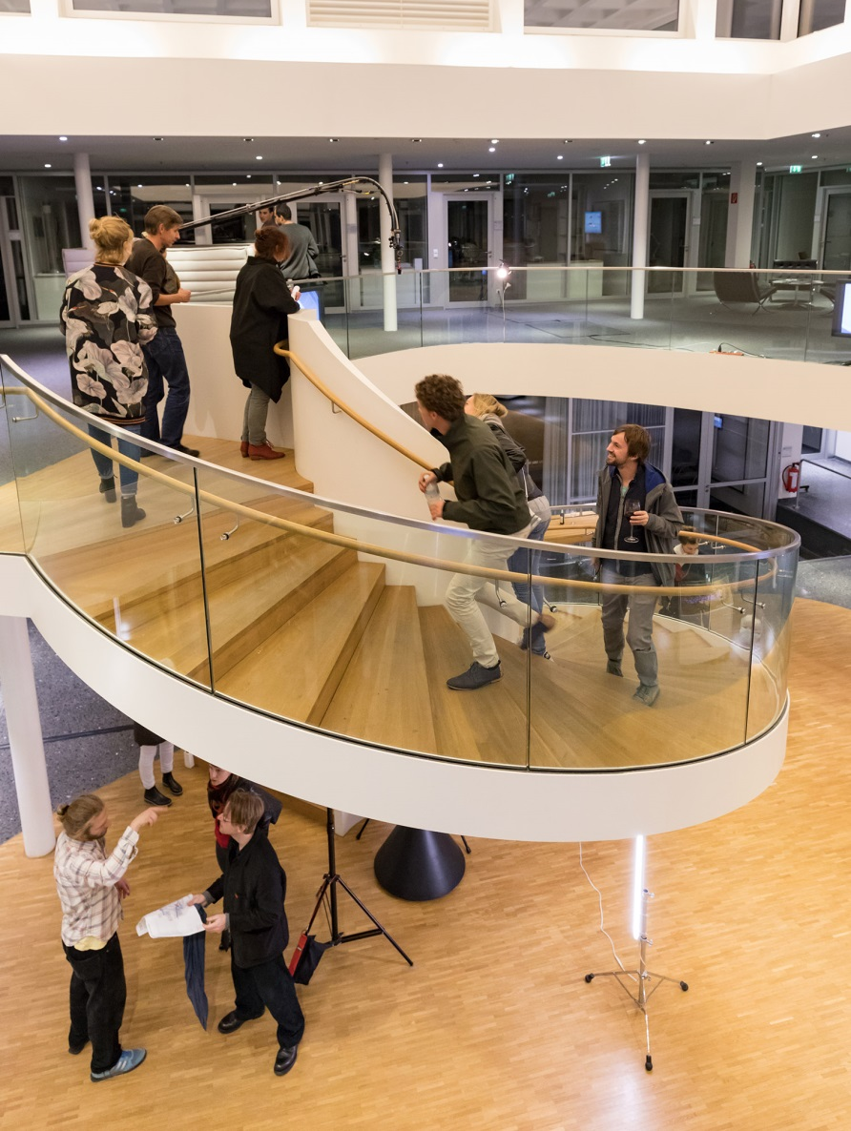

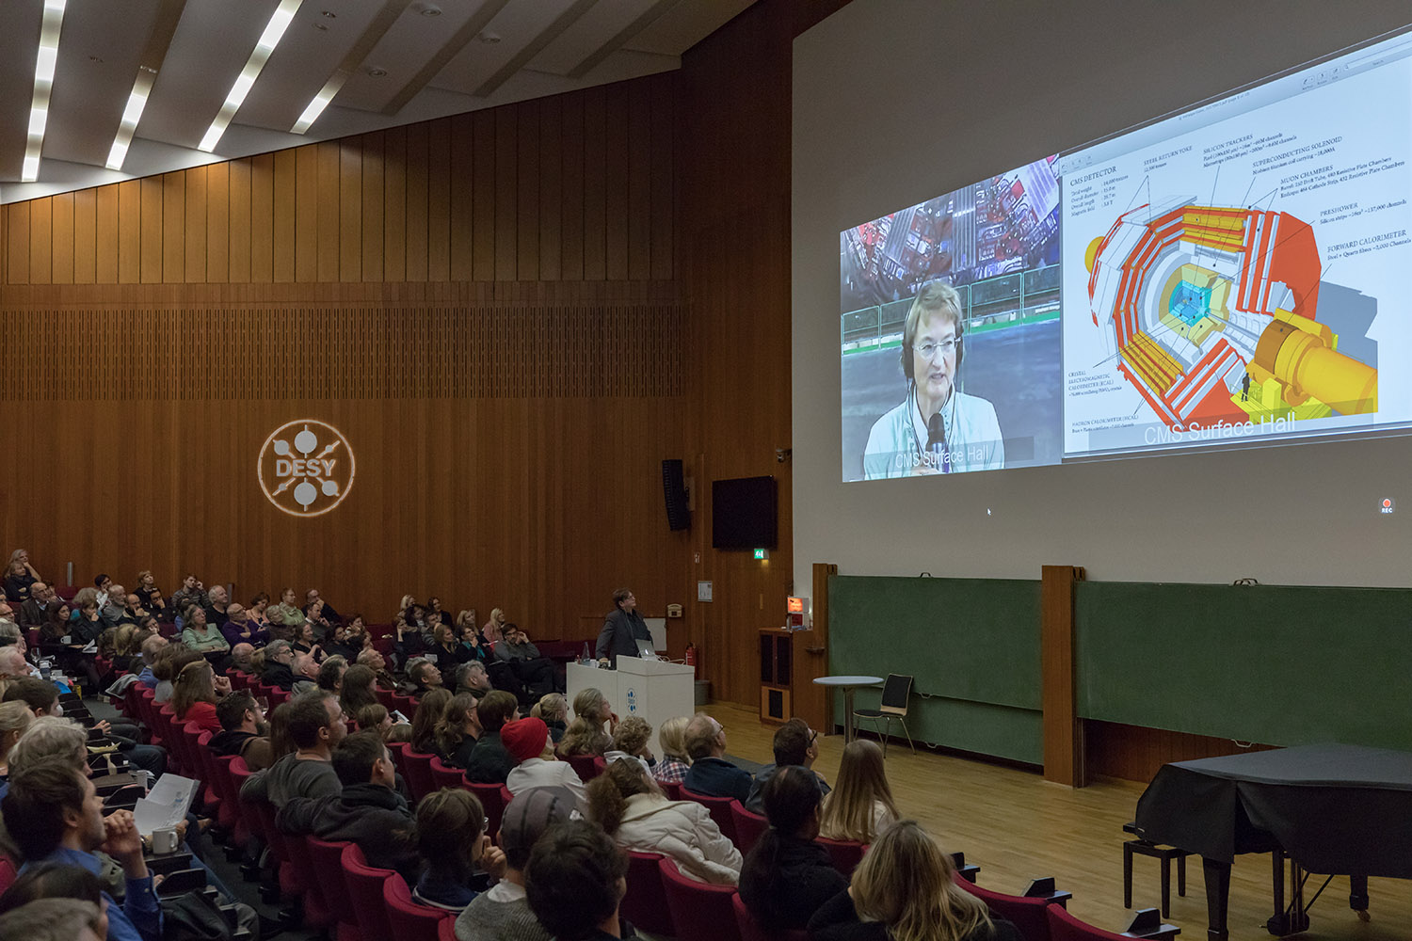
Dark Matter
The exhibition: impressions

Slide 18
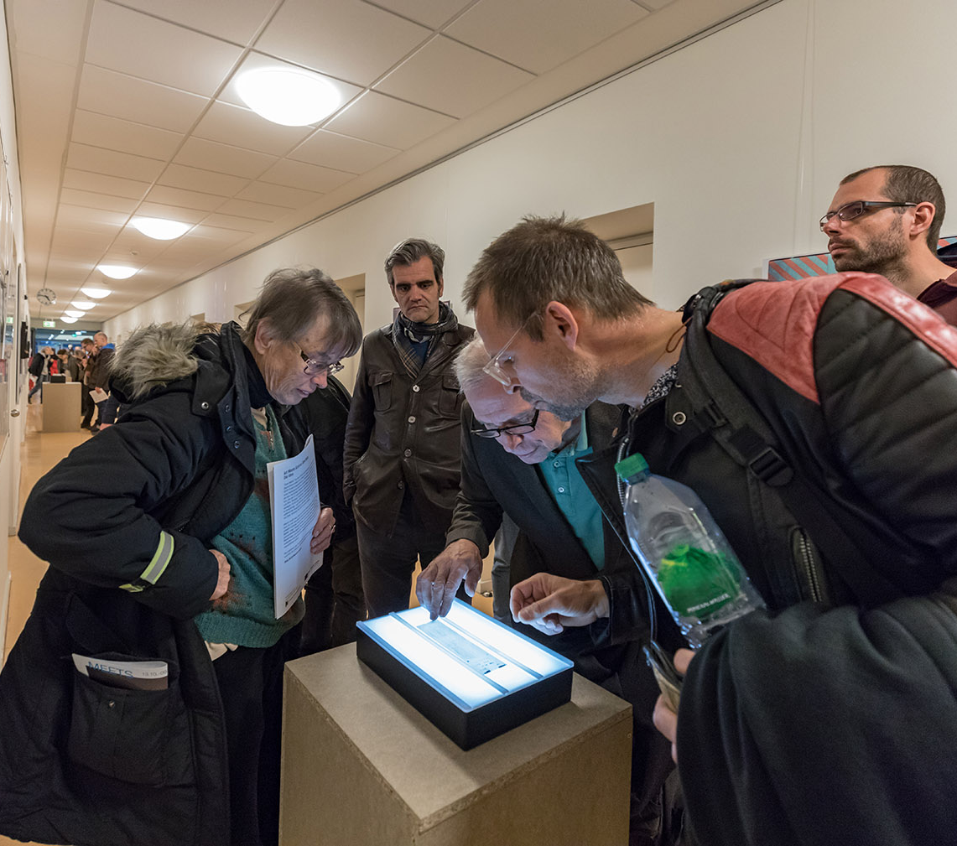
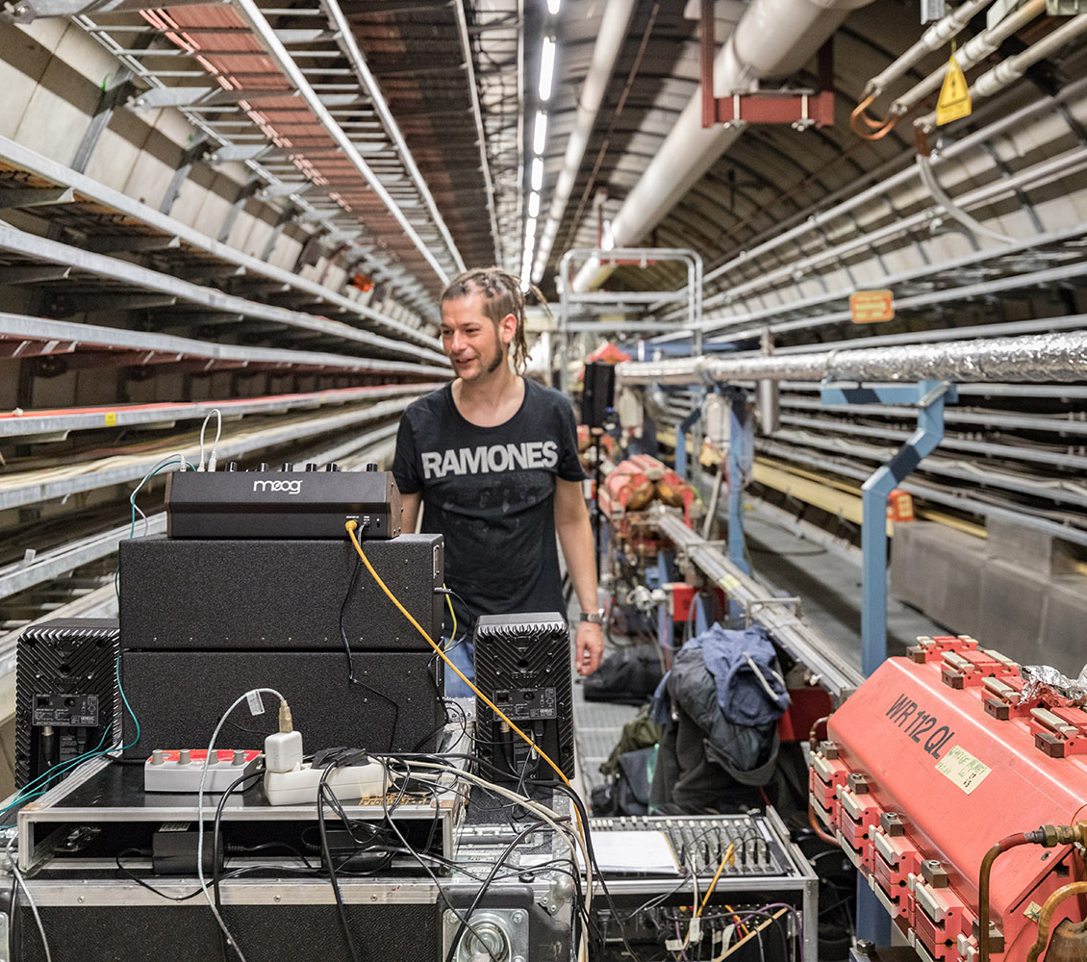
Dark Matter
The exhibition: impressions

Slide 19
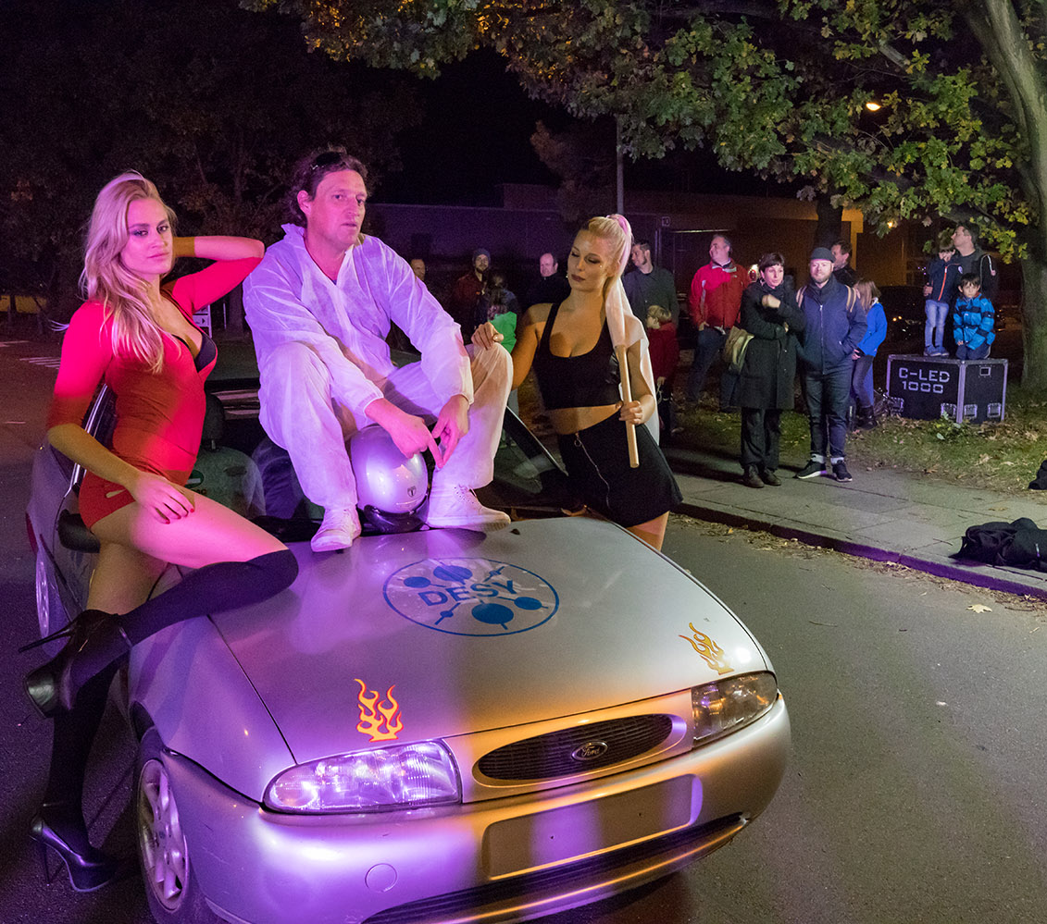
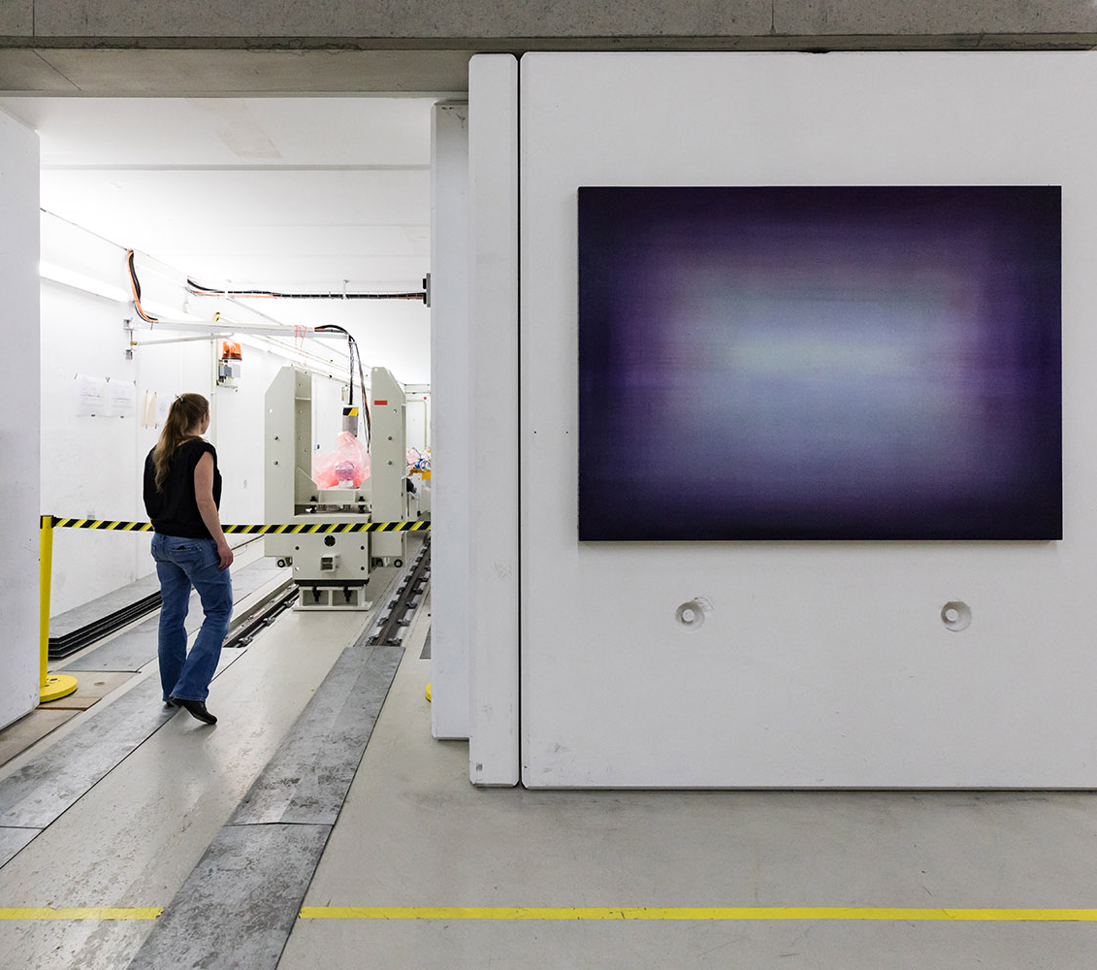
Dark Matter
The exhibition: impressions

Slide 20



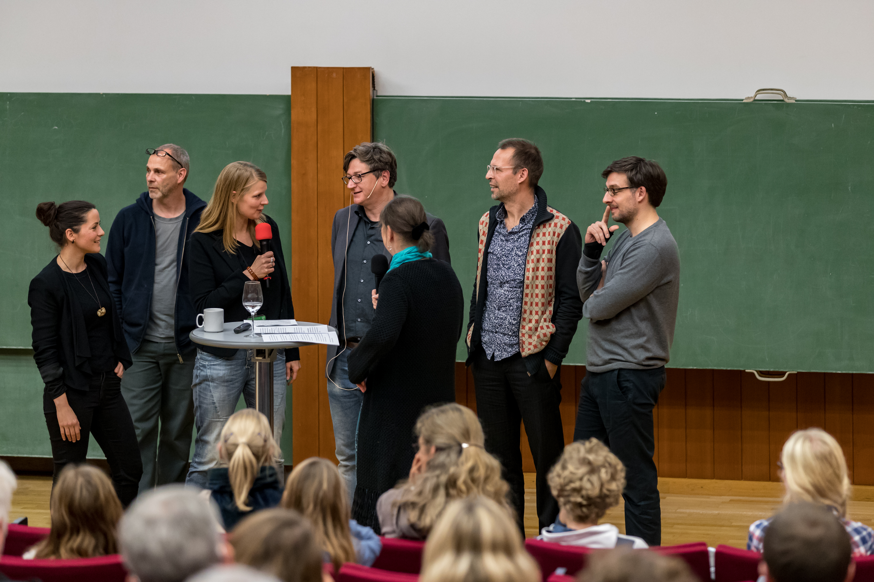

Dark Matter
Science places and artworks were sometimes hard to distinguish

Slide 21
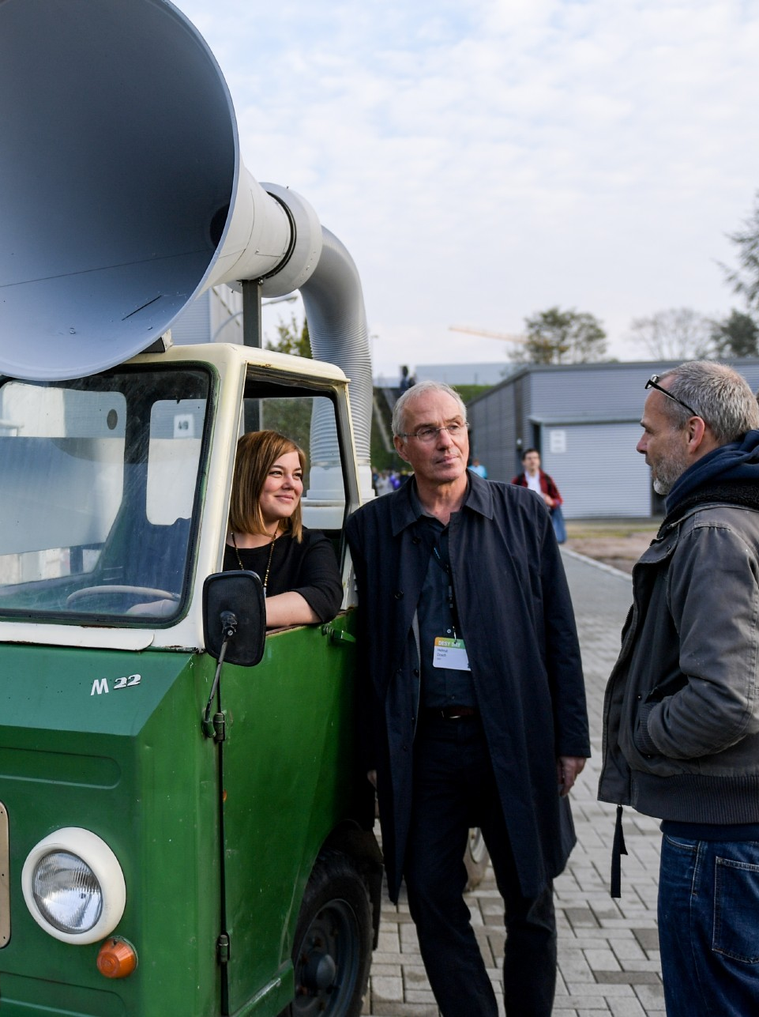
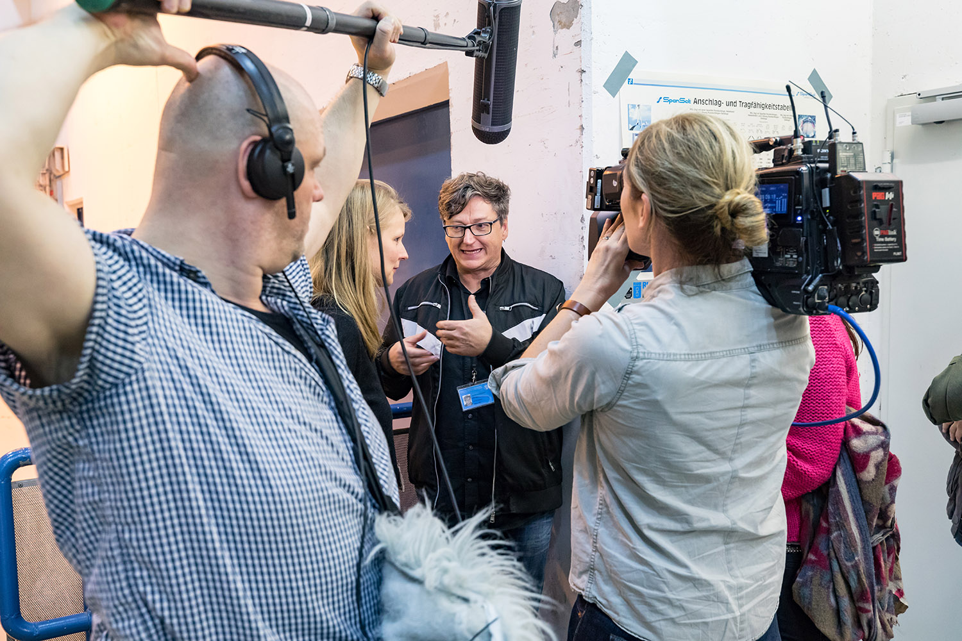
Dark Matter
Media interest for the exhibition was high

Slide 22
Media response Dark Matter
Berichterstattung | gesamt: 50 Beiträge
Darunter:
NDR, Hamburg Journal
FAZIT:
DESY konnte durch das Kunstprojekt neue Interessens-gruppen für seine Forschungs-inhalte begeistern.
DESY erreichte durch die Ausstellung überregionale Aufmerksamkeit und positive Berichterstattung über die Fachpresse hinaus.
Darunter:
spiegelonline
welt.de
hamburg.de
abendblatt.de
Szene-hamburg.de mopo.de
taz.de
hamburg.de
heuteinhamburg.de
gemeintipphamburg.de
Goethe-institut-hamburg.de
Darunter:
Die Welt
TAZ
Mopo
Hamburger Abendblatt

Slide 23
Outlook
More art will meet more science
The pilot project was very successful. DESY will build on this success:
DESY is working on a concept for a sustainable art-meets-science project
  Several ideas for follow-up projects already in the pipeline
  Board of curators to be founded
  DESY starts its own art collection
  Artists in residence
  … and more

Slide 24
Backup: Video
Documentation video by Kreativ Gesellschaft
https://vimeo.com/247946339

