Slide 1









Measurements and Simulations of Surface Radiation Damage Effects on IFX and HPK Test Structures
F. Moscatelli^{a,b}, A. Morozzi^{b,c}, D. Passeri^{b,c},
S. Mattiazzo^{d}, G.-F. Dalla Betta^{e,f}, V. Hinger^{g} and G. M. Bilei^{b}
ª CNR-IOM of Perugia, via Pascoli 1, 06123, Perugia, Italy
^{b} INFN of Perugia, via Pascoli 1, 06123, Perugia, Italy
^{c} Department of Engineering – University of Perugia, via G. Duranti 93, 06125, Perugia, Italy
^{d} Dipartimento di Fisica e Astronomia e INFN di Padova, via Marzolo 8, 35131 Padova, Italy
^{e} DII University of Trento, via Sommarive 9, 38123, Trento, Italy
^{f} TIFPA INFN, via Sommarive 14, 38123 Trento, Italy
^{g} HEPHY, Austrian Academy of Sciences, 1050 Wien, Austria

Slide 2
Outline
Motivations
Experimental measurements (X-rays irradiations)
  Different test-structures (MOS capacitors, Gated Diodes, Interstrip resistance test structures)
  Different providers (HPK, IFX) and processes
  TCAD Simulation Results
  Model validation: comparison between simulation findings and experimental data
    Conclusions and future developments

Slide 3
Motivations and goals
Study the effects of surface damage on silicon devices at high doses (HL-LHC operation greater than 50 Mrad for Outer Tracker and 1 Grad for Inner Tracker).
Surface damage can strongly influence the breakdown, the inter-electrode isolation, the dark current and the charge collection efficiency of the sensor.
Extension of the predictive capability of the past “University of Perugia” numerical TCAD model to these very high doses:
    Physically-grounded parametrization,
    Keep low the number of traps (e.g. avoiding fitting),
    No over-specific modelling (e. g. device and technology independent)
    Deep understanding of physical device behavior.
Extraction from simple test structures of relevant parameters to be included within the model
Validation of the new modeling scheme through comparison with measurements of different test structures manufactured by different vendors with different processes before and after irradiation.

Slide 4
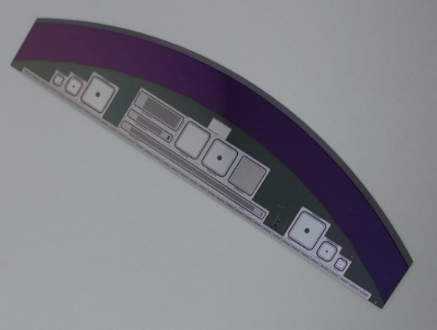
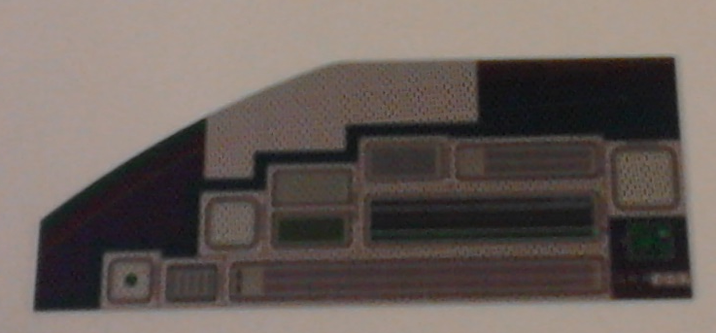
Test structures IFX and HPK
IFX
HPK
MOS
capacitor
Cap-TS
for Rint
MOS
capacitor
Gated-diode
Gated-diode
MOS capacitors
1 gated diode (called GCD)
Strip structures for Rint measurements
Measurement Campaign: X-ray irradiation
  carried out in Padova (IT). Dose rate 0.8 Mrad/hour
  doses range: 0.05 ÷ 100 Mrad(SiO₂)
  Measurements after irradiation / annealing 80°C 10 min.

Slide 5
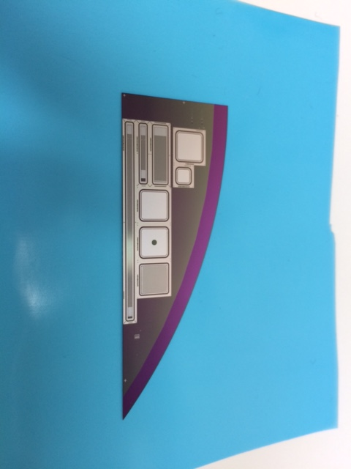
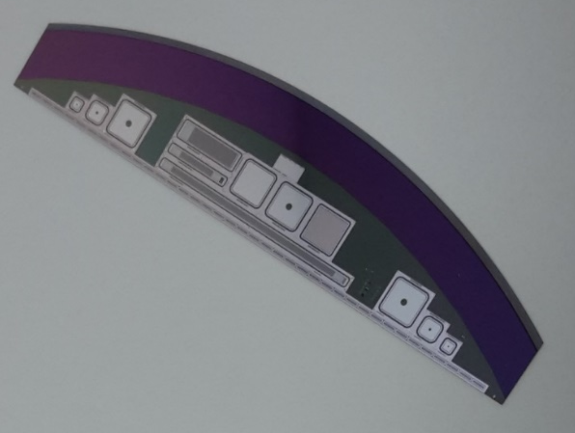
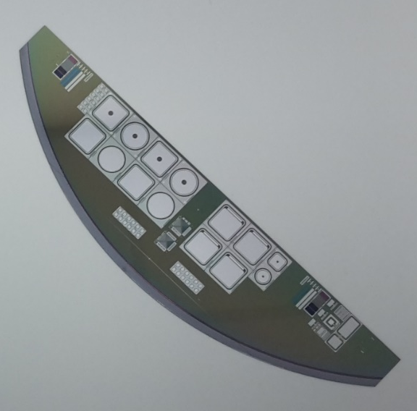
IFX devices
1st campaign 0.05-20 Mrad
IFX 8-inch 2S run
MOS
GCD
Rint
2nd campaign
IFX 6-inch PS-S run
MOS
FET
2nd campaign
IFX 8-inch 2S run
MOS

Slide 6
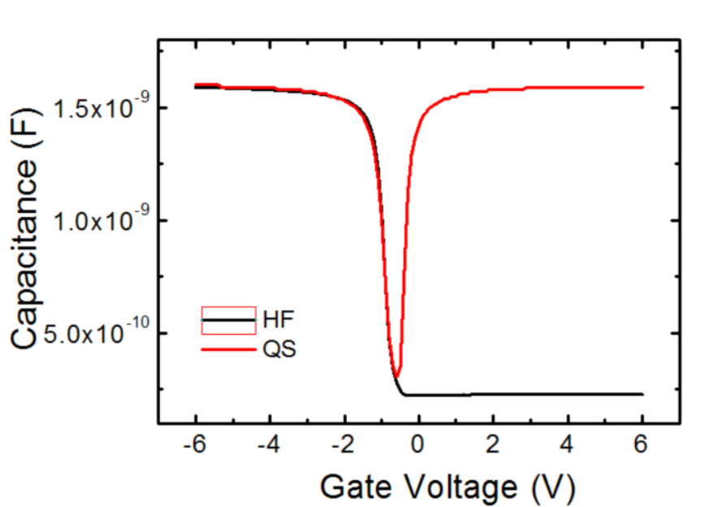
MOS Capacitors: measurements
p-type substrate.
HF measurements at 100 kHz with a small signal amplitude of 25 mV.
The QS characteristics were measured with delay times of 0.5 s using a voltage step of 100 mV.
Effective oxide charge density N_{EFF} obtained from V_{FB} measurements.
Unbiased devices during the irradiation steps. Dry N flux during measurements.
IFX PS-S
IFX 2S

Slide 7
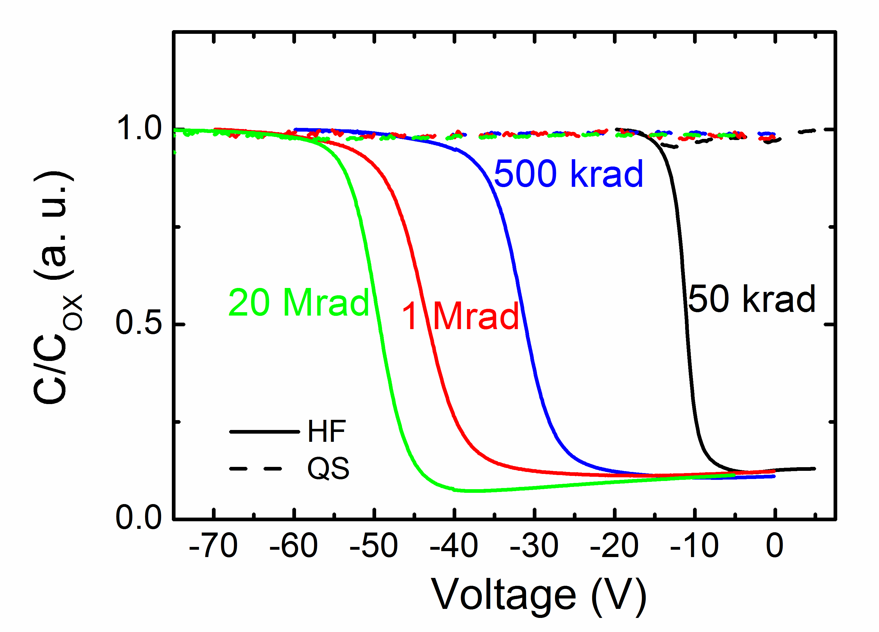
IFX 2S MOS CV Measurements after X-ray
V_{FB} ≅ -10 V at 50 krad
V_{FB} ≅ -17 V at 100 krad (not shown in this figure)
V_{FB} ≅ -30 V at 500 krad
V_{FB}≅-42 V at 1 Mrad
V_{FB}≅-50 V at
10-20 Mrad

Slide 8
IFX 2S MOS CV after X-ray 2nd campaign
V_{FB} ≅ -5 V at 50 krad
V_{FB} ≅ -7 V at 100 krad
V_{FB} ≅ -18 V at 500 krad
V_{FB}≅-23 V at 1 Mrad
V_{FB}≅-35 V at
10 Mrad
V_{FB}≅-65 V at
100 Mrad

Slide 9
IFX PS-S CV after X-rays
V_{FB} ≅ -4 V at 50 krad
V_{FB} ≅ -5 V at 100 krad
V_{FB} ≅ -11 V at 500 krad
V_{FB}≅-15 V at 1 Mrad
V_{FB}≅-40 V at
10 Mrad
V_{FB}≅-55 V at
100 Mrad

Slide 10
HPK CV after X-rays
Process p-stop (no implant under the oxide)
P-spray

Slide 11

IFX - MOSFETs
V_{th} = -0.1 (unirradiated)
Unbiased devices during the irradiation steps
Radiation → interface traps (N_{IT}) + trapped-oxide (N_{OX}) → V_{th} shift (ΔV_{th}).
ΔV_{th} is separated into a contribution due to N_{IT} and due to N_{OX,} from I_{DS}-V_{GS} of MOSFET (method proposed in McWorther Applied Physics Letters 48, 133 (1986))
${∆V}_{th}={∆V}_{N_{it}}$ + ${∆V}_{N_{ox}}$

Slide 12
IFX p-type Summary of measurements
For N_{EFF} :
  Differences among the three processes at low doses.
  At high doses similar results.
PS-S has higher interface traps

Slide 13
HPK p-type Summary of measurements
As expected very similar values for HPK devices

Slide 14
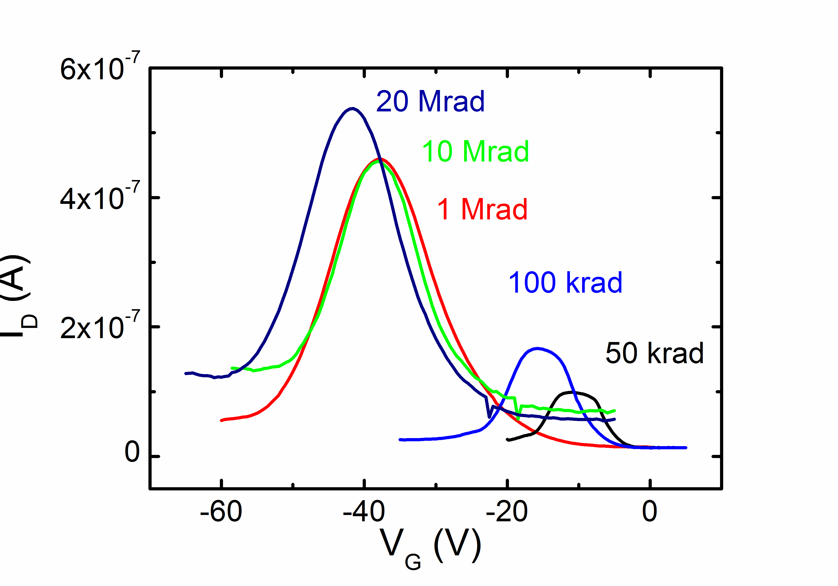
IFX and HPK p-type GCD after X-ray irradiation
IFX
HPK
Annealing 80°C 10 min
Surface velocity s₀ evaluated as a function of the dose
Area 11.71 mm² Area 6.14 mm²

Slide 15
Interstrip resistance after X-ray irradiation
P-stop 1st campaign
P-stop 2nd campaign
Interstrip resistance values are similar between the two campaigns

Slide 16
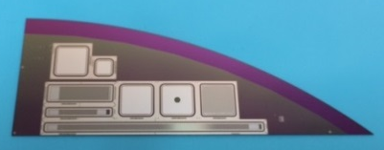
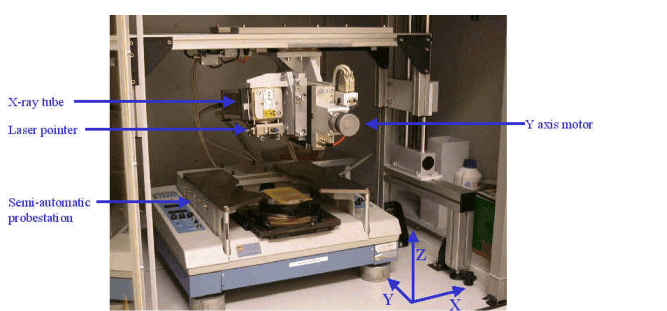
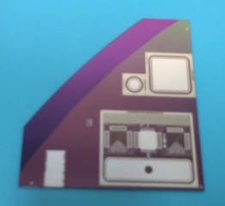
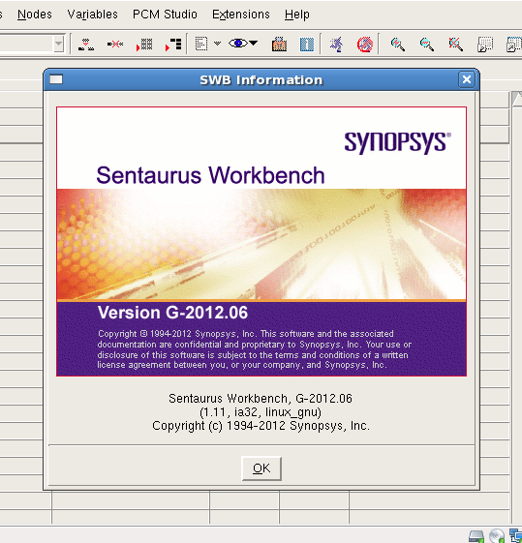
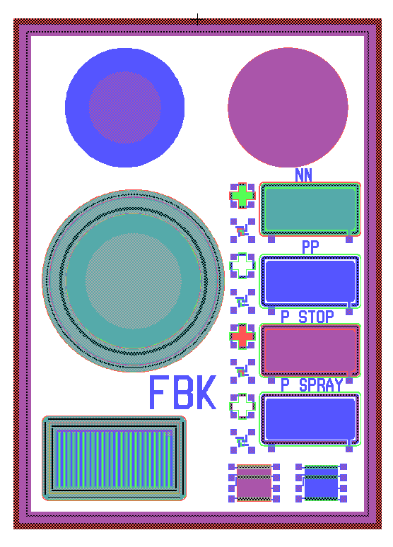
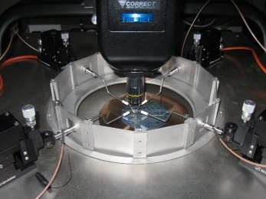
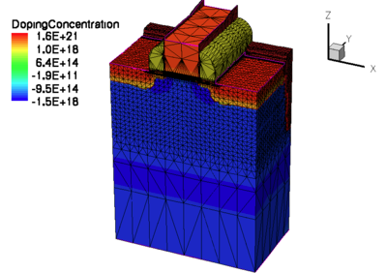
New “University of Perugia” model
MODEL
PARAMETERS EXTRAPOLATION
TEST STRUCTURE
MEASUREMENTS
MODEL VALIDATION
DETECTOR OPTIMIZATION

Slide 17


Surface Damage Model: Gaussian
Interface trap state energy modelling
E_{C}
E_{C} - 0.40
E_{V} + 0.70
E_{C} - 0.60
E_{V}
Type | Peak Energy (eV) | Density (cm⁻²) | σ (eV)
Acceptor | E_{C} - 0.40 | 40% of acceptor N_{IT} [1] (N_{IT}=M·N_{OX}) | 0.07
Acceptor | E_{C} - 0.60 | 60% of acceptor N_{IT} [1] (N_{IT}=M·N_{OX}) | 0.07
Donor | E_{V} + 0.70 | 100% of donor N_{IT} (N_{IT}=M·N_{OX}) | 0.07
F. Moscatelli et al., Effects of Interface Donor Trap States on Isolation Properties of Detectors Operating at High-Luminosity LHC, IEEE Transactions on Nuclear Science, 2017, Vol. 64, Issue: 8, 2259 - 2267

Slide 18
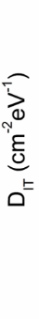
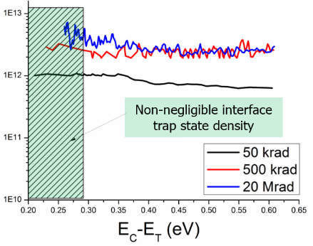

Surface Damage Model: Uniform Bands
Interface trap state energy modelling
E_{C}
Conduction Band
Acceptor Band
E_{C} - 0.56 eV
Donor Band
E_{V} + 0.6 eV
E_{V} + 0.3 eV
E_{V}
Valence Band
Type | Energy (eV) | Band width (eV) | Concentration (cm⁻²)
Acceptor | E_{C} ≤E_{T}≤E_{C}-0.56 | 0.56 | Dit = Dit(Φ)
Donor | E_{V}+0.3 ≤E_{T}≤E_{V}+0.6 | 0.30 | Dit = Dit(Φ)
F. Moscatelli et al: “Analysis of surface radiation damage effects at HL-LHC fluences: Comparison of different technology options”, NIMA https://doi.org/10.1016/j.nima.2018.07.081

Slide 19
IFX 2S MOS capacitors: simulations
Irradiated structures IFX 2S 1st campaign.
C-V measurements compared to simulations at different doses.
  Good agreement for IFX devices!

Slide 20
IFX 2S 2nd campaign MOS capacitors
Irradiated structures IFX 2S 2nd campaign.
C-V measurements compared to simulations at different doses with measured N_{IT} and N_{OX} of 2S wafer.

Slide 21
IFX PS-S MOS capacitors
Irradiated structures IFX PS-S 2nd campaign.
Low N_{OX} at low doses
Higher N_{IT}

Slide 22
HPK p-type MOS capacitors: simulations
Irradiated structures HPK p-type without p-spray.
C-V measurements compared to simulations at different doses.
  Using the same model with measured N_{OX} and N_{IT} good agreement between simulation and experimental data

Slide 23
HPK MOS capacitors with p-spray: simulations
Irradiated structures HPK p-type with p-spray.

Slide 24
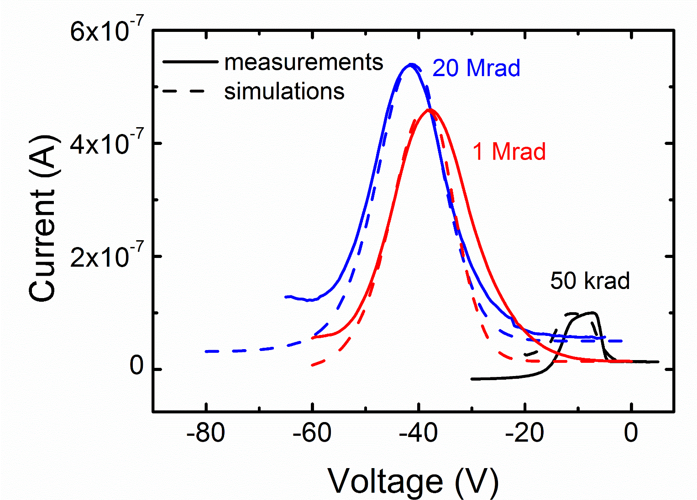
Gated diodes
p-type substrate
Irradiated structures IFX p-type.

Slide 25
Interstrip resistance HPK
Good agreement using the same model used to simulate MOS capacitors

Slide 26
Conclusions
  Extensive measurements campaign on 5 different IFX and HPK n-on-p test structures before and after irradiation with X-rays.
  Surface radiation damage effects have been deeply investigated aiming at the extraction of the most relevant parameters:
    cross-check of N_{OX}, N_{IT}, D_{IT} evaluated by different methodologies from different test structures, for different vendors (HPK and IFX) and different processes.
  Development of the radiation damage modelling scheme, suitable for commercial TCAD tools (e.g. Synopsys Sentaurus), with a good agreement between measurements and simulations
  Application to the analysis and optimization of different classes of silicon detectors to be used in the future HEP experiments.

Slide 27
Future developments
  Bias the IFX and HPK devices during X-rays irradiation
  Irradiate new HPK batches FZ290 and thFZ240
  Irradiate test structures first with X-rays and then with neutrons to combine surface and bulk damage

Slide 28
Backup slides

Slide 29
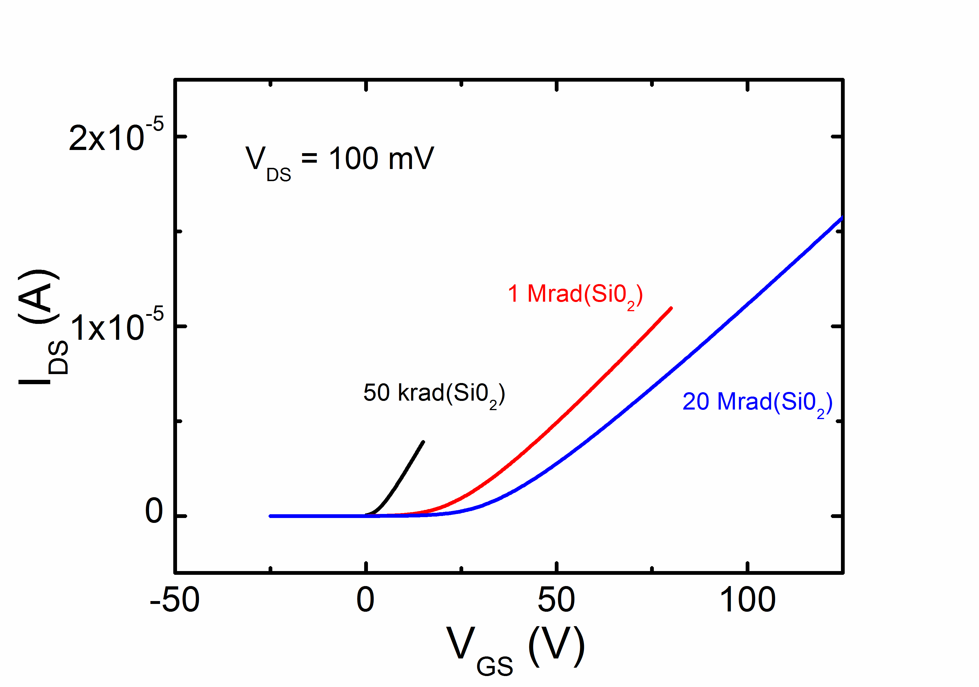
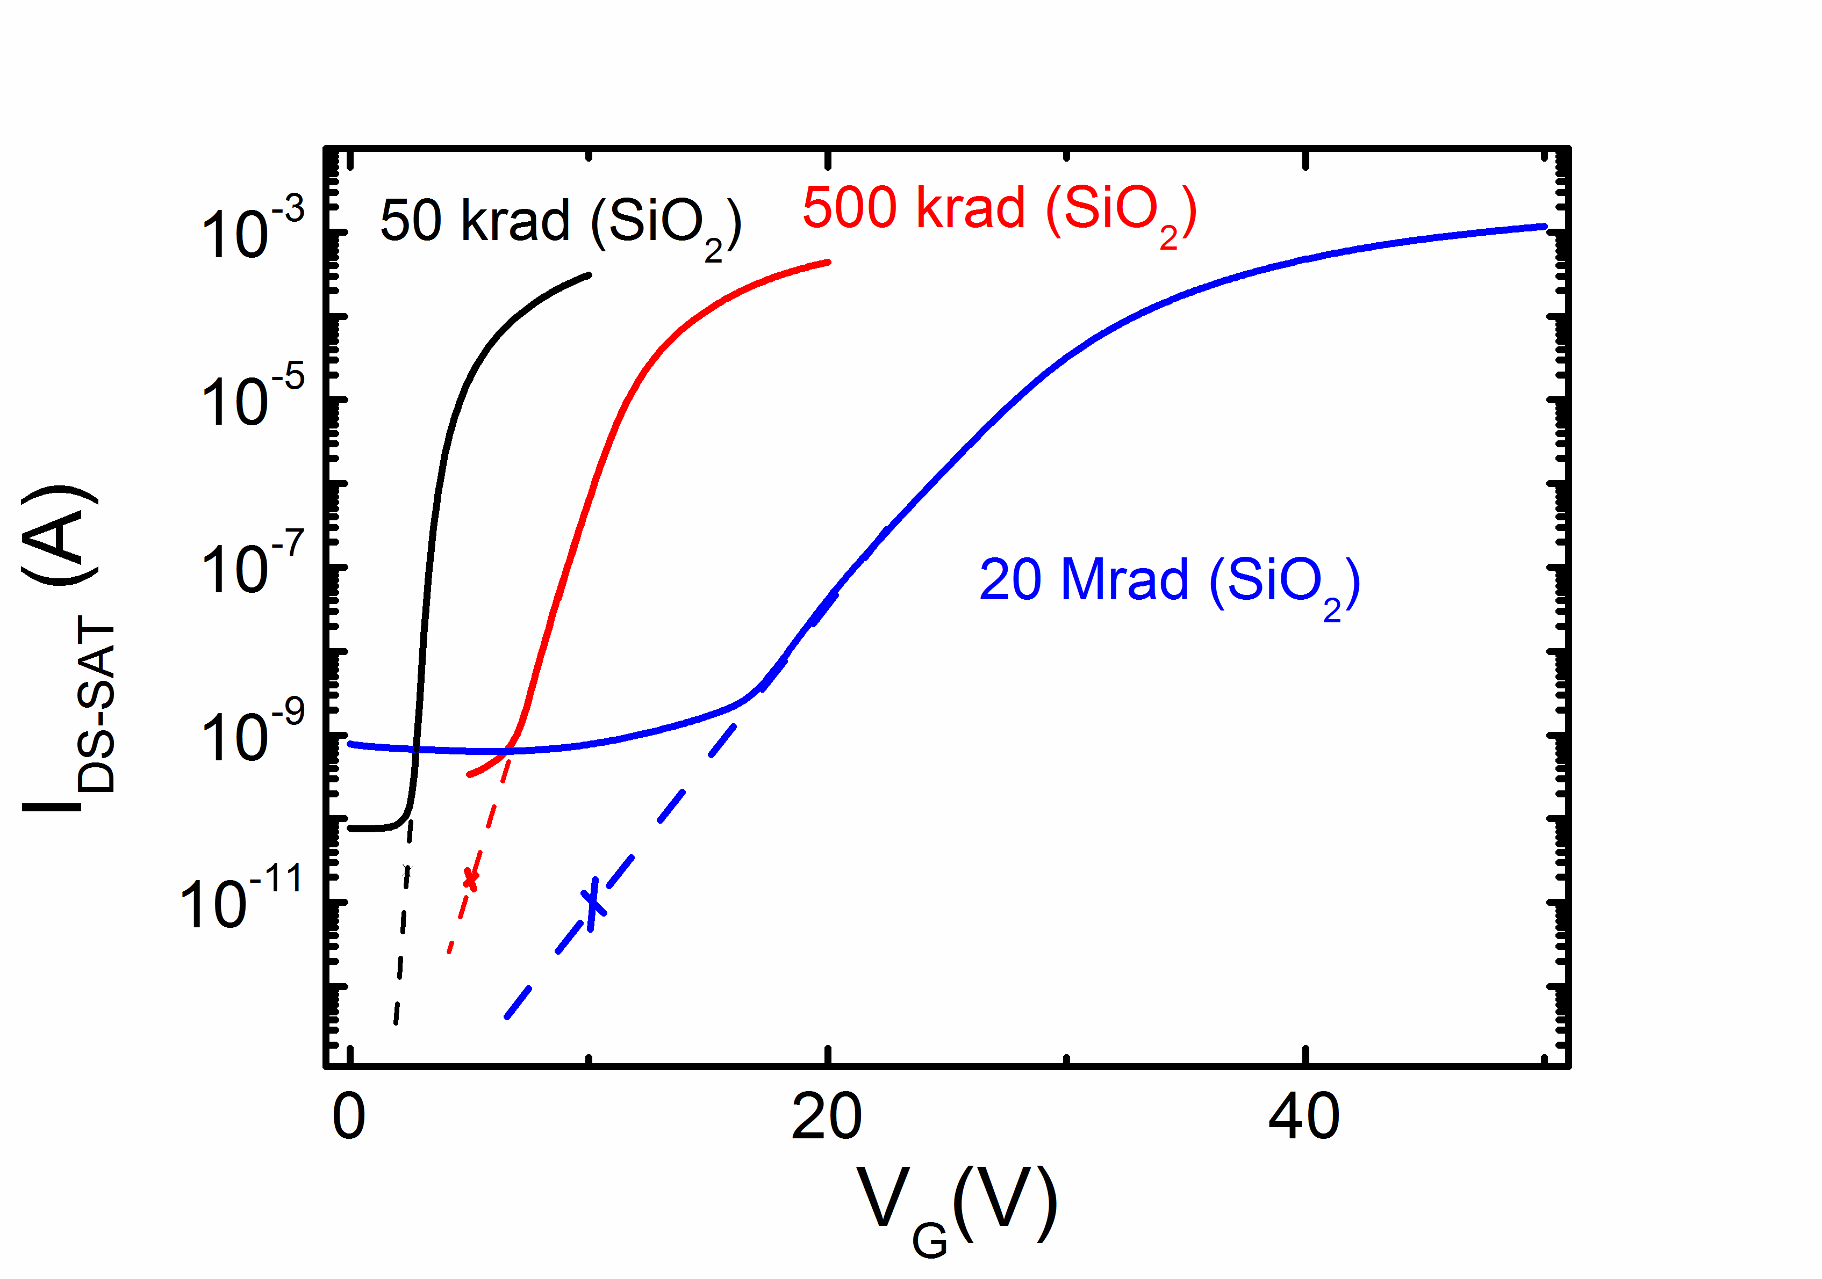
FBK - MOSFETs
V_{th} = -0.8 ÷ 0.1 V (unirradiated)
Unbiased devices during the irradiation steps
Radiation → interface traps (N_{IT}) + trapped-oxide (N_{OX}) → V_{th} shift (ΔV_{th}).
ΔV_{th} is separated into a contribution due to N_{IT} and due to N_{OX,} from I_{DS}-V_{GS} of MOSFET (method proposed in McWorther Applied Physics Letters 48, 133 (1986))
${∆V}_{th}={∆V}_{N_{it}}$ + ${∆V}_{N_{ox}}$
pMOSFET
nMOSFET
x
x
x

Slide 30
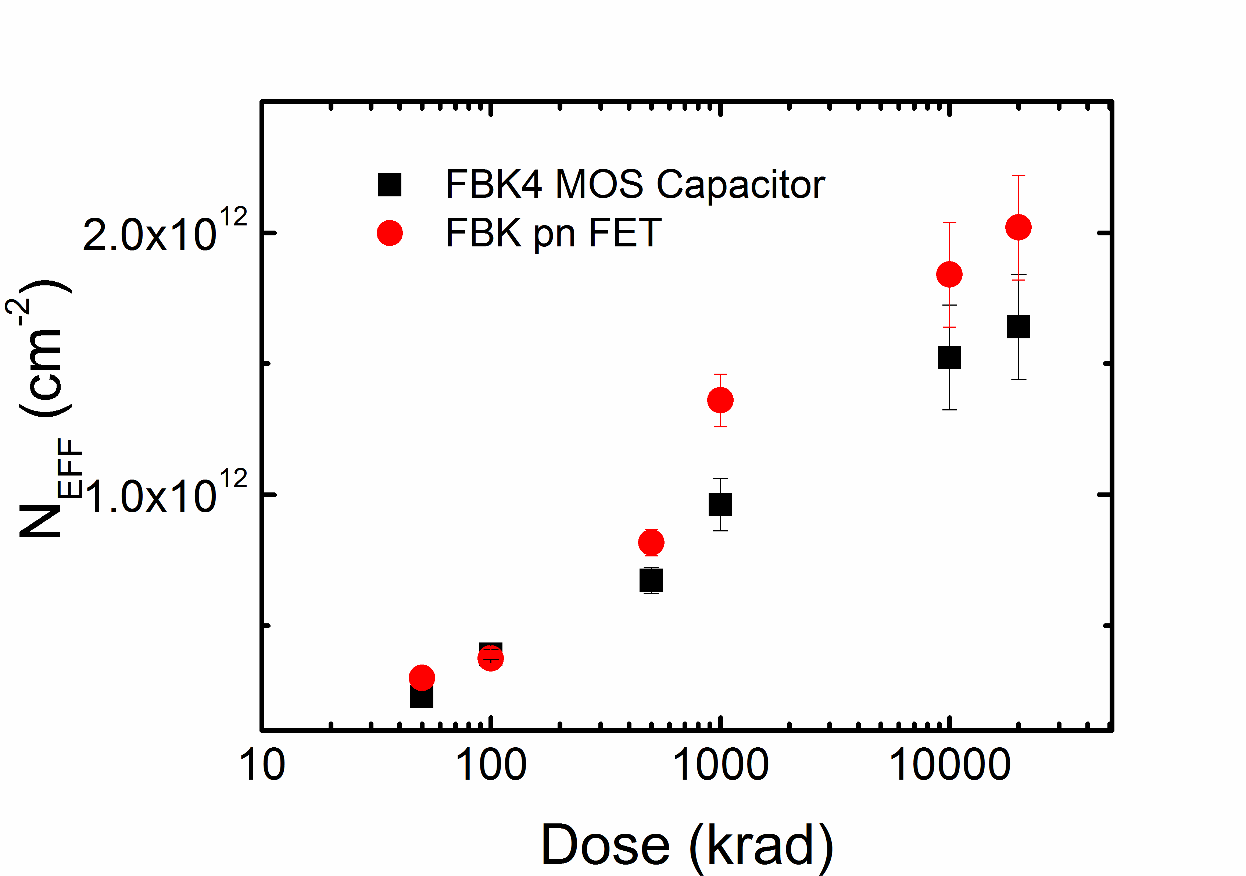
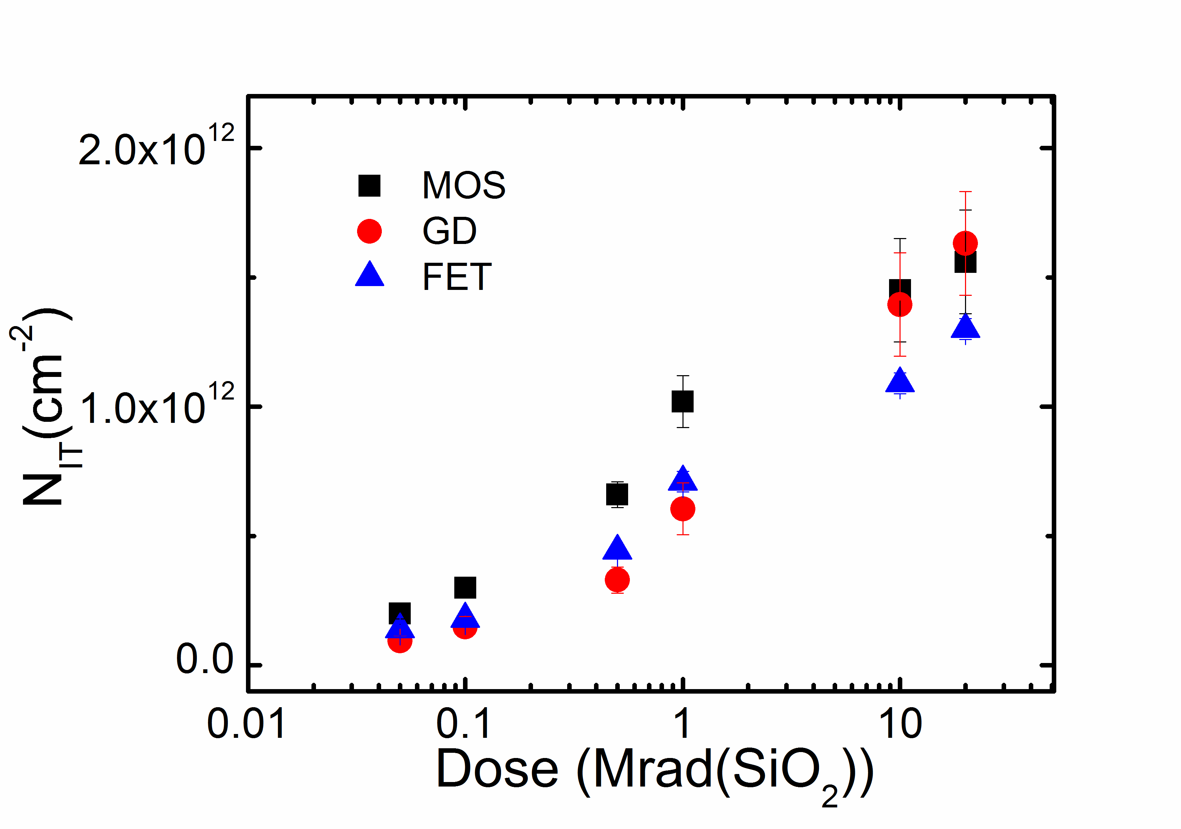
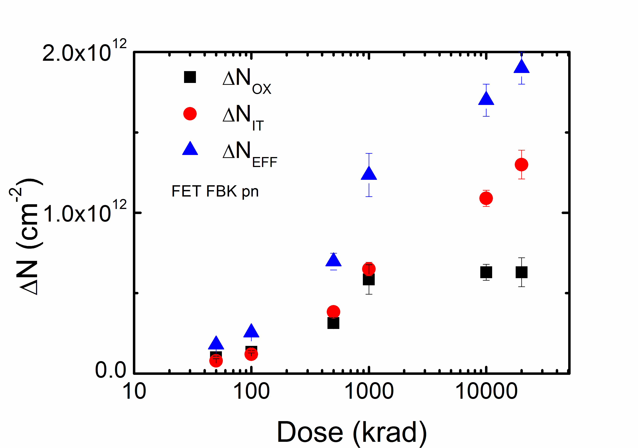
FBK Summary of measurements – p-type
Effective oxide charge density (N_{EFF})
Integrated interface trap density (N_{IT})
Describe the Donor trap state characterisics
as INPUT PARAMETERS to the TCAD tool

Slide 31
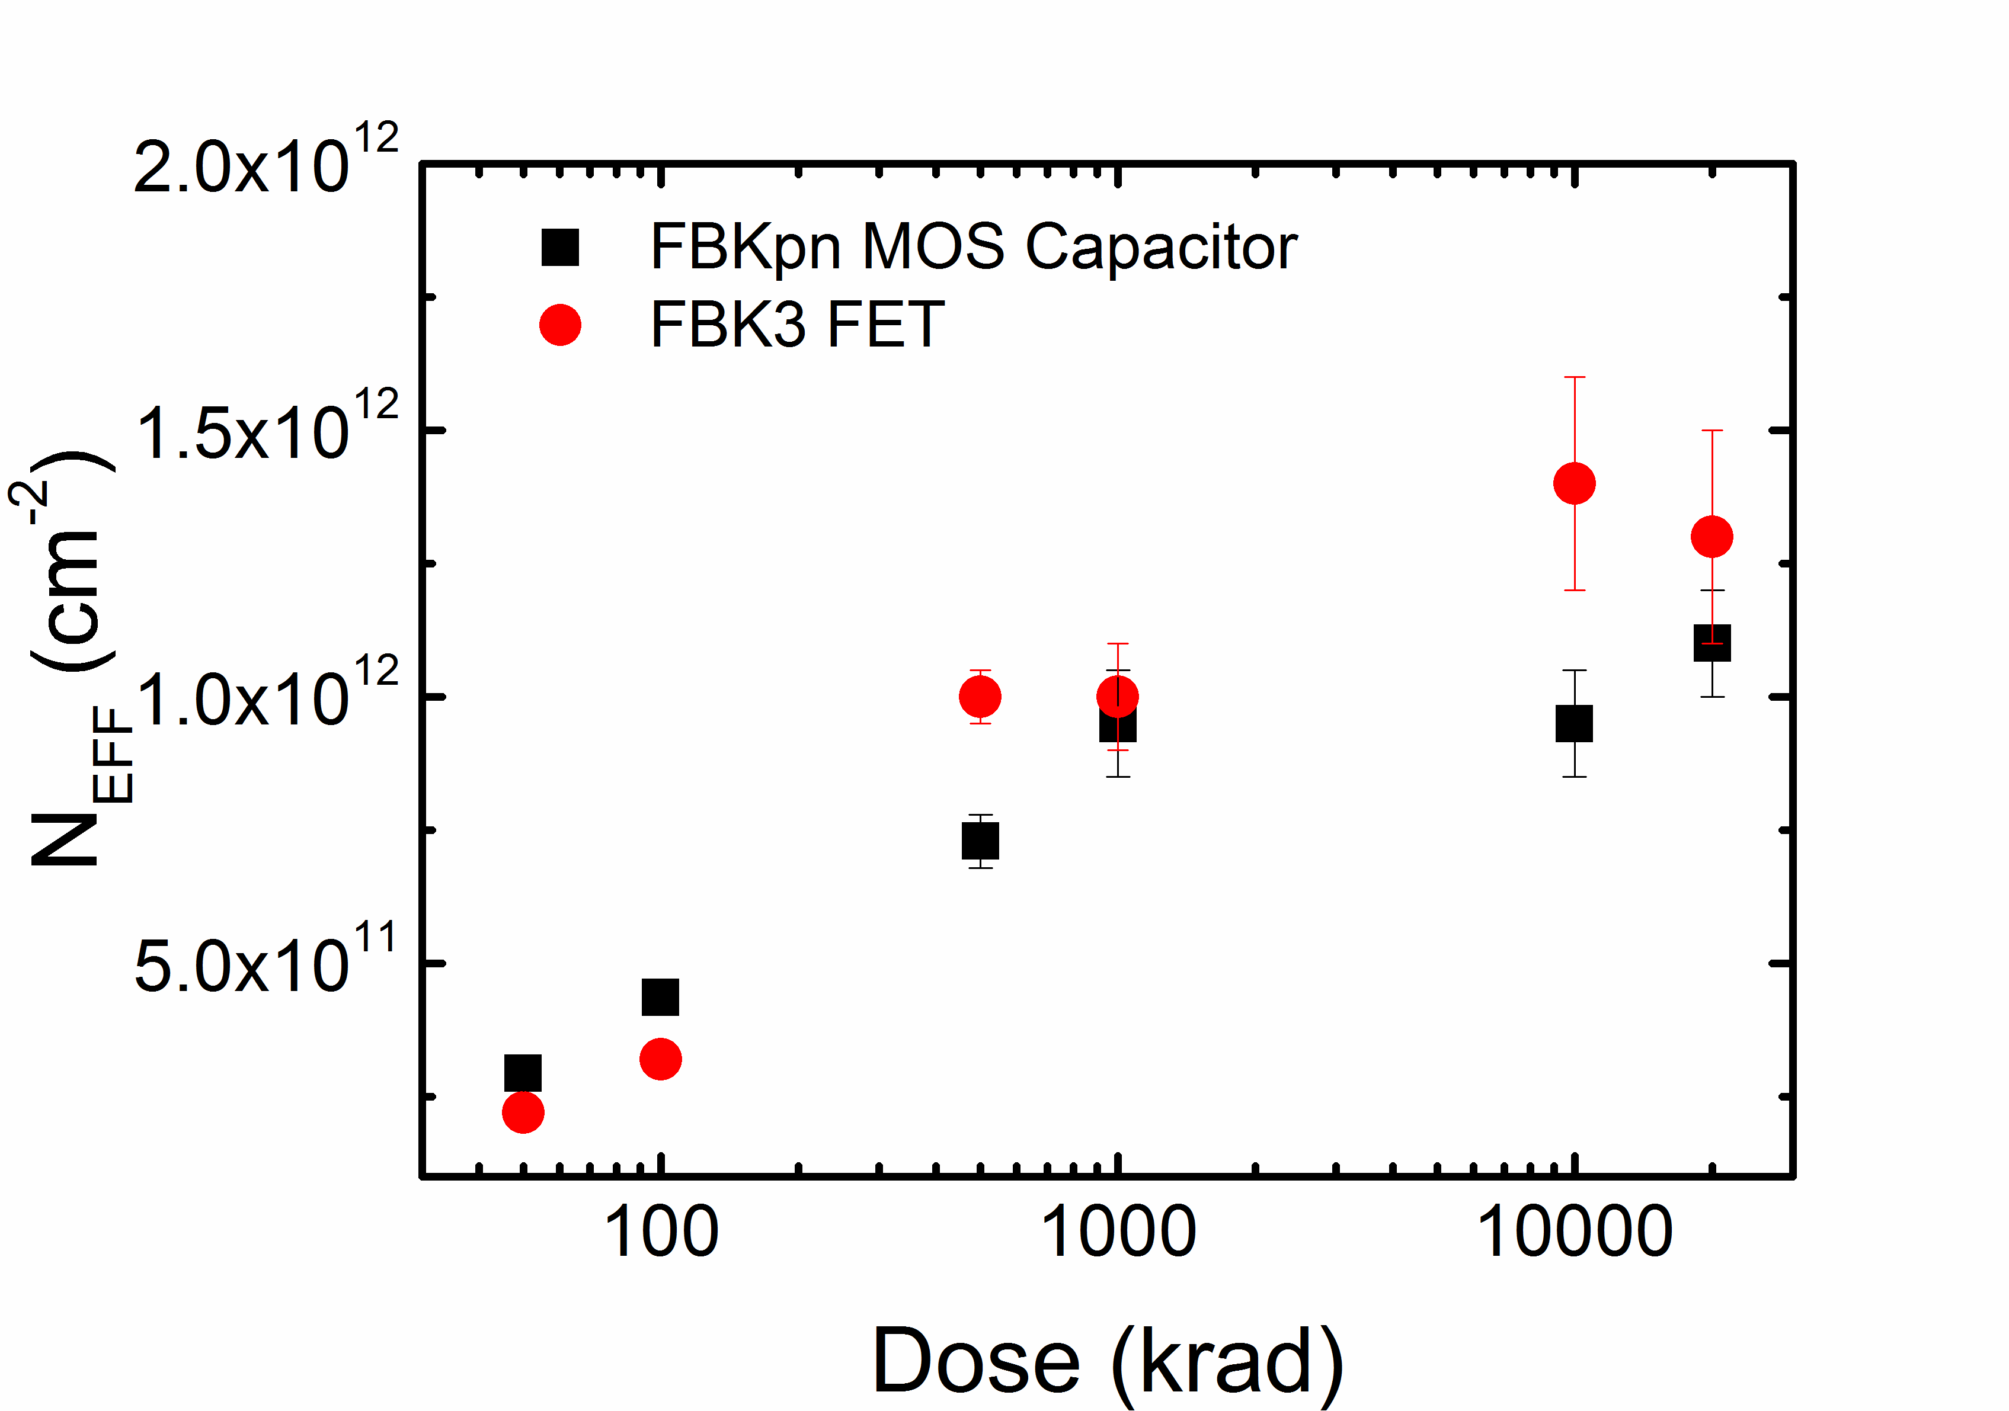
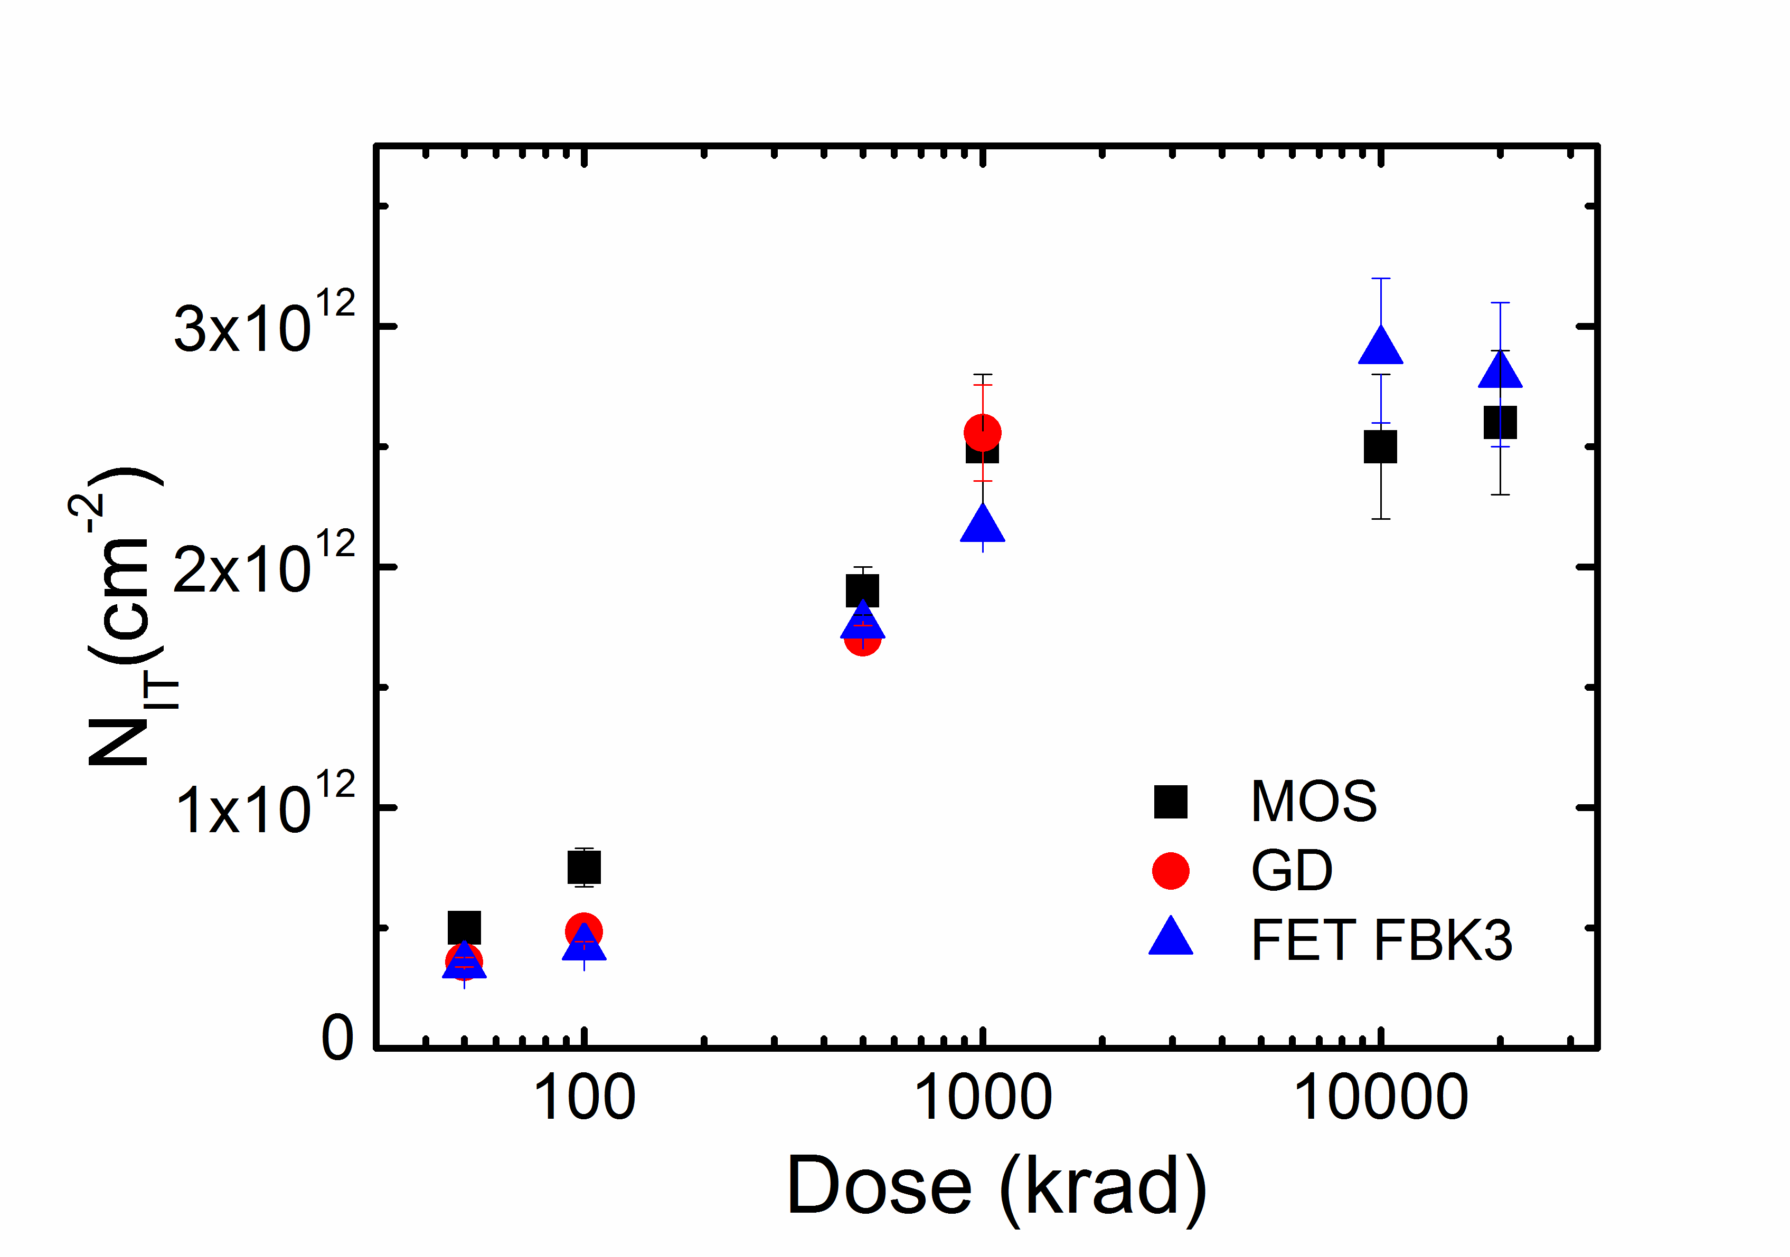
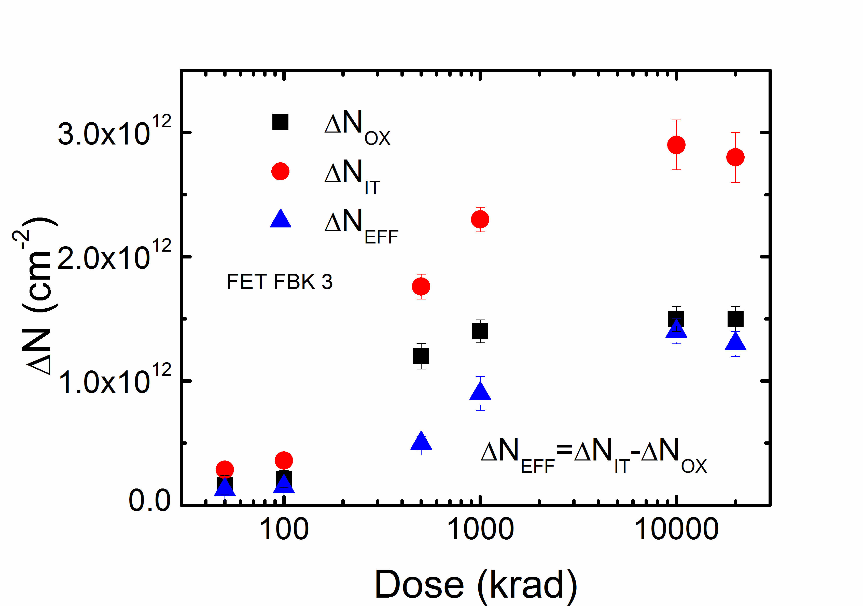
FBK Summary of measurements – n-type
Effective oxide charge density (N_{EFF})
Integrated interface trap density (N_{IT})
Describe the Acceptor trap state characterisics
as INPUT PARAMETERS to the TCAD tool

Slide 32
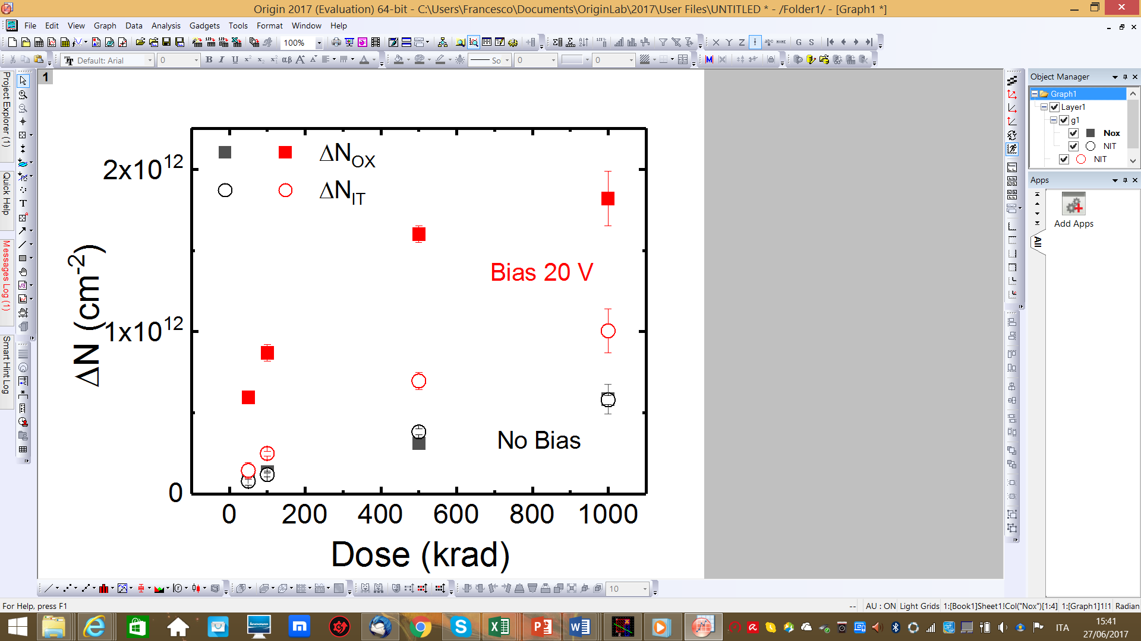
Two different irradiation conditions: without/with biasing the devices.

