Slide 1
LHC BPMs
Status quo & Introduction
Manfred Wendt
BE-BI-BP

Slide 2
LHC BPM Specs 2002

Slide 3
LHC BPM Specs 2002 (cont.)
From:
LHC-BPM-ES-0004 rev 2.0
Functional Specification
MEASUREMENT OF THE BEAM POSITION IN THE LHC MAIN RINGS

Slide 4
Reminder: Present BPM System Layout

Slide 5
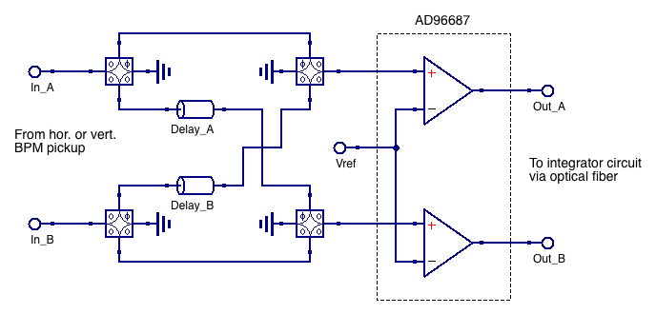
Wide-Band Time Normalizer
70 MHz LPF & AD96687 define the core BPM performance
  ~46 dB dynamic range, ±1 mV internal offset
Vref is set to +2 mV (HI sensitivity) or + 67 mV (LO sensitivity)

Slide 6
Some limitations of the present system
Sensitive to signal reflections
  Minimized by LO sensitivity setting
Temperature sensitivity of the integrator circuit
  Improved by use of temperature stabilized racks
“Electronic” offset at low bunch intensities
  Caused by the difference in the signal propagation delays in the two comparators for low overdrive voltages. Conceptual limitation.
Bunch-to-bunch signal “leakage”
  Caused by the integrator?!
Aging effects of the comparator?
Reduced S/N due to 70 MHz LPF
Complex analog signal conditioning circuit
  Long-term maintenance, spares, calibration, etc.

Slide 7
Interlock BPM Approach
One chain for both electrodes in one plane
  Minimize drifts and aging problems
Direct digitization by fast ADC
  Prototype with Texas Instruments ADC12J4000
  12 bits, 3.2 GSa/s, ~ 8.7 ENOB
Comb Filter
Att. & Gain
ADC
FPGA

Slide 8
iBPM Comb-BPF
25 ns
Delay 12.5 ns
Beam
25 ns
Delay 2 ns
LP filters
Stripline pick-up
Filter output
Tunnel
Electronic rack

Slide 9
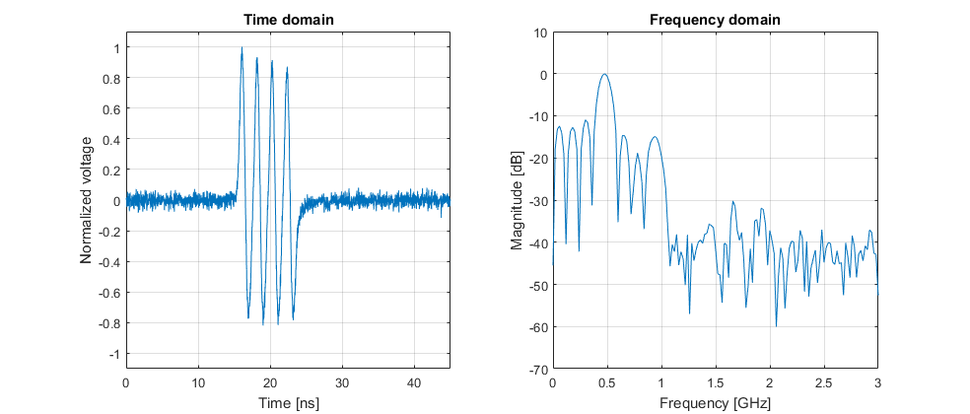
Comb-BPF Beam Measurement
Signal from LHC stripline electrode captured at 60 GS/s through ~70m cable + delay line filter

Slide 10
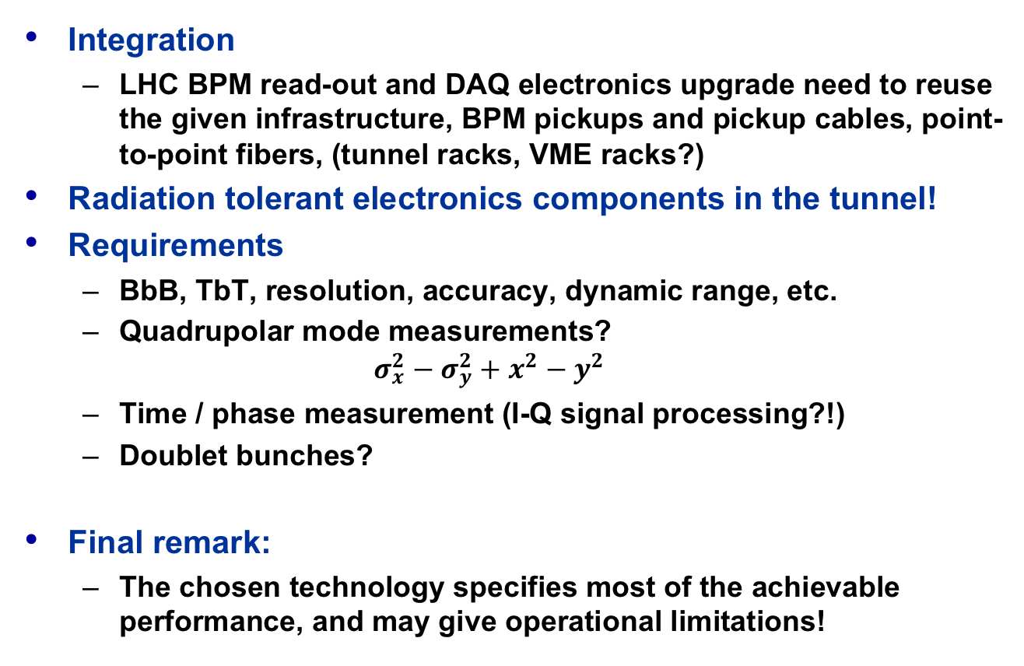
Other Aspects…
Integration
  LHC BPM read-out and DAQ electronics upgrade need to reuse the given infrastructure, BPM pickups and pickup cables, point-to-point fibers, (tunnel racks, VME racks?)
Radiation tolerant electronics components in the tunnel!
Requirements
  BbB, TbT, resolution, accuracy, dynamic range, etc.
  Quadrupolar mode measurements?
  $σ_{x}^{2}−σ_{y}^{2}+x^{2}−y^{2}$
  Time / phase measurement (I-Q signal processing?!)
  Doublet bunches?
Final remark:
  The chosen technology specifies most of the achievable performance, and may give operational limitations!

