Slide 1
BPM performance for operation
In LHC Run1 and Run 2
J. Wenninger

Slide 2
General remarks
The overall performance of the LHC BPM system was excellent, and it is one of the ingredients to the machine reproducibility that allowed us to double the design luminosity.
  This presentation points out issues, but it should not leave a negative impression !
The availability of the system was very good, no major downtime was induced to the system to my knowledge (at least not from BPMs + electronics).
  Channel availability is typically ~95% (20 channels out of 500 per plane and beam flagged as suspicious).
The system is however affected by a few features that originate from its design, and that do impact operation to some extend. In this presentation I will point out such features that are worth improving.

Slide 3
Resolution
For regular operation of orbit & trajectory, the resolutions are adequate.
  From threading with probe to orbit with nominal the performance is adequate.
For ‘accuracy’ see later…

Slide 4
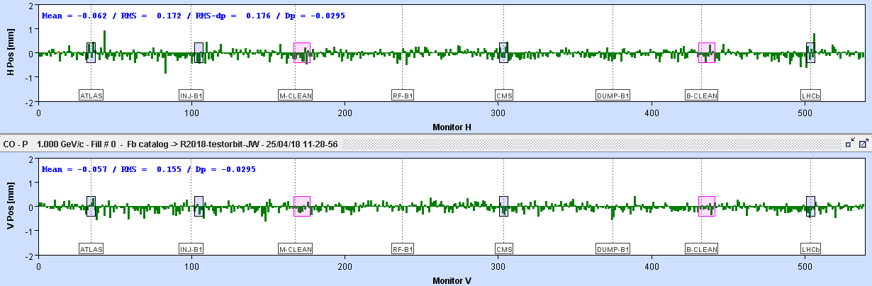
Beam pattern
The response of the LHC BPM electronics is beam pattern dependent with differences O(50-150 μm rms) between beam type.
  At fixed bunch intensity, when the bunch pattern is changed (50 ns, 25 ns etc), the residual error is O(20-50 μm rms).
    It would be much larger without the calibration with the correct pattern.
  Between a probe and a nominal bunch the sensitivity switching generates systematic orbit changes O(150 μm rms).
    Rather reproducible, could be compensated by some redesign, for example automatic correction etc.
Beam 1 probe-nominal orbit difference ( systematic)

Slide 5
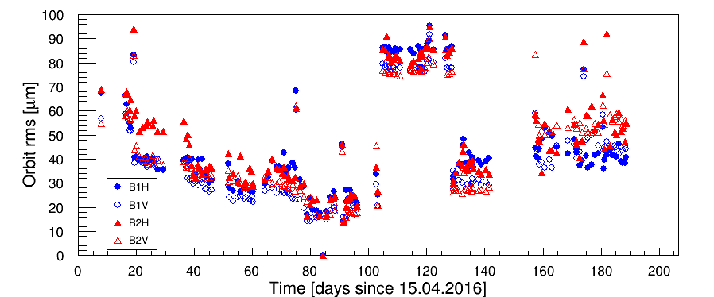
Pattern effects
The orbit reproducibility (excluding the experimental IR) is excellent over an entire run – here 2016 – and even from year to year !
  Short term reproducibility ~20 μm (~ week),
  Long term reproducibility ~40-60 μm → also from year to year !
    Part of this may be due to ground motion.
  Incorrect BPM calibrations have a significant impact.
orbit RMS evolution wrt reference on 14.07.2016 for 25 ns beam fills
BPM calibration !

Slide 6
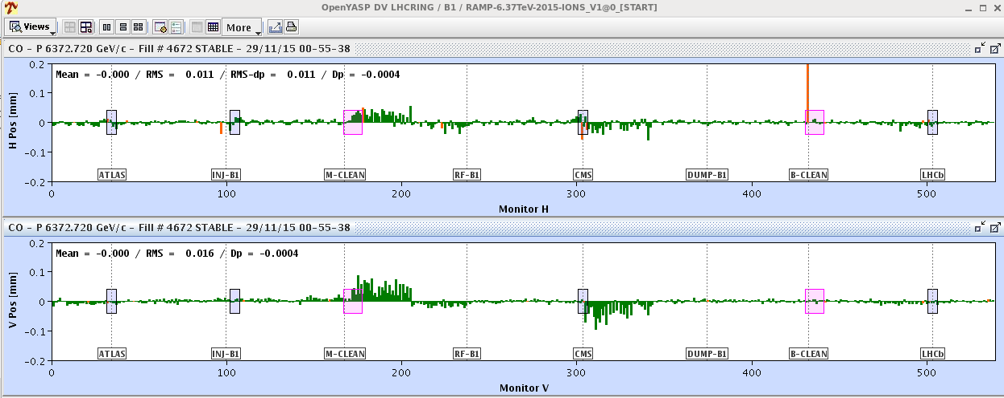
Crate temperatures
The orbit stability was improved a lot after LS1 with the rack cooling.
Some systematic shifts are however still observed, although they are smaller by factor ~5-10 wrt Run 1.
  This improvement allowed us to run the orbit FB with collisions since 2015 (but only with gentle correction strategy).
  Local offsets of 50 μm can still appear, although ~10-20 μm is more common.
When the orbit FB is operated aggressively (many SVD eigenvalues) these offsets are ‘put on the beam’. Not a serious limitation for the moment, but not nice and limits the overall orbit quality.

Slide 7
Intensity range
By design the system with its high / low sensitivity ranges does not operate too well when bunch intensities are close to the switching range.
  In general not an issue for standard orbit because we rarely operate with bunch intensities of 2E10 to 3-4E10.

Slide 8
Collision point steering
The reproducibility of the collision point is clearly critical for LHC. We do not want to find the beams in every fill.
Since the reproducibility of the BPM readings is larger than the current IP beam size (~10 μm) the orbit correction strategy has a significant impact.
  By experience + simulations we have settled on a strategy with ~400 out of 520 orbit response eigenvalues (‘shallow’ minimum).
    Too many eigenvalues: BPM ‘noise’ is propagated to the IP, faulty BPMs can have dramatic impact.
    Too few eigenvalues: IP orbit not well enough corrected.
The reproducibility of the orbit at the IP can be assessed from an analysis of the local corrections (orbit bumps called luminosity corrections) that are applied during a run.

Slide 9
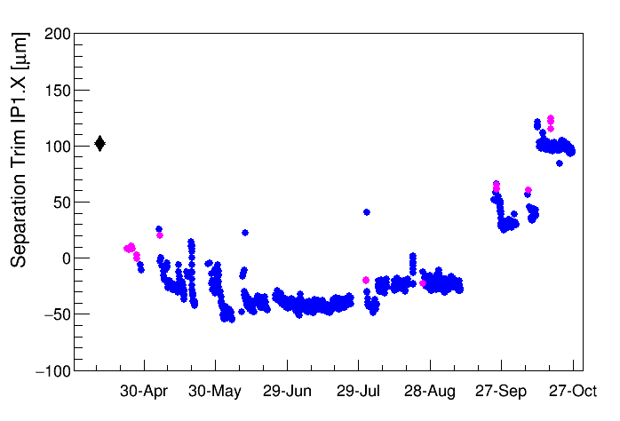
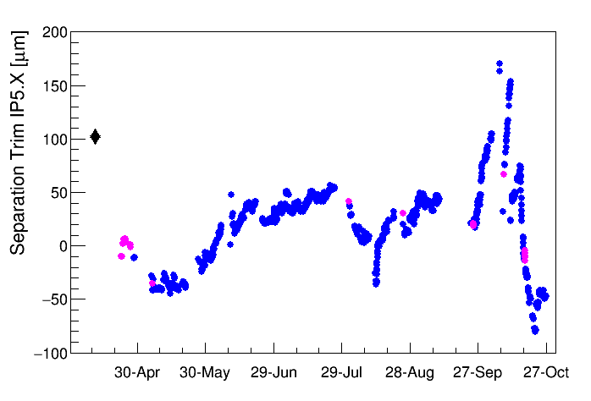
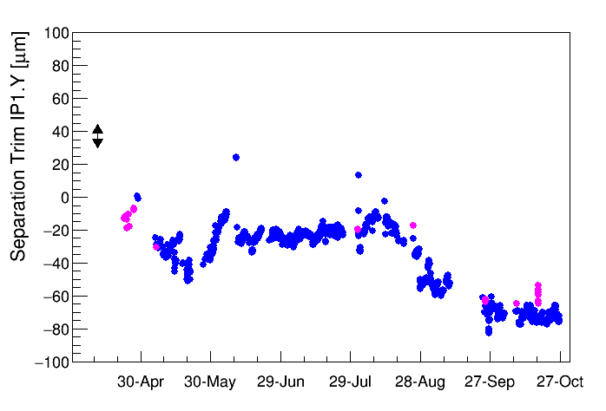
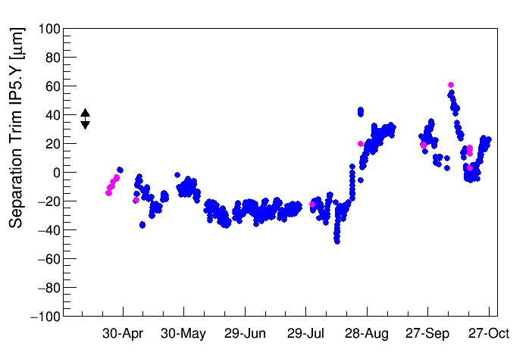
Collision point reproducibility
The luminosity corrections are expressed here as the total separation trim drift with time. The horizontal plane is more ‘active’ – triplet supports.
  Thermal shield cooling, quenches, sudden movements.
Triplet goes for a walk…
IP1H
Quench
IP5H
Cryo stop
Thermal shield
Thermal shield
IP1V
IP5V

Slide 10
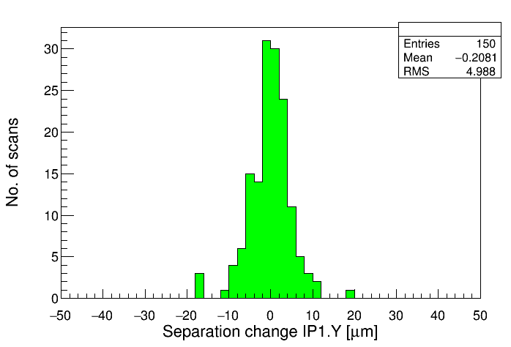
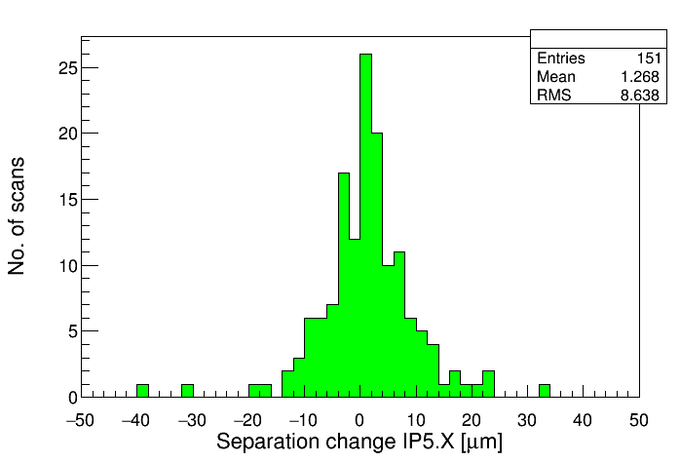
Fill-2-fill reproducibility in 2016
The fill-2-fill (short term) rms beam separation change is ≈ σ/2.
In all planes the ‘core’ reproducibility is similar, but the tails from perturbations are quite different.
IP | Hor [μm] | Ver [μm]
1 | 6.3 | 5.0
5 | 8.6 | 6.4
Compare to the 20 μm overall reproducibility !
σ = 11 μm (β* = 40 cm / ε = 2 um)
IP1V
IP5H

Slide 11
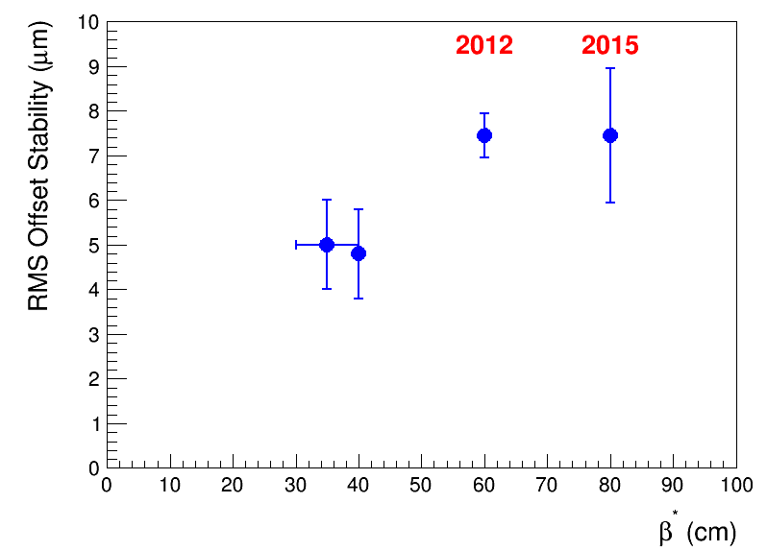
Fill-2-fill reproducibility
The reproducibility does not degrade with lower β* (= smaller beam size) contrary to a common ‘fear’.
This trend is a sign that we are not propagating (all) the BPM errors to the IP.
2016/7

Slide 12
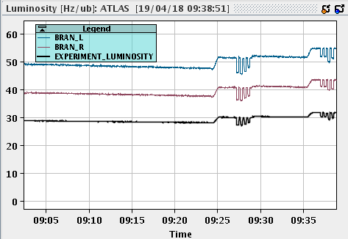
Complex manipulations
Since 2017, we have introduced crossing angle and β* levelling in operation.
During those operations we rely on the orbit FB to stabilize the orbit while changing the crossing angle or optics.
  Note that only relative changes are important.
The excellent stability of the orbit and the quality of the levelling are an indicator of the excellent short term accuracy of the orbit.
  We are operating ~ HL-LHC area, and we are doing pretty well.
  IP stabilities of ~ O(μm).

Slide 13
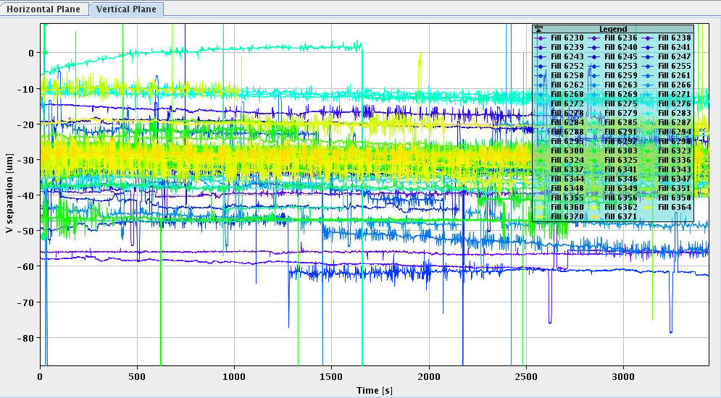
DOROS
The DOROS BPMs at the Q1s are helpful to find collisions when they are ‘lost’ (begin of run, new configuration, etc).
But the fill-to-fill reproducibility was so far insufficient to use them for deterministic fine steering of the IP offsets.
  Excellent O(μm) to measure relative changes over times of minutes to hours, less performed for fill to fill for example.
Predicted offset between B1 and B2 using the DOROS Q1 BPMs for all 2017 autumn physics fills.
Since the beams were optimized all traces should be on top of each other (never mind the offset).
The spread indicates the DOROS fill to fill reproducibility.

Slide 14
IP BPMs
The IP BPMs at Q1-Q3 are installed in the common vacuum chamber and therefore see both beams.
  Overall one observes more outliers in the common BPMs with train operation than in the rest of the machine. Possibly signs of cross-talk, although difficult to prove.
The asynchronous (= all orbit triggers) orbit can suffer from cross-talk:
  Imperfect directionality,
  Asymmetric bunch intensities (→ p – ion operation …).
The synchronous orbit (= bunch selective) can overcome this problem once the beams are synchronized (cogging at high energy) by measuring ‘clean’ bunches (i.e. with no counterparts).
  Sometimes a bit awkward, but workable.
  Does not solve the problem is p-ion when the two RF frequencies are not locked as the beams slip continuously against each other – makes the BPMs unusable.
The problem is more severe when the intensity ratio of beams is very large.

Slide 15
Orbit improvements
Suggested improvement list (~ priority ordered):
Mitigate/eliminate the beam pattern dependence.
Mitigate/eliminate the temperature effects.
For IR BPMs lower the reproducibility to 10 μm or less.
  For the arcs / rest of the machine, the quality is ~ok. Improvements in the collimation section of IR7 may be useful.
Mitigate/eliminate the low/high sensitivity systematics.
  Issue with operation near switching threshold.
Common vacuum chamber BPMs:
  Maintain possibility to select subset of bunches for acquisition,
  Consider options that would allow to measure un-cogged beams (lower priority).

