Slide 1
Requirements for BPM Upgrade in IR6
C. Bracco and W. Bartmann

Slide 2
Outline
Reminder about motivation for interlock BPMs in IR6
Functional specifications (old and new)
BIS and SIS thresholds and wished reliability after LS3

Slide 3
Motivation for having interlock BPMs in IR6
Aperture limitation at the extraction septum for extracted beam (nominal dumps) ➔ orbit ≤ ±4 mm for loss-free extraction.
Need to constantly monitor TCDQ position wrt beam to insure adequate protection in case of asynchronous dump
Possible failures and reaction time:
  Slow orbit drifts: ~1 s (> 0.1 s) ➔ orbit feedback able to react and stabilize the orbit keeping drifts < ±1 mm ➔ SIS (checking local orbit at TCDQ using interlock BPM signal, average signal over 1 s not bunch-by-bunch)
  Fast drifts: D1 failure ➔ 50 μm/turn ➔ need to react before orbit ≥ ±4 mm to insure clean extraction ➔ <70 ms reaction time ➔ not possible to correct with feedback ➔ BIS (interlock BPMs)

Slide 4
Functional Specifications after LS3
Keep presents configuration and positions:
  8 BPMs in total, 4 per beam monitoring, H and V beam position in IR6)
  Electronics in two independent front-end systems ➔ redundancy (SIL3 reliability level).
  Auto-trigger (not based on timing signals)
  FPGA trigger checking every 89 us (synchronized with LHC revolution frequency)
  bunch-by-bunch and turn-by turn measurements
  Threshold as Machine Critical Settings
  Possibility to define position thresholds plus two time windows and related number of bunches (how many bunches over how many turns allowed to be outside tolerances). Need to avoid dangerous situations without increasing spurious dumps.
    Window 1: small number of bunches over large number of turns (at present 70 bunches and 200 turns)
    Window 2: large number of bunches over small number of turns (at present 250 bunches over 10 turns)
    Numbers to be probably re-evaluated taking into account higher intensity and brightness
Intensity range protons: 5e9 – 2.5e11 ppb for HL-LHC (nominal 2.3e11 plus some margin). Single bunches and up to ~2900 bunches. Compatible with all operational beams (25 ns and 8b+4e)
Intensity range ions: 5e7 – 2.1e8 ppb and up to ~1300 bunches, 50 ns bunch spacing.
Reproducibility: ± 0.2 mm from one dump to the other over the full dynamic range

Slide 5
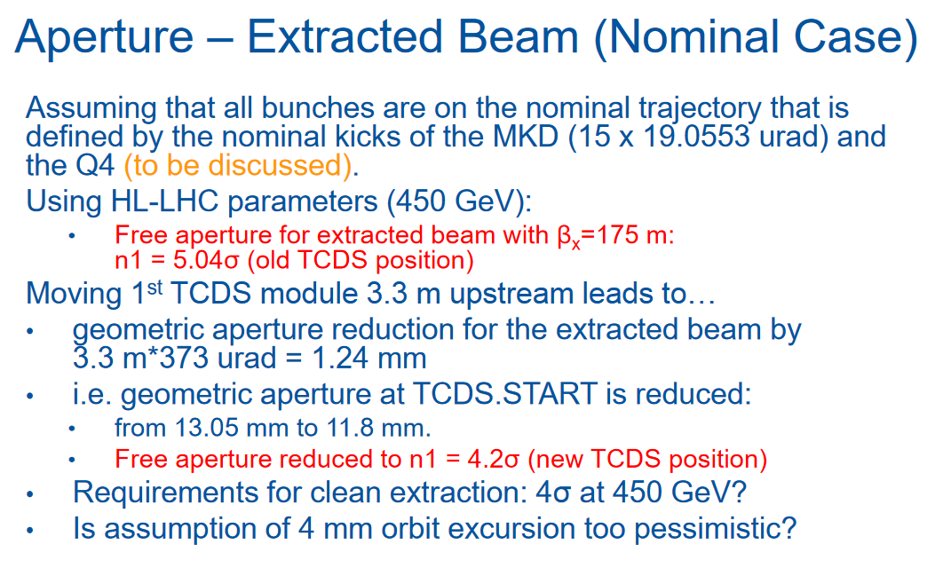
BIS Thresholds
BPM Interlock presently set at ±3.5 mm for all energies. Need to allow room for injection oscillations ~2σ (~4 mm*) and tune measurements.
Ideally BPM limits should be reduced to ±3.0 mm for all energies. Smaller beams ➔ ~3 mm** for injection oscillations, reduced extraction aperture due to installation of additional TCDS module (extraction septa protection element)
Courtesy of C. Wiesner
* Assuming 3.5 μm normalized emittance
** Assuming 2.5 μm normalized emittance

Slide 6
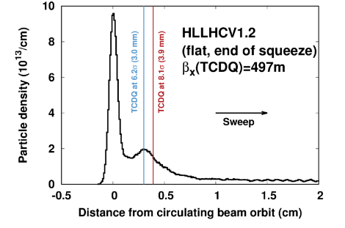
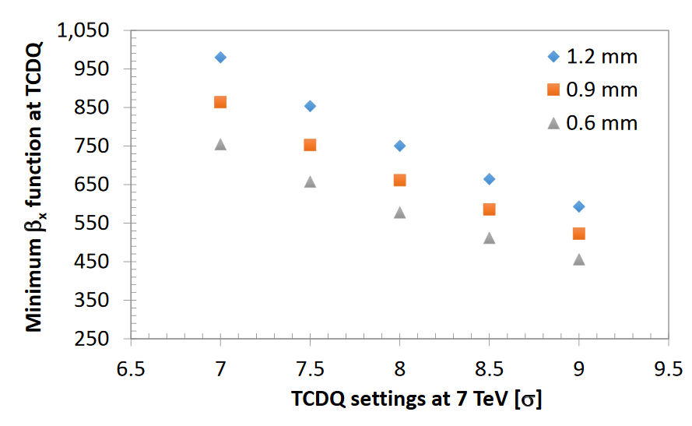
SIS Thresholds
BPM limits at TCDQ, at present 2 mm at injection (1 sigma), 1.2 mm at 6.5 TeV.
Need to reduce the limits at top energy to < 600 μm due to minimum allowed effective TCDQ gap > 3 mm taking into account all margins (0.3 mm setup and optics errors + Dx*Dp/p + orbit offset depending on achievable interlock BPM reliability and orbit stability) ➔ optics constraints** (the actual HL-LHC optics is compatible with the requirement on the gap if the condition on the interlock BPMs can be relaxed from 1.2 mm to 0.6 mm) and relative TCT-TCDQ retraction (achievable β*)
Jorg looking at option of using BPMs integrated in TCSP for SIS interlock on orbit at TCDQ. Still to be fully validated and made operational. Good reason to give up with improving interlock BPM reliability?
**https://indico.cern.ch/event/638356/contributions/2613967/attachments/1473104/2280260/OpticsLBDS_Dispersion.pdf

Slide 7
Summary
Wish list for after LS3
Need reliable interlock BPMs in IR6 and adequate thresholds (to be revised) to protect the machine against damage:
  Loss-free normal dumps
  Correct positioning of TCDQ wrt beam
Need to minimize the number of unwanted spurious dumps
Same functional specifications as present system but:
  Larger dynamic range (higher bunch intensity)
  Tighter HW thresholds (loss of aperture due to installation of third TCDS module)
  Tighter SW thresholds (allow for more optics flexibility keeping the TCDQ safe, minimize TCT/TCDQ retraction and improve β* reach)

