Slide 1
Report on design of test stand and beam instrumentation

Slide 2

Test stand at CERN
Foreseen for ARIES studies WP16 – Intense, RF modulated E-beams (IRME):
  Design and build a test stand for testing gun including instrumentation suitable for measuring the transverse and longitudinal profiles of the RF modulated electron beam
  Measure the properties of the RF modulated electron beam created by the gun using this test stand
  [50x70mm oval e-beam, 5-10A, 22kV]
Can be used for:
  Studies high intensity e-gun for Beam-Beam Long Range compensation:
    Few mm round e-beam, up to 20A, 20-35kV
    Modulation at 40MHz for BPM measurements
  Test Gas Curtain Monitor
  If HEL-HL-LHC becomes baseline:
    Characterise e-guns
    Validate, commission modulators
    Test beam instrumentation, modulators, interlocks,

Slide 3
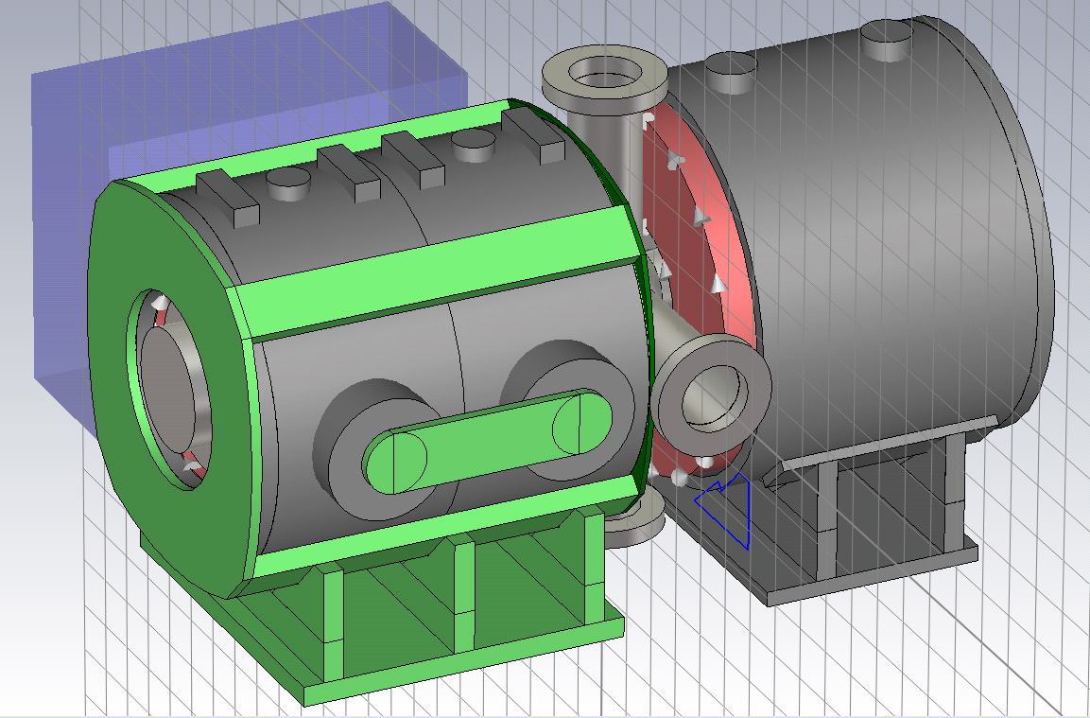
Test stand development at CERN:
Purpose of the first stage:
  Preparation:
    Commissioning hardware (magnets, vacuum, HV system, control, etc.)
    Safety and technical aspects of operation
    Commissioning diagnostic procedures (current, profile, position)
Measurements:
  Electron gun tests: characterization
  Electron gun: anode modular
Preparation for upgrade
Gun solenoid (twins), collector solenoid, prototype of diagnostic box (pin-hole Faraday cup + YAG screen monitor).

Slide 4
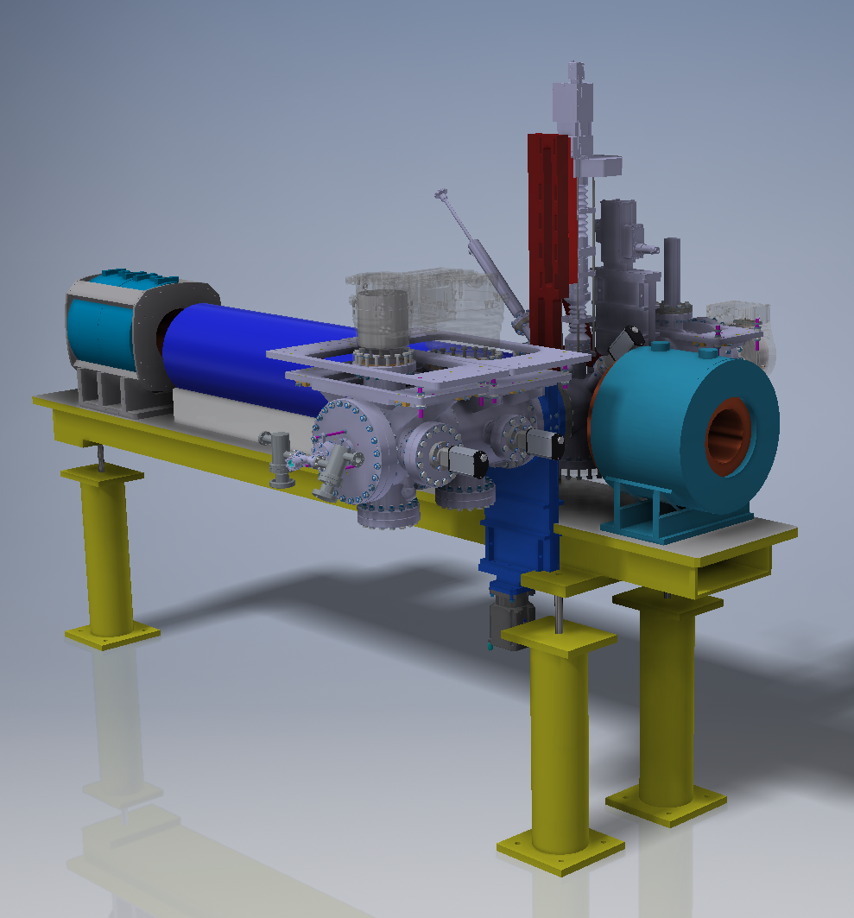
Test stand development at CERN. Upgrade.
Purpose and measurements of stage 2:
Allow drift and see beam deformations/rotations/… computer model validation
Study electron beam dynamics in regime close to virtual cathode
Study electron beam dynamics with compression
Test Beam Position Monitor ‘shoe-box’ or ‘strip-line’ with very HF modulation
Test effect of very HF modulation (<10% current) on beam dynamics (microbunching?) for HEL

Slide 5
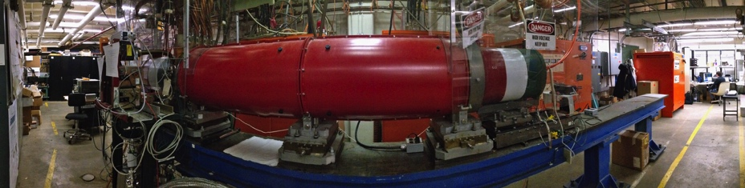
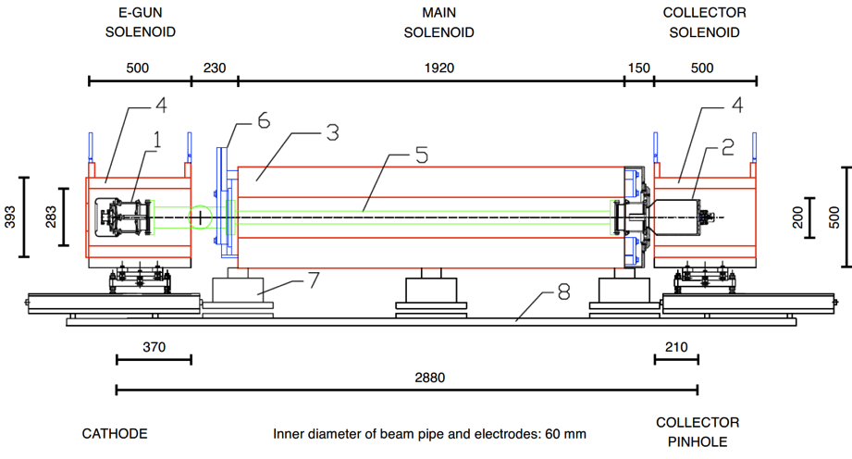
E-lens test stand at FNAL
https://cdcvs.fnal.gov/redmine/projects/elens/wiki/Test_Stand
Operational, up to 10 kV, 8μs x 1Hz pulses (or higher at < 5A)
Used to test CERN guns, will be used for testing guns for space-charge compensation at IOTA ring. Could be used to test HF modulators.
Diagnostics: pin-hole FC in collector

Slide 6
Simulations and computer codes
Reliable and verified simulation technics and models are required
Computer codes that will be used for simulation for electron gun and beam dynamics:
  CST particle studio
  WARP
  Results of gun simulations using TRACK and UltraSAM (2D codes) are available
  BENDER

Slide 7
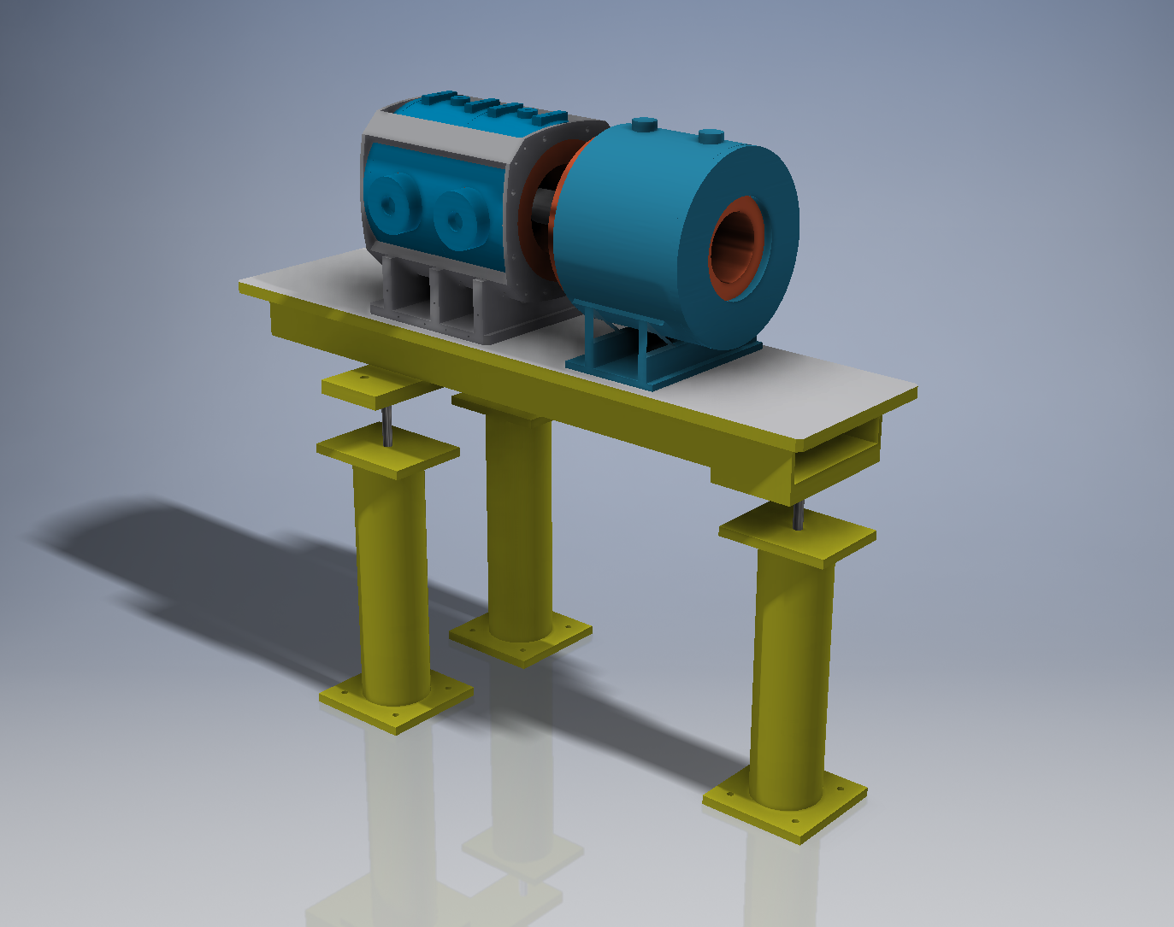
Current status: solenoids
Solenoids (gun & collector) were recuperated
Alignment support was recuperated
  Alignment tables for solenoids are in production
8 Power converters (45 V – 140 A) from DELTAELECTRONIKA were delivered at CERN
  560 A for gun solenoid (up to 0.3T)
  560 A for collector solenoid (up to 0.5T)

Slide 8
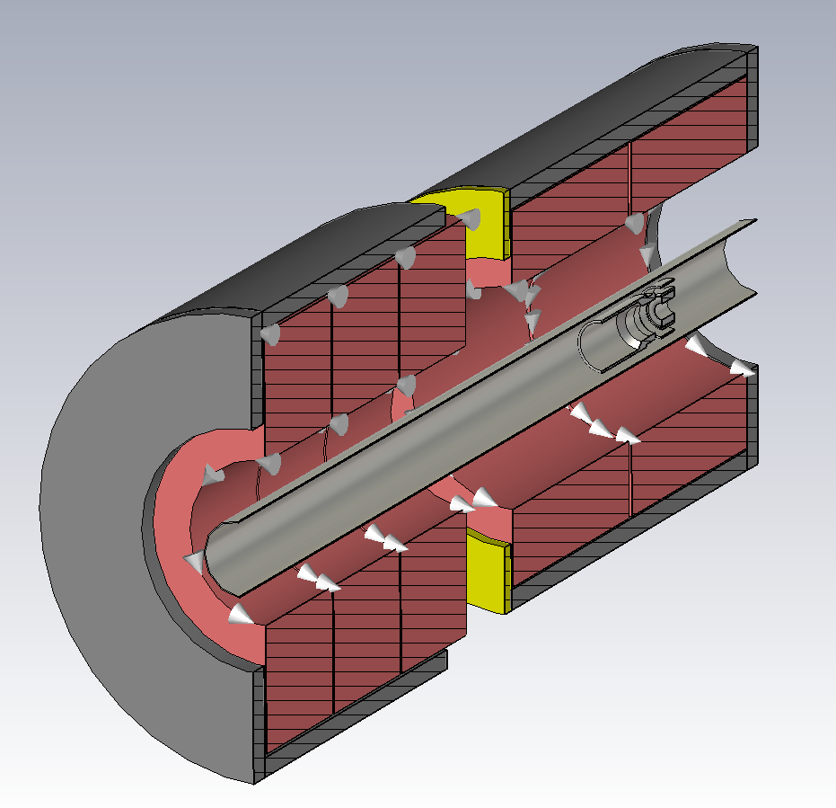
CST model of the solenoids
Gun solenoid (2 coils)
Collector solenoid (3 coils)
B field depending on current is calculated
B field map during solenoids commissioning using XYZ scanner and Hall probe

Slide 9
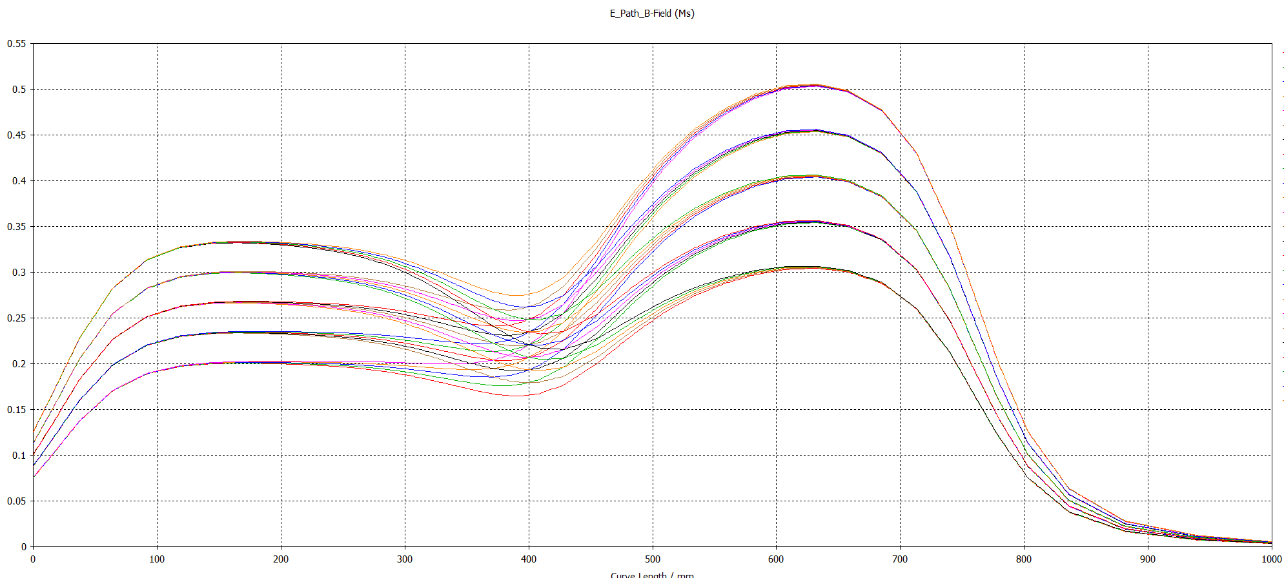
Magnetic field along Z axis for different currents in the test bench
BDB
500 A
450 A
400 A
350 A
300 A
Cathode
500 A
450 A
400 A
350 A
300 A
Gun solenoid
Collector solenoid

Slide 10
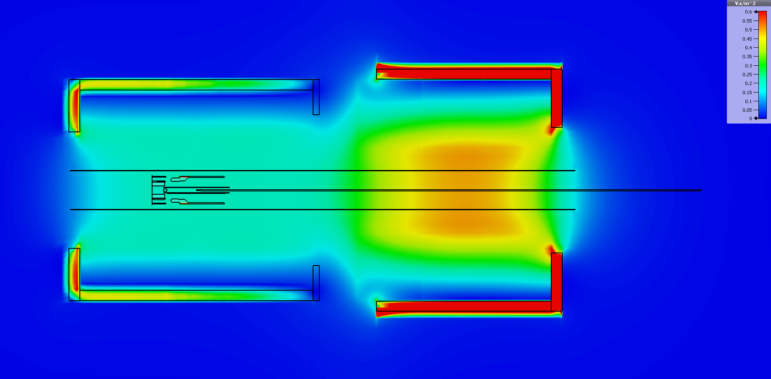
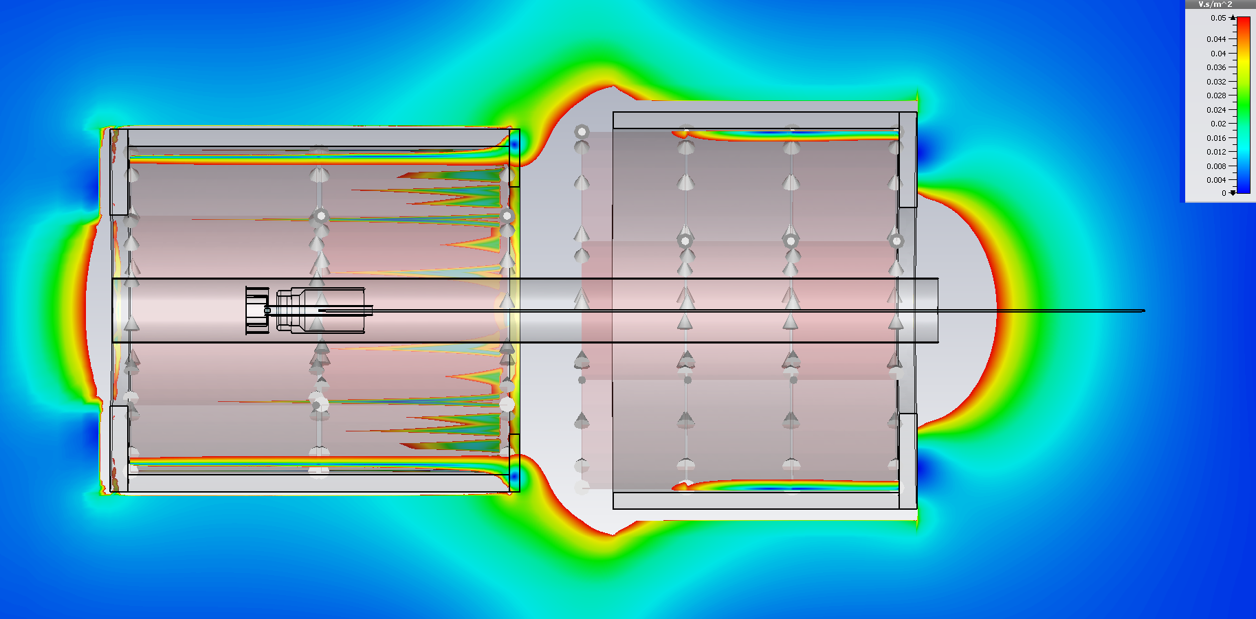
Magnetic field on X=0 plane for 300A in GS and 500A in CS
Threshold 0.05T

Slide 11
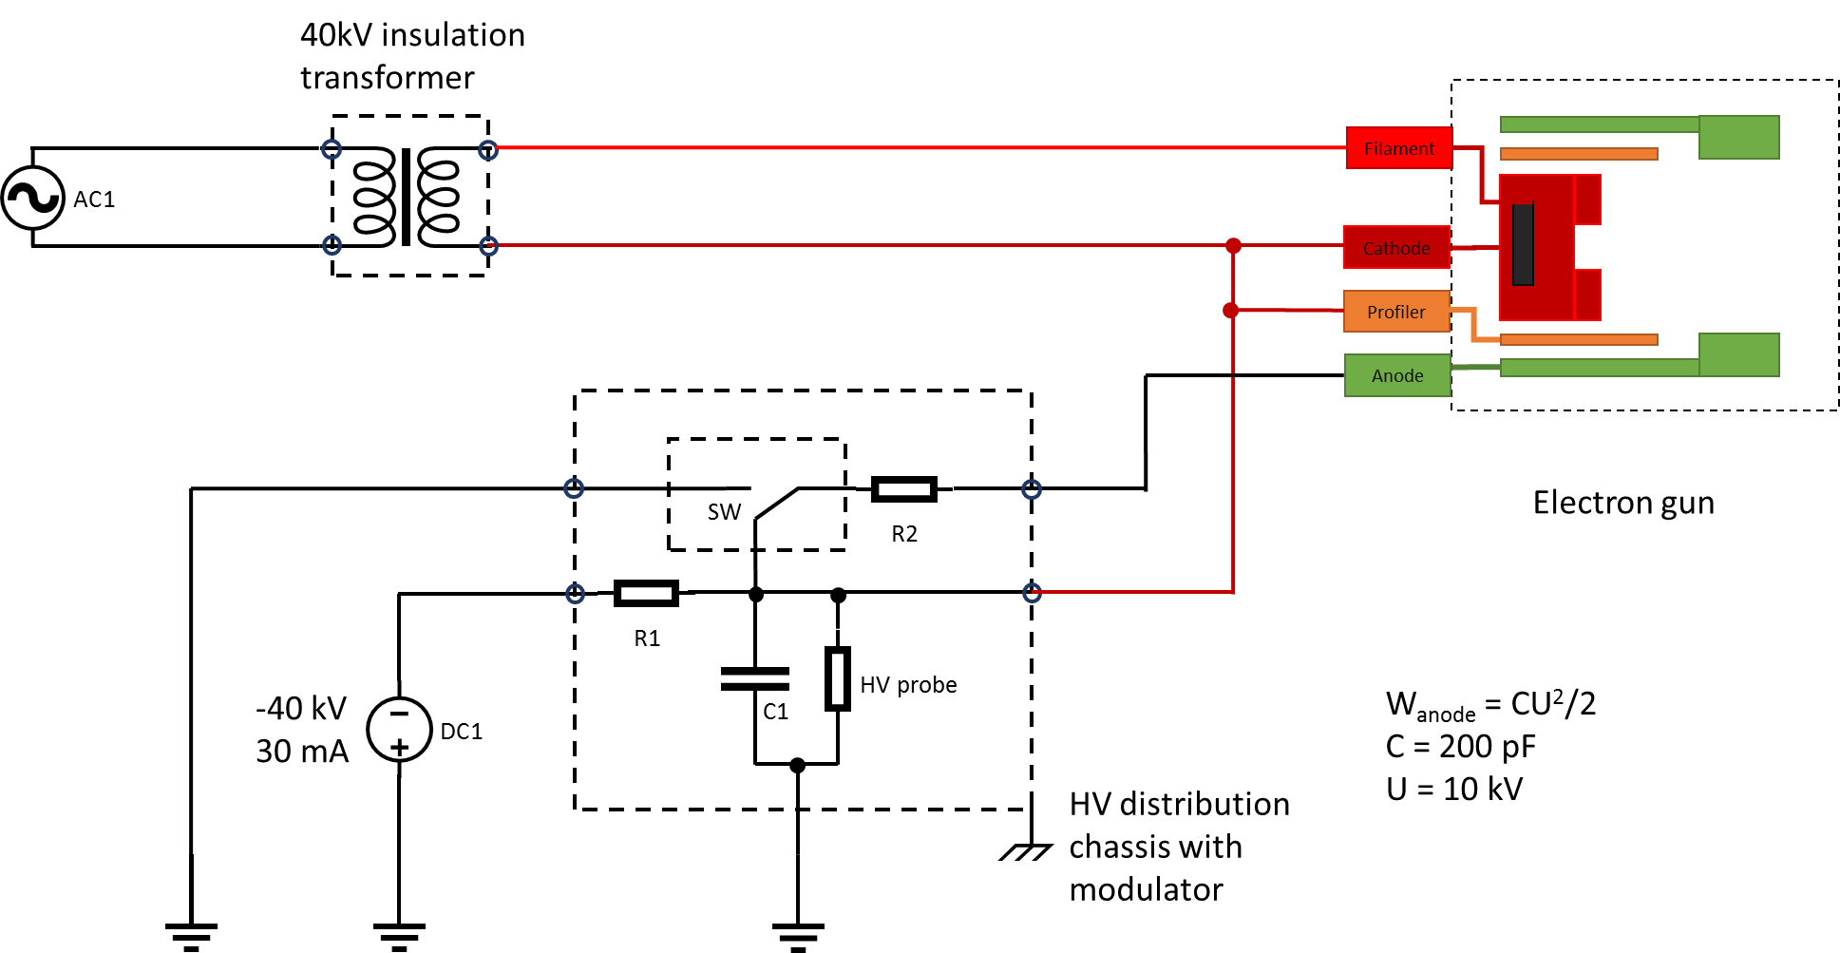
HV schematic
Operation in pulsed mode
BELHKE HV switch (HTS 401-10-GSM) for anode modulation
Faraday Cage during upgrade
¿ Requirements (V, I) for filament for GSI gun ?
¿ Requirements of the pulse (rise time, duration) for GSI gun ?

Slide 12
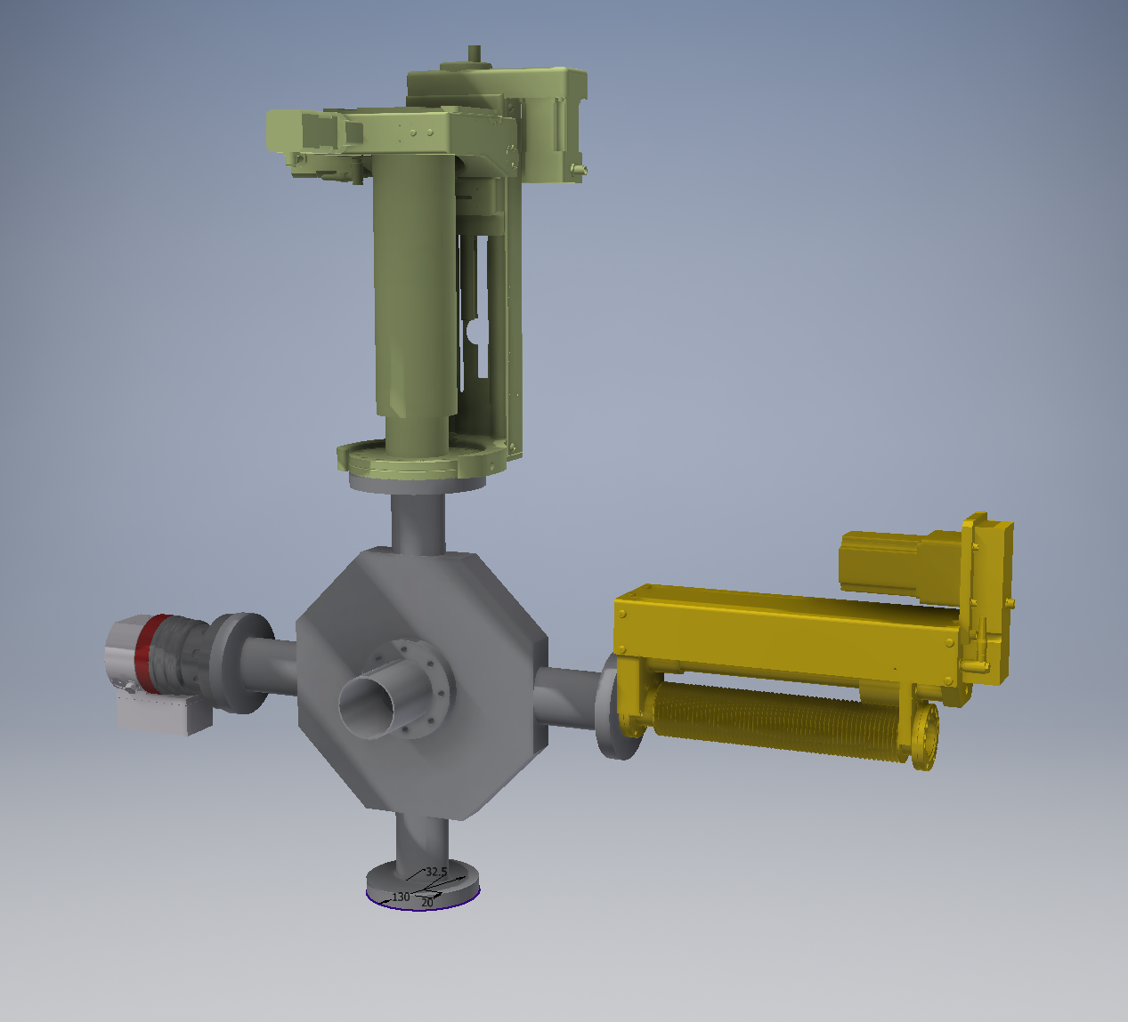
Beam diagnostic box
Beam diagnostic box includes:
  XYZ scanner with Faraday Cup
  YAG:Ce screen
  Port for vacuum pump

Slide 13
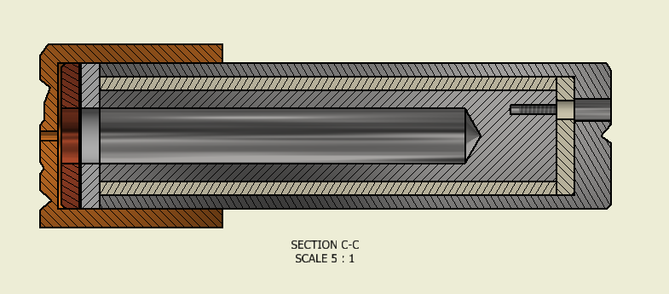
BDB: Faraday Cup
Pin hole Faraday Cup
Z=±20 mm
Mo aperture 1 mm
W aperture 0.2 mm
X=±25 mm
Y=±25 mm

Slide 14
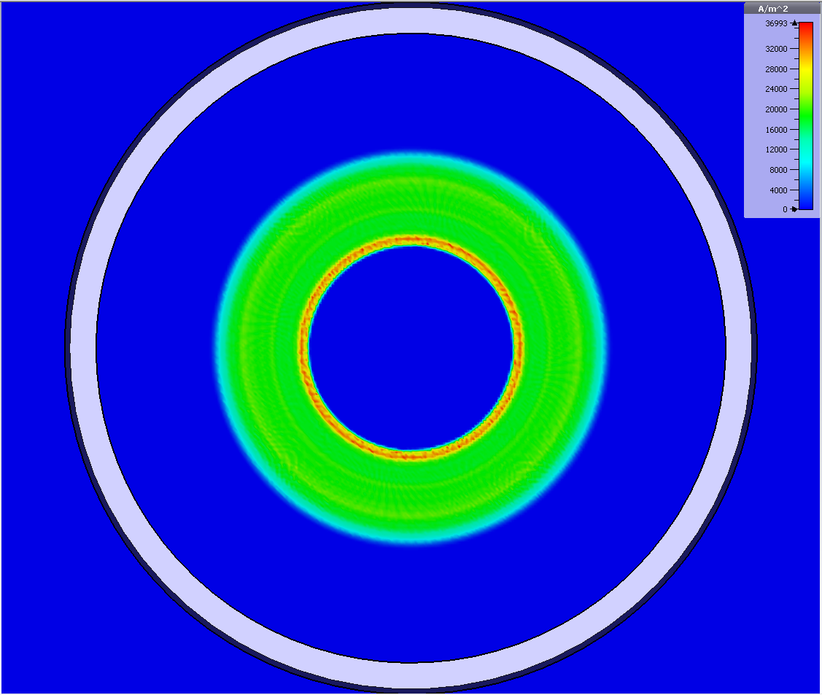
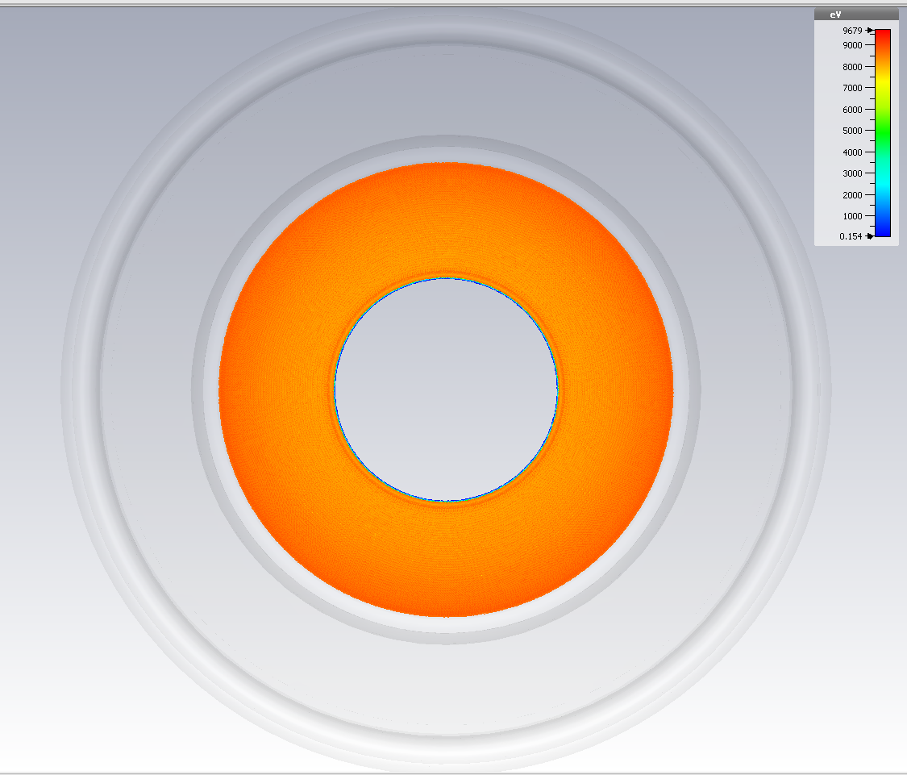
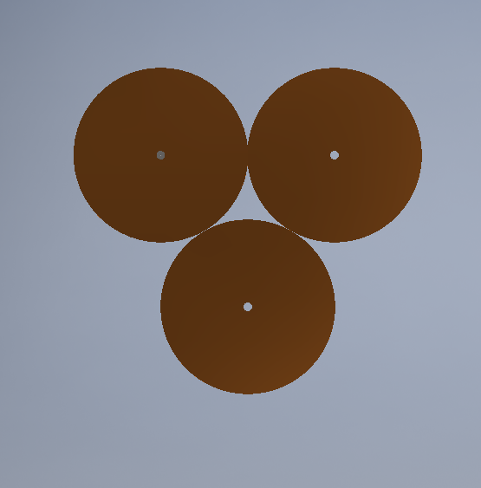
BDB: Faraday Cup
Current density
Energy density
FC array on one actuator:
Decrease time for scan
Different apertures
*Design of FC with HV repeller is under development

Slide 15
BDB: YAG:Ce screen
Actuator with YAG:Ce screen
  3 screens (D=50 mm) are delivered at CERN
  Beam profile in one pulse
  Fragile (can be destroyed after one long pulse)
  Requires view port on the collector side

Slide 16
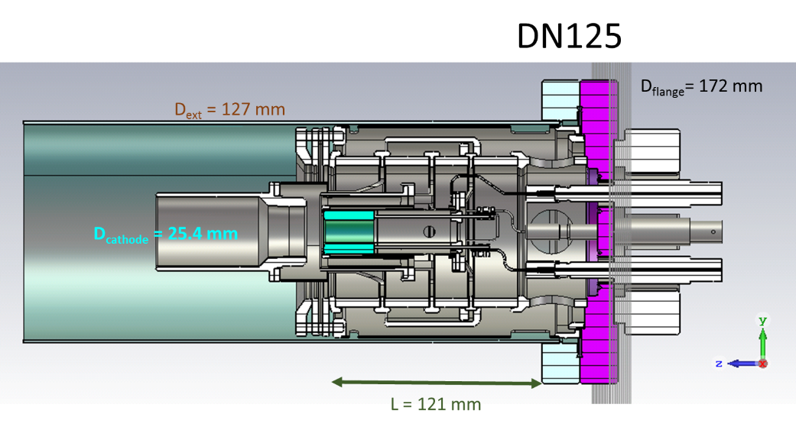
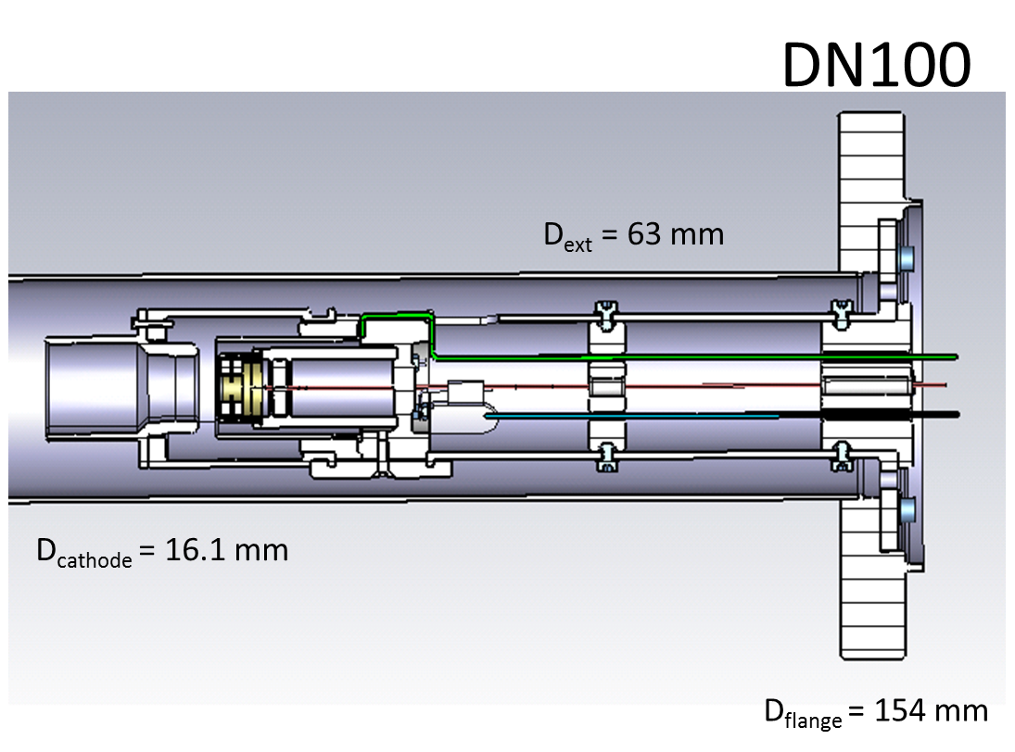
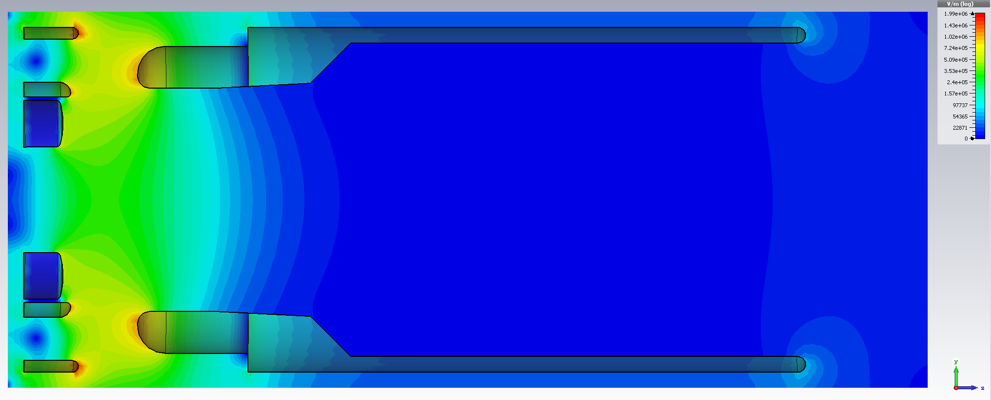
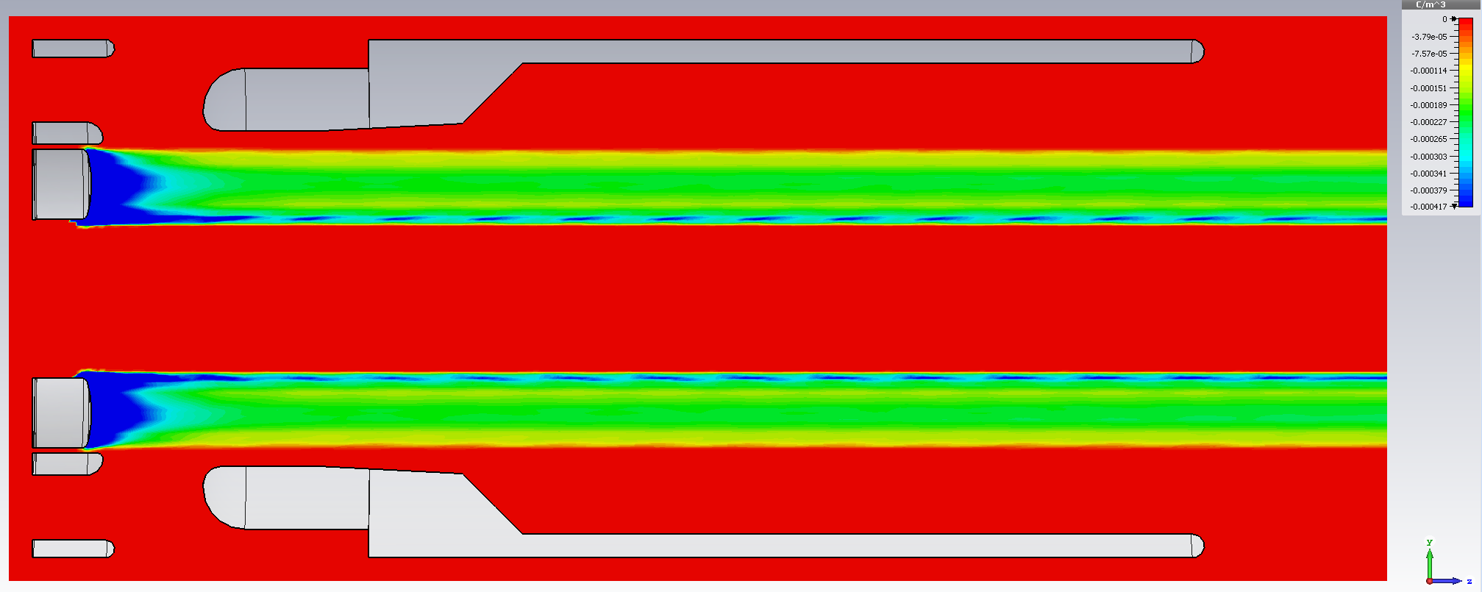
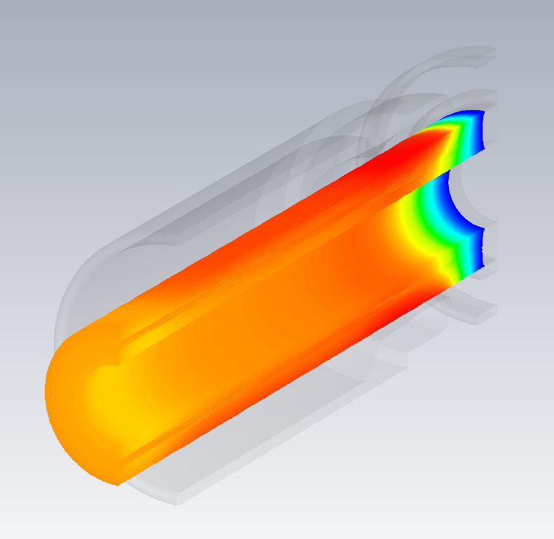
Stage 1: measurements
Gun characterization
  Measurements like in FERMILAB, but without 2 m drift for 25.4/16.1mm guns
  Comparison experimental results with CST/WARP/TRAK/UltraSAM (to use output beam profile distribution as inputs for beam dynamics simulation)
Anode modulator
  33 kHz at full range (0 V – -10kV), 200pF at 10kV at 33 kHz…
  ~MHz at % level (beam modulation for BPM)
  *Test modulator but not the beam/BPM

Slide 17
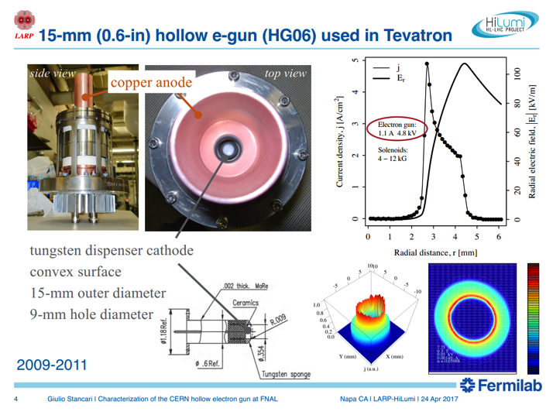
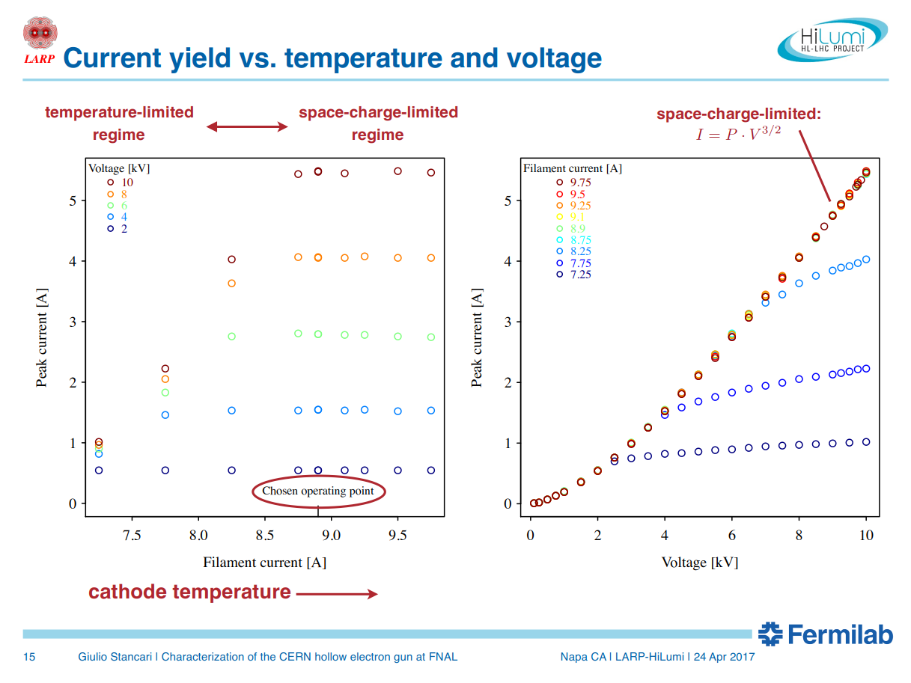
FNAL test stand: measurements
Electron gun characterization
G. Stancari FNAL
G. Stancari FNAL

Slide 18
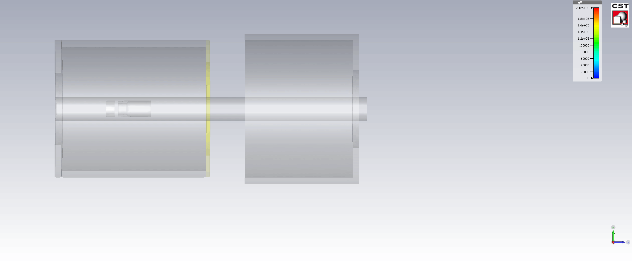
Collector
View port for YAG:Ce screen
Faraday Cup with repeller and view port as collector (no water cooling)
To finalize design simulations with GSI gun are required
¿ Resolution 1 Gs/s ?

Slide 19
Summary and outlook
A test stand at CERN is being constructed in a phased approach:
  Stage 1 (Gun Solenoid – Diagnostic box – Collector solenoid) can be used for:
    E-gun characterization both for HL-LHC HEL (in parallel or after FNAL) and SIS18 SCC lens;
    Benchmark simulation codes (CST, WARP, TRAK, UltraSAM)
    E-gun studying for BBLR compensation;
    Test anode modulator
    Test and commission BGC
  Stage 2 (+ drift solenoid) is needed to:
    Test RF modulation for SIS18 SCC lens;
    Test BPM for electrons (HF or LF modulation);
    Investigate electron beam dynamics and benchmark simulation codes (CST, WARP, …)
Issues:
  Cooling water in the building 236

