Slide 1
High Precision Timing Distribution for HL-LHC
Pre-meeting / Introduction & Welcome

Slide 2
Setting-up the mandates of the High Precision Timing Distribution project and Interest Group

Slide 3
Agenda
Introduction
High Precision Timing for CMS
High Precision Timing for ATLAS
An example of targeted study: improving the phase stability in serial links
The High Precision Timing Distribution project and Interest Group: mandate and operation

Slide 4
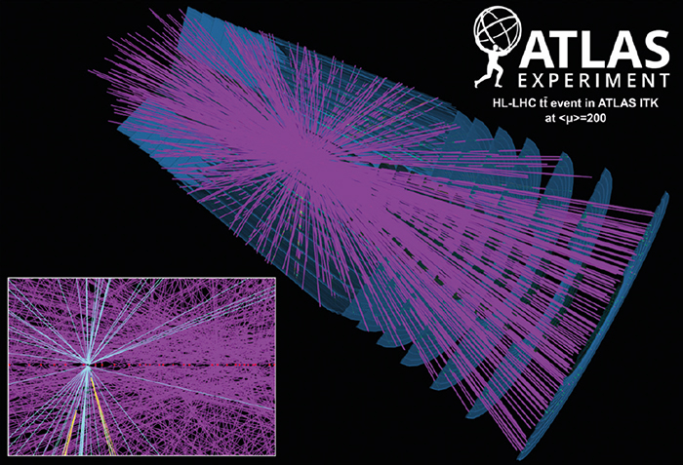
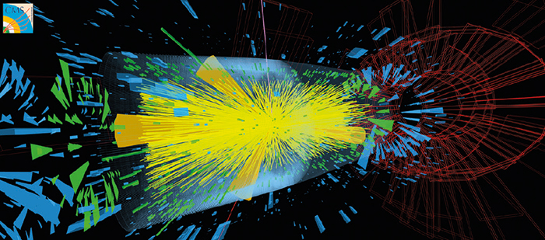
New playing rules with the HL-LHC
High Pile-up expected for HL-LHC
  From 20 (LHC nominal) to ~200 (HL-LHC)

Slide 5
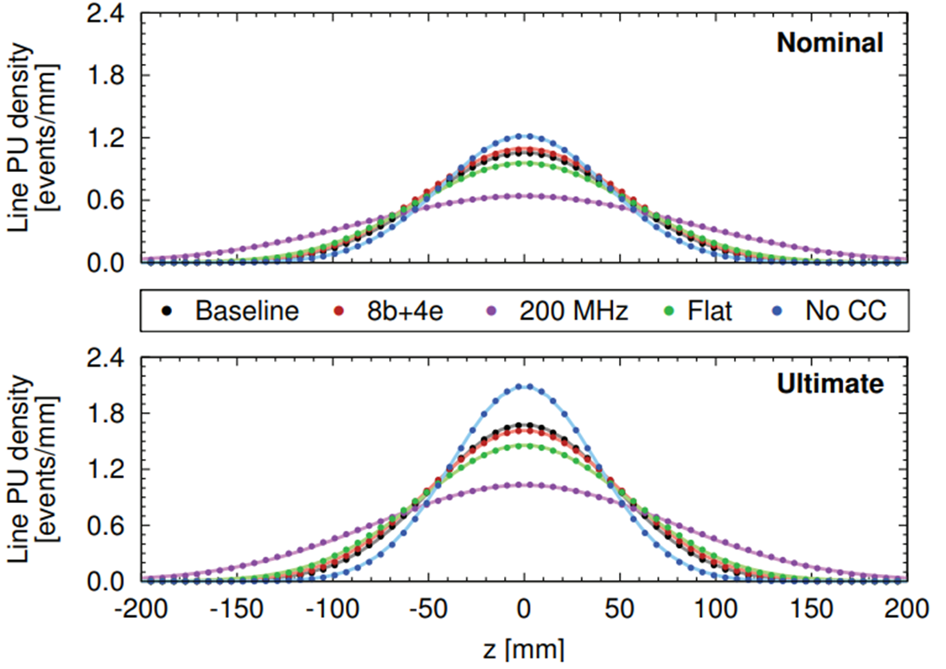
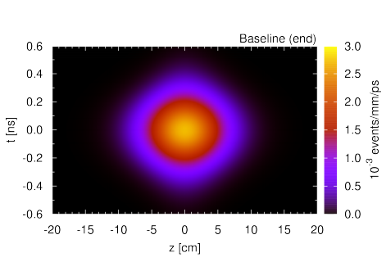
Impact on Luminous Region
Josh Bendavid (CERN/LPC), Oct 2017
CMS Detector performance for HL-LHC
http://accelconf.web.cern.ch/AccelConf/ipac2017/papers/tupik089.pdf
Interactions distributed in space and time at every bunch crossing
  Space: 35 to 70 mm rms
  Time: 180 to 275 ps rms
3D-vertexing will not be enough. Time shall be used as a 4th dimension to help.

Slide 6
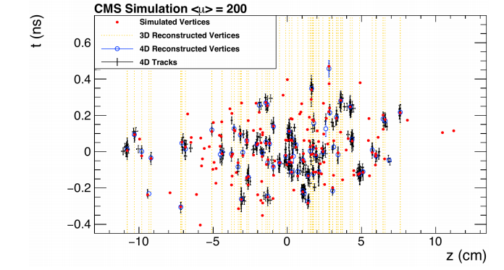
Going 4D..
Josh Bendavid (CERN/LPC), Oct 2017
CMS Detector performance for HL-LHC
Traditional three-dimensional vertex fit can be upgraded to a four-dimensional fit, with pileup vertices explicitly reconstructed in position along the beamline and time within the bunch crossing
Simulations show that for 20-30 ps time resolution, a 3-5x reduction in effective pileup density for track-primary vertex association can be expected (ie back to a pile-up of ~50 equivalent to current LHC situation)

Slide 7
Going 4D…
Upgrading Calorimeters (photons, hadrons)
Adding specific Timing detectors for charged particles
  MIP Timing Detector for CMS
  HGTD for ATLAS
Challenging tasks by themselves, but implicitly assuming an excellent clock distribution scheme…
    High stability in time of each individual link
    High detector-wide stability
    Precise tracking of clock propagation time

Slide 8
CMS and ATLAS Timing Requirements
CMS / Jeroen Hegeman
ATLAS / Laurent Serin

