Slide 2


Welcome - Herzlich willkommen
Besuch des
BRG Bruck and der Leitha
29 März 2018
to Accelerating Science and Innovation
Notes:
2

Slide 3

CERN
What is it ?

Slide 4
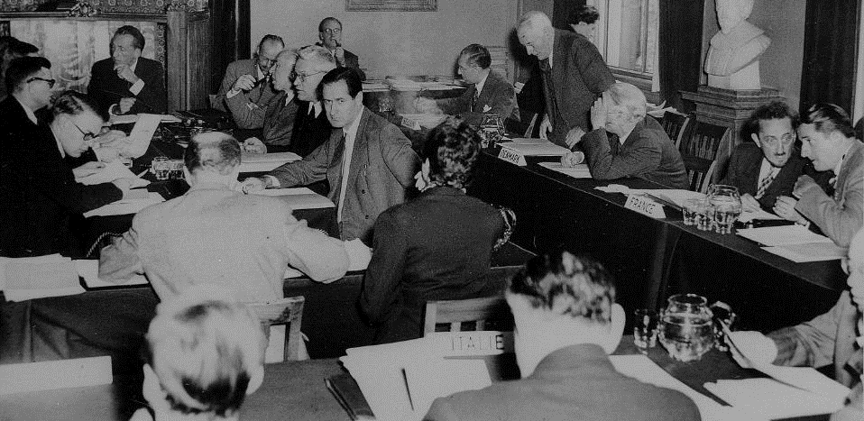

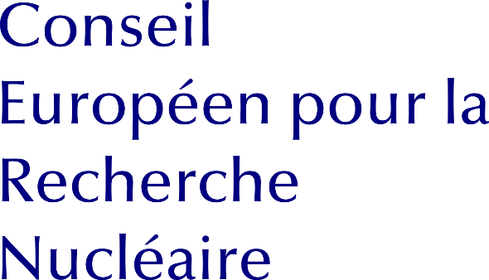

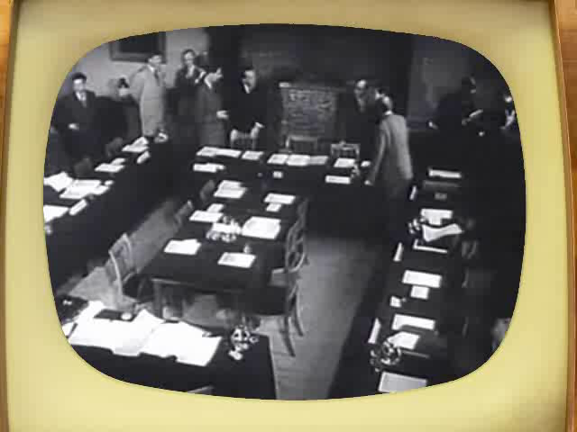
What does « CERN » stand for?
1952
Notes:
Ask the audience what they think «CERN» acronym stands for before showing the answer.
After WW II, fundamental research in Europe was not leading anymore.
Many scientists were flying away to the United States.
In order to stop this movement, eminent scientists gathered in meetings to setup a structure to continue fundamental research in physics in Europe.
They were gathered as a «Council» which means there were just holding meetings and they did not (yet) had a lab or led experiments.
The images are from Amsterdam meeting in 1953 when the CERN convention was signed.

Slide 5
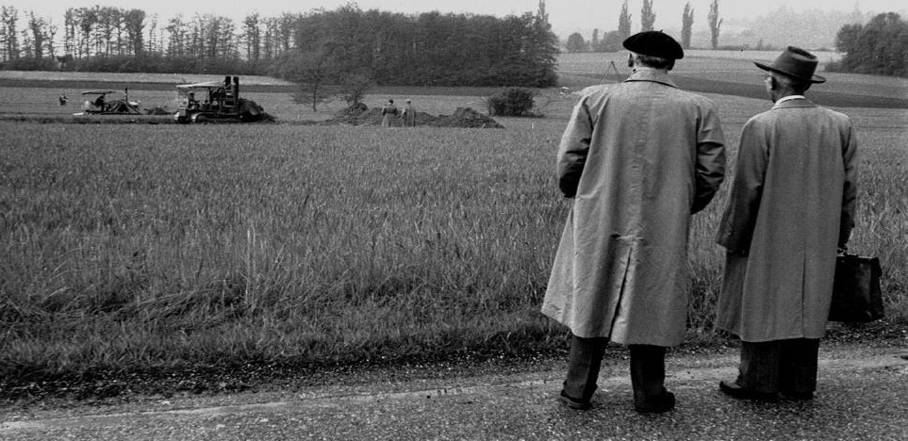
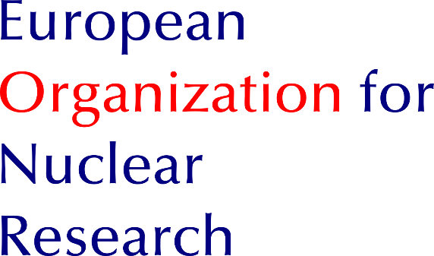
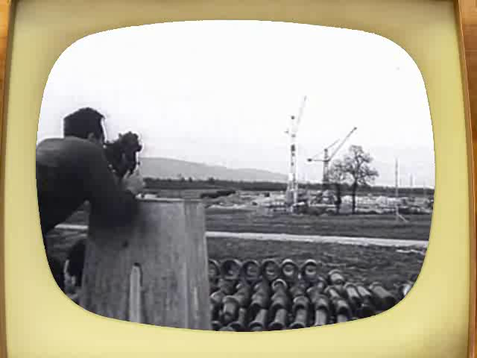
What does « CERN » stand for?
1954
Notes:
It is decided to build the «European Organization for Nuclear Research». It comes into existence in 1954.
Geneva is chosen for its central location, the neutrality of Switzerland, the International visibility.
International Organization format was chosed to guarantee neutrality and independance.
The Organization, unlike the Council, has labs and has research activties.
But as the Organization is still «led» by a Council, the CERN acronym was kept.

Slide 6
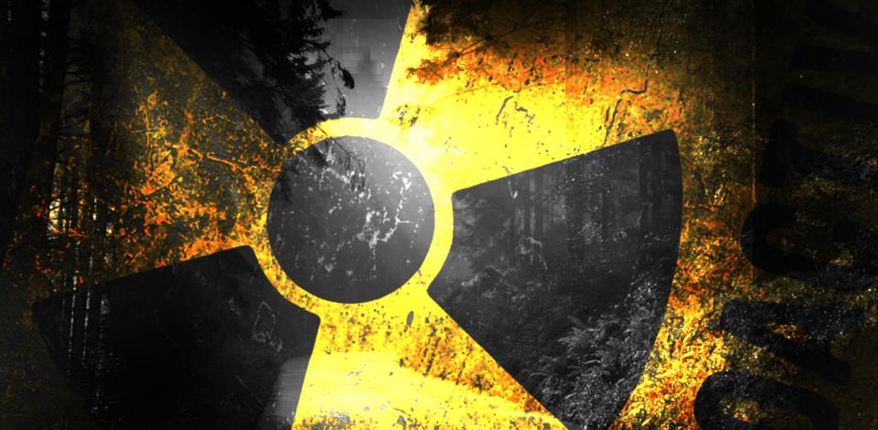


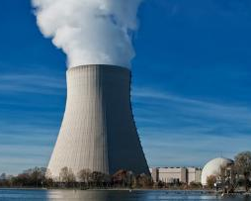
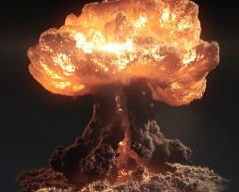
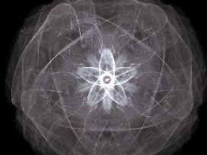
Nuclear?
European laboratory for particle physic
Notes:
(you can question the audience for each image: do we produce electricity? do we produce bombs? Etc.)
The word «Nuclear» should not be misunderstood:
- CERN does not produce electricity (but consumes a lot)
- CERN does not produce military applications out of nuclear power (forbidden by CERN convention, and, anyway, all research results are made publicly available and there are scientists from many countries in each experiment… therefore no risk that exclusive military applications are developed).
- CERN studies the structure of matter. In the 50’s, the nucleus is the main object of study about matter. The word «Nuclear» comes from that.
Nowadays CERN is studying the components of the components of the nucleus. Therefore CERN can use (after being allowed by the Council) an alternative «branding» which is more accurate and less open to interpretation: « European laboratory for particle physics »

Slide 7
CERN
Who is it ?
Notes:
Who is behind CERN?

Slide 8
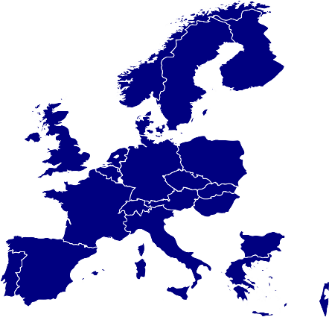






Member states
Germany
20.27%
France
15.39%
United Kingdom
13.88%
Italy
11.48%
Spain
8.28%
ca 1 Bn CHF
Netherlands
4.60%
Switzerland
3.64%
Belgium
2.78%
Poland
2.66%
Sweden
2.61%
Norway
2.55%
Austria
2.22%
Denmark
1.76%
Greece
1.64%
Finland
1.39%
Portugal
1.20%
Israel
1.19%
Czech Republic
1.03%
Hungary
0.65%
LHC
Slovakia
0.50%
Bulgaria
0.28%
Notes:
First, CERN is funded by 21 Members States.
Mostly European ones. But since 2008 any country in the world can apply for membership, either full or associate.
Israel is the last country which has joined CERN as full Member in 2014.
These countries give ca 1 Bn CHF (this is the budget of a mid-sized University) per year.
This money allows CERN to fulfill its mission: provide and support the needed infrastructure for scientits to make experiments.
That covers: equipment, transport, maintenance, factoring, paying people and… build accelerators.
That does no cover the research cost itself (see collaboration on next slide).
The money is paid by each country pro rata their GDP (Gross Domestic Product).
Therefore Germany which contributes to 20.27% makes the «relative» SAME effort than Bulgaria which contributes for 0.28%.
Of course, in important decisions, Germany will «weight» 20%, and Bulgaria only 0.28%
The decision treshold for important decisions is 75% of the budget represented in the vote.
The big 4 countries (DE, FR, UK, IT) only account for a bit more than 60%. They need the support of smaller countries and cannot impose their views.

Slide 9
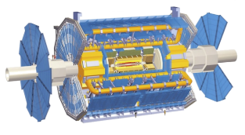


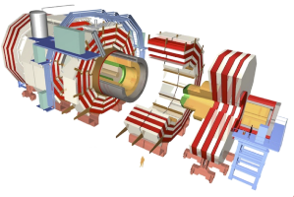

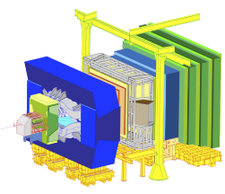


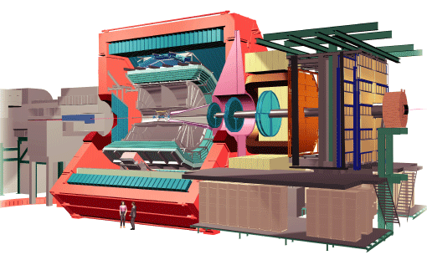

Collaborations
ATLAS
CMS
LHCb
ALICE
Notes:
Second, in addition to Member States, any country (see USA and China on the illustration but there are many more) can join CERN activities through scientific «collaborations».
A collaboration is an agreement with many differents research institutions (universities, national laboratories etc) to put resources in common: money and people. Each institution decide which collaboration they want to join or not. Not all countries participate to all collaborations.
Collaborations typically plan, design, build and operate an experiment (usually a detector)l
There are hundreds of collaborations/experiment at CERN even though 4 of them drive most of the resources, the 4 LHC experiments.
The collaboration must of course frist get approved by CERN Scientific Policy board.

Slide 10
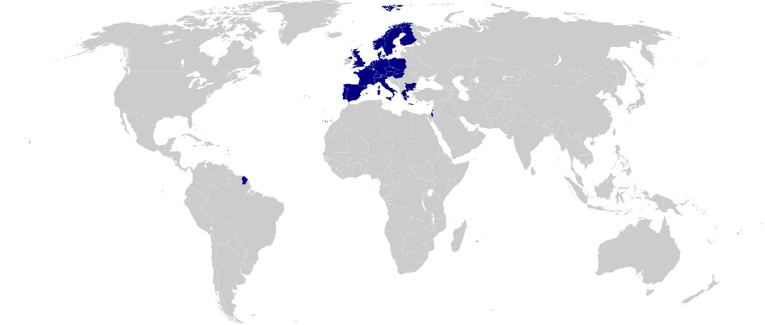
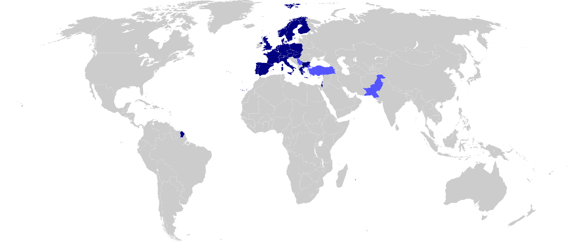

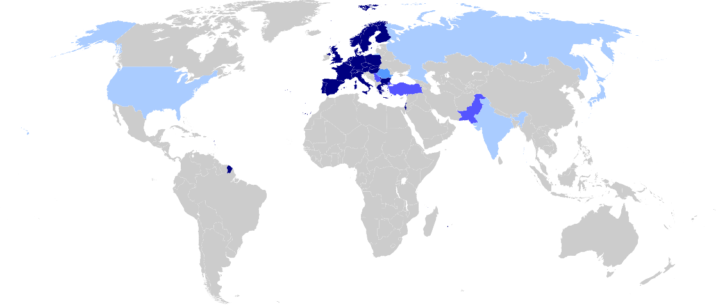
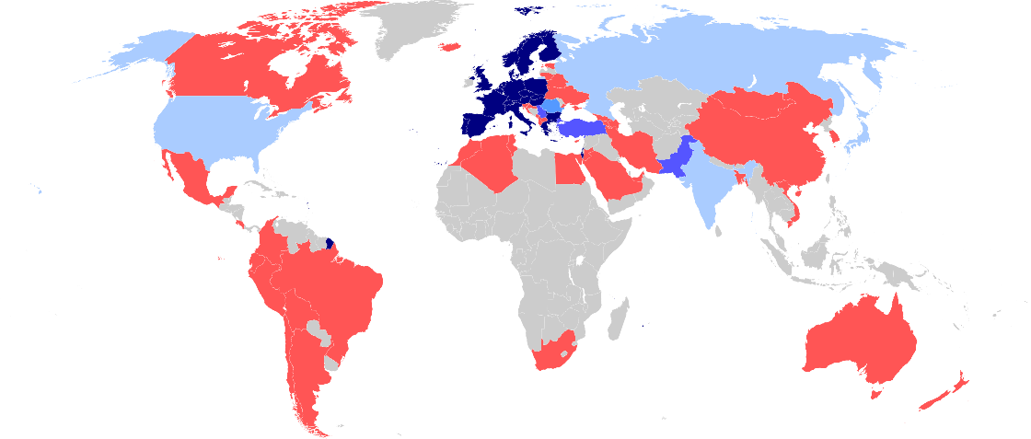

A world collaboration
22 members
2 associates
2 candidate
Observers
Cooperation agreements
Scientific contacts
Notes:
Even though the «E» in CERN stands for European, CERN became a WORLD actor in the particle physics community.
In fact, half of the world particle physicists ARE connected with CERN at some point. No other scientific domain has reached this level of integration.

Slide 11










+15’000!
How many persons?
2’500 staff
600 fellows &
apprentices
500 students
11’000 users
2’000 external
companies
Notes:
CERN employs «only» 2500 persons. In which there are «only» 70 research physicists (you can ask the audience if they can guess this).
As Fellows and Apprentices are here for a first employement experiences.
The number of students can vary from 300 to 600 depending of the time of the year. It’s mostly university students.
The core population of CERN is made of about 11’000 «users», called like that because they are here to «use» CERN’s facilities.
They are NOT employed by CERN and come in the frame of the collaborations.
They are not all the time at CERN. Some spend 5% of their time at CERN (a few days a year), some spend 100% of their time. It really depends on their function in the collaboration, on the need for them to be on site, or, on the other hand, the possibility for them to work remotely.
Given the size for CERN’s population, many services are externalized (mail, transport, restaurants, etc) to firms.

Slide 12
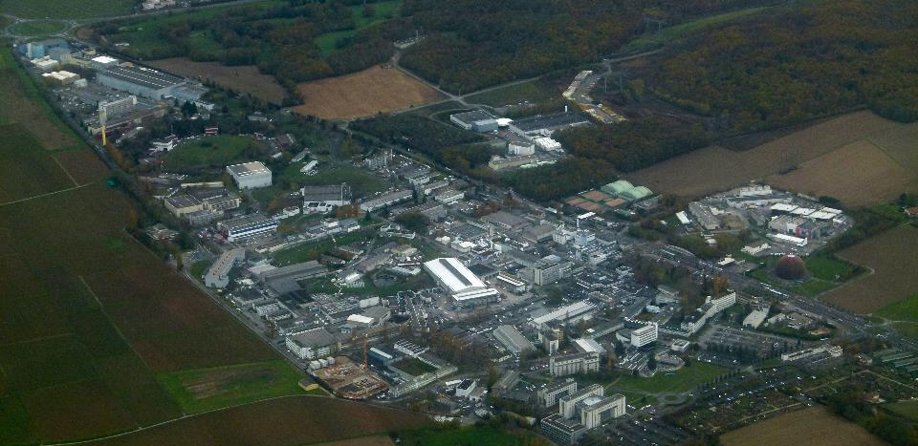

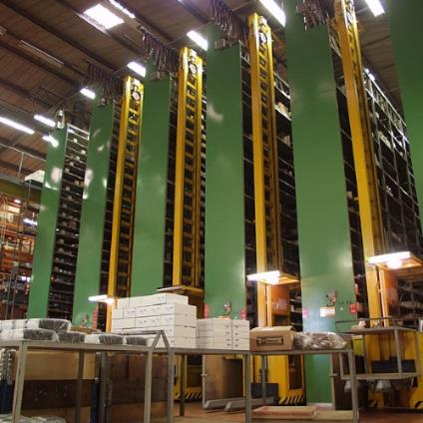
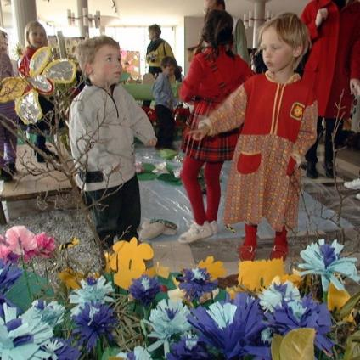
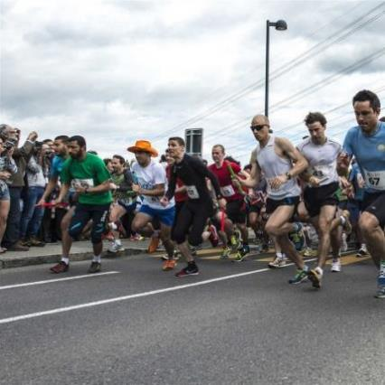
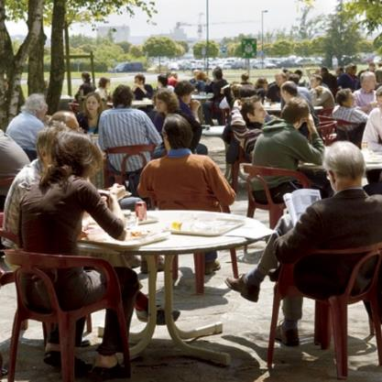

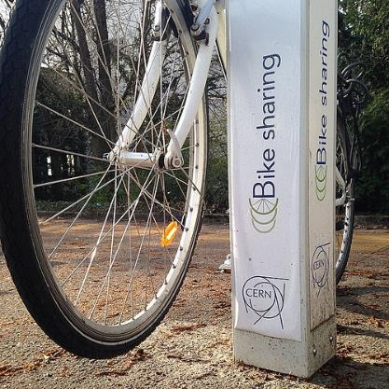
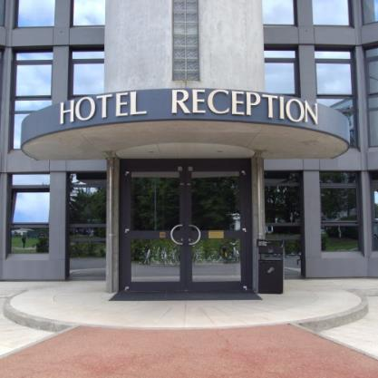
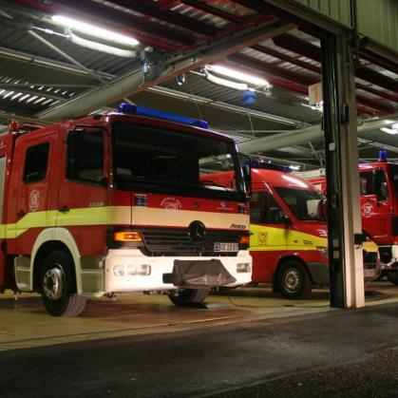
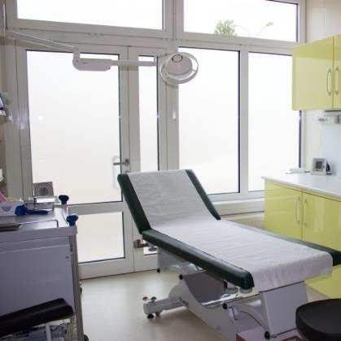
Like a small town
Mail, Stores…
Library
Hotels
Kindergarten
Clubs, Associations
Bank, Post Office,
Travel Agent
Medical Service
Fire Brigade
Tramway, bus, bikes
Restaurants
Notes:
CERN has 2 main sites. The most populated one is Meryrin, straddling accross the French-Swiss border (unique in the World).
CERN’s territory, even though by Switzerland and France is under the control of the Organization. This means local French and Swiss authorities do not have access to it unless agreed by CERN’s Director General.
CERN is like a small town with various services you can find in a town. And also with the problems of a small town: mobility, parking, ageing of some buildings etc
There is even a demonym for the people working at CERN: «les Cernoises et les Cernois».

Slide 13
CERN
What for ?

Slide 14

Fundamental research
Notes:
CERN’s goal is FUNDEMENTAL research, not APPLIED research.
CERN is not to improve the way electricity is produced or rockets are launched.
CERN is to help answering questions and for a better understanding of the Universe.

Slide 15
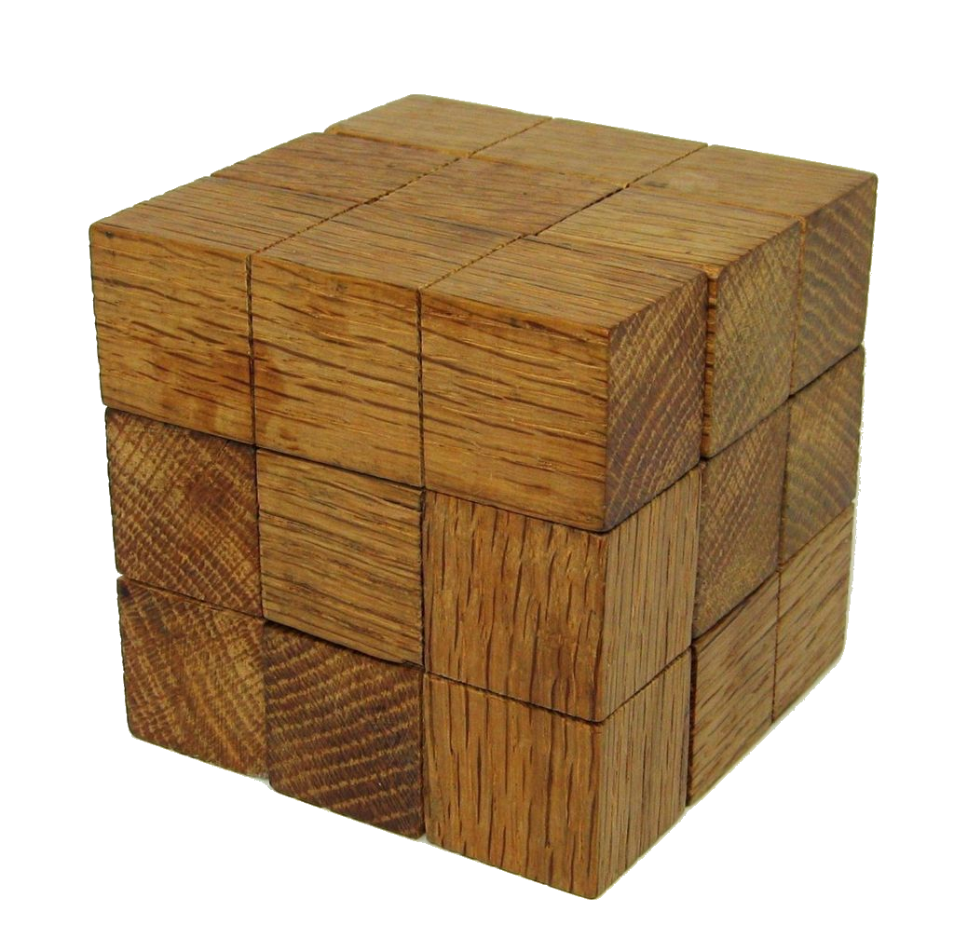
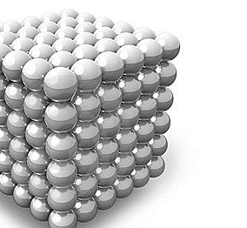
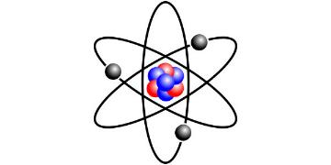
What is the matter made of ?
?
u
u
d
atom
electron
nucleus
proton
neutron
quark
4th - 5th
century
BCE
End of
19th
century
Beginning of
20th
century
1960s
Notes:
Let’s take a sample question: what is the matter made of.
In history, usually, theorists came with ideas (out of their imagination, out of maths…) then, in a second phase experimentalists were proving or disproving the theories.
Democritus (460 BCE – 370 BCE) proposed to cut things into halves, then again and again until you have an indivisible object (ἄτομος in Greek). Nice theory but impossible to prove until technology evolves.
By the end of 19th Century, scientist found out that «Atom» was not a good name as it was splittable in nucleus and electrons orbiting around it.
Then it was found that nuclei themselves were made of «hadrons» (Protons and Neutrons).
That was the understanding of matter when CERN was created, hence «Nuclear» in its name
In the 60’s (CERN is already a few years old) it was found that
Currently we think that electrons and quarks are «fundamental particles» i.e. they are not made of something else. Or are they? History shows that scientific research allows to look further and to reconsider the previous «discoveries». It’s an endless process.
Finish with a little poll with the audience, don’t be shy, there is no wrong answer:
Who believes there is an inner structure in the quark, still to be discovered?
Who believes there is no inner structures and that we have found the ultimate fundamental particles?
….
There is in fact a 3rd option: who believes we don’t have a clue but labs like CERN will help finding out?

Slide 16
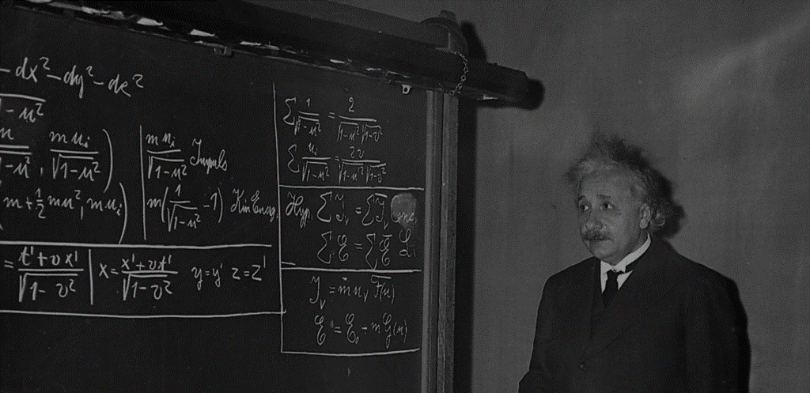
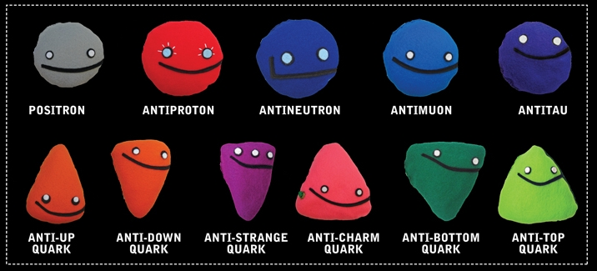













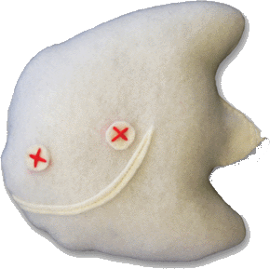



Standard Model
Checking theories
Images: www.particlezoo.net
LEPTONS
QUARKS
ORDINARY
MATTER
ELECTRON
ELECTRON
NEUTRINO
UP
DOWN
MUON
MUON
NEUTRINO
CHARM
STRANGE
TAU
TAU
NEUTRINO
TOP
BOTTOM
4 forces
GLUONS
Strong force
PHOTONS
Electro-magnetic force
BOSONS
Weak force
GRAVITONS
Gravity
Notes:
So… CERN is here to check theories… Amongst many other, one is very largely agreed upon: the standard model.
It is a kind of particle dictionnary.
It predicts there are 12 matter particles. But we can see that only 3 of them are sufficient to create all atoms (up quark and down quarks make protons and neutrons hence all nuclei, if you add electrons you have any atom…)
What are the others? They are particles which exists briefly in extreme conditions of energy. They tend to decay into less massive, more stable particles like the ones on the first line.
At CERN we are reproducing these extreme conditions of energy (on a microscopic and harmless level) which allows us to produce and observe these particles. For a bery brief moment, but long enough.
In addition to the 12 matter particles, there are «force» particles which bound the matter ones together: gluons «glue» together the up and down quarks in protons and neutrons, photons are exchanged between electrons and nuclei making the electron orbit around it, W and Z bosons which are important in nuclear reactions were first observed at CERN in the 80s, only the Graviton has never been observed so far.
To be complete, for every particle, there is an «antiparticle». This is a particle with the same mass but with an opposite electric charge a bit like a reflection in a mirror.
With antiparticles you can make antiatoms, therefore antimatter.
Have you every manipulated antimatter? I hope not as matter and antimatter when they get in touch anihilate with 100% energy release. That means that 1g of matter put together 1g of antimatter would wipe out Geneva and its surroundings… So better not shake hands when you meet your antiyou.

Slide 17
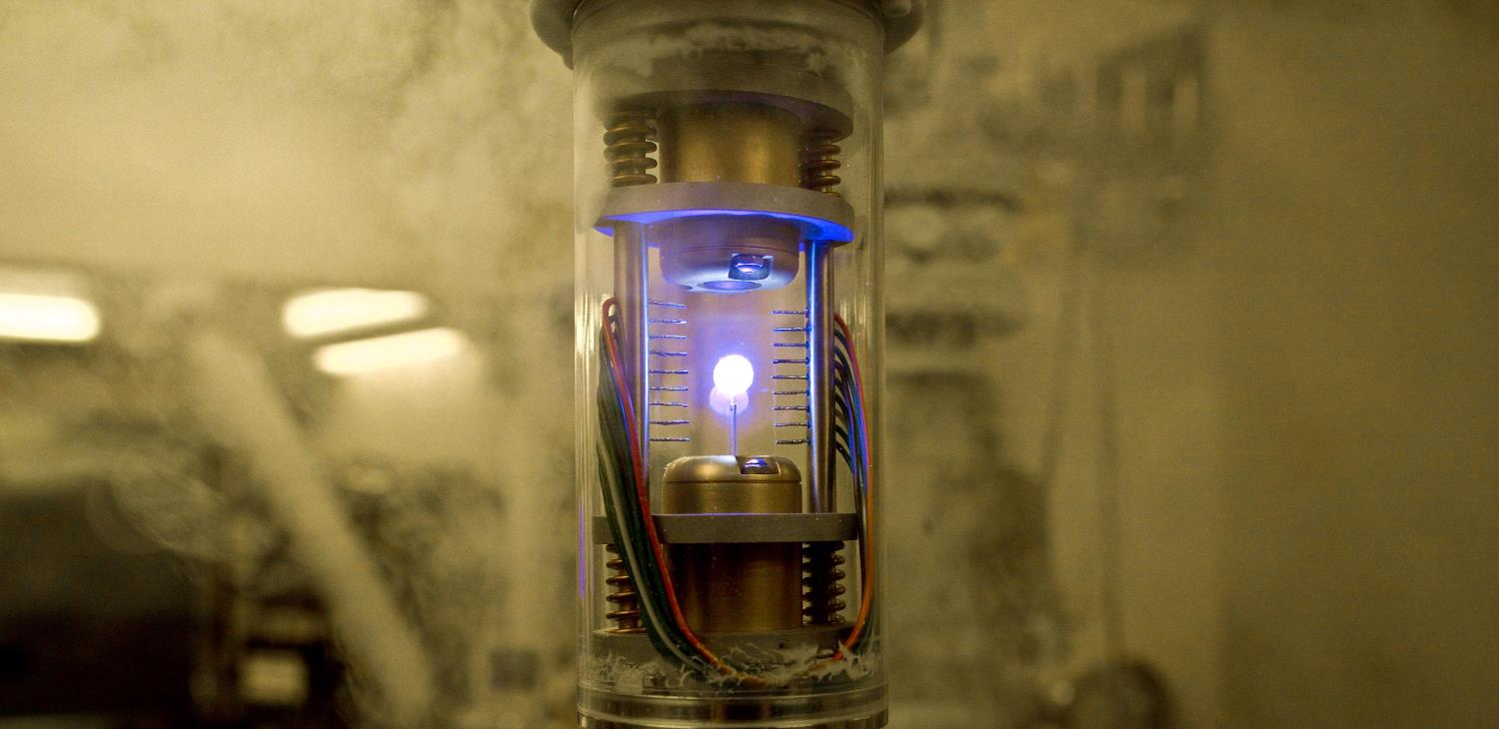
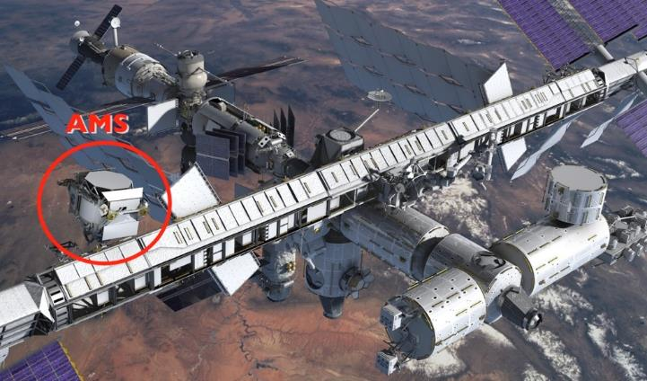
Answering questions…
Antimatter ?
Notes:
Theorists believe that at the moment of the Big Bang, a theory telling that all universe is an expansion of a tiny space of pure energy which was transformed into matter, as many particles than antiparticles were created. It is also believed that the first instants of the universe was a gigantic anihilation of partcles and their counter anti-particles which were just created. But it seems that out of 1 billion particle-antiparticle anihilation, 1 particle survived… And that what makes the current Universe… apparently made only of matter. Why matter has won over antimatter? Are we sure there is no antimatter left from the Big Bang?
CERN is looking at that question with various experiments amongst which:
AD (Antimatter Decelerator) creates anti atoms and slows them down to eventually trap them (the image here is the one from Angels and Demons movie, our trap is bigger, sexiers and consumes much more energy)
AMS is an experiment on the International Space Station which looks for traces of primordial antimatter from space. It needs to be there outside of the Earth’s atmosphere where many particle collisions occur and produce briefly anti-particles. The AMS Control Centre is located at CERN and receives signals from the experiment.

Slide 18
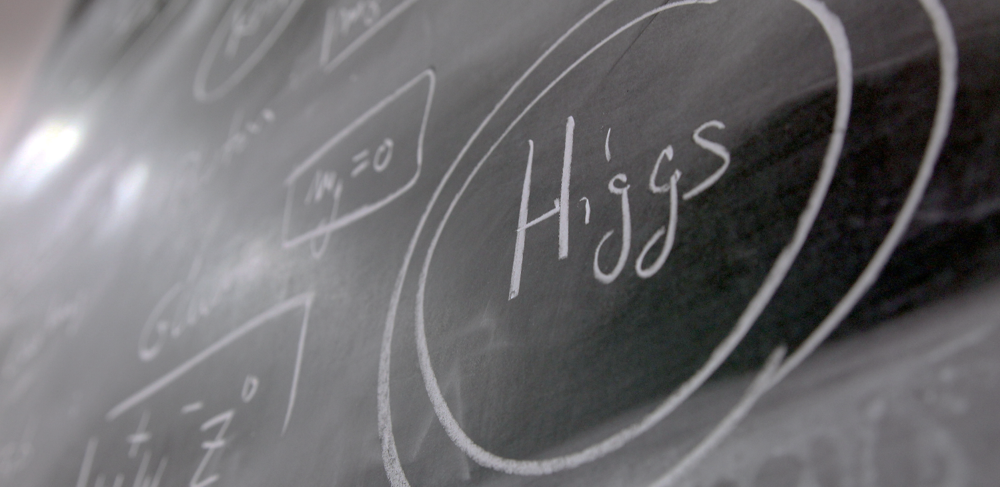
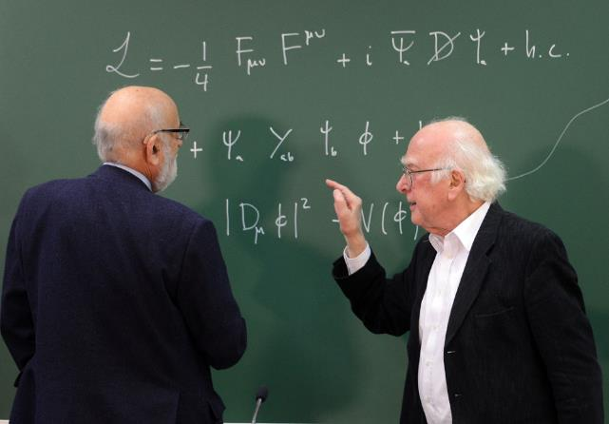
Answering questions…
Higgs ?
Notes:
CERN also helped proving certain theories like the existence of the «Higgs Boson».
This particle is responsible for giving its mass to all other particles. It is very important in the standard model.
It was predicted in 1964 by 2 Belgian physicists (François Englert and Robert Brout), then by the Scottish physicist (Peter Higgs) and others later.
If took 48 years to have the experiments (ATLAS and CMS) which proved its existence. The discovery was announced at CERN on 4th July 2012.
This discovery led François Englert and Peter Higgs (only surviving of the 3)to be rewarded by a Nobel Prize in 2013.

Slide 19
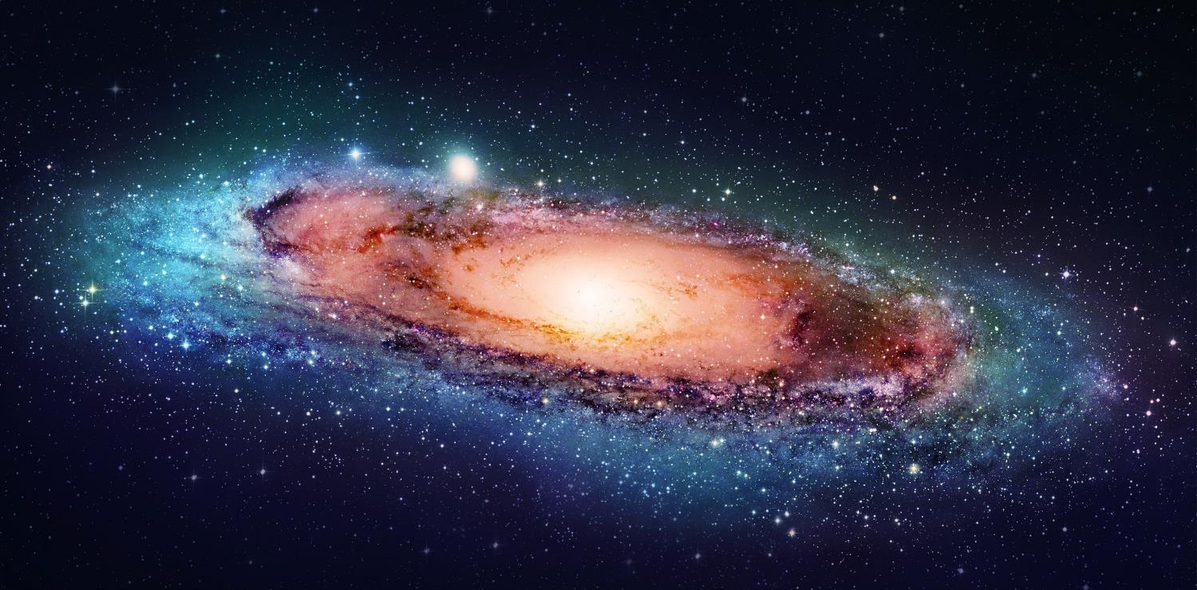
Answering questions…
Dark matter ?
Notes:
But we have many more questions unanswered.
For example when we look at galaxies far away, and at their rotation speed, the estimated mass of the visible matter (stars, planets, clouds of gas etc) is not sufficient to «keep it together». At the speed it rotates, this galaxy should split away.
And the worrying thing is that is seems we are missing 95% of the needed mass…
What is 95% of the universe’s mass made of? Dark matter? Dark energy? There are many theories again (Supersymetry amongst others). CERN may help finding out more about it.

Slide 20
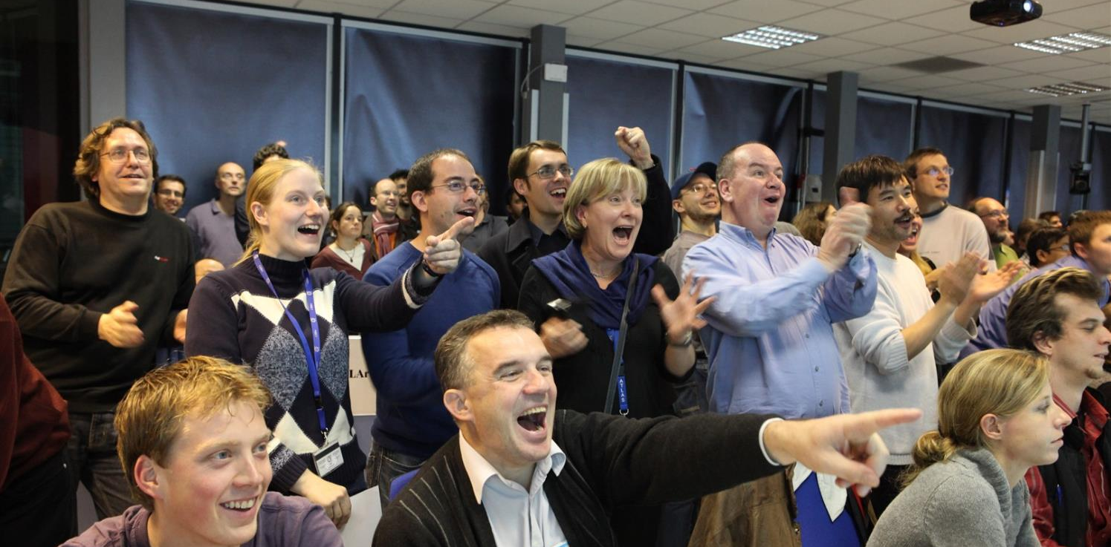
Collaborate
Notes:
In order to face all these questions and challenges, scientists need huge, complex and costly instruments.
Therefore international collaboration is the only way to answer these questions. CERN accounts for half of the world particle physicists.

Slide 21
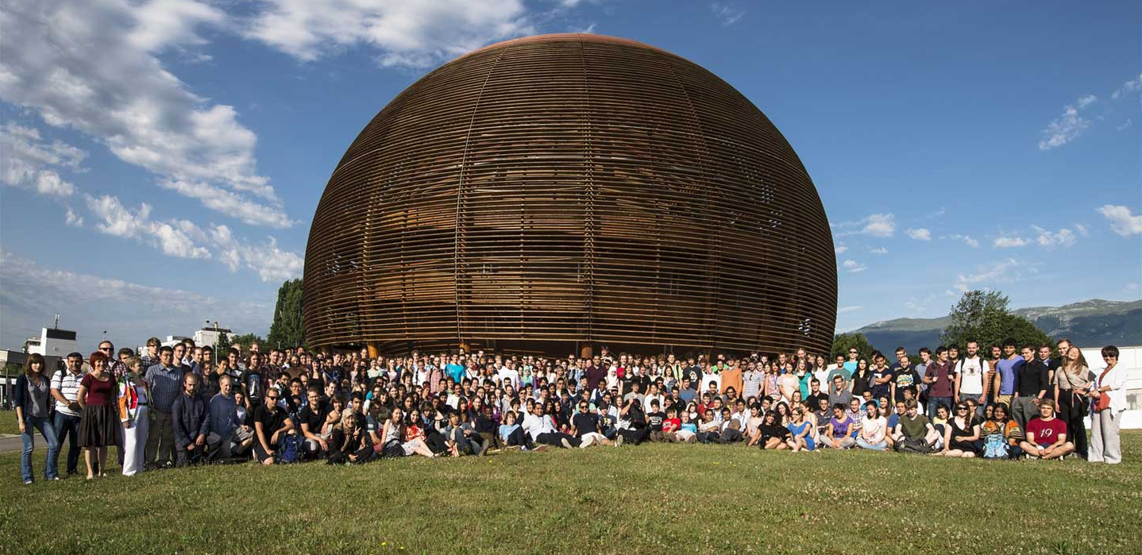
Educate
Notes:
A last goal of CERN is to educate: students of course by welcoming them at CERN for internships, but also the general public, by making its discoveries available and understandable. CERN is visited each year by 100’000 visitors on guided tours. And many more visit CERN’s permanent exhibitions. This presentation is part of CERN’s educational effort.

Slide 22
CERN
How does it work ?
Notes:
Now we have many questions to answer. But how are we going to proceed?

Slide 23
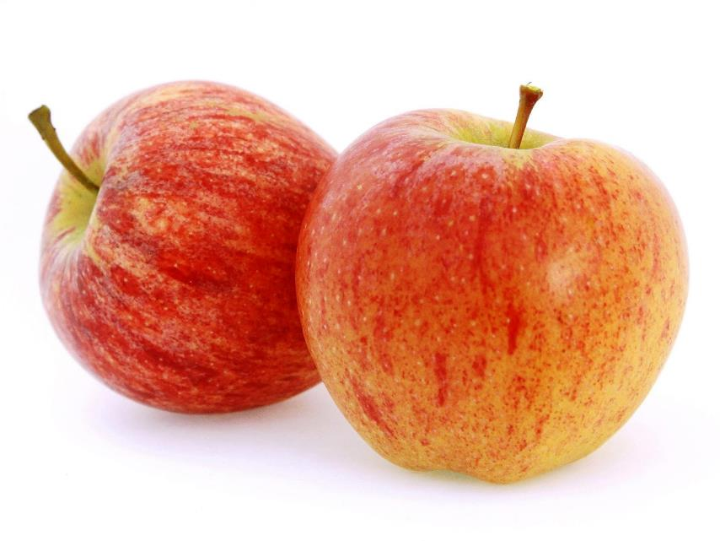
Accelerating and colliding
Notes:
Most of CERN’s experiments are made of collisions. We take 2 objects and smash them together at very high speed.
Let’s take 2 apples. What happens if we smash them together?
At very low speed, not much. They will stop each other. That’s a «Level 1» collision.
At higher speed, they will damage each other, change direction, slow down. That’s a «Level 2» collision.
At very high speed (imagine we use apple cannons), they will explode. That’s a «Level 3» collision.
We have all experienced such collisions: with cars, bikes, ourselves (not «Level 3» hopefully).
At CERN we want to produce «Level 4» Collisions… This level is so high in energy, that out of the collisions will come… pears, bananas, strawberries, kiwis and… of course apples. Sound strange?

Slide 24
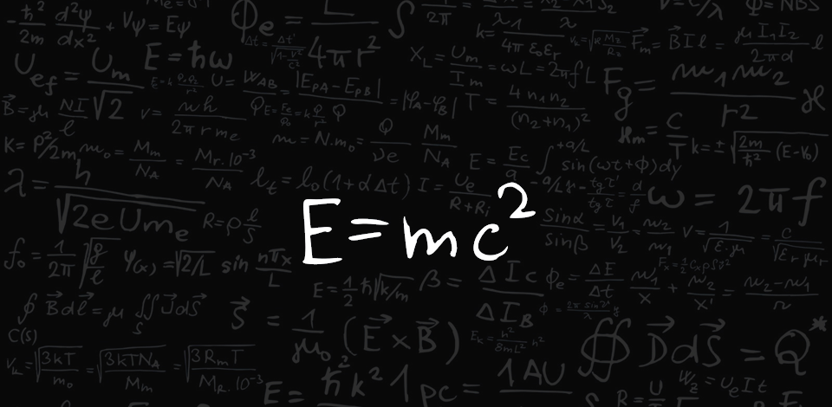
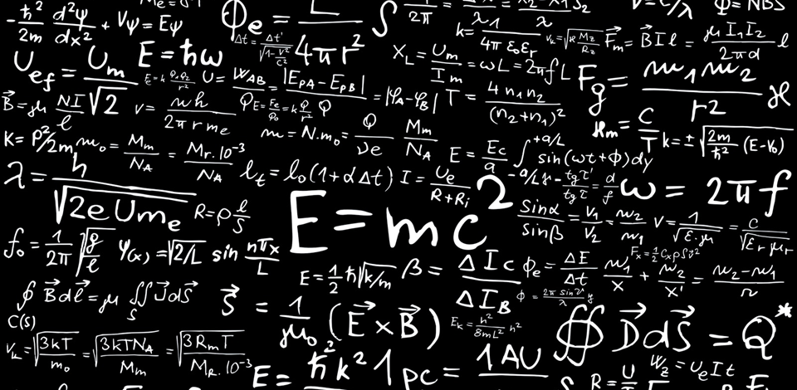
Incredible levels of energy
Notes:
In fact we are only applying the most famous physics formula: «E=mc2».
This formula tells us one thing: energy (E) can be transformed into (=) matter (m).
So why have you never noticed the production of other fruits when smashing 2 apples at very high speed? It’s because the «c2» in the formula. «c» stands for the speed of light (300’000 km/s in the vacuum). If you square it, that makes a very big number. And an equation is a kind of scale with 2 plates on both sides of the «=» sign. If you put «c2» on one plate, then you need a lot of «E» on the other plate to reach balance. If you take large objects like apples, no chance you will reach the level of «E» needed. We will never be able to assign our apples enough energy.
That is why we use smaller objects. The smaller the object to be smashed the easier it is to assign it a «relative» high level of energy. And that is why at CERN we do not have the «Large Apple Collider» but we have the «Large Hadron Collider». We will accelerate hadrons (protons and neutron), the components of the nucleus at an incredible level of energy.

Slide 25

Incredible levels of energy
7 TeV
100’000’000’000’000’000’000’000
u
u
d
Notes:
Each proton we accelerate at CERN will eventually reach an energy of 7 TeV (Tera electron-Volt).
Does that sound familiar to you? Can explain what level of energy it represents in everyday life? (ask the audience)
This is the incredible energy of a… flying mosquito!
OK… For you and me of course this is insignificant. But remember that we grant this energy to ONE proton.
A normally well-fed mosquito is made of about 10^23 protons! It’s like we are trasnsferring the energy of ALL these protons to ONE if them.
So, at the proton level, this is very very energetic. Remember, it’s the amount of energy proportional to the size of the accelerated object which counts!

Slide 26
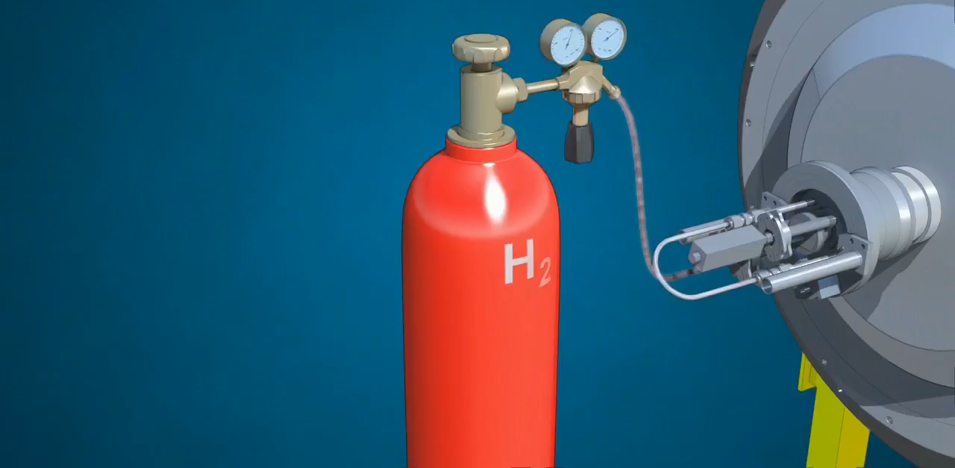
Accelerators
chain
Notes:
But how do we produce protons and grant them the energy of a flying mosquito?
First we start with a bottle of hydrogen gas.
Hydrogen is quite close to what we want. It’s made of protons. With one electron orbitting around.
We send hydrogen gas through an electric field. Proton which has a positive charge goes through. Electron whic has negative charges bounces back and it removed. We are then left only with protons.
They are sent through the LINAC (LINear Accelerator) which uses alternating electric fields to either attract or push the protons. It is so efficient that after only 45m they have been accelerated to a 1/3 of the speed of light, that is 100’000 km per second. Needless to say that continuing in straight lines will be impractical.
We then send the protons to the Booster which will prepare bunches of protons in 4 superposed rings.
They are then sent in the PS (Proton Synchrotron). This machine is 600m circumference, was built in 1959 and is still in use! In 1.2 seconds it accelerate protons to 99% of the speed of light. Very efficient. But cannot go faster. We then need to transfer protons to the «2nd gear of our accelerator complex».
The SPS (Super Proton Synchrotron) build in 1976 and of 7km curcumference. In 3 seconds, it accelerate particle to 99.9% of the speed of light. Once again cannot go faster.
Then half of the particles are sent clockwise and half anti-clockwise into the LHC (Large Hadron Collider). This machine is the largest machine on Earth: 27 km circumference. It will take about 20 minutes to reach our maximum velocity: 99.9999991% of the speed of light which correspond to 7 TeV energy.

Slide 27
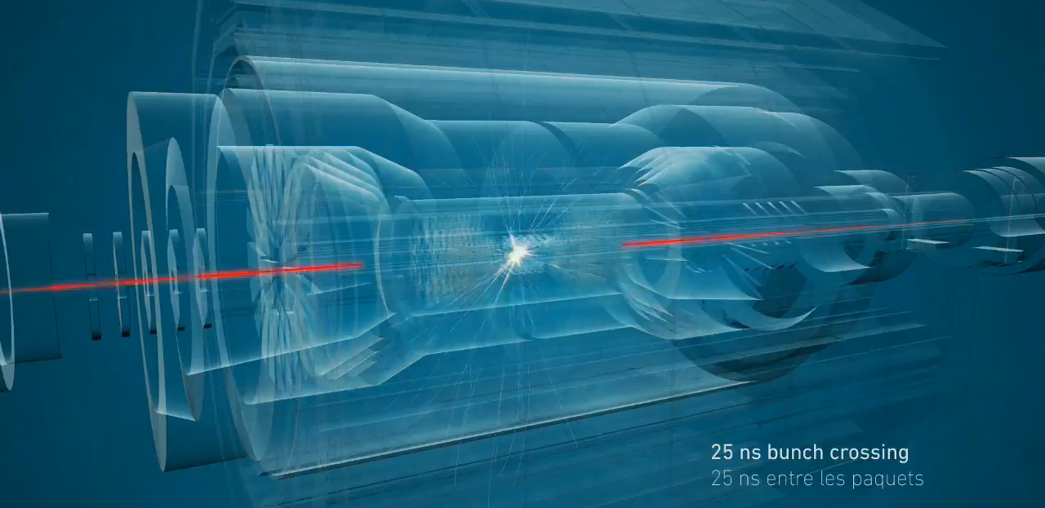
Million of collisions
Notes:
The 2 beams are circulating in separate pipes and in 4 places we cross the 2 pipes over so that collision occur there and only there.
We have built particle detectors which will observe and record the traces of new particles created in the collision.
There are so many protons and they go so fast that around 600 million collisions will occur every SECOND in each of the 4 detectors.
These detectors are a bit like huge digital cameras of about 100 Megapixel resolution. Guess the size of the SD card to store the LHC’s pictures?

Slide 28
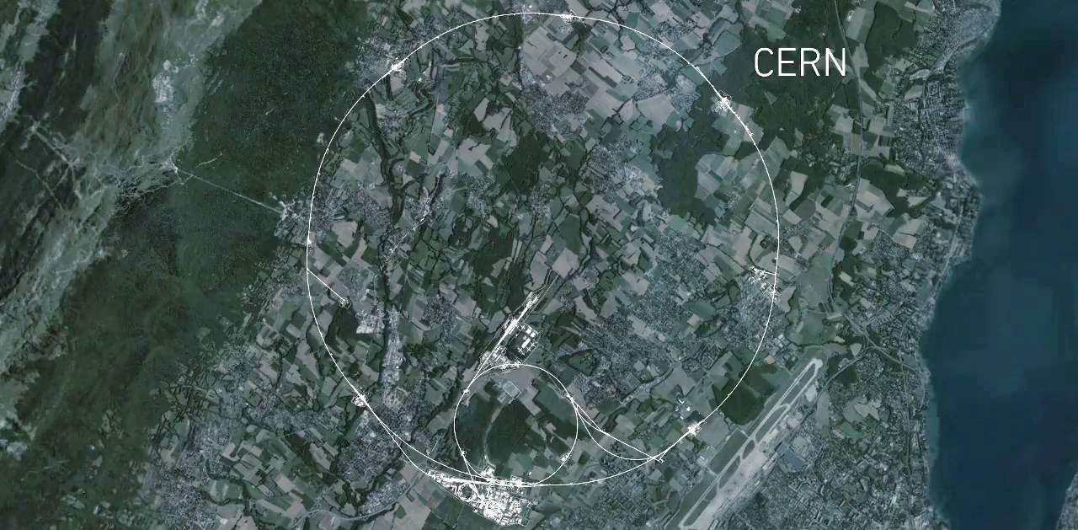
CMS
Largest
machine
on Earth
ALICE
ATLAS
LHCb
Notes:
This is a map of the complex of main accelerators of CERN.
The dotted line is the French-Swiss border.
The 2 main CERN sites are Meyrin and Prévessin (as big, but not as built nor populated)
The PS is the tiny 600m ring on the Meyrin site, the SPS goes accross the border and the LHC takes all the space between Geneva airport and the Jura (dark green on the left).
The 4 red dots represent where the 4 detectors are located.

Slide 29
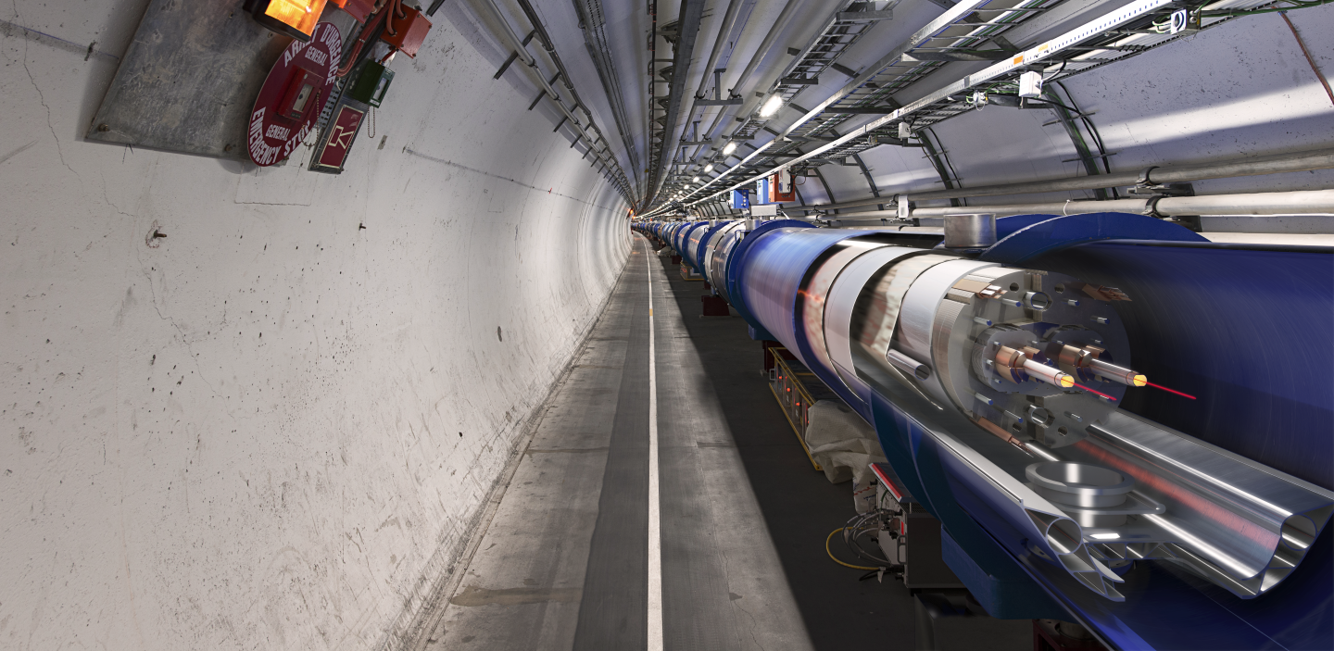
The most
powerful
magnets
Notes:
The LHC is built underground, mainly for financial reasons (would have cost too much to buy all the land and would have been impractical anyway).
It also provide natural shielding of radiations for the population but also shielding from cosmic rays to the 4 detectors.
The LCH is mainly hosted in a 3m diameter tunnel containing mostly superconducting magnets and some accelerating devices.
You can see on the picture that the 2 counter-rotating beams are hosted in different pipes, making collisions impossible there.

Slide 30
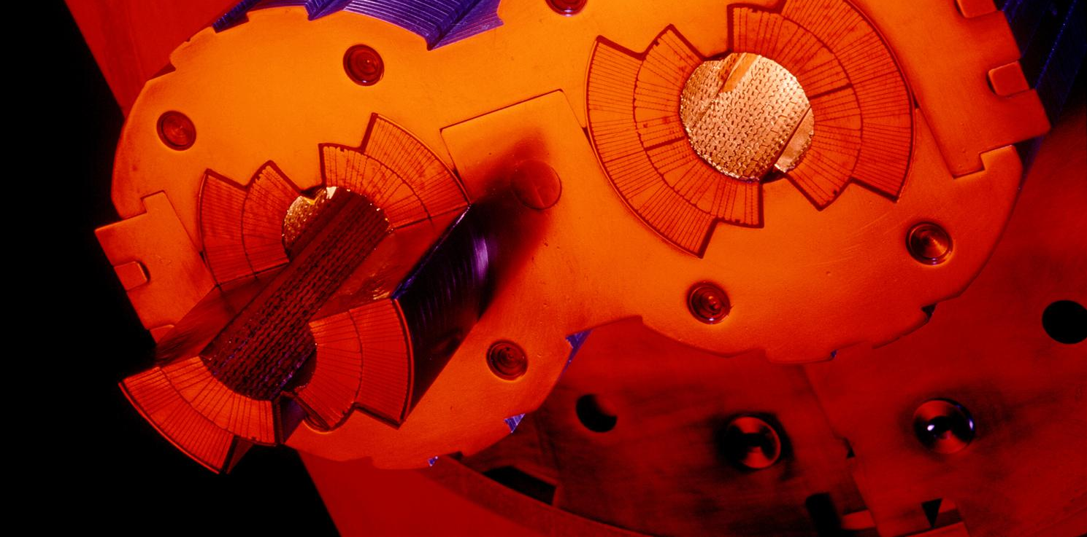
The highest vacuum
Notes:
These 2 pipes need to be as empty as possible (otherwise protons would hit air molecules all the time).
Thanks to turbo-molecular pumps and other technologies, we reach a vacuum of 10^-13 atmosphere in the centre of the pipes: this is 10 times emptiers than on the surface of the Moon or as empty as in the solar system.
The magnetic field which curves the beam, is provided by the coils surrounding the pipes. As each beam holds as much energy as in a high-speed train, the magnets must deliver a tremendous magnetic field of 9 T (tesla). This equates to 200’000 times the magnetic field of Earth (ca 45 micro tesla)
For that, each of the small electric cableyou see around the vacuum pipes (1mm by 10mm section) a current of 11’000 amperes (in comparison in your home there is a current of about 20 amperes in the wires).

Slide 31
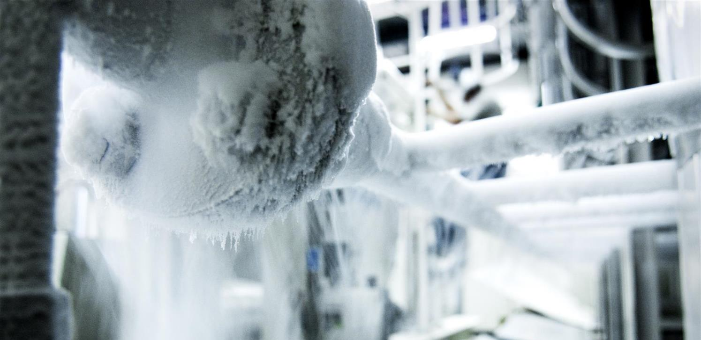
The
coldest
temperature
Notes:
That’s why we need to cool down the cables to the lowest temperature possible.
We have to reach -271°C (or 1.9° kelvin, which is 1.9° above the absolute zero).
At that temperature, the cables made of Niobium Titanium (NbTi) are «superconducting», it means they don’t heat up anymore as they have no electric resistance.
LHC is colder than the vast majority of the Universe whose average temperature is 2.725° kelvin (if you look for a «cool» place to work, CERN is a good one)
This is possible thanks to cryogenic facilities using 120 tonnes or 700’000 litres of Helium!

Slide 32

The largest detectors
Notes:
Now that we have accelerated the particles, let’s collide them!
This is possible only in the 4 points where we cross-over the beams.
The collision point is tinier than a needle head.
Here is the ATLAS detector, the largest of the 4 LHC detectors. Look at the small persons next to it.
It is 50 long, 25m diameter and weights 7’000 tonnes, the same as the Eiffel Tower.
The collision of protons will create new particles in all directions. That’s why the detector often have this cylindrical shape.

Slide 33

ATLAS
Notes:
Here is a real picture of ATLAS.
Noticed the man at the bottom?
ATLAS is a multi-purpose experiment looking for the Higgs Boson (which it has found in 2012), dark matter candidates etc.
It gathers 3000 physicists from 174 universities and institutes in 38 countries.

Slide 34

ALICE
Notes:
Here is a ALICE.
This experiment looks more particularly at the creation of the «Quark Gluon Plasma» state of matter which existed moments after the Big Bang.
For that it wait for the beams of Lead Nuclei which occur about 10% of the beamtime of the LHC.
It gathers 1500 physicists from 154 universities and institutes in 37 countries.

Slide 35

CMS
Notes:
Here is a CMS.
Like ATLAS, this is another multi-purpose experiment. It also discovered the Higgs Boson in 2012.
The C in CMS stands for Compact. Even though it does not look compact to most of you, this experiment is twice as small as ATLAS but twice as heavy: 2 times the Eiffel Tower (14’000 tonnes)!
It gathers 2600 physicists from 182 universities and institutes in 42 countries.

Slide 36

LHCb
Notes:
And the final experiment on the LHC is LHCb. Is is name after the «b» quark which it studies.
In fact LHCb studies the behaviour difference between the b quark and the anti-b quark.
It tries to find difference in the symmetry which may account for the lack of antimatter in the Universe.
It gathers 800 physicists from 69 universities and institutes in 17 countries.

Slide 37

The
largest
computing
grid
Notes:
All these detectors will generate loads of data… about 1 PB (petabyte = million of gigabyte per… SECOND!)
Impossible to store so much data. Anyway not needed.
The event the experiments are trying to create and observe are very rare.
That’s why we make so many collisions but we keep only the interesting ones.
Therefore next to each detector is a «trigger», a kind of filter made of various layers (first electronic, then computers) which will select and keep only 1 collision out of a million average.
In the end will still generate dozens of Petabytes of data each year. We need about 200’000 computer CPUs to analyze this data.
As CERN has only about 100’000 CPUS we share the date over more than 100 computer centre over the planet (usually located in the physics institutes participating to the LHC collaboration). This is the Computing Grid, a gigantic planetary computer and hard drive!

Slide 38


World Wide Web
Notes:
How do you share data and documentation amongst 10’000 physicists?
The internet was invented in the 70’s but was really not user friendly.
One man proposed a system to unify it in1989. He is Tim Berners-Lee and was working at CERN.
Like any technology developed by CERN, it was freely given to the World in 1993. Which made the Web a planetary star!

Slide 39




Medical applications: MedAustron collaboration
Knowledge and technology transfer are central CERN activities.
Realisation of the MedAustron ion therapy accelerator in Wiener Neustadt
Notes:
If you have brain tumor, you may try to use chimiotherapy to cure it. But the cure goes all over your body and damage healthy organs.
You may use radiotherapy, but this will certainly damage healthy tissues around the tumor (image on the right).
Or you can use proton therapy using acceleration techniques directly derived from CERN’s technology. Proton therapy will damage more precisely leaving healthy tissued untouched (image on the left).

Slide 40

Safety
Notes:
You can use a particle detector to see what’s inside a suitcase in car in a truck without unloading it…
That’s particularly handy for customs, airports, harbours etc.

Slide 41


Humanitarian
Notes:
CERN hosts UNOSAT, a UN agency specialized in the analysis of satellite images, especially comparing them before and after a natural disaster or a war.
This shows pictures taken before and after the earthquake in Nepal in 2015. With the power of Computing Grid, very precise comparison can be processed in minutes to count the number of houses, roads, infrastructure touched and give valuable information in short time to emergency response teams.

Slide 42
CERN
What’s next ?

Slide 43








Future Circular Collider Study
International FCC collaboration (CERN as host lab) to study:
pp-collider (FCC-hh) → main emphasis, defining infrastructure requirements
~100 km tunnel infrastructure in Geneva area, site specific
e⁺e⁻ collider (FCC-ee), as potential first step
p-e (FCC-he) option, integration one IP, e from ERL
HE-LHC with FCC-hh technology
CDR for end 2018
~16 T ⇒ 100 TeV pp in 100 km

Slide 44



In a nutshell…
Fundamental research
Largest international scientific collaboration
Technology transfer in benefit of society
Notes:
In a nutshell:
CERN is a organization devoted to fundamental research
It hosts the largest international scientific collaborations
By facing technological challenges, CERN develops technologies which are useful for society.
(the picture show solar panels on top of Geneva airport, using the LHC vacuum technology to make them more efficient)

Slide 45

Some links…
Information : www.cern.ch
CERN TV : youtube.com/cern
Recruitment : www.cern.ch/jobs
Notes:
We have invented the web, so please use it! ;-)

