Slide 1
Vertex and Tracker Technologies
CLICdp Advisory Board
Dominik Dannheim (CERN)
on behalf of the CLICdp collaboration

Slide 2
Outline
Vertex- and tracking-detector requirements
Sensor and readout technologies
Simulations and DAQ
Detector integration studies
Conclusions

Slide 3
CLIC vertex- and tracking detector requirements
Vertex detector:
efficient tagging of heavy quarks through precise
determination of displaced vertices:
  good single point resolution: σ_{SP}~3 μm
    small pixels <~25x25 μm², analog readout
  low material budget: ⪅ 0.2% X₀ / layer
    low-power ASICs + air cooling (~50 mW/cm²)
Tracker:
Good momentum resolution: σ(p_{T}) / p_{T}² ~ 2 x 10⁻⁵ GeV⁻¹
→ 7 μm single-point resolution (~30-50 μm pitch in Rφ)
→ many layers, large outer radius (~140 m² surface)
→ ~1-2% X0 per layer
→ low-mass supports + services
Both:
20 ms gaps between bunch trains
→ trigger-less readout, pulsed powering
few % maximum occupancy from beam backgrounds
→ sets inner radius and limits cell sizes
→ time stamping with ~5 ns accuracy
→ depleted sensors (high resistivity / high voltage)
moderate radiation exposure (~10⁴ below LHC!):
  NIEL: < 10¹¹ n_{eq}/cm²/y
  TID: < 1 kGy / year
Vertex-detector simulation geometry
260 mm
0.84 m²
Tracker simulation geometry
3 m
137 m²
4.6 m

Slide 4
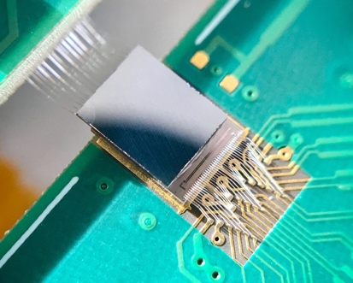
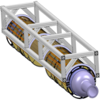
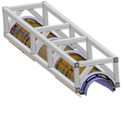
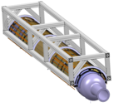
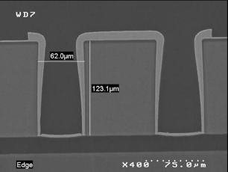
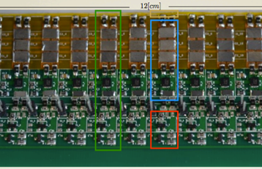
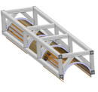
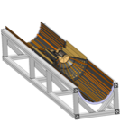
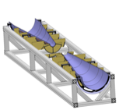
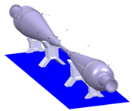
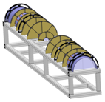
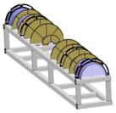
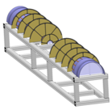
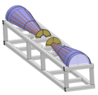
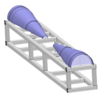
CLIC pixel-detector technology R&D
Sensor + readout technologies
Sensor + readout technology | Currently considered for
Bump-bonded Hybrid planar sensors | Vertex
Capacitively coupled HV-CMOS sensors | Vertex
Monolithic HV-CMOS sensors | Tracker
Monolithic HR-CMOS sensor | Tracker
Monolithic SOI sensors | Vertex, Tracker
Beam test
CLICpix + 50 μm sensor
C3PD+CLICpix2 glue ass.
ATLASPIX HV-CMOS
INVESTIGATOR HR-CMOS
Cracow SOI
Detector integration studies
Interconnects
Powering
Cooling
Light-weight supports
Detector
assembly
Challenging requirements lead to extensive detector R&D program
~10 institutes active in vertex/tracker R&D
Collaboration with ATLAS, ALICE, LHCb, RD53, AIDA-2020

Slide 5
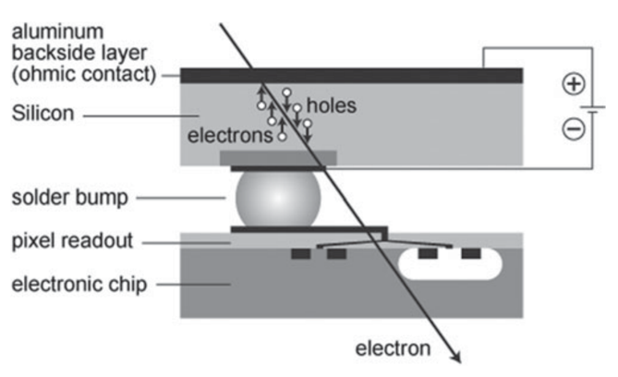
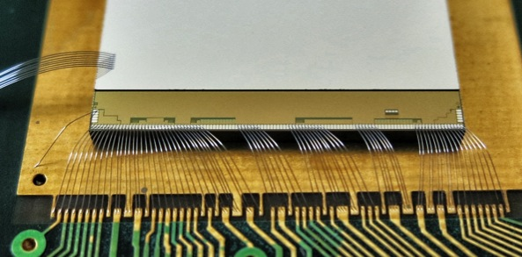
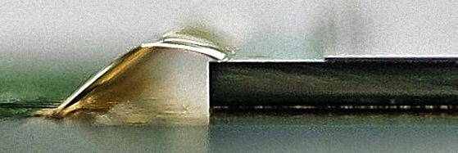
Hybrid planar sensor technology
Hybrid pixel detector
Planar pixel sensors bump-bonded to r/o ASICs
Considered for vertex detector
Status:
Comprehensive thin-sensor studies with slim-edge
and active-edge sensors (50-300 μm thickness)
on Timepix/Timepix3 readout ASICs (55 μm pitch)
Cluster sizes vs. thickness
Track residuals vs. thickness
Timepix with 50 μm
active-edge sensor
14 mm
50 μm sensor
700 μm Timepix
Achievable resolution limited by fraction of 2-hit clusters
→ Not enough charge sharing in ultra-thin sensors
CLICdp-Note-2016-001

Slide 6
Hybrid planar sensor technology
Hybrid pixel detector
Planar pixel sensors bump-bonded to r/o ASICs
Considered for vertex detector
Status:
Comprehensive thin-sensor studies with slim-edge
and active-edge sensors (50-300 μm thickness)
on Timepix/Timepix3 readout ASICs
CLICpix/CLICpix2 prototype r/o ASICs with in-pixel
time and energy measurement, 25x25 μm² pitch,
implemented in 65 nm TSMC process,
including full 12” wafer from RD53 prototype run
Single-chip bump-bonding with 25 μm pitch
~100% efficiency, few ns timing, σ_{SP}~7 μm
CLICpix with 50 μm planar sensor
1.6 mm
CLICdp-Conf-2017-010

Slide 7
Hybrid planar sensor technology
Hybrid pixel detector
Planar pixel sensors bump-bonded to r/o ASICs
Considered for vertex detector
Status:
Comprehensive thin-sensor studies with slim-edge
and active-edge sensors (50-300 μm thickness)
on Timepix/Timepix3 readout ASICs
CLICpix/CLICpix2 prototype r/o ASICs with in-pixel
time and energy measurement, 25x25 μm² pitch,
implemented in 65 nm TSMC process,
including full 12” wafer from RD53 prototype run
Single-chip bump-bonding with 25 μm pitch
~100% efficiency, few ns timing, σ_{SP}~7 μm
Ongoing work:
Validation of new single-chip bump-bonding process
Beam tests for CLICpix2 planar-sensor assemblies
Reduce σ_{SP}: ELAD sensors with enhanced charge sharing
Future developments:
Even smaller pixels (28 nm process technology), lower detection threshold
New hybridisation methods: Cu pillars, Indium, Anisotropic Conductive Film, …
Module/stave building studies
CLICpix with 50 μm planar sensor
1.6 mm
CLICdp-Conf-2017-010

Slide 8
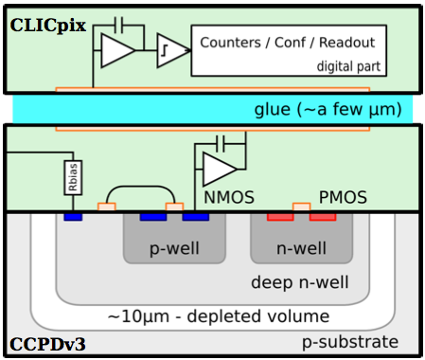

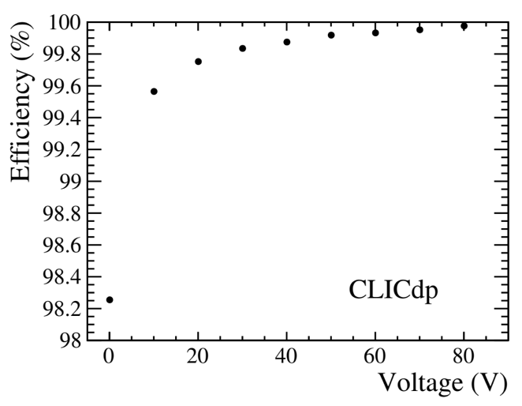
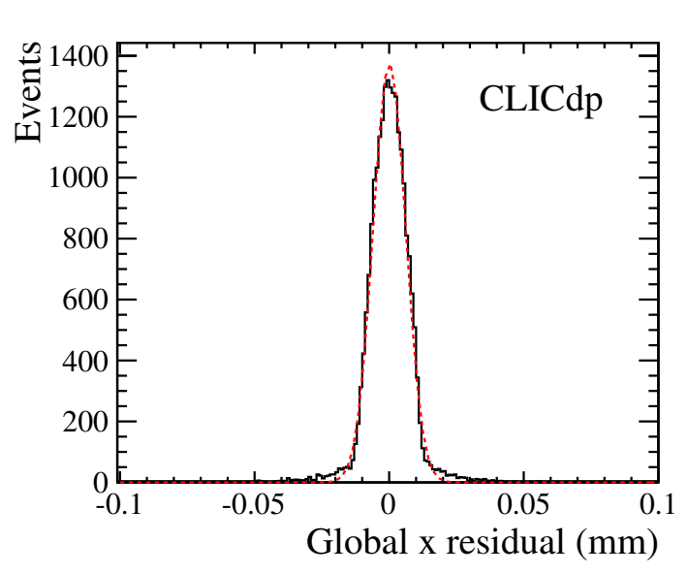
Capacitively coupled HV-CMOS sensors
Active High-Voltage (HV) CMOS sensors, large fill factor:
electronics inside charge-collection well, depletion through HV
Capacitive coupling to r/o ASICs
→ thin glue layer replaces costly small-pitch bump bonds
Considered for vertex detector
Results:
Two generations of active sensors (CCPDv3, C3PD)
in AMS 180 nm HV-CMOS process,
10-1000 Ohm cm substrates, 25x25 μm² pitch
Glue assemblies with CLICpix/CLICpix2:
~90-100% efficiency, few ns timing, σ_{SP}~6 μm
Finite-element simulation of capacitive coupling
Capacitively Coupled Pixel Detector
C3PD/CLICpix2 glue assembly
CCPDv3/CLICpix efficiency
CCPDv3/CLICpix residuals
σ_{SP}~6 μm
Threshold ~1200 e⁻
Threshold
~1200 e⁻
NIM A 823 (2016) 1-8;
JINST 12 P09012 (2017)

Slide 9
Capacitively coupled HV-CMOS sensors
Active High-Voltage (HV) CMOS sensors, large fill factor:
electronics inside charge-collection well, depletion through HV
Capacitive coupling to r/o ASICs
→ thin glue layer replaces costly small-pitch bump bonds
Considered for vertex detector
Results:
Two generations of active sensors (CCPDv3, C3PD)
in AMS 180 nm HV-CMOS process,
10-1000 Ohm cm substrates, 25x25 μm² pitch
Glue assemblies with CLICpix/CLICpix2:
~90-100% efficiency, few ns timing, σ_{SP}~6 μm
Finite-element simulation of capacitive coupling
Ongoing work:
Evaluation of sensors with high-resistivity substrates
Optimization of gluing process (uniformity, reproducibility)
Simulation of the entire transfer chain
Future developments:
Module concept? (difficult!)
A/C coupling at the fab (wafer) level + TSV
A/C coupled passive CMOS sensors?
Capacitively Coupled Pixel Detector
C3PD/CLICpix2 glue assembly
NIM A 823 (2016) 1-8;
JINST 12 P09012 (2017)

Slide 10
Monolithic HV-CMOS sensors
AMS 180 HV-CMOS
Active HV-CMOS sensors with fully
integrated readout
Considered for tracker
Results:
ATLASPIX prototypes in AMS 180 nm HV-CMOS process:
40 x 120 μm² pitch, data-driven column-drain readout
99.5% efficiency, σ_{t}~16-20 ns, σ_{SP}~13 μm
(almost no charge sharing; timing limited by r/o system)
Similar developments with LFoundry HV-CMOS process
ATLASPIX HV-CMOS prototype
Efficiency
Residual in column direction
Residual in row direction
Timing residual
CLICdp
work in
progress
CLICdp work in progress
CLICdp work in progress

Slide 11
Monolithic HV-CMOS sensors
AMS 180 HV-CMOS
Active HV-CMOS sensors with fully
integrated readout
Considered for tracker
Results:
ATLASPIX prototypes in AMS 180 nm HV-CMOS process:
40 x 120 μm² pitch, data-driven column-drain readout
99.5% efficiency, σ_{t}~16-20 ns, σ_{SP}~13 μm
(almost no charge sharing; timing limited by r/o system)
Similar developments with LFoundry HV-CMOS process
Ongoing work:
Beam tests of ATLASPIX with improved readout system
(timing, lower threshold, power consumption tests)
Future developments:
Adapt pixel layout to CLIC requirements (~30 μm pixel width)
Improve digital design: power pulsing
Reduce periphery area?
ATLASPIX HV-CMOS prototype

Slide 12
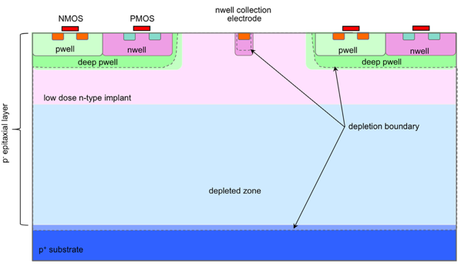
Integrated HR-CMOS sensors
Integrated CMOS sensors on High-Resistivity (HR) substrate
Small fill factor: electronics outside charge-collection well
Considered for tracker
Results:
Tests with INVESTIGATOR analog prototype chip
in TowerJazz 180 nm HR-CMOS process
(ALICE development), 20x20 - 50x50 μm² pitch
For 28x28 μm² pitch, external readout:
99.3% efficiency, σ_{t}<5 ns, σ_{SP}~4 μm
HR-CMOS process
INVESTIGATOR HR-CMOS test chip
X resolution vs. threshold:
Efficiency vs. threshold:
CLICdp
preliminary
CLICdp
preliminary
CLICdp-Note-2017-004

Slide 13
Integrated HR-CMOS sensors
Integrated CMOS sensors on High-Resistivity (HR) substrate
Small fill factor: electronics outside charge-collection well
Considered for tracker
Results:
Tests with INVESTIGATOR analog prototype chip
in TowerJazz 180 nm HR-CMOS process
(ALICE development), 20x20 - 50x50 μm² pitch
For 28x28 μm² pitch, external readout:
99.3% efficiency, σ_{t}<5 ns, σ_{SP}~4 μm
Ongoing work:
Design of fully integrated CLICTD chip:
30 x 300 μm² pitch, segmented electrodes,
in-pixel time + charge measurement
Future plans:
Thinning to 100 μm
Larger prototypes
Further process optimization / smaller feature size?
→ could also become an option for the vertex detector
HR-CMOS process
INVESTIGATOR HR-CMOS test chip
CLICdp-Note-2017-004

Slide 14
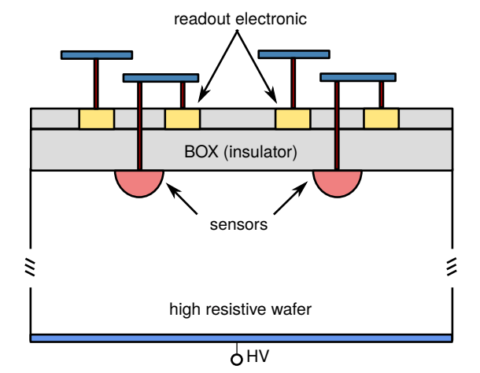
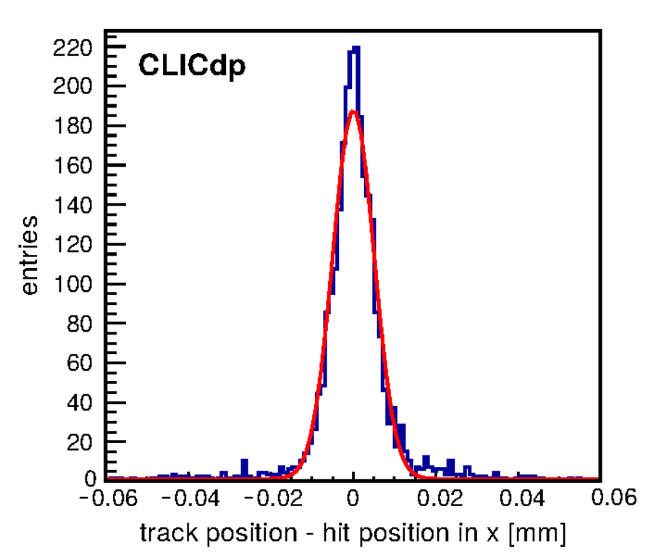
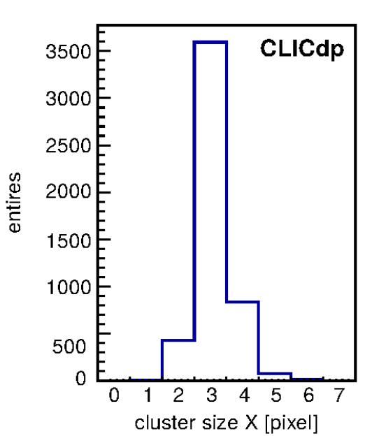
Monolithic SOI sensors
Silicon-On-Insulator (SOI): Sensor and electronics integrated on single wafer
with high-resistivity substrate, separated by insulation oxide layer + buried p-wells,
Considered for vertex and tracker
Results:
Cracow SOI test chip in 200 nm LAPIS SOI process,
with various geometries and technology parameters:
>=30x30 μm² pitch, single SOI and double SOI,
different r/o schemes
Test results for 500 μm thickness, 30x30 μm² pitch, rolling-shutter r/o:
>99% efficiency, σ_{SP}~4.5 μm
SOI pixel detector
Residual in column direction
Cluster size in column direction
Cracow SOI test chip
σ~4.8 μm
CLICdp-Pub-2018-001

Slide 15
Monolithic SOI sensors
Silicon-On-Insulator (SOI): Sensor and electronics integrated on single wafer
with high-resistivity substrate, separated by insulation oxide layer + buried p-wells,
Considered for vertex and tracker
Results:
Cracow SOI test chip in 200 nm LAPIS SOI process,
with various geometries and technology parameters:
>=30x30 μm² pitch, single SOI and double SOI,
different r/o schemes
Test results for 500 μm thickness, 30x30 μm² pitch, rolling-shutter r/o:
>99% efficiency, σ_{SP}~4.5 μm
Ongoing work:
Production of CLIPS vertex test chip, targeted to LC vertex
requirements: 20x20 μm² pitch, snapshot r/o of analog time
and charge measurement, ≧100 μm thickness
Analysis of first-generation prototype test-beam data
Development of readout system for CLIPS
Future plans:
Larger chips, improved readout
SOI pixel detector
Cracow SOI test chip
CLICdp-Pub-2018-001

Slide 16
Sensor and readout simulation
Simulations are crucial for understanding performance of prototypes and developing new sensors and readout ASICs
Complex simulation chain: ionization process, charge transfer, capacitive coupling, r/o ASIC response, beam-telescope setup
Various tools available: Geant4, TCAD process and device simulation,
COMSOL multi-physics, parametric models, SPICE circuit simulation
Results:
2D TCAD simulations of planar and HV/HR-CMOS sensors
COMSOL results for capacitive coupling
Parametric simulations and circuit simulations for r/o ASIC optimization
Geant-4 simulations combined with parametric models
→ Allpix² simulation framework, validated for planar sensors
Ongoing work:
Validation of Allpix² simulations for SOI, HV/HR-CMOS
3D TCAD simulations for HV/HR-CMOS sensors
Future plans:
Include Timing in Allpix² simulations
Allpix² simulations of new prototypes
MIP in underdepleted HV-CMOS pixel sensor
CLICdp-Note-2017-006

Slide 17
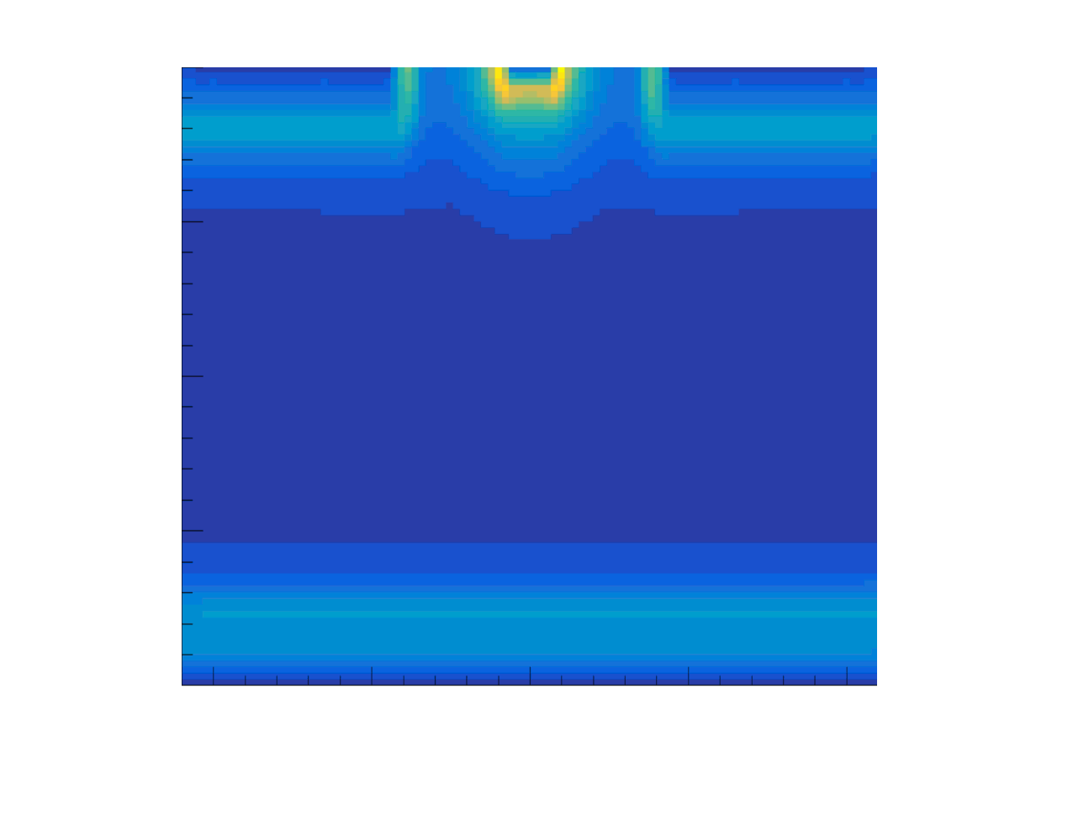
Sensor and readout simulation
Simulations are crucial for understanding performance of prototypes and developing new sensors and readout ASICs
Complex simulation chain: ionization process, charge transfer, capacitive coupling, r/o ASIC response, beam-telescope setup
Various tools available: Geant4, TCAD process and device simulation,
COMSOL multi-physics, parametric models, SPICE circuit simulation
Results:
2D TCAD simulations of planar and HV/HR-CMOS sensors
COMSOL results for capacitive coupling
Parametric simulations and circuit simulations for r/o ASIC optimization
Geant-4 simulations combined with parametric models
→ Allpix² simulation framework, validated for planar sensors
Ongoing work:
Validation of Allpix² simulations for SOI, HV/HR-CMOS
3D TCAD simulations for HV/HR-CMOS sensors
Future plans:
Include Timing in Allpix² simulations
Allpix² simulations of new prototypes
MIP in underdepleted HV-CMOS pixel sensor
CLICdp-Note-2017-006

Slide 18
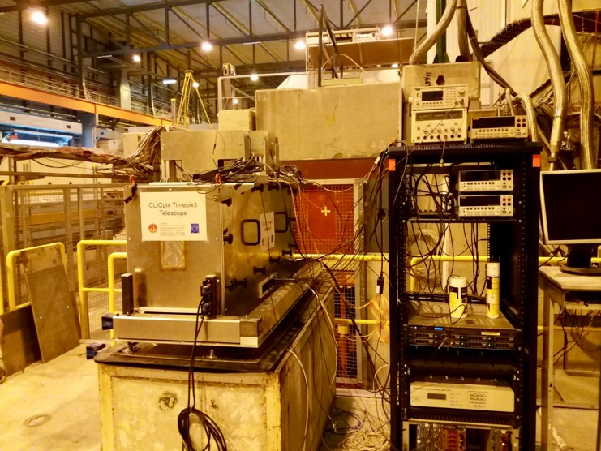
DAQ
Lab and beam tests require flexible scalable DAQ
hardware and software
Results:
High-rate beam telescope with Timepix3 detector planes
(~1 MHz track rate, ≲2 μm resolution, ~1 ns time resolution)
CaRIBOu universal readout system developed with ATLAS:
  System-on-Chip (SoC) architecture
  Peary DAQ software in Linux system inside FPGA core
  Integration of CLICpix2, C3PD, ATLASPIX
Ongoing work:
New Carboard hardware release with enhanced features
CLICTD and CLIPS integration
Preparing for beam tests outside CERN during LS II in 2019/20
Future plans:
Integrate FCAL readout electronics
Scale to larger systems:
→ Timepix4 beam telescope with CaRIBOu?
→ Prototype of functional ladder?
CLICdp Timepix3 telescope in SPS H6 beam line
CaRIBOu with CLICpix2 r/o ASIC
CLICdp-Conf-2017-012

Slide 19
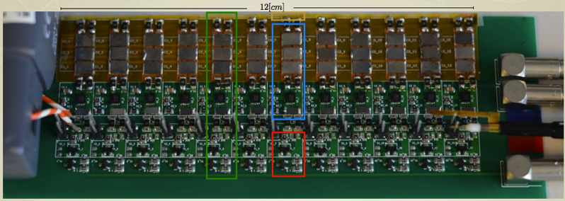
Powering
Powering concept has major impact on material budget and heat load
Small duty cycle of CLIC machine (<10⁻⁵) allows for power pulsing,
reducing average power consumption
Results:
Prototypes for low-mass power pulsing and power delivery concept for vertex detector
Local energy storage and voltage regulation
Small continuous current through low-mass Al cables, stable voltages for r/o ASICs
~0.1%X0 material in detector area, expected to decrease to 0.04%X0 in future
Through-Silicon-Via (TSV) interconnect process (developed for Timepix3 ASICs)
Future plans:
Adapt concept to requirements of new chips for vertex and tracker?
Prototype ladder with real ASICs?
Prototypes of low-mass flex cables?
Investigate serial powering?
Power-pulsing prototype
→ More details on power pulsing
in talk on DAQ / readout
by Eva Sicking in this session
CLICdp-Note-2015-004

Slide 20
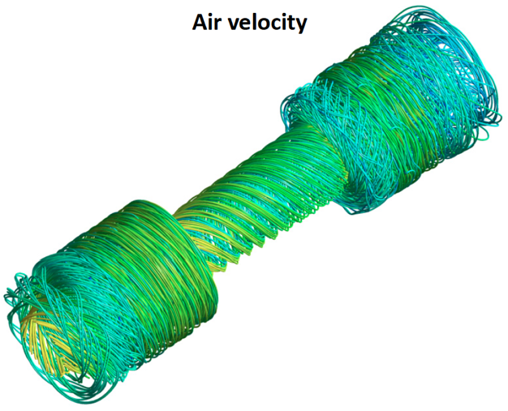
Cooling
Vertex detector and tracker require cooling systems with sufficient cooling power and minimal impact on physics performance (material budget, vibrations, constraints for detector layout)
Results:
Simulations and prototype measurements for vertex air cooling concept
with spiral-shaped disc layers
→ ~50 mW/cm² feasible
Water cooling concept for tracker
(copied from ALICE ITS upgrade,
no dedicated CLIC studies)
→ ~150 mW/cm² feasible
Ongoing work:
Micro-channel cooling studies (for DEPFET)
Future plans:
Optimization study for vertex/tracker
operation temperature?
Develop liquid (micro-channel, CO2?)
cooling concept as backup solution for vertex?
Refine tracker cooling concept?
1:1 scale air cooling thermal test setup
60 cm
Mass Flow: 20.1 g/s
Average velocity:
@ inlet: 11.0 m/s
@ z=0: 5.2 m/s
@ outlet: 6.3 m/s
Finite-element simulation
of air velocity
CLICdp-Note-2016-002

Slide 21
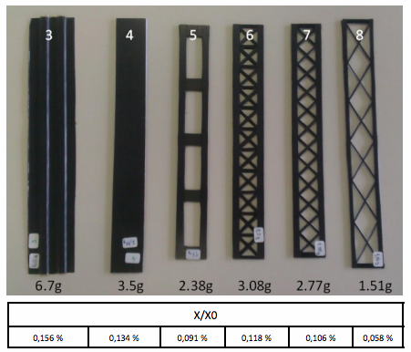
Mechanical integration
Material budget allows for only ~0.1%X0 from cables+supports in vertex region, <1%X0 in tracker
Development of low-mass supports with sufficient rigidity required
Low-mass services, optimized routing concepts
Results:
Low-mass CFRP stave prototypes for vertex detector, FE simulations
Concept for supports, beam pipe and cabling in vertex region, FE simulations
Low-mass tracker support-structure concept, validated in FE simulations
Prototype for outer tracker support segment
Future plans:
Investigate new technologies: truss-like carbon structures (→ ALICE ITS upgrade)
Build more refined prototypes (including cables, …)?
Concept for services routing through outer detector elements?
N.B.: details depend strongly on r/o technology choices
CFRP support prototypes
Prototype of outer barrel tracker support structure
26 mm
CLICdp-Note-2015-002

Slide 22
Conclusions
Stringent requirements for CLIC vertex and tracking detectors
have inspired broad and integrated technology R&D program
Various sensor + readout technologies under study
Resolution target for vertex layers remains challenging
Monolithic pixel detectors under development for large-area tracker
Detector integration studies demonstrate feasibility of proposed detector concepts
Thanks to everyone who provided material for this talk!

Slide 23
Additional Material

Slide 24
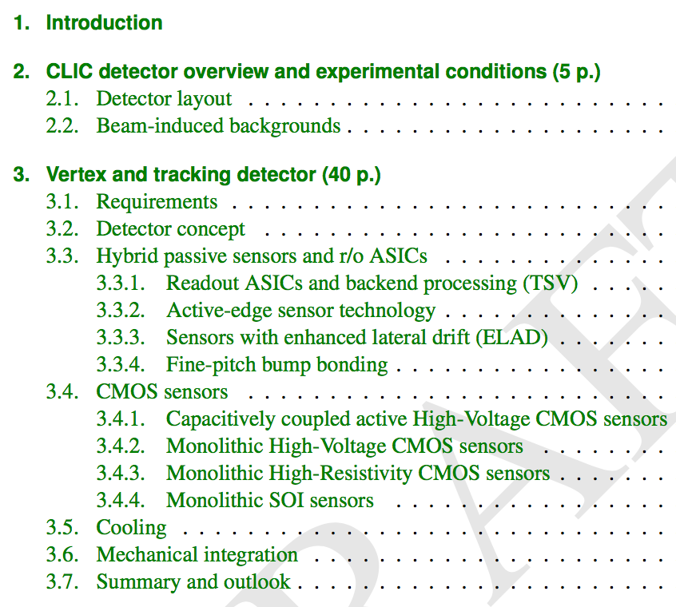
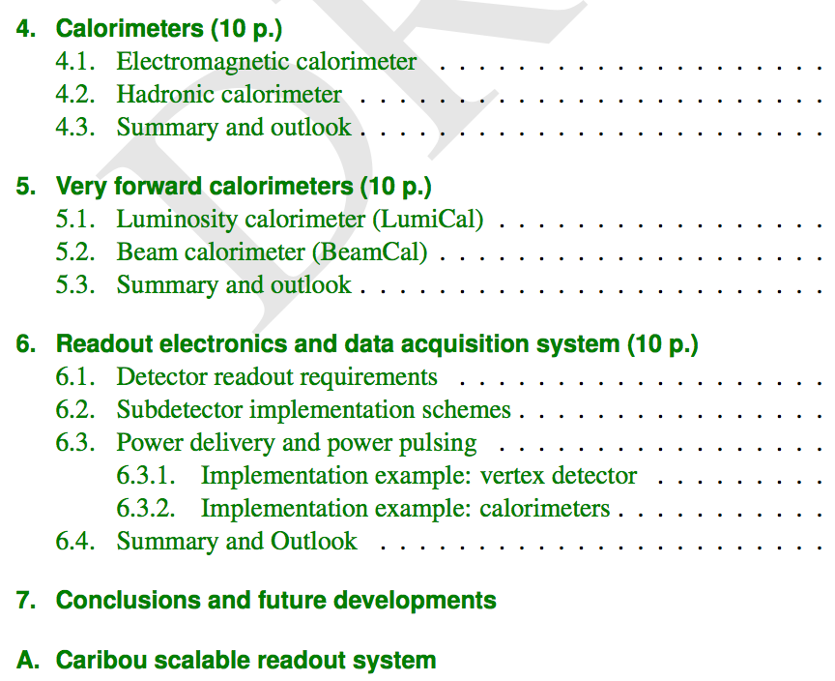
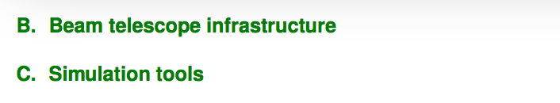
Detector R&D document
Document in preparation: Detector Technologies for CLIC
→ Input to European Strategy Update process in 2019
Description of R&D status for vertex/tracker, calorimetry, readout electronics, tools
Defined scope, team of editors
Targeting CERN yellow report, 80-90 pages, ~50% vertex/tracker
Aim for first draft by summer 2018
K. Krüger
A. Levy
A. Nürnberg,
D. Dannheim
S. Kulis,
E. Sicking

Slide 25
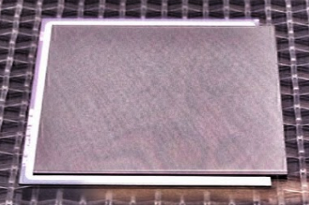
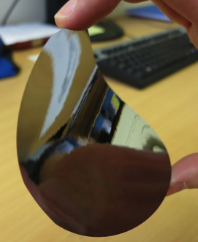
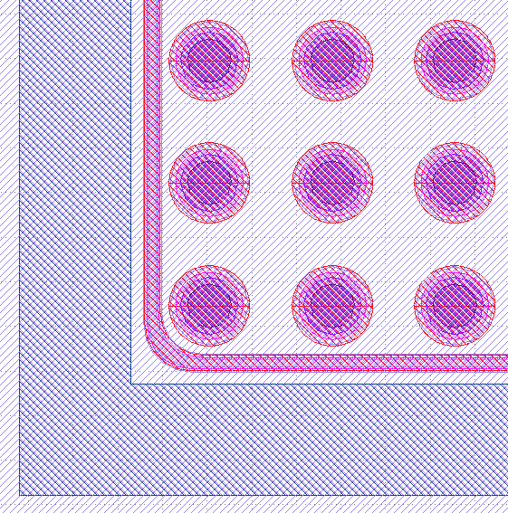
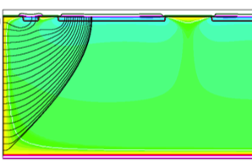
Thin-sensors with Timepix(3) r/o
Planar sensor assemblies with 55 μm pitch
  Goal: test feasibility of ultra-thin sensors
  with minimized inactive regions
  Producers: Micron and Advacam/VTT
  Readout: Timepix / Timepix3
  50-500 μm sensor,100-700 μm ASIC thickness
  slim-edge and active-edge layouts
  Test-beam campaigns at DESY and CERN PS/SPS
  ultimate goal: 50 μm sensors on 50 μm ASICs
Micron/IZM assembly: 100 μm slim-edge
sensor on 100 μm Timepix ASIC
14 mm
50 μm silicon wafer
Advacam assembly w. 50 μm active-edge sensor
Advacam active-edge sensor
14 mm
floating
guard ring
active
edge
100 μm
50 μm sensor
55 μm
700 μm Timepix

Slide 26
Efficiency of thin-sensor assemblies
Energy deposition (all clusters)
Test-beam measurements of Timepix/Timepix3
assemblies with different sensor thicknesses:
  Sufficient energy deposition for MIPs,
  even for 50 μm sensors
  Good agreement with Geant4 simulations
  High detection efficiency (>99%) under
  normal operating conditions
50 μm n-in-p
Timepix3 assembly
CLICdp
work in progress
CLICdp-Note-2016-001
Energy deposition (per cluster size)
Most probable energy deposition
Detection efficiency
50 μm p-in-n
Timepix assembly
Nominal
threshold
~860 e⁻
Notes:
Overall Efficiency means no cut at all (masked pixel etc…)

Slide 27
Resolution of thin-sensor assemblies
Track residuals 50 μm n-in-p Timepix3 assembly
Track residuals vs. thickness
2-pixel
clusters
1-pixel clusters
CLICdp
work in progress
Cluster sizes vs. thickness
Achievable resolution limited by
fraction of 2-hit clusters
→ Not enough charge sharing
in ultra-thin sensors
Smaller pixel pitch required
(see following slides)
CLICdp-Note-2016-001
Notes:
Overall Efficiency means no cut at all (masked pixel etc…)

Slide 28
CLICpix planar-sensor assemblies
65 nm demonstrator CLICpix r/o ASIC:
  64 x 64 pixel matrix
  25 μm pixel pitch
  simultaneous 4-bit time (TOA) and
  energy (TOT) measurement per pixel
Single-chip indium bump-bonding with 25 μm pitch
at SLAC (C. Kenney, A. Tomada)
Functional assemblies produced with 50-200 μm
thick planar sensors (Micron, Advacam active edge)
<4 μm single-point resolution for 200 μm thickness
For 50 μm thickness not enough charge sharing,
limits resolution to >~7 μm (~1300 e- threshold)
CLICpix with 50 μm planar sensor
1.6 mm

Slide 29
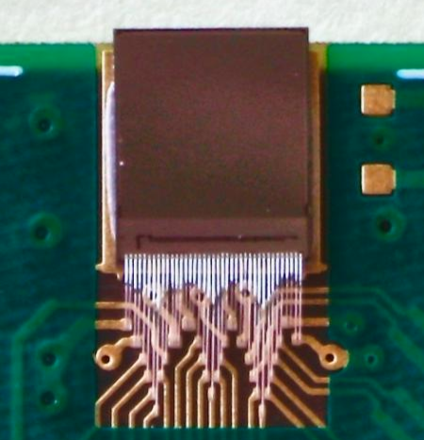
CLICpix2 r/o ASIC
New CLICpix2 in same 65 nm process as CLICpix:
Increased matrix size to 128 ⨉ 128 pixels
Longer counters for charge (5-bit) and timing (8-bit) measurements
Improved noise isolation and removal of cross-talk issue observed in first CLICpix
More sophisticated I/O with parallel column readout and 8/10 bit encoding
Integrated test pulse DACs and band gap
Test results with chips from Multi-Project-Wafer-Run
Same chip on RD53 wafer, received in Dec 2017 (change from 5+1 to 7+1 metal layers)
→ access to full wafers for bump-bonding
process development
CLICpix2
4 mm
CLICpix2 analog F/E specifications

Slide 30
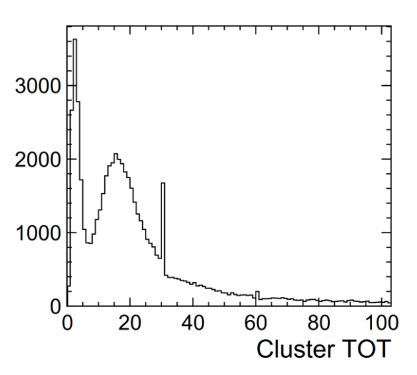
C3PD HV-CMOS sensors
C3PD: active HV-CMOS sensor for capacitive coupling
Commercial 180 nm High-Voltage CMOS process: transistors in deep n-well, acting as collecting electrode
Footprint matching CLICpix2: 128 x 128 pixels, 25x25 μm²
Charge Sensitive Amplifier (CSA) + unity gain buffer
Production wafers of various resistivities:
20, 80, 200, 1000 Ohm cm
Test-beam results for standard bulk resistivity:
~20 Ohm cm, ~15 μm depletion at 60 V
First lab tests for assemblies with 80 Ohm cm
confirm larger drift signal, increased active depth ~25 μm
Schematic cross section of C3PD
Sr-90 source exposure
C3PD chip thinned to 50 μm
CLICpix2 + C3PD
20 Ohm cm
substrate
CLICpix2 + C3PD
80 Ohm cm
substrate
V=60 V
Noisy pixels
Not masked
V=60 V
CLICdp
Work in
Progress
CLICdp
Work in
Progress
Assembly 7
Assembly 10

Slide 31
C3PD+CLICpix2 in test beam
C3PD+CLICpix2 assembly in Timepix3 telescope
Test-beam measurements in CLICdp Timepix3 telescope for 5 assemblies with 20 Ohm cm substrate:
  C3PD bias scans
  CLICpix2 threshold scans
  Angles between 0º (perpendicular) and 30º
Analysis in progress
Preliminary results show difference in cluster signals and sizes (varying glue-assembly quality)
Similar residuals of 8.5-9 μm (threshold <~1000 e⁻),
as expected from low cluster multiplicities
Expect improved performance for high-res. substrates
Cluster signal
Cluster size
Position resolution
CLICdp
work in progress
CLICdp
work in progress
CLICdp
work in
progress
Ass. 1
Ass. 3
Ass. 5
Ass. 1
Ass. 3
Ass. 5
Ass. 1
Ass. 3
Ass. 5

Slide 32
C3PD+CLICpix2 time resolution
Track time resolution of CLICdp Timepix3 telescope <~1 ns
→ precise characterization of DUT timing capabilities
CLICpix2: 100 MHz ToA clock → 10 ns time binning
Gauss fit of time residuals shows width of ~9 ns
Tail towards later times, as expected from time walk
→ Time residual reduced to ~7 ns after time-walk correction
Hit time residuals in C3PD+CLICpix2 assembly
Time Walk in C3PD+CLICpix2 assembly
CLICdp work in progress
(after correction)
(before correction)
CLICdp
work in
progress
Ass. 5

Slide 33
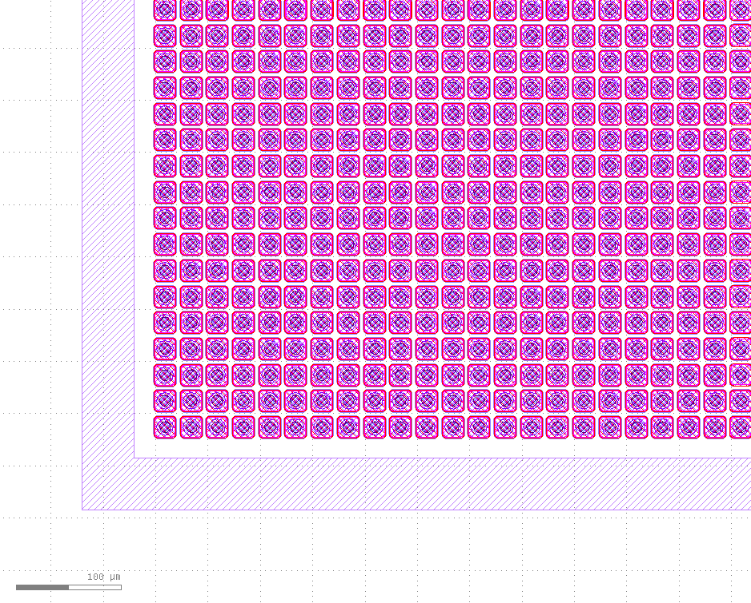
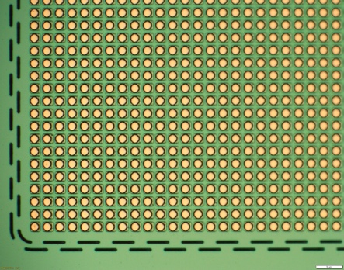
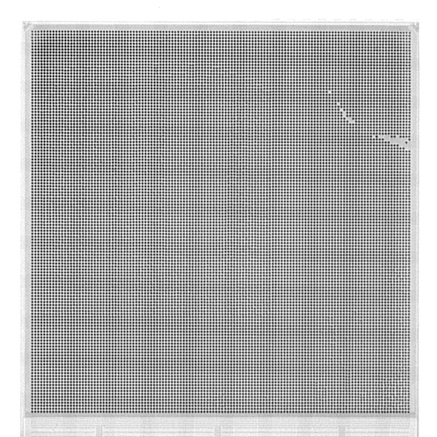
Planar sensors on CLICpix2
Test results with planar sensors (25x25 μm² pitch) needed
for full assessment of CLICpix2 performance
Planar active-edge CLICpix2 sensors with UBM available:
  Advacam MPW production with ATLAS (50-150 μm thick)
  FBK AIDA-2020 production (130 μm thick)
Single-chip bump-bonding on carrier wafers in progress at IZM
+ thinning of ASICs
Future plan: develop wafer-level bump deposition process
for CLICpix2 wafer from RD53 submission
Advacam active-edge CLICpix2 sensor
FBK active-edge CLICpix2 sensor
RD53 12” wafer with CLICpix2
Bumped CLICpix2 ASIC
X-ray of CLICpix2 bump-bonded to 100 um thick Advacam active-edge sensor

Slide 34
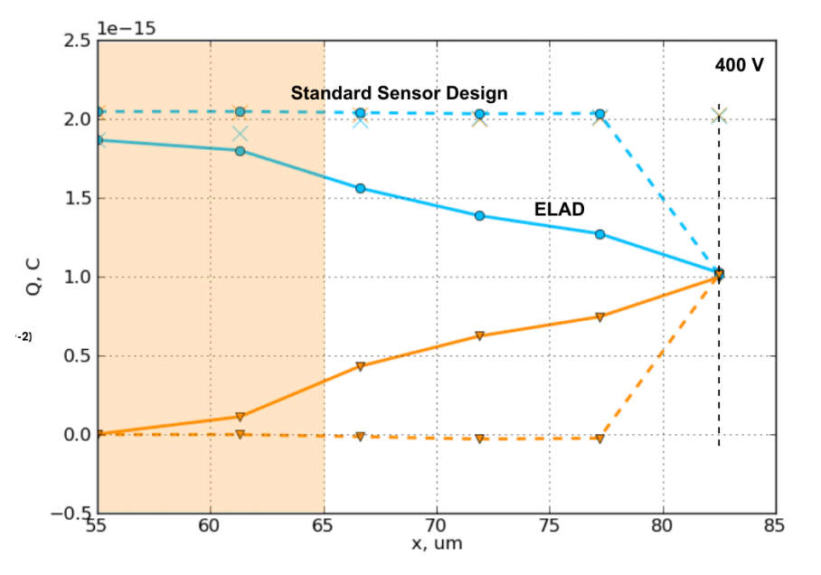
ELAD sensors
Position resolution in very thin sensors so far limited to
~pixel pitch / √12 (almost no charge sharing)
New sensor concept for enhanced charge sharing
Enhanced LAteral Drift sensors (ELAD), H. Jansen (DESY/PIER)
Deep implantations to alter the electric field
→ lateral spread of charges during drift, cluster size ~2
→ improved resolution for same pitch
Challenges:
  Complex production process, adds cost
  Have to avoid low-field regions (recombination)
Ongoing TCAD simulations:
  Implantation process
  Sensor performance for MIPs
First production in 2018: generic test structures, strips
and test sensors with Timepix footprint (55 μm pitch)
ELAD sensor layout
p
n
p
Patent DE102015116270A1
p
n
p
p
n
p
Integrated charge as function of MIP position
TCAD simulation of current from MIP
Q [C]
epi
layers
main pixel signal
t=1.2 ns
A. Velyka
neighbour pixel signal
A. Velyka
Distance to px center [um]

Slide 35
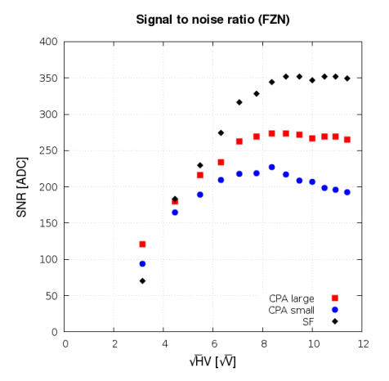
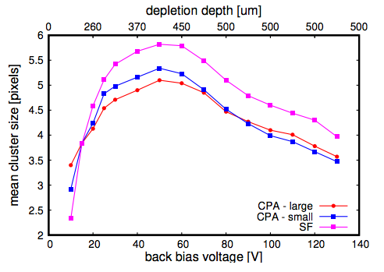
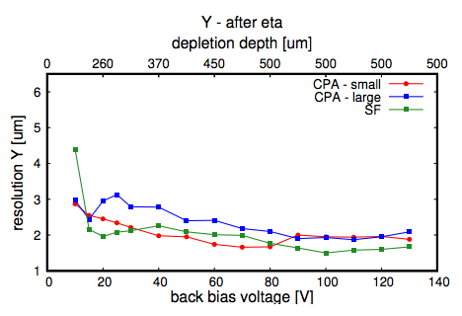
Monolithic SOI sensors
SOI pixel detector
Sensor and electronics integrated on single wafer
with high-resistivity substrate,
separated by insulation oxide layer + buried p-wells,
Considered for vertex and tracker
Cracow SOI test chip in 200 nm LAPIS SOI process,
with various geometries and technology parameters:
>=30x30 μm² pitch, single SOI and double SOI,
different r/o schemes
Test results for 500 μm thickness, 30x30 μm² pitch, rolling-shutter r/o:
>99% efficiency, σ_{SP}<~2 μm
Cracow SOI test chip
Signal-to-Noise
Cluster size
Resolution in y-direction
CLICdp
Work in
Progress
CLICdp
Work in
Progress
CLICdp
Work in
Progress
Telescope resolution
unfolded

Slide 36
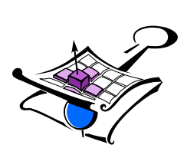

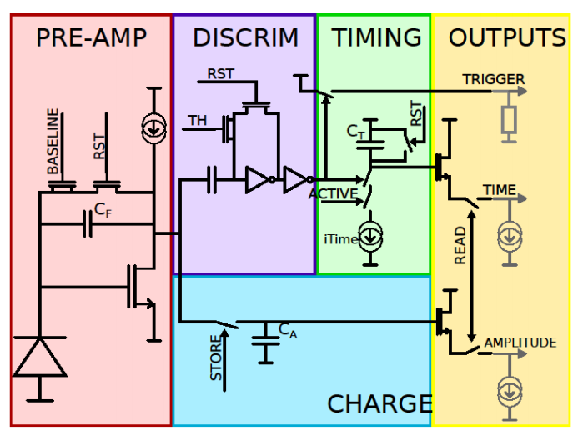
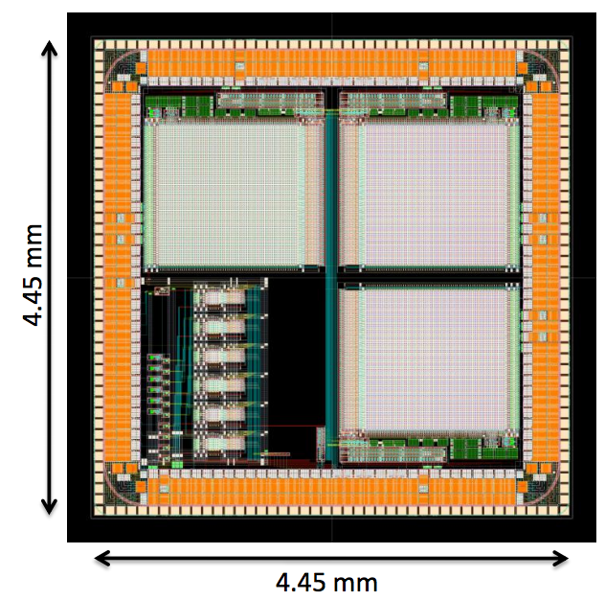
CLIPS SOI sensor
CLIPS: New AGH SOI chip design targeted to Linear Collider VTX detectors:
  64x64 matrix with 20x20 μm² pixels
  Targets spatial resolution <3 μm, time resolution <10 ns
  Analog charge and time information in storage capacitors in each pixel
  → no need for fast clock distribution into matrix
  Snapshot analog readout between bunch trains with external ADC
  On chip trigger to reduce the data rate
Chip submitted November 2017
→ 300-500 μm thick samples expected in April 2018
→ 75-100 μm thinned wafers ~June 2018
CLIPS layout
CLIPS pixel design

Slide 37
Monolithic HV-CMOS: ATLASPIX
    180 nm HV-CMOS process:
  Fully integrated chip designed for ATLAS ITk upgrade
  Process modification: isolated PMOS
  25 x 400 pixels, 130 μm x 40 μm pixel size
  20-1000 Ω cm substrates
  Charge amplifier, discriminator in pixel
  ToT and ToA in periphery (point-to-point connection)
ATLASPIX process cross section
I. Peric et al.
    Tests for 80 Ω cm ATLASPIX_Simple in view of CLIC tracker requirements:
  Laboratory calibration and beam tests in CLICdp Timepix3 telescope at CERN SPS
    Efficiency 99.6%
    Limited charge sharing → box-shaped residuals, σ~pitch/√12
    Time resolution ~30 ns, dominated by 10 MHz r/o clock, to be improved with new Caribou r/o system
Efficiency
Residual in column direction
Residual in row direction
Timing residual
CLICdp
work in
progress
CLICdp work in progress
CLICdp work in progress

Slide 38
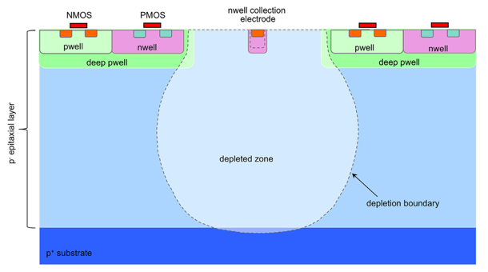

Monolithic HR-CMOS: INVESTIGATOR
    180 nm HR-CMOS process:
  High-Resistivity epitaxial layer (15-40 μm, 1-8 kΩ cm)
  CMOS circuitry shielded by deep P-well
  Small collection diode → small capacitance:
    Maximise signal/noise
    Low analogue power consumption and fast timing
  Frontside biasing:
    Bias voltage limited by CMOS transistors to -6 V
Standard process
    Modified process:
  Additional low-dose N-implant to achieve full lateral depletion:
    Improved radiation tolerance
    Faster charge collection
    Backside biasing possible (not limited to -6 V)
Modified process
W. Snoeys et. al:http://dx.doi.org/10.1016/j.nima.2017.07.046)
INVESTIGATOR test chip developed for ALICE (W. Snoeys et al.):
    134 mini-matrices with 8 x 8 pixels (variation of pixel size, collection electrode size, …)
    Source follower in each pixel, analog signals routed to periphery
    Readout with external 65 MHz sampling ADC per pixel
    Beam tests in CLICdp Timepix3 telescope,
    using chips with 25 μm epi thickness and 28 μm pitch, both processes
Investigator chip layout

Slide 39
INVESTIGATOR resolution and efficiency
Impact of charge sharing on spatial resolution and efficiency for standard & modified process (pitch of 28 μm, bias voltage of -6 V):
X cluster size vs. threshold:
X resolution vs. threshold:
Efficiency vs. threshold:
CLICdp
preliminary
CLICdp
preliminary
CLICdp
preliminary
    More charge sharing for standard process
    Better spatial resolution for standard process down to ~ 3.5 μm
    Earlier drop of efficiency (at lower thresholds) for standard process
    Expected from non depleted regions (diffusion)
    Efficiency & spatial resolution for both process variants within requirements for CLIC tracker.

Slide 40
INVESTIGATOR timing
Timing resolution for standard & modified process (pitch of 28 μm, bias voltage of - 6 V):
Standard process:
Modified process:
    Comparable timing resolution for both processes
    (Readout sampling frequency of 65 MHz limits achievable precision)

Slide 41



CLICTD monolithic HR-CMOS tracker chip
    Good performance of studied 180 nm HR-CMOS technology with respect to requirements of CLIC tracker
    → Technology used for ongoing design of a fully integrated chip for the CLIC tracker
CLIC Tracker Detector (CLICTD) – monolithic HR-CMOS sensor with 30 μm x 300 μm pixels
    Segmented macro-pixel structures to maintain advantages of small collection diode (prompt and fully efficient charge collection) while reducing digital logic:
    Discriminator output of
    8 collection diodes
    combined in logical OR
      Output of logical OR passed to digital circuitry:
      Simultaneous 8-bit ToA and 5-bit ToT measurements
      Expect σ_{SP}~7 μm in short direction (charge sharing)
      Hit bit pattern → maintain good resolution also in long direction
      100 MHz clock to achieve 10 ns time binning
      Chip design in progress, target submission date: ~May 2018

Slide 42

Allpix² simulation framework
Modular simulation framework for silicon tracking detectors
Simulates full chain from incident radiation to digitized hits
Modern and well-documented C++ code
Full Geant4 simulation of charge deposition
Fast charge propagation using drift-diffusion model,
can import electric fields in the TCAD DF-ISE format
Simulation of HV-CMOS sensors with capacitive coupling
Easy to add new modules for new digitizers, other output formats, etc.
For Introduction, User manual and code reference visit: https://cern.ch/allpix-squared
MIP in underdepleted HV-CMOS pixel sensor
Beam telescope with tilted DUT
Beam profile in telescope sensor

Slide 43



Allpix² validation
FEI4/H35DEMO: capacitive coupling
with non-uniform glue deposition
Validation ongoing using test-beam data:
  Timepix3 planar sensor assemblies:
  Charge distribution, cluster size and spatial residuals
  in good agreement with test beam data
  New sensor types and features are being added by users:
    SOI pixel detectors
    capacitively coupled HV-CMOS sensors
    ELAD sensors
    …
Sensor row
CLICdp
work in progress
efficiency
FNAL Data
Sensor column
Sensor row
CLICdp
work in progress
efficiency
Allpix² simulation
Cluster charge
Sensor column
Cluster size
Spatial residuals
CLICdp
Work in Progress
CLICdp
Work in Progress
50 μm thick
Timepix3
sensor
CLICdp
Work in
Progress
50 μm thick
Timepix3 sensor
50 μm thick
Timepix3 sensor
Data
Allpix²
Data
Allpix²
Data
Allpix²

