Slide 1


Iteration on length of high order correctors
E. Todesco, A. Musso H. Prin(CERN)
M. Sorbi M. Statera (INFN)
5 April 2018 - Geneve

Slide 2
LAYOUT
Iteration on the corrector strength is needed
  Summary of strength used in the baseline
  Larger a₄, b₅, M. Giovannozzi team shows that we are at 87% of the nominal force for order 4 and 5
  Best estimates of field quality are based on 3 short models
    We see large values of a4 and b5 about 2-3 times larger than our tables
  We shoud act now – no time to have ore data from long models
Multipole | Intgrated gradient (T m) | (units) | Magnet length (m)
a₂ | 1.000 | 50 | 0.841
a₃, b₃ | 0.063 | 3 | 0.123
a₄, b₄ | 0.046 | 2.2 | 0.990
a₅, b₅ | 0.025 | 1.7 | 0.107
b₆ | 0.086 | 3.2 | 0.449
a₆ | 0.017 | 0.8 | 0.102

Slide 3
LAYOUT
Explored possibilities
  https://indico.cern.ch/event/707076/ (February 2018)
  50% more current to get 30% more strength
    Viable, but does not look as best option: much lower margin, and limited effect
  30% more length to get 50% more strength
    Protection ok, 320 mm more in the cold mass if we also increase order 3
  Decision by April, call for tender for series is being prepared (contract to be signed in January 2019)
    Impact on costs is less than 5%, for the moment in the noise

Slide 4
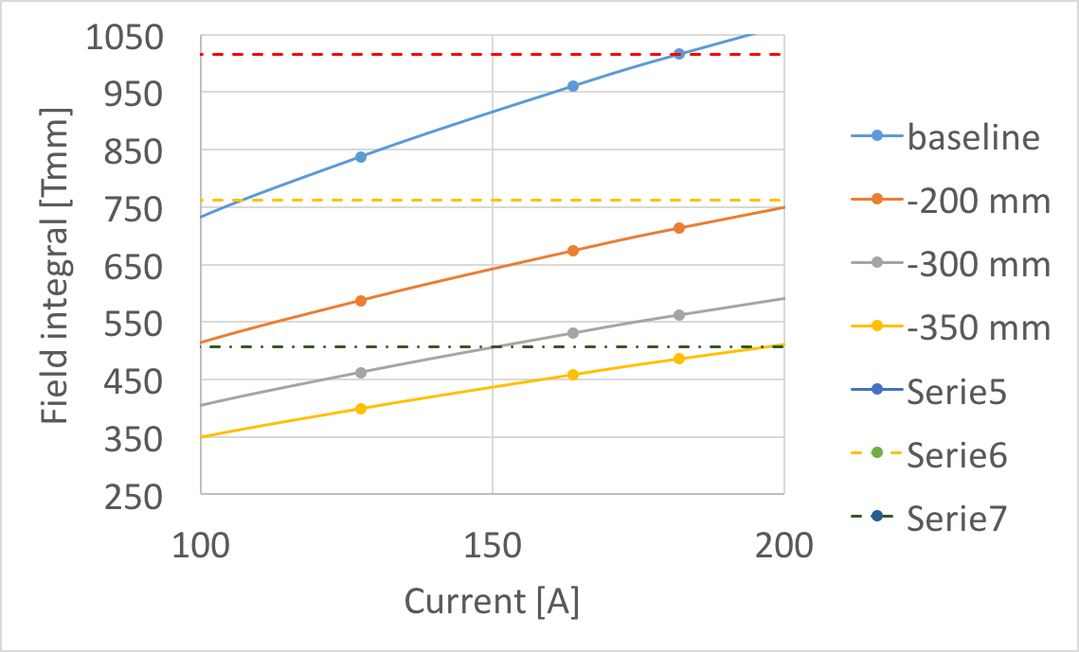
LAYOUT
Where to find the 320 mm?
    120 mm found from optimization of the lay-out
  Option of a shorter skew quadrupole
    200 mm less in the skew quad would mean correcting 35 units instead of 50
  Iteration on the strength of the skew corrector is ongoing (WP2)
    Today in the LHC we can correct up to 39 units, and we use the magnets at 40% of maximum current (we correct 16 units)
    Decision to be taken soon (April): Lasa is writing the invitation to tender
Corrector strength | (units at 17 mm) LHC | (units at 23 mm) LHC | (units at 50 mm) HL-LHC
a₂ | 39 | 39 | 50
b₃ | 1.1 | 1.5 | 3.0
a₃ | 1.8 | 2.5 | 3.0
a₄, b₄ | 0.8 | 1.5 | 2.2
a₅, b₅ | - |  | 1.7
b₆ | 0.8 | 2.8 | 3.2
a₆ | - |  | 0.8

Slide 5
A FURTHER POSSIBLE DEVELOPMENT
  The dependence on the current is highly non linear due to saturation
    If we could work with 25 units correction (half of the strength of what we have today) this would open to door to have 120 A circuits, and no dump

