Slide 1
18 kA / ±10 V Power converter
Project status
Serge PITTET, Jean-Paul Burnet
Technical Coordination Committee – CERN - 05/04/2018

Slide 2
Outline
Project overview
    Background.
    Schedule.
    Ressources.
    System Description.
Converter overview
    Typical waveform.
    Project requirements.
    Topology selection.
    R&D situation.
Technical highlights
    Energy Storage System.
    Crowbar.

Slide 3
Project background
Purpose:
    Provide a 18kA 2-quadrants power converter for the HL-LHC inner triplets, to ramp down in the shadow of the main LHC dipole magnets.
Deliveries:
    2 prototypes (end 2020).
    4 +1 operational power converters (LS3).
Budget:
    2 MCHF for 2.op prototype power converters.
    2 MCHF for 5 (4.op +1.sp) power converters.
    500 kCHF for 1.sp set of Power modules + DCCT + ctrl elec. units (Crate, FGC, RegFGC cards).

Slide 4
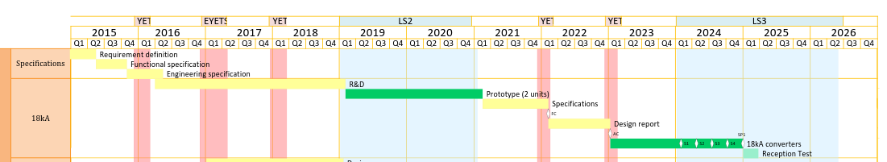
Master Schedule
R&D phase ongoing.
In-line with EVM.

Slide 5
Manpower Resources (2018-03 estimate)
 |  | Run 2 |  | LS2 |  | Run 3 |  |  | LS3
 |  | 2017 | 2018 | 2019 | 2020 | 2021 | 2022 | 2023 | 2024 | 2025 | Total
Required | Engineer_{staff} | 0.1 | 0.2 | 0.6 | 0.6 | 0.9 | 0.7 | 0.6 | 0.5 | 0.5 | 4.6 | 22.5
 | Technician_{staff} |  | 0.3 | 0.8 | 0.8 | 0.5 | 0.5 | 0.5 | 0.8 | 0.8 | 3.2
 | Fellow |  | 0.7 | 1.0 | 1.0 | 0.8 |  |  |  |  | 2.5
 | TTE |  | 0.2 | 1.0 | 0.8 |  |  |  |  |  | 2.8
 | External | 1.0 | 3.9 | 2.4 |  |  |  |  |  |  | 7.3
Affected | S. Pittet | 0.1 | 0.2 | 0.2 | 0.1 | 0.4 | 0.7 | 0.6 | 0.5 | 0.5 | 3.3 | 15.7
 | L. de Mallac |  |  | 0.4 | 0.5 | 0.5 |  |  |  |  | 1.4
 | M. Gros |  | 0.5 |  |  |  |  |  |  |  | 0.5
 | M. Sardano |  | 0.3 | 0.8 | 0.8 | 0.5 | 0.5 | 0.3 |  |  | 3.2
 | External | 1.0 | 3.9 | 2.4 |  |  |  |  |  |  | 7.3
Planed | Technician_{staff} |  |  |  |  |  |  | 0.2 | 0.8 | 0.8 | 1.0 | 6.8
 | Fellow |  | 0.2 | 1.0 | 1.0 | 0.8 |  |  |  |  | 2.5
 | TTE |  | 0.2 | 1.0 | 0.8 |  |  |  |  |  | 2.1

Slide 6
System description
Baseline scheme for the Inner-Triplet magnets powering.
PC1
Converter | PC1 | PC2 | PC3 | PC4
Output current [A] | 18000 | ±2000 | ±2000 | ±35
Output voltage [V] | ±10 | ±10 | ±10 | ±10* *under discussions

Slide 7
Project overview
    Background.
    Schedule.
    Ressources.
    System Description.
Converter overview
    Typical waveform.
    Project requirements.
    Topology selection.
    R&D situation.
Technical highlights
    Energy Storage System.
    Crowbar.

Slide 8
Typical waveform
Ramp-up from 1 kA to 18 kA at 16 A/s (~18 min).
Flat-top operation lasts for an average of 15 hours.
Ramp down from 18 kA to 1 kA in the shadow of the main LHC dipole magnets (~20 min).

Slide 9
Project Requirements
Ramping down the current in the magnet is mainly done using the resistance of the cables - LHC case.
With the new SClink, a 2-quadrant converter is required to recover the magnets energy (40 MJ).
GRID
1Q
converter
LOAD
cables

Slide 10
Topology selection
A new 2-quadrant design of high current converter with integrated energy storage is proposed.
It reduces the peak power drawn from the network from 200 kW down to around 40 kW, and minimizes the cost of electrical infrastructure.
It increases the immunity to grid perturbations.
It eases the control of the power flow.
Energy Storage
System
2Q
converter
LOAD
GRID
1Q
converter

Slide 11
R&D situation
Overall structure and sub-components topologies have been defined.
Three collaborations - EPFL, LIC, CSEM - agreements ongoing for the output stages.
One collaboration under preparation for a full scale industrial prototype.
CERN design for the global integration and specific items: DCCT rack, crowbar, separator, power racks, control.
CSEM
LIC, EPFL
Energy Storage
System
2Q
converter
LOAD
GRID
1Q
converter

Slide 12
Project overview
    Background.
    Schedule.
    Ressources.
    System Description.
Converter overview
    Typical waveform.
    Project requirements.
    Topology selection.
    R&D situation.
Technical highlights
    Energy Storage System.
    Crowbar.

Slide 13
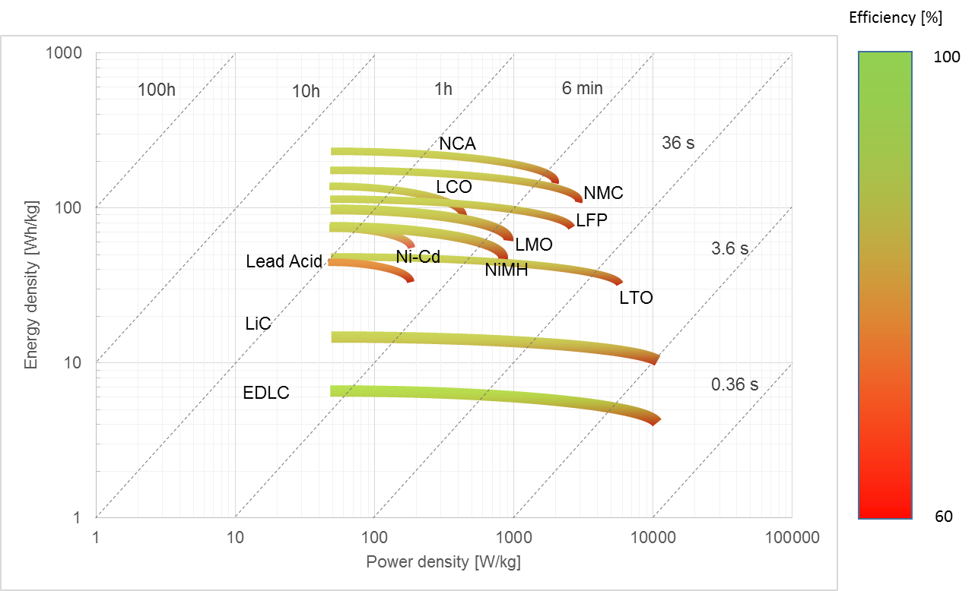
Energy Storage System
Efficiency Ragone plot (gravity densities)
Most of the technologies can provide a reasonable efficiency.
100
90
Batteries
80
Supercapacitors
70
HL-LHC 18 kA typical time constant
60

Slide 14
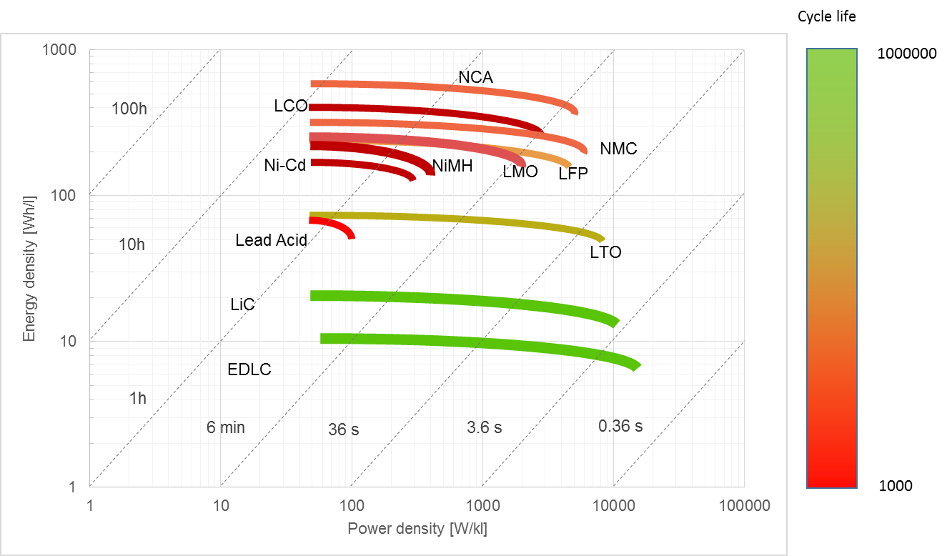
Energy Storage System
Cycle life Ragone plot (gravity densities)
Only three candidates can provide the expected lifetime:
Lithium titanium oxide batteries (LTO), Supercapacitors (LiC and EDLC).
1000000
Batteries
100000
Supercapacitors
10000
HL-LHC 18 kA typical time constant
1000
[W/l]

Slide 15




Energy Storage System
Candidates selection
LTO is the most cost and size effective technology for this application.
Multiple suppliers:
 | EDLC Supercapacitors | LiC Supercapacitors | LTO Batteries
Weight [kg] | 2500 | 1390 | 900
Volume [l] | 2550 | 1200 | 700
Number of racks | 5 | 2-3 | 2
Total cell price [€] | 250k | 216k | 40k + BMS
Cycle life | 1M | >200k | >75k

Slide 16
Project overview
    Background.
    Schedule.
    Ressources.
    System Description.
Converter overview
    Typical waveform.
    Project requirements.
    Topology selection.
    R&D situation.
Technical highlights
    Energy Storage System.
    Crowbar.

Slide 17
Crowbar
Requirements
In case of fault, the crowbar system shall be able to ramp down once the current. Even without electricity and cooling water, the blackout case.
Pending request to increase the crowbar voltage from 10 V to 50 V is currently being analyzed, since impacting strongly converter design & performance (followed by the MCF).
High precision is required at the output of the converter (accuracy class 0, Current ripple < 20 mA_{rms}).

Slide 18
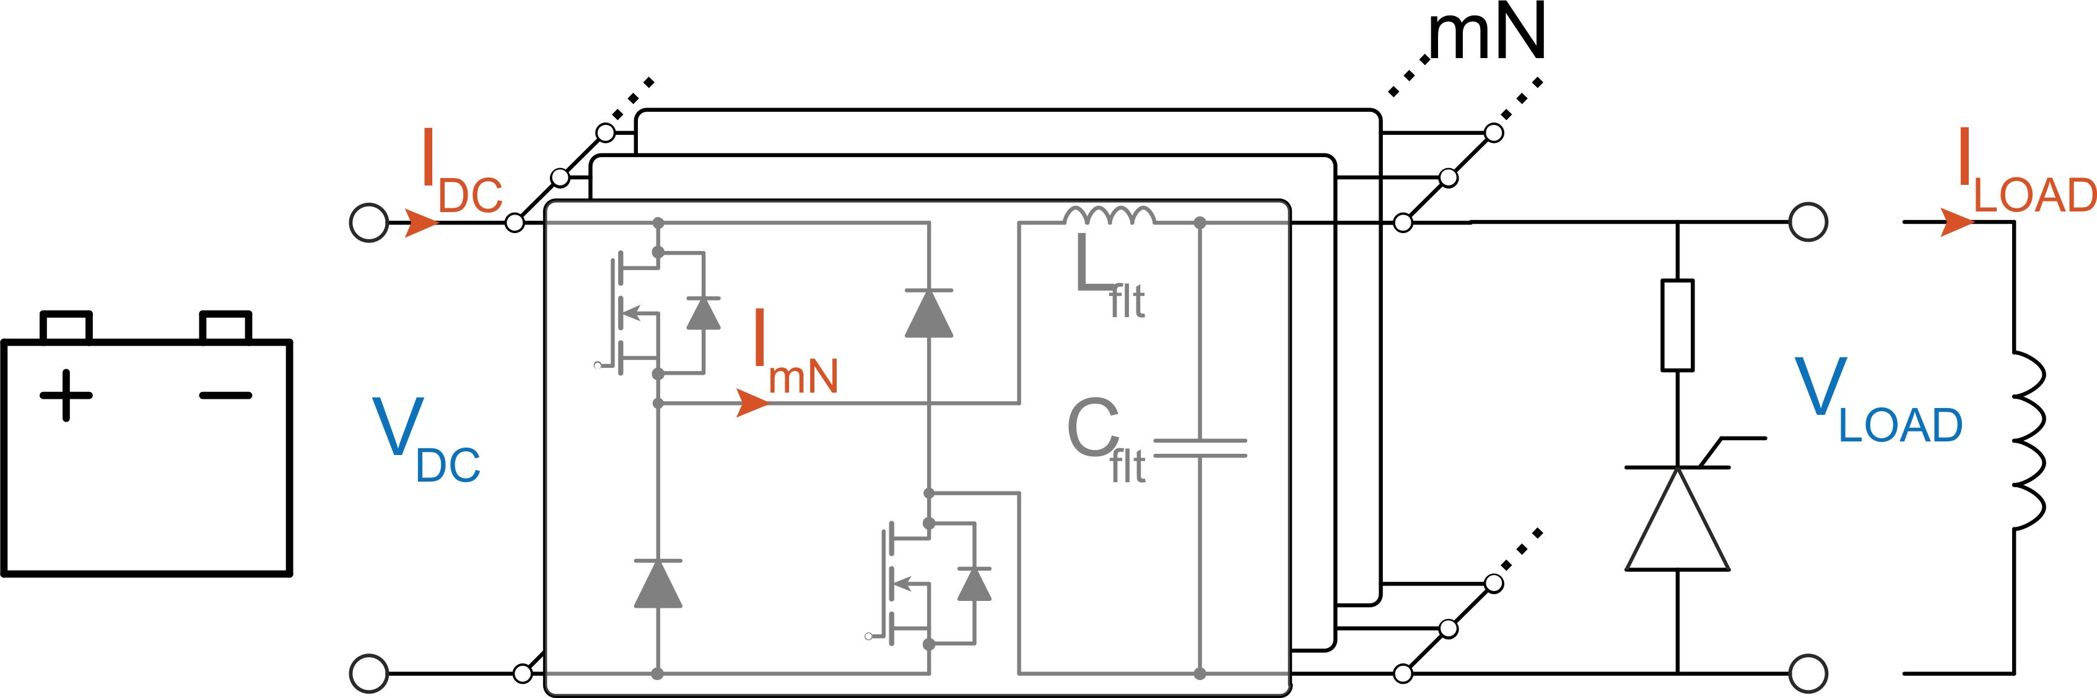
Crowbar
Technical constraints
The converter will be made of N sub-converters composed of m branches (N x m > 100).
Because of the free-wheeling diodes, the load voltage |V_{LOAD}| cannot exceed the DC-bus voltage V_{DC}.
Normal operation requires a DC-bus voltage V_{LV} around 12V.
Increasing the crowbar voltage would increase the output ripple, power losses, converter size and crowbar peak power.

Slide 19
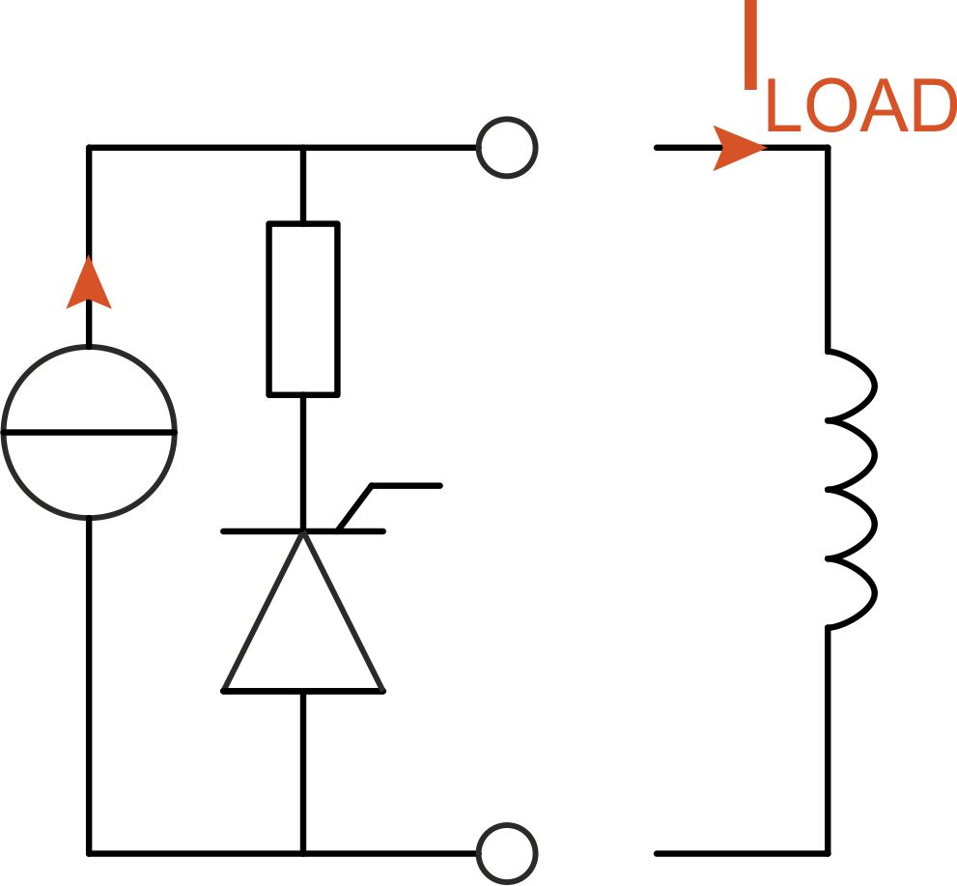
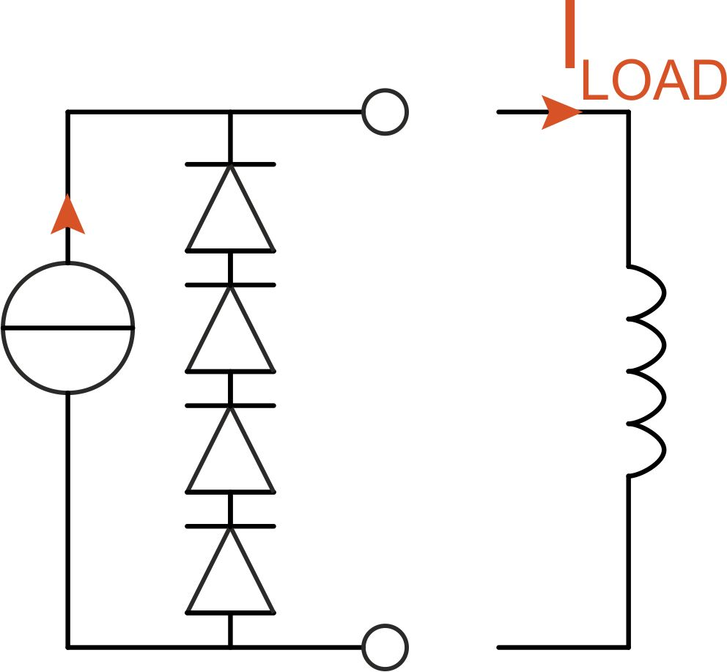
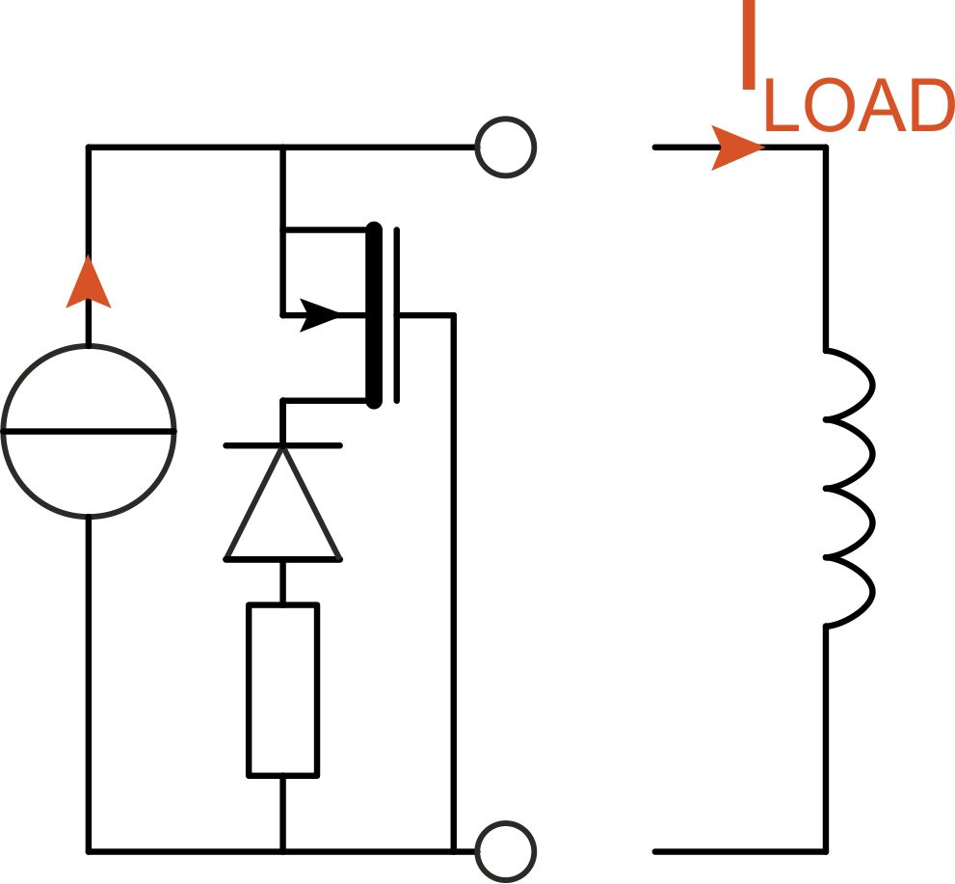
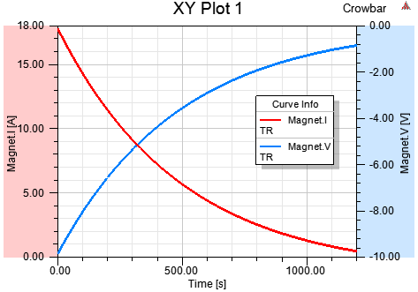
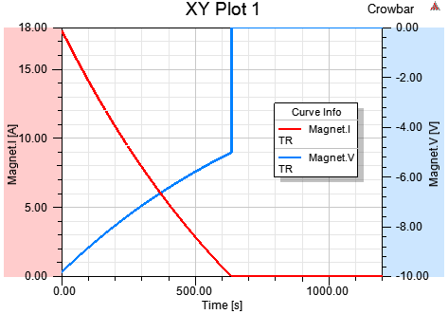
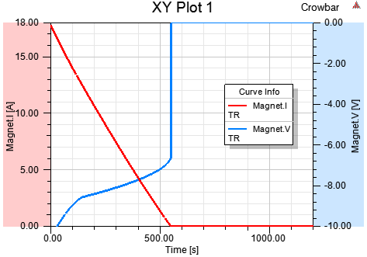
Crowbar
Mitigation
Alternative schemes could speed up the ramp down without increasing the peak output voltage.
Thyristor based
20 min
Diodes based
11 min
MOSFET based
9 min
X10
series
Magnet current [kA], voltage [V]

Slide 20
Conclusion
  The overall structure and sub-components topologies have been defined.
  A battery technology has been identified.
  The conceptual study is ongoing. Design of the power converter to be started in 2019.
  The crowbar ratings are being reviewed by the MCF.
Next steps:
  Approval of the functional specification (end 2018).
  Validate the demonstrators (end 2019).
  Finalize converter integration (end 2019).

Slide 21
Thank you for your attention
- Comparative Study of two-quadrant DC/DC stage in power supply for superconduction magnets (ICIT-IEEE 2018, edms 1918772).
- High-Current Low-Voltage Power Supplies for Superconducting Magnets (EE 2017, edms 1832844).
- HL-LHC 18 kA: ESS pre-study (CSEM, edms 1926350).

