Slide 1


Slide 2
1. EXISTING SITUATION AND INTRODUCTION
In the region of the inner triplet magnets, the heat load represents an identified issue since Run 2 […] and will exceed the cooling capability of the foreseen cryogenic plant [2] in the HL-LHC era.
The baseline measure to overcome this limitation is the coating of the beam screens of the inner triplet magnets with a low Secondary Electron Yield (SEY) a-C thin film.
The specific development for the LHC BS configuration has been shown ([3], [4]). At present, the coating of 10m long BS with performance within specification has been demonstrated.

Slide 3
1. EXISTING SITUATION AND INTRODUCTION
In order to validate the in-situ coating process in the LHC and increase the margin for arc cooling in sectors 23 and 78 for the HL-LHC era, a proposal to coat some standalone magnets was presented in the LHC Performance Workshop 2018, coming from the development team [5] and from the Task Force on Beam Induced Heat Load [6].
The proposal has been endorsed by the recommendations of the CMAC
The very same strategy has been endorsed by the 46th HL-LHC TCC following the presentation of WP12 [8].

Slide 4
2. REASON FOR THE CHANGE
Coating a selected number of Q5 and Q6’s BS during LS2, in combination with additional instrumentation, will enable to estimate the heat load reduction with LIU beams. It will also allow early validation of the in-situ coating procedure, tooling and activity duration in anticipation of the LS3 in-situ campaign.
Furthermore, an additional margin in the refrigeration power for the sectors 23 and 78 would be achieved by coating the standalone magnets in R2 and L8 with a low SEY a-C thin film. This is particularly relevant for the HL-LHC era, since these sectors are cooled by ex-LEP’s refrigerators.

Slide 5
3. DETAILED DESCRIPTION
3.1 MAGNETS TO BE COATED
Table 1 — Beam screen orientation, drawings relevant to the coating campaign and the heat loads expected with HL-LHC beam for the cases of maximal SEY of 1.3 and 1.1 [10].

Slide 6
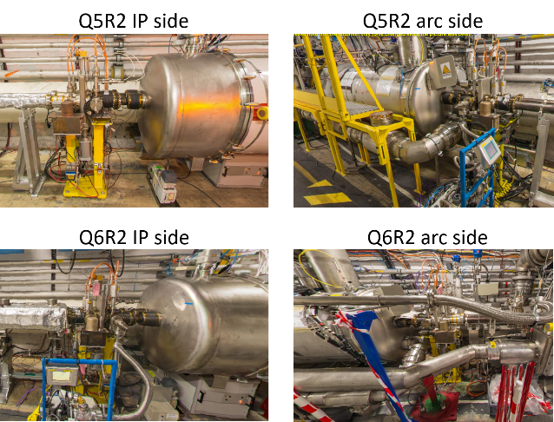
3. DETAILED DESCRIPTION
3.1 MAGNETS TO BE COATED

Slide 7
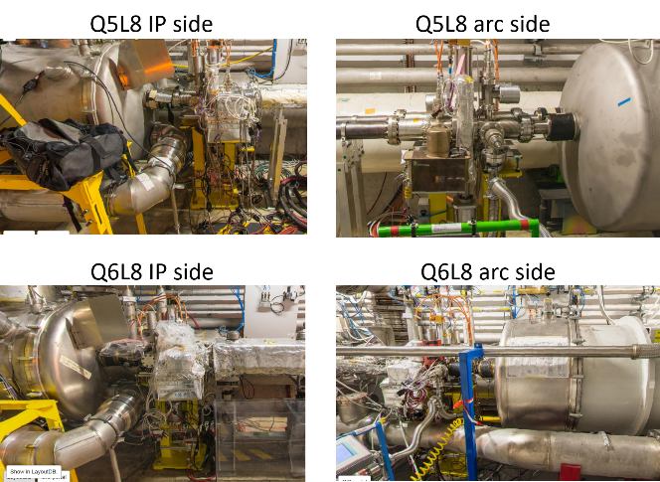
3. DETAILED DESCRIPTION
3.1 MAGNETS TO BE COATED

Slide 8
3. DETAILED DESCRIPTION
3.2 The coating process
In a first step is applied a 150 nm thick titanium layer in order to enhance the adhesion and to decrease the outgassing of the beam screen and the cold bore and in a second phase a top layer of carbon (50 nm thick) is deposited.
During the deposition of the carbon layer, titanium is also deposited (and subsequently covered by the carbon) in order to pump the hydrogen and the water molecules present in the plasma and ensure that the maximal secondary electron yield remains below 1.1.
The overall thickness of the titanium layer will not exceed 500nm.
A study conducted by BE-ABP concluded that the overall impact is negligible compared to the other sources of impedance. [12]

Slide 9
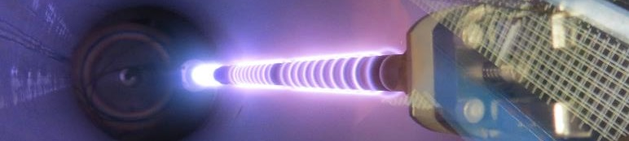
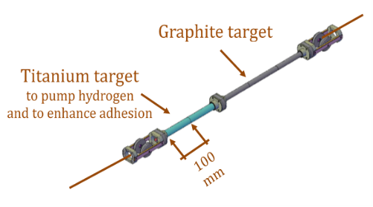
3. DETAILED DESCRIPTION
3.2 The coating process
the operation is done at ambient temperature and no bakeout is applied.
During the deposition, the maximal power applied to the sputtering source is 30 W, distributed along 30 cm of target. This results on a maximal temperature at the cold bore below 65ºC.

Slide 10
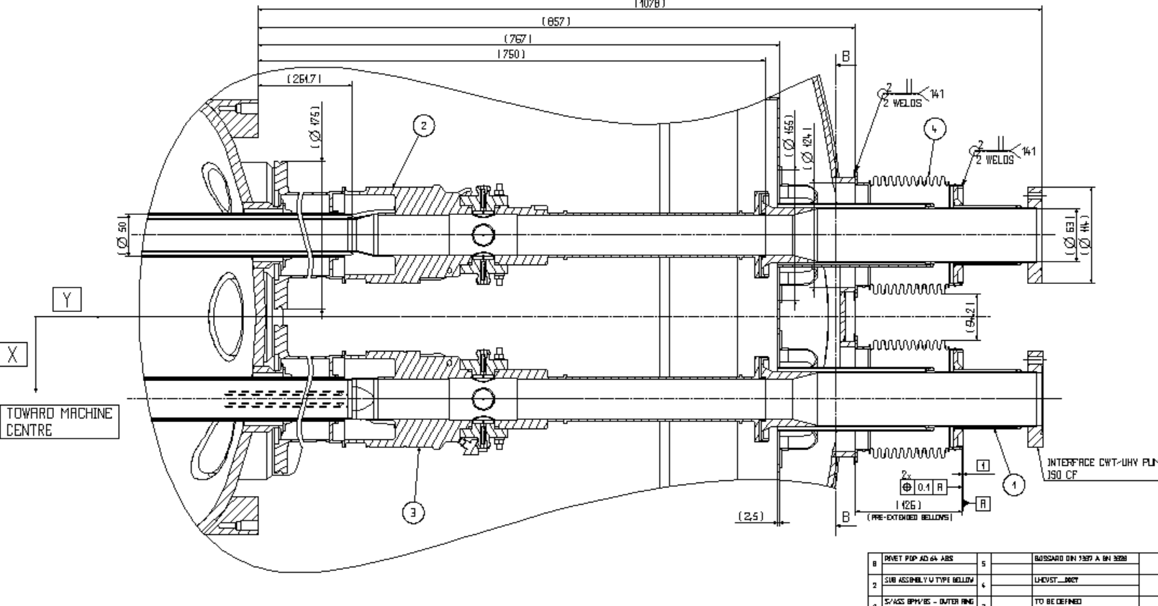
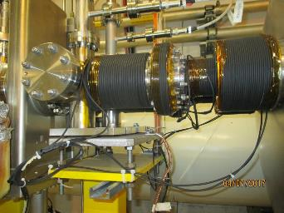
3. DETAILED DESCRIPTION
3.2 The coating process
The beam screens will be fully coated but, due to the geometry of the coating source, the first 30 cm of the cold/warm transitions will not be completely covered with the carbon layer.
Anti-multipacting solenoides
Uncoated sections

Slide 11
3. DETAILED DESCRIPTION
3.2 The coating process
Table 2 — Schematic of the operations and intervening teams necessary to deploy the coating in the Q5 and Q6 magnets.

Slide 12
4. IMPACT ON OTHER ITEMS
5. IMPACT ON COST, SCHEDULLE AND PERFROMANCE
6. IMPACT ON OPERATIONAL SAFETY
7. WORKSITE SAFETY
8. FOLLOW-UP OF ACTIONS
9. REFERENCES

Slide 14
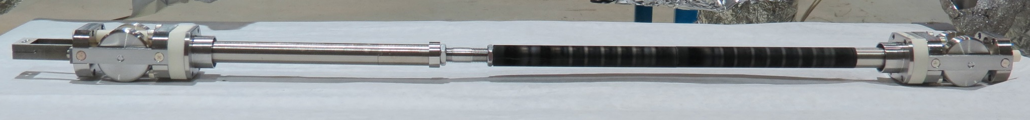
2 – In-situ a-C coating
1 spool for mechanical cable
+
2 spools for electrical cables
How it is done
1 spool for mechanical
cable
Cold bore + beam screen
Ar injection
Turbo molecular
pump
titanium
carbon

Slide 15
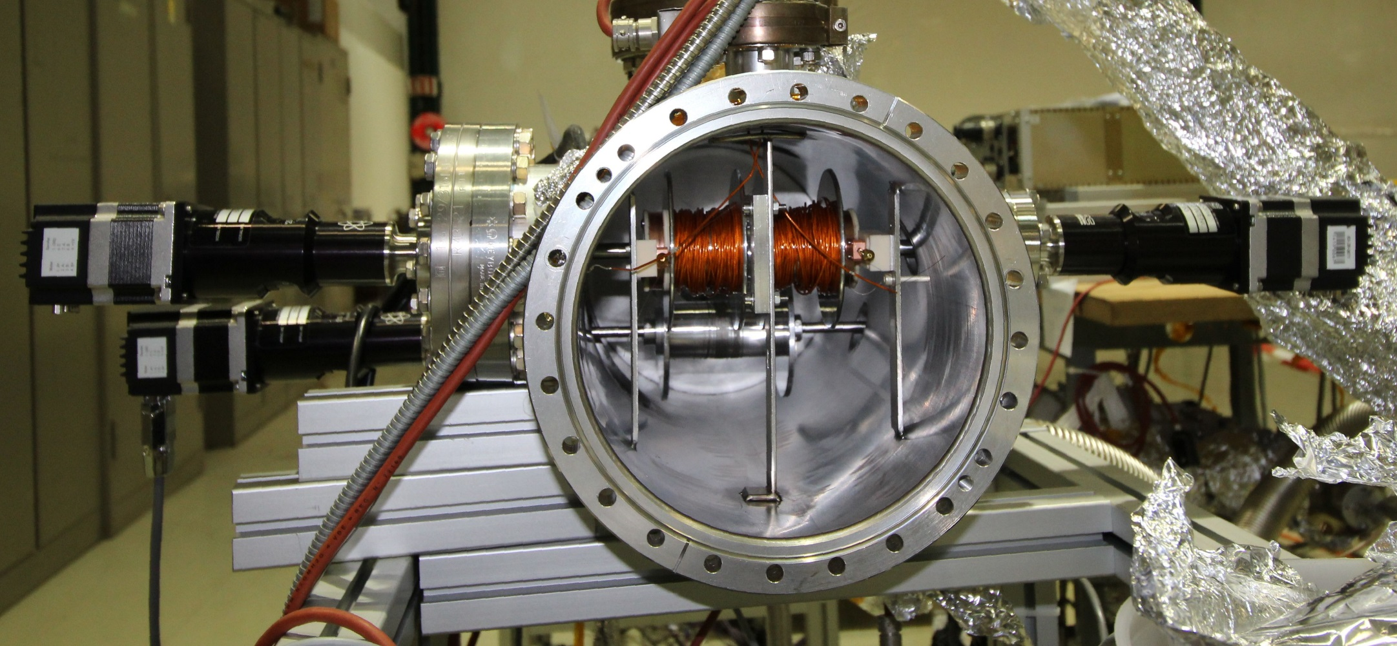
2 – In-situ a-C coating
1 spool for mechanical cable
+
2 spools for electrical cables
How it is done
1 spool for mechanical
cable
Cold bore + beam screen
Ar injection
Turbo molecular
pump
Electrical cables
Stepper motors
Stepper motor
mechanical cable
3 spools to be encoded!
(+ a 4th at the other extremity)

Slide 16
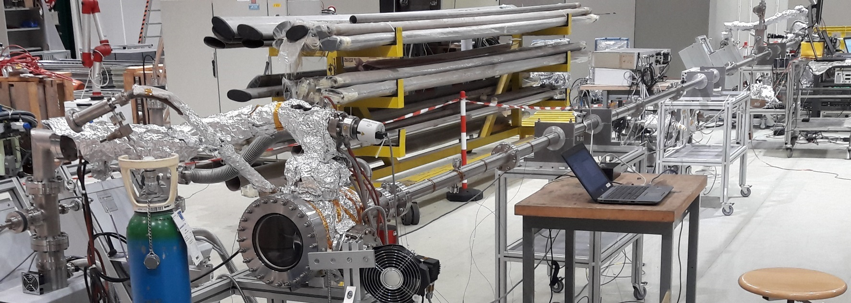
2 – In-situ a-C coating
1 spool for mechanical cable
+
2 spools for electrical cables
How it is done
1 spool for mechanical
cable
Cold bore + beam screen
Ar injection
1st step: Ti pre-coating (250 nm)
Turbo molecular
pump
10 meters

Slide 17
2 – In-situ a-C coating
1 spool for mechanical cable
+
2 spools for electrical cables
How it is done
1 spool for mechanical
cable
Cold bore + beam screen
Ar injection
1st step: Ti pre-coating (250 nm)
Turbo molecular
pump
2st step: carbon coating ~90 nm (with Ti flashes ~250nm)
10 meters

Slide 18
2 – In-situ a-C coating
Performance:
SEY along 10 meters
Tests in accelerators (e-Cloud detectors + COLDEX+ LHC Pilot sector)
Control of particulates
OK. To be confirmed in final recipe for LHC (2018)
Vacuum: pump down, Isotherms, Photodesorption yield.
OK but a new BS operation temperature is proposed (between 60K and 80K). To be confirmed in final recipe for LHC (2018). Photodesorption yield ok at 77 K. (@KEK)
Calculation ok: the increase is acceptable.
To be measured in 2018
Impedance: calculations and measurement.
Ok in all trials, after 10 thermal quenches.
To be confirmed in a BS already exposed to the beam. (MB3409 Q4 2017)
Adhesion.
Ok for IP2 & IP8 (up 200 MGy).
To be measured in 2018 with final recipe.
Resistance to radiation

Slide 19
2 – In-situ a-C coating
Performance: SEY along 10 meters
Maximal SEY_{max} < 1.1 along 10 meters of arc type BS
(100ºC)
2 m in type 74 BS

