Slide 1
PS Internal Dump with HOM Coupling Loops & Cooling Tubes
B. Popovic
05/04/2018

Slide 2
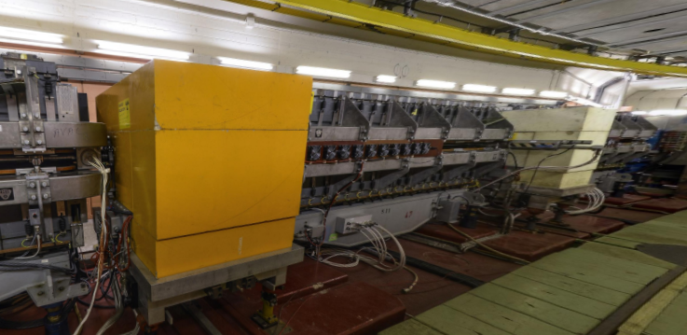
Overview
Replacement for installed PS Dumps
  Straight sections 47 & 48
  Installed vacuum vessels are rectangular
Straight Section 47
Straight Section 48

Slide 3
Overview
Study of Preliminary dump presented at IWG14*
  EN-STI Design changes:
    Cooling hoses changed
    Vessel volume reduced as much as possible
Current EM model from CAD model from EN-STI (20/02/18)
Tapers presented at LIU-PS BD WG #12**
HOM Couplers presented at IWG #18^
Further simulation results presented today
  Compare circular & elliptical tapers, both with HOM loops
  Inclusion of cooling tubes
*https://indico.cern.ch/event/671318/contributions/2746286/
**https://indico.cern.ch/event/710562/contributions/2918960/
^https://indico.cern.ch/event/707776/contributions/2931874/

Slide 4
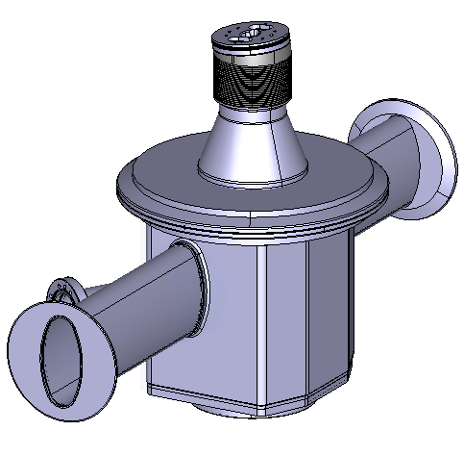
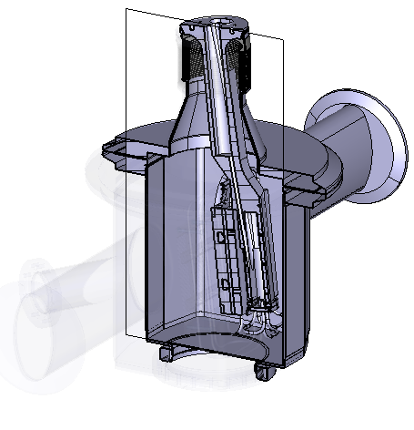
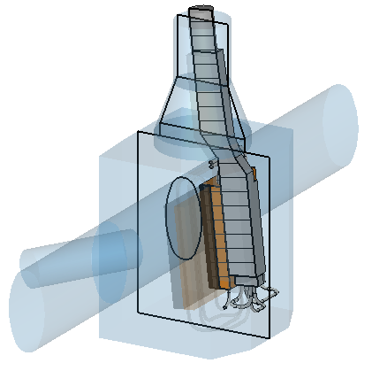
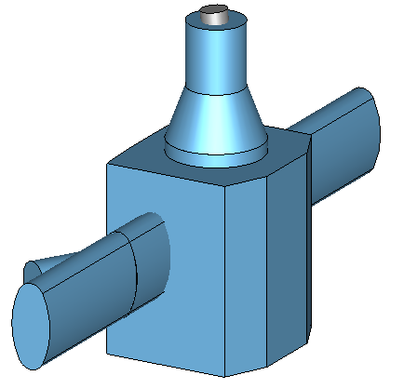
EM Model from EN-STI CAD Model

Slide 5
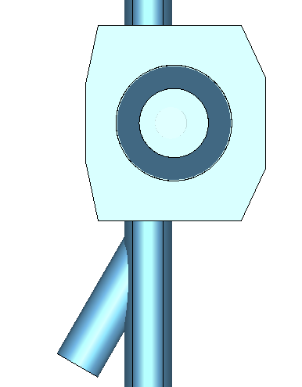
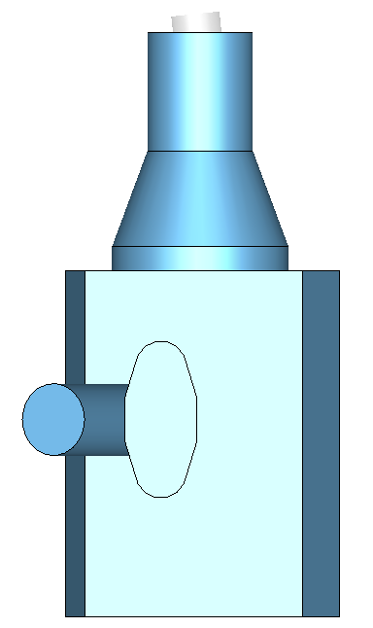
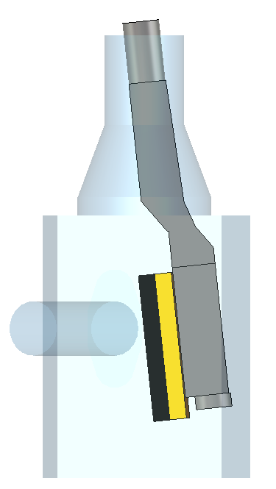
Object Geometry Overview
Free geometry parameters available
  Beam pipe tapers
    Shunt impedance reduction
  Chamfer lengths & angles
    Negligible effect
Possible Taper Locations
Beam
Beam Pipe View
Actuator
Beam
PS
Beam Pipe
Beam Pipe View (Transparent)
Viewport
Taper Locations
Actuator
Beam
Moveable
Dump

Slide 6
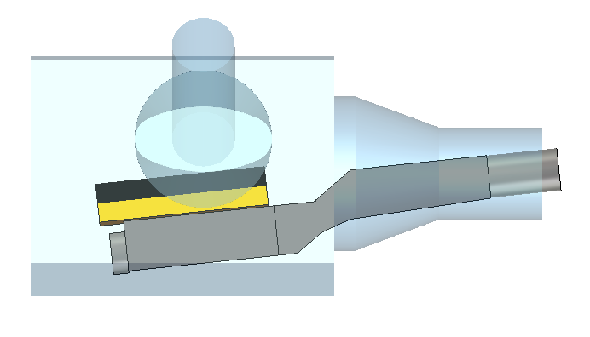
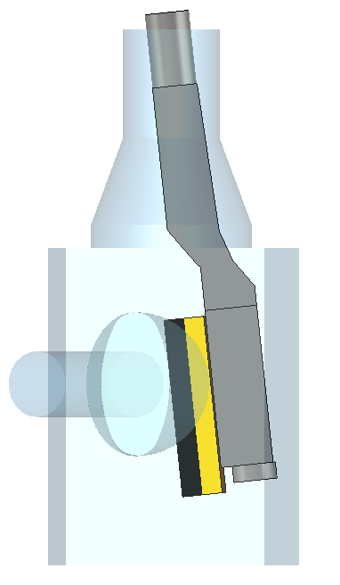
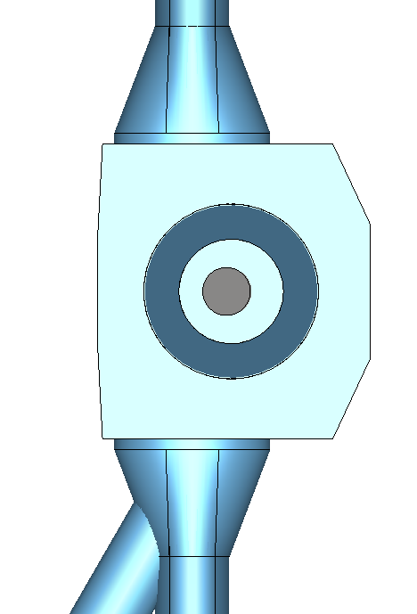
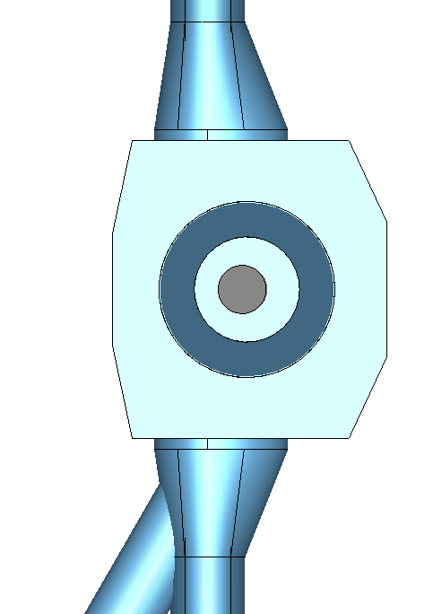
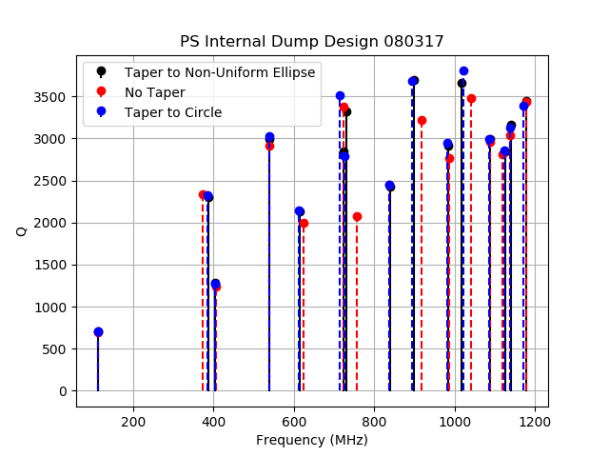
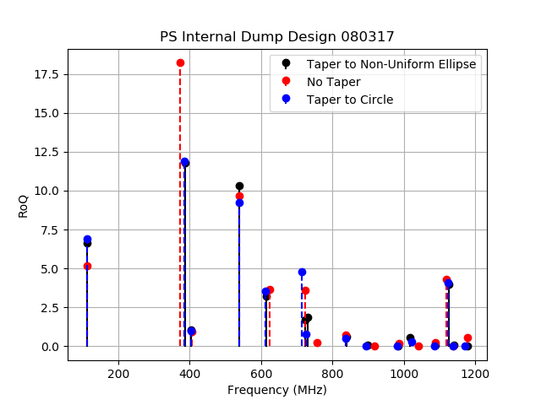
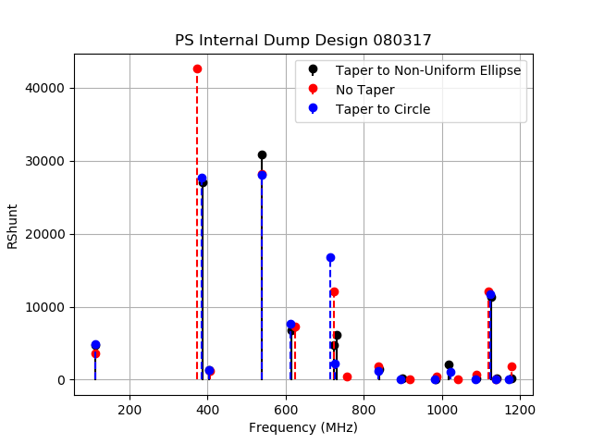
Taper Design Results: Eigenmode
Taper to Circle
Taper to Non-Uniform Ellipse
Beam
Beam
Beam
Beam

Slide 7
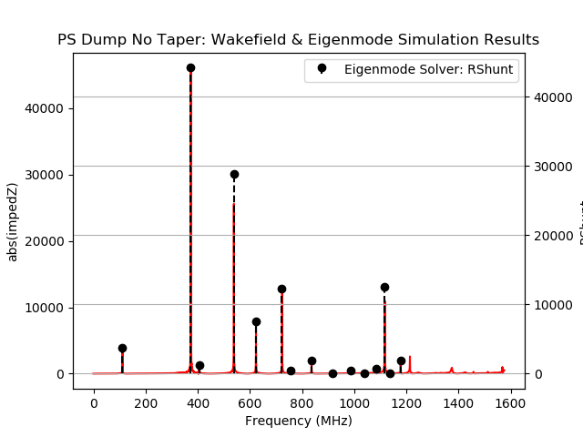
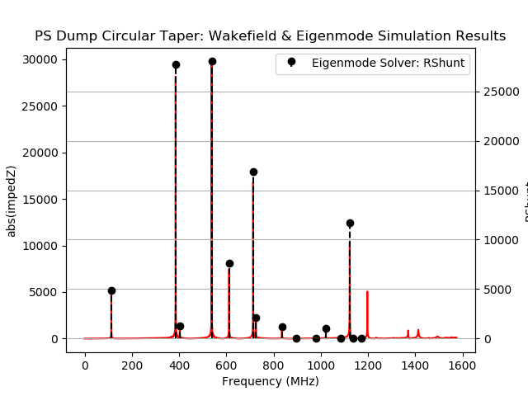
Taper Design Results: Wakefield
Good agreement between Eigenmode & Wakefield Solvers
*Note the different scales
No Taper
Taper to Circle
385 MHz Mode
540 MHz Mode
385 MHz Mode
540 MHz Mode

Slide 8
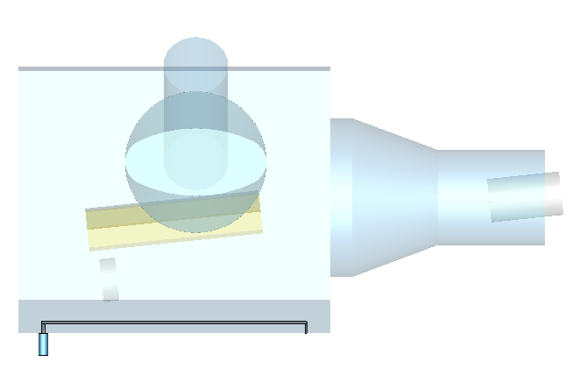
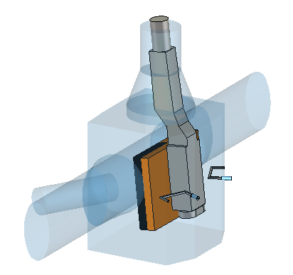
HOM Couplers
Stripline HOM Coupler
Limited geometric free design parameters => HOM Coupler
Placed in bottom of vacuum vessel
Stripline HOM was explored
  Parallel to dump arm
  Increase in vessel size to accommodate
    Increase of 385 & 540 MHz mode R-shunt
  Unsatisfactory performance
Two shorted loops
  Couple to Modes at 385 & 540 MHz
    H-Field
Beam
Stripline
Loop HOM Couplers
Loops

Slide 9
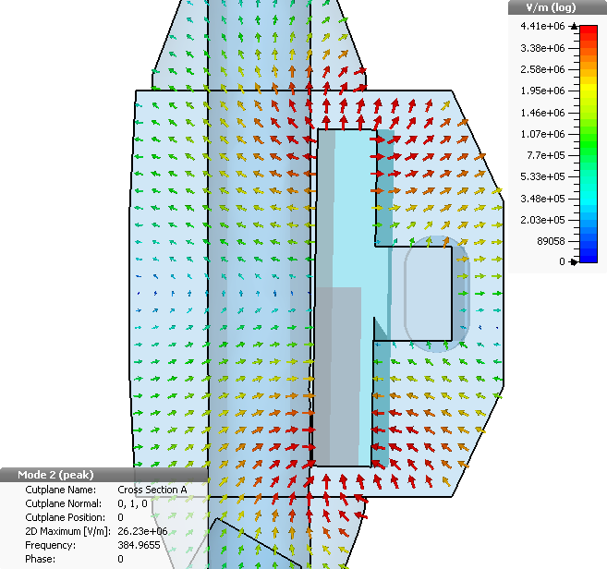
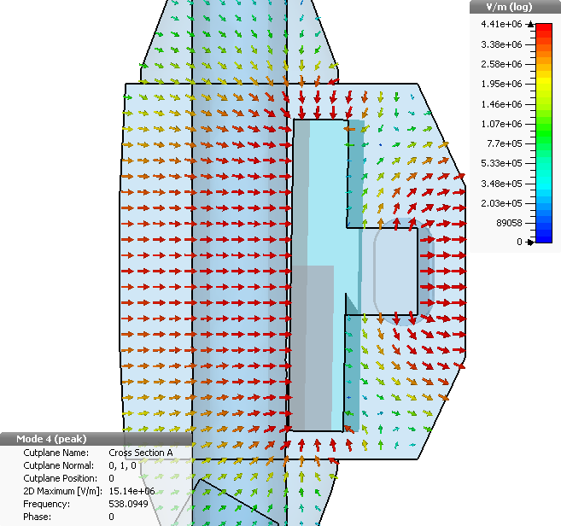
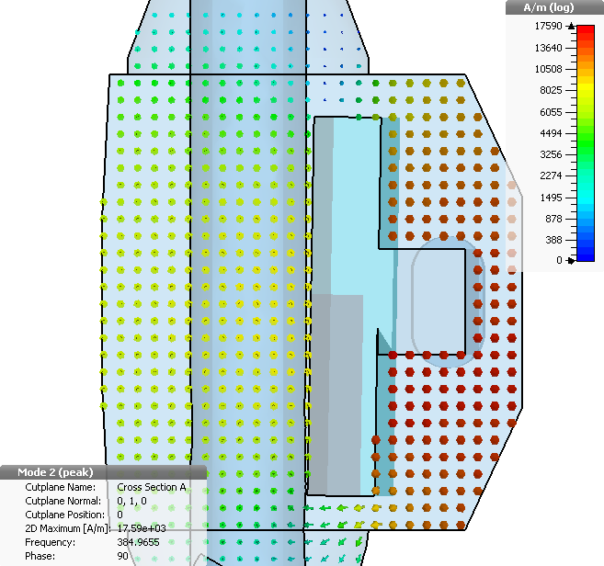
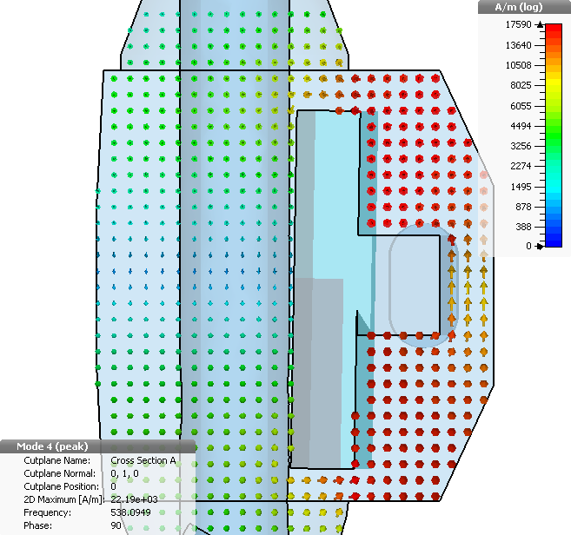
Undisturbed/Unmitigated Field Patterns
Cut plane
Mode at 385 MHz
Mode at 540 MHz
E-Field
E-Field
Beam
Field View
Mode at 385 MHz
Mode at 540 MHz
Beam
H-Field
Beam
H-Field

Slide 10
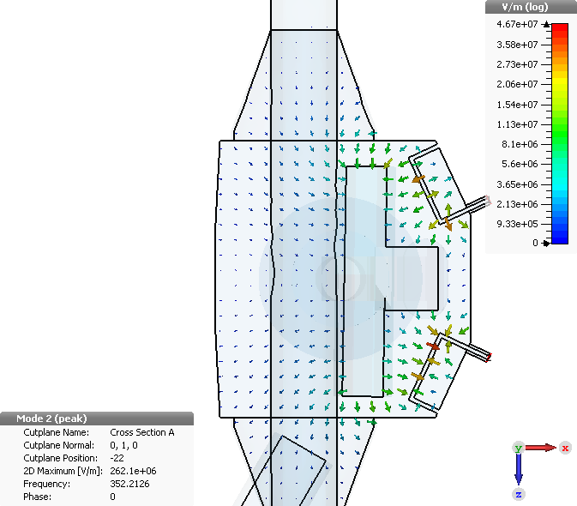
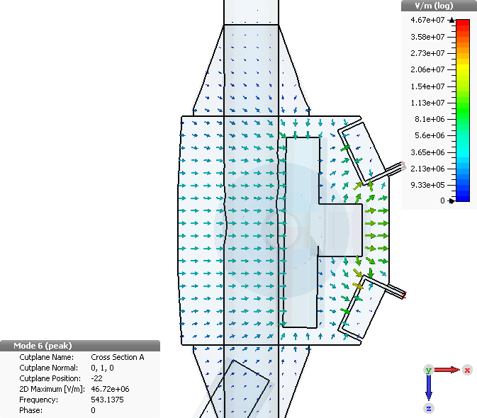
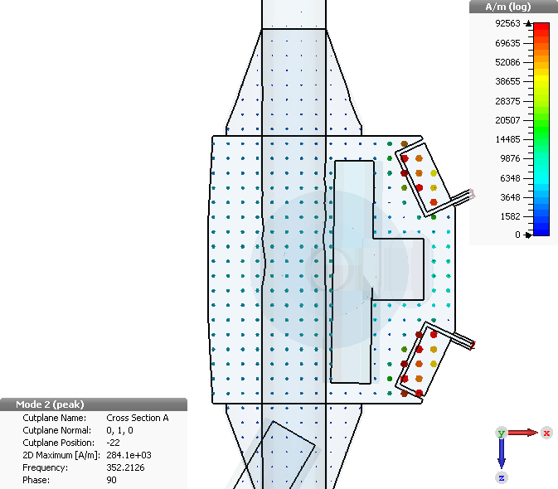

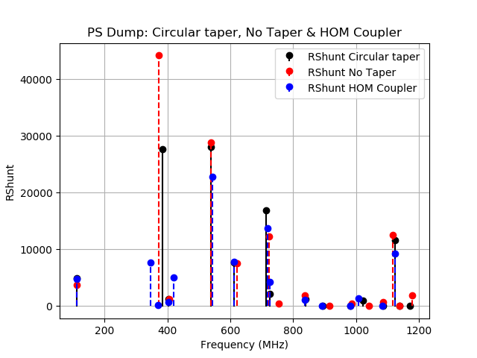
With HOM Coupler Field Patterns
Mode at 352 MHz
Mode at 543 MHz
E-Field
Beam
E-Field
Beam
Mode at 352 MHz
Mode at 543 MHz
H-Field
H-Field

Slide 11
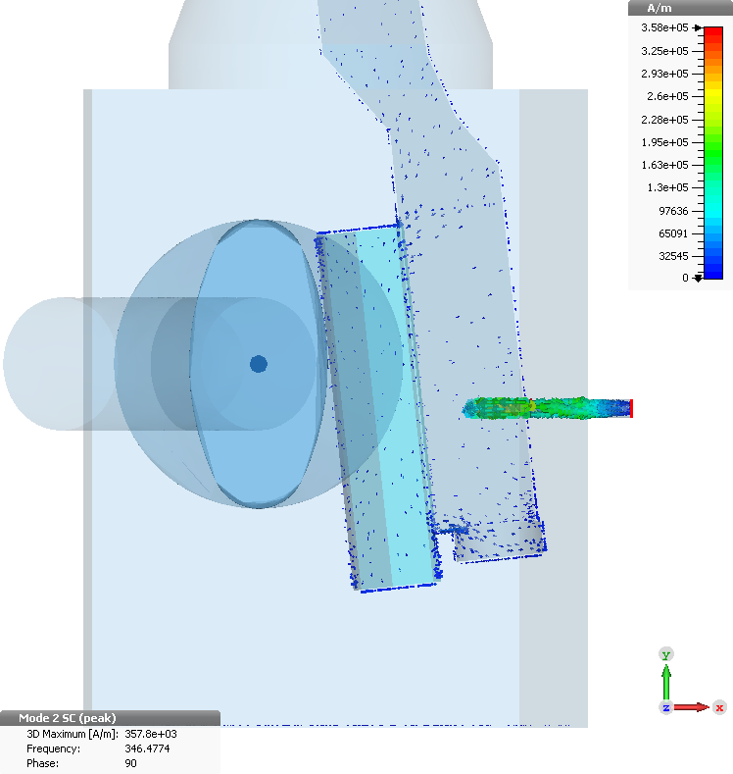


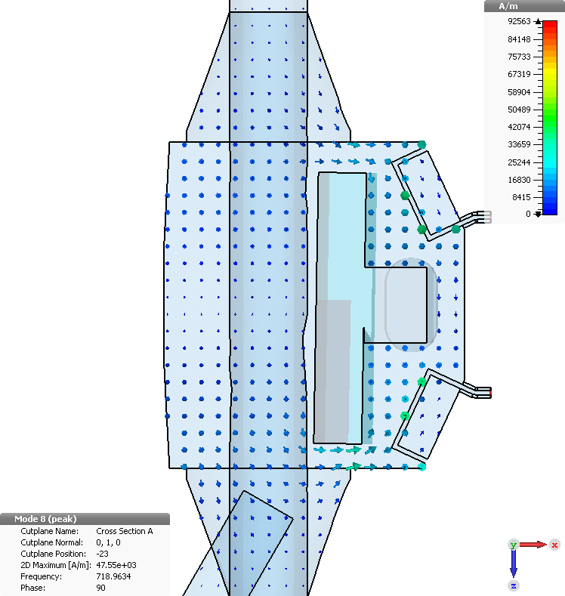
With HOM Coupler Field Patterns
Mode at 352 MHz
Mode at 543 MHz
Mode at 718 MHz
Surface Currents
Surface Currents
Surface Currents
H-Field
H-Field
H-Field

Slide 12
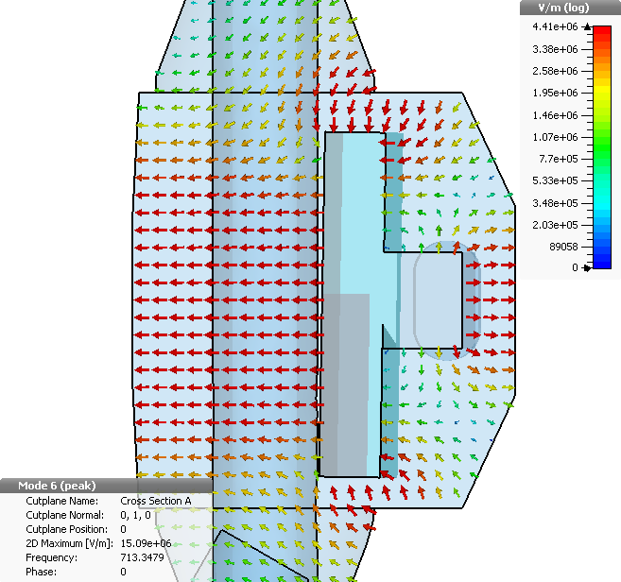
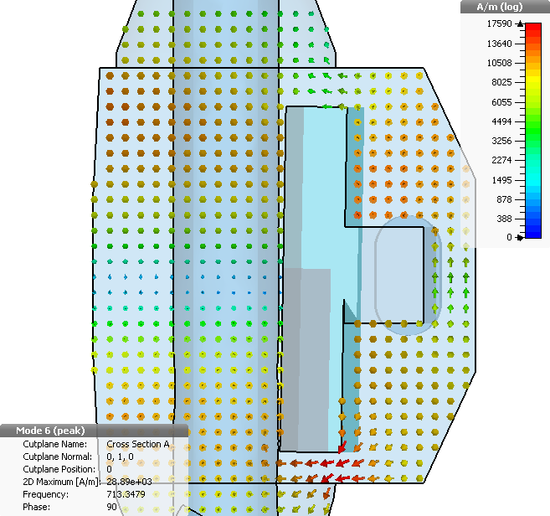
Undisturbed/Unmitigated Field Additional Mode Discussion
Mode at 385 MHz
Mode at 540 MHz
Mode at 713 MHz
E-Field
E-Field
E-Field
H-Field
H-Field
H-Field

Slide 13
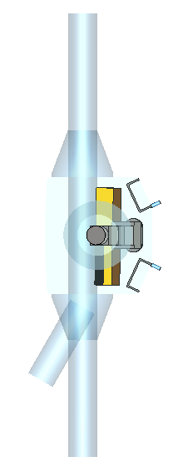
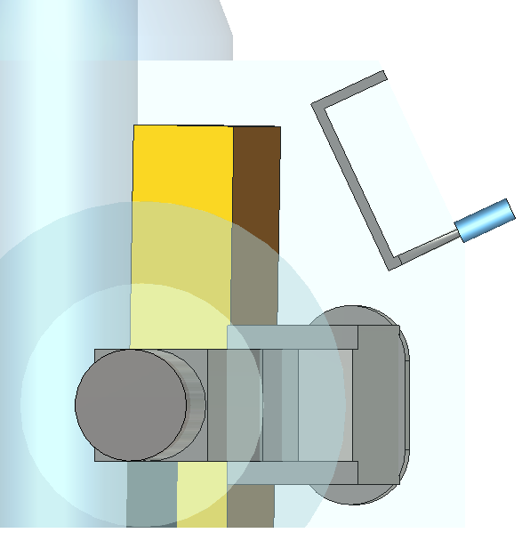
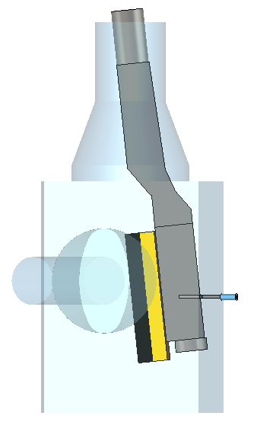
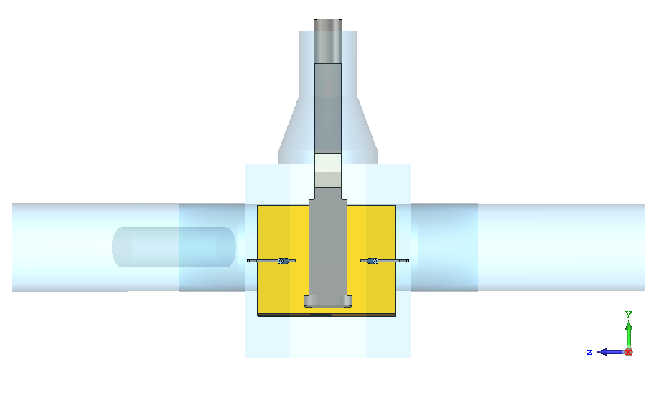
Coupling Loops Geometry
Gap
30 mm
50 Ohm
Width
70 mm
Side View
Thickness
4 mm
Beam
Bottom View
Beam View
Beam
Beam
Geometric Center of Vacuum Vessel

Slide 14
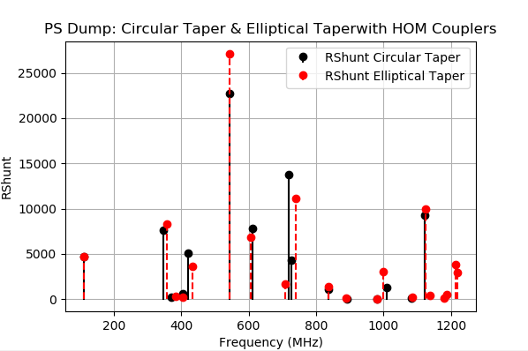
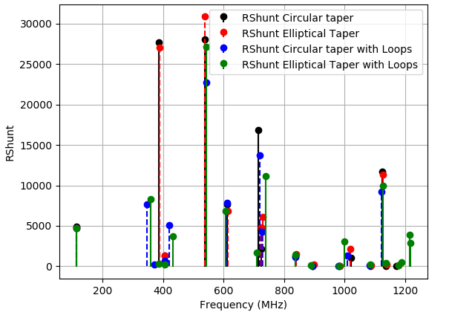
With HOM Couplers: Compare Elliptical & Circular Tapers
Circular Taper with HOM couplers provides better performance at 540 MHz Mode

Slide 15
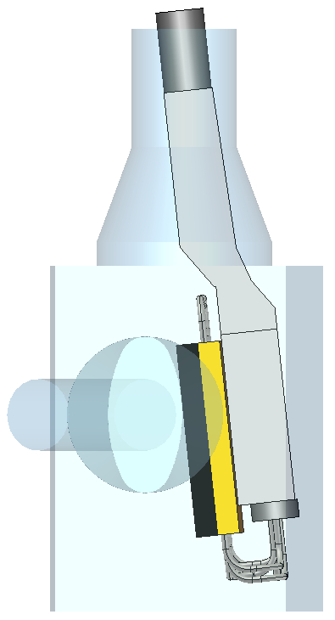
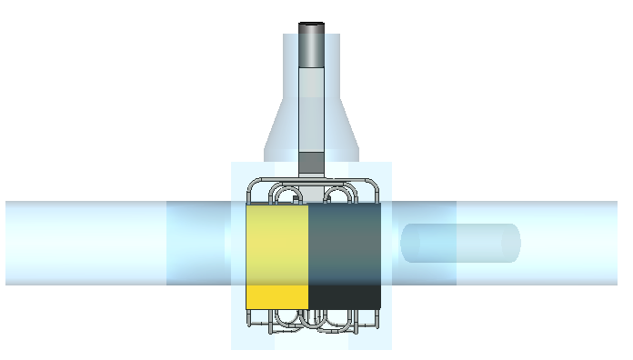
Model with Cooling Hoses

Slide 16
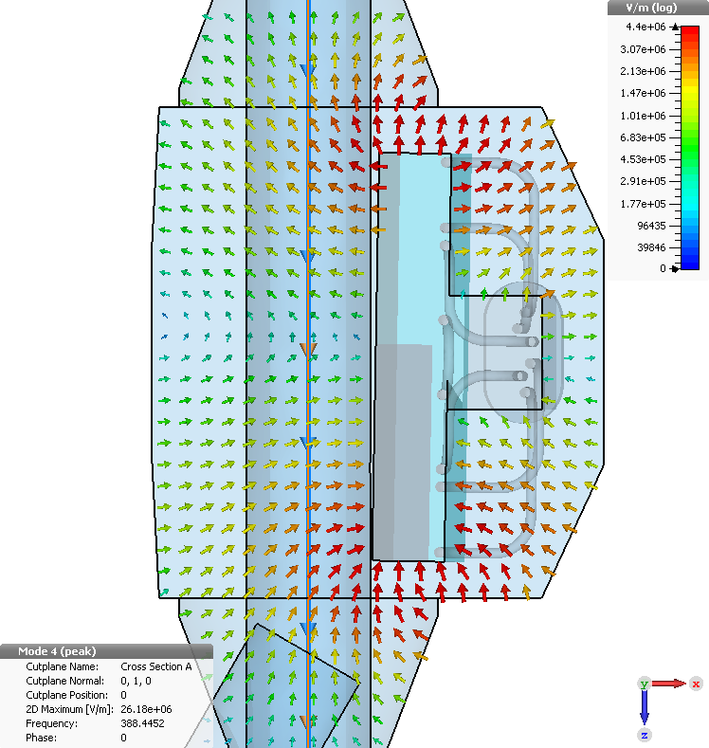
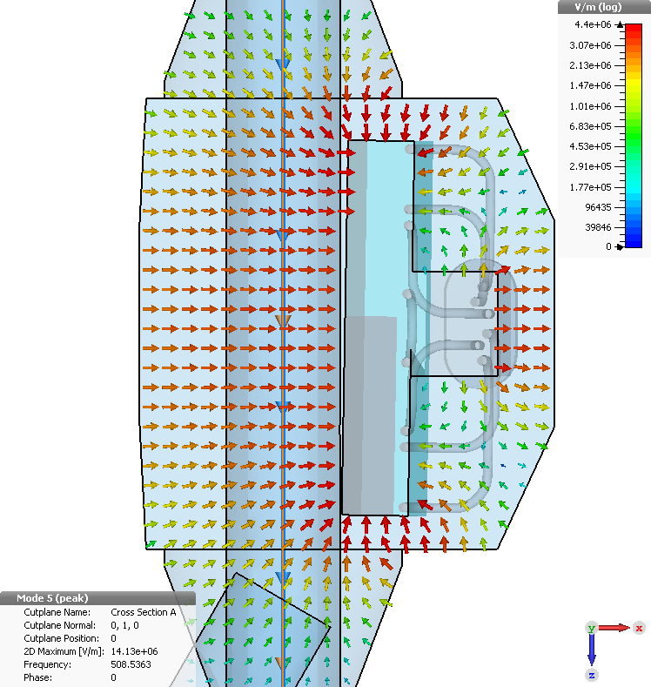
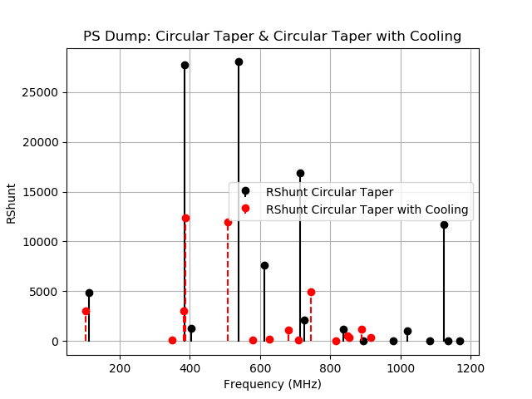
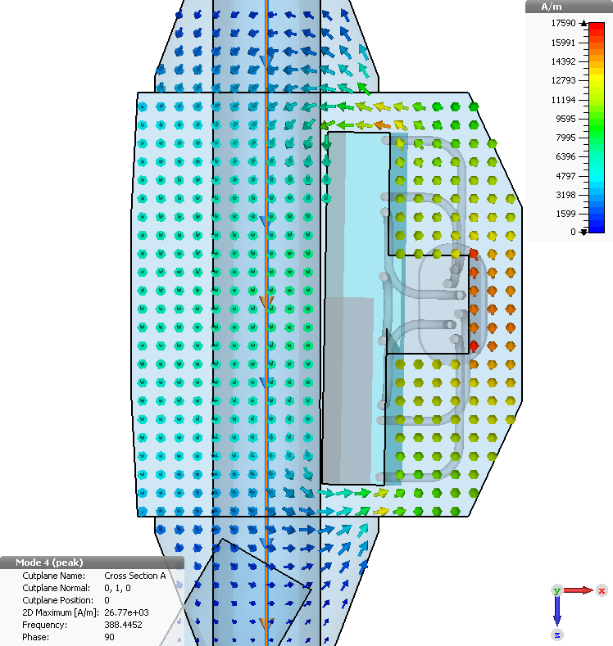
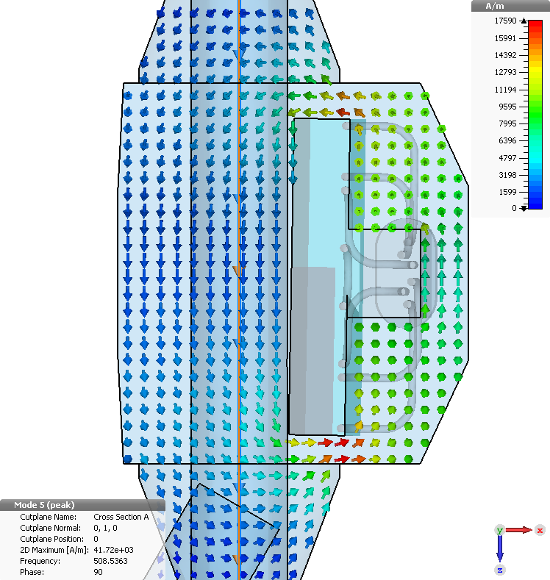
Modes with Cooling Hoses
Mode at 385 MHz
Mode at 540 MHz
E-Field
E-Field
Mode at 352 MHz
Mode at 543 MHz
H-Field
H-Field

Slide 17
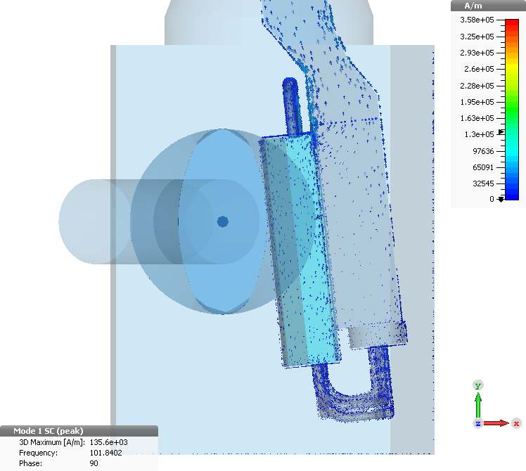
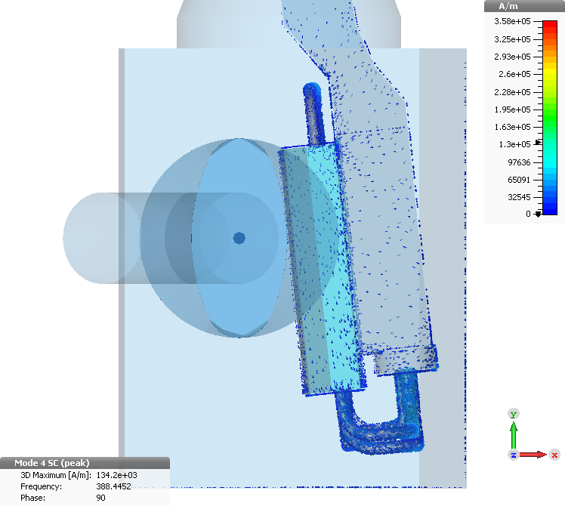
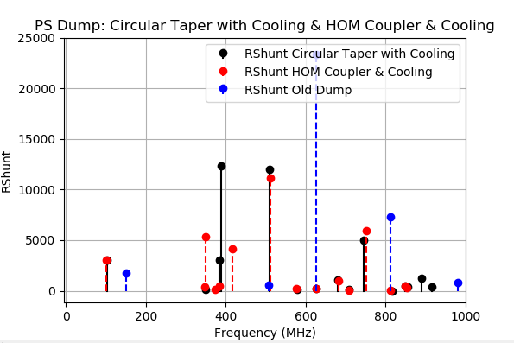
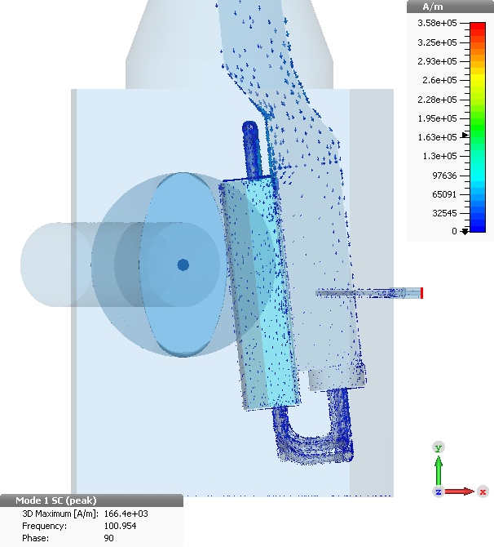
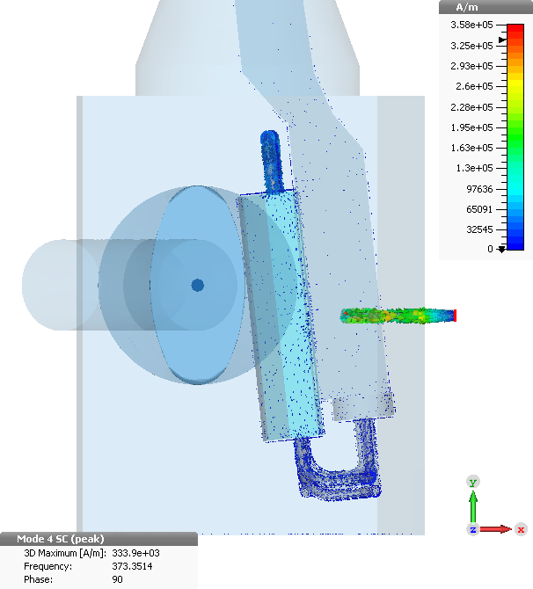
Surface Currents with & w/o Coupling Loops
Mode at ~100 MHz
Mode at ~380 MHz
Cooling tubes are coupling to the mode as well
With Coupling Loops
Mode at 100 MHz
Mode at 380 MHz

Slide 18
Conclusion
Three Possibilities Presented
  Beam Pipe Tapers
    Circular or Complex Elliptical Shape
  Stripline Coupler
  Magnetic Loop Couplers
Magnetic Coupling Loops Give best performance
  In addition to circular beam pipe taper
  Reduce R-Shunt of Problem Modes ( 352 & 540 MHz)
No modification to overall tank geometry to accommodate
Cooling loops are coupling to modes as well
  Further reduction of R-Shunt in all cases

Slide 19
Pathforward
Decision on:
  Circular tapers
  Coupling loop implementation
Time table for impedance measurements of the PS Dump

Slide 20
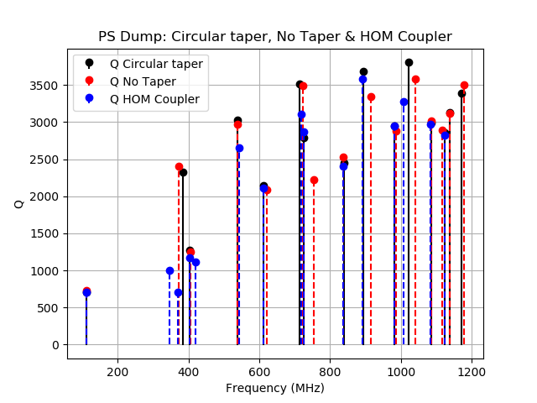


Compare Eigenmode Simulations (No cooling loops)

Slide 21


Simulations with Cooling Tubes
With Taper Design
With Taper Design & HOM Couplers

Slide 22



Comparing Cooling Loops model with & w/o HOM Coupler

Slide 23


Modes with Cooling Hoses
Mode at 385 MHz
Mode at 540 MHz
Mode at 713 MHz
E-Field
E-Field
E-Field
H-Field
H-Field
H-Field

