Slide 1






Beam measurements of the longitudinal impedance, previous measurements and plans
M. Migliorati, H. Damerau, A. Lasheen
LIU - LHC Injectors Upgrade Project

Slide 2
Measurements of quadrupole synchrotron frequency shift (high energy)
zero-amplitude synchrotron frequency
Setup to measure the longitudinal quadrupole beam transfer function.
Example screen shot of amplitude and phase of the quadrupole BTF

Slide 3
Measurements of quadrupole synchrotron frequency shift (high energy)
data from 2012 campaign
X=

Slide 4
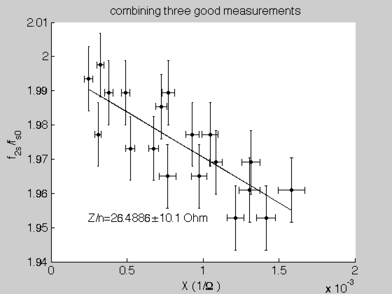
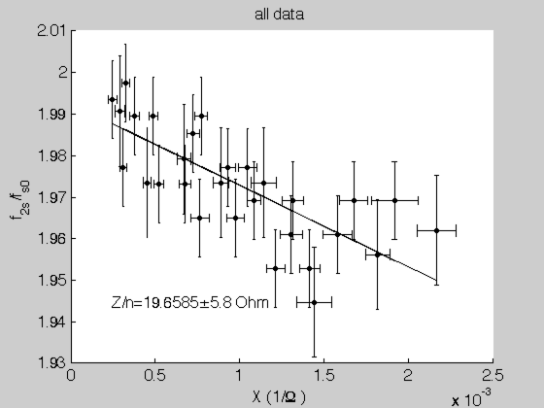
Measurements of quadrupole synchrotron frequency shift (low energy)
Combining several measurements of three MDs, with 180 kV and two different emittances, ignoring few points (two)
combining all measurements of all MDs (90 and 180 kV)
?
Too low? Too high uncertainty

Slide 5
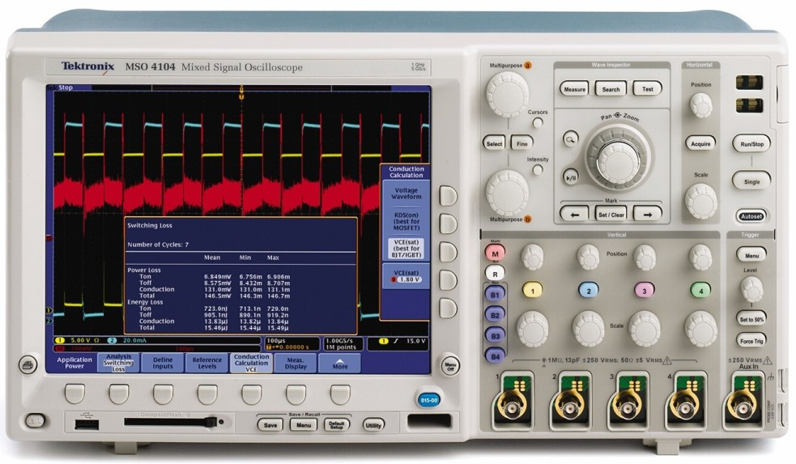
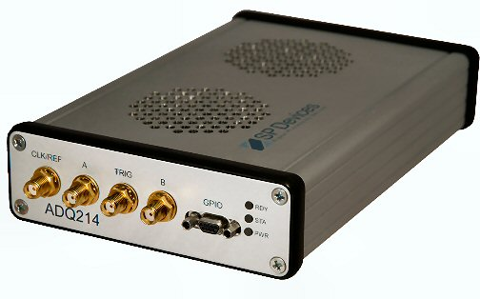
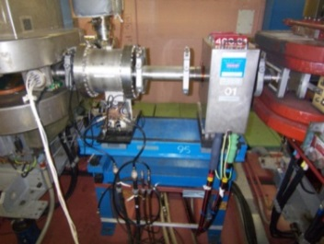
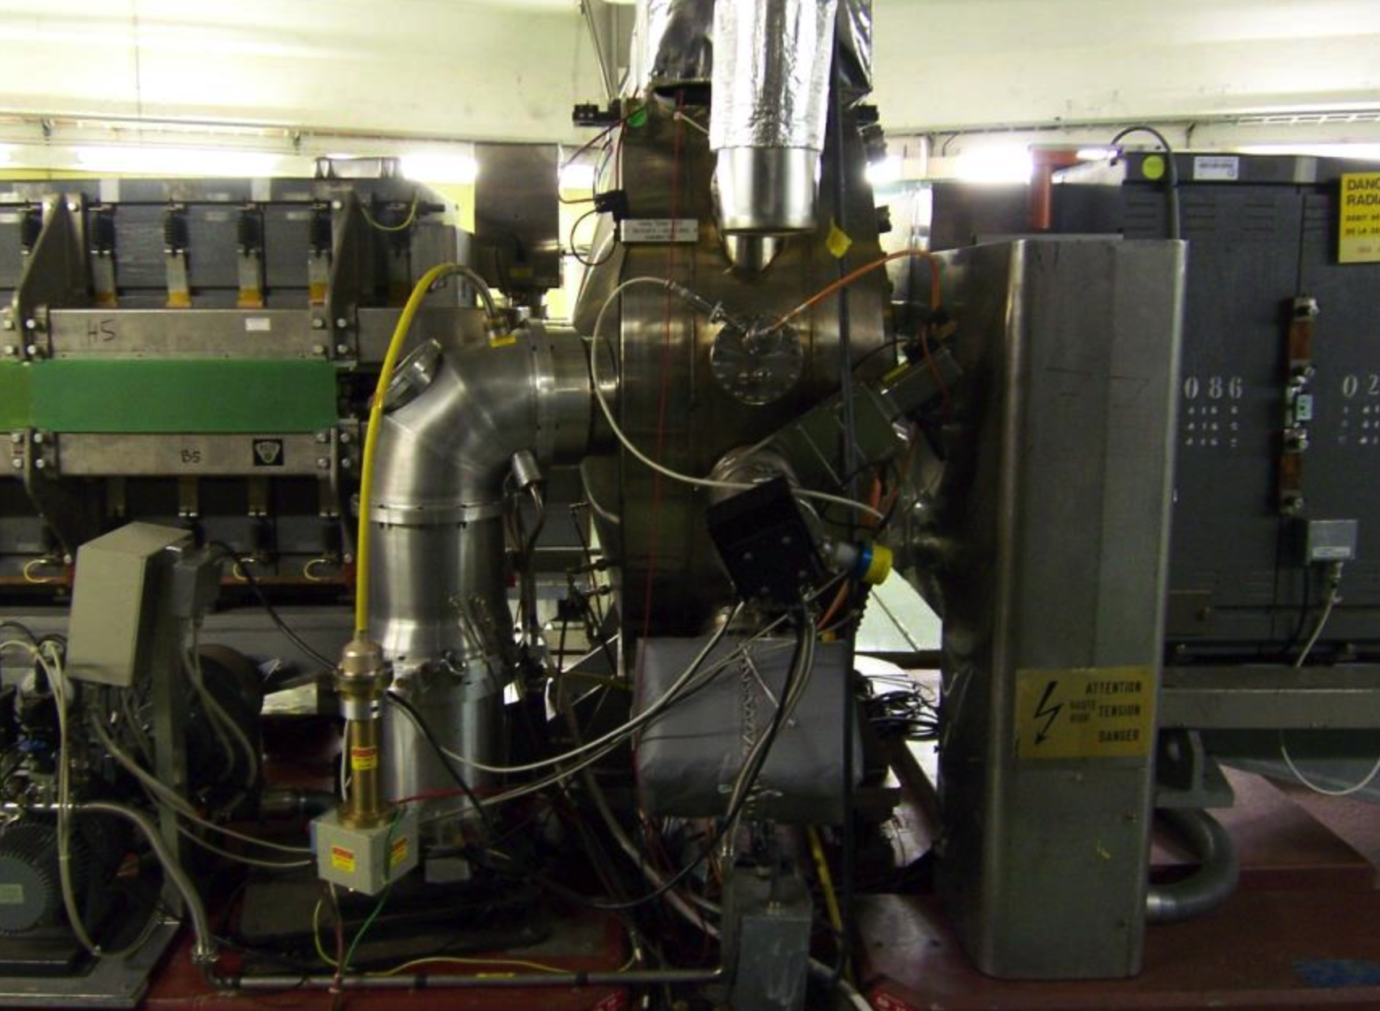
Measurements of synchrotron phase shift
Setup
Oscilloscope
CERN PS
proton machine
ADQ214 Digitizer
CH A
CH B
CH1
CH2
CH3
CH4
We measured the phase shift in two ways:
distance of a bunch with respect to a reference one
time of beam signal with respect to the cavity signal
Beam signal
drive
return
We changed the voltage of the PS Booster blow-up cavity to scan the bunch intensity in the PS.
pickup
40 MHz cavity

Slide 6
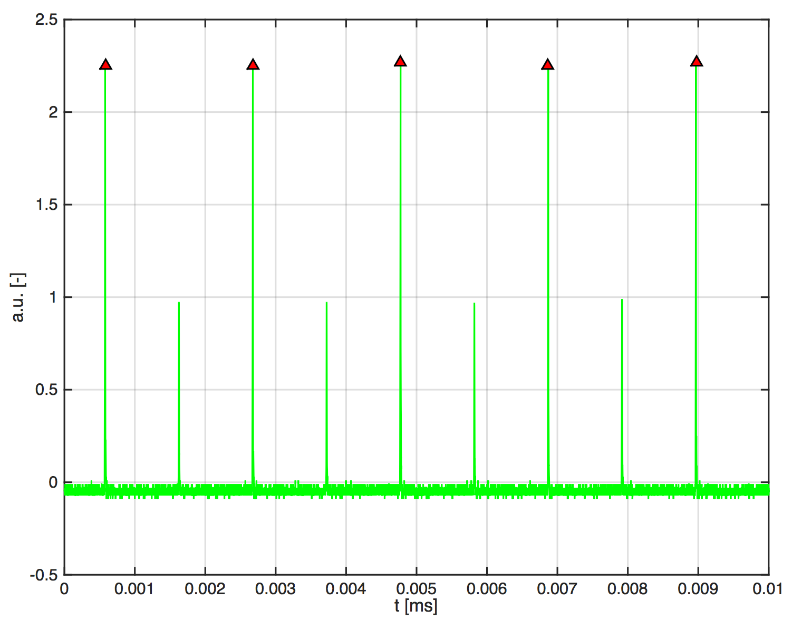
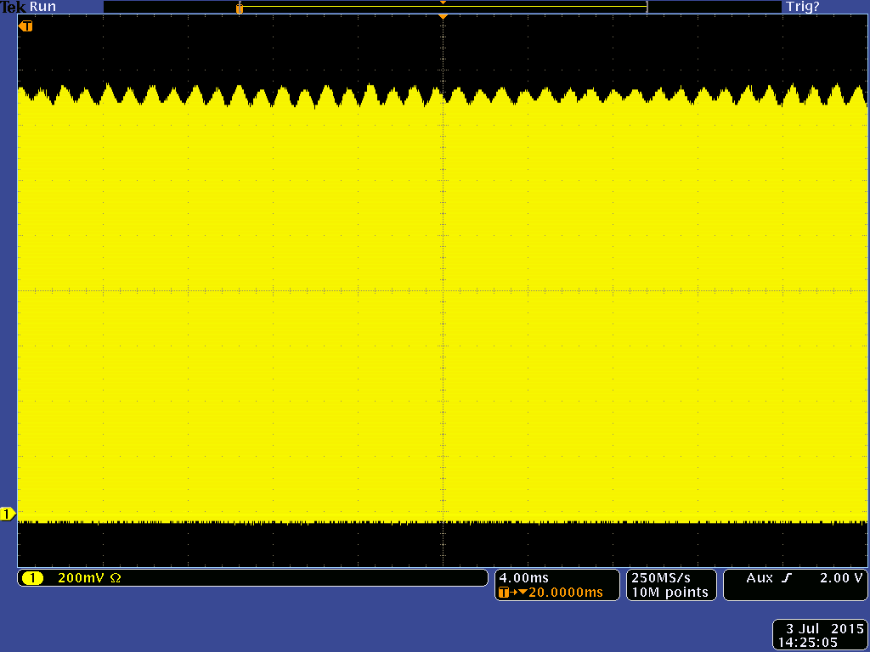
Measurements of synchrotron phase shift
Results
Zoom:
10 μs = few turns
4 ms

Slide 7
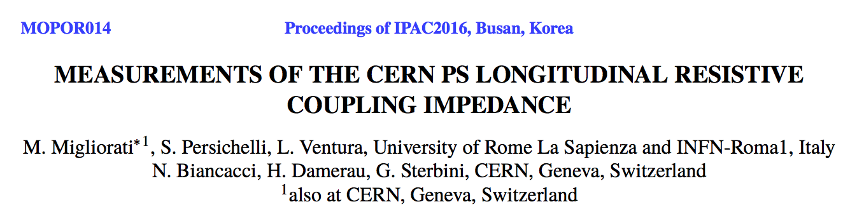
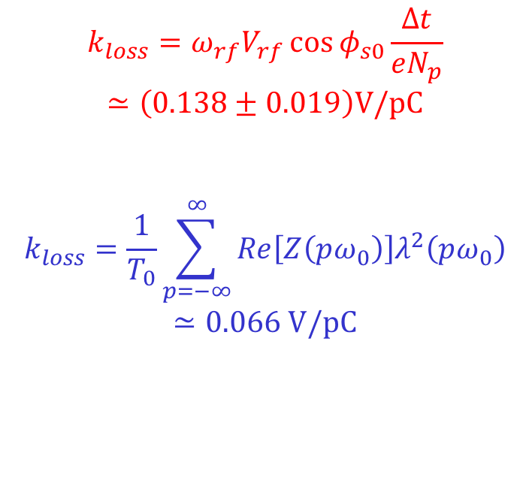
Measurements of synchrotron phase shift
Results at 100 kV
$$k_{loss}=ω_{rf}V_{rf}\cos{φ_{s0}}\frac{Δt}{eN_{p}}$$
$$≃\left(0.138±0.019\right)V/pC$$
$$k_{loss}=\frac{1}{T_{0}}\sum_{p=−∞}^{∞}{Re\left[Z\left(pω_{0}\right)\right]λ^{2}\left(pω_{0}\right)}$$
$$≃0.066 V/pC$$

Slide 8
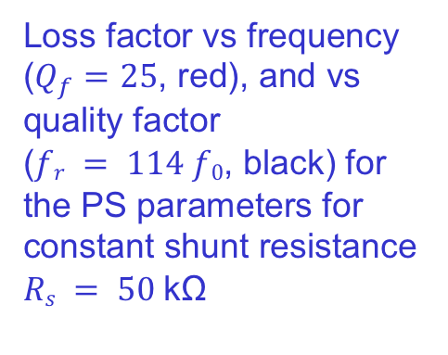
Measurements of synchrotron phase shift
Possible explanation of the discrepancy of measurements and estimation: added HOMs
Loss factor vs frequency ($Q_{f}=25$, red), and vs quality factor
($fr = 114 f0$, black) for the PS parameters for constant shunt resistance $Rs = 50$kΩ

Slide 9
Plans before LS2 and needed beams
Measurements of quadrupole synchrotron frequency shift at high (flat top) and low (flat bottom) energy. We need a single bunch with population up to 4.5x10¹¹ and emittance of 0.3 eVs.
For low energy: just 2.5 GeV or also 1.4 GeV?
Measurements of synchrotron phase shift at high energy. We need two bunches, one used as reference at 2x10¹¹ and the other one with varying intensity up to 4.5x10¹¹. Do we also try lower energies?

