Slide 1
Longitudinal instability threshold for the new internal dump
s
LIU-PS Beam Dynamics WG – 04/04/2018
A. Lasheen
Acknowledgments:
S. Albright, H. Damerau, B. Popovic, E. Shaposhnikova, C. Vollinger

Slide 2
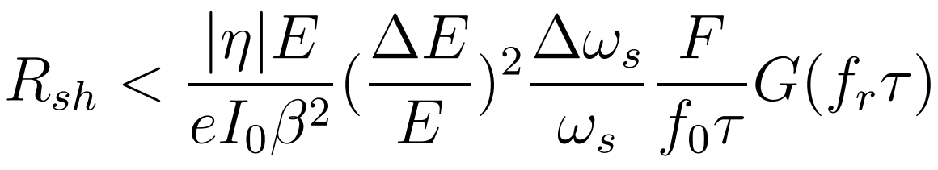


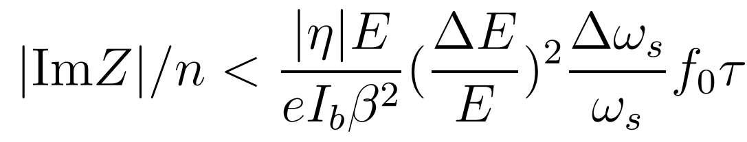
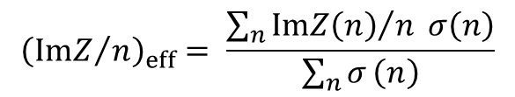
Longitudinal instability threshold
Coupled bunch instability threshold (narrow-band impedance source)
Loss of Landau damping (broad-band impedance source)
Calculated for different beam and impedance configurations along the ramp (to be extended…):
  Flat bottom in h=7
  Plateau in h=21
  Flat top in h=21
  Flat top before double splittings in h=21
  Flat top after double splittings in h=84
$${\left({ImZ}/n\right)}_{eff}= \frac{\sum_{n}{{ImZ\left(n\right)}/n σ\left(n\right)}}{\sum_{n}{σ}\left(n\right)}$$
E. Shaposhnikova, http://cds.cern.ch/record/691957/files/project-note-242.pdf

Slide 3
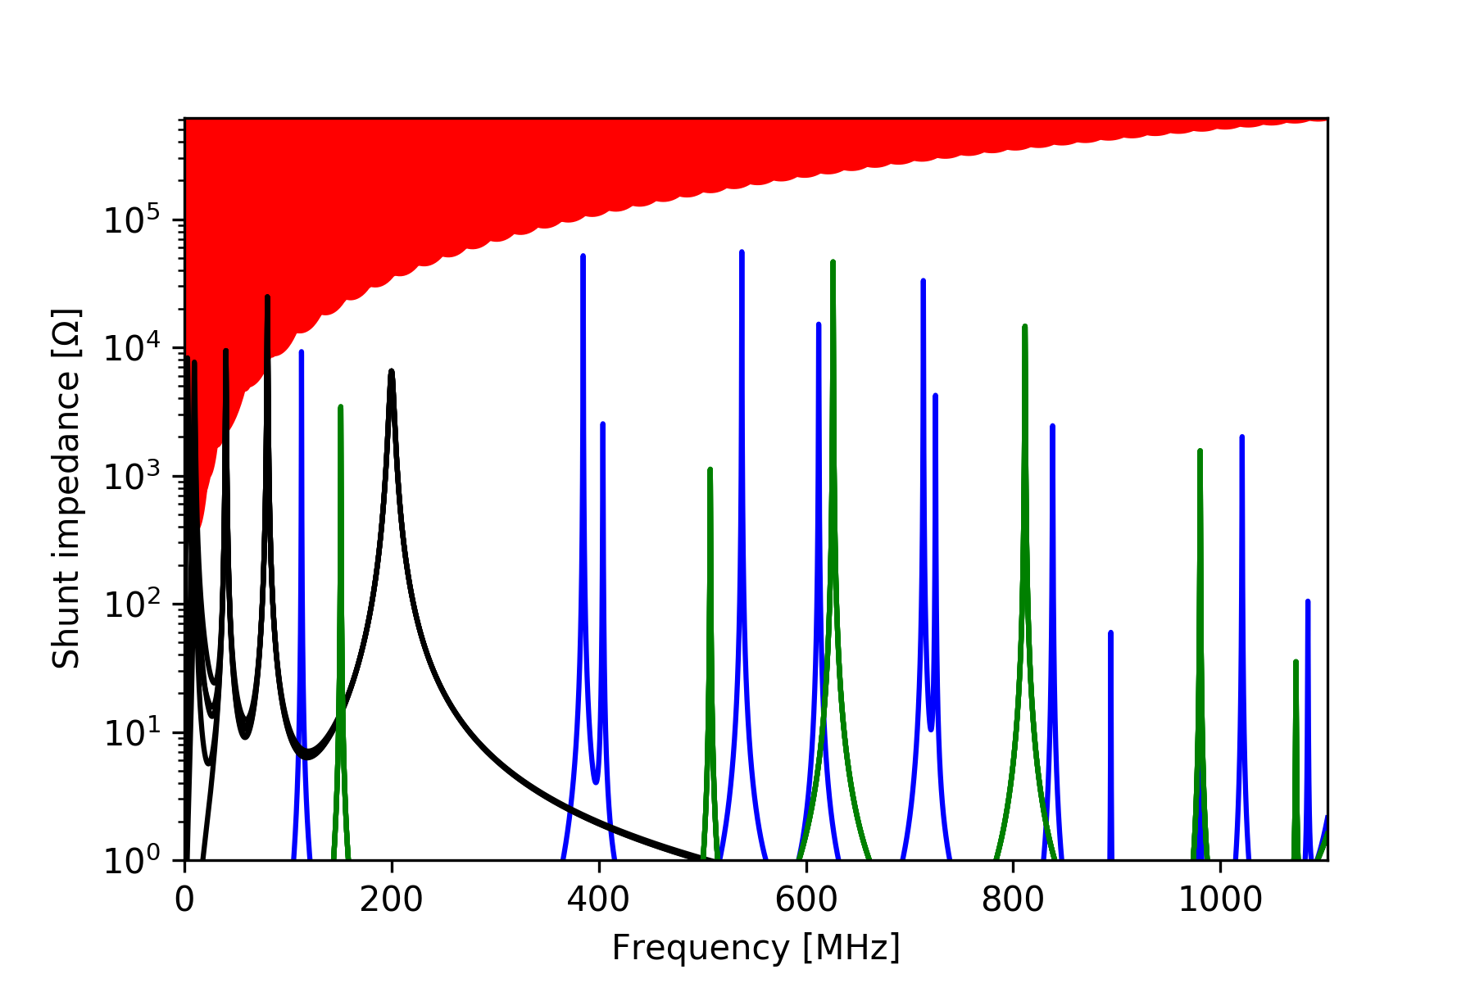
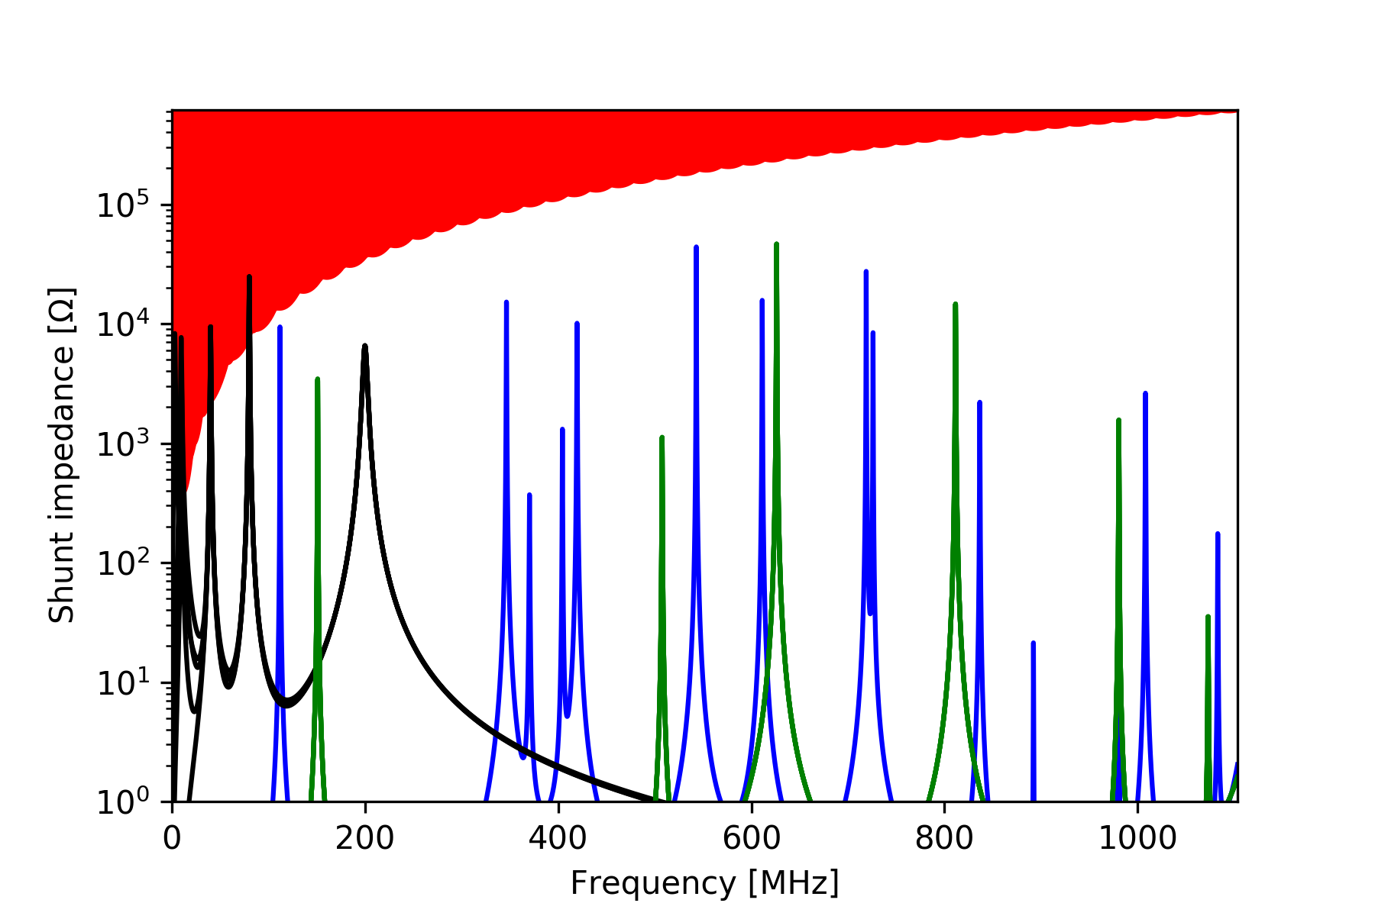
Estimations for the new internal dump
With tapers
With tapers and HOM couplers
Colors:
  Red: Threshold for coupled bunch instability for LIU intensity
  Blue: new internal dumps impedance
  Black: rf cavities
  Green: old internal dumps
The effective reactive impedance for loss of Landau damping is small: ~ 0.1 Ohm (wrt to a present budget of ~20 Ohm at top energy). This value is ~twice higher wrt the old internal dumps.

Slide 4
Conclusions
The new internal dump impedance remains below the instability threshold for the LIU intensity, but not with a large margin
The HOM couplers allow to give more margin to the modes around 400 MHz
The mode at 113 MHz cannot be coupled by the HOM couplers and is the closest mode to the threshold for coupled bunch instability
Analytical estimations for the microwave instability threshold are ongoing

