Slide 1
Polarized target status
10/4/2018

Slide 2
Outline
Magnet commissioning status
- commissioning items
- new field rotation procedure
Pump room intervention
Target loading schedule and preparation

Slide 3
 |  | Magnet Commissioning in 2018
20/3 | MSS Trim | Quench back heater for trim coils, control currents
20/3 | Solenoid | Power ON (10 A)
21/3 | MSS Sol | Slow discharge of solenoid
21/3 | MSS Dip | Slow discharge of dipole
22/3 | MSS Sol | Quench back heater for solenoid, fast discharge at 70 A (6 times)
22/3 | MSS | Resistance of current leads without helium flow
28/3 | Sol | Full current of 646 A
28/3 | Dip | Full current of 590A
28/3 | Sol | Stability test
29/3 | Dip | Stability test
29/3 | MSS | Safety for filed rotation (Logics of “Tiroir de Securité” ) until 4/4
9/4 - | Sol Dip Trim | Present field rotation procedure (longitudinal ←→transverse)
 | Sol Dip Trim | New field rotation procedure (longitudinal ←→transverse)
 | Sol Trim | TE mode procedure (should be finished until 20/4 )
 | Sol Dip | Long stability test by power convertor team NEW request
 | Sol Trim | Field homogeneity with material

Slide 4
Other issues on the commissioning
Modification
- voltage monitoring cards for current detection (23/3)
- new MSS program
- new power convertor control system (4/4)
- new script for filed rotation (5,6/4)
Magnetic filed warning sign
Magnet field direction
- sol : + current → point to downstream
(opposite from 2015)
- dip : + current → point to up

Slide 5
Trim coils operation in 2015
+650 A
Dipole current
Time
Solenoid current
-650 A
Trim coils setting
+
0
-

Slide 6
Trim coils operation in 2015 (Transverse mode)
Dipole current
+650 A
Solenoid current
0 A
Time
Trim coils setting
+
0
-

Slide 7
New trim coils operation in 2018 (Field rotation mode)
-- scenario 1
Dipole current
SMC procedure
+650 A
0 A
Time
Solenoid current
-650 A
Trim coils setting
+
0
-

Slide 8
Trim coils operation in 2018 (Transverse mode)
-- scenario 1
Dipole current
+650 A
Solenoid current
0 A
Time
Trim coils setting
+
0
-

Slide 9
MSS for field rotation
Dip
+465 A
Sol Dip
+80 A
-236 A
-
+236 A
-135 A
+135 A
Sol
-80 A
Done
-465 A
To be checked
Allowed region by MSS

Slide 10
Pump room intervention
15/11 : Intervention started.
(3 weeks in the first planning)
19/1 : Scaffold was removed.
4/4 : started installation of missing 3 valves
and electrical connections
9/4 : operation test

Slide 11
Target loading schedule and preparation
17/4 Tue : target loading
16/4 Mon : loading platform installation
- LN2 bath, two LN2 dewars, leak detector
20/4 Fri : loading platform removal
21/4 Sat – 24/4 Tue : TE calibration
LN2 order
Gerhard will arrive on Monday.
The 221 door will Keep key access.
Scaffold for He3 pumping line installed on Monday

Slide 12
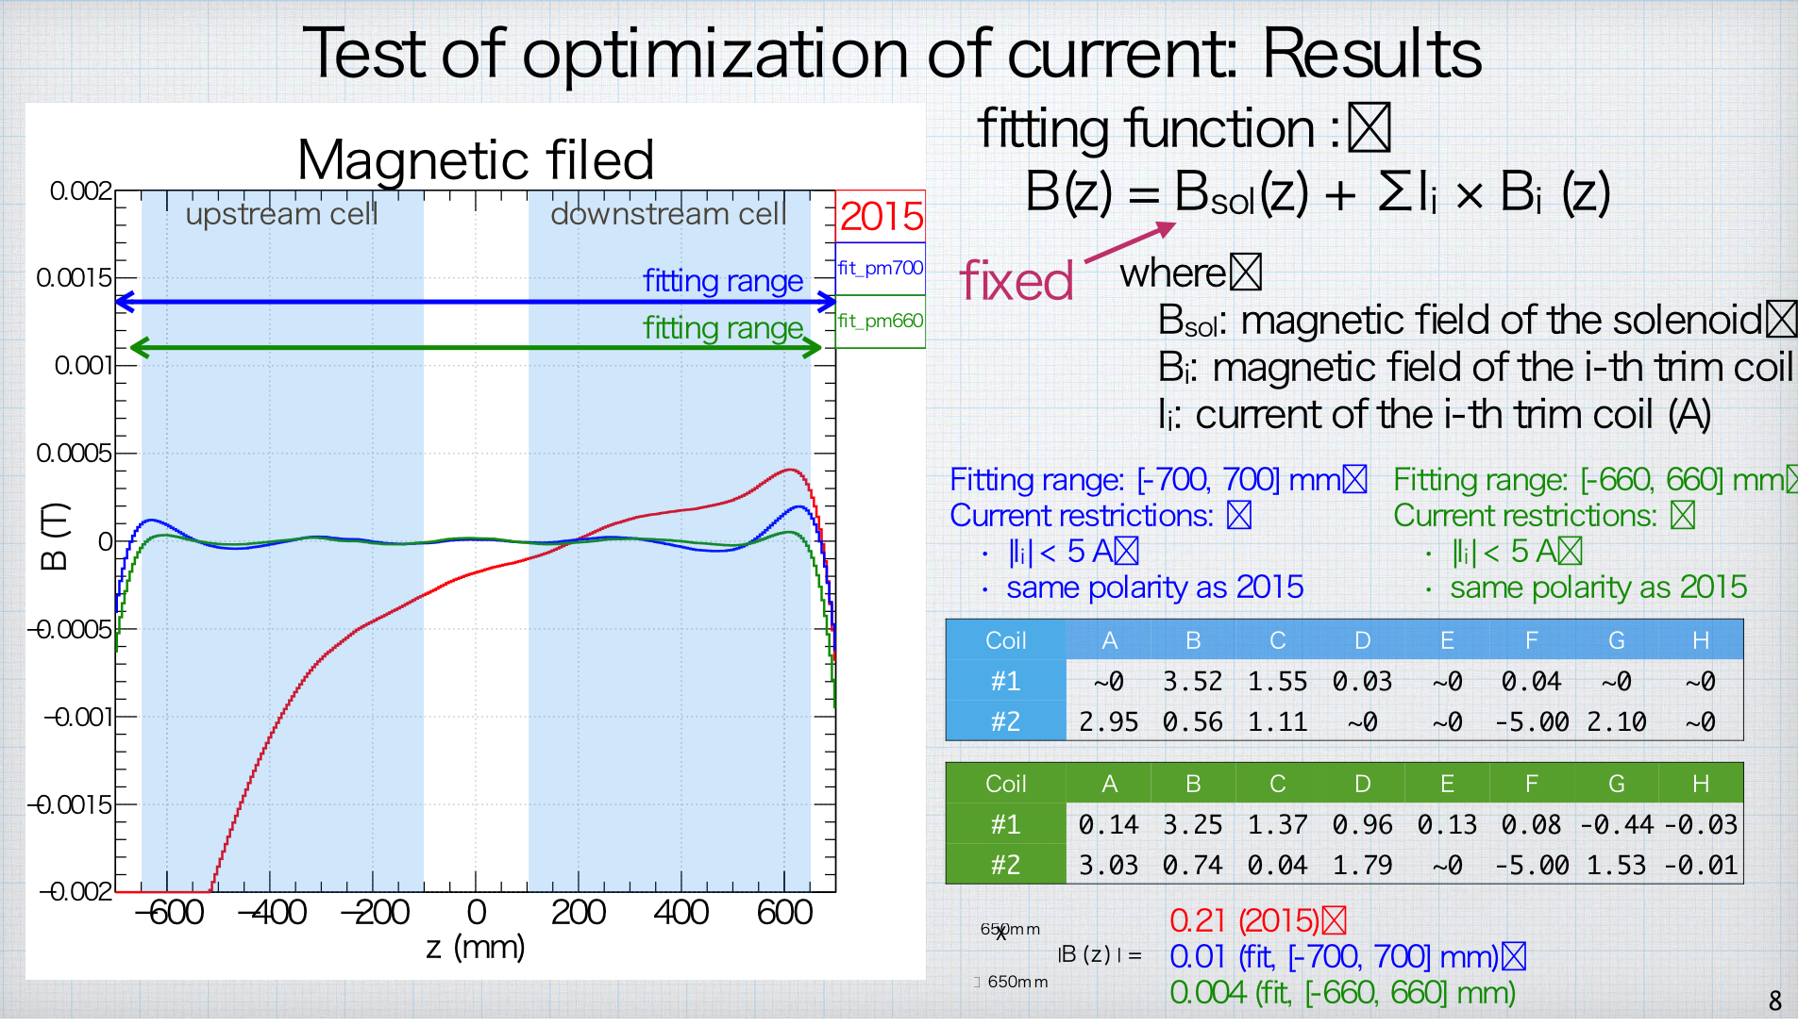
Genki’s Calculation of the filed homogeneity with trim coils

Slide 13
Produced by Caroline

