Slide 1

The HiRadMat Facility
Overview and Perspectives for Post LS2
F. Harden (on behalf of the HiRadMat Team)
CERN
1

Slide 2
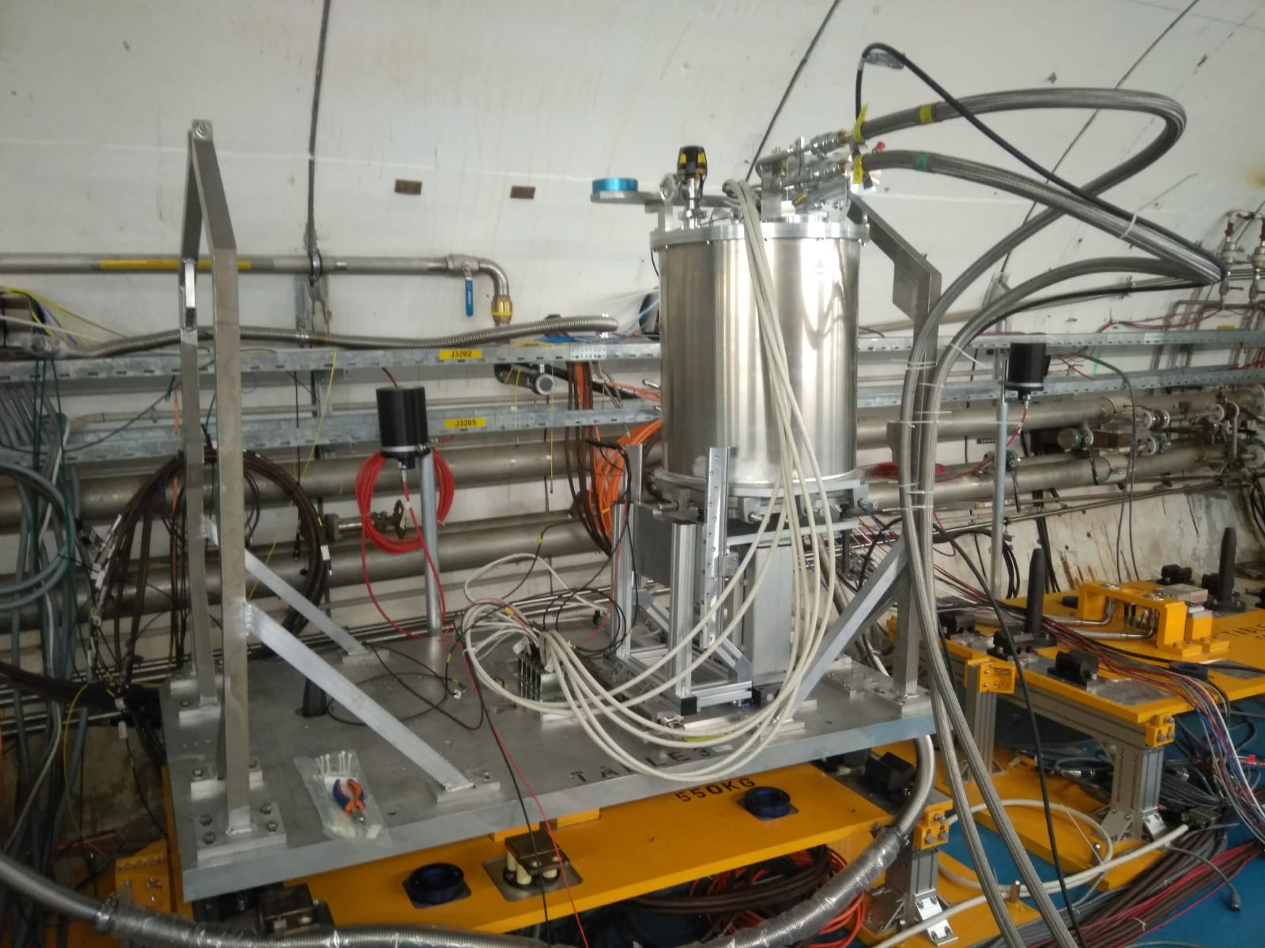
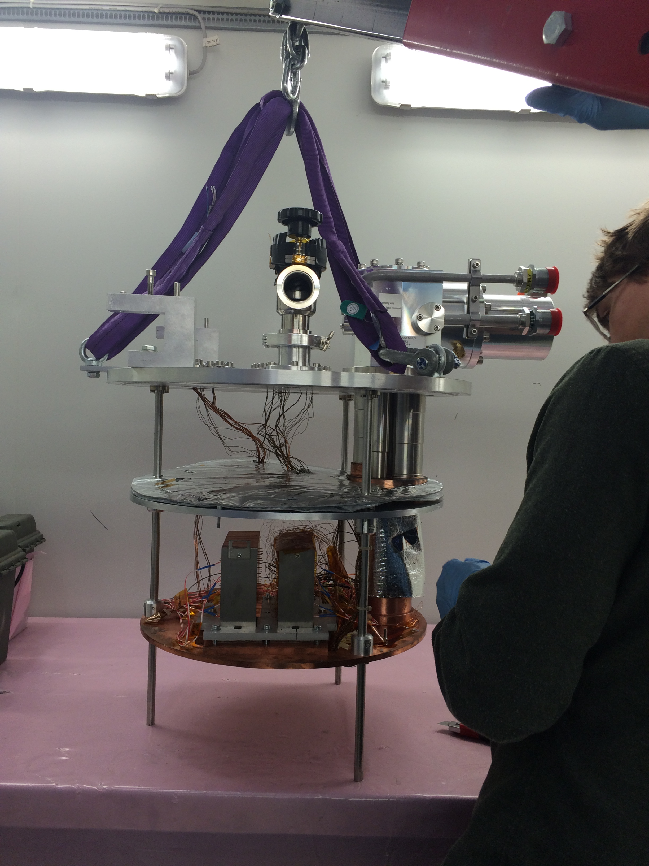
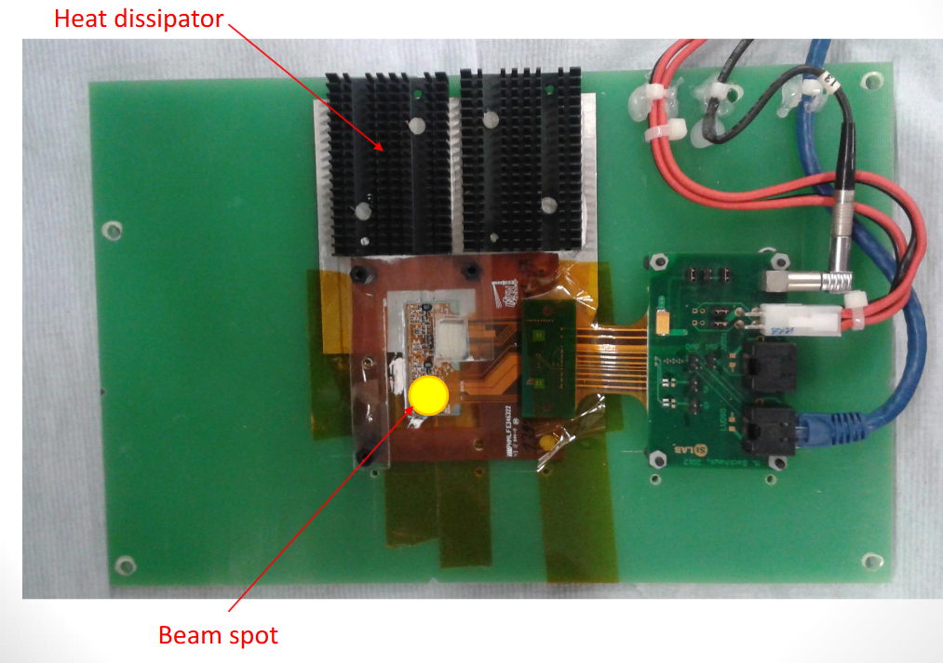
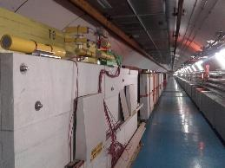
HiRadMat at a Glance
SextSc investigated damage limits of superconducting magnets, via use of cryostat to reach temperatures ~4K.
Originated from the LHC Collimation Project, due to requirements for a facility capable for “testing accelerator equipment with beam shock impacts¹ using high power LHC type beams²”.
The High Radiation to Materials (HiRadMat) testing facility took its first beam in 2012 and has continued to deliver pulsed, high intensity, LHC-type beam to over 40 experiments.
ATLAS investigated radiation hardness and damage threshold of pixel tracker detectors.
BLM2 studied the signal linearity and response, calibration, saturation and comparison of different types of Beam Loss Monitors
¹ http://lhc-collimation-project.web.cern.ch/lhc-collimation-project/HiRadMat.htm
² R. Assmann et al., “User Requirements for a Test Facility with High Power LHC Type Beam”, 2009, EDMS No: 1130296
2

Slide 3
Fundamental Details
Irradiation Facility for R&D using pulsed high energy, high intensity, proton (& ion beams).
Facility has, so far, completed experiments on materials, equipment, prototype, detectors, instrumentation and cryogenic testing.
HiRadMat Proton Beam
Beam Energy | 440 GeV
Pulse Energy (max) | 2.4 MJ
Bunch Intensity | 5.0×10⁹ to 1.2×10¹¹ protons
Number of Bunches | 1 to 288
Minimum Pulse Intensity | 5.0×10⁹ protons (1b at 5.0×10⁹ ppb)
Maximum Pulse Intensity | 3.5×10¹³ protons (288b at 1.2×10¹¹ ppb)
Pulse Length (max) | 7.95 µs
1 σ r.m.s. beam radius | 0.5 to 2.0 mm (standard) [0.25 to 4.0 mm currently upon request]
Total allocated protons/year into facility | 1.0×10¹⁶ protons (equivalent to approx. 10 experiments per year)
3

Slide 4

ARIES – Transnational Access
Provides funding as part of the European Union’s Horizon 2020 Research and Innovation Programme.
Part of WP10 (Materials Testing).
Project started in 2017.
4000 Transnational Access hours completed (2700 during EuCARD-2).
  2017
  50% of 2017 experiments applied for TNA:
  HRMT19: BLM2 (ESS, Lund, Sweden).
  HRMT41: ATLAS pixel (INFN Genova, IFIC Valencia, CAS China, PNPI Russia).
  HRMT21: RotColl (SLAC USA, U. Malta).
  HRMT36: MultiMat (U. Malta, Brevetti-Bizz SME Italy).
  2018
  40% of experiments applied for TNA:
  HRMT19: BLM2 (ESS, Lund, Sweden).
  HRMT47: ATLAS PixRad (INFN Genova, IFIC Valencia, CAS China, PNPI Russia). Linked with HRMT41.
  HRMT38: FlexMat (GSI Germany).
  HRMT43: BeGrid2 (FNAL USA, STFC UK, KEK/JAEA Japan).
4

Slide 5
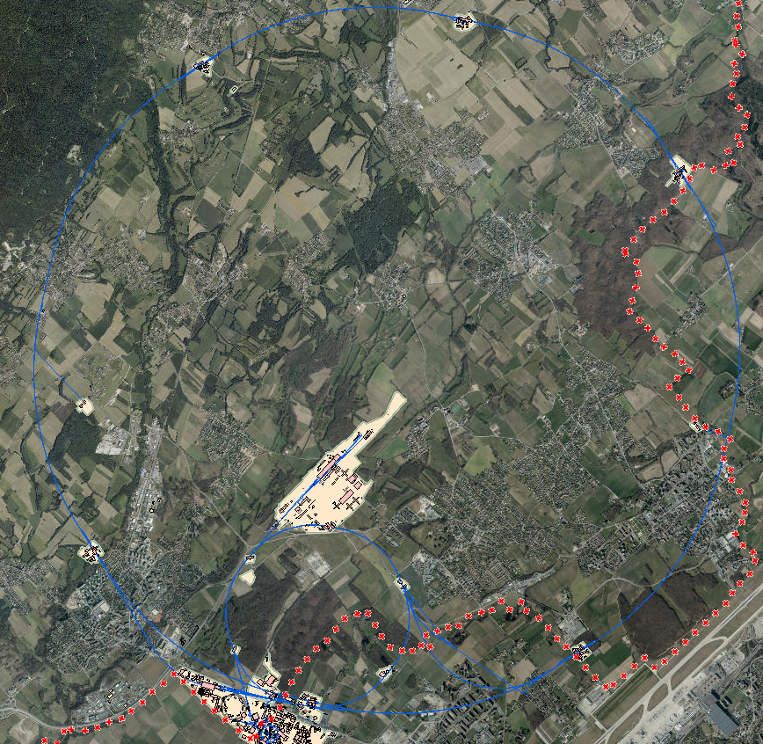
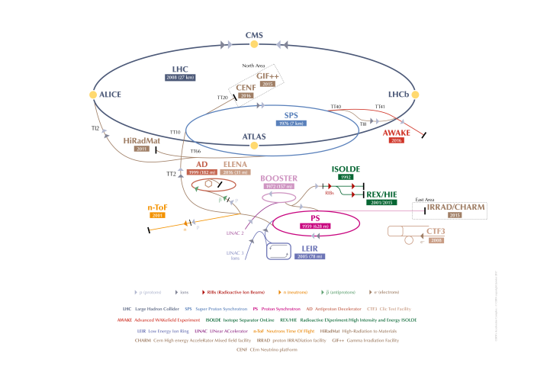
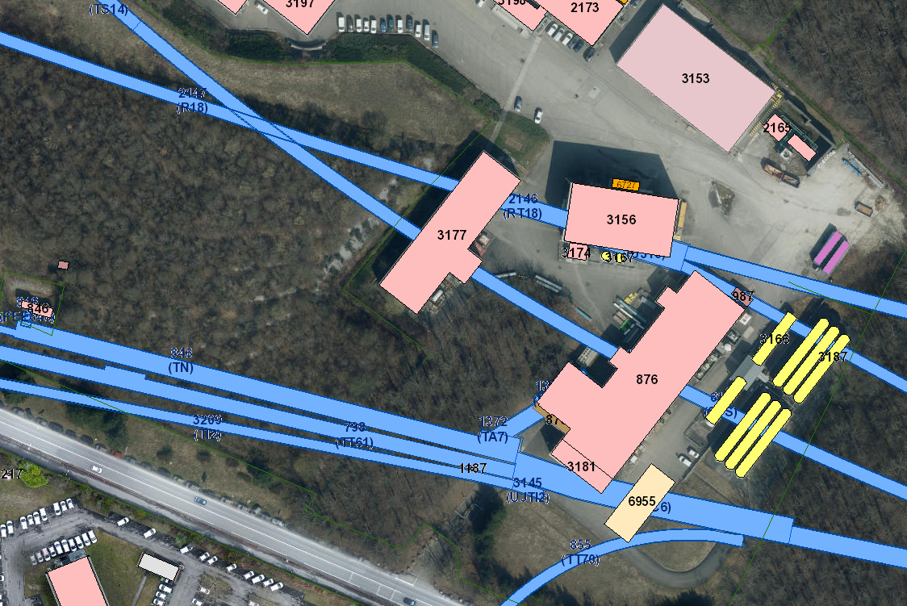
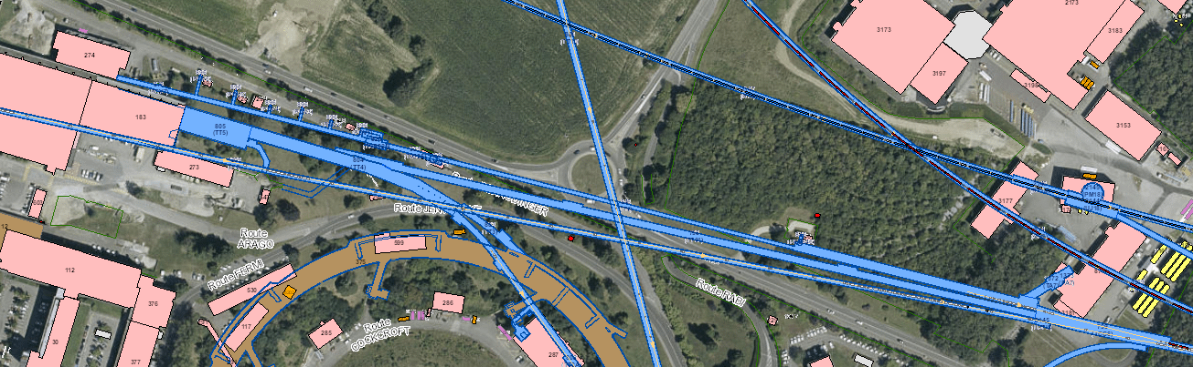
How does HiRadMat fit into the CERN Accelerator Complex?
HiRadMat
5

Slide 6
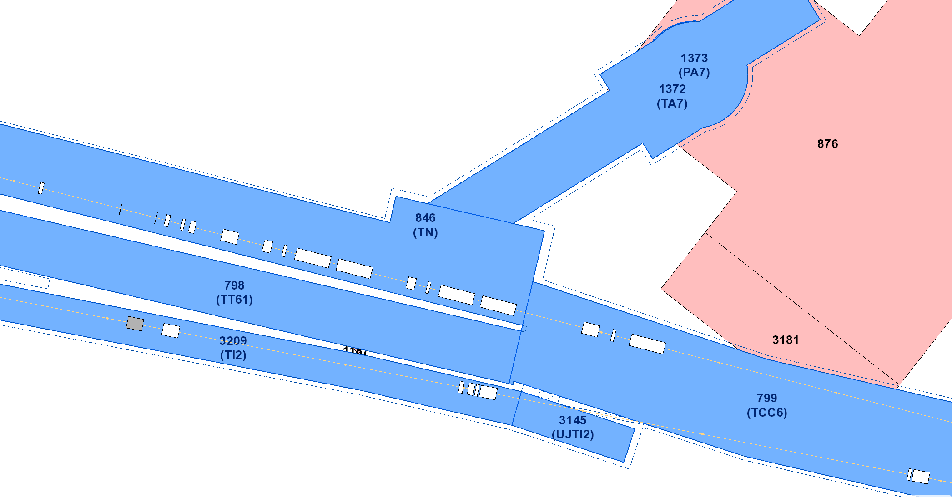
6

Slide 7
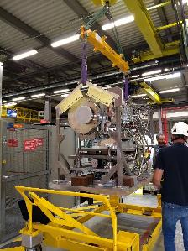
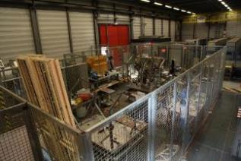
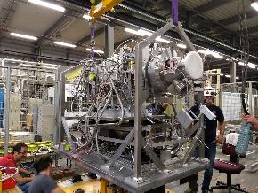
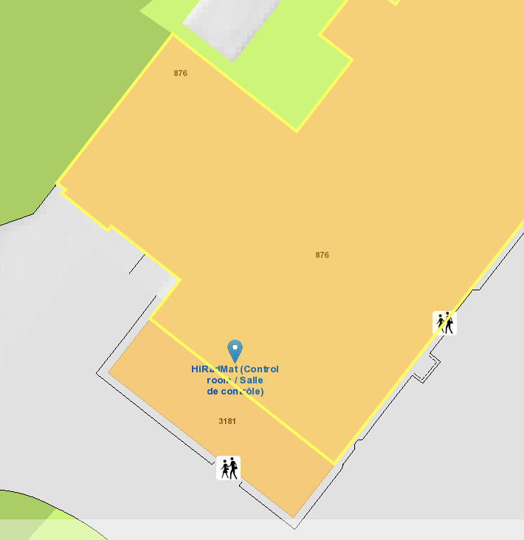
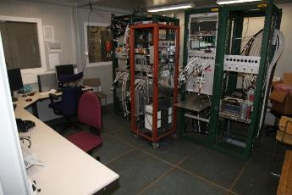
Surface Infrastructure
HiRadMat Surface Lab
Located in bldg. 876/R-017.
Supervised Radiation Area.
Contains laboratory fixed tables enabling pre-commissioning tests on experiments before final installation in experimental area.
Entrance to materials lift shaft to TNC
HiRadMat Surface Lab (~10 m²)
Not to scale – for illustration only)
HiRadMat Control Room
Located in bldg. 876/R-003.
DAQ and offline monitoring systems can be set-up for each experiment.
7

Slide 8
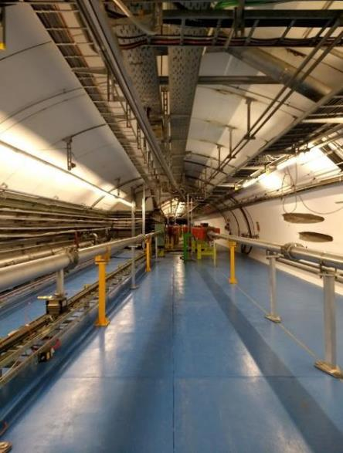
SPS Extraction to HiRadMat
HiRadMat is adjacent to an SPS extraction point to LHC.
All interventions to HiRadMat are dependent upon the LHC schedule resulting in all access being planned, flexible and executed efficiently.
LHC
HiRadMat
8

Slide 9
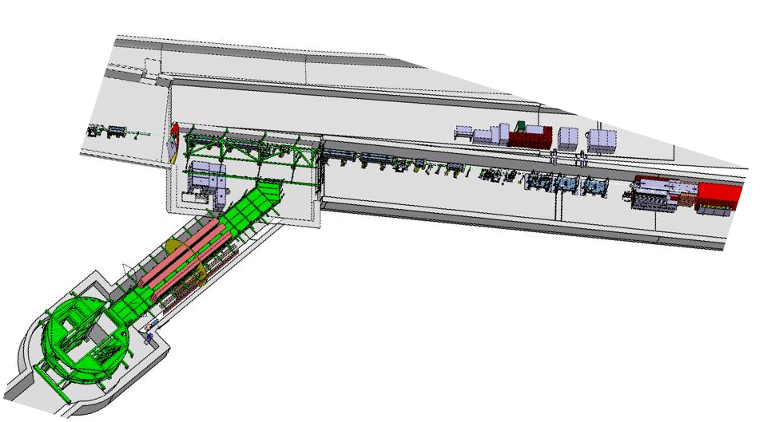
Irradiation Area
LHC Extraction
TT61 – HiRadMat
TJ7
HRM Extraction
TNC – HiRadMat Irradiation area
9

Slide 10
Irradiation Area
TJ7
Shielded area available for additional DAQ systems.
Overhead crane remote system.
Patch panel in signal rack for connections to HRM-Control Room.
Cooling Water connections.
10

Slide 11
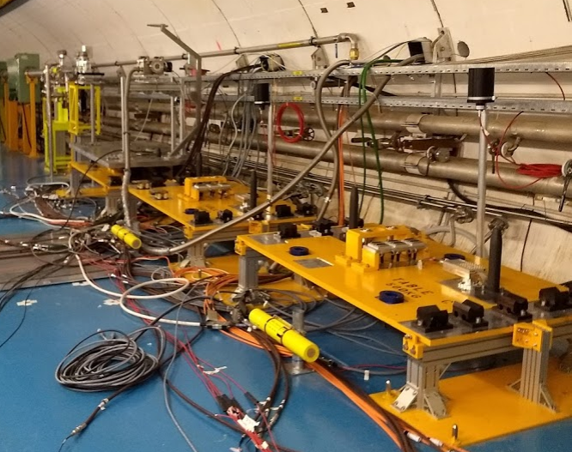
Irradiation Area
TNC
3 Experimental Stands in HiRadMat Experimental Area
Stand A: Dedicated Beam Instrumentation Stand providing beam diagnostics and monitoring systems.
Stand B & C: Dedicated Experimental Stands enabling different optics to be achieved.
Tables are cooled by a cooling circuit (30 kW, 3m³/h, 9bar)
Power provided (4kV / 2.5 kA)
Signal cables (50 V / 2 A) for motorization stages, cameras, etc.
Stand A
Stand B
Stand C
11

Slide 12
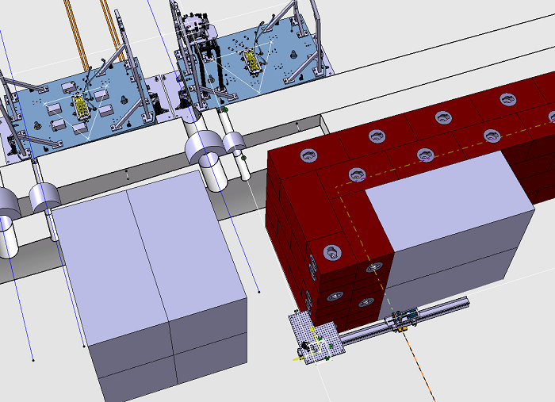
Irradiation Area
TT61
HiRadMat has dedicated feed-throughs into an adjacent tunnel (TT61) where additional electronic and measurement systems can be added. Progress has been made to shield this area from radiation effects.
3D model of feed-through between HiRadMat Experimental Area and Electronics Area.
12

Slide 13
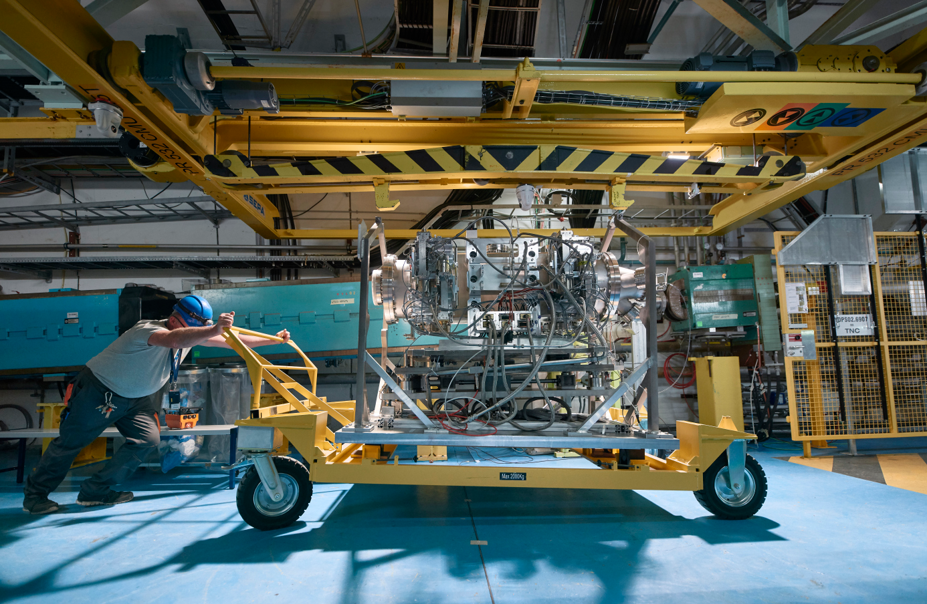
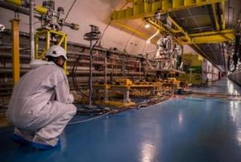
Support for Users
Preparation Phase
All experimental proposals are reviewed for their scientific merit and feasibility by the HiRadMat Scientific Board.
Accepted proposals are then reviewed by the HiRadMat Technical Board where technical aspects, safety files and beam operations are evaluated.
Design Phase
Design and Integration Checks.
Technical Discussions, including safety requirements, on-line monitoring requirements, etc.
Design assistance/production available.
Installation Phase
Access to CERN services from collaborating teams, including, Survey, Mechatronics and Measurements, Mechanical and Materials Engineering, Beam Instrumentation, Handling, Radiation Protection.
Installations into HiRadMat Irradiation Area
13

Slide 14
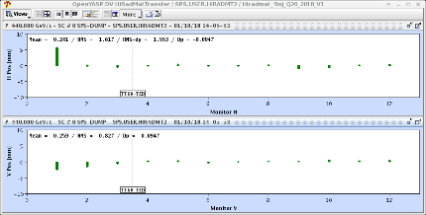
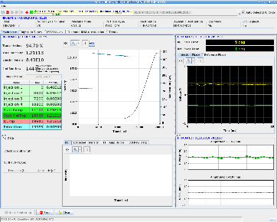
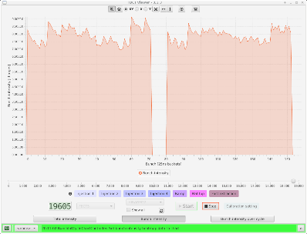
Support for Users
SPS Operation
Colleagues from SPS Operations provides high quality proton (or ion) beam to the HiRadMat experiment. Standard procedures relating to beam trajectory, beam emittance, beam spot size, proton bunch sets, etc. are all completed by the experts during the dedicated HiRadMat beam time.
Example of the HiRadMat proton beam trajectory for 12 bunches delivered to experiment.
Example of the extracted intensity for delivered 144 protons.
Example of quality of bunch-bunch intensity for 144 bunches (2×72 bunches)
14

Slide 15
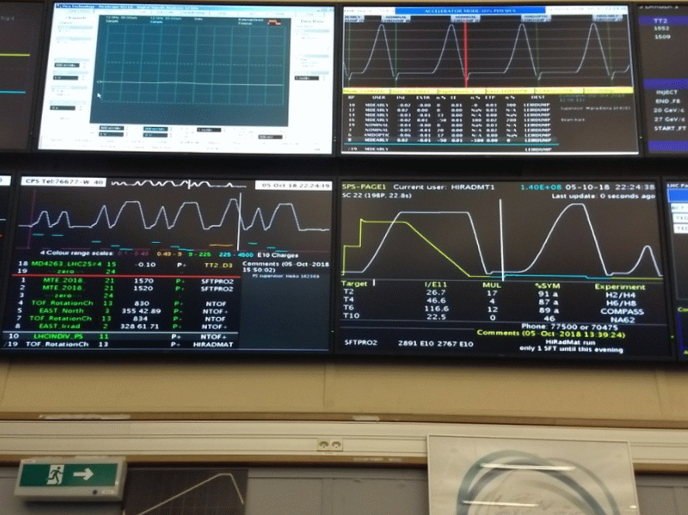
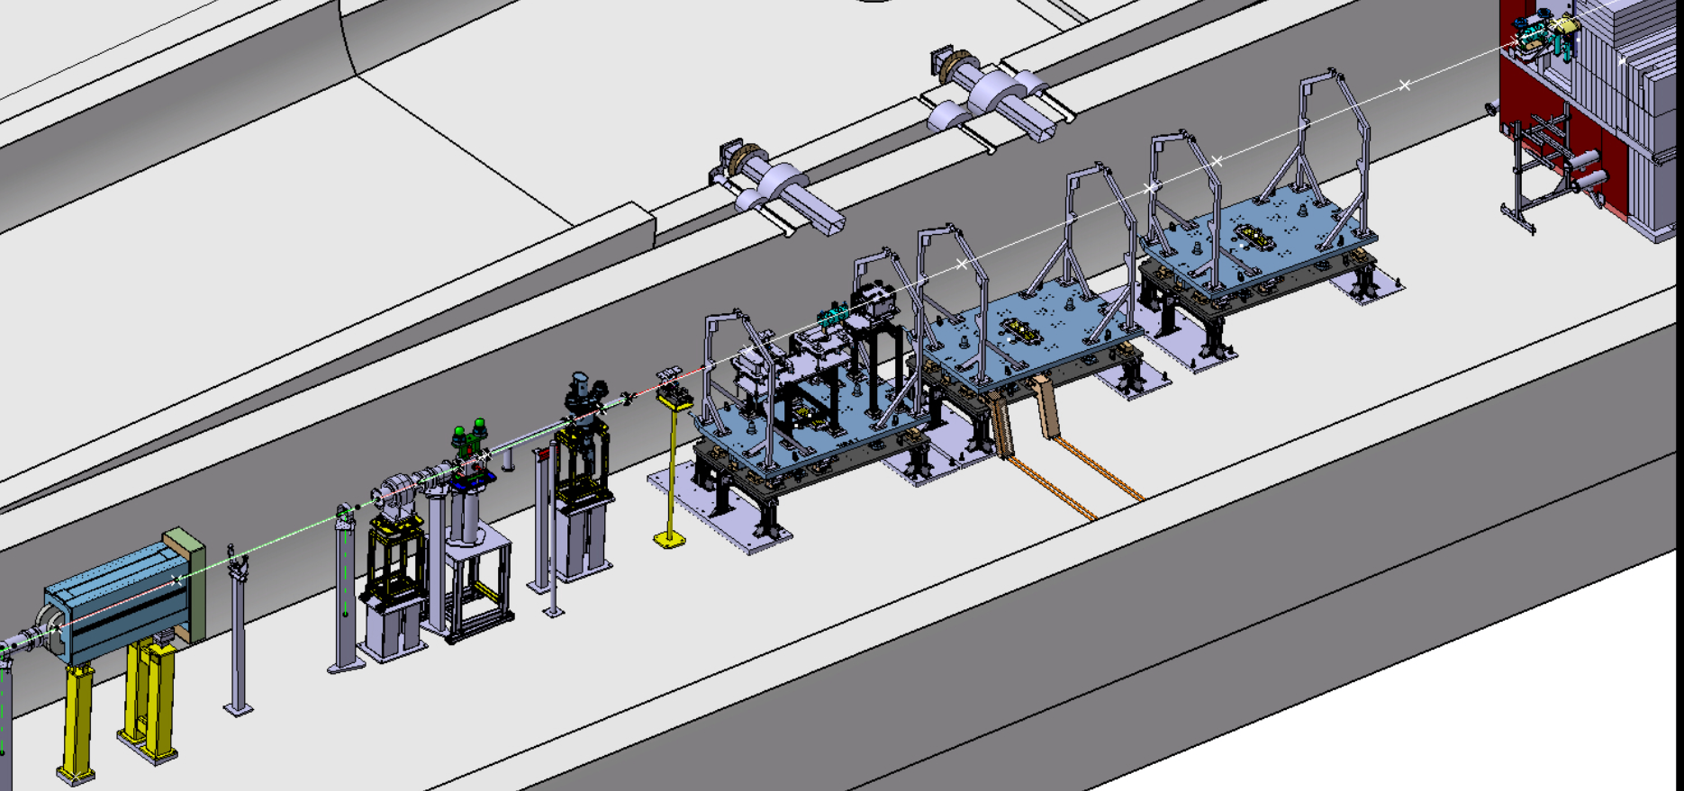
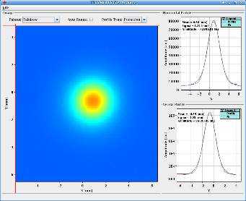
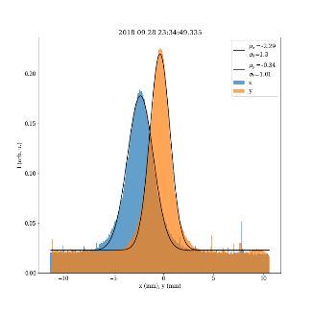
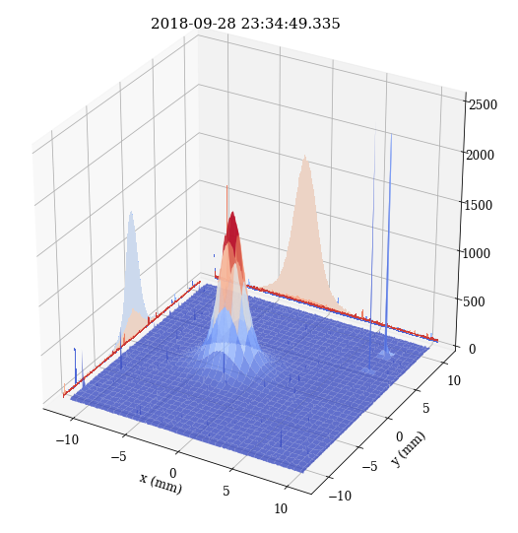
Support for Users
HiRadMat Operation
CERN colleagues available to assist with in situ measurements and monitoring, e.g. LDV, strain gauges, radiation hard camera, experiment motorisation.
Beam diagnostic systems provided through collaboration with HiRadMat and Beam Instrumentation Group.
Data stored and available for analysis after beam time.
Fixed Beam Instrumentation Table, currently includes a Diamond Detector, BPKG and BTV
Image obtained from HRM-BTV
15

Slide 16
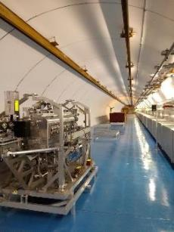
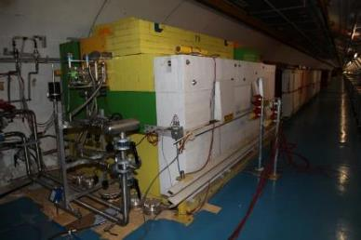
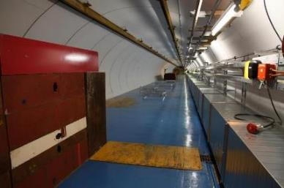
Post-Irradiation/Cool-Down Time
After irradiation, experiments are moved to the HiRadMat cool-down area (usually 1-2 weeks after beam) to enable the integral dose of the experiment to decrease.
After a sufficient cool-down period, Radiation Protection release the experimental container from HiRadMat. It is then transported to an appropriate irradiation facility (as arranged by experimental team) for post-irradiation analysis by the users.
HiRadMat Beam Dump
HiRadMat Cool-Down Area
16

Slide 17
Proven Track Record and Future Planning
Since its commissioning in 2012, HiRadMat has proven its state-of-the-art facilities can be used outside its design remit, with a multitude of novel experiments completed.
The facility has continued to advance to meet user requirements and to provide its facilities to global researchers.
During LS2, HiRadMat will continue to develop with improvements to the following areas:
  Renovation of TNC/TJ7/TT61.
  Electrical Patch Panel installation and cabling checks.
  Renovation of Surface Lab and HRM-Control Room.
  Modifications to HiRadMat Operations Support for better user experience.
17

Slide 18
Facility Expectations and Requirements
HiRadMat is a unique irradiation facility.
Feedback from users regarding requirements, for example:
  HL-LHC type beams?
  Data Acquisition Upgrades?
  Proton/Ion requests?
  Interest beyond accelerator physics?
Goal: To make HiRadMat a world-renowned facility.
BUT..........
18

Slide 19
WE NEED YOU!
19

Slide 20
Request for Letters of Intent
Request deadline 28th February 2019.
LOI to include:
  Scientific Description (executive summary, scientific motivation).
  Technical Description (measurement methods, materials inventory).
  Requests for HiRadMat Support (DAQ systems, in situ monitoring requirements).
  Operational Description (protons/ions, intensity, spot size, etc.)
20

Slide 21

Purpose
Determine interest in HiRadMat for post-LS2 experiments.
Extend collaboration beyond Accelerator Physics Community.
Determine what necessary upgrades are needed to reach out to different communities.
Potential upgrades of the facility if deemed appropriate.
https://indico.cern.ch/event/767689/
21

Slide 22

Further Discussion

Slide 23

Thank you to all teams & groups involved with the HiRadMat operation:
BE/BI, BE/OP, EN/CV, EN/EA, EN/HE,
EN/MME, EN/SMM, EN/STI, HSE/RP, TE/MPE
23

Slide 25
Back-Up Slides

Slide 26
HiRadMat Super Cycle Information
HiRadMat ‘Long’ Super Cycle:
  HRM_LS = 22.8 s, SFTPRO = 10.8 s, MD cycle = 7.2 s (3.6 s potentially depending on planning).
  TOTAL = 40.8 s (or 37.2 s).
HiRadMat ‘Short’ Super Cycle:
  HRM_SS = 8.4 s, SFTPRO = 10.8 s, MD cycle = 7.2 s (3.6 s potentially depending on planning).
  TOTAL = 26.4 s (or 22.8 s).

Slide 27
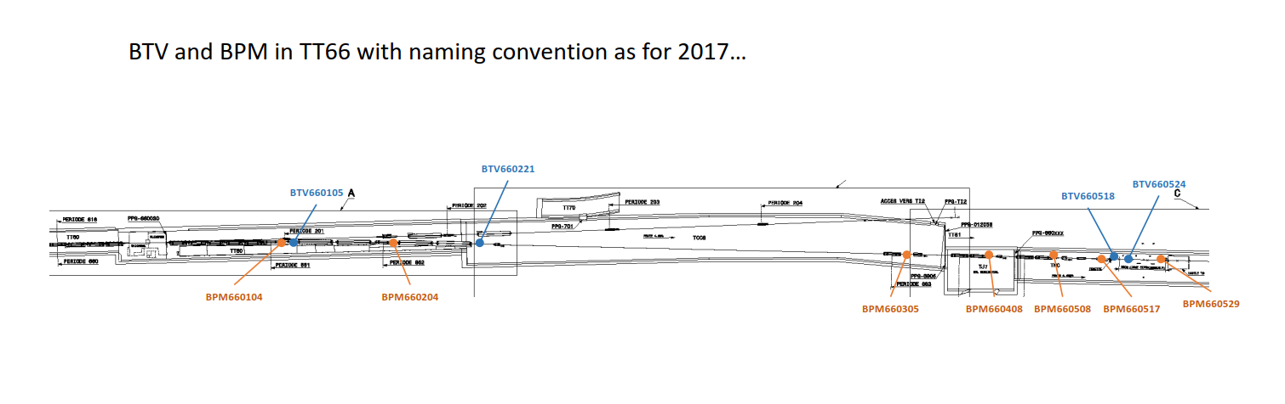
BTV-BLM-TT66 Line

Slide 28
HRM facility layout and access
Access to HiRadMat
  Only without extraction to TCC6 (=TI2 and HRM)
  SPS can continue cycling.
Since 2014: TT61 is used for placing DAQ equipment only 10 m from the impact centre
Access coordinated with BE/OP, particularly in view of LHC operation
  Often stand-by for access during several days
  Great flexibility by RP and TRANSPORT (HE) is highly appreciated.

Slide 29
Access to V0-V7
Muon pits of former WANF
Exposed to muon beam in forward direction of HiRadMat target area
Access to be restricted upon RP request
Access to VO needed about twice a year for intervention by CV
Skipping installation of full-fletched access control system (SPS)
Padlocks with manual veto system like in the North Area
  Agreed by EN, BE and RP (EDMS 1578411)
  Installed by BE/ICS
  Manual veto held by EN/EA
Installation completed, operational from 2016
V6
V0
ISR
HiRadMat

Slide 30
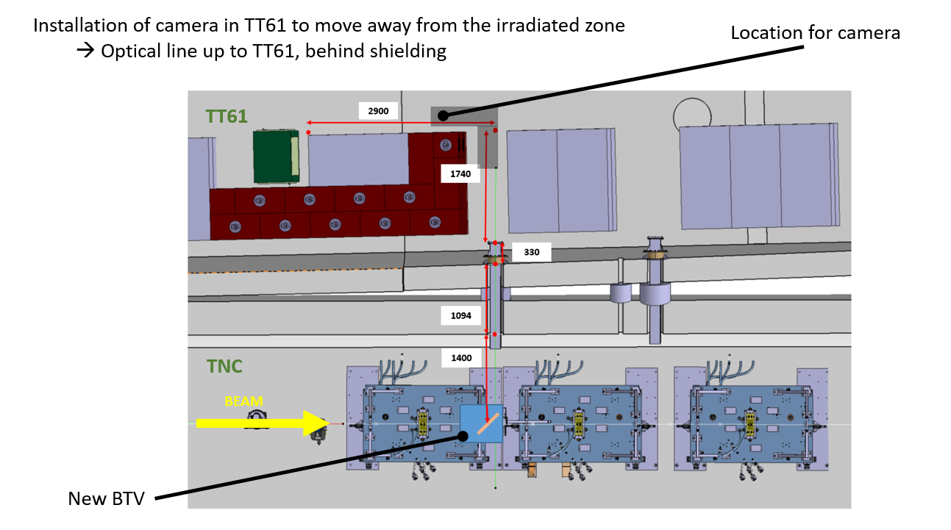
BTV Optical Path

Slide 31
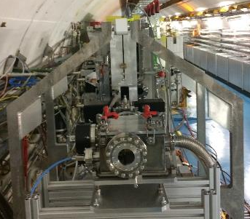
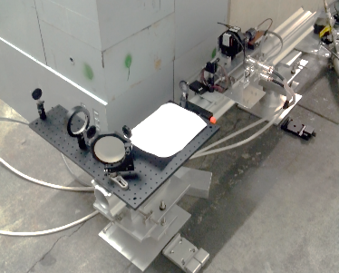
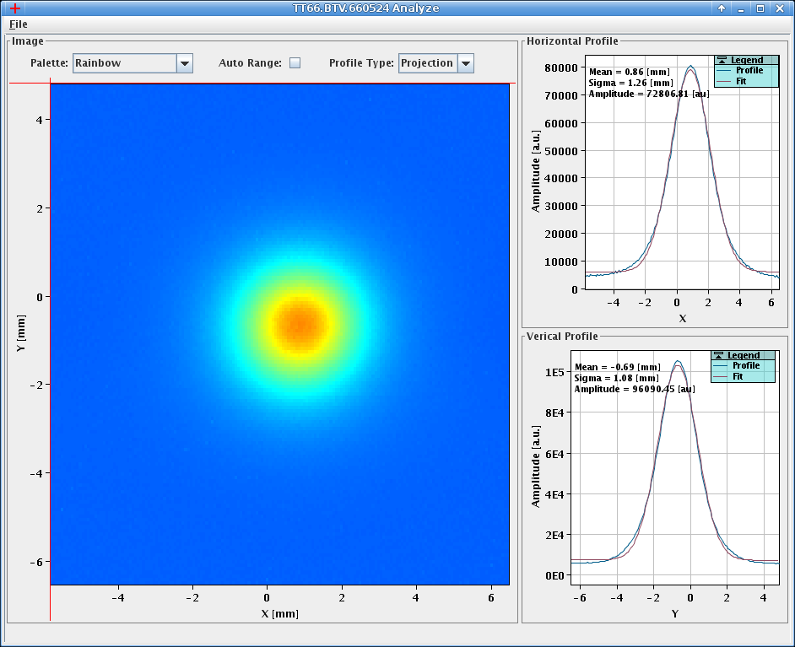
Beam Diagnostic Instrumentation
Photons
Photons
Proton Beam
Beam diagnostic & monitoring equipment
Optical path relating to beam profile capture in adjacent tunnel
Image/Data acquired from the HiRadMat beam diagnostic and monitoring system

Slide 32
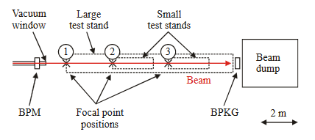
Variable Beam Optics
Optics updated.
Optics currently calculated for beam radii of σ = 0.25 – 4 mm.
HRM beam optics standards 0.5 – 2 mm Table B and Table C (FP2 and FP3 respectively).
Table B (FP2) can achieve optics to as low as σ = 0.25 mm.
C. Hessler et al. “The Final Beam Line Design for the HiRadMat Test Facility”, IPAC’10, Kyoto (2010)

Slide 33
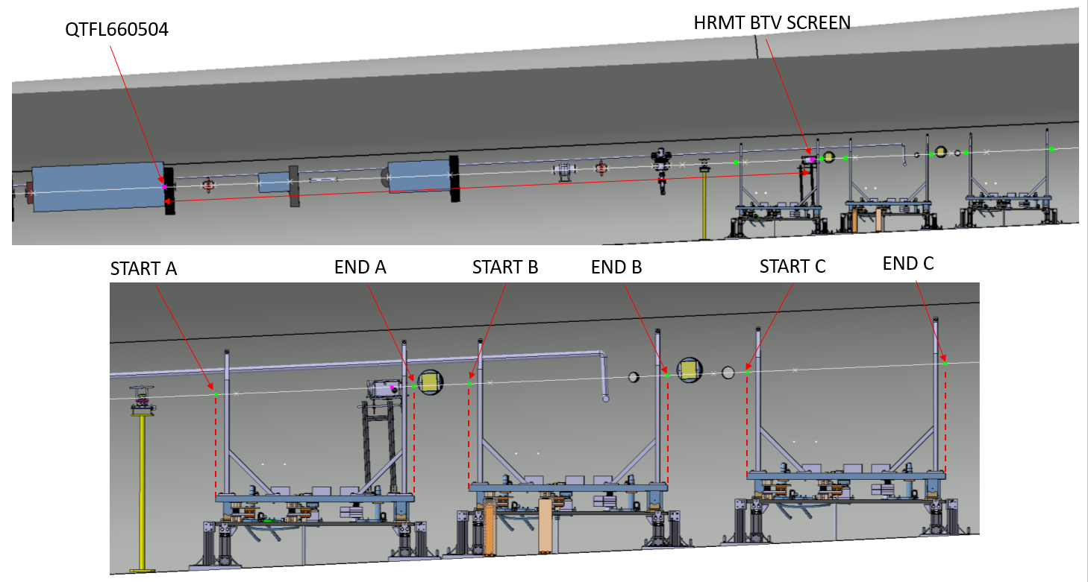
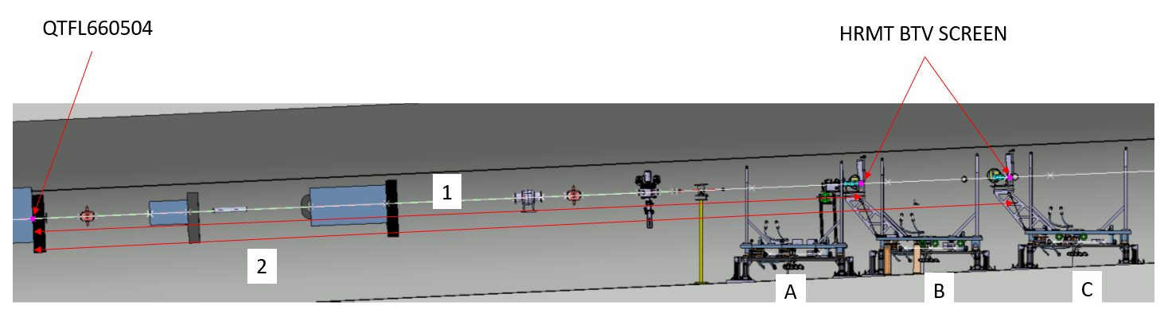
HRM Optics
Courtesy of V. Clerc (EN/EA)

Slide 34
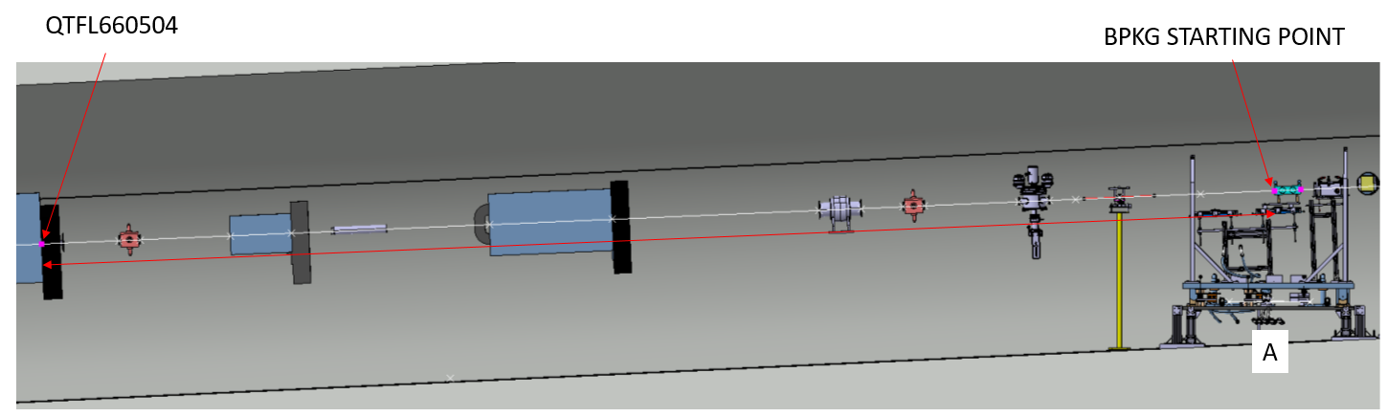
HRM Optics
Courtesy of V. Clerc (EN/EA)
300 mm

Slide 35
HRM Optics Distance Info
Courtesy of V. Clerc (EN/EA)
1 - Exit point of QTLF660504 to start point of table A with respect to an experimental table being installed => 13028.081 mm
2 - Exit point of QTLF660504 to end point of table A with respect to an experimental table being installed => 14979.85 mm
3 - Exit point of QTLF660504 to start point of table B with respect to an experimental table being installed => 15523.081 mm
4 - Exit point of QTLF660504 to end point of table B with respect to an experimental table being installed => 17474.85 mm
5 - Exit point of QTLF660504 to start point of table C with respect to an experimental table being installed => 18259.082 mm
6 - Exit point of QTLF660504 to end point of table C with respect to an experimental table being installed => 20210.85 mm
7 - Exit point of QTLF660504 to the BPKG STARTING POINT on table A => 14072.544 mm
8 - Exit point of QTLF660504 to the HRM-BTV screen on table A => 14762 mm
9 - Exit point of QTLF660504 to the HRM-BTV screen on table B => 15238.427 mm
10 - Exit point of QTLF660504 to the HRM-BTV screen on table C => 17974.402 mm

Slide 36
Ions
HiRadMat Ion Beam (data from 2015)
Beam Energy | 173.5 GeV/nucleon (36.1 TeV per ion)
Pulse Energy (max) | 21 kJ
Bunch Intensity | 3.0×10⁷ to 7.0×10⁷ ions
Number of Bunches | 52
Minimum Pulse Intensity | 3.0×10⁷ ions (1b at 3.0×10⁷ ions)
Maximum Pulse Intensity | 3.64×10⁹ ions (52b at 7.0×10⁷ ions)
Pulse Length (max) | 5.2 µs
Beam size at target | Variable around 1 mm²

Slide 37
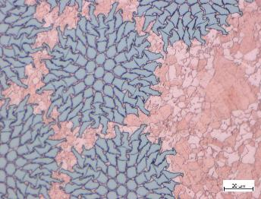
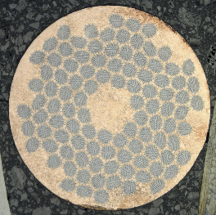
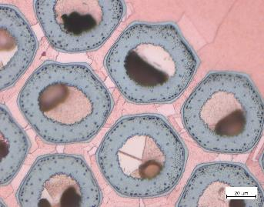
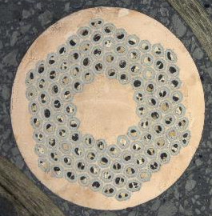

Superconducting wires/ tapes
Courtesy of A. Will
Nb-Ti strand (LHC)
Nb₃Sn strand (HL-LHC)
HTS tapes (future acc. magnets..?)
Image from C. Senatore, CAS Zuerich 2018
Image courtesy M. Meyer, CERN

Slide 38
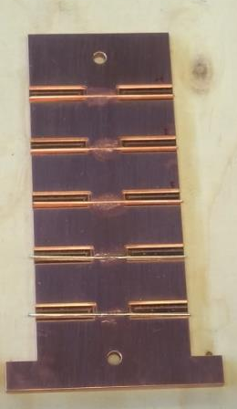
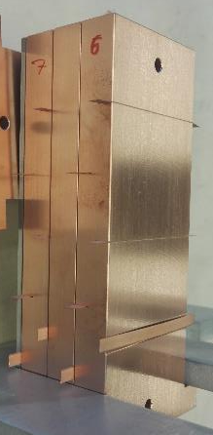
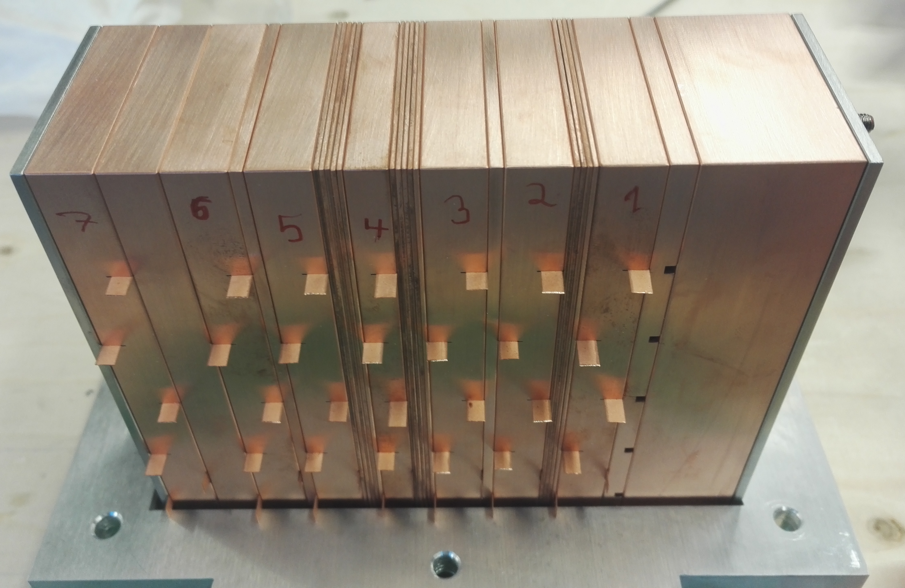
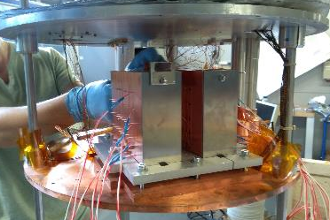
Sample Holders
Courtesy of A. Will
Nb₃Sn
YBCO
Nb₃Sn
Nb-Ti: 20 short strand samples
  50 mm, Ø 0.825 mm
Nb₃Sn: 30 short strand samples
  50 mm, Ø 0.85 mm
YBCO tapes: 40 samples
  60 mm x 4 mm x 0.2 mm
Nb₃Sn
Nb-Ti
Nb-Ti
p+
HTS
LTS

