Slide 1
Displacement cross section measurements in J-PARC and potential for HiRadMat
RaDIATE Collaboration Meeting at CERN Dec 20 2018
(JAEA/J-PARC) Shin-ichiro. Meigo,
H. Matsuda, Y. Iwamoto,
S. Hasegawa, F. Maekawa,
H. Iwamoto
(KEK/J-PARC) M. Yoshida, T. Nakamoto, T. Ishida,
and S. Makimura
Present study includes the results of “Measurement of displacement cross section at J-PARC for structural material utilized at ADS” entrusted to JAEA by MEXT

Slide 2
Contents
Introduction
  Present and future plan of J-PARC
Experiment for measurement displacement (DPA) cross section at J-PARC
  Experiment Ep 0.4 to 3 GeV at 3NBT
  Comparison with calculation model
Summary

Slide 3
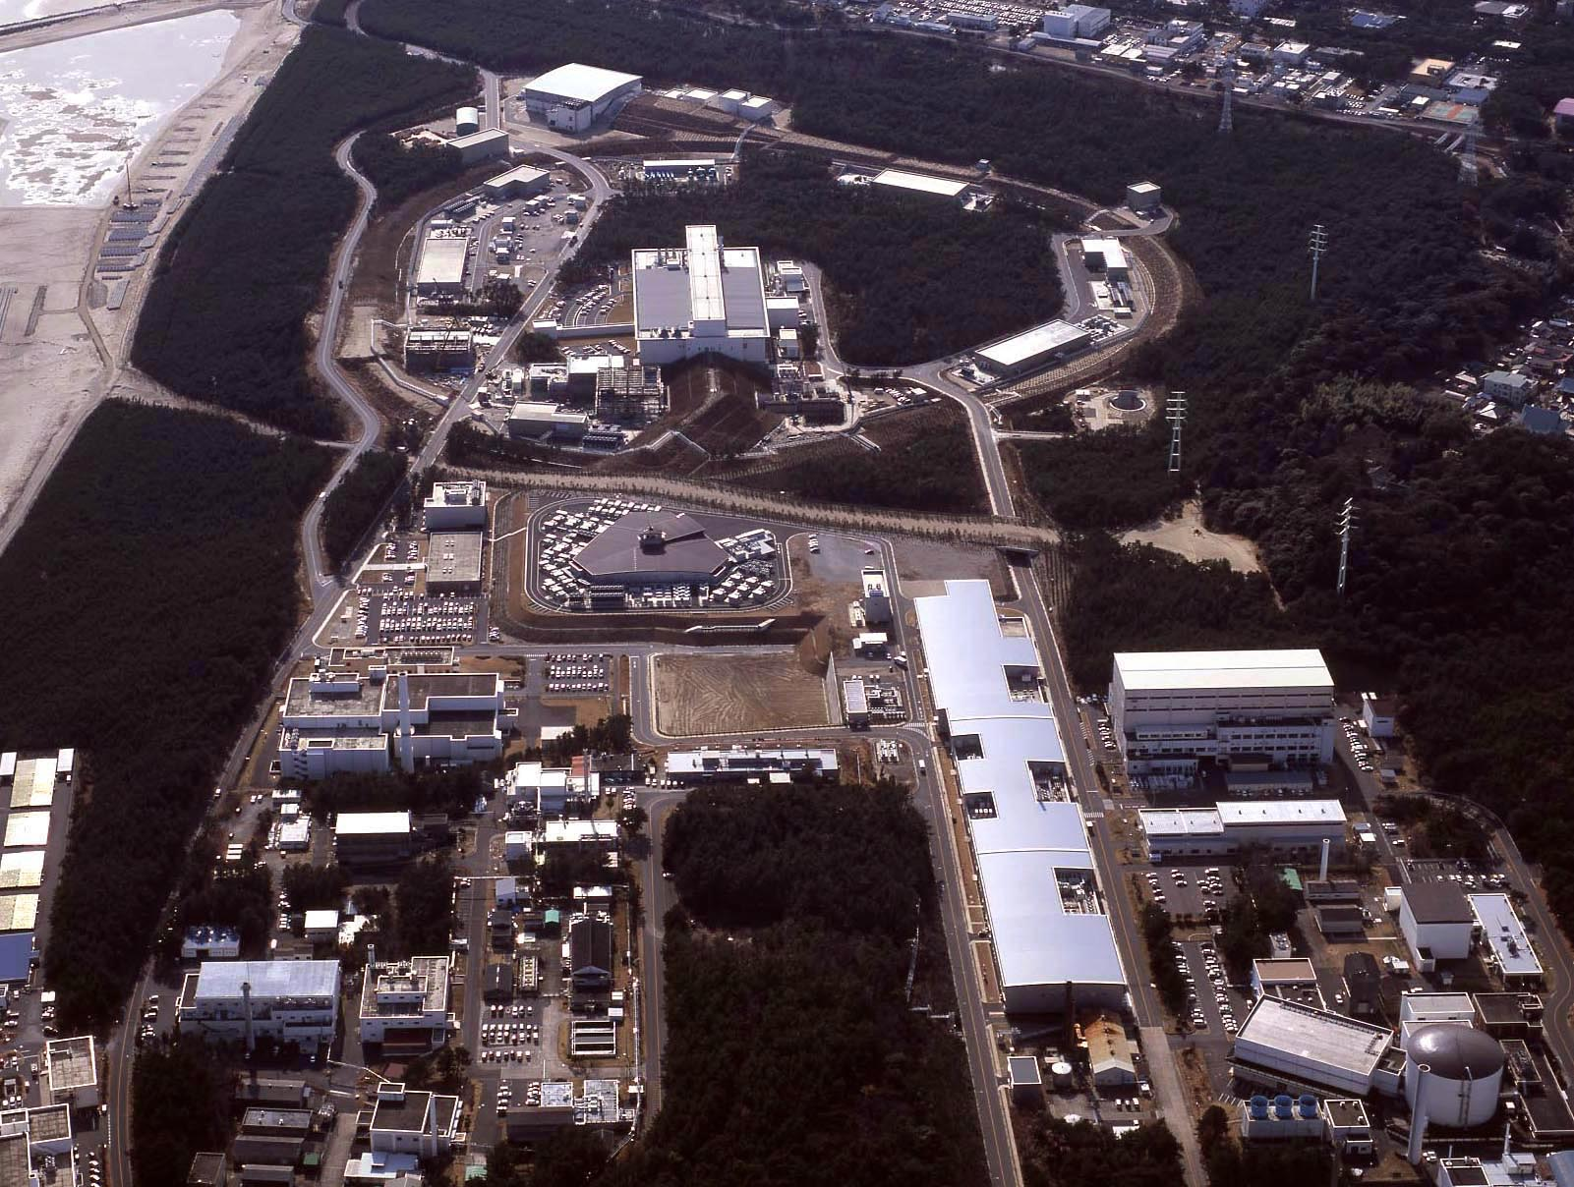
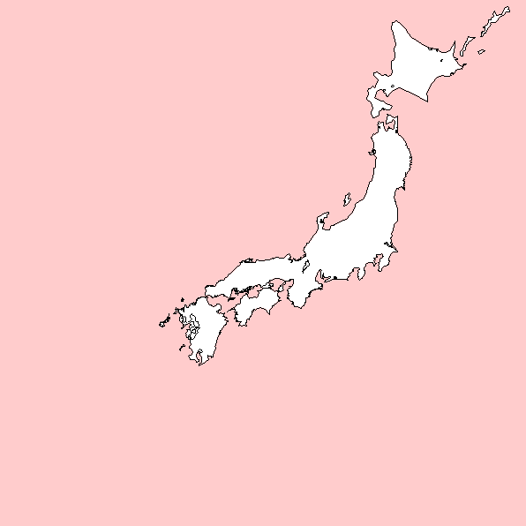
Hadron Experiment Facility
30GeV Synchrotron
MR (0.75MW)
Materials & Life Science Facility (MLF)
Bird’s eye photo
3GeV Synchrotron
RCS (25Hz,1MW)
Neutrino Exp. Facility
(294km to Super KAMIOKANDE)
Transmutation
Facility (TEF)
(Phase II）
Linac
400MeV(50mA)
JFY2007 Beam
JFY2008 Beam
JFY2009 Beam
JRR-3M
800m to MLF
Neutron beam lines (23)
J-PARC = Japan Proton Accelerator Research Complex

Slide 4
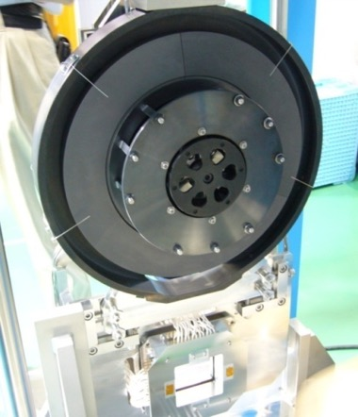
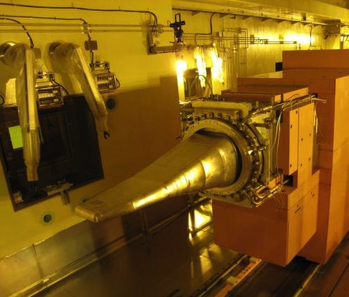
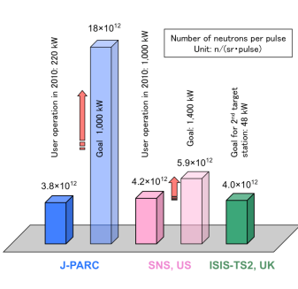
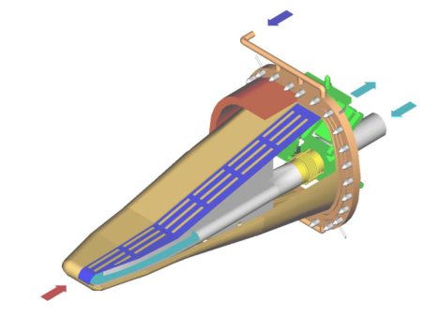
Targets in Material Life Experimental Facility (MLF)
Muon production target
  Carbon graphite
  Highest μ⁻ intensity
Neutron production target
  Mercury (Hg)
Highest pulse intensity in the world
SS container
Thick. 2cm
Diam. Φ33cm
L 2m
W 34cm
Light water
Safety hull
Double wall: Helium layer observed radiation
Hg
8% beam loss
Ptron

Slide 5
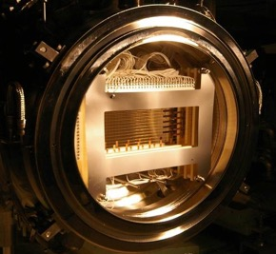
Target for high-intensity hadron accelerator and superconductor in high radiation area
Proton beam window in J-PARC spallation neutron source: Aluminum alloy (φ 0.6 m)
T2K beam window
Titanium alloy (Ti-6Al-4V)
For damage estimation of target material, DPA is utilized based on displacement cross section.
High accuracy of the displacement cross-section is required.
Proton
3 GeV
Proton 30 GeV
Superconductor resistivity change due to radiation is crucial for superconducting magnet.
Superconducting magnet system in COMET (J-PARC)

Slide 6
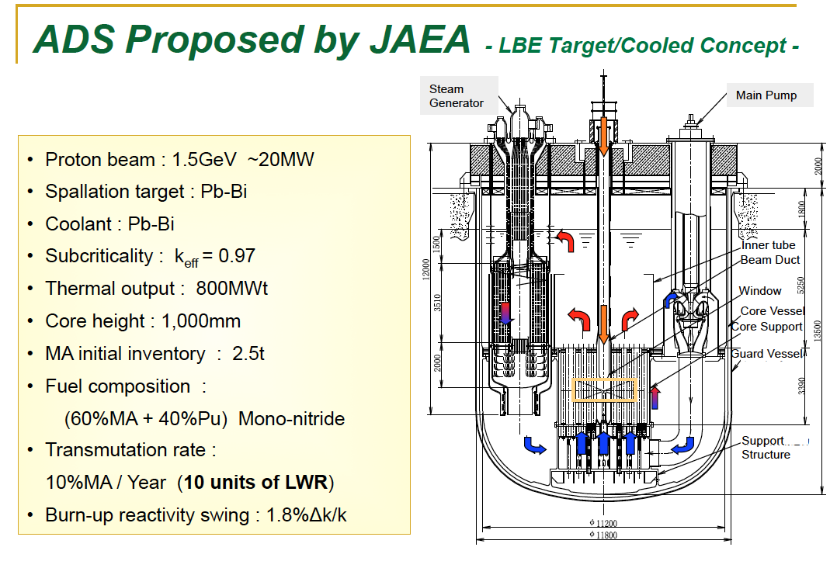
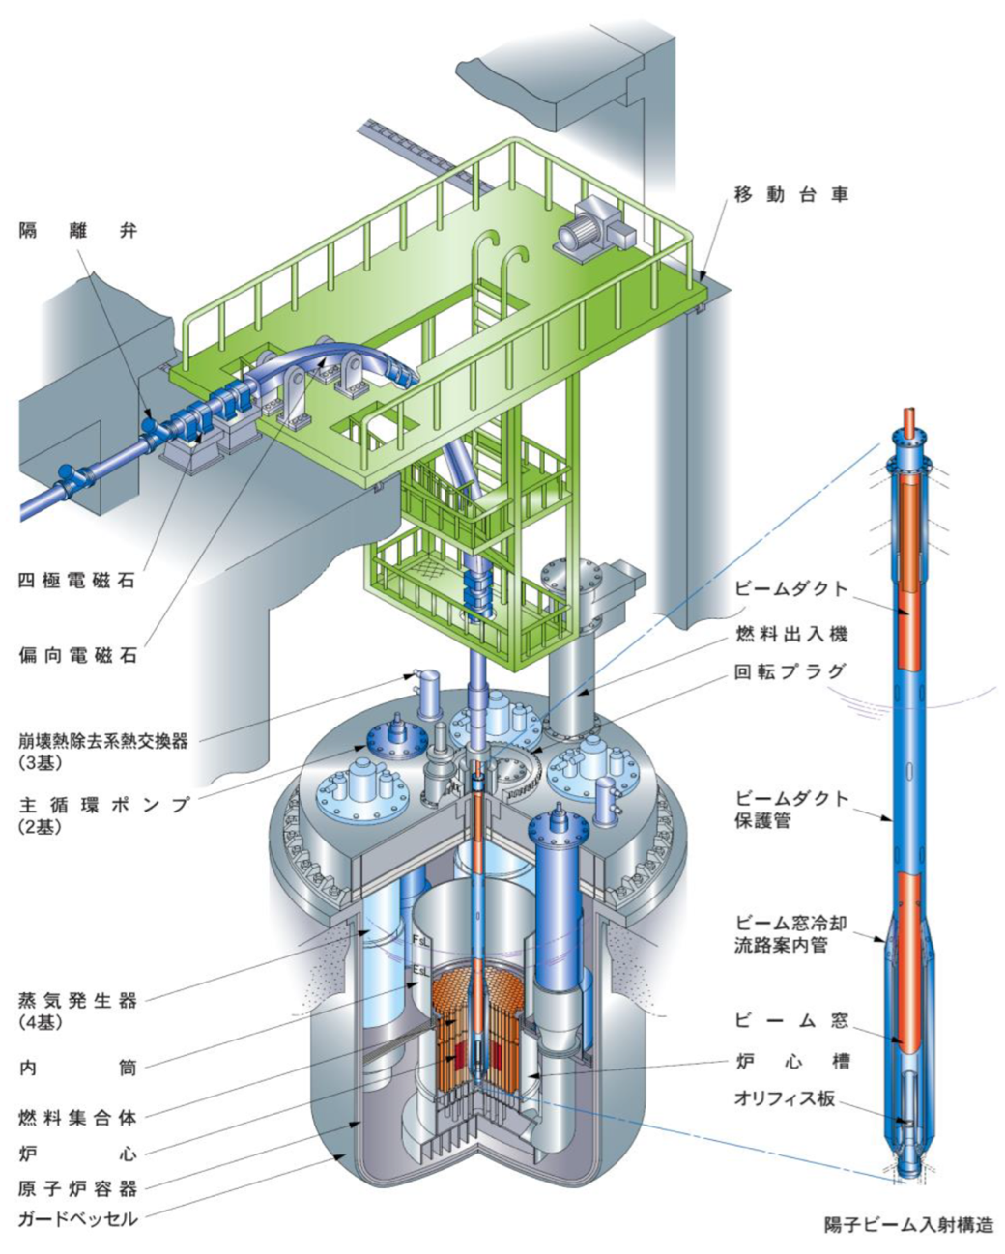
ADS proposed by JAEA
Belgium ADS program MYRRHA at SCK・CEN (Mol) approved 558 M€
~ 30 MW
Beam window
Beam window: 20 dpa/year. Accuracy of dpa is required for damage estimation.

Slide 7
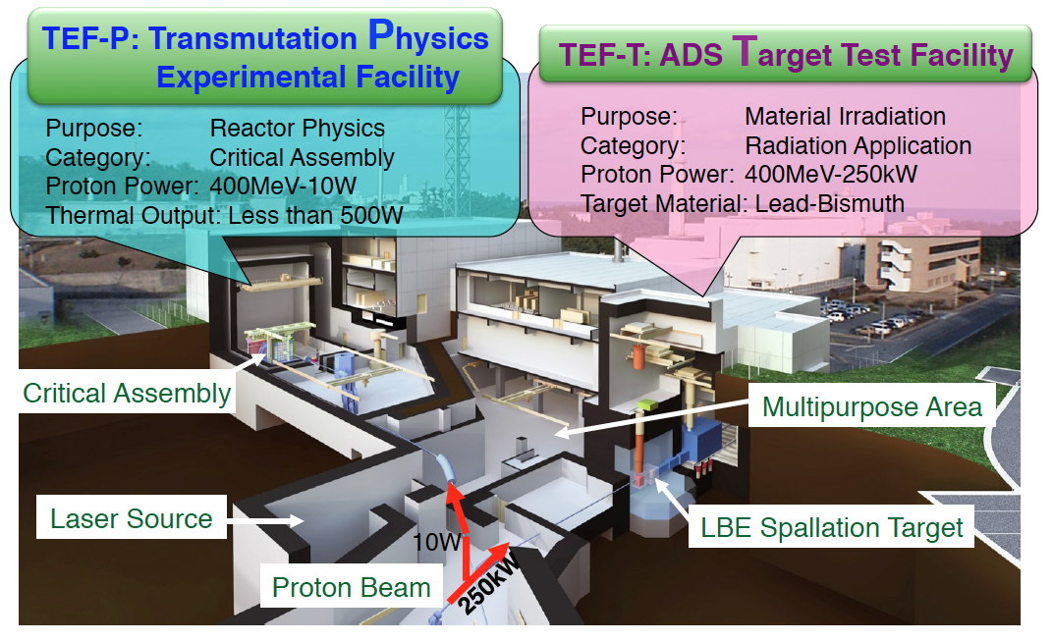
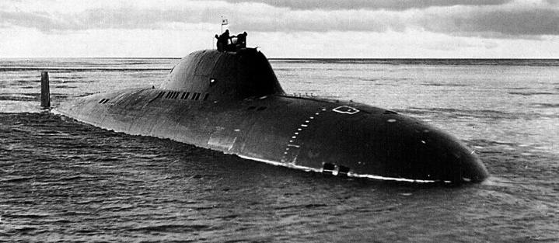
Transmutation Experimental Facility (TEF)
Soviet submarine (LBE)
For R&D of ADS, 0.4 GeV beam by LINAC will be delivered to TEF.

Slide 8
Beam transport from RCS to MLF
600ns
Ep: 3GeV
Power: 1MW
Already demonstrated
Rep.: 25Hz
600ns
Length of 3NBT: 314m
Partial beam goes to MR
FX: 2.48 s, SX: 5.5 s
50-GeV MR
FWHM ~150ns
road to
coast
Material and Life Science Experimental Facility (MLF)
Dump
Neutrino line
3NBT
MUSE
JSNS
3-GeV
RCS
3-50BT
Muon target
Neutron target

Slide 9
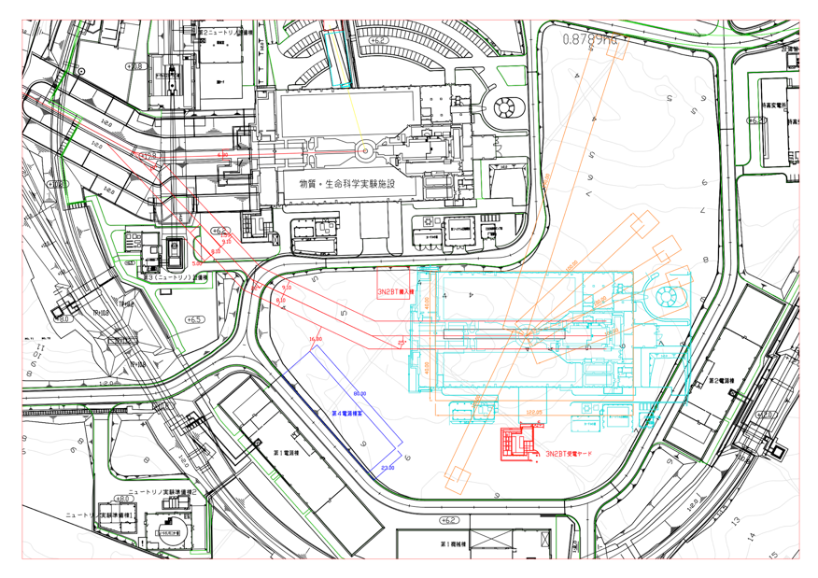
Second target station plan
1st target ST (TS-1): 24 Hz: 1MW
2nd target ST (TS-2) 1Hz : 42kW (Designed to accept 1 MW)
TS-1
TS-2
Ep3GeV
n
μ

Slide 10
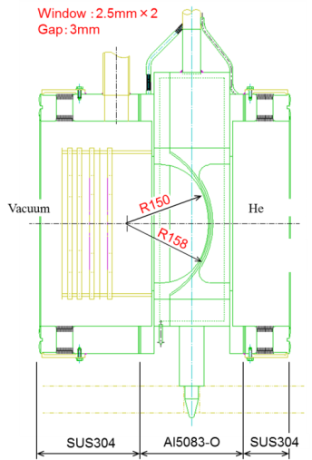
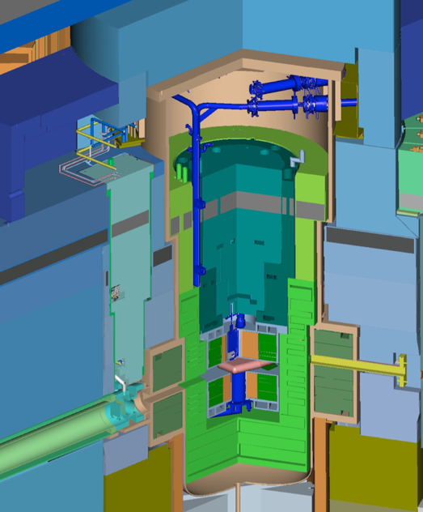
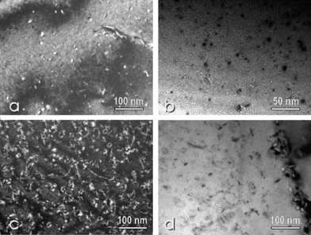
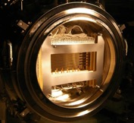
Proton Beam Window at MLF (A5083)
Lifetime estimation based on Post Irradiation Examination (PIE) for safety shroud (AlMg3) at SINQ in PSI
Considering difference of proton energy, to predict lifetime of the PBW with high accuracy for validation of calculation
Result at SINQ/PSI for 0.6GeV
Y. Dai, et al, J. Nucl Mat. 343 184 (2005)
Lifetime of PBW: Determined by He gas production (1200 appm) 2 years*
By recent PIE result of the SINQ (2400 apmm), lifetime may be applicable to 3 years.
Height: 3.8m
Weight：10t
* S. Meigo, et al, J. Nucl Mat. 450 141 (2012)

Slide 11
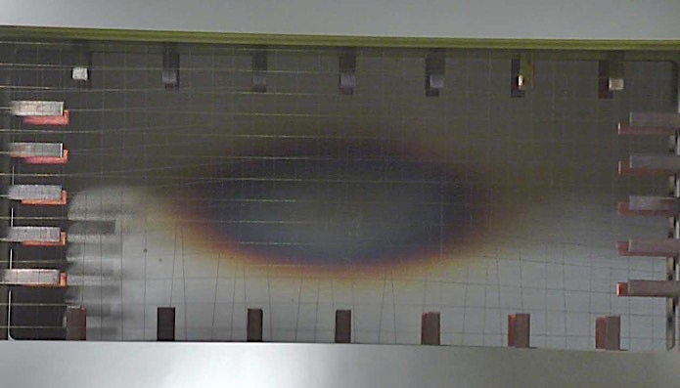
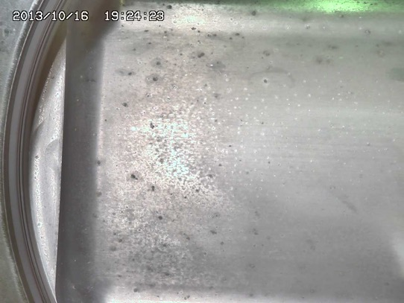
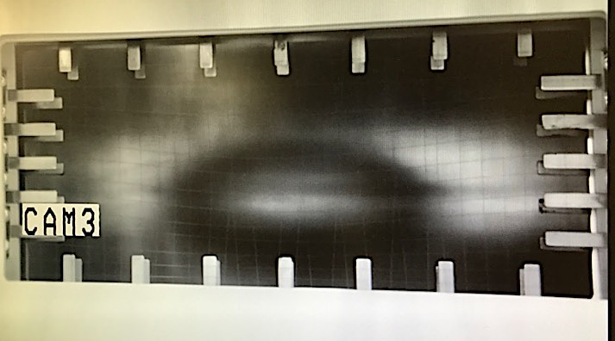
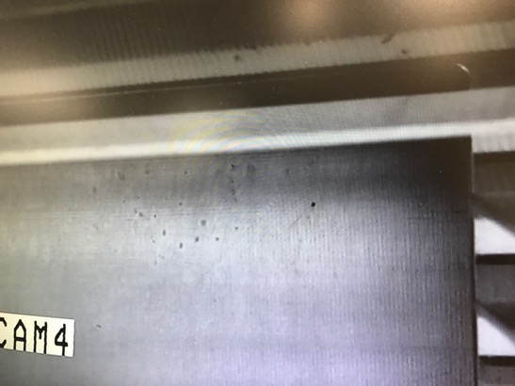
Inspection spent PBW
PBW #1 (obs. 2013 Oct) 1916 MWh (1.4x10²² POT)
Vacuum side(~1x10⁻⁴ Pa)
Helium side (~1bar)
PBW #2 (obs. 2017 Aug) 2510 MWh (1.9x10²² POT)

Slide 12
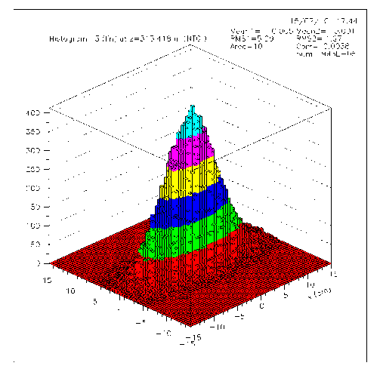
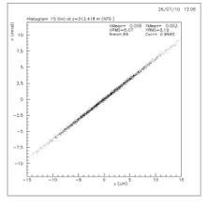
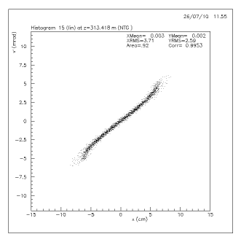
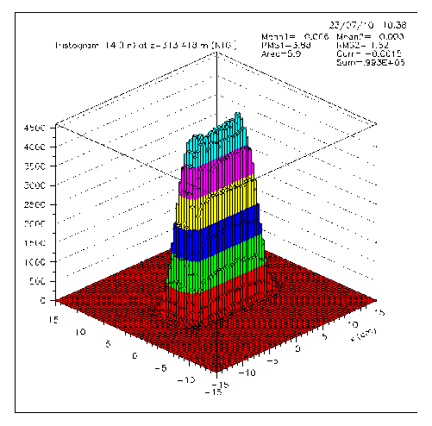
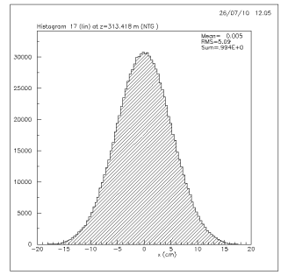
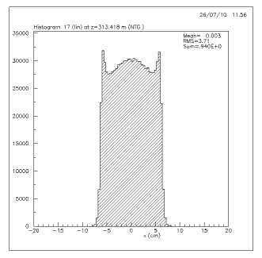
Beam peak density reduction with octupole magnet
Normal optics (i.e. linear ) → Gaussian
  Nonlinear optics with OCT shaping flat beam to reduce the peak
OCT 0A
Linear
With OCT
Phase space
Divergence
Vert.
Hori.
OCT 698A
Position
Position
Spatial distribution
Intensity
Position
Position
Vert.
Hori.
Principal: Folding edge to center
Reduction ~40% (10→6 μA/cm² at 1MW)

Slide 13
Beam operation at MLF
Major interruption : Earthquake, Hadron facility accident, Water leak Hg target (x2)
Kicker magnet (KM) failed. But keep operation w/o failed KM ( 2 of KM failed out of 8)
Helium bubbler flow choking. Mirror for LDV came off due to welding issue.
Present 500 kW
Availability ~95%

Slide 14
Demonstration of 1 MW for 1h
On July 2018 4th, 1 MW beam test for 1h
Once chance per year before outage
Vacuum worse found at RCS
W/O failed one quadrupole magnet operated

Slide 15
Vacuum at BT during 1 MW
1 MW
Mass 3
C+O₂->CO₂
Mass 16 (O₂)
Mass 44 (CO₂)
Mass 3
Overall vacuum pressure was low.
Drastically increase pressure of mass number 3 (probably T) as increase of beam power. (1 MW: ~12 times of 500 kW)
Gas treatment system for exhaust of pump was implemented on summer 2018.
Tritium production in cooling water for magnets and beam scraper is an another issue.

Slide 16
PKA and DPA
DPA (Displacement per Atom) is estimated by calculation based on PKA.

Slide 17
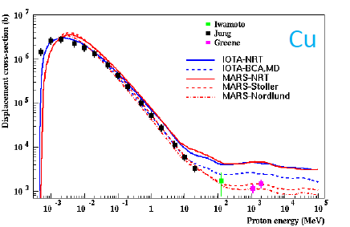
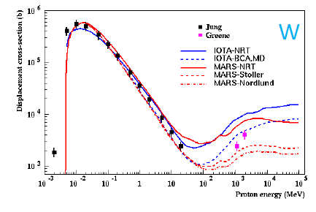
DPA and displacement cross section
Although DPA is widely utilized for estimation of damage, displacement cross section has not been enough validated.
    DPA = flux x Displacement cross section
  Displacement cross section has been measured only Cu and W for a few energies of protons
  Among calculation showing large discrepancies among models.
N. Mokhov HPTW2016

Slide 18
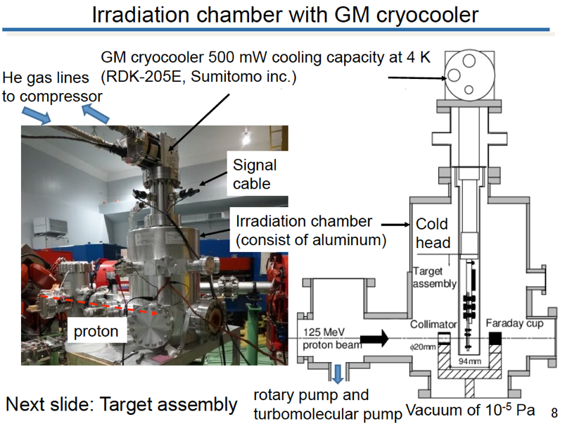
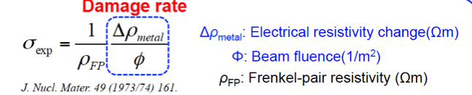
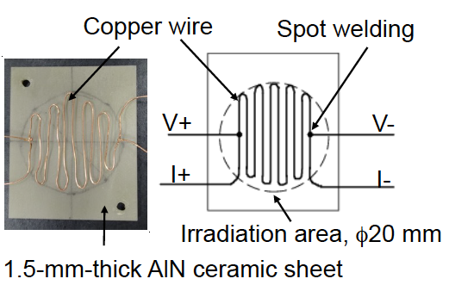
Measurement of DPA cross section at Kyoto univ
Irradiation on metal at cryogenic temperature with GM cryocooler
By observing increase of electrical resistance, the cross section can be observed.
Experiment at J-PARC
Samples and GM placed at exit of 3-GeV synchrotron for various energy of proton 0.4 to 3 GeV
Other experiment performed at other sites for energy < 400 MeV
Measurement for Cu already performed at Kyoto university for 125 MeV proton

Slide 19
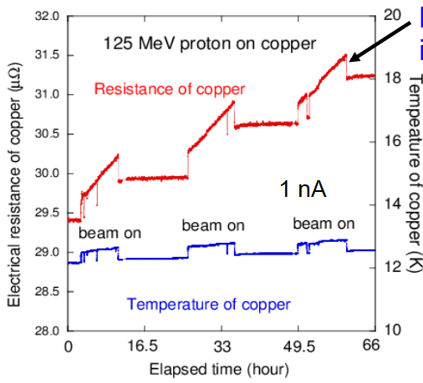
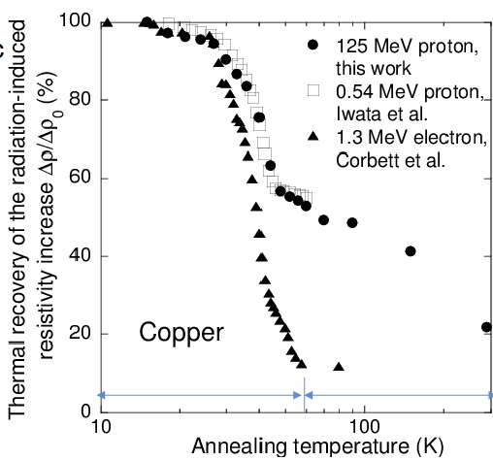
Experimental condition
Temp rising ~20 K will be acceptable.
If time permits, lowest beam is preferable.
However, it makes worse accuracy of beam
charge. (Vary 1x10¹⁰ – 2x10¹³ protons/shot)
1 nA x 12h = 3x10¹⁴ protons
Several shots of beam at MLF
Y. Iwamoto et al.

Slide 20
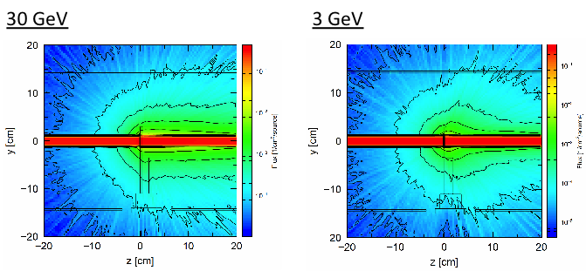
Radiation safety for J-PARC exp.
Particles flux during irradiation
Calc. geom. model
Residual dose at 0.3 m of sample
φ 30mm
Incident energy | Cooling 4h (μSv/h) | Cooling 7d (μSv/h)
3 GeV | 19 | 0.01
30 GeV | 29 | 0.02
Protons： 5x10¹⁴
Residual dose: Confirmed enough small for handling
Confirmed to fit criteria of beam loss (1 W/m) for maximum beam to dump (8 kW)
20

Slide 21
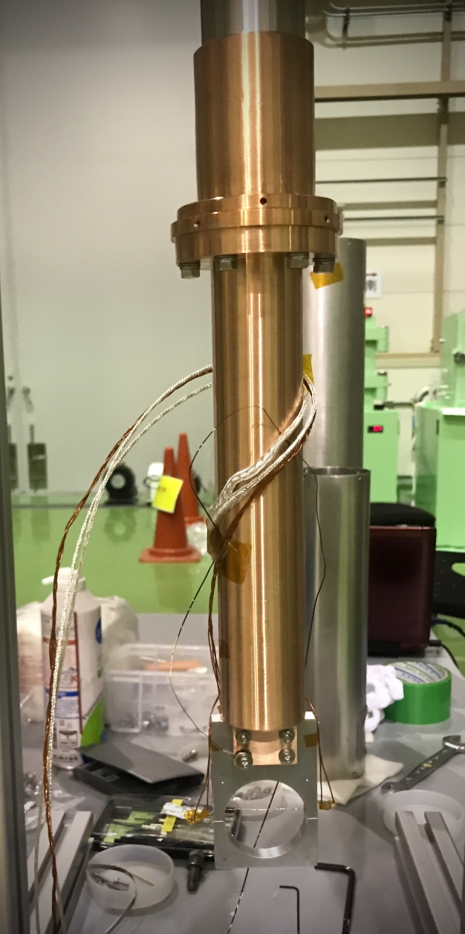
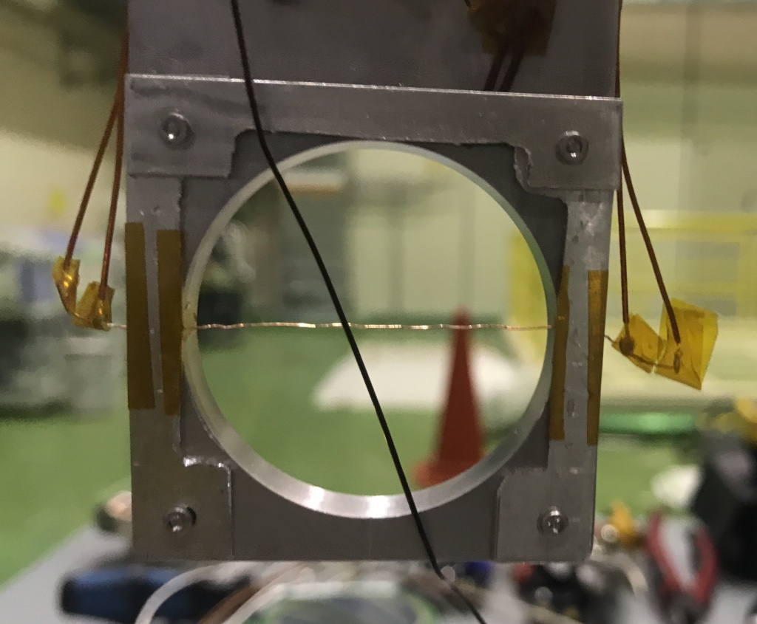
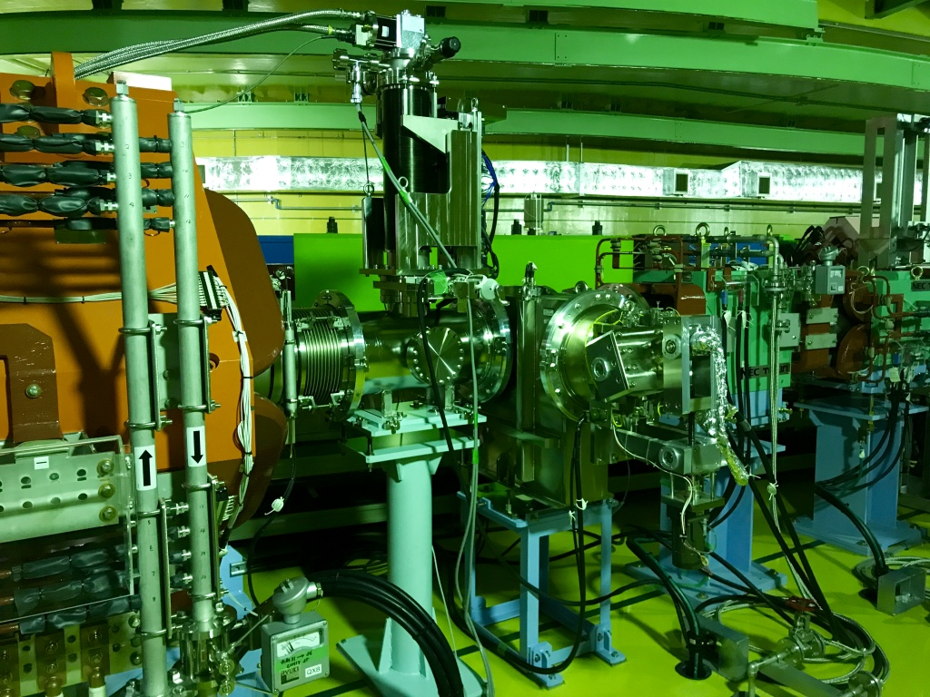
Measurement of cross section for 0.4～3 GeV proton
Experiment at RCS with change of radiation license
With changing extraction timing of RCS, kinetic energy of proton can vary from 0.4 to 3 GeV.
Cold head and sample
Under cryotemperature (~ 20 K), displacement cross section(σ) was obtained by increase of resistivity (Δρ_{cu}) due to proton irradiation with average flux (φ(E))
Cu wire (φ 0.25 mm) with purity 99.999%
annealed 1,350 K
ρ_{FP}: Resistivity change by a Frankel pair (2.2x10⁻⁶ Ωm)
Vacuum chamber with 4-K GM cooler
40 mm
To MLF
Beam
From RCS
Beam dump
Vertical view
1 m

Slide 22
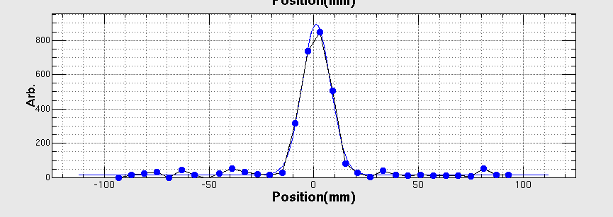
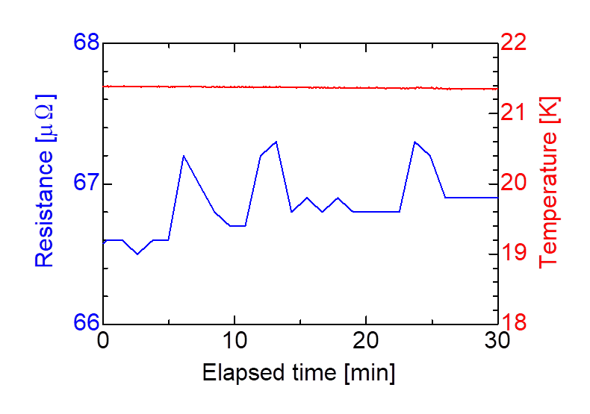
Experimental result
Resistance and temperature during irradiation
Vertical beam profile
50 shots
50 shots
50 shots
Ep (GeV) | Resistivity change (ΔΩm³X10⁻³¹) | σ_{dpa} (b)
0.8 | 2.35±0.31 | 1070±284
1.3 | 2.32±0.26 | 1053±270
2.2 | 2.49±0.21 | 1133±277
3.0 | 2.49±0.16 | 1010±244
0.4μΩ
150 shots x 3.3x10¹² = 5x10¹⁴protons
Experiment was carried out for protons with 0.8, 1.3, 2.2 and 3.0 GeV
To obtain resistance with high accuracy, 4 wire with delta mode with averaging was applied.
Beam width on the sample was obtained with the beam profile monitor.
Error is dominated with resistivity change by creation of the Frankel pair (23%).

Slide 23
Cascade sample holder
RCNP (Osaka univ.) experiment by Iwamoto
Experiment at 3NBT in J-PARC
To obtain Cu and Al data, cascade scheme applied.
Achieved ~5 K
Cascade target of 4 pieces (Al, Fe, Cu, W) applied
Temp ~19 K
In future improved to achieve ~5K

Slide 24
Calculation with PHITS code
Displacement cross section with PHITS implemented following models
  Norgett-Robinson-Torrens (NRT) model
  Athermal recombination corrected (arc) model (Nordlund model)
    Nature comm. 9, 1084, 2018
NRT (Cu Ed 33 eV):
Nordlund (Cu Ed 33 eV):
N_{d}: Number of displacement
T_{d}: Displ. energy
N_{d} different for T_{d}>83 eV
ー NRT
ー Nordlund

Slide 25
Comparison with models calculation
NRT model
overestimates ~ x3
Nordlund model
good agreement
Present data imply that the DPA should be calculated with Nordlund model.
Ratio of NRT/Nord is constant above ~200 MeV.
If the displacement cross section sustains to NRT for Ep< 10 MeV, the cross section for Ep>100 MeV is ~2 times.
NRT/Nordlund

Slide 26
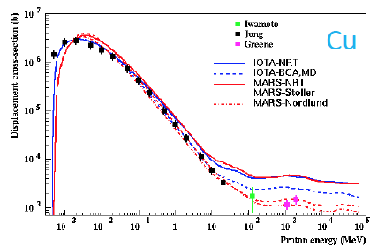
Comparison with MARS

Slide 27
Al and W results
As Mokhov suggestion, should be improved

Slide 28
Analysis of contribution for DPA
Fission and spallation fragment dominating

Slide 29
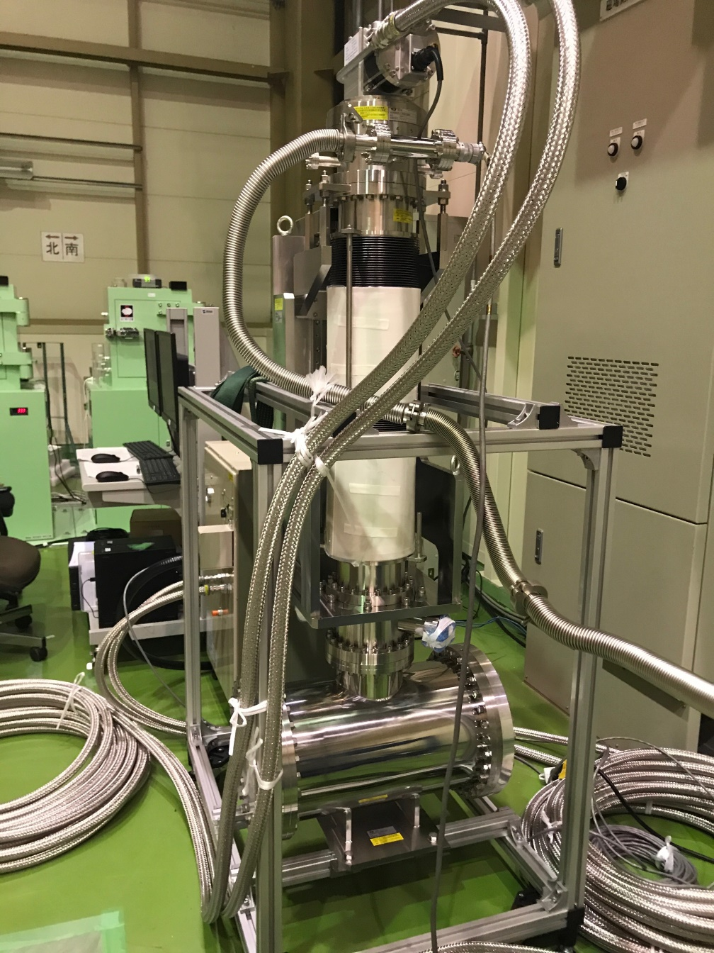
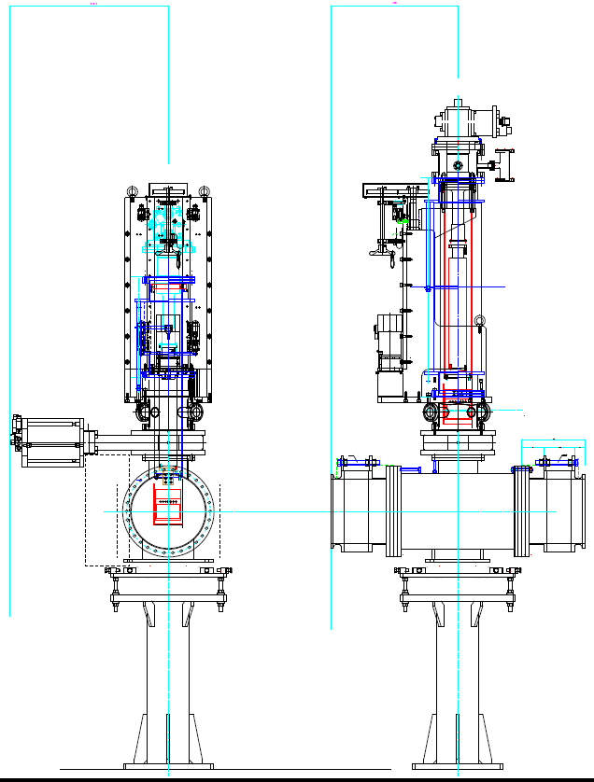
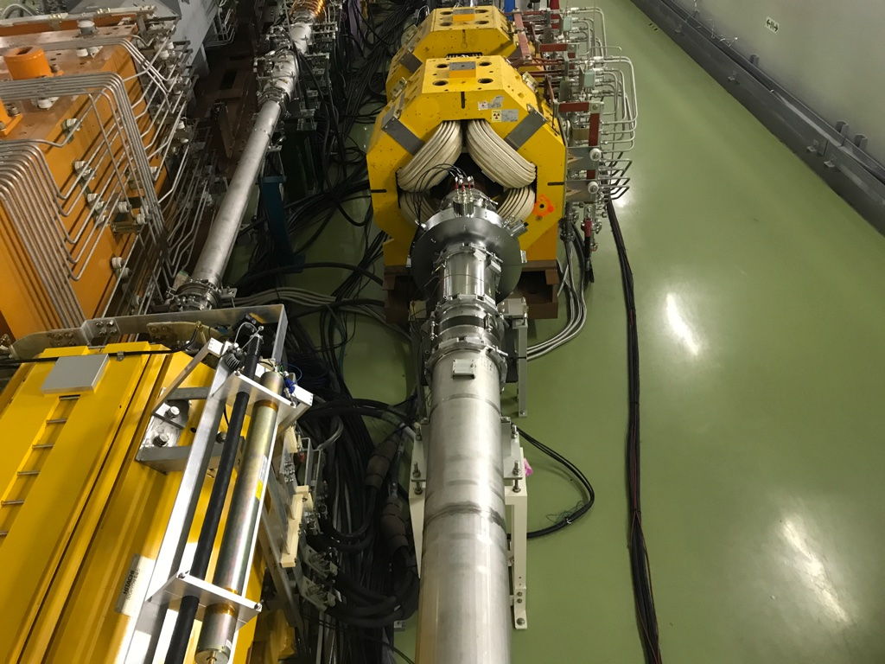
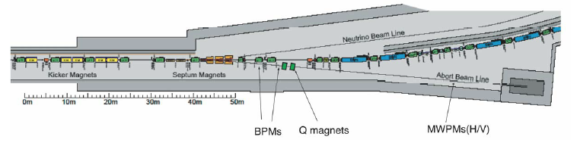
Plan at MR for 3〜30 GeV
MR abort dump
  PAC will approve soon
  Next year will be performed.
616 mm
990 mm

Slide 30
Possibility at FNAL and HPTW
Relatively easy experiment
Equipment
  GM cooler
  Vacuum chamber
  Instruments to observe sample resistance
Instruments should be placed at near the sample with low radiation
Requirement of experiment
  Beam monitor and properties
    not only for beam position but also width and Twiss parameter
  Beam scan procedure
  If beam loss allowed, thick sample holder should be applied to cool the sample

Slide 31
Impact on material property analysis
5
6
7
8
Gas production is good index to determine the lifetime

Slide 32
Summary
Displacement cross section, measurement for 0.4〜30 GeV protons has conducted in J-PARC.
  Experiment performed for Al, Fe, Cu and W with 0.8, 1.2, 2.2 and 3 GeV protons.
  Calculation compared with the present data.
    NRT: ~3 times overestimation
    Arc-dpa (Nordlund) : pretty good agreement
NRT cross section will be discussed in IAEA.
In future, similar experiment will be performed at FNAL and HiRatMat.

