Slide 1
Overview of RaDIATE-organized BLIP irradiations
K. Ammigan on behalf of the RaDIATE collaborators
5th RaDIATE Collaboration Meeting
CERN, Geneva

Slide 2
Introduction
Motivation
Radiation damage study of various critical accelerator component materials using high energy protons, relevant to current and future high-energy high-intensity accelerator facilities
Objectives
Long-term irradiation of several materials of interest relevant to various RaDIATE participants at the Brookhaven Linac Isotope Production facility
Perform Post-Irradiation-Examination (PIE) to characterize radiation-induced property changes
  Strength properties (tensile, bend, fatigue) and micro-mechanics (nano-indentation, micro-cantilevers)
  Thermal properties (CTE, thermal conductivity) and annealing effects
  Microstructural analysis (SEM, TEM, EBSD)
Use HE proton irradiation data to compare/correlate with LE ion irradiation effects
Generate irradiated specimens for thermal shock testing at the HiRadMat facility

Slide 3
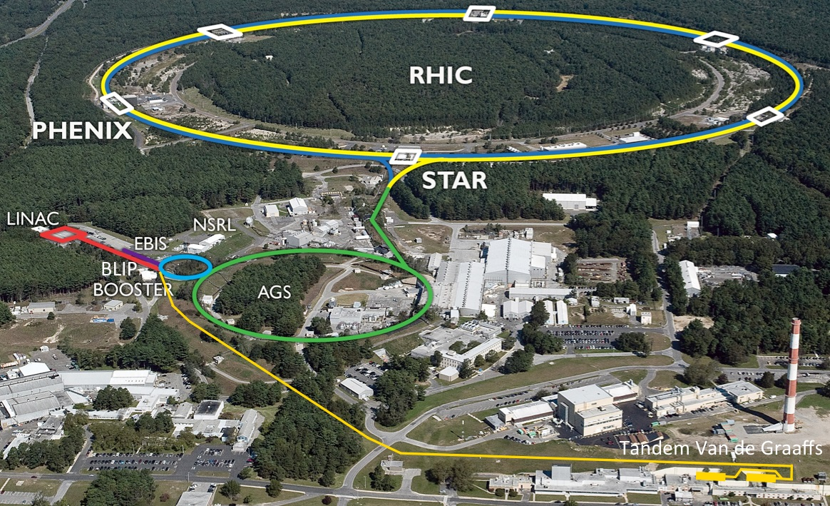
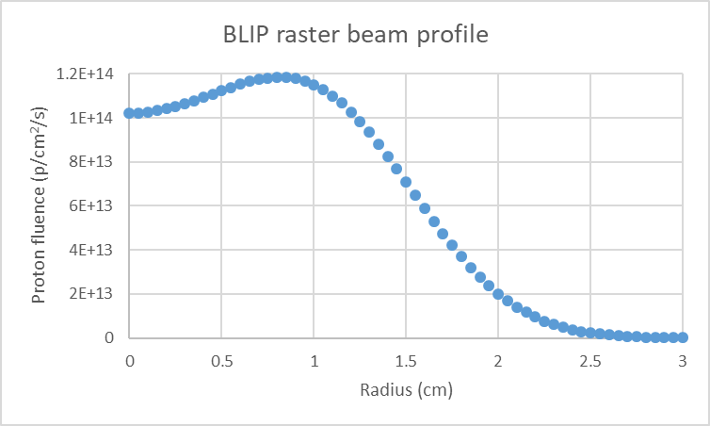
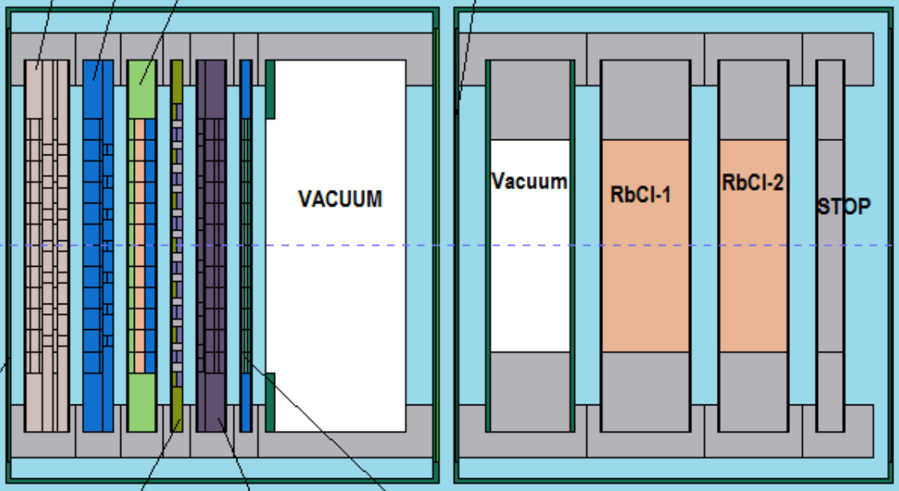
BLIP facility at BNL
Proton energy: up to 200 MeV
Peak current: 165 µA
Frequency: 6.67 Hz
Materials irradiation in tandem and upstream of isotope targets
Optimized materials target array required to deliver uniform and precise beam energy and flux for isotope production
RaDIATE targets
Isotope targets

Slide 4
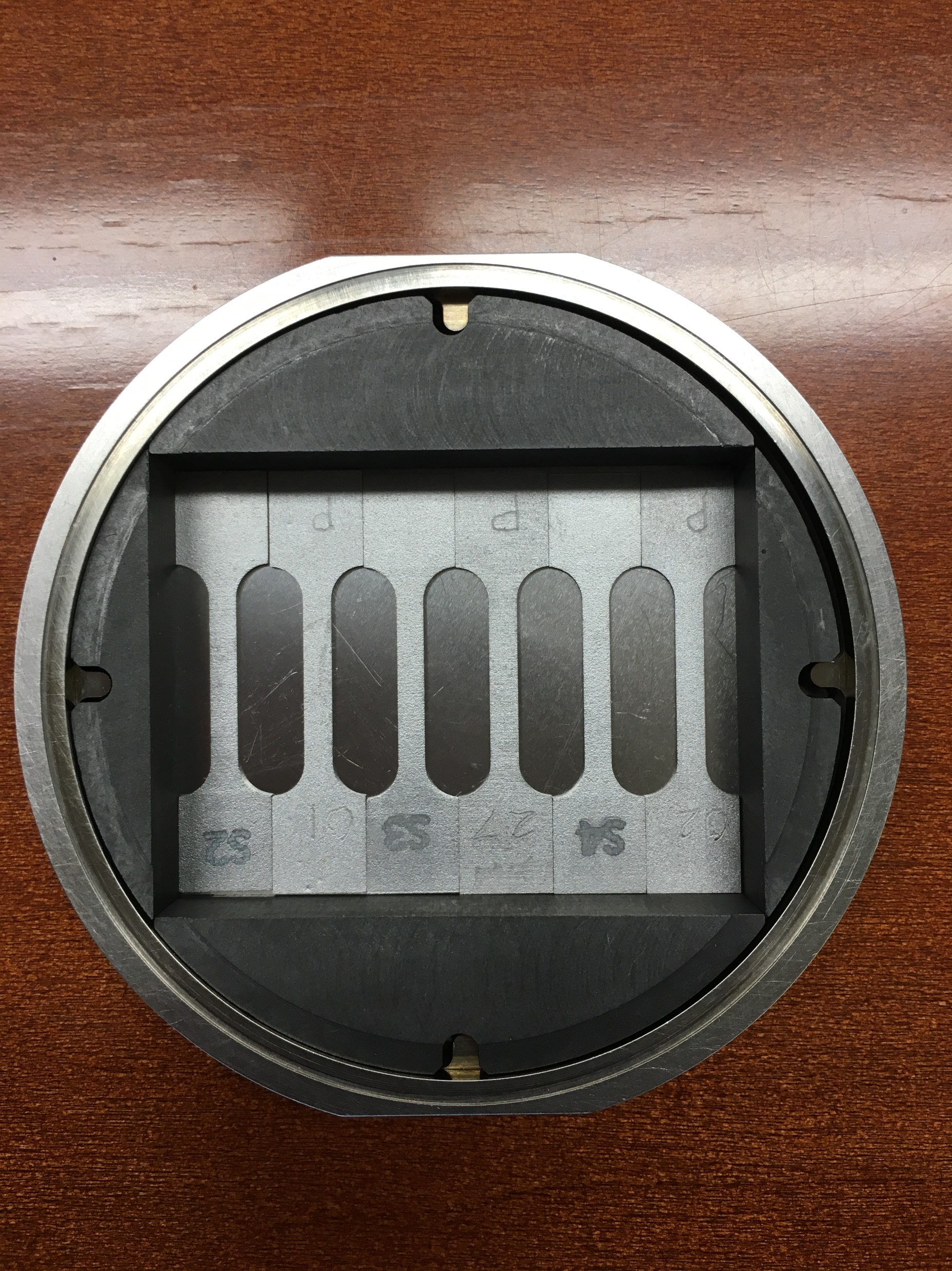
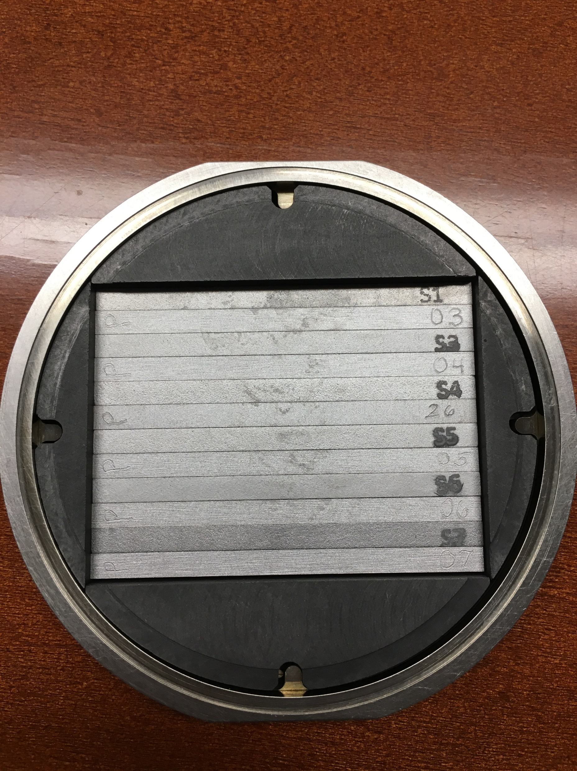
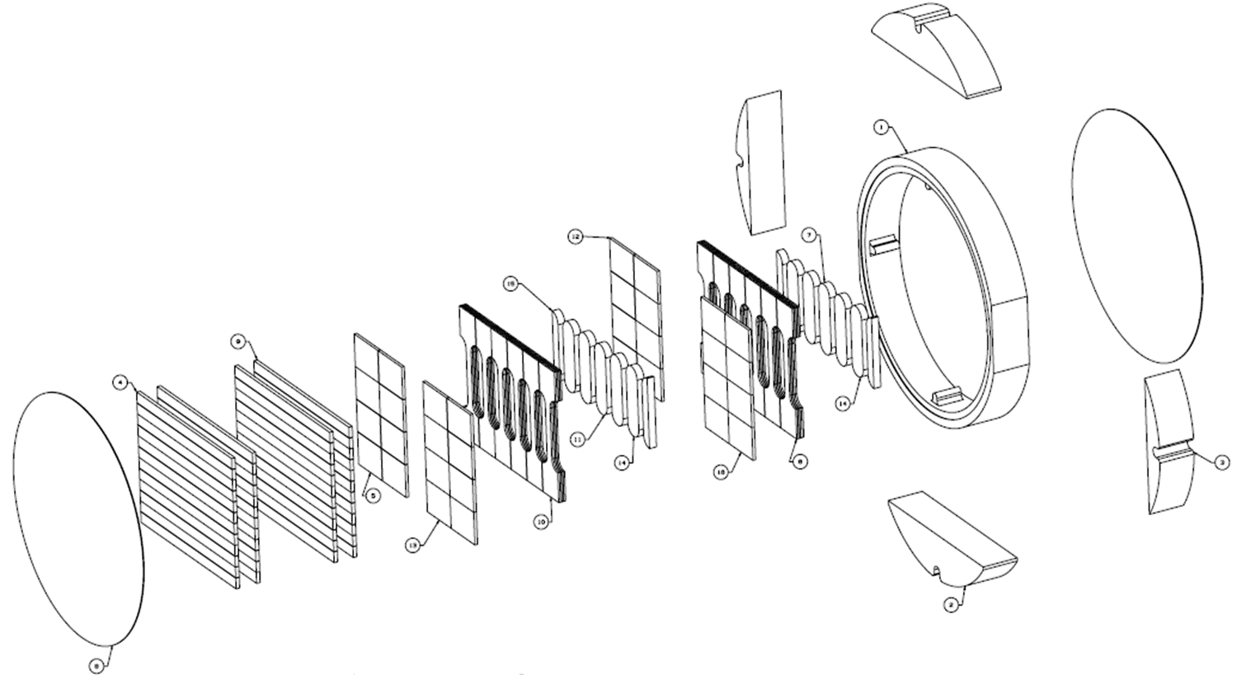
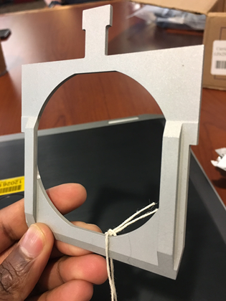
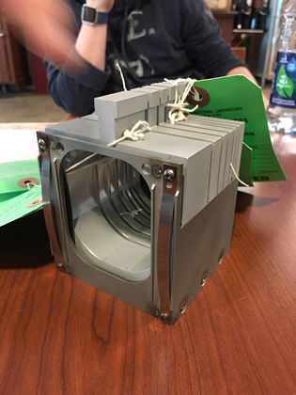
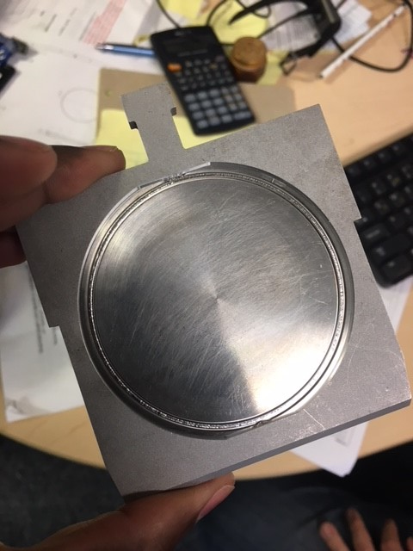
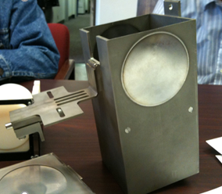
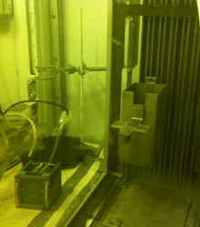
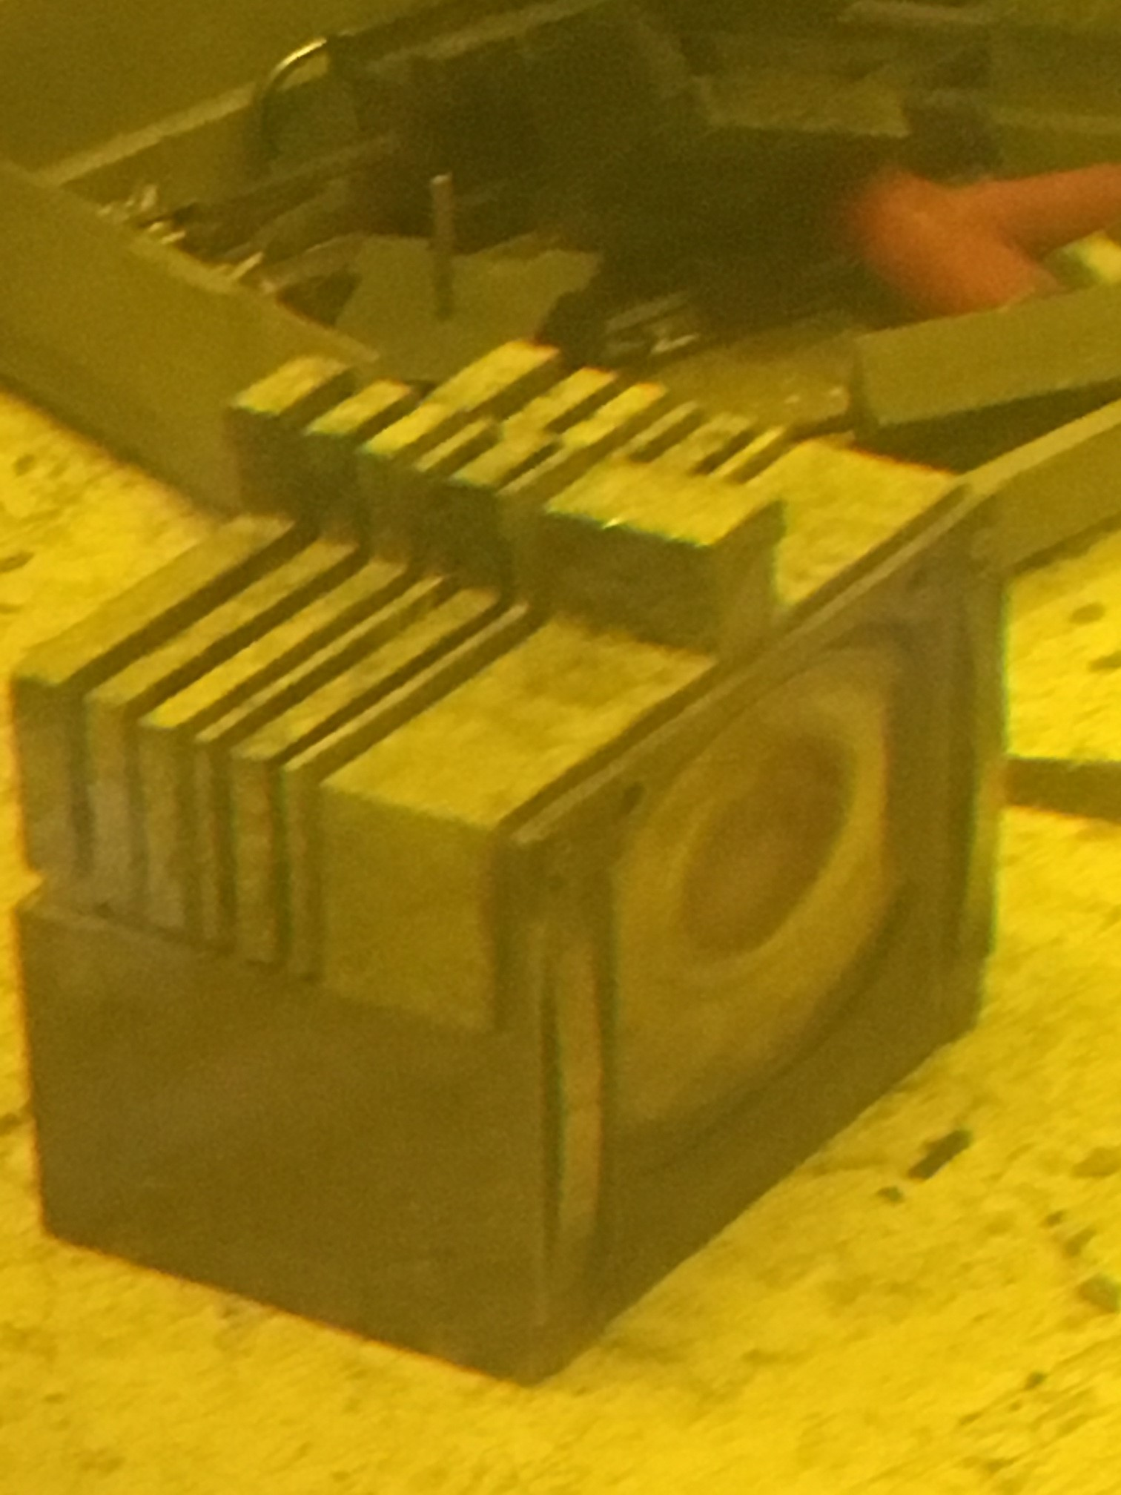
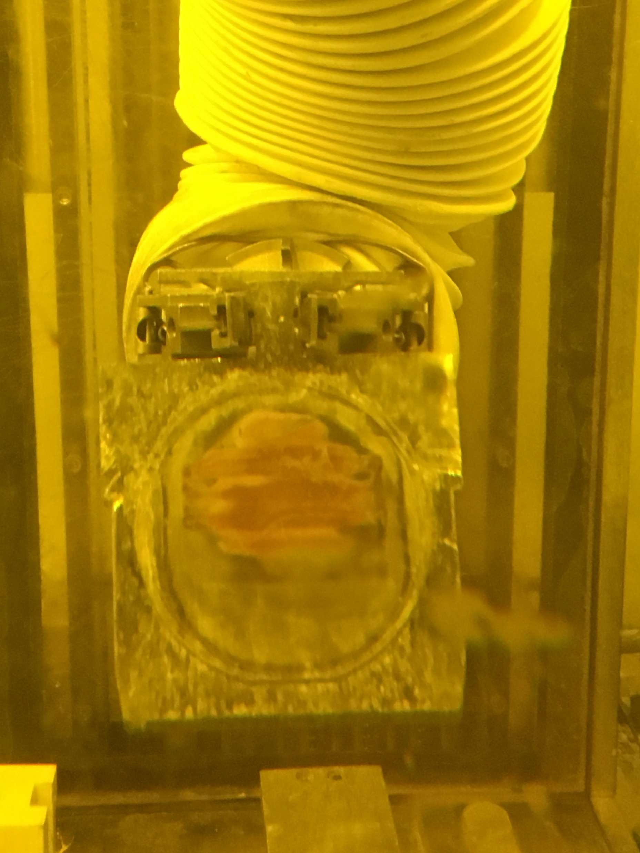
Irradiation test set-up
1. Specimens enclosed in stainless steel capsule
Aimed to maintain < 50 µm gap between specimens to ensure uniform beam energy degradation
2. Capsule fitted into capsule holder
3. Capsule holders inserted into basket
6 capsules in basket with 2.5 mm water gap in between
4. Basket inserted in target box and lowered in beam line
5. Targets after irradiation
Target box in BLIP hot cell before being lowered into beam line

Slide 5








RaDIATE BLIP irradiation summary
Consisted of 9 capsules from 6 RaDIATE institutions with over 200 material specimens relevant to beam intercepting devices in various current/future accelerator facilities
181 MeV incoming protons used for RaDIATE irradiation
Irradiation campaign executed in 3 phases with different target box configurations
  6 capsules in target box during each irradiation phase
Total protons on target: 4.57E21 (154 µA avg)

Slide 6
RaDIATE BLIP irradiation summary
Capsule 1: Beryllium (FNAL)
Targets and beam windows
PF-60, S-65F, S-200F, S-200FH
Capsule 2: Graphite (FNAL)
Targets
IG-430, ZXF-5Q, GC-20 (glassy carbon)
Capsule 3: Silicon (CERN/KEK)
KEK Muon target, CERN SPS internal dump
Silicon, SiC-coated C, expanded graphite
Capsule 4: Aluminum (ESS)
Proton beam window
Al 6061, 5754-O, luminescent coatings
Capsule 5: Upstream Titanium (FNAL/KEK/FRIB)
T2K target containment window, FRIB beam dump
Gr5, Gr 23, DMLS
Capsule 6: Downstream Titanium 1 (FNAL/KEK)
T2K target containment window
Gr 5, Gr 23, Gr9
Capsule 7: High-Z (CERN)
AD/BDF target, SPS internal dump
TZM, CuCrZr, Ir, flexible graphite (replaced capsule 6)
Capsule 8: CERN 2 (CERN)
BDF target cladding, collimators
TaW, Si, CfC, MoGr, PNG (replaced capsule 3)
Capsule 9: Downstream Titanium 2 (FNAL/KEK)
T2K target containment window
Gr 5, Gr 23, Gr 6, Gr 2, Ti 15-3 (replaced capsule 7)

Slide 7
RaDIATE BLIP irradiation summary

Slide 8
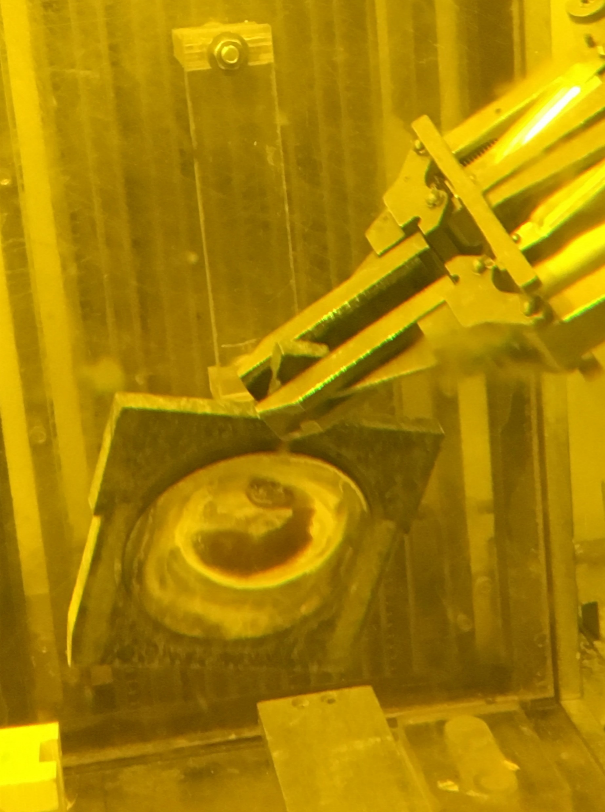
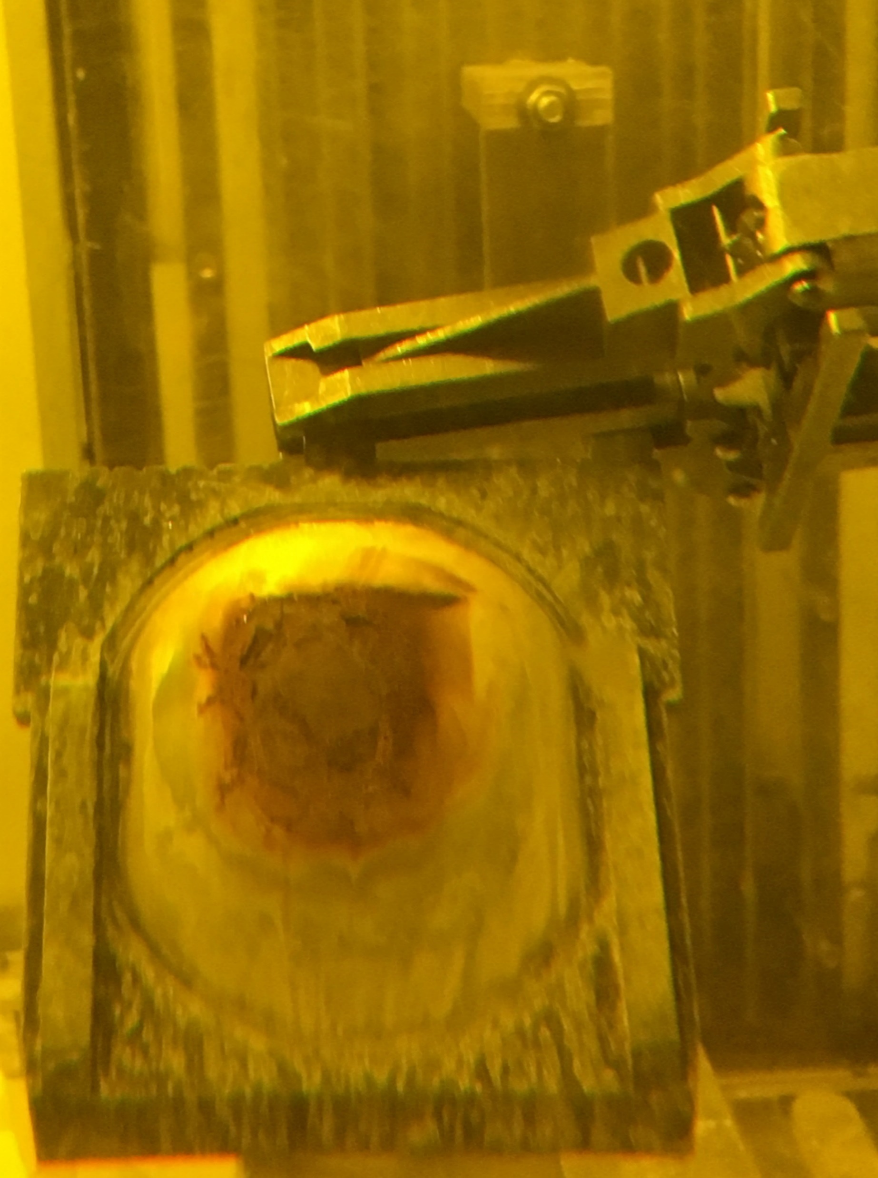
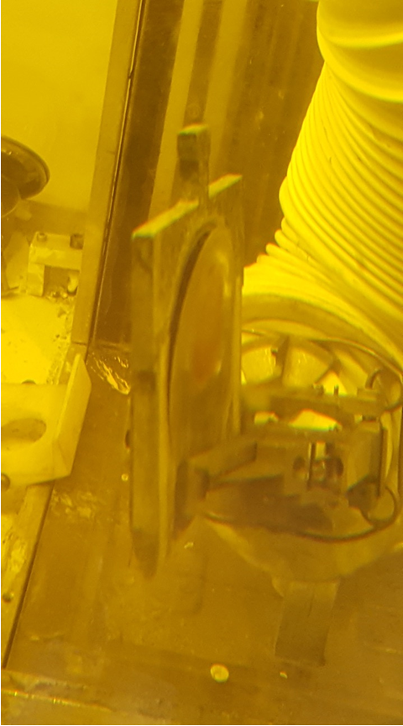
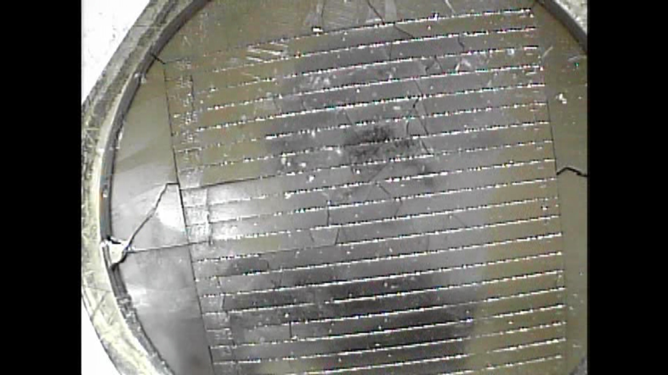
RaDIATE BLIP irradiation summary
Irradiation run ended in March 2018
Unfortunately 3 (Al, US Ti, Graphite) out of the 9 capsules were breached during irradiation & one capsule (Si) suffered some traumatic event that broke all interior specimens
Al
US Ti
C
Si
Root cause of failure is unclear at the moment and could be attributed to several factors (discussed at yesterday’s working meeting)
  Overheating, beam offset, poor weld quality, water cooling, capsule handling, etc.
Specimens from remaining 5 capsules are available for PIE work

Slide 9
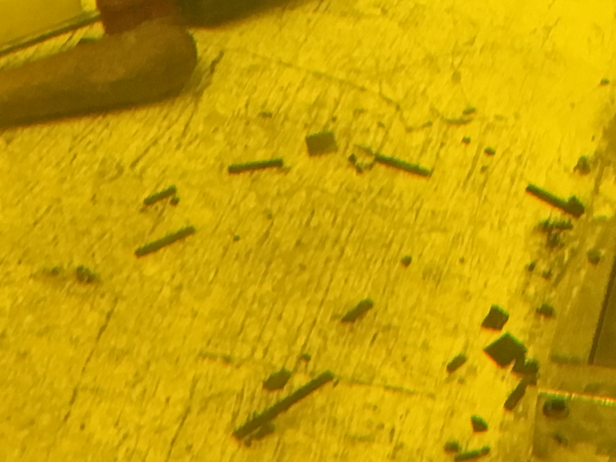
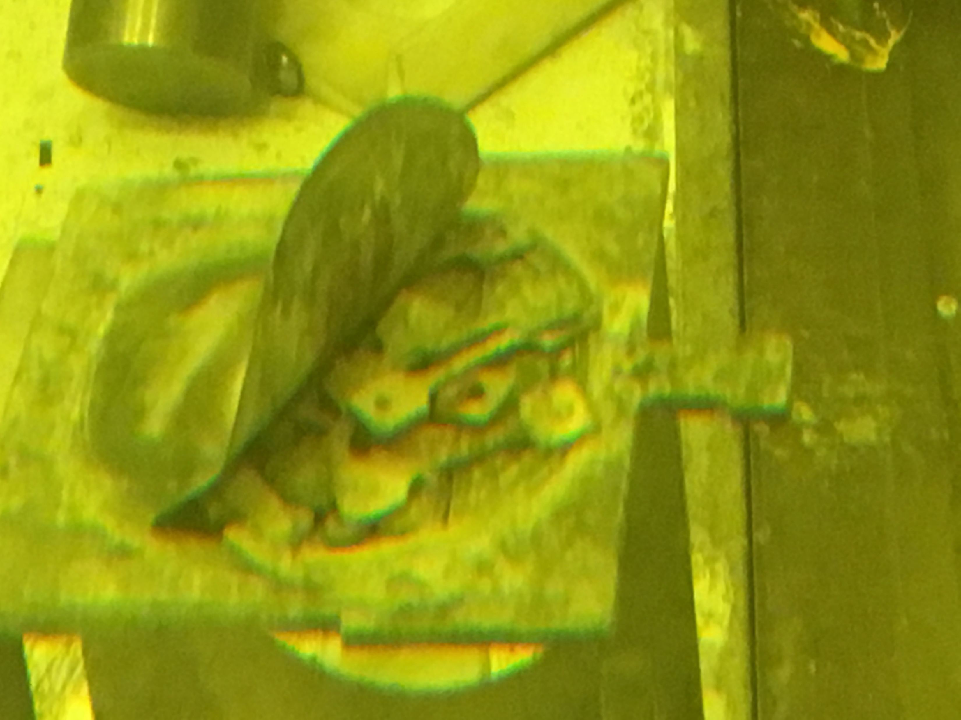
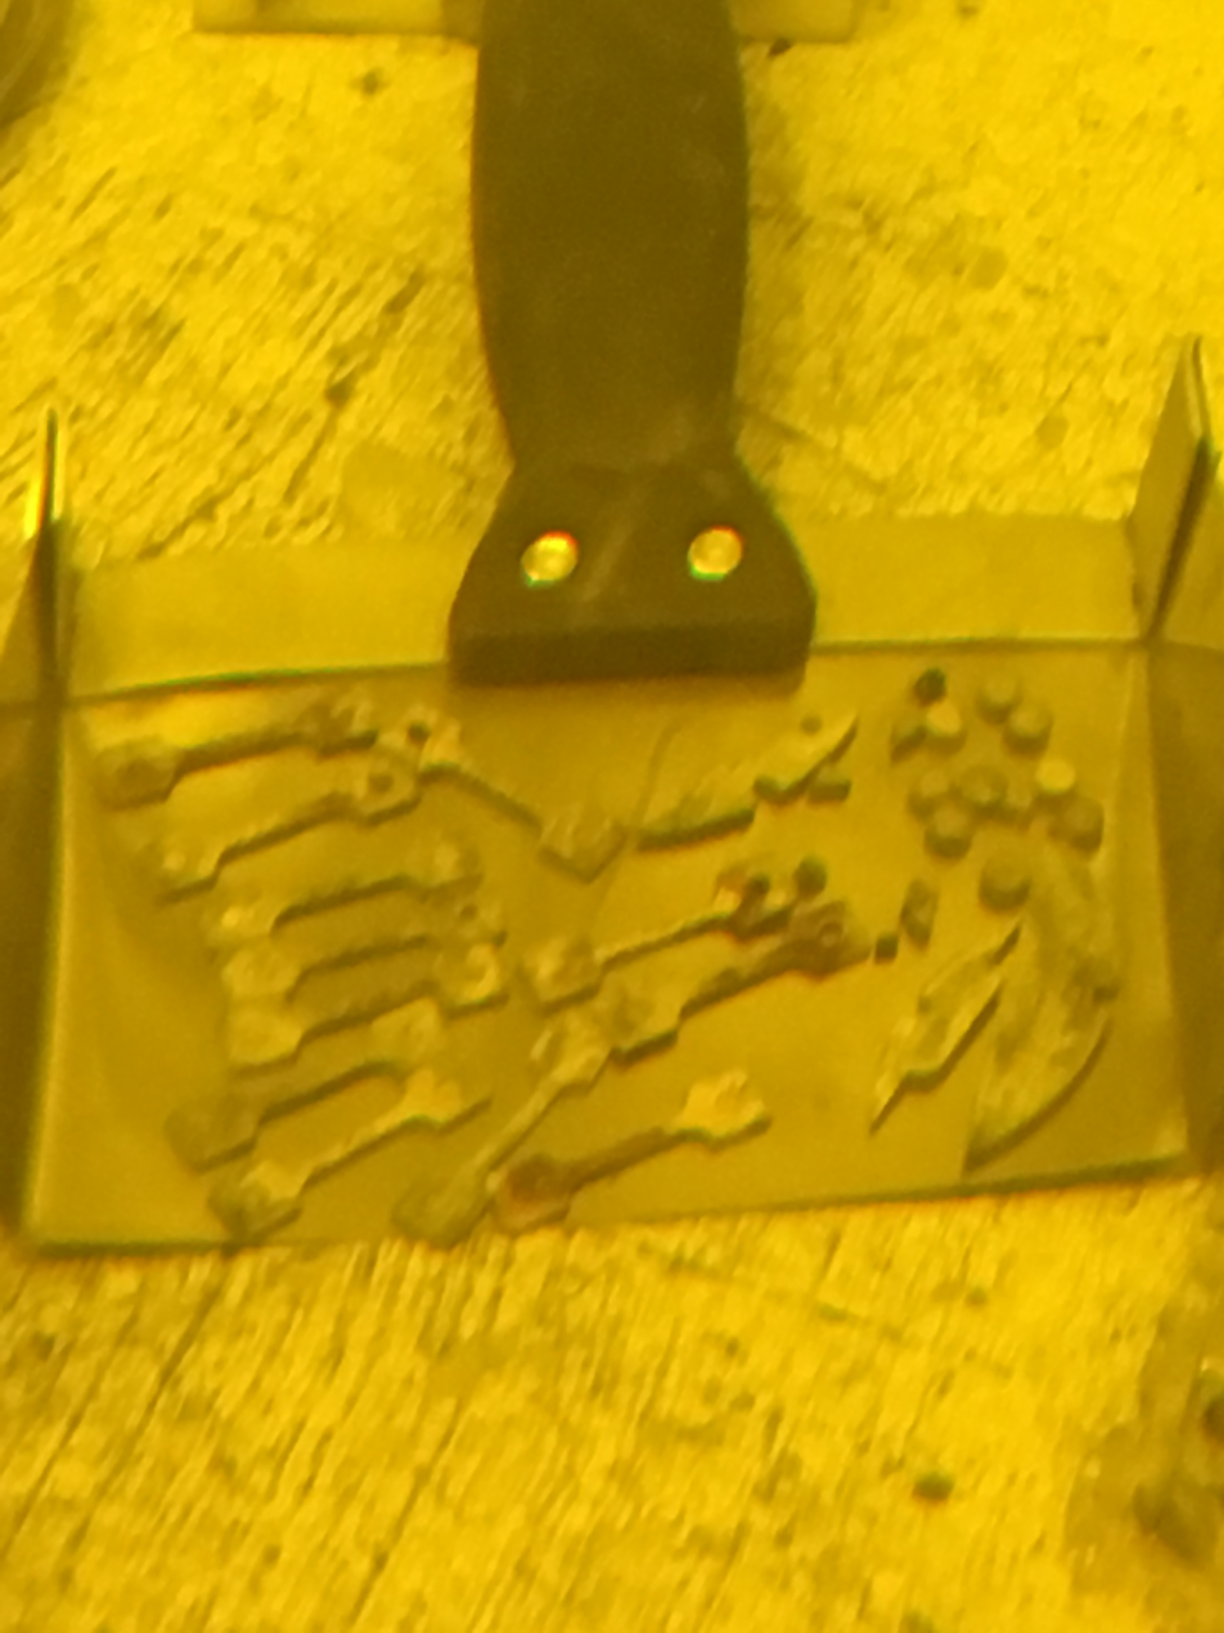
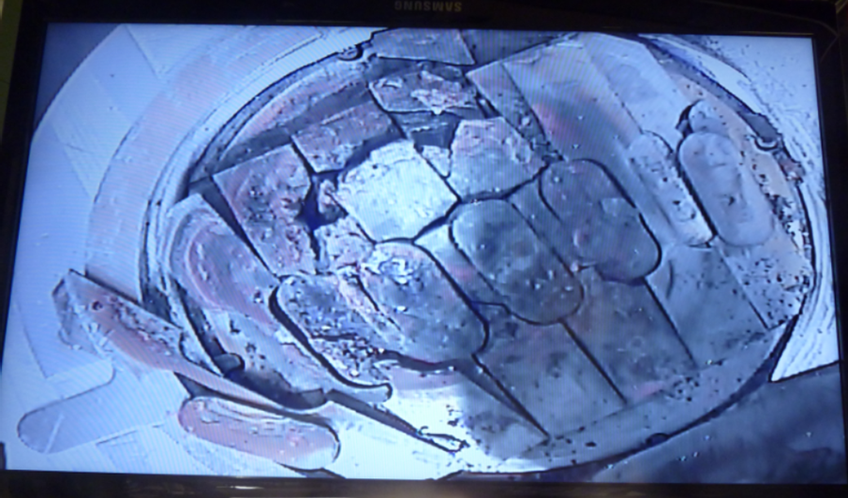
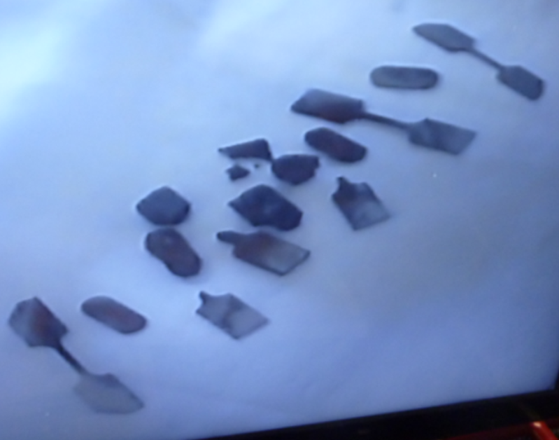
Salvaged specimens from damaged capsules
ESS Aluminum capsule
Some specimens recovered (at BNL)
FNAL Graphite capsule
5 HiRadMat specimens recovered and inserted in HRMT43
6 CTE, 9 tensile & 4 bend bars intact
Potential PIE work likely to be done at BNL
No plans to proceed with PIE at the moment
CERN/KEK Silicon capsule
KEK/FRIB US Titanium capsule
1 SiC-coated C & 2 Si specimens inserted in HRMT43
Remaining 4 SiC-coated C at PNNL
  Cracks observed in two specimens
  SEM & TDS PIE work at PNNL
Microstructural analyses for Si bend bars?
A few micro/tensile specimens per layer intact
Microstructural analyses at PNNL?
Irradiation conditions (temperature, oxidation, etc.) uncertain for breached capsules

Slide 10
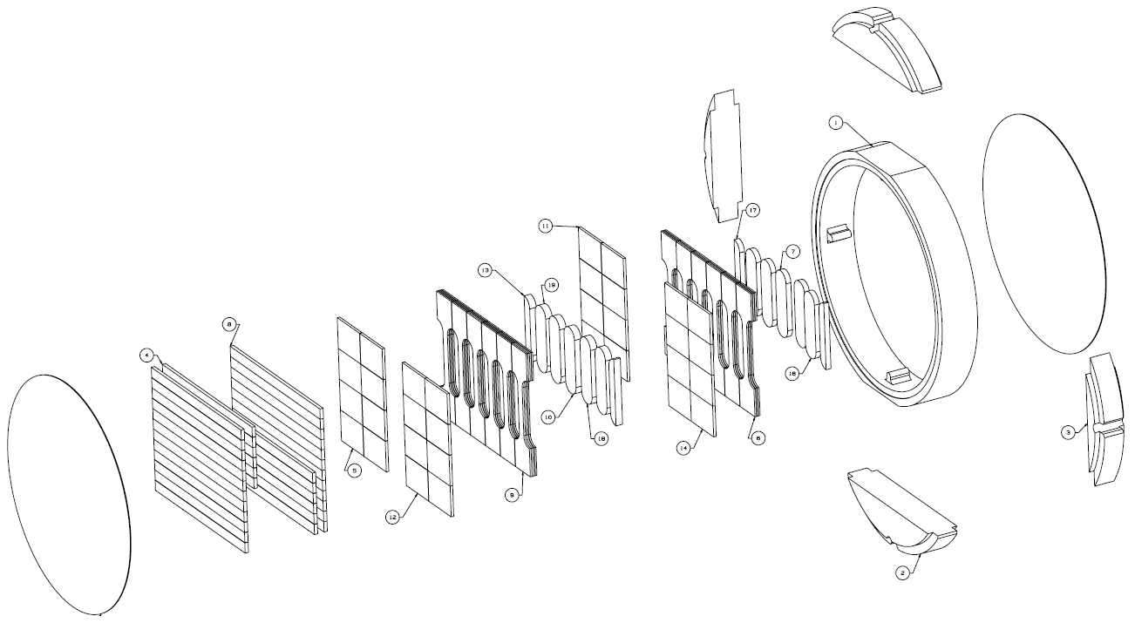
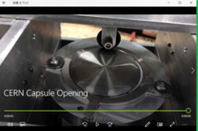
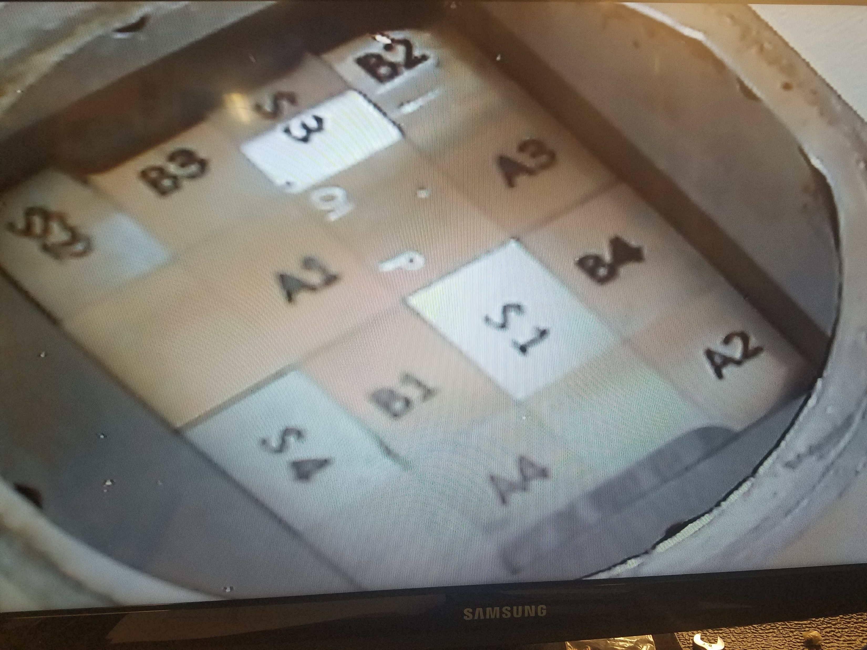
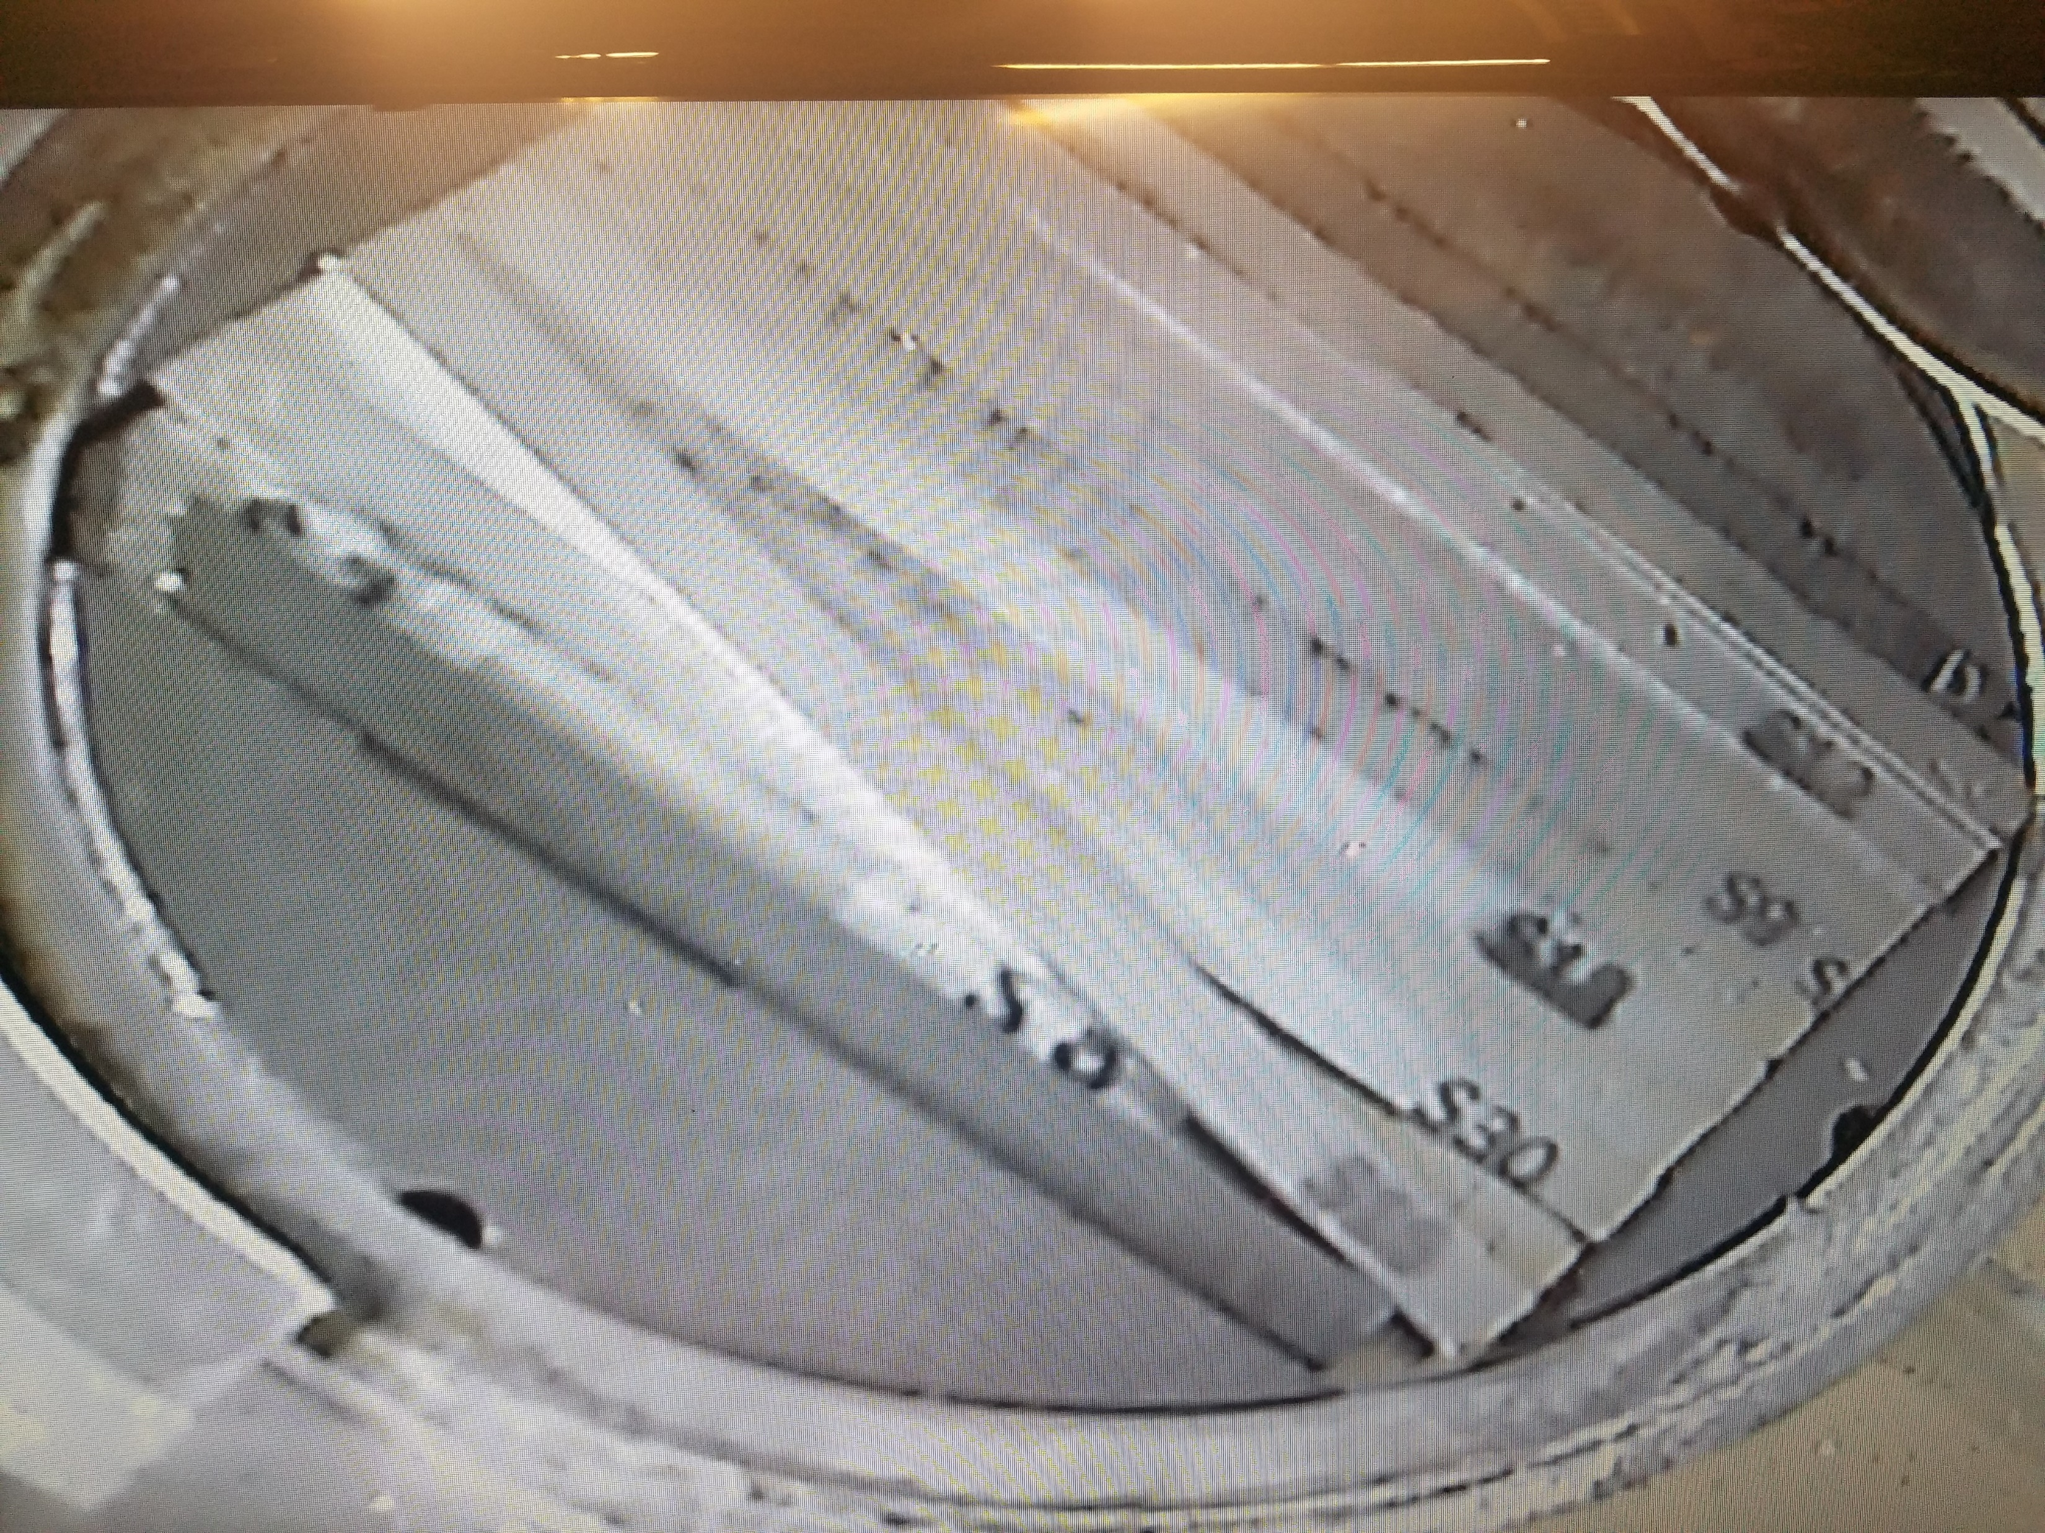
Beryllium capsule status
POT: 4.57E21, Peak DPA: 0.06
Peak irradiation temperature ~520 °C
Several Be grades: PF-60, S-65F, S-200F, S-200FH
36 bend bars, 42 tensile specimens, 32 HiRadMat specimens, 10 microstructural specimens
Capsule shipped and opened at PNNL
Remote handling capsule opener
HiRadMat specimens shipped to CERN for HRMT43 thermal shock experiment
PIE work at PNNL (2019)
Bend tests
Tensile tests
Microstructural analyses

Slide 11
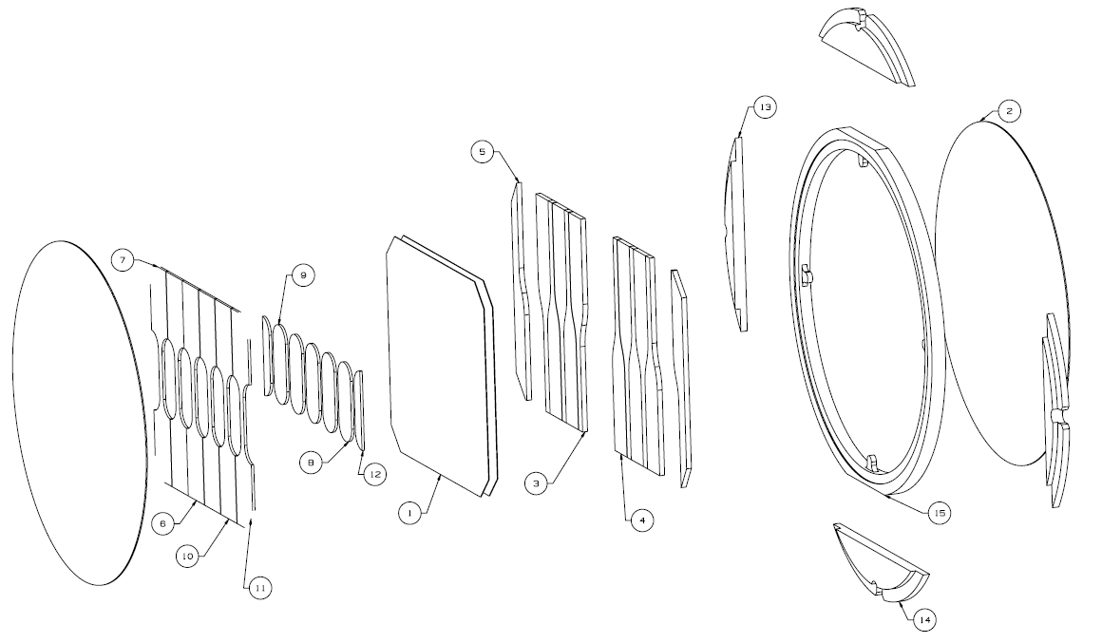
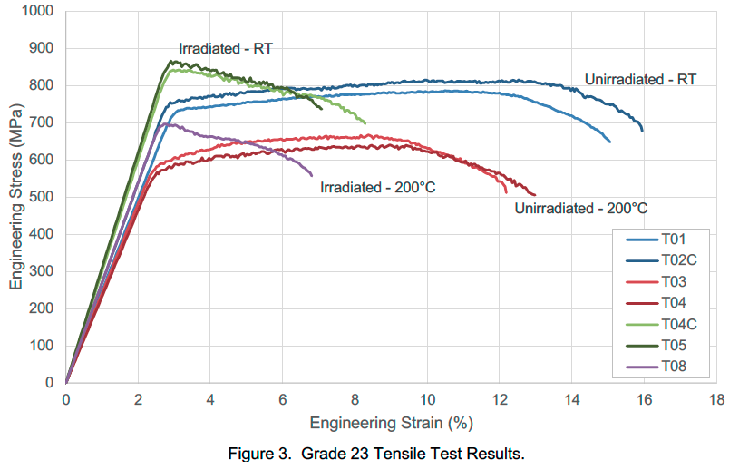
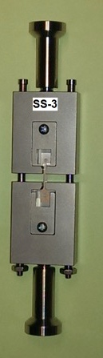
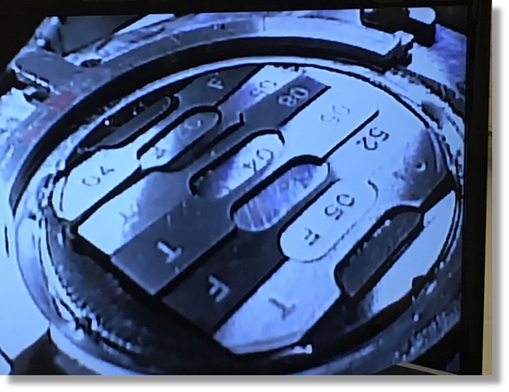
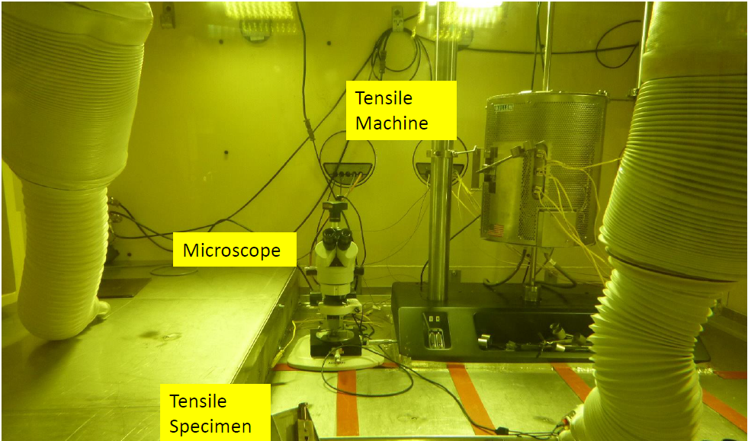
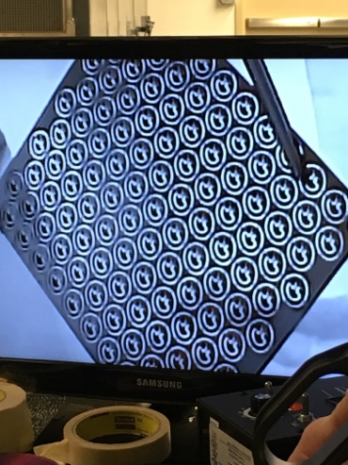
DS Ti 1 capsule status
POT: 7.30E20, Peak DPA: 0.25
Peak irradiation temperature ~130 °C
Several Ti alloys: Gr5, Gr23, Gr9
6 tensile specimens, 5 microstructural specimens, 10 fatigue specimens, 1 meso-scale fatigue foil
Capsule shipped and opened at PNNL
Preliminary tensile tests indicate hardening at relatively low dose
Two specimens shipped to CERN for HRMT43 experiment
Meso-scale fatigue foil
PIE work (2019)
Fatigue specimens to FNAL
Meso-scale foils to Oxford
Microstructural analyses at PNNL

Slide 12
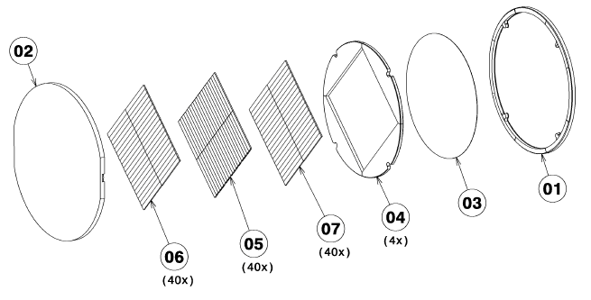
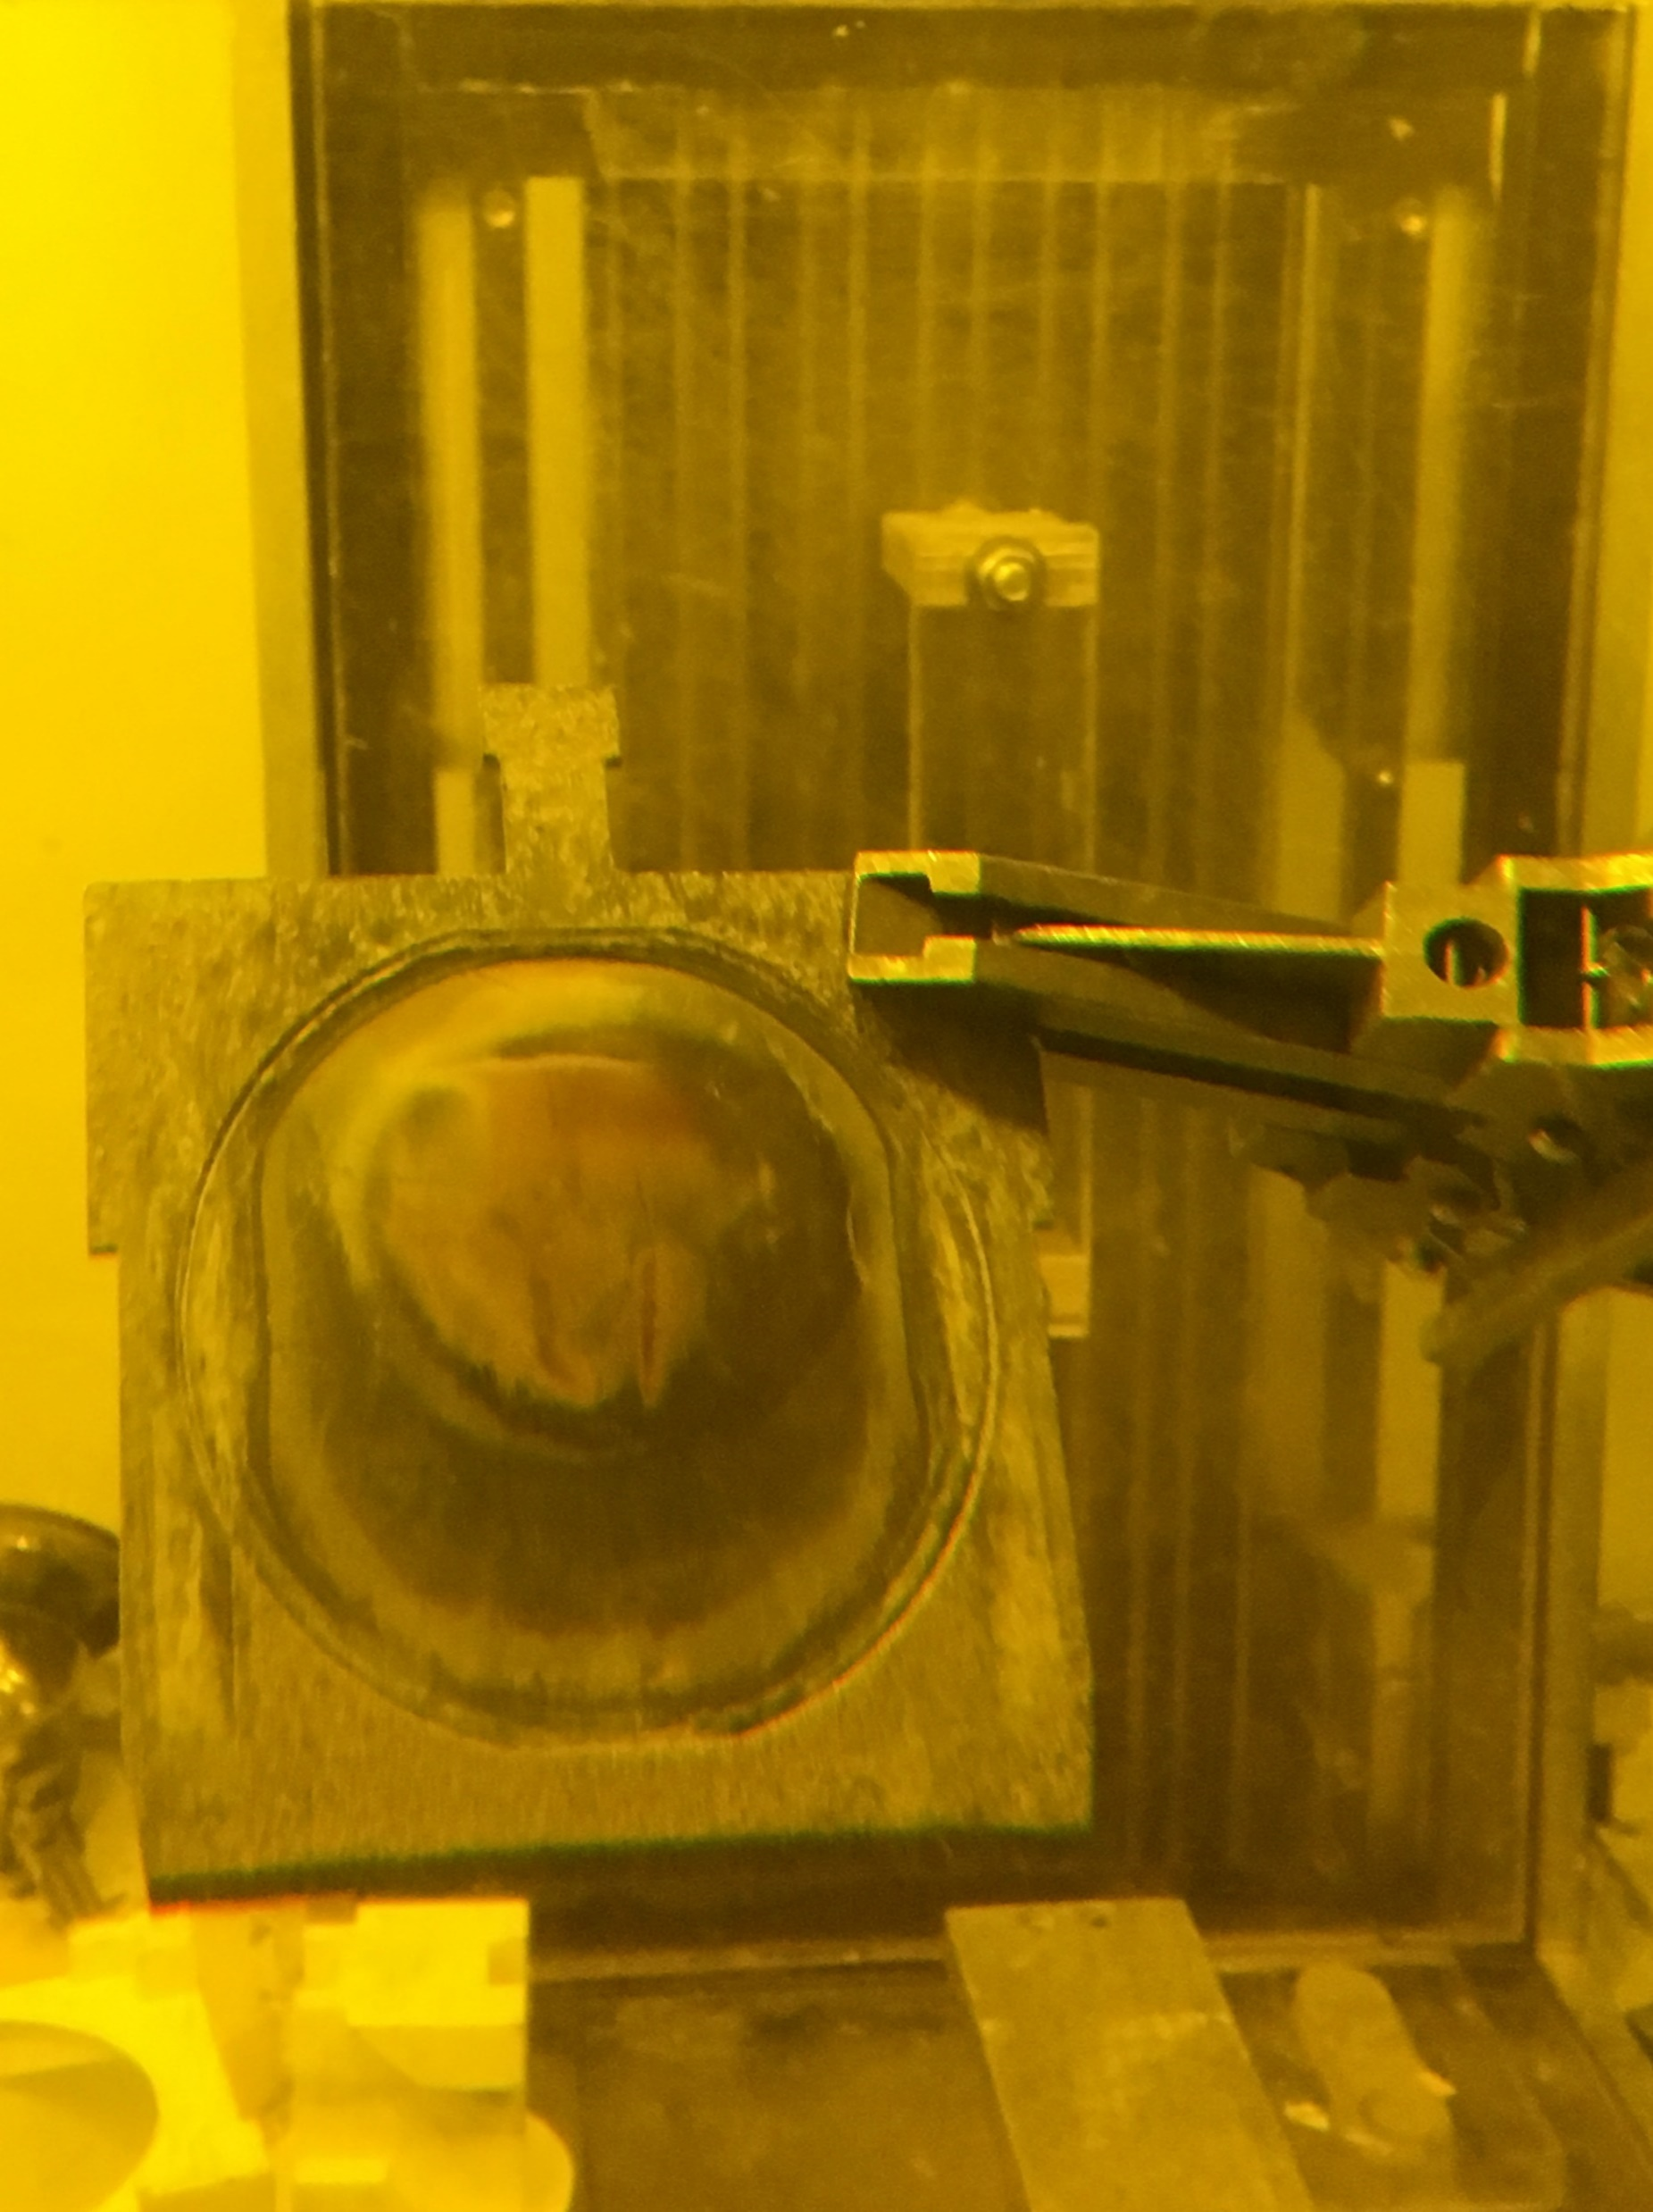
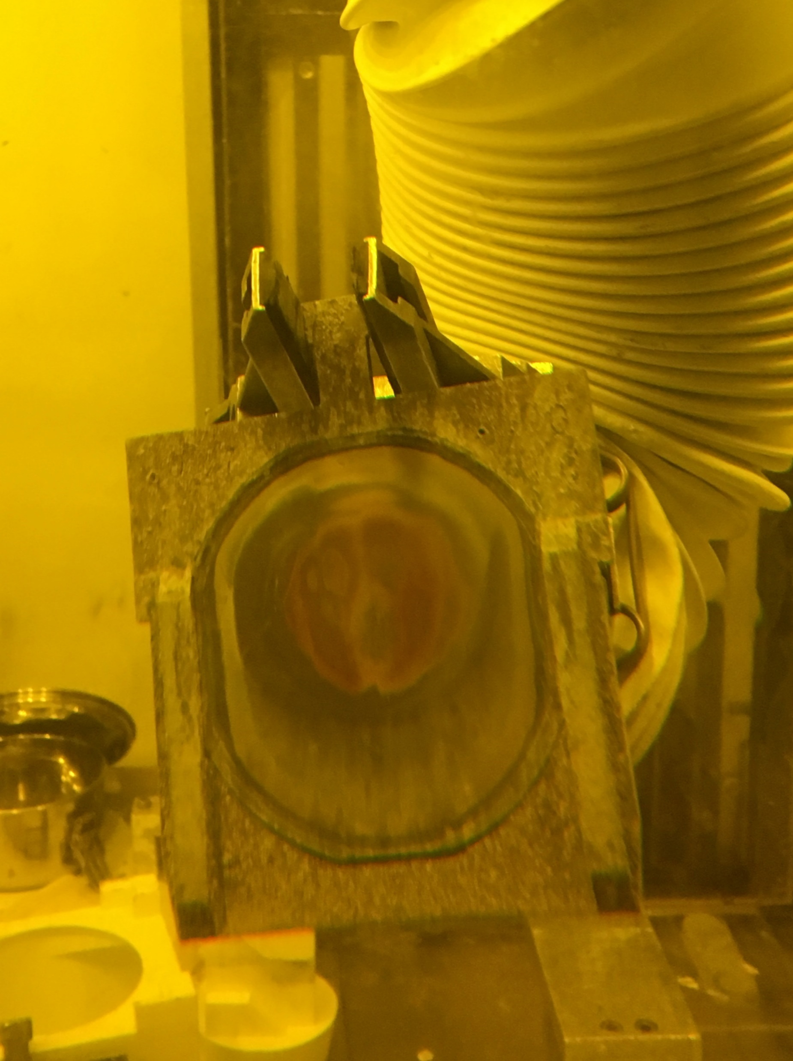
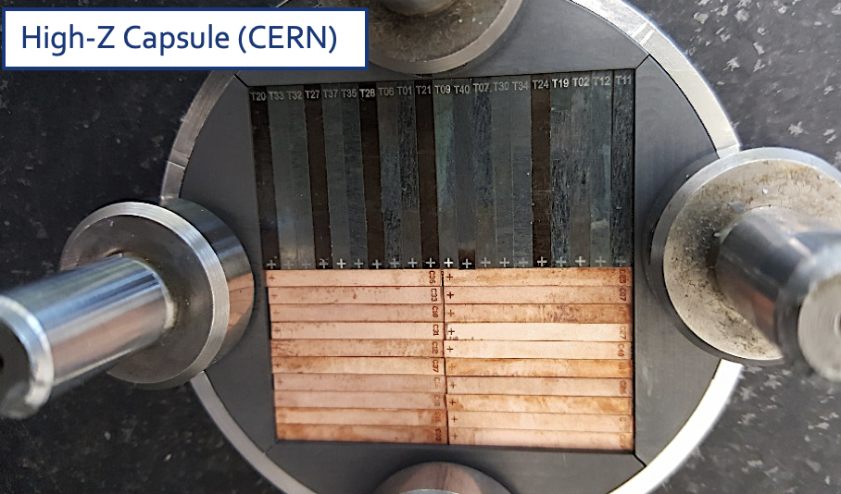
High-Z capsule status
POT: 1.03E21, Peak DPA: 2.75 (Ir)
Peak irradiation temperature ~860 °C
40 bend bars each for CuCrZr, Ir, TZM
1 flexible graphite sheet
Capsule currently at PNNL
PIE work (2019)
  4-point bending test
  PIE location yet to be confirmed

Slide 13
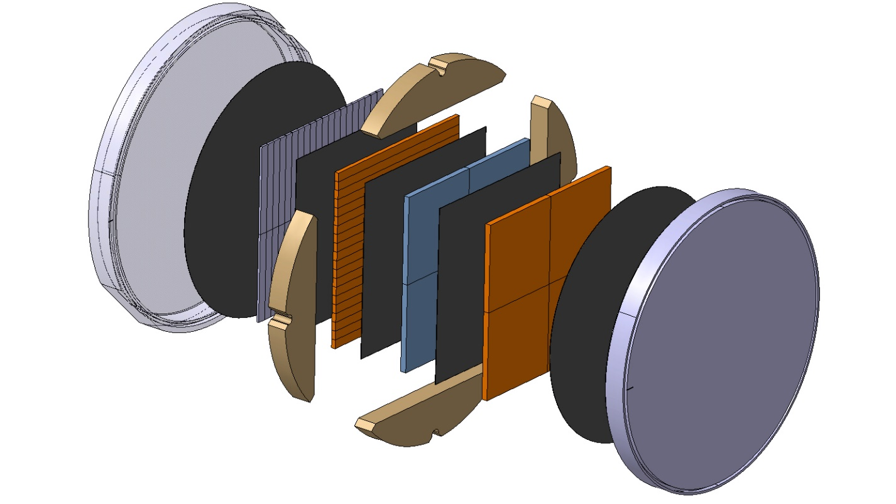
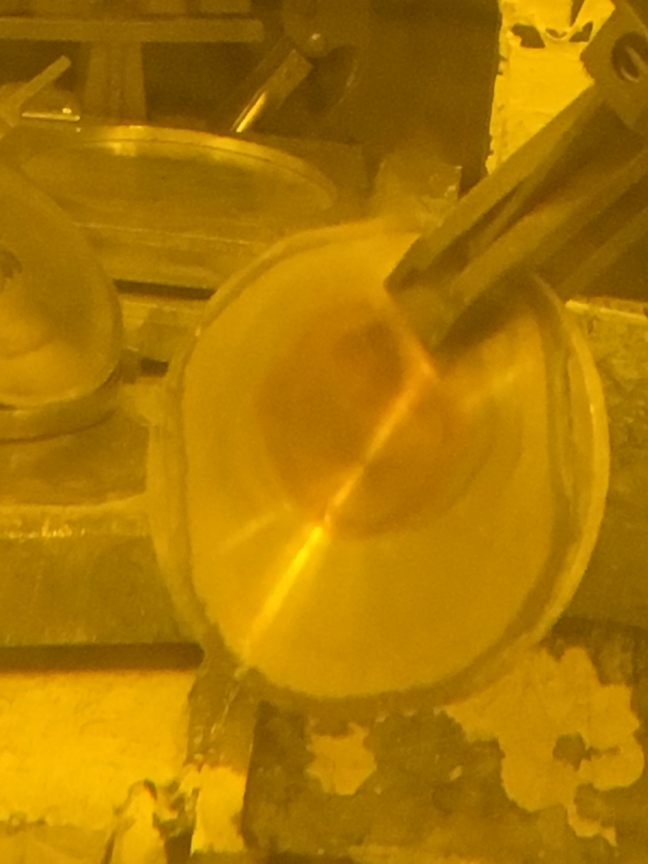
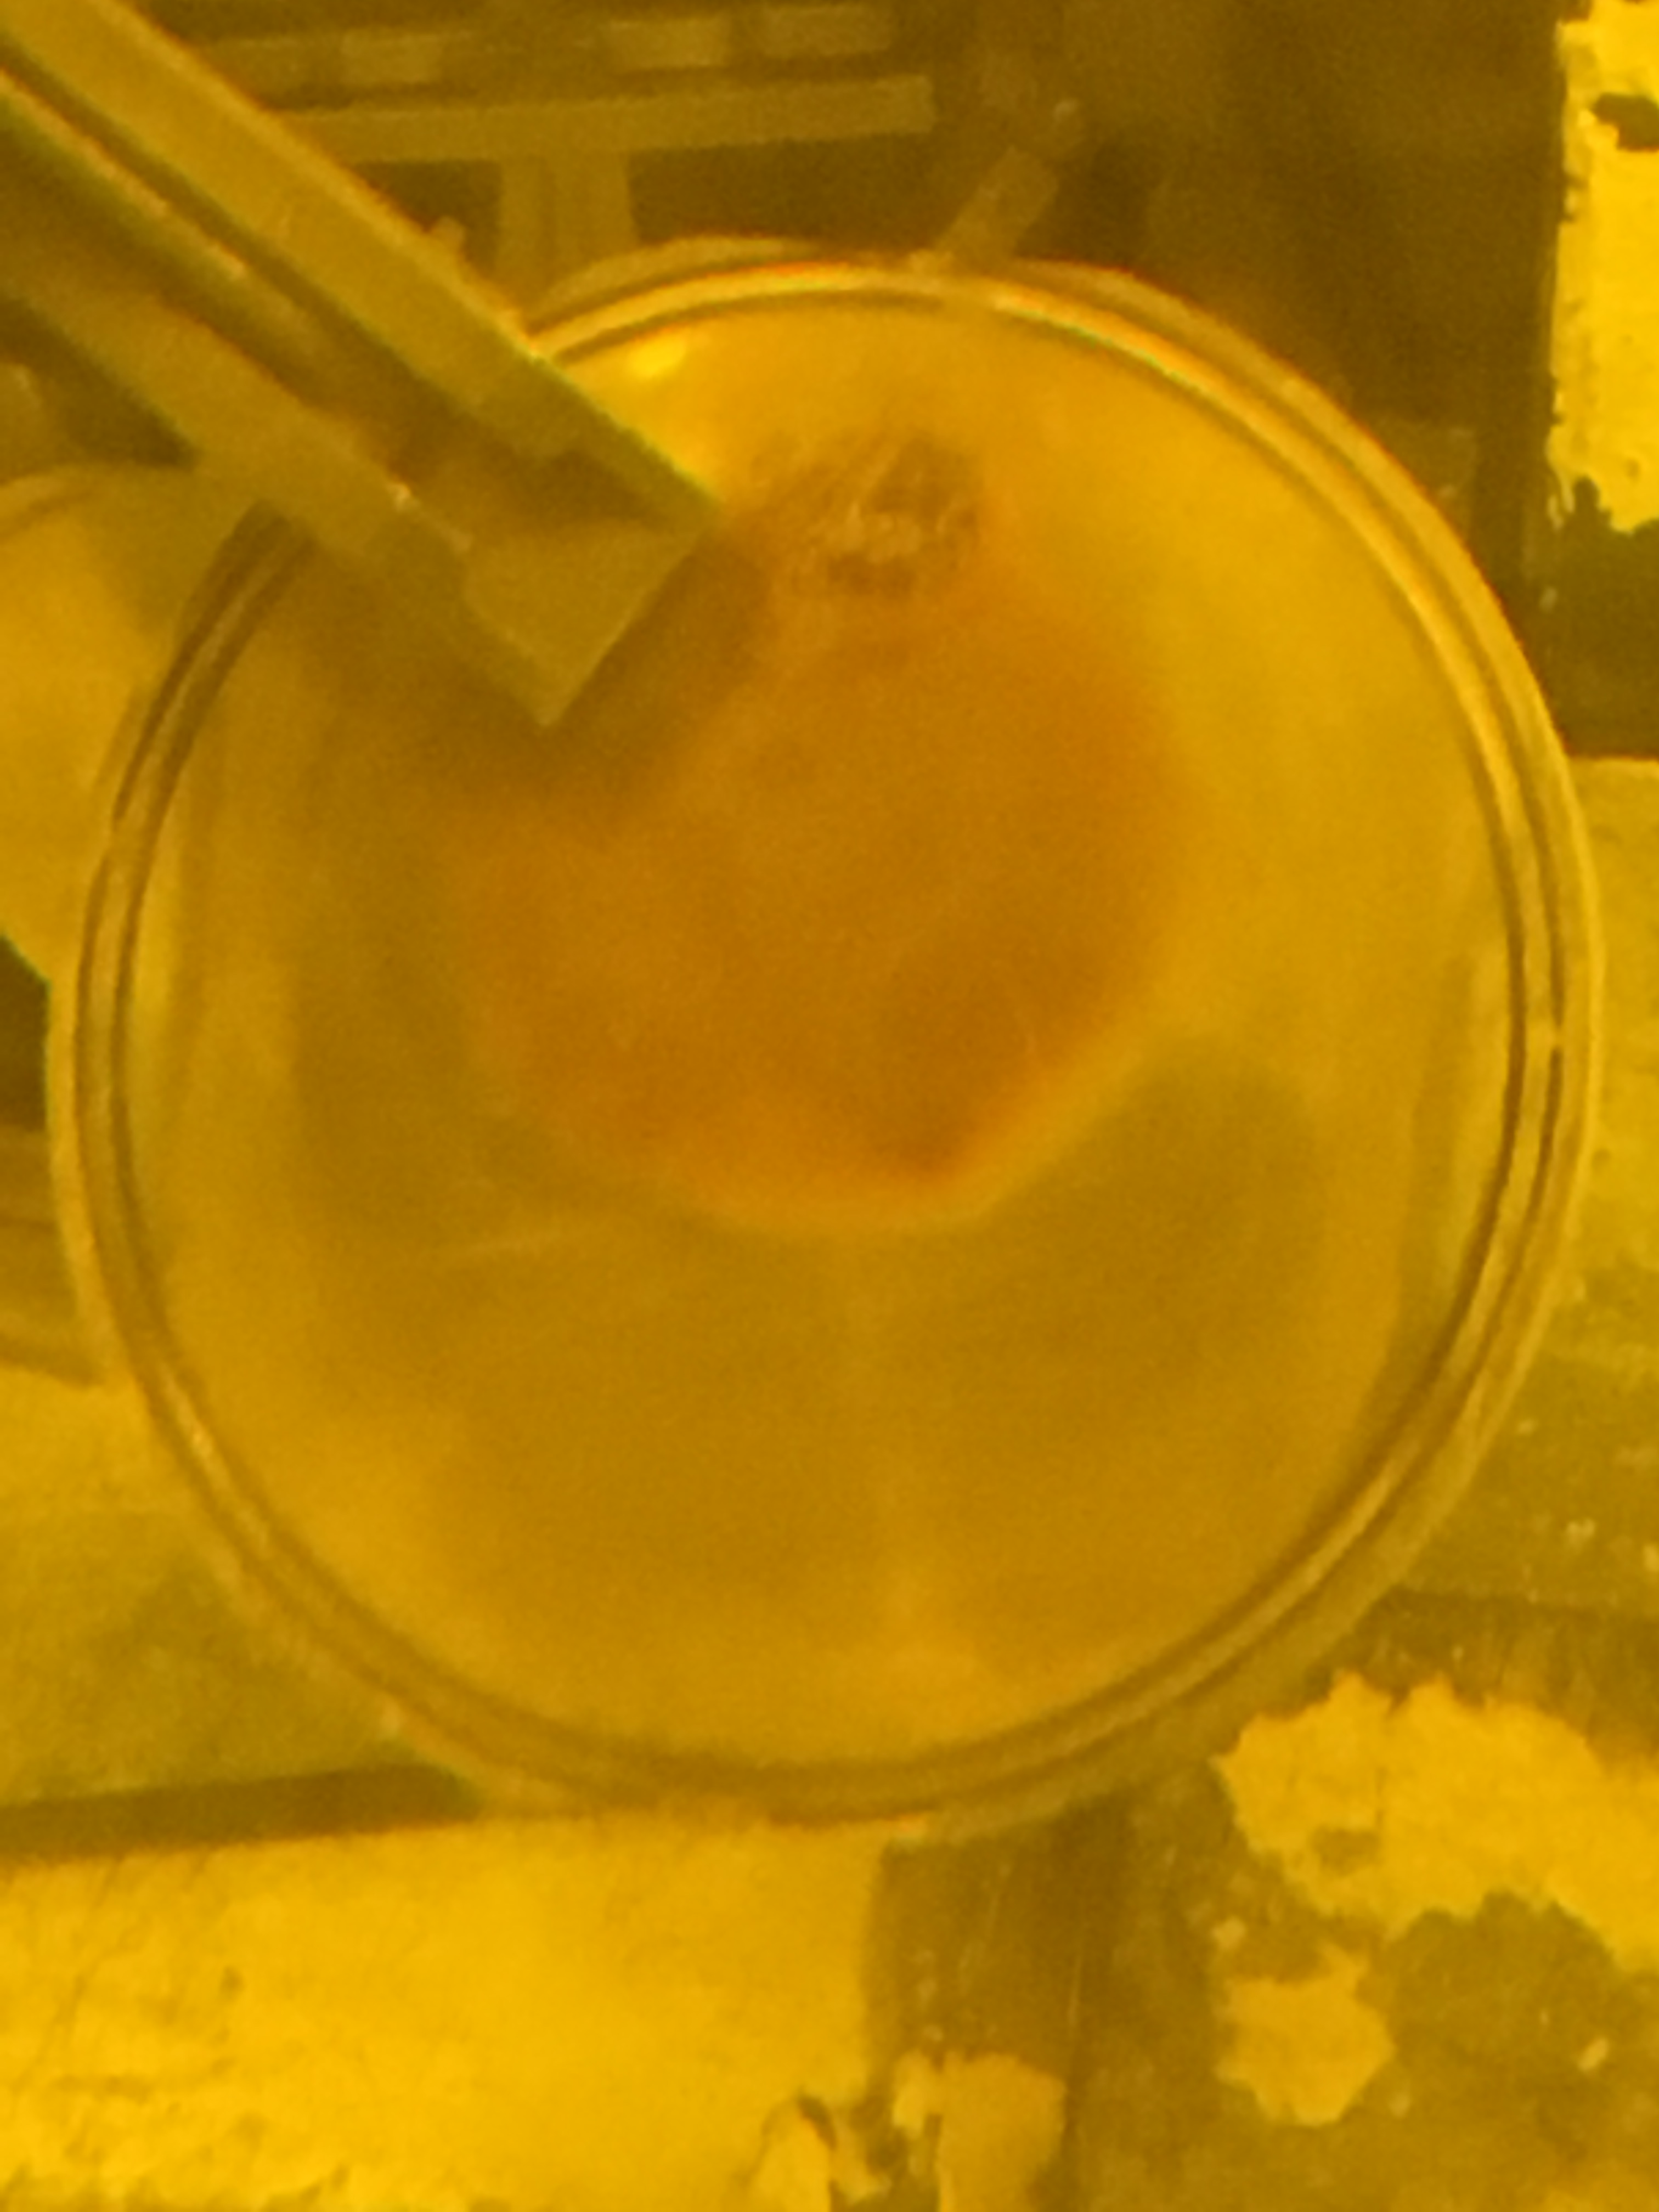
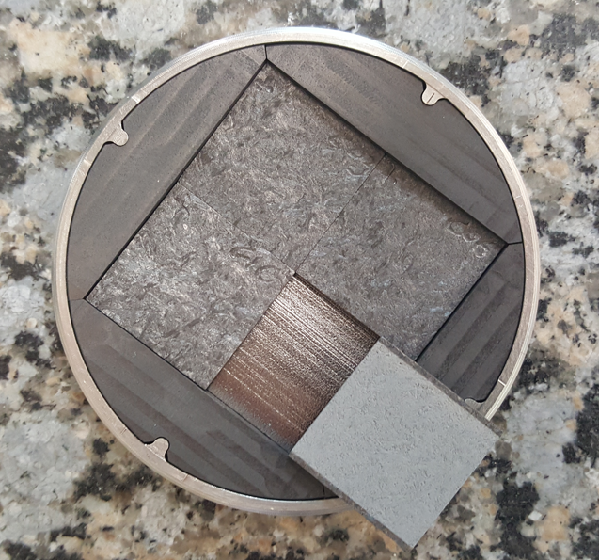
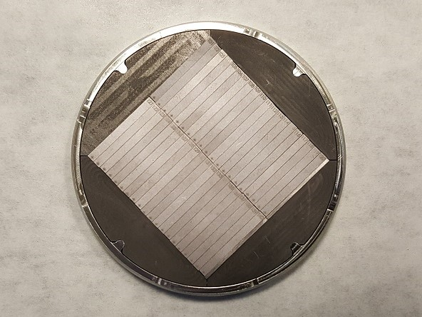
CERN-2 capsule status
POT: 2.80E21, Peak DPA: 4.77 (TaW)
Peak irradiation temperature ~230 °C
TaW, Si, CfC, MoGr, PNG
Bend bars (40 TaW, 40 Si) and foils/plates for microstructural analyses
0.5 TaW
1 Si
1.35 CfC
1.35 MoGr
Capsule currently in storage at BNL
4.5 C
0.1 PNG
PIE work (2019)
4-point bending test, optical and SEM microscopy
PIE location yet to be confirmed

Slide 14
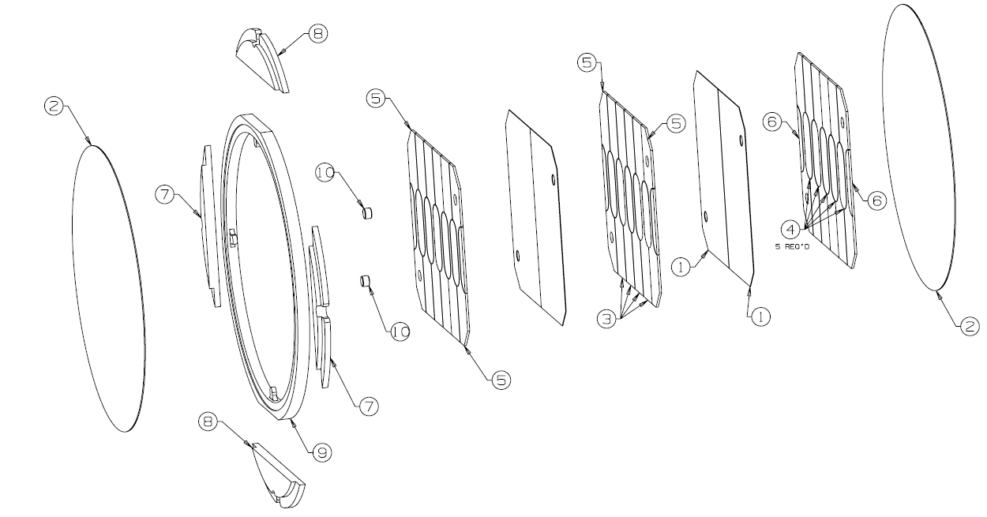
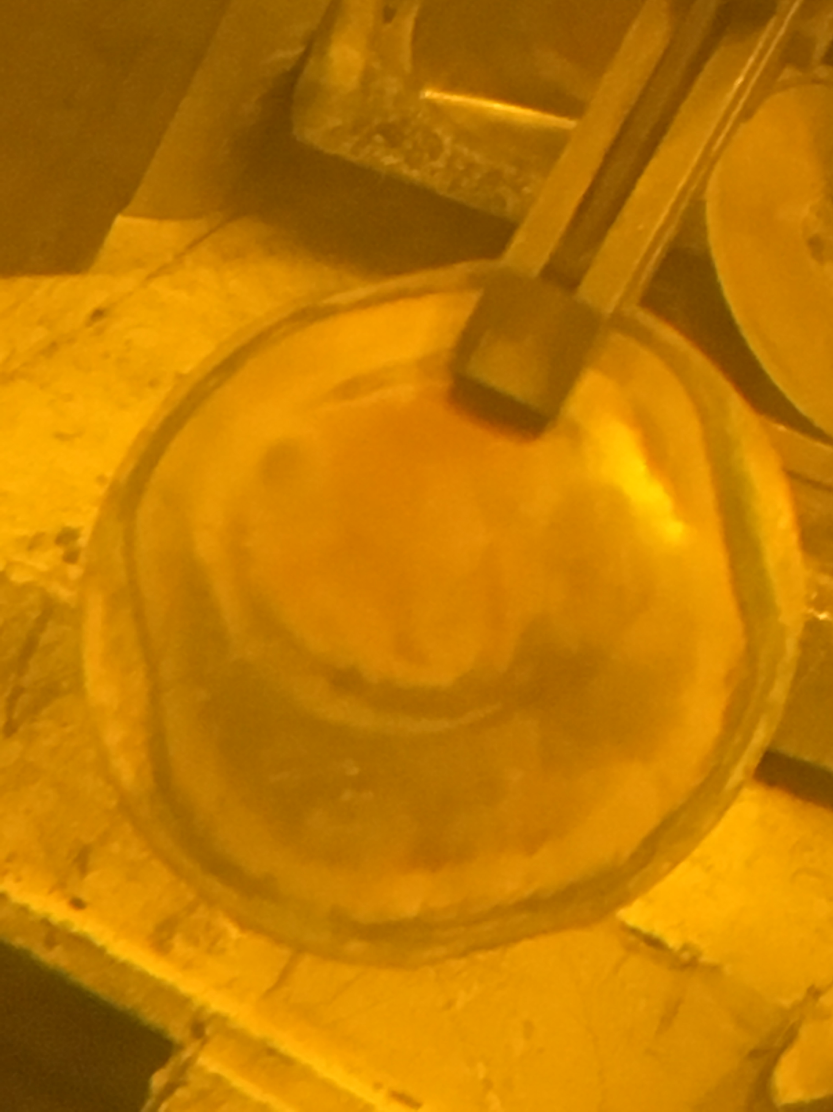
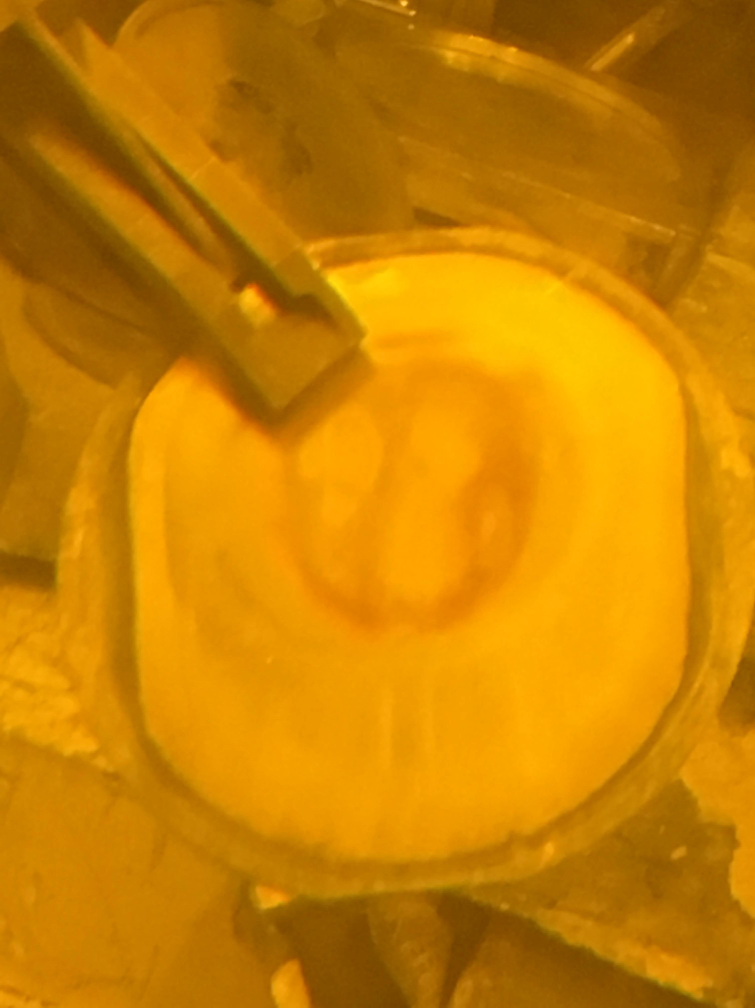
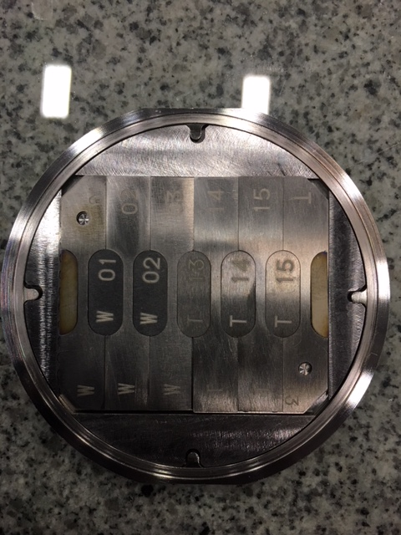
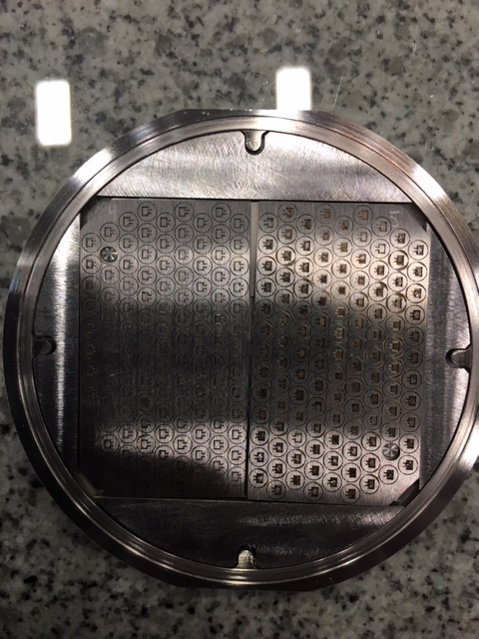
DS Ti 2 capsule status
POT: 2.81E21, Peak DPA: 0.95
Peak irradiation temperature ~130 °C
Several Ti alloys: Gr5, Gr6, Gr2, Gr23, Ti-15-3
18 tensile specimens, 15 microstructural specimens, 4 meso-scale fatigue foils
Capsule in storage at BNL
PIE work (2019)
Meso-scale foils will be shipped to Oxford
Tensile tests and microstructural analyses at PNNL

Slide 15
Next steps
Capsule shipment and PIE work prioritization
Coordination and logistics of shipping capsules and specimens to various institutions
  BNL > PNNL > Oxford
  BNL > CERN
  PNNL > FNAL
  PNNL > CERN
Timeline and priority for PIE need to be established
Additional Type A container for shipment?
Working meeting this afternoon (13:00)
BLIP irradiation scheme (discussed at yesterday’s working meeting)
Investigate capsule failure root causes
  Overheating, beam position, weld quality, water flow characteristics, capsule handling, etc.
How can we improve design of next irradiation campaign at BLIP?
  Better control/understanding of irradiation environment
  CFD analyses to confirm flow/cooling characteristics
  More robust capsule design
  Handling procedures and installation/beam checks

Slide 16
Conclusions
RaDIATE BLIP irradiation achieved desired beam time on capsules
  8-week irradiation with 4.57E21 POT (154 µA average)
Unfortunately, 4 out of a total of 9 capsules were breached/damaged
  Hope to still get some PIE data out of salvaged specimens
PIE of specimens from 5 intact capsules will generate valuable results for multiple materials over the next two years
Next BLIP irradiation (2021?)
BLIP one of the very few facilities currently accessible to perform HE proton material irradiations
  Provides baseline radiation damage data to compare and correlate with other irradiation methods (LE ions)
Before the next irradiation, the goal is to better understand BLIP irradiation conditions and have more beam/instrumentation diagnostics along with a robust experimental design

Slide 17
Acknowledgement
Many thanks to all the RaDIATE institutions involved in the design and execution of this irradiation run
Special thanks to
BNL BLIP colleagues for their support
C. Cutler, D. Kim, D. Medvedev, N. Simos, L. Mausner and others at BNL
Oakridge National Laboratory for providing a Type a container for capsule shipment
B. Reimer, D. McClintock

Slide 18
Thank you for your attention

