Slide 1
IR magnets and MDI integration
A.Bogomyagkov, A.Krasnov, E.Levichev, S.Pivovarov, S.Sinyatkin
Budker Institute of Nuclear Physics, Novosibirsk, Russia

Slide 2
Initial conditions and constrains
Full crossing angle 30 mrad.
First (defocusing) quad QC1 is placed in L*= 2.2 m from the IP.
Set of magnets (QC1, QC2, A-sol, screening sol, correctors) in a cryostat which has to occupy ≤100 mrad cone.
Lumical at 1m to 1.25 m in not symmetrical space covering +140 mrad and -100 mrad.
IP vacuum chamber with 30 mm inner diameter increasing with distance.
A BPM (at each tube) before the cryostat.
Remote vacuum flanges.
Bellows before the cryostat.

Slide 3
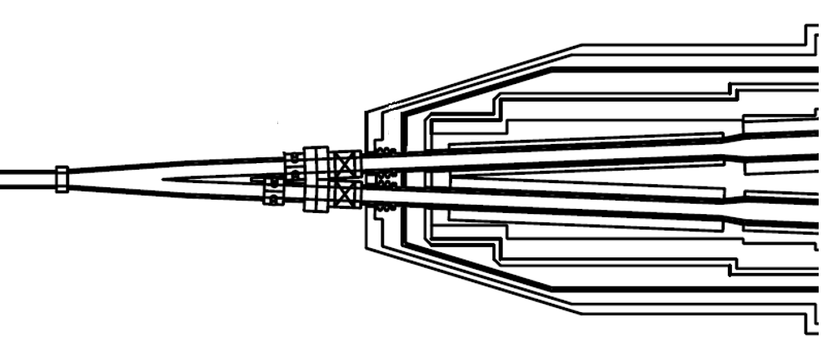
MDI scheme
Very schematical example from KEK.
Cryostat wall thickness
Remote flange
Cooled Y-chamber, HOM absorber, SR masks
Cooled IP Be tube
Cryostat
IP
Flange and Be tube cooling inlet
BPM module
Bellow

Slide 4
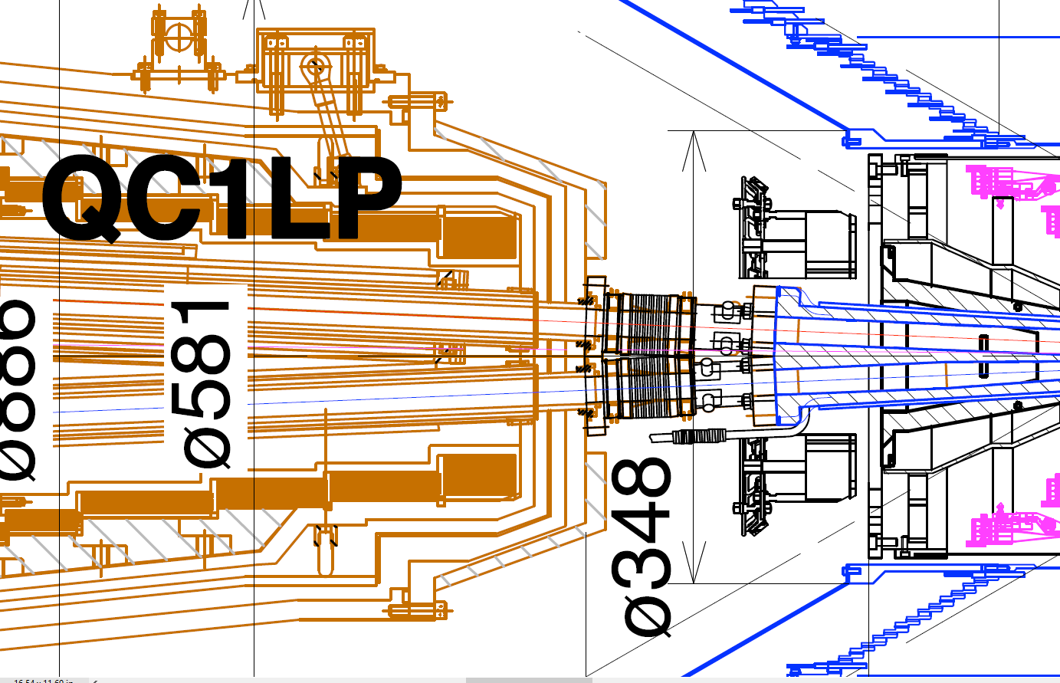
Cryostat “wall” thickness (KEK)
58 mm
According to BINP experts (~50 SC wigglers), a minimum cryostat “wall” thickness is ~30-50 mm, which corresponds well to the KEK example drawing.
37 mm
50 mm
Outer SS wall 15 (5) mm
10 (7) mm superinsulation
Cu screen 4 (2) mm
10 (3) mm vacuum
Inner SS wall 6(5) mm
In total: ~45 (22) mm

Slide 5
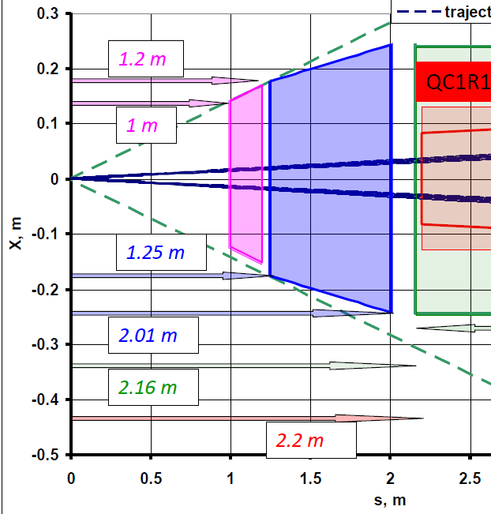
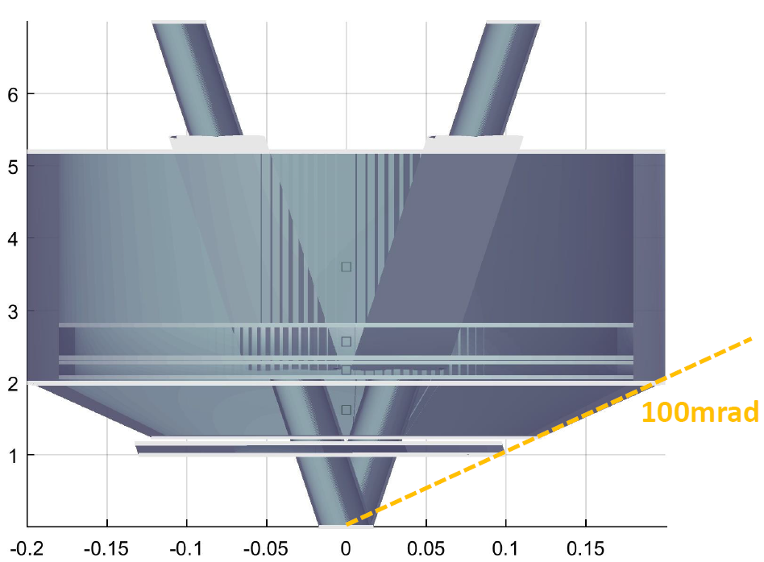
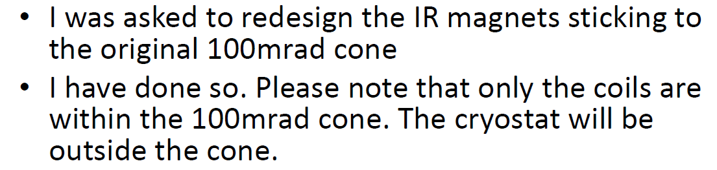
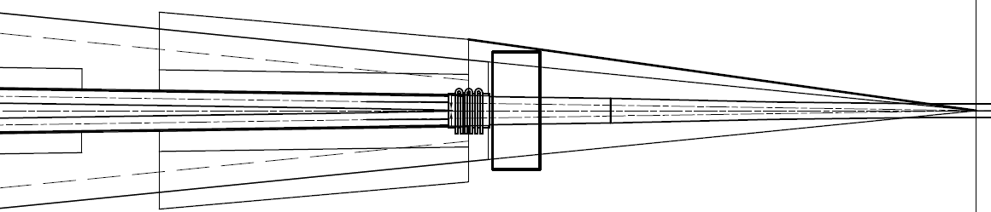
February MDI meeting at CERN
Mike’s design
Sergey’s design
Anti-sol by Mike
Anti-sol by Sergey
Cryostat is in the 100 mrad cone with 50 mm wall
Lumical
QC1
140 mr
100 mr
Anti-sol
Neither Mike’s no Sergey’s (old) design fits the cryostat
HOM abs.

Slide 6
February MDI meeting at CERN
LumiCal
ScS
CS
HOM Absorber
Qs
Between remote flanges
Two bellows
NEG pump, custom design
Remote flange

Slide 7
Koratzinos design, (February)

Slide 8
Remote flange prototype
Flange outer dimensions:
Length 71.5 mm
Flange 2*radius(2*43)+ distance between beams
At s=1619 mm
Flange outer size
Receiving part
1619*0.03+86=134.57 mm
Incoming part
134.57+6=140.57 mm

Slide 9
Current IR design
Present designs does not fit the 100-mrad-cone with the cryostat.
Having the flange inside the cryostat, how to fit mechanical transmission of the flange?
Reduction of antisolenoid diameter is not possible, because it will degrade the vertical emittance due to the strong horizontal field at the beam’s orbit.
Stray field from large diameter antisolenoid needs a large gap before the first quadrupole.
Even if we increase 100 mrad cone to 140 mrad, still there are problems with accommodation of HOM absorber, flanges, bellows, BPMs, NEG pump (needs to be activated by heating to 400°C).

Slide 10
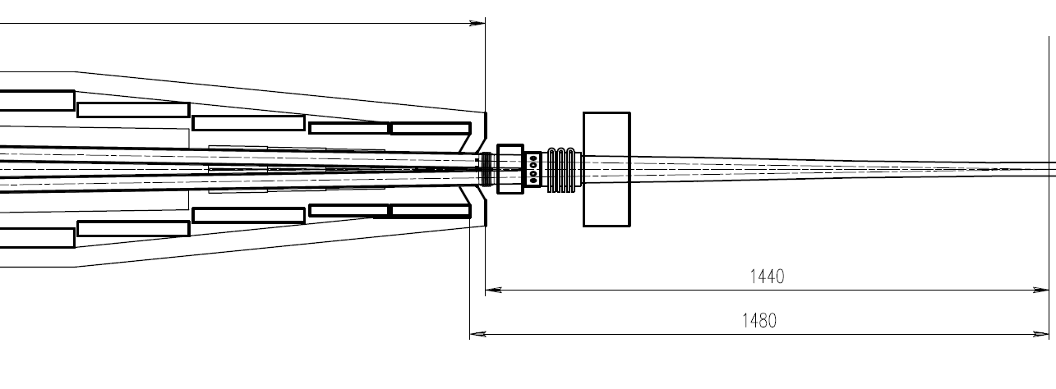
New design of the cryostat tip (preliminary)
Individual antisolenoids for each beam shifted closer to QC1 and covered by common screening solenoid ( –2 T).
Remote flange
Screening sol
Cryostat, 100 mrad, 22-50 mm “wall” thickness
HOM abs. + NEG pump
BPM
Lumical
Bellows
Antisolenoid x 2

Slide 11
Compact single beam solenoid
Individual anti-solenoid for each beam covered by common screen-solenoid ( –2 T) shifted closer to QC1.

Slide 12
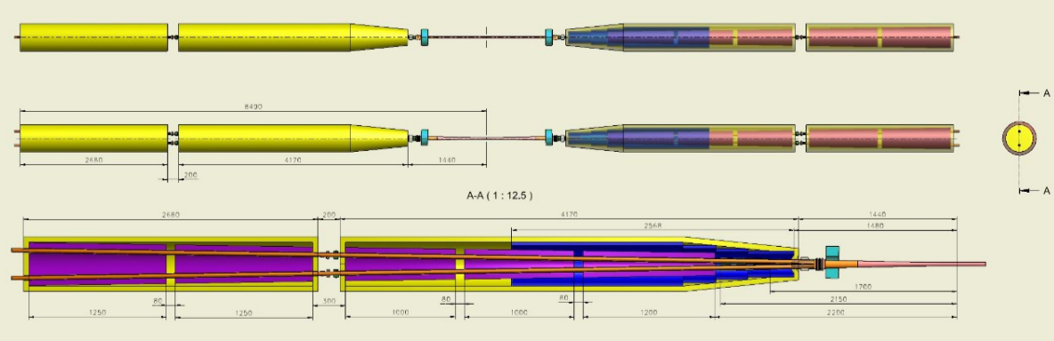
Overall size
500

Slide 13
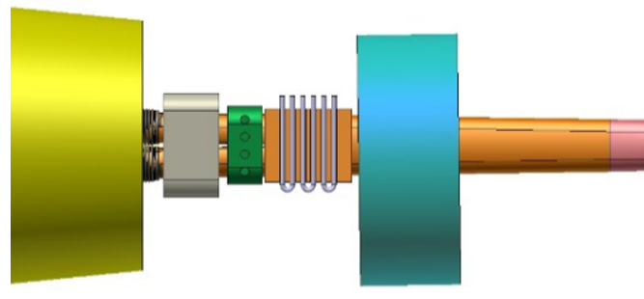
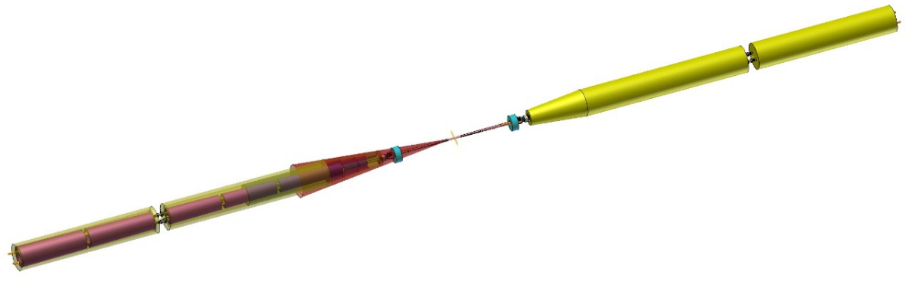
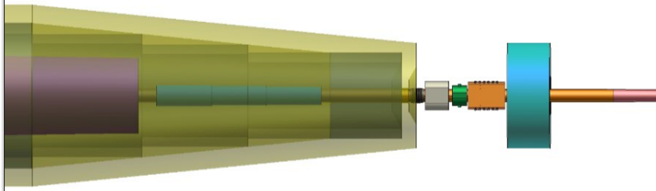
3D views
HOM abs NEG pump
Flange
QC2 cryostat
QC1 cryostat
BPM
Lumical
Anti-sol
100 mrad cone
QC1

Slide 14
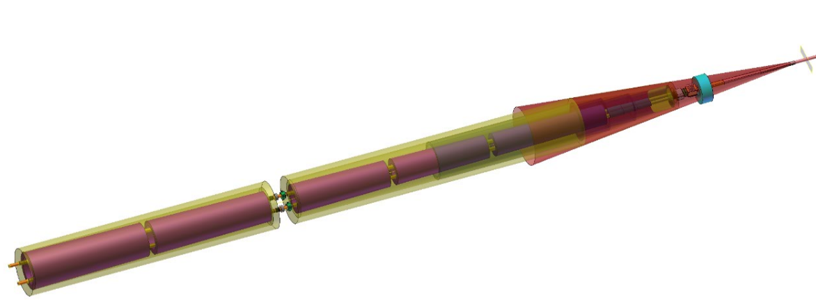
3D views
QC1 cryostat
QC2 cryostat
100 mrad cone

Slide 15
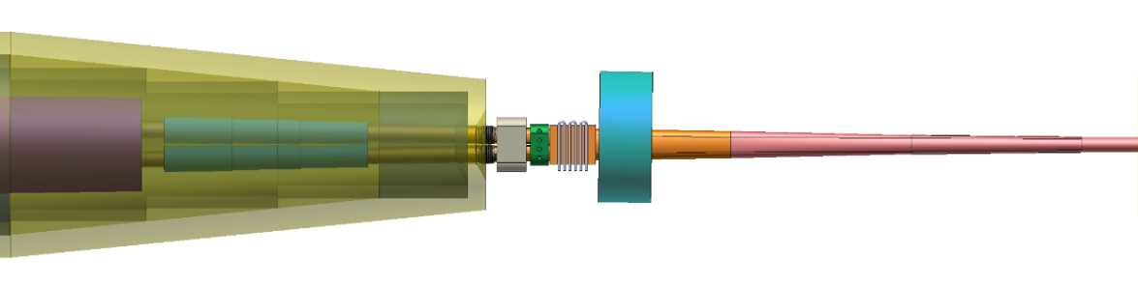
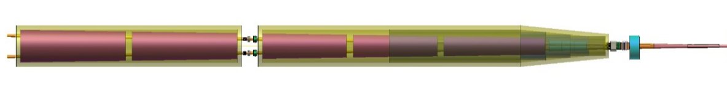
3D views

Slide 16
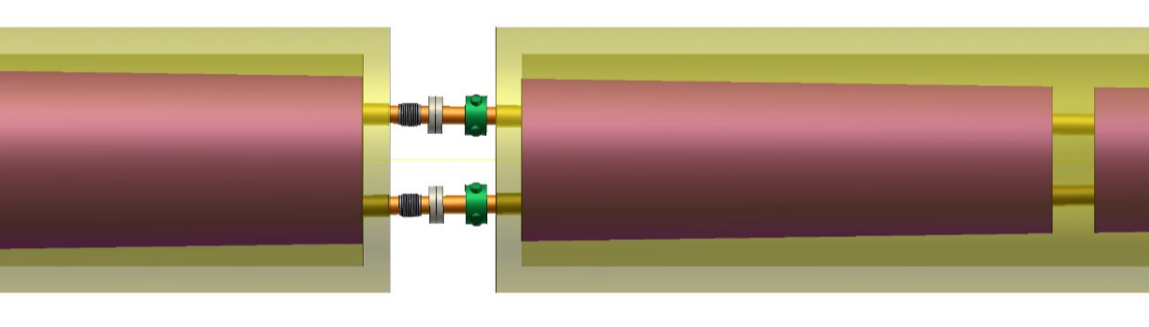
3D views without comments

Slide 17


Assembling with remote control flanges I

Slide 18
Assembling with remote control flanges II

Slide 19
Assembling “on a table” I
500
500

Slide 20
Assembling “on a table” II

Slide 21
3D views without comments

