Slide 1



Task 4.1 – Quench Analysis
B. Auchmann (CERN/PSI), S. Bermudez-Izquierdos (CERN), A. Cario (KIT), C. Calzolaio (PSI), F. Grilli (KIT), J. Lucas (Elytt)
WP 4 Meeting, Oxford Instruments, April 4 2018

Slide 2
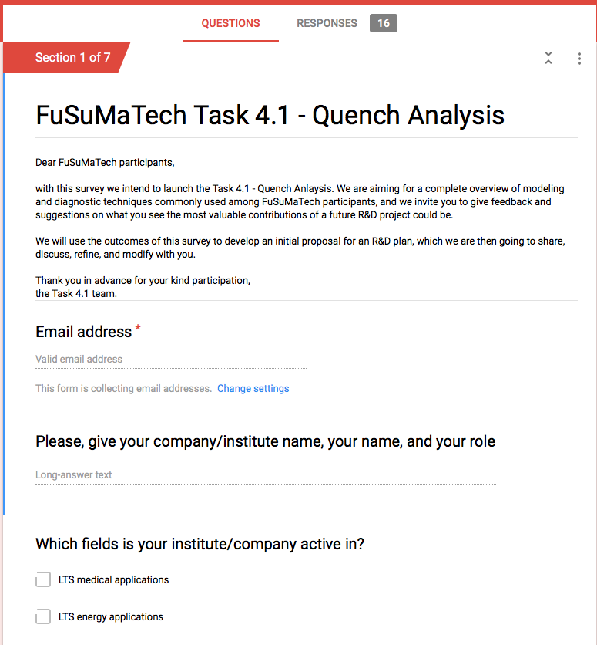
Online Survey
Online Survey among FuSuMaTech participants launched in Jan. ‘18..
  Sixteen responses from:
  Bilfinger Noell, CEA (2x), CERN (3x), CNRS,
  Elytt, INFN, KIT (2x), Oxford Instruments,
  PSI, SigmaPhi, Tesla (2x)
  Missing response from: AS-G, Alstom, STFC.
  Industries (ordered by multiplicity)
  LTS accelerators, LTS medical, HTS energy,
  HTS accelerator, LTS energy.
  Typical geometries (ordered by multiplicity):
  Solenoids, long accelerator,
  short accelerator

Slide 3
Survey Results
Some questions and answers:
  Software used: ANSYS 2D, COMSOL 2D, Opera vector fields, QLASA, ROXIE, STEAM, other in-house
  Comm. software limitations/potential:
    (+) support, rather flexible, HPC,
    (–) workarounds necessary for superconductivity, setup time, licenses, computation time, blackboxes
  Largest needs:
    Materials data base working with commercial tools, HTS support, efficient 3D, easy generic workflows, coupling to helium fluid dynamics
  HPC: >50% of participants would benefit from better HPC support
  Validation: 94% would benefit or benefit a lot from documented and measured bench-mark cases for code validation.
  Material parameters: strong support for generic mat. database to interface with multiple soft.s, list of “missing” data for LTS and HTS data.
  Diagnostics needs: improved conductor temperature meas. Fast and distributed sensing, detection and diagnostics for HTS

Slide 4
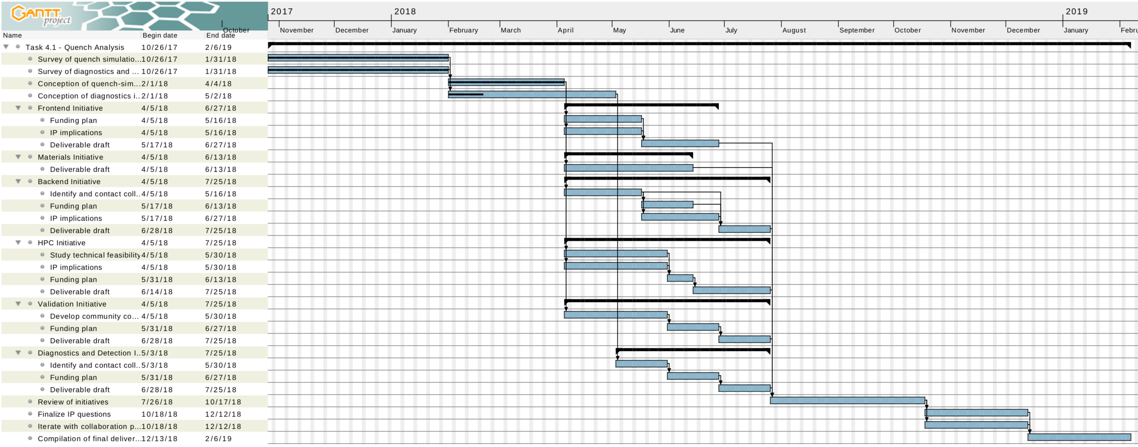
Planning
See if diagnostics&detection should be incorporated in Task 4.3?

Slide 5
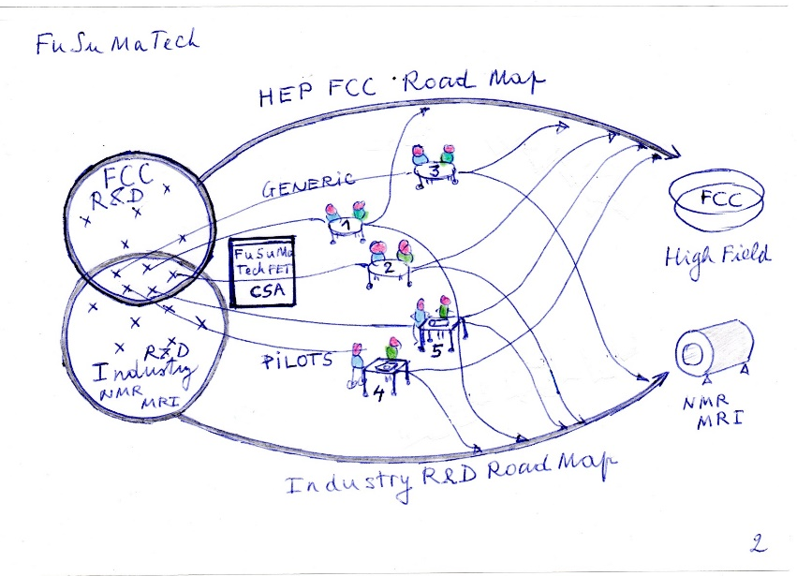
Next Steps
Next five months:
  Refine (as task team) the list of R&D initiatives .
    Assign each initiative to two or more team members.
    Present the status to the community at the April 19 FuSuMaTech workshop.
  Prepare a plan (2-3 pages in total) for the task initiatives until August 2018, to circulate among participants, including:
    organizational structure of each initiative,
    time range and resources,
    integration with WP5 as pilot project,
    feedback to FCC road map,
    potential collaboration partners ,
    funding opportunities,
    licensing questions,
    IP implications.
Beyond August ’18:
    draft project proposal
    contact potential additional partners
    find solutions to IP and licensing questions
    contribution to final deliverable
[A. Dael]

