Slide 1
Progress of X-band High-Gradient
Choke-mode Accelerating Structures
Xiaowei Wu
on behalf of the Tsinghua X-band team and collaboration
2019/3/13

Slide 2
Outline
Introduction
Design and fabrication of Choke-mode structures
Breakdown phenomenon study of Choke-mode structures
High-gradient performance of Choke-mode structures
Summary

Slide 3
Outline
Introduction
Design and fabrication of Choke-mode structures
Breakdown phenomenon study of Choke-mode structures
High-gradient performance of Choke-mode structures
Summary

Slide 4
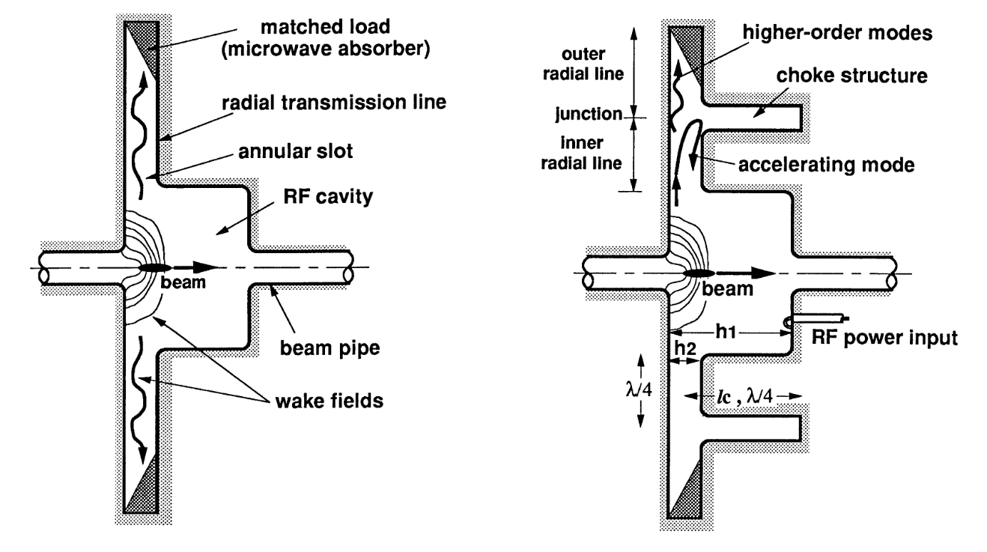
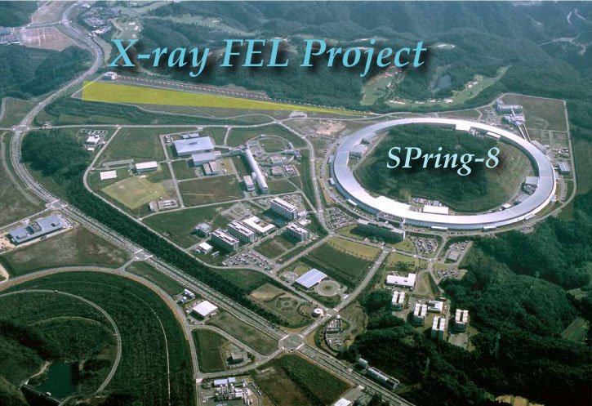
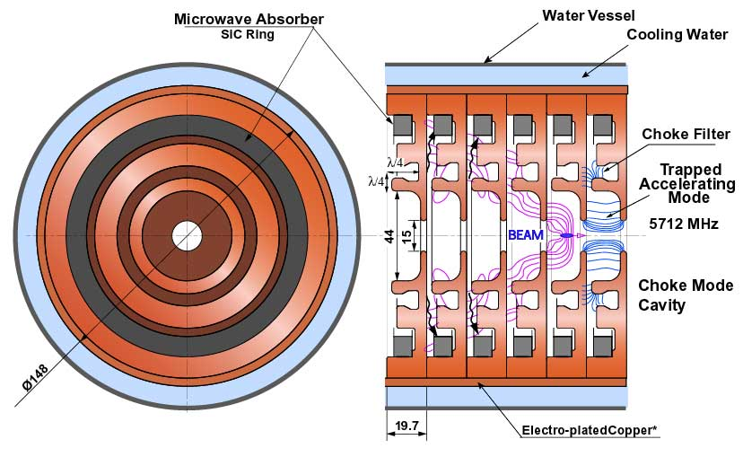
Choke-mode structure
Proposed by T. Shintake in 1992
  HOM absorbed by the absorption materials in the end of the radial line
  λ/4 choke reflects the fundamental mode
Applied in Spring-8 and SACLA XFEL
  working at C-band (5.712 GHz)
  damp the HOM via the radial line
  gradient around 35-40 MV/m
Alternative choice for CLIC main linac
T. Shintake, Japanese J.Appl.Phys.31:L1567-L1570 (1992)
R. M. Jones, Phys. Rev. ST Accel. Beams 12, 104801, 2009.
http://www.spring8.or.jp
Notes:
The choke reflects the accelerating mode, but unwanted HOMs can pass the choketobeabsorbedintheload

Slide 5
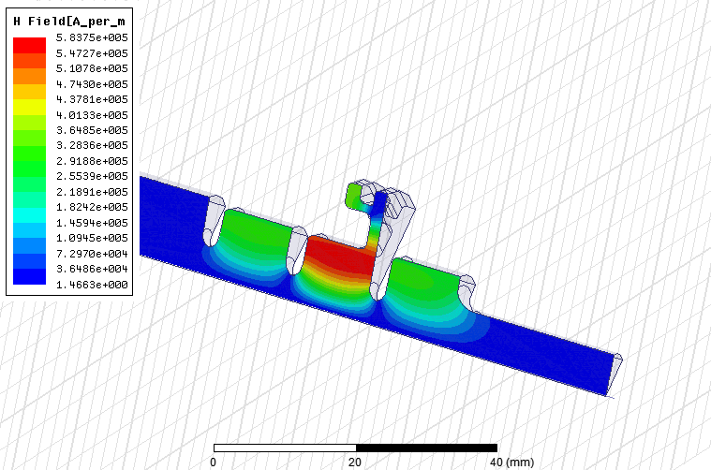
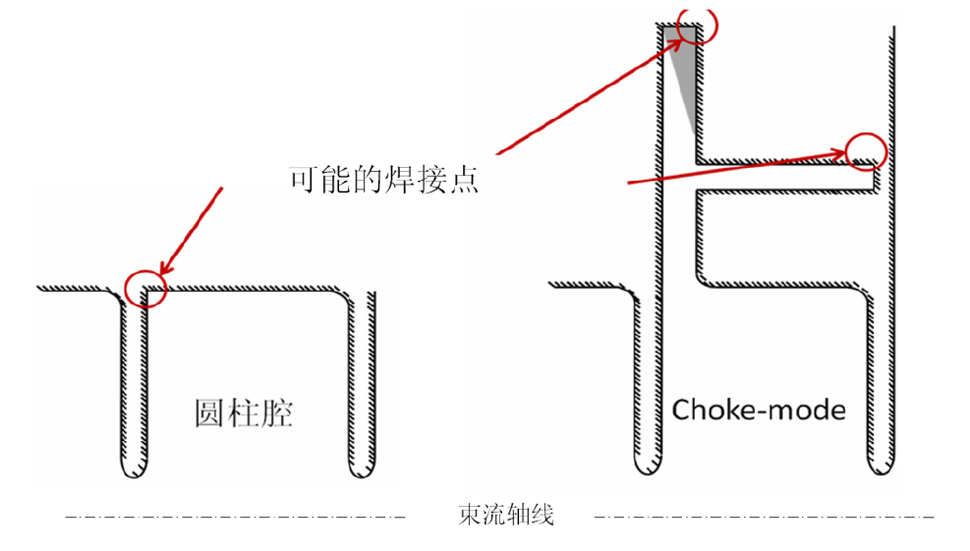
Why Choke-mode structure?
Circular symmetric, easy fabrication
Low surface magnetic field, low pulse heating, low breakdown rate
Low magnetic field at the welding joint
High-gradient performance of X-band choke is still unknown
Magnetic field of Choke-mode structure
Cylinder structure vs Choke-mode structure
Possible welding joint
Cylinder structure
Choke-mode
Beam line
Hao.Zha, ph.D thesis

Slide 6



Players
Tsinghua University
  Xiaowei Wu, Jiaru Shi, Hao Zha, Huaibi Chen, et al.
KEK
  Linac shift leaders and Mitsubishi operators
  Karube, Kawabata, Asai from CarrierCom
  Matsui, et al from PlusWork
  Tetsuo Abe, Toshiyasu Higo, Shuji Matsumoto, Toshikazu Takatomi, Yoshio Arakida,
CERN
  Walter Wuensch, et al.

Slide 7
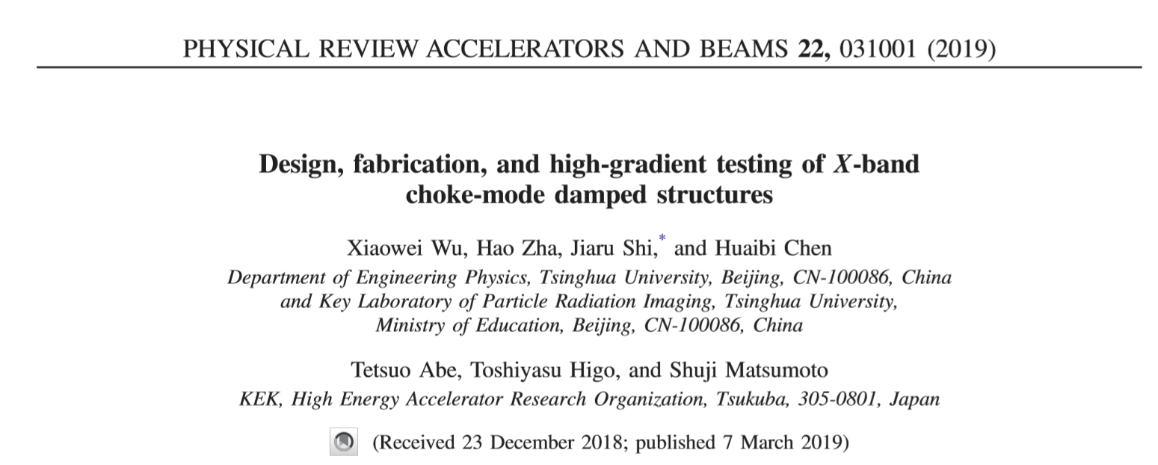
Recent publication

Slide 8
Outline
Introduction
Design and fabrication of Choke-mode structures
Breakdown phenomenon study of Choke-mode structures
High-gradient performance of Choke-mode structures
Summary

Slide 9
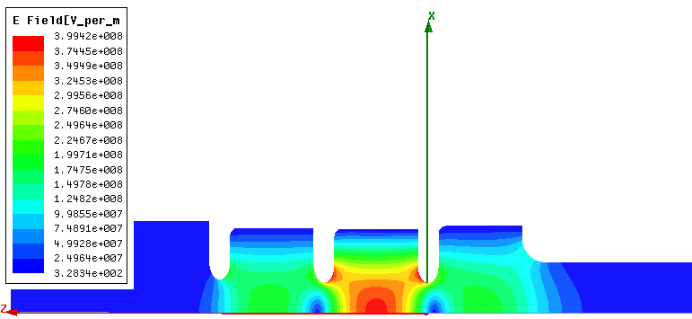
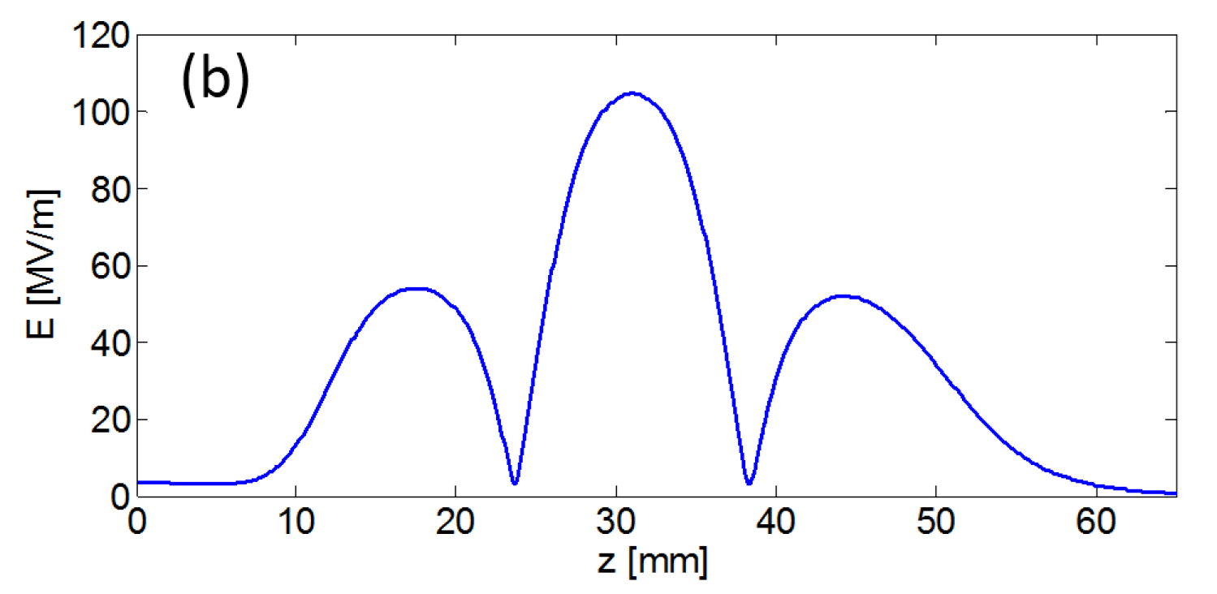
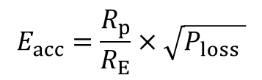
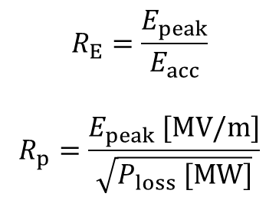
Single-cell standing-wave structure study
To study the X-band choke high-gradient performance
Single-cell structure consists of three cells
  Firstly conducted in SLAC
  Easy fabrication, short testing time
  Field in middle cell (test cell) is two times of that in other cells
$$R_{E}=\frac{E_{peak}}{E_{acc}}$$
$$R_{p}=\frac{E_{peak} [MV/m]}{\sqrt{P_{loss} [MW]}}$$
$$E_{acc}=\frac{R_{p}}{R_{E}}×\sqrt{P_{loss} }$$
  Single-cell structure
  Z-axis E field

Slide 10
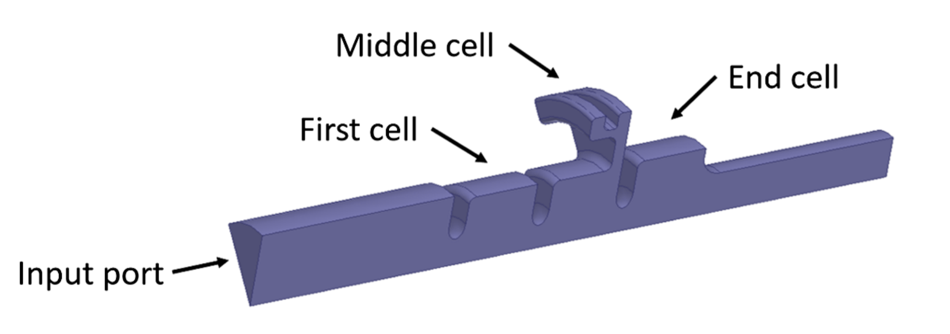
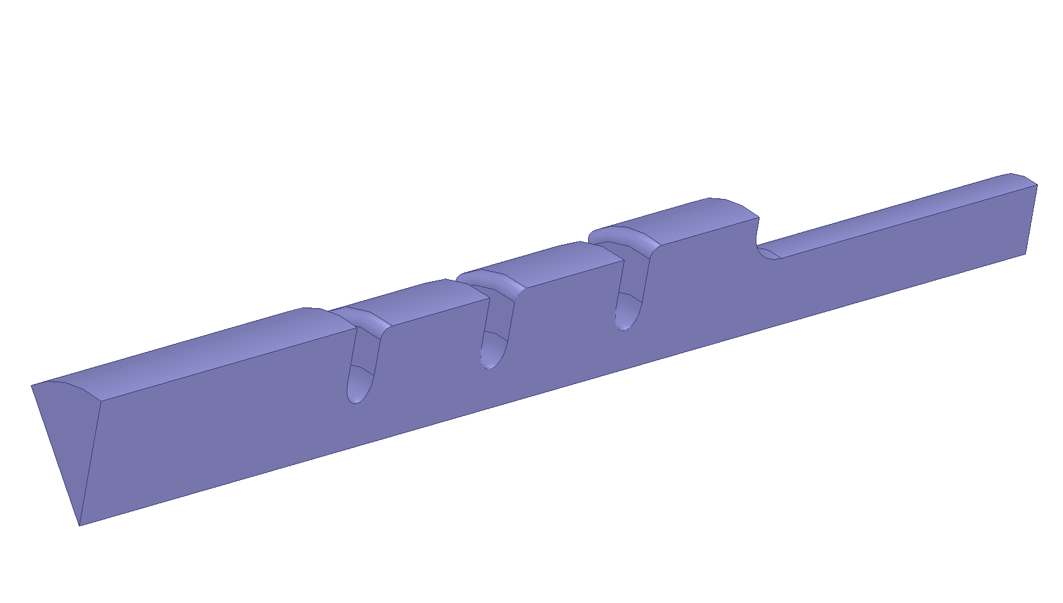
Design of Choke-mode cavities
Compare the effect of different choke dimensions to high-gradient performance
Design six single-cell standing-wave (SW) structures, working at 11.424 GHz
  THU-CHK-#1~ THU-CHK-#5 (different choke dimensions)
  THU-REF (single-cell structure without choke)
Choke-mode cavity
Reference cavity
Notes:
(1C-SW-A3.75-T2.6-CHOKE2.1)

Slide 11
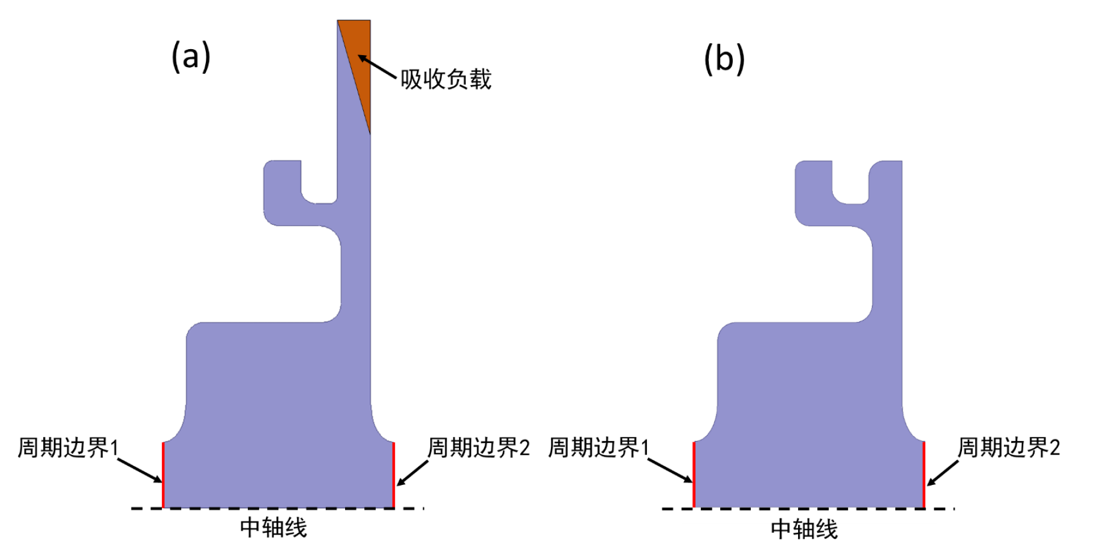

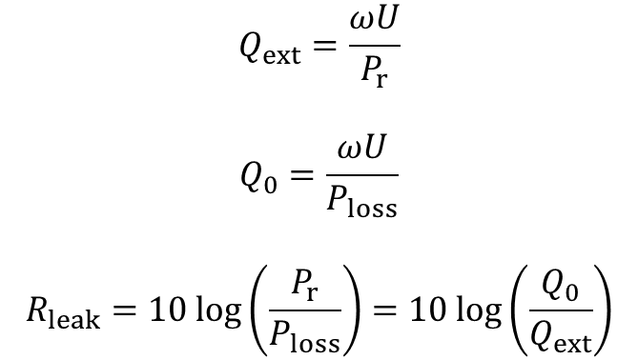
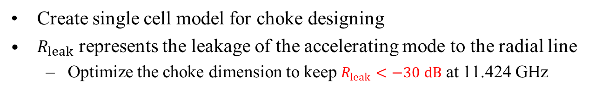


Middle cell design
Create single cell model for choke designing
$R_{leak}$ represents the leakage of the accelerating mode to the radial line
  Optimize the choke dimension to keep $R_{leak}<−30 dB$ at 11.424 GHz
$$Q_{ext}=\frac{ωU}{P_{r}}$$
$$Q_{0}=\frac{ωU}{P_{loss}}$$
$$R_{leak}=10 log\left(\frac{P_{r}}{P_{loss}}\right)=10 log\left(\frac{Q_{0}}{Q_{ext}}\right)$$
  $Q_{ext}$ Model
  $Q_{0}$ Model
$P_{r}$ is the power absorbed by the radial line
$P_{loss}$ is the power loss of the main cavity
Notes:
The choke reflects the accelerating mode, but unwanted HOMs can pass the choketobeabsorbedintheload

Slide 12
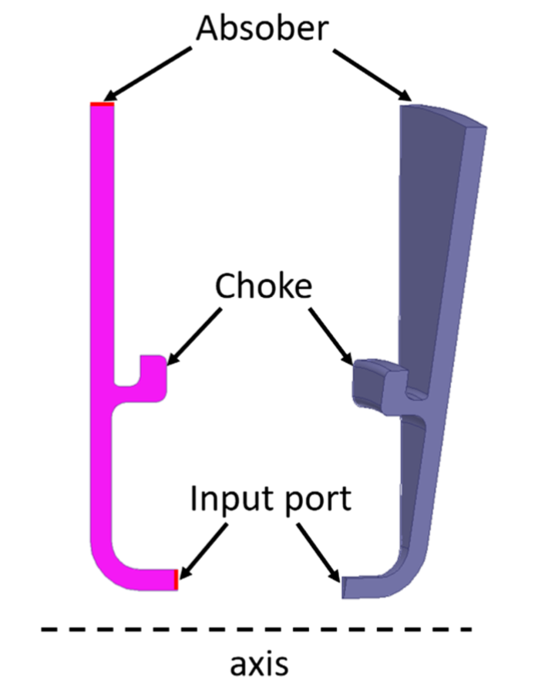
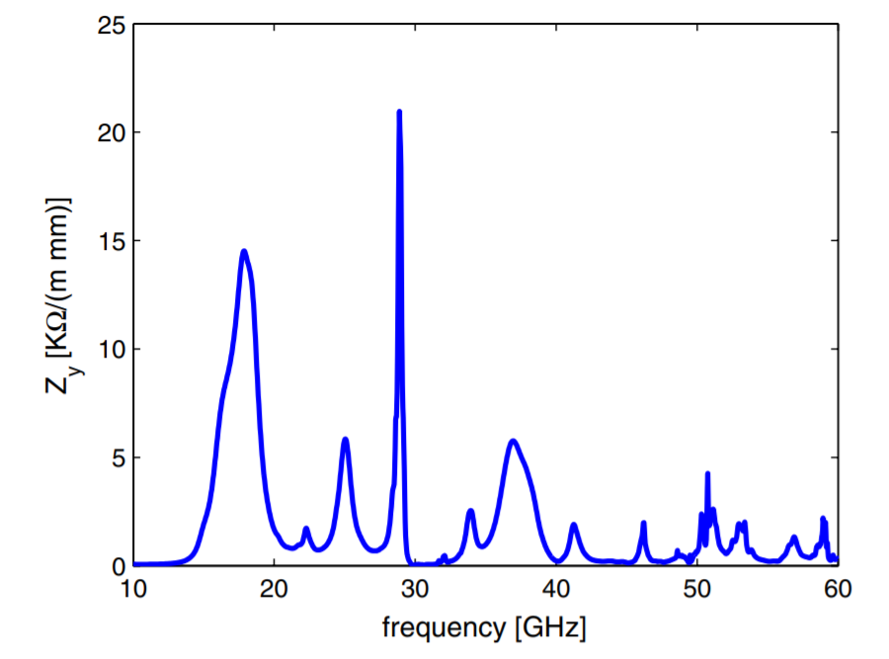
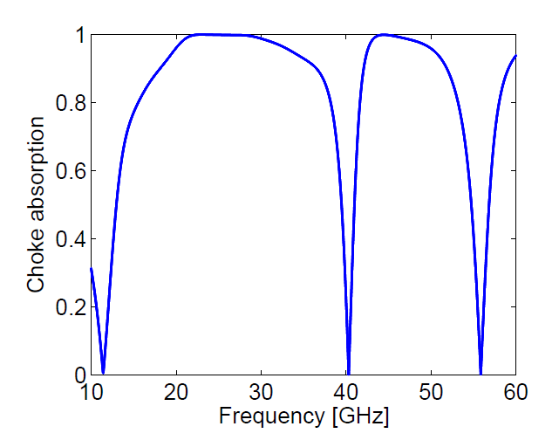
Choke absorption curve
Coaxial-radial line with choke model
  Determine the absorption of higher-order-modes (HOMs) by the choke
Some dipole modes have high kick factor between 15 GHz and 40 GHz from the wakefield impedance spectrum
  The fully reflected frequencies were kept out of this region
Wake spectrum
Absorption Curve
Dangerous region!
Notes:
zero absorption points in the curve indicate that modes at these frequencies are fully reflected by the choke, which are so called parasitic modes. Some dipole modes have high kick factor between 15 GHz and 40 GHz from the wakefield impedance spectrum of choke-mode accelerating structure

Slide 13
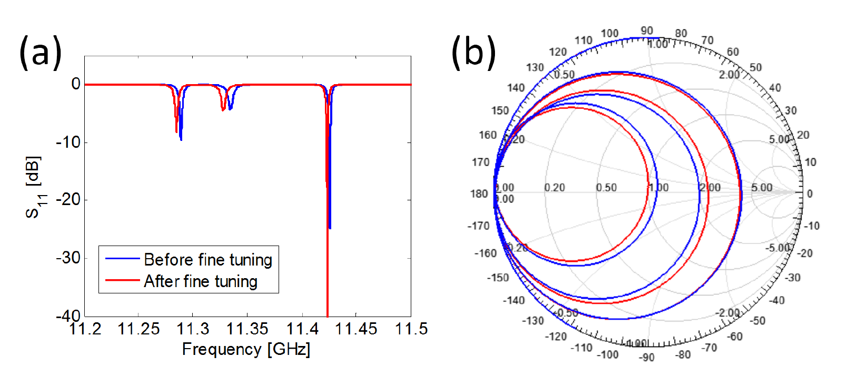
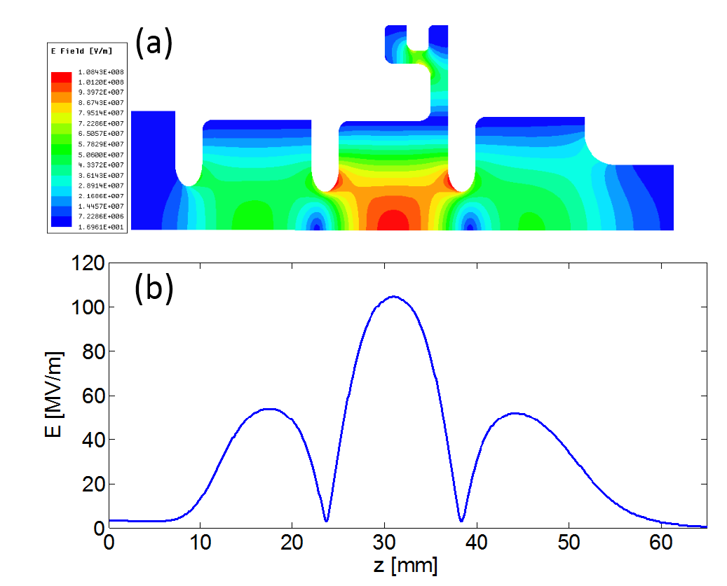
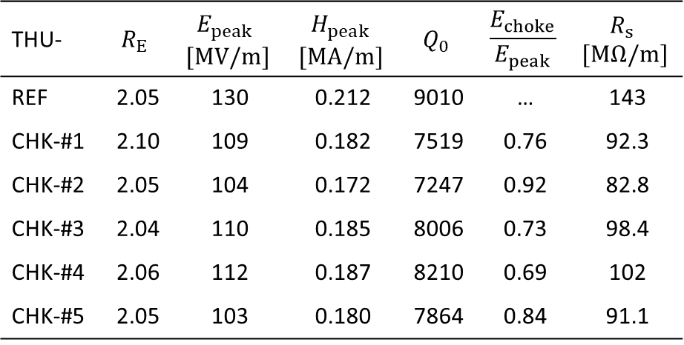

Cavity tuning
Tune the full structure
  Work at π-mode, 11.424 GHz
  Critical coupling
Modify choke dimension to change the choke field
  THU-CHK-#1~ THU-CHK-#5
Structure tuning
RF parameters
Choke-mode structure E field
THU- | $$R_{E}$$ | $$E_{peak}$$ $$[MV/\text{m}]$$ | $$H_{peak}$$ $$[MA/\text{m}]$$ | $$Q_{0}$$ | $$\frac{E_{choke}}{E_{peak}}$$ | $$R_{s}$$ $$[MΩ/m]$$
REF | 2.05 | 130 | 0.212 | 9010 | … | 143
CHK-#1 | 2.10 | 109 | 0.182 | 7519 | 0.76 | 92.3
CHK-#2 | 2.05 | 104 | 0.172 | 7247 | 0.92 | 82.8
CHK-#3 | 2.04 | 110 | 0.185 | 8006 | 0.73 | 98.4
CHK-#4 | 2.06 | 112 | 0.187 | 8210 | 0.69 | 102
CHK-#5 | 2.05 | 103 | 0.180 | 7864 | 0.84 | 91.1
*Normalized to $P_{loss}=1 MW$

Slide 14
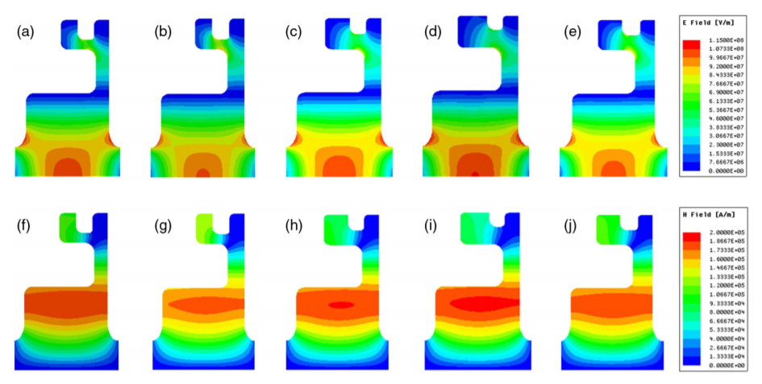
Choke field distributions
The loss power of the whole structure is normalized to 1 MW
E field
H field

Slide 15
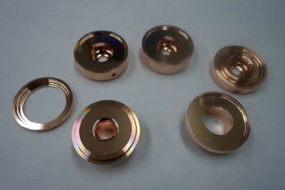
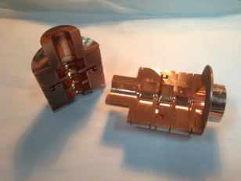
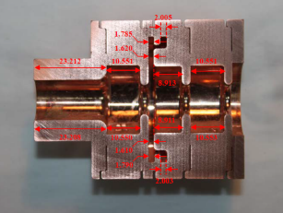
Fabrication
Cell manufacture and diffusion bonding at Tsinghua University
A diffusion bonding test of choke-mode cavity was done to check the quality as contact areas of each choke-mode structure disks are not consistent vertically
Good results were seen after cutting the test structure
Choke-mode cavity cell
Diffusion bonding test

Slide 16
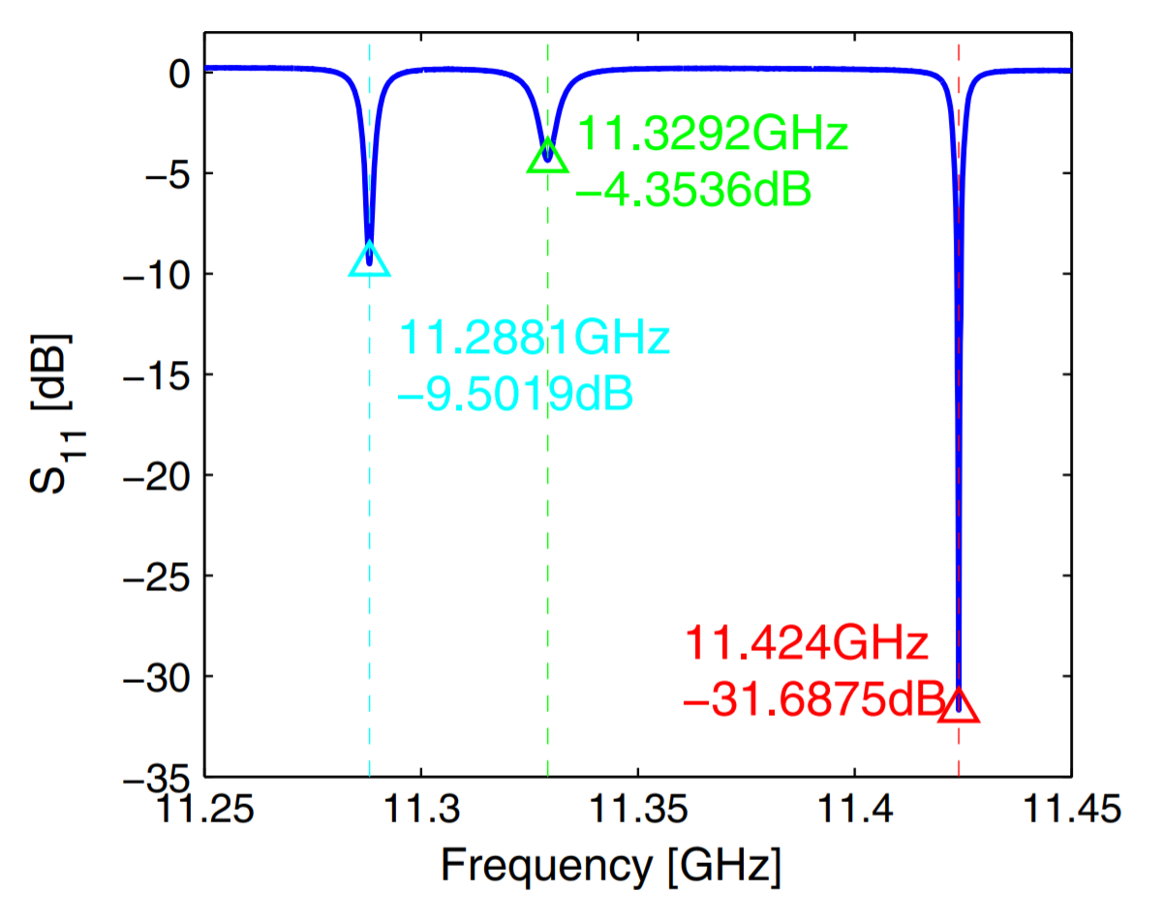
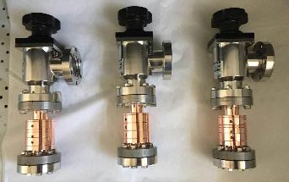
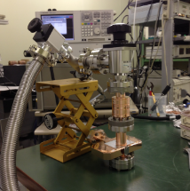
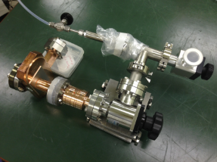
Low-power RF measurements
Bench test, tuning, and baking were done in Tsinghua
Structures shipped to KEK after being closed by vacuum valves to keep vacuum environment
Frequency check at KEK kept consistent with the test results in Tsinghua University
Notes:
THU-CHK-#3

Slide 17
Outline
Introduction
Design and fabrication of Choke-mode structures
Breakdown phenomenon study of Choke-mode structures
High-gradient performance of Choke-mode structures
Summary

Slide 18
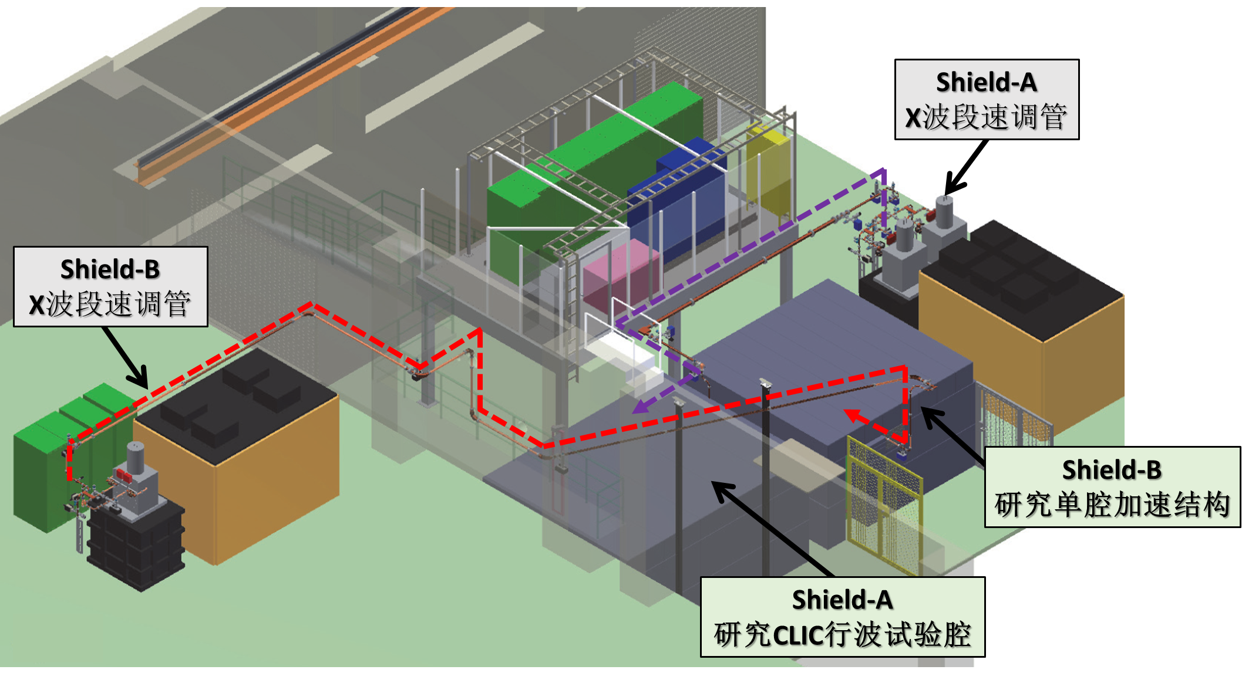
High-gradient test stand
High-gradient test was conducted in Nextef at KEK (New X-band Test Facility)
Frequency: 11.424 GHz
Repetition rate: 50 Hz
Shield-A, traveling-wave structure test stand, max power of 100 MW
Shield-B, standing-wave structure test stand, max power of 33 MW

Slide 19
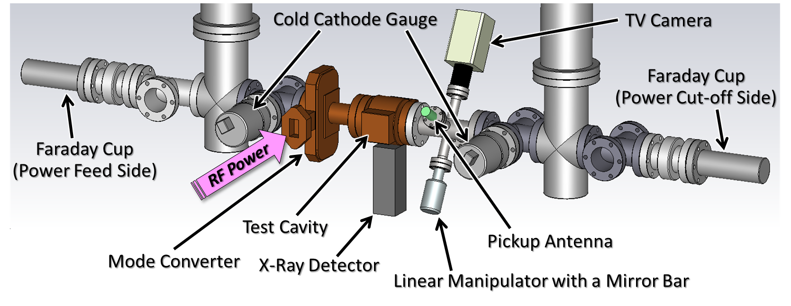
Shield-B setup
High-gradient test carried out in Shield-B of Nextef
Shield-B test stand
  Incident and reflection waves collected by Directional Couplers
  Dark current captured by Faraday Cups
  Other detection equipment
T. Abe et al., Proceedings of PASJ2016

Slide 20
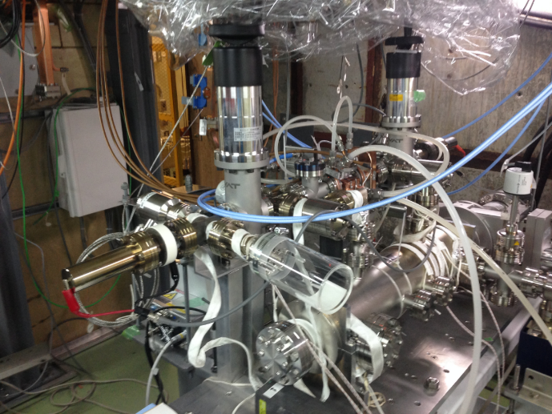
Shield-B setup
WR90 Waveguide
TM₀₁ Mode Launcher
Power Flow
Test Cavity
Faraday Cups

Slide 21
RF pulse shaping
Use double step input waveform
Filling time around 100ns
Keep the ratio of the two steps constant to make flat E field inside cavity
Increase the width of the second step
Increase the width of the second step

Slide 22
Typical breakdowns w or w/o current flash
Two types of breakdown events were observed
  Breakdown with current flash (CF-BD)→ speculated to be occur in the cylinder cavity
  Breakdown without current flash→ speculated to be occur in choke
98.6% breakdown events were accompanied with current flash in THU-REF
  Faraday Cup has good capture rate for the dark current
Normal event
Breakdown event with current flash：CF-BD
Breakdown event
without current flash
Incident
Reflect
Incident
Reflect
Incident
Reflect
FC Current
FC Current
FC Current

Slide 23
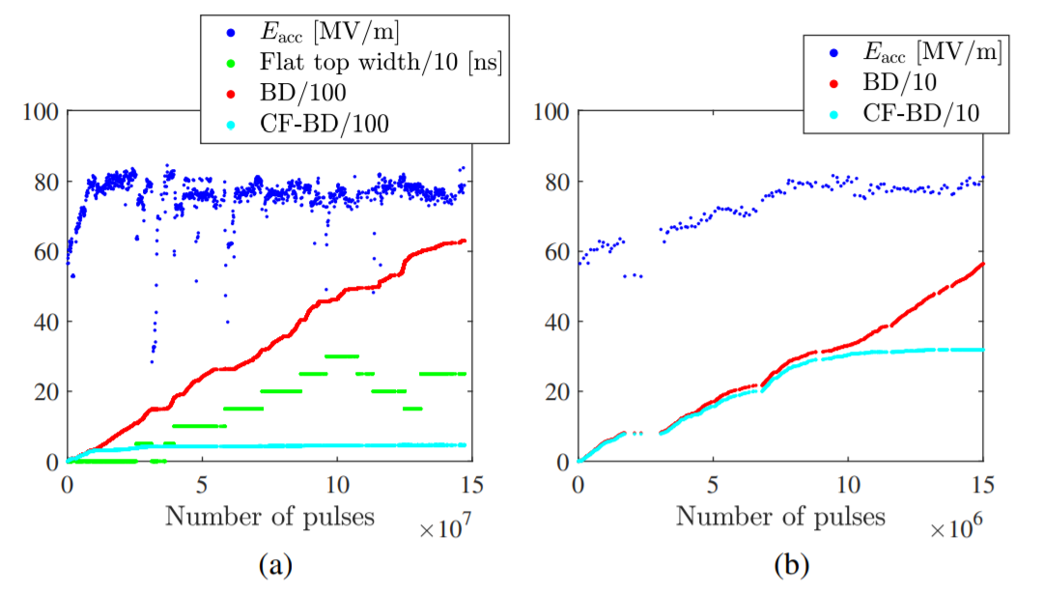
Two types of breakdowns
Breakdowns were accompanied by the current flash into the Faraday cup during the initial ramping stage of THU-CHK-#1
After initial ramping, few current flash breakdowns were observed in the detected events
Same phenomenon was seen in THU-CHK-#1 and THU-CHK-#2
Zoom of the beginning
Notes:
tendency

Slide 24
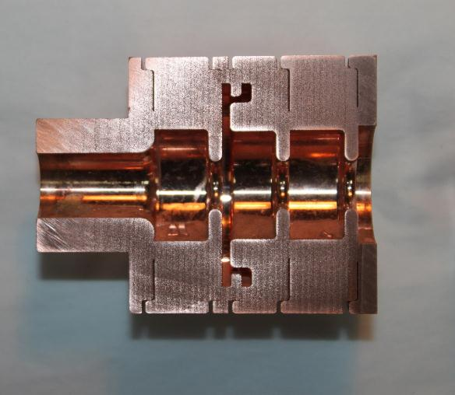
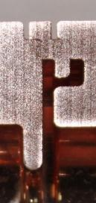
Postmortem of choke-mode structure
Cut THU-CHK-#1 twice (B1 and B2)
B2
B1
We kept the bonding joint to check whether there are any flaw during the diffusion bonding in the second cutting
The red lines are bonding joints

Slide 25
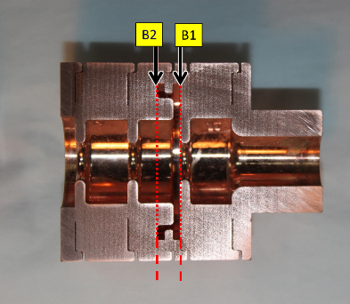
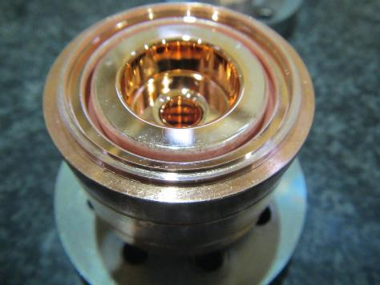
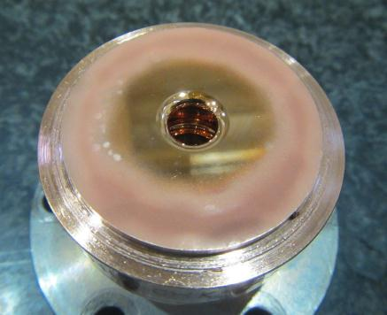
After the cutting
The surfaces of the irises and cavity are very clean.
KEYENCE VE-8800 was used to do the further inspections
This surface is also clean.
The surface of this choke groove seems to be very bad.
On this surface, the surface roughness is the worse than the choke groove in the left photo.
Modified from Abe’s presentation

Slide 26
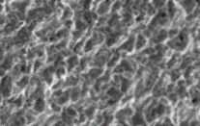
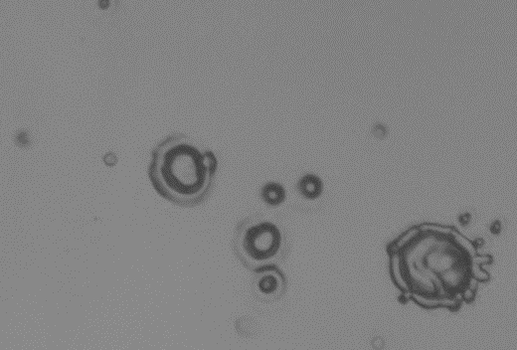
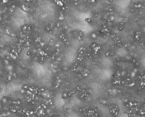
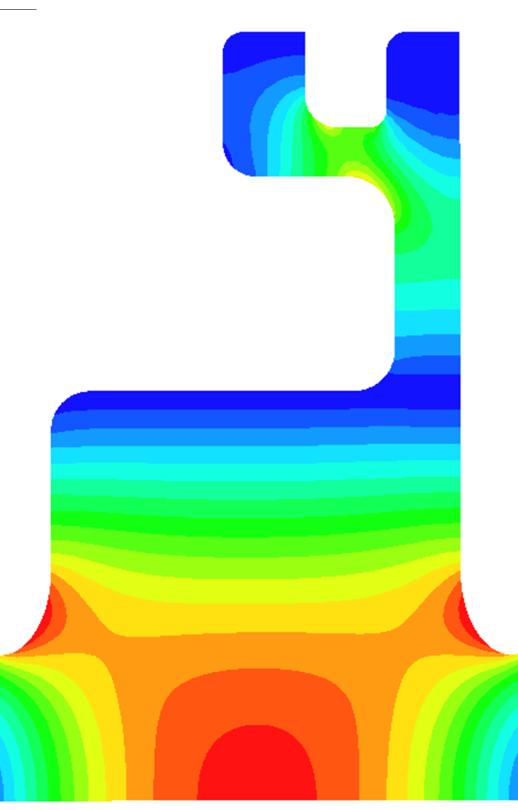
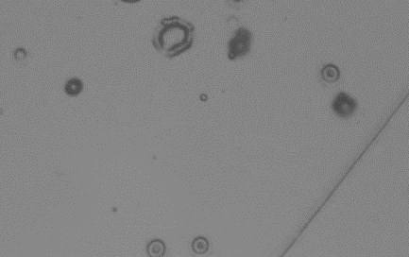
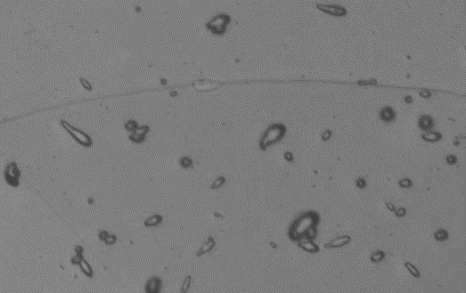
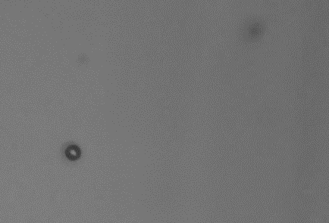
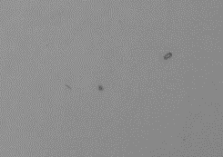
Inner surface observation results
Conclusion：
Many breakdown spots at B、C
Copper sputtering at E、F、G
Choke was damaged
Iris area was clean
A
100 μm
E
100 μm
F
B
100 μm
E
A
100 μm
F
C
B
C
G
D
G
100 μm
100 μm
H
D
H
Choke E field
100 μm
100 μm

Slide 27
Inner surface observation results
Conclusion：
Many breakdown spots at B、C
Copper sputtering at E、F、G
Choke was damaged
Iris area was clean
High-gradient performance limited by the breakdown events at choke area!
A
100 μm
E
100 μm
F
B
100 μm
E
A
100 μm
F
C
B
C
G
D
G
100 μm
100 μm
H
D
H
Choke E field
100 μm
100 μm

Slide 28
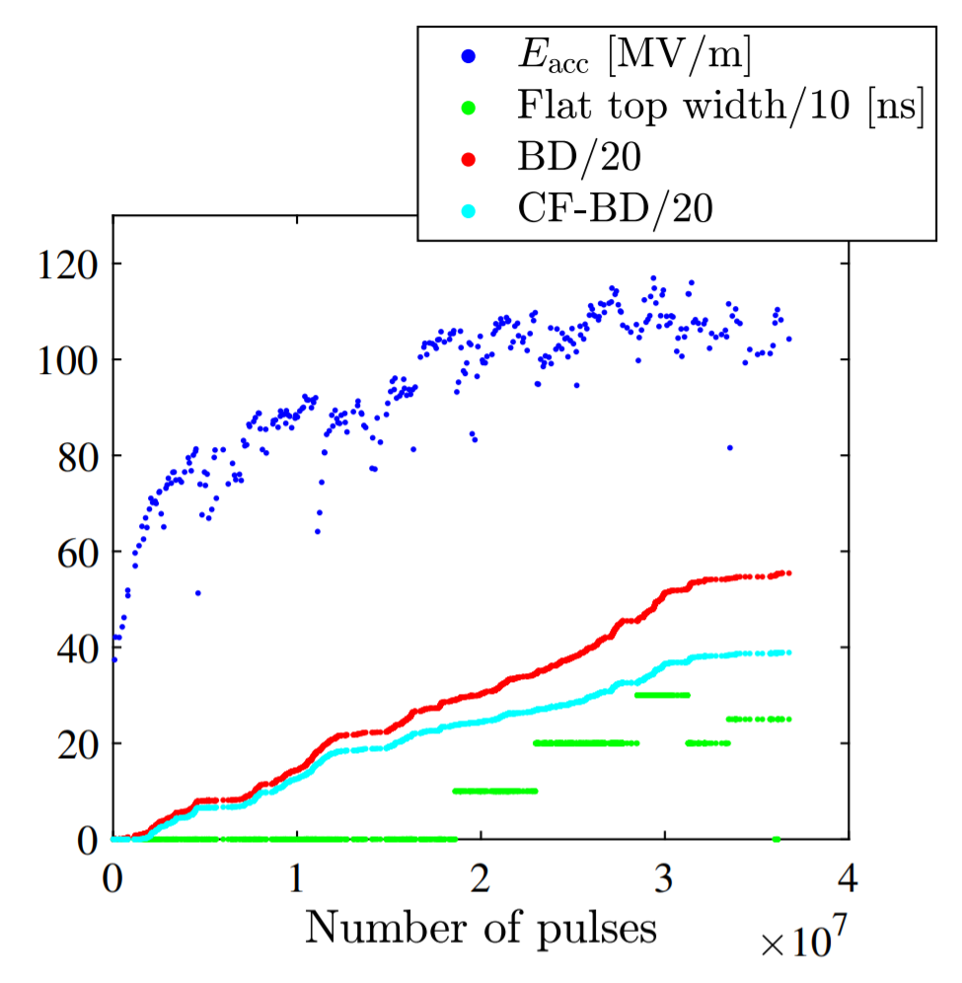
THU-CHK-#3 breakdown signals
Breakdown events accompanied with current flash observed during the whole test
Both of the two types occurred when gradient got saturated
Same phenomenon was seen in THU-CHK-#4 and THU-CHK-#5

Slide 29
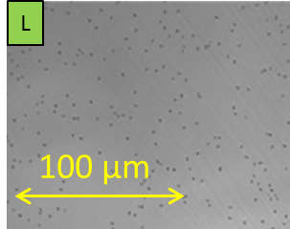
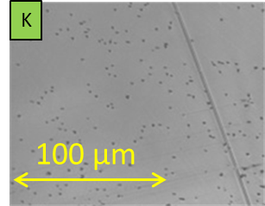
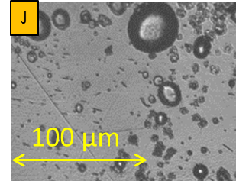










  THU-CHK-#3 observation results
Choke E field

Slide 30
  THU-CHK-#3 observation results
Conclusion：
Many breakdown spots at B、C、E、H、J
Both choke and iris areas were damaged
High-gradient performance limited by the breakdown events at choke and iris areas!
Choke E field

Slide 31
Outline
Introduction
Design and fabrication of Choke-mode structures
Breakdown phenomenon study of Choke-mode structures
High-gradient performance of Choke-mode structures
Summary

Slide 32



High-gradient history of Choke-mode structures
THU-CHK-#1
  Cannot ramp input power after $1.0×{10}^{7}$ RF pulses, same as THU-CHK-#2
  Max gradient reached 83.9 MV/m at longer pulse operation
THU-CHK-#4
  Fast ramping speed, same as THU-CHK-#3
  Max gradient reached 123 MV/m at longer pulse operation
THU-CHK-#1
THU-CHK-#4

Slide 33

High-gradient history of THU-REF
Max gradient reached 145 MV/m
Validate Tsinghua X-band single-cell fabrication technology
98.6% breakdown events were accompanied with current flash

Slide 34




Comparison of single-cell structures
Same max value of $E_{choke}$ in THU-CHK-#1 and THU-CHK-#2
  Breakdown in choke limits high-gradient performance
Fast ramping speed in THU-CHK-#4
  Increase choke dimension can increase the $E_{choke}$ and high-gradient performance
${E_{acc}}^{∗}$ is normalized to a flat top width of 250 ns and a bpp of $2.0×{10}^{−5}$
THU-CHK- | $${E_{acc}}^{∗}$$ $$[MV/m]$$ | $${E_{choke}}^{max}$$ $$[MV/m]$$ | $$\frac{E_{choke}}{E_{peak}}$$
#1 | 80.1 | 128 | 0.76
#2 | 68.3 | 129 | 0.92
#3 | 110 | 163 | 0.73
#4 | 125 | 177 | 0.69
#5 | 100 | 172 | 0.84
$$\frac{BDR}{{E_{acc}}^{30}∙τ^{5}}=constant$$
A. Degiovanni, et al. PRAB 19, 032001, 2016

Slide 35






High-gradient performance evaluation of chokes
Study the relationship between max normalized gradient G, $E_{choke}\text{/}E_{peak}$ and dimension $D$ [mm] by applying the high-gradient test data of choke-mode structures
$$\frac{BDR}{{E_{acc}}^{30}∙τ^{5}}=constant$$
$$G=constant×{\left(E_{choke}\text{/}E_{peak}\right)}^{α}×{\left(D\right)}^{β}$$
$$CHK=173×{\left(E_{choke}\text{/}E_{peak}\right)}^{−0.707}×{\left(D\right)}^{0.711}$$
CHK can be used to guide choke design, evaluate high-gradient performance
Only determined by the geometry
$$G=\frac{E_{acc}∙τ^{1/6}}{{BDR}^{1/30}}$$
THU-CHK- | $E_{choke}$/$E_{peak}$ | $$D [mm]$$ | $$G [MV/m]$$
#1 | 0.76 | 1.26 | 250
#2 | 0.92 | 1.26 | 213
#3 | 0.73 | 1.89 | 343
#4 | 0.69 | 2.21 | 391
#5 | 0.84 | 1.88 | 312
*The data above is based on the BDR measurements results

Slide 36
Summary
Several single-cell SW structures were designed, fabricated, and tuned at Tsinghua University
High-gradient test was conducted in Nextef at KEK
  THU-CHK-#4 reached 123 MV/m at a flat top width of 100 ns
Choke-mode structure breakdown phenomenon was studied
  Two types of breakdown events were seen
  Current signal can be used to classify the breakdown type
A new quantity was proposed to guide the design of high-gradient choke-mode structures
  Obtained from the summary of the high-gradient experiments

Slide 37

Next step…
Wakefield calculation and optimization of the travelling-wave choke-mode structure (TD26-CDS-E) based on latest choke dimension
High-gradient test of TD26-CDS-E

Slide 38

Related paper
More details can be found via the link:
https://journals.aps.org/prab/abstract/10.1103/PhysRevAccelBeams.22.031001#
Thank you!

Slide 39
Backup

Slide 40

High-gradient history of THU-CHK-#2

Slide 41

High-gradient history of THU-CHK-#3

Slide 42

High-gradient history of THU-CHK-#5

