Slide 1
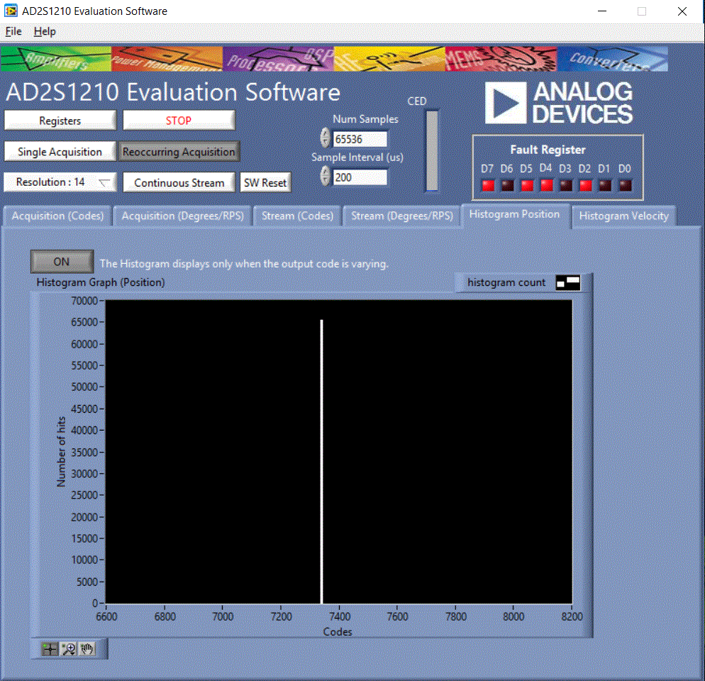
How it should look like.
No noise.

Slide 2
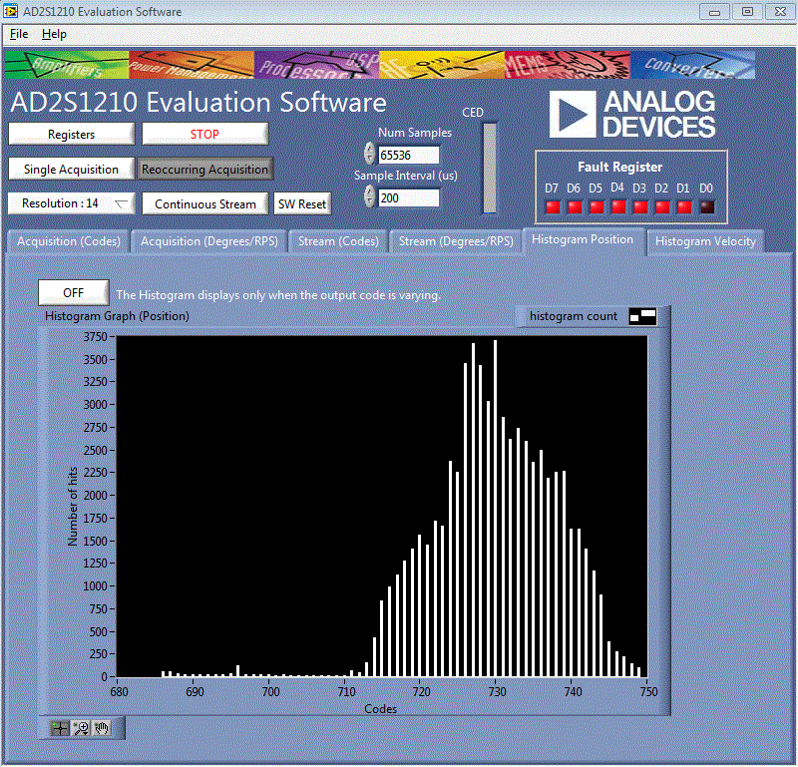
How Looks like i PS with noise.
Workarounds for PS
Improve the grounding of the cable to
the board
Find the right voltage span for the resolver.
Use lowpass filter, Fc 5.4kHz.
Resolver in lab 100m cable
Improve the grounding of the cable to
the board
Find the right voltage span to the resolver.
Because there is no Vacuum shielding on the
Resolver which give us a amplified
signal back.

