Slide 1
ILGAD TCAD Simulations: first approximations
F.R. Palomo¹, S.Hidalgo², I.Vila³
fpalomo@us.es
¹Dept. Ingeniería Electrónica, Escuela Superior de Ingenieros
Universidad de Sevilla, Spain
²CNM-IMB Barcelona, Spain
³IFCA Santander, Spain

Slide 2
Introduction
Development of several ILGAD models to test gain variation with bias and n+/pwell doping
Improvement in the ILGAD models compared with experimental data
Analisis of radiation effects in ILGAD
  300um New Perugia Trap + Kramberger Acceptor removal models
  50um New Perugia Trap + Kramberger Acceptor removal models

Slide 3
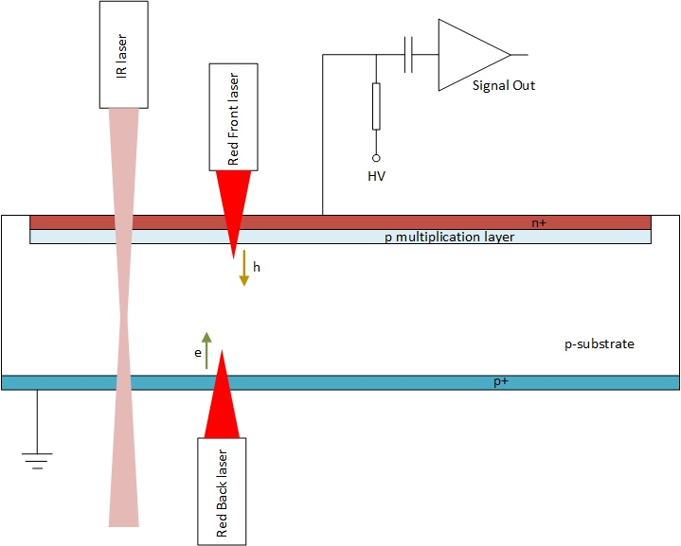
Sentaurus TCAD Simulation SetUp
P1Left
P1Right
Inverse Low Gain Avalanche Detector
(ILGAD) cross-section
50 μm
y
30 μm
x
z
Simulation Setup:
Red Pulsed Laser: 670 nm, 10 μm spot, 50W/cm², 200 ps,
BackIllumination at P1 Right
FrontIllumination aligned with P1 Right
IR Pulsed Laser: 1064nm, 30W/cm²,10 mm spot, 30W/cm², 200 ps at P1 Right
2D detector model: 1 μm in Z direction, 5 mm in X direction,
300/50 μm in Y direction)
Doping profiles under confidenciality rules

Slide 4
ILGAD IV Experimental
Experimentally we see a full
depletion at the n++-p junction
(multiplication layer) around
30V and a soft behaviour in the
IV plot up to ~400 V
I.Vila, Update on the ILGAD characterization, RD50 Nov 22th 2016

Slide 5
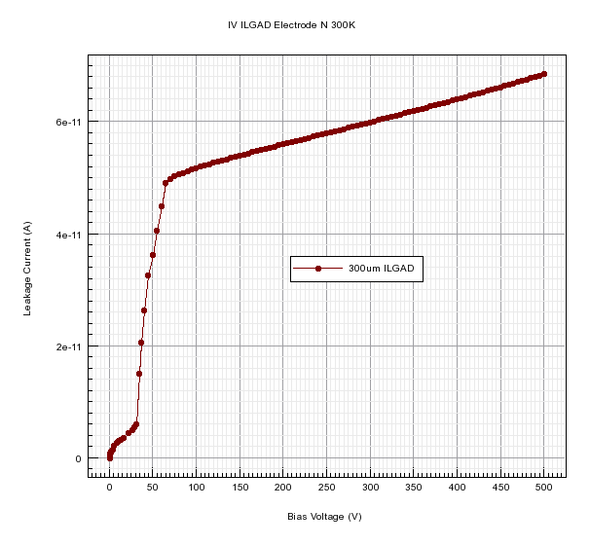
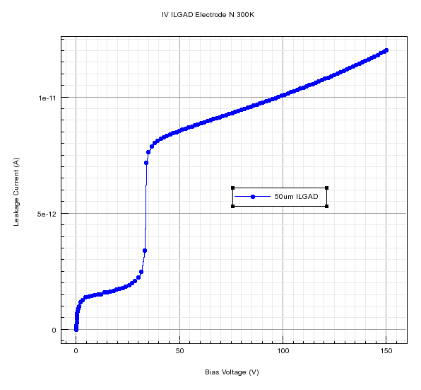
ILGAD IV Simulation
300μm ILGAD
50μm ILGAD
Both ILGAD models (300 μm, 50 μm thickness) show full depletion at n++-p (multiplication layer) around 30 V, as expected.
For the 300 mm we choose 150V, 300V, 450V as bias voltage, for the 50 mm we choose 50V, 100V, 150V as bias voltage

Slide 6
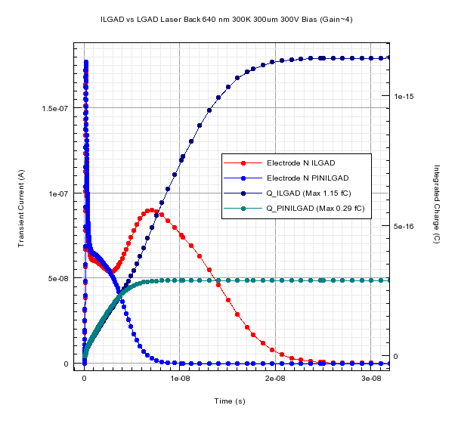
ILGAD 300 μm Red Laser Back Transient: Simulation shows gain (~4)
Laser 670nm (red), illuminating on P1 right strip (just in the middle), signal observed in the N electrode (cathode). Comparing ILGAD and its associated PIN (PINILGAD) the plot
shows a gain factor around 4 (model verification).

Slide 7
ILGAD Red Laser Back Transient Experimental 300K
Experimental data illuminating the anode (back side), with a red laser (670nm) in the P1 Right strip
I.Vila, Update on the ILGAD characterization, RD50 Nov 22th 2016

Slide 8
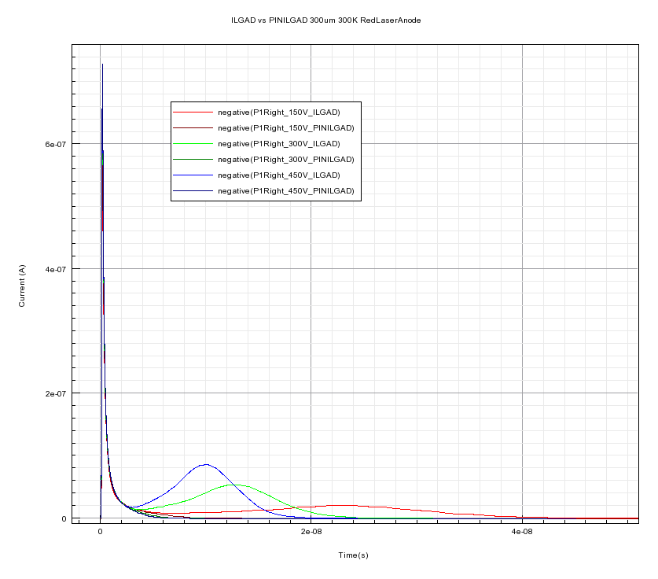
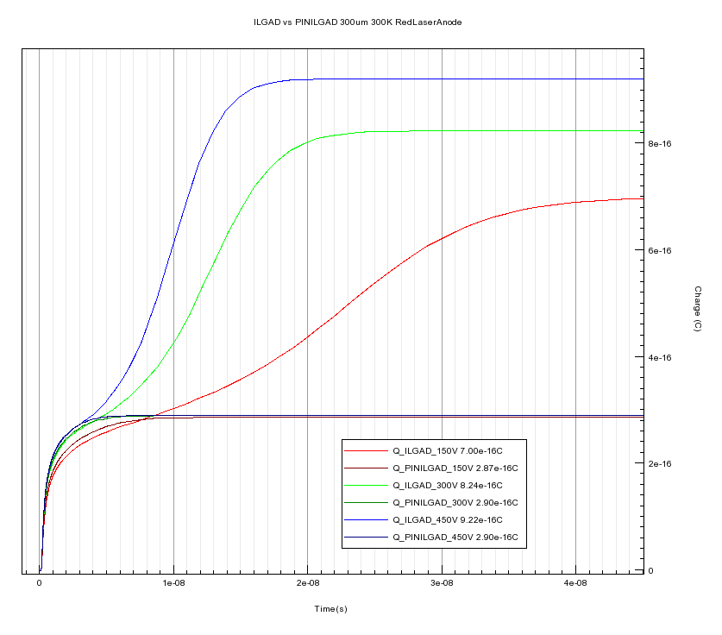
ILGAD 300 um Red Laser (670nm) Back Transient P1Right
Q 450V 9,22e-16C
Q 300V 8,24e-16C
Q 150V 7e-16C
Primary Electrons
Q PINILGAD~2,9e-16C
Multiplication Onset
Secondary
Holes

Slide 9
ILGAD Red Laser Front Transient Experimental 300K
Experimental data illuminating the cathode (front side), with a red laser (670nm) alligned with P1 Right strip
I.Vila, Update on the ILGAD characterization, RD50 Nov 22th 2016

Slide 10
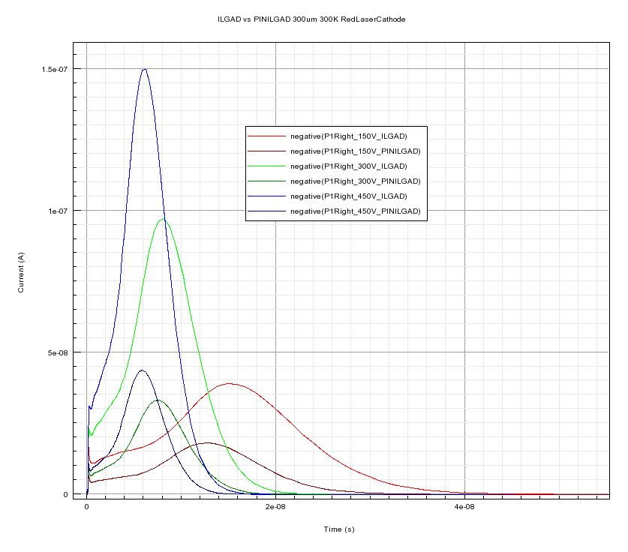
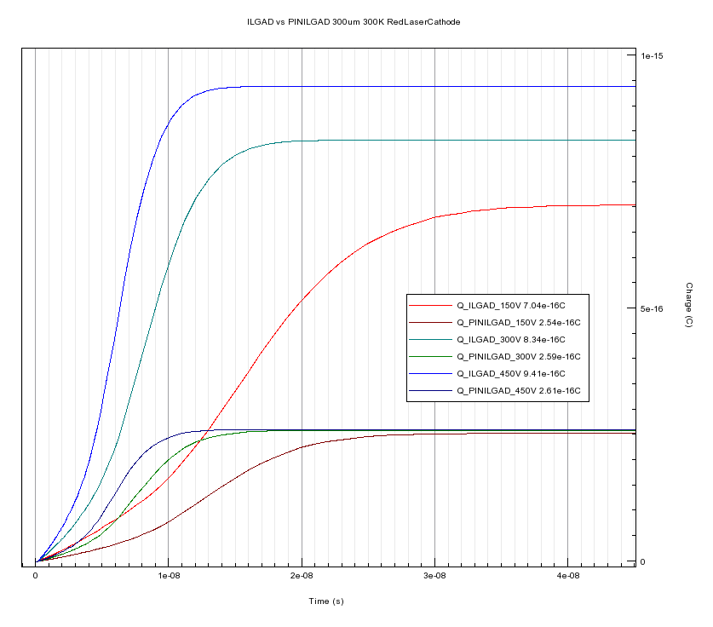
ILGAD 300μm Red Laser (670nm) Front
Q 450V 9,41e-16C
Q 300V 8,34e-16C
Q 150V 7e-16C
Primary and Secondary hole current
Multiplication Onset
Q PINILGAD~2,6e-16C

Slide 11
LGAD IR Laser Experimental Results
Experimental data TCT laser (IR, 1064nm) alligned with P1 Right strip
I.Vila, Update on the ILGAD characterization, RD50 Nov 22th 2016

Slide 12
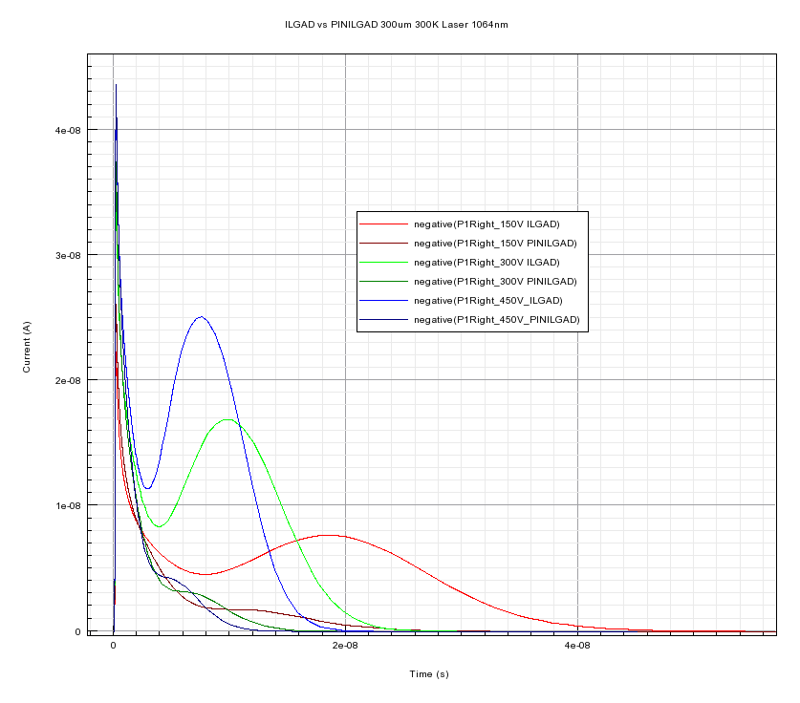
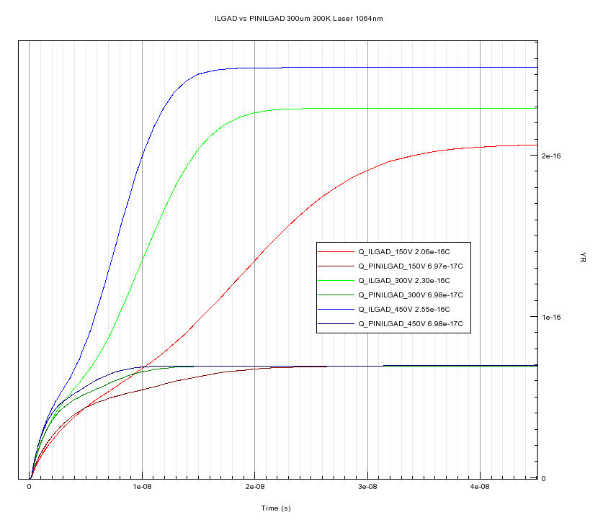
ILGAD 300um IR (1064nm) Laser
Q 450V 2,55e-16C
Q 300V 2,30e-16C
Q 150V 2,1e-16C
Q PINILGAD~6,98e-17C

Slide 13
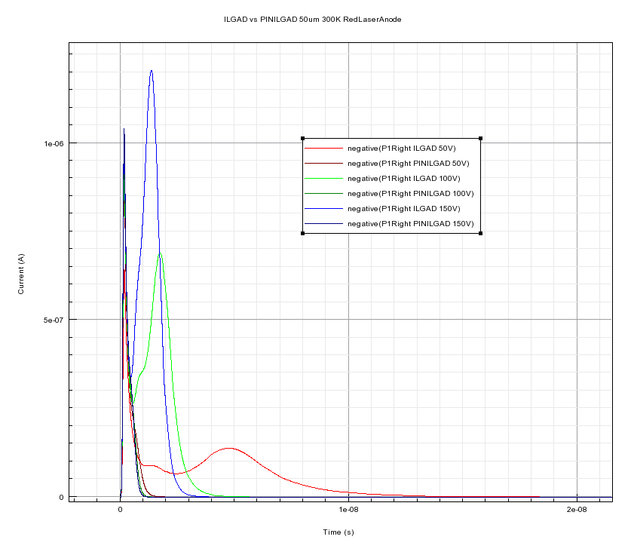
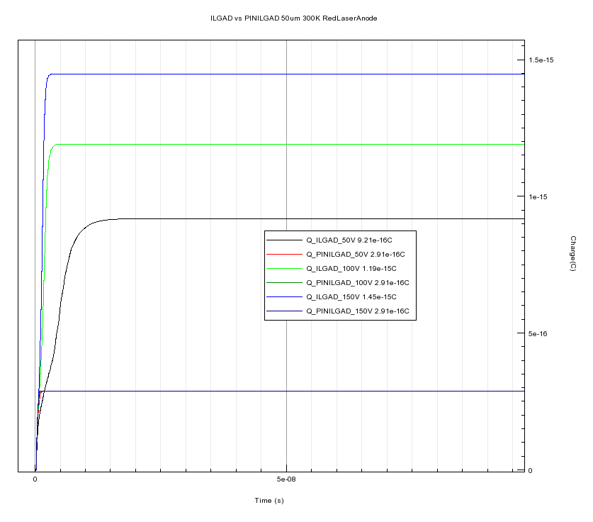
ILGAD 50 um Red Laser (670nm) Back Transient P1Right
Q 450V 9,21e-15C
Q 100V 1,19e-15C
Q 50V 9,21e-16C
Q PINILGAD~2,9e-16C

Slide 14
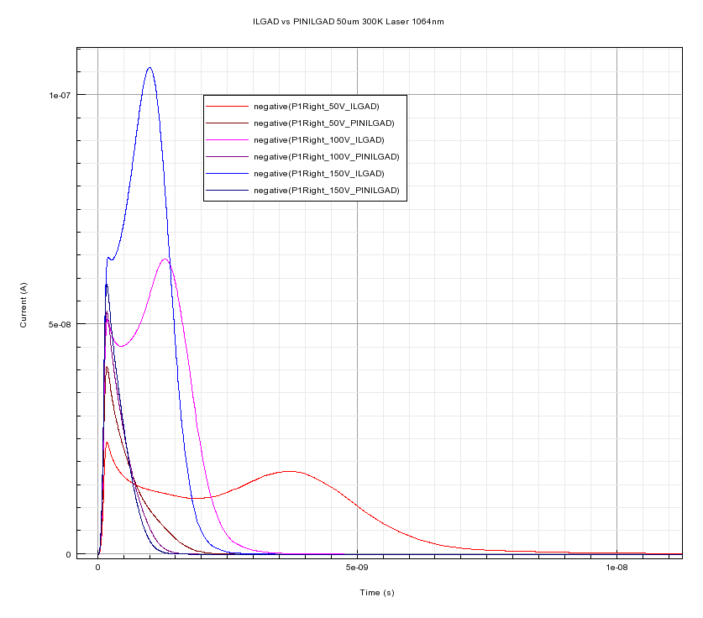
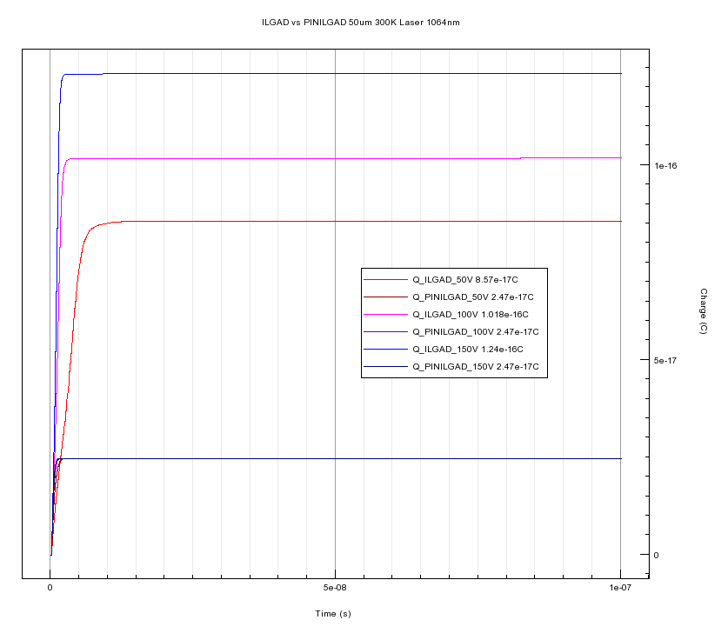
ILGAD 50 um IR (1064nm) Laser Transient P1Right
Q 150V 1,24e-16C
Q 100V 1,02e-16C
Q 50V 2,47e-17C
Q PINILGAD~2,47e-17C

Slide 15
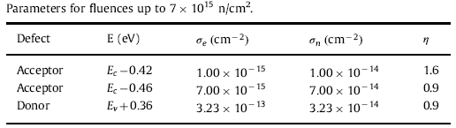
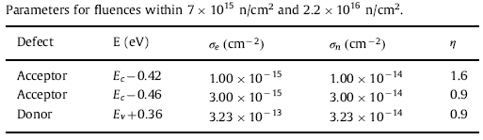

Radiation Damage Models
New Perugia
One damage model, Traps+Acceptor Removal
New Perugia Model φ =1e15 up to 7,5e15 n_{eq}/cm²
Acceptor Removal
$$N_{A}=N_{A}e^{−cφ}$$
c=10e⁻¹⁶ cm⁻²
Radiation effects in Low Gain Avalanche Detectors after hadron irradiations, G.Kramberger et al., JINST 2015 10 P07006
Modeling of radiation damage effects in silicon detectors at high fluences
HL-LHC with Sentaurus TCAD, D.Passeri et al, NIMA 824 (2016), 443-445

Slide 16
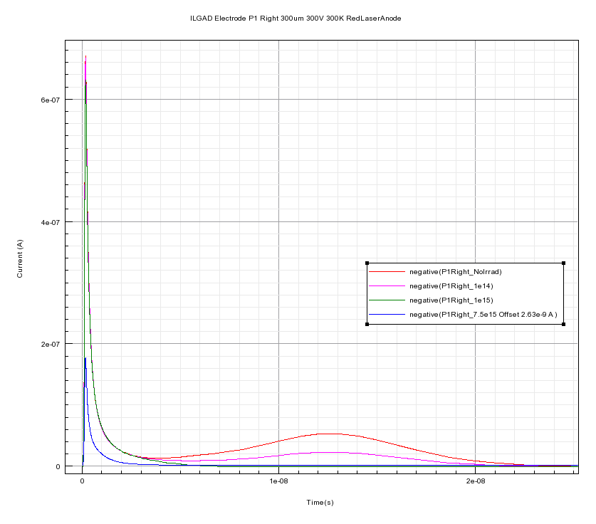
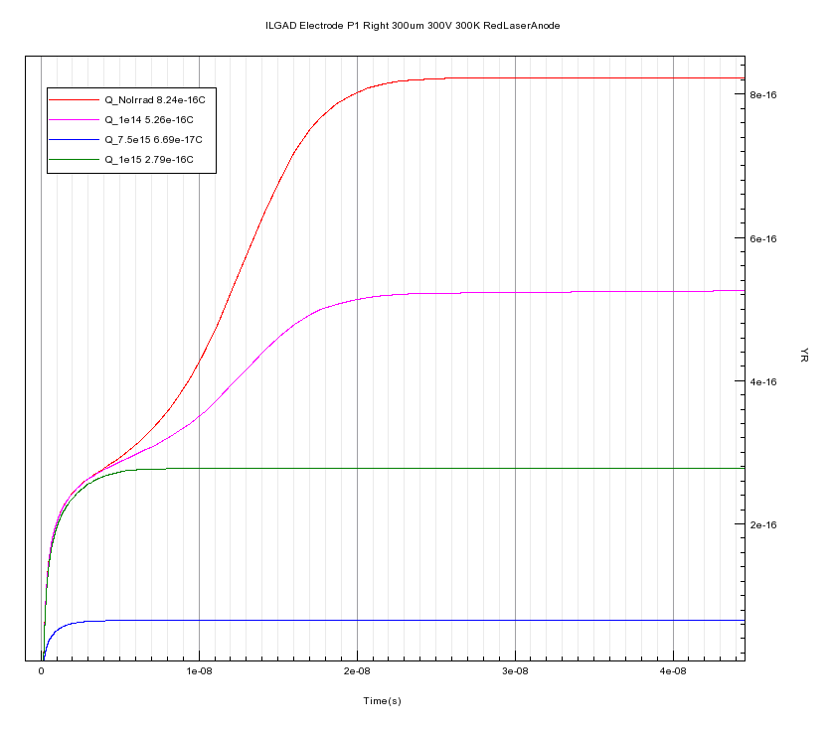
LGAD 300 um RedLaserBack 300K Irradiation P1 Right
Fluence n/cm² | Charge P1 Right ILGAD (fC) | % of reduction
NoIrrad | 8,24e-1 | -
1e14 | 5,26e-1 | 63,8%
1e15 | 2,79e-1 | 33,8%
7,5e15 | 6,69e-2 | 8,1%

Slide 17
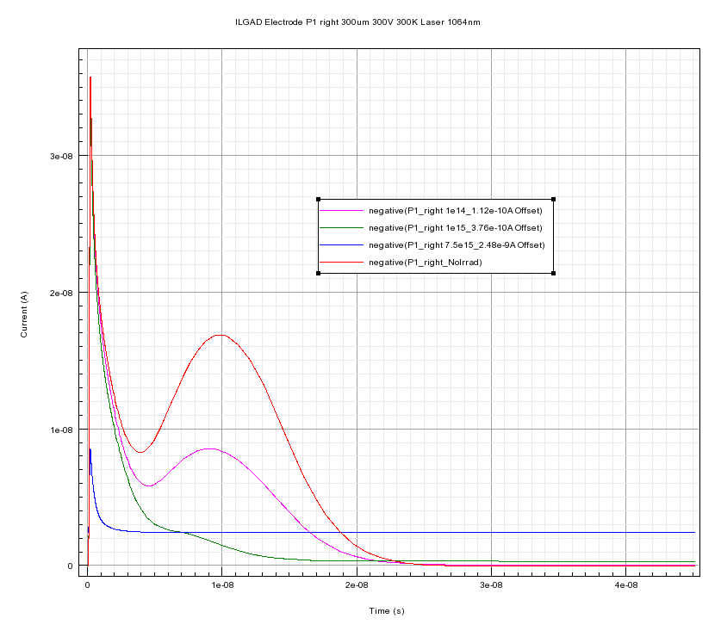
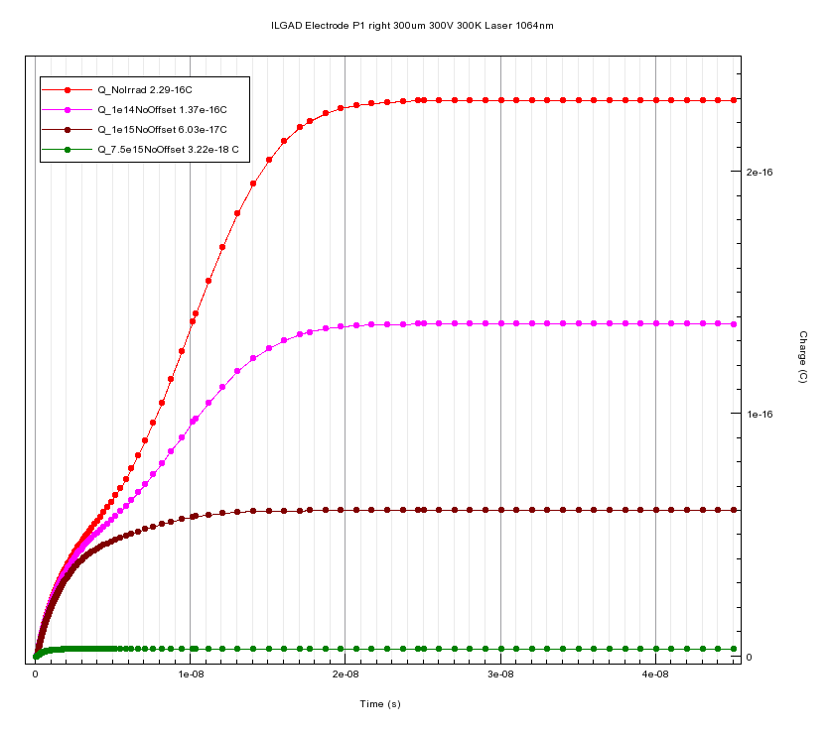
LGAD 300 um IR Laser 300K Irradiation P1 Right
Fluence n/cm² | Charge P1 Right ILGAD (fC) | % of reduction
NoIrrad | 2,29e-1 | -
1e14 | 1,37e-1 | 59,8%
1e15 | 6,03e-2 | 26,3%
7,5e15 | 3,22e-3 | 1,4%

Slide 18
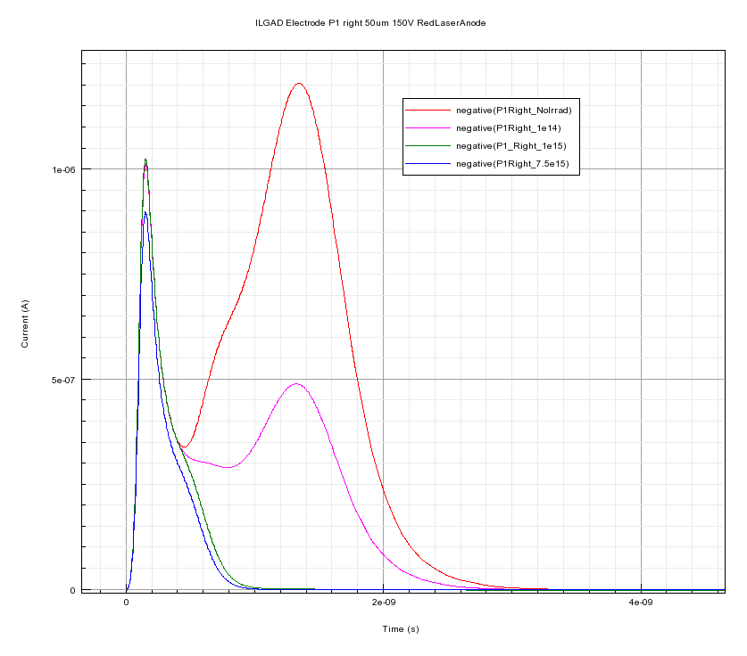
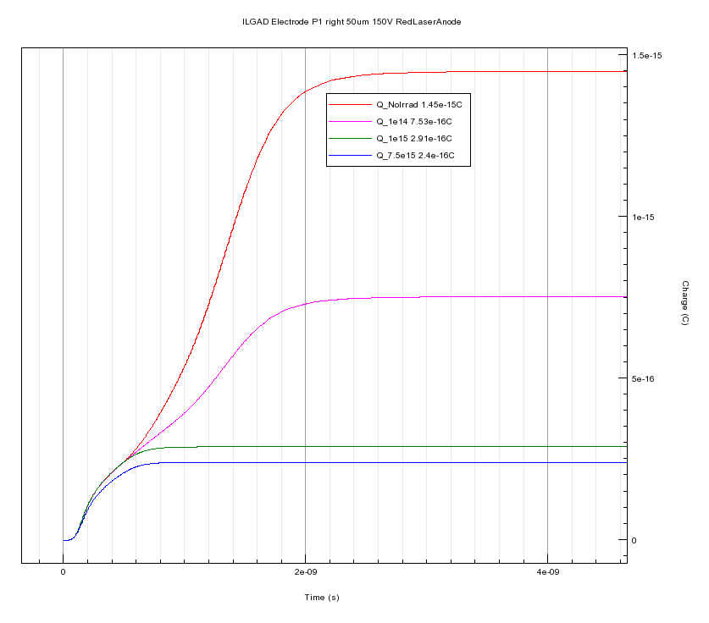
LGAD 50 um RedLaserBack 300K Irradiation P1 Right
Fluence n/cm² | Charge P1 Right ILGAD (fC) | % of reduction
NoIrrad | 1,45 | -
1e14 | 7,52e-1 | 51,8%
1e15 | 2,91e-2 | 20,1%
7,5e15 | 2,4e-1 | 16,5%

Slide 19
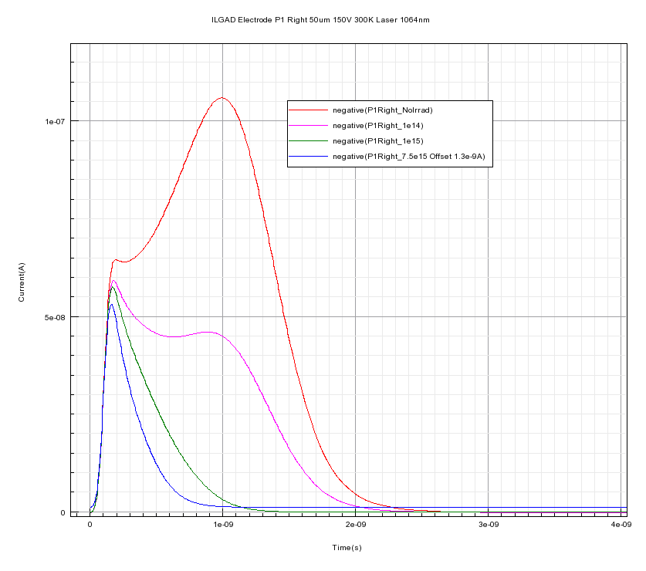
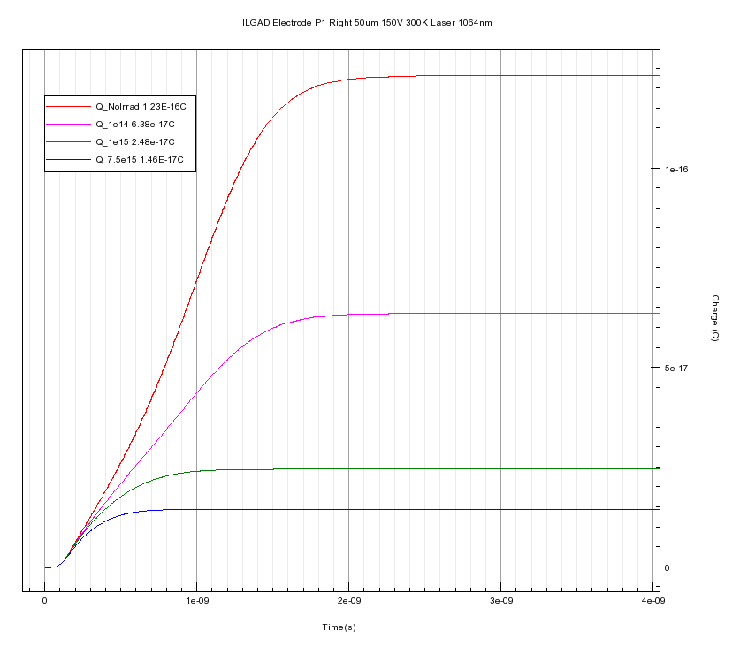
LGAD 50 um IR Laser 300K Irradiation P1 Right
Fluence n/cm² | Charge P1 Right ILGAD (fC) | % of reduction
NoIrrad | 1,23e-1 | -
1e14 | 5,38e-2 | 43,7%
1e15 | 2,48e-2 | 20,1%
7,5e15 | 1,45e-3 | 1,1%

Slide 20
Conclusions
The ILGAD model shows reasonable agreement with experiments (experimental results available are for a similar model, no exactly the same).
The timing behavior (rising edge) at the central right anode strip shows no dependence with radiation
The gain and signal general behaviour under irradiation is similar to the LGAD as expected
As expected, the 50 μm device shows better behaviour under radiation

Slide 21
Thanks for your attention
fpalomo@us.es

