Slide 1

FCC Week 2018
Amsterdam, April 9-13, 2018

Slide 2

FCC-ee Beam Vacuum Concept:
the Beam Pipe of FCC-ee
Contents
Machine parameters
SR spectra and outgassing loads
Vacuum chamber geometry
Vacuum pumping system
E-cloud mitigation
Expected performance, pressure profiles in the arcs
Machine Detector Interface areas
Summary and conclusions

Slide 3
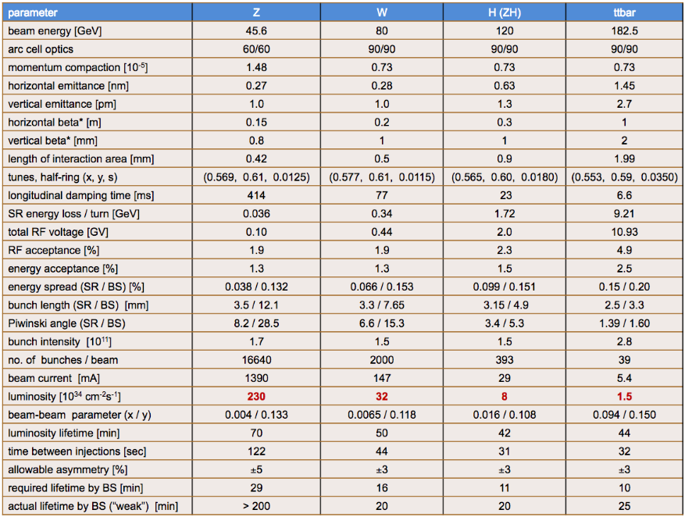
Machine parameters
Machine parameters from official web page http://tlep.web.cern.ch/content/machine-parameters
Very small vertical emittance for all energies
High current (B-factory level) for Z-pole
Luminosity lifetime τ_{lum} dominates beam current decay, but vacuum lifetime must be at least several times longer than τ_{lum}: good vacuum is a must

Slide 4
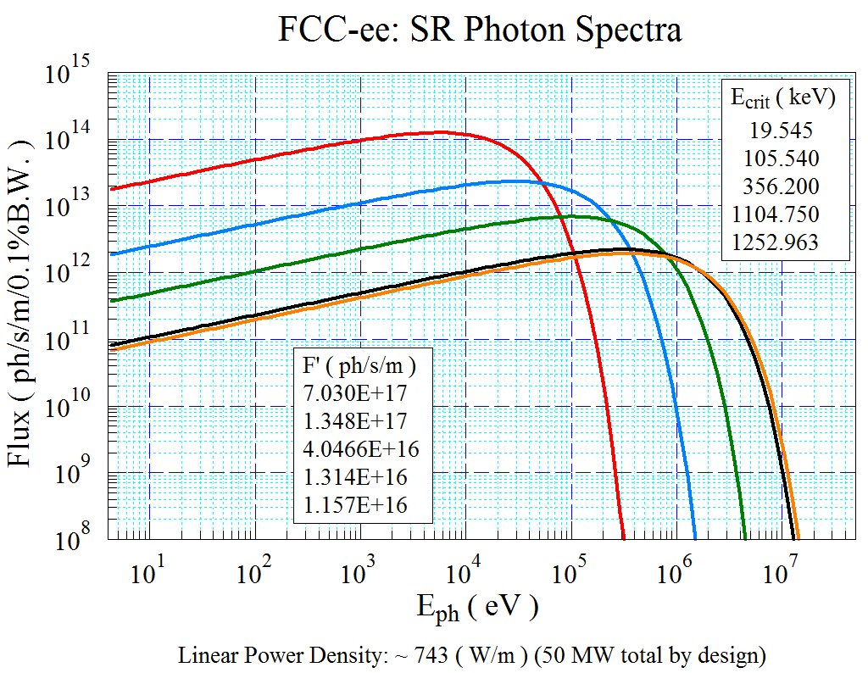
SR spectra and outgassing loads
Z-Pole: very high photon flux (→ large outgassing load);
Z-pole: compliance with scheduled operation (integrated luminosity first 2 years), requires quick commissioning to I_{NOM}=1.390 A;
T-pole (182.5): extremely large and penetrating radiation, critical energy 1.25 MeV;
T-pole (and also W and H): need design which minimizes activation of tunnel and machine components;
W, H-pole: intermediate between Z and T; still E_{crit} > Compton edge (~100 keV)

Slide 5
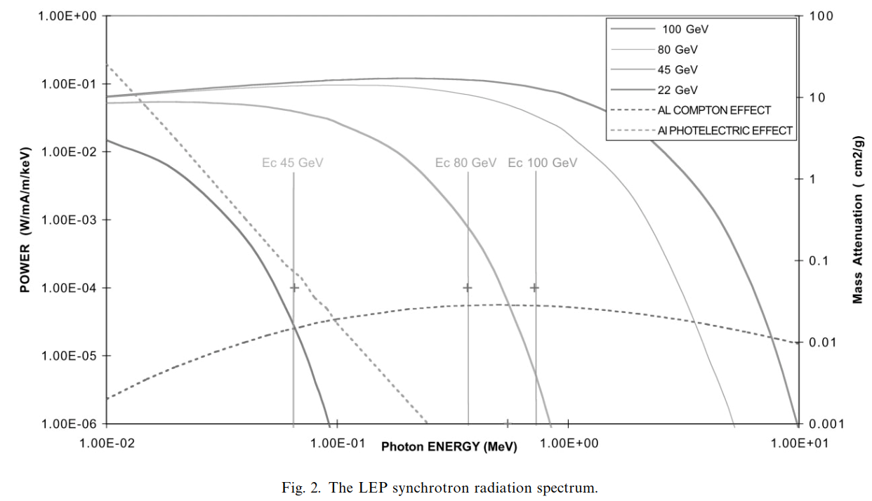
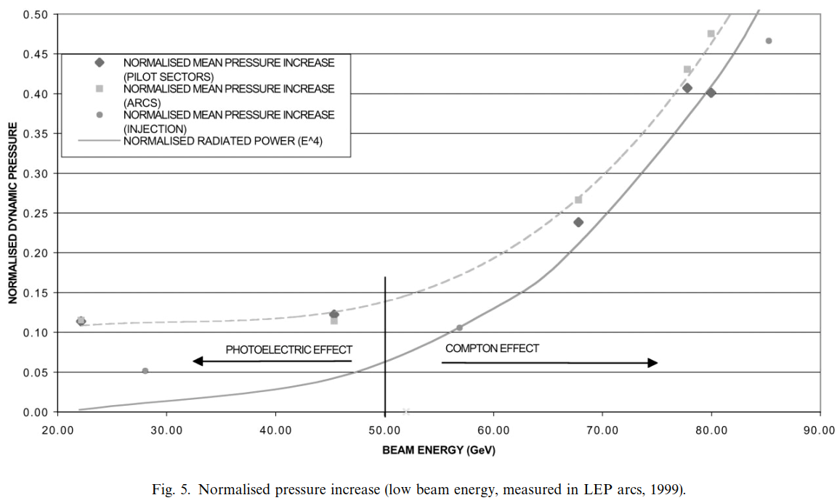
SR spectra and outgassing loads
Gas Load for W-, H-, T-poles will have a significant contribution proportional to SR power, due to Compton photons (as per LEP operation, ref. “The pressure and gas composition evolution during the operation of the LEP accelerator at 100 GeV”, M. J. Jimenez et al., Vacuum 60 (2001) p183-189);
F (FCC-ee)>100 keV (%)
Z 0.0639
W 9.220
H 28.852
T(175) 47.810
T(182.5) 49.717
If copper alloy is chosen as the material for the vacuum chamber, then a smaller fraction goes into Compton, and shielding improves;
In addition, copper has a lower photon-stimulated desorption yield;

Slide 6
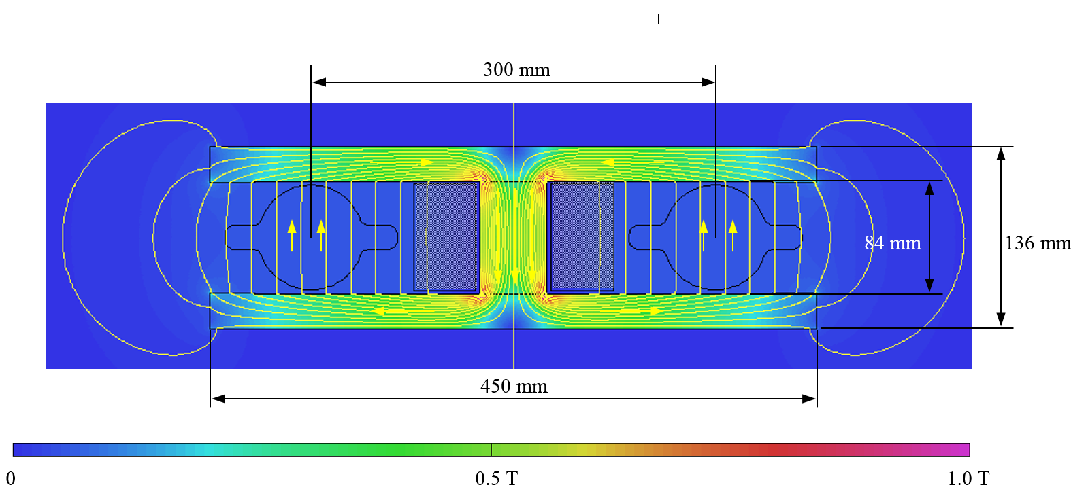
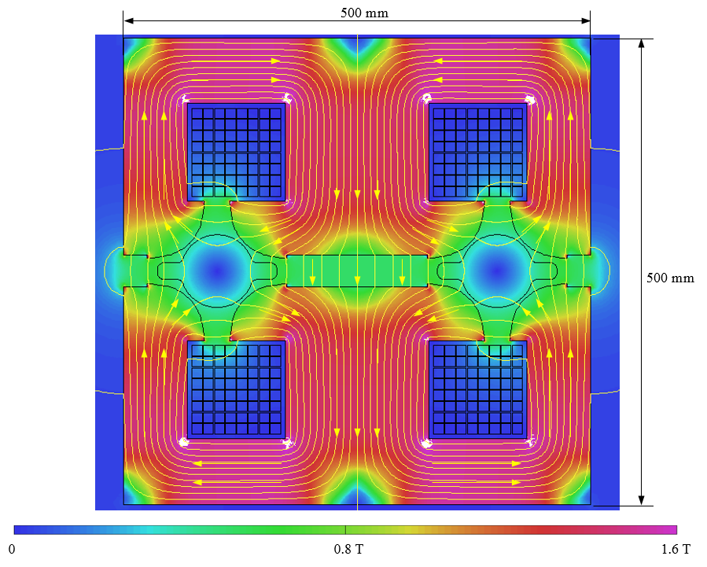
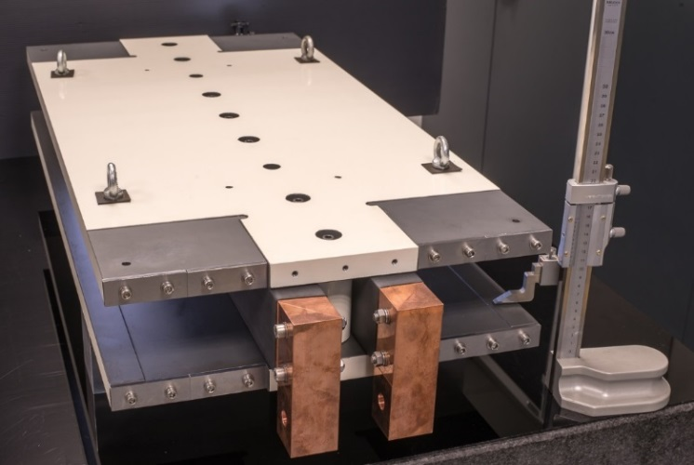
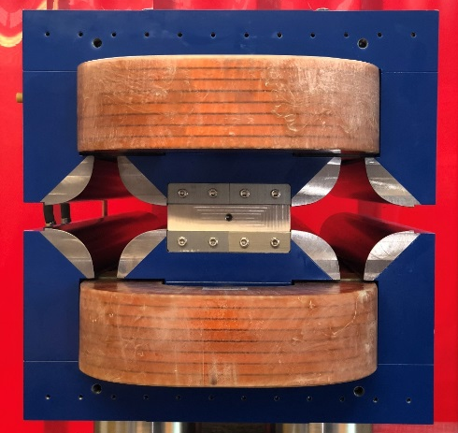
Integration with magnets
Combined-yoke dipoles and quadrupoles –
← Magnetic models → and 1m-long prototypes
Courtesy of A. Milanese, CERN
(see his contribution at Proc. FCC Week 2017, Berlin)

Slide 7
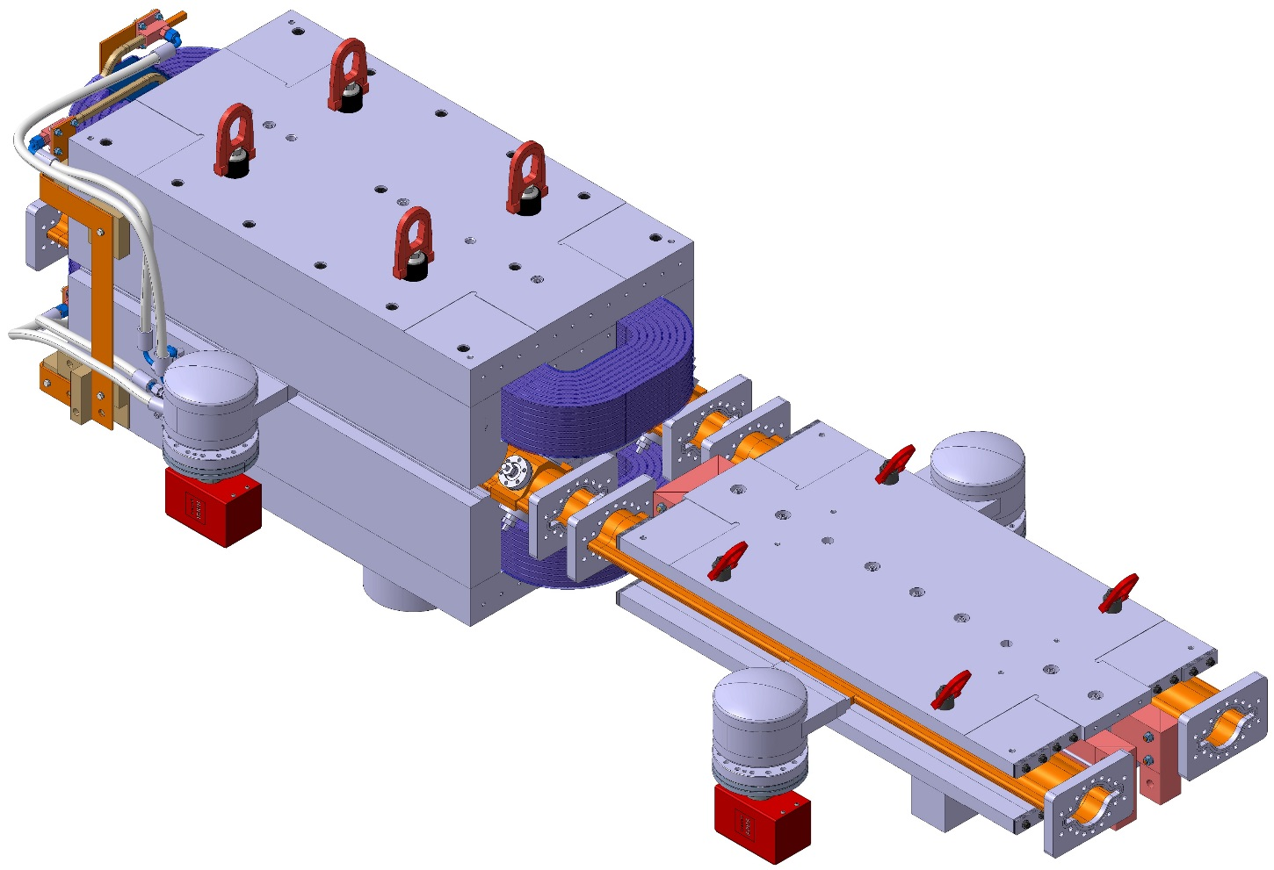
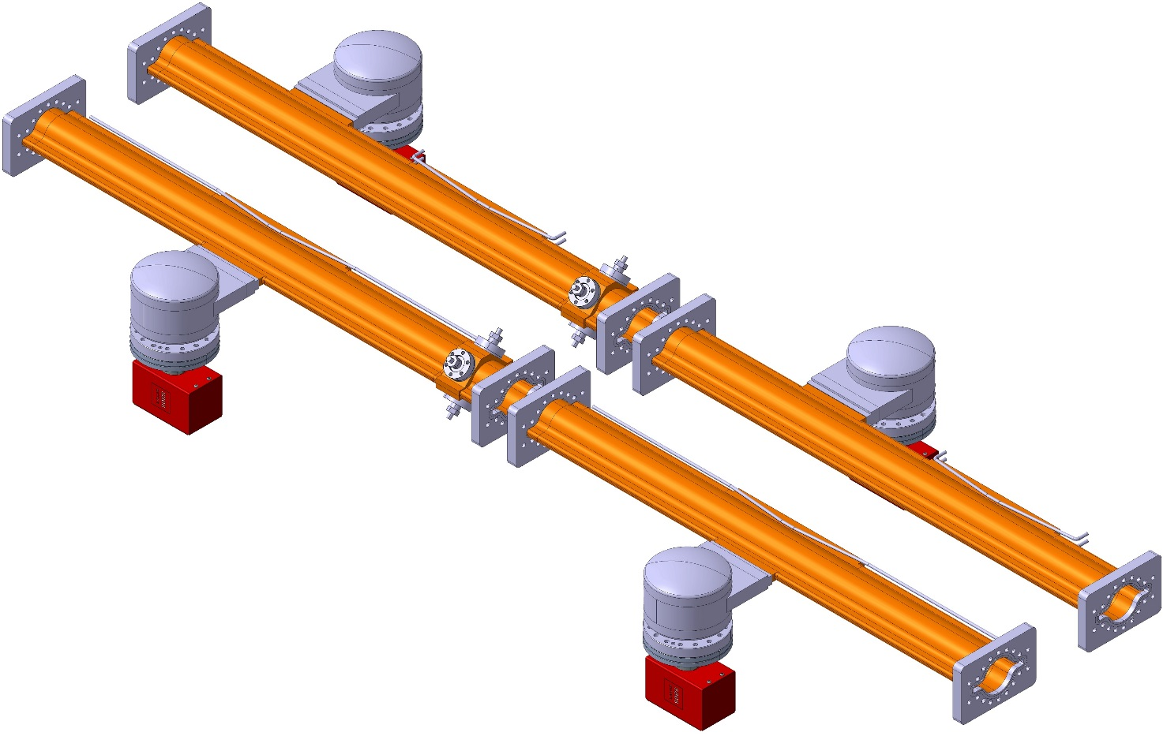
Vacuum chamber geometry
Need to use non-circular flanges
in order to avoid interference with quad coils
Vacuum chamber cross section: 70 mm ID with”winglets” in the plane of the orbit (SUPERKEKB-like);
Low-loss “comb-type” bellows modules here
(see next slides)
CAD model of the1m-long common-yoke dipole and quadrupole prototypes with arc vacuum chambers (courtesy of M. Gil Costa, CERN/CIEMAT) ;
The chambers feature lumped SR absorbers with NEG-pumps placed next to them;

Slide 8
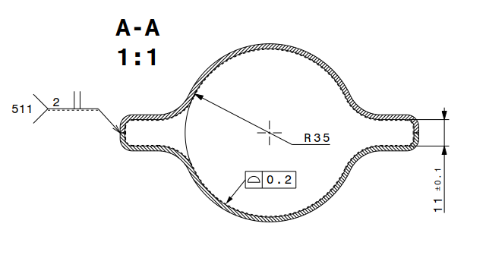
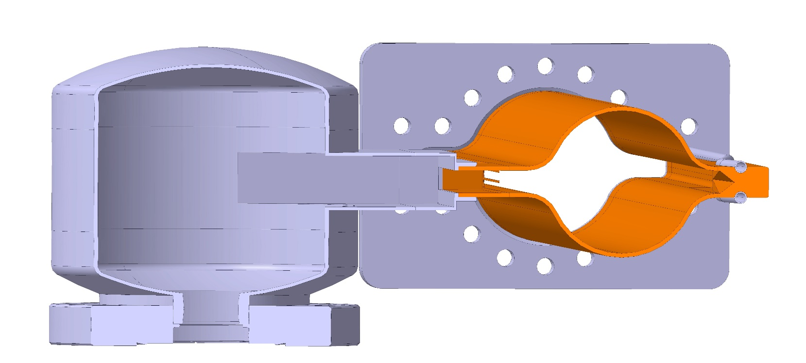
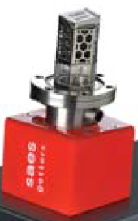
Vacuum chamber geometry
Material: OFC copper
Lumped absorbers (1 every ~ 6 m, covering the entire horizontal SR photon fan)
NEG PUMP HERE
Two-halves cross section (only for prototype)
Left: Cross-section of the prototype (real chamber will have cooling pipes running on both sides of winglets;
Right: Cross-section at pumping dome/absorber location; The connection to the beam chamber is via a slotted grid; The SR absorber is placed in front of the pumping dome (for external beam only); The conductance of the pumping dome and tapered transition is ~ 110 l/s (CO, 20 C);

Slide 9
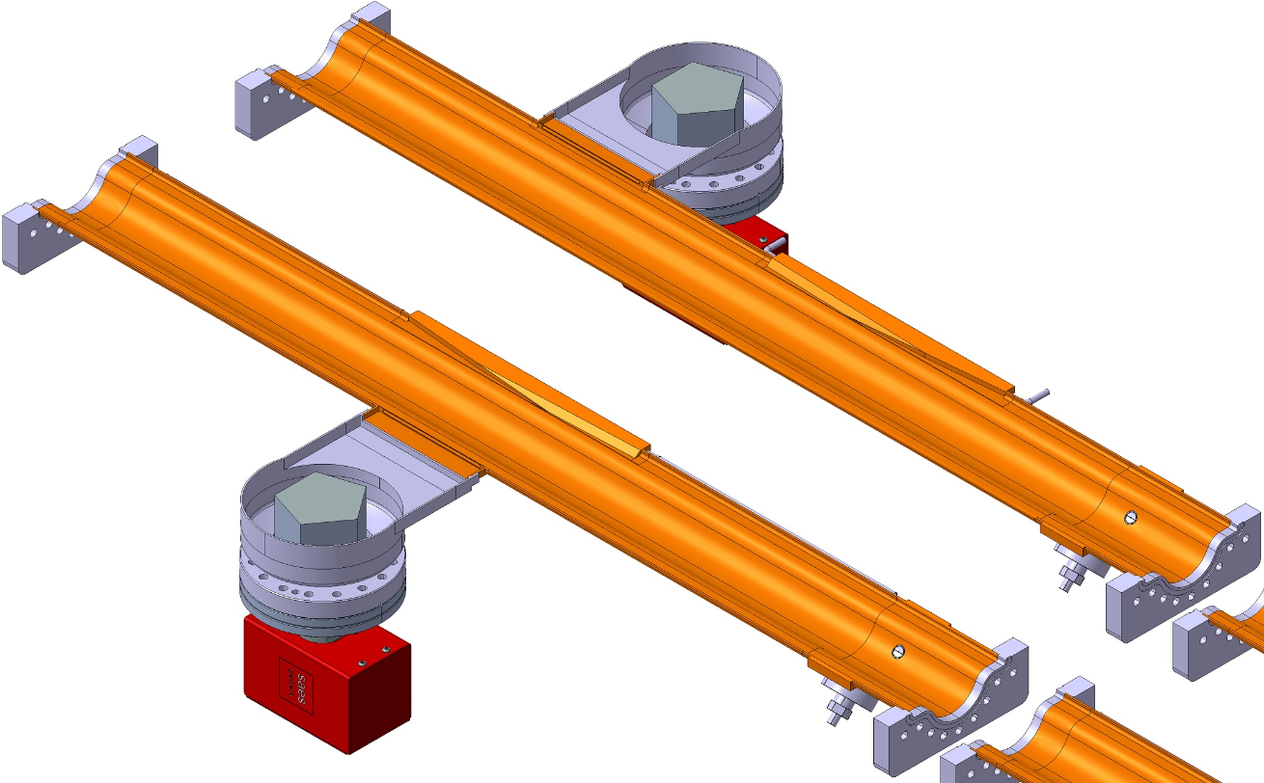
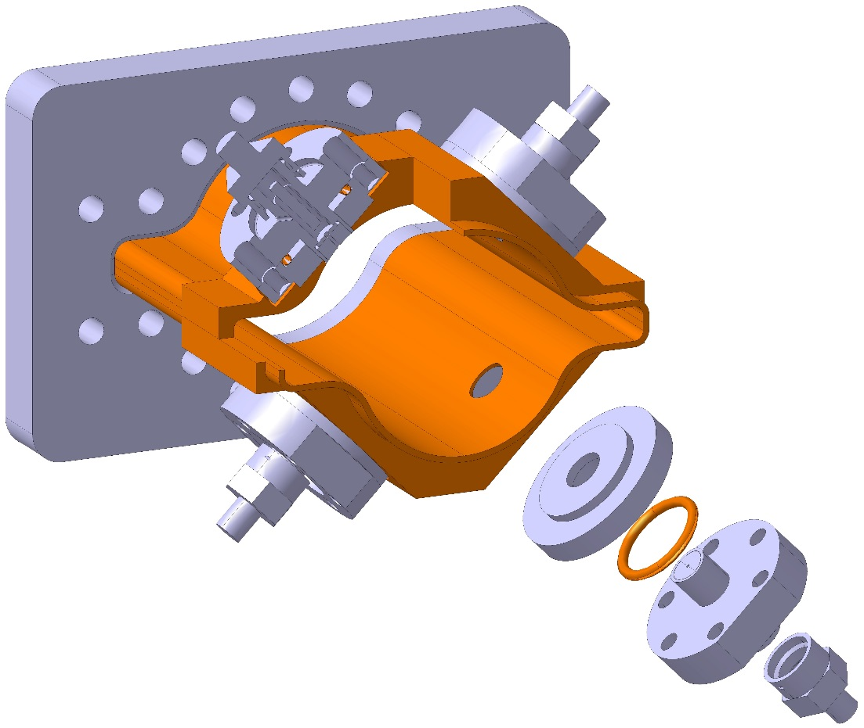
Vacuum chamber geometry
Low-impedance Matsumoto–Ohtsuka-type vacuum flanges (KEK-B, SUPERKEKB)
BPM block: low-impedance design, machined from block and e-beam welded
External Ring:
Pump.Port precedes ABS
Internal Ring:
Pump.Port face ABS
This vacuum chamber geometry, with lumped absorbers, is also useful in order to minimize the amount of scattered high-energy radiation (see A. Infantino et al., “Radiation environment assessment in the FCChh and FCCee machines”, this conference)

Slide 10
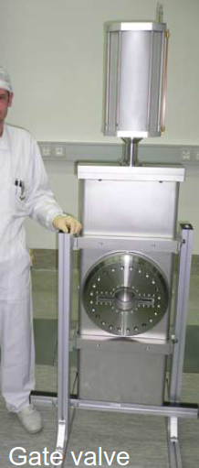
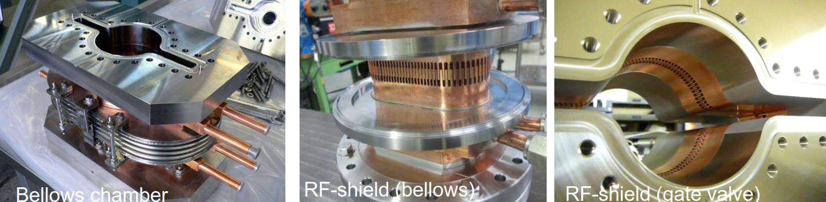
RF contact fingers
Low-loss, water-cooled, “comb-type” contact fingers (KEK concept, to be adapted to our dimensions)
Ref. - Y. Suetsugu et al., “Design and construction of the SuperKEKB vacuum system” – J. Vac. Sci. Technol. A 30 (2012) 031602
- K. Shibata, KEK, Proc. ECLOUD’12, June 2012

Slide 11
Vacuum pumping system
The common-yoke design for the magnets does not allow us to use a chamber-antechamber design like LEP; the proposed pumping concept is based on a design philosophy combining a reduction of the SR-induced outgassing load thanks to the lumped absorbers, the use of high-speed/high-capacity pumps placed next to the absorbers, and the use of thin-film coatings or surface texturing which would reduce the amount of gas generated by SR photons and avoid the contribution to outgassing of e-cloud multipacting;
The proposed, baseline design is the following:
NEG-coating
High-capacity lumped NEG pumps (NEXTorr, SAES Getters)
One open issue with NEG-coating is its contribution to the longitudinal resistive-wall instability¹;
It is being addressed experimentally now at CERN², and will be also tested with SR at the Photon Factory soon³
1 E. Belli et al., “Impedance model and single-beam collective effects”, this conference
T. Finkley Sinkovits et al., “Minimum effective thickness for activation and low total electron yield of TiZrV non-evaporable getter coatings”, this conf.
Y. Tanimoto et al., Photon Factory, KEK (to be published)

Slide 12
E-cloud mitigation
As already mentioned, the baseline option is the use of NEG-coatings; it is known to have a low SEY
An experimental research program is underway at CERN in order to determine what minimum thickness of the NEG-coating would be tolerable without affecting the longitudinal resistive-wall instability threshold, providing a sufficiently low secondary electron yield (SEY), and providing also a low photon-stimulated desorption (PSD) yield after repeated saturation/activation cycles.
So far (see refs. 1 and 2 previous slide) 30, 90, and 200 nm-thick coatings have been tested via XPS analysis (oxygen dissolution profiles vs depth), and 4 thermal cycles (activation at 250 C);
The results are encouraging
Plan-B options are:
  amorphous carbon
  titanium nitride
  laser-ablated surface texturing¹⁻⁴
  clearing electrodes
  1 O. Malyshev et al., “A Facility for Studying ESD from NEG Coated Surfaces at Cryogenic Temperatures”, this conf.
  O. Malyshev et al., “NEG Coatings and laser surface engineering (LASE) electron cloud mitigation techniques”, this conf.
  T. Sian et al., “New LASE surfaces obtained with various lasers and their parameters for e-cloud mitigation”, this conf.
  R. Valizadeh et al., “Recent development in Laser ablation surface engineering for reduction of secondary electron yield”, this conf.

Slide 13
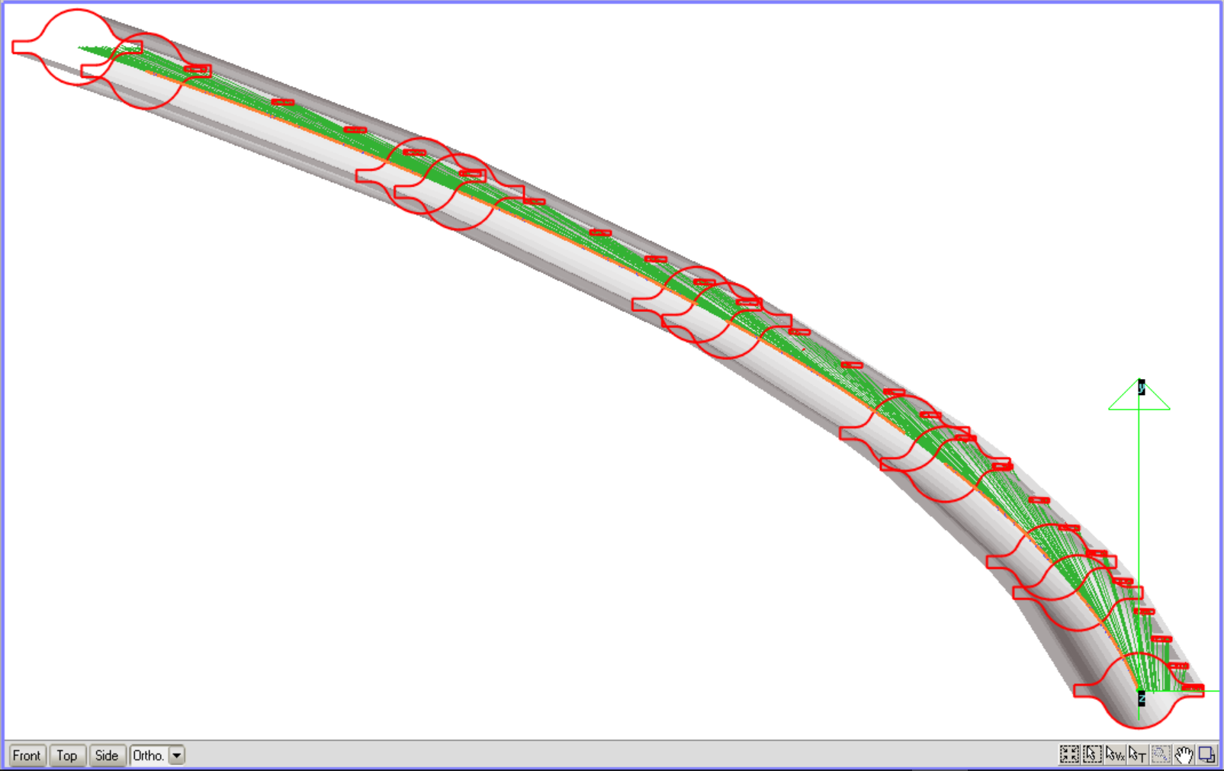
Expected performance,
pressure profiles in the arcs
One ~140 m-long section of the arc lattice (latest optics) has been modelled (5 dipoles of 3 different lengths and 3 quadrupoles)
Lumped SR absorbers have been placed so that they cover 100% of the primary SR photon fan (i.e. ray-tracing with zero reflectivity, see figure)
In total, 24 absorbers placed at ~ 5.8 m average distance between each other
Periodic boundary conditions (not strictly true, but close enough for vacuum purposes)
1 NEG pump upstream of each absorber (like for the external beam, worst case)
3D SYNRAD+ model for ray-tracing;
Boundaries of dipole-to-quad areas and SR absorbers are highlighted in red

Slide 14
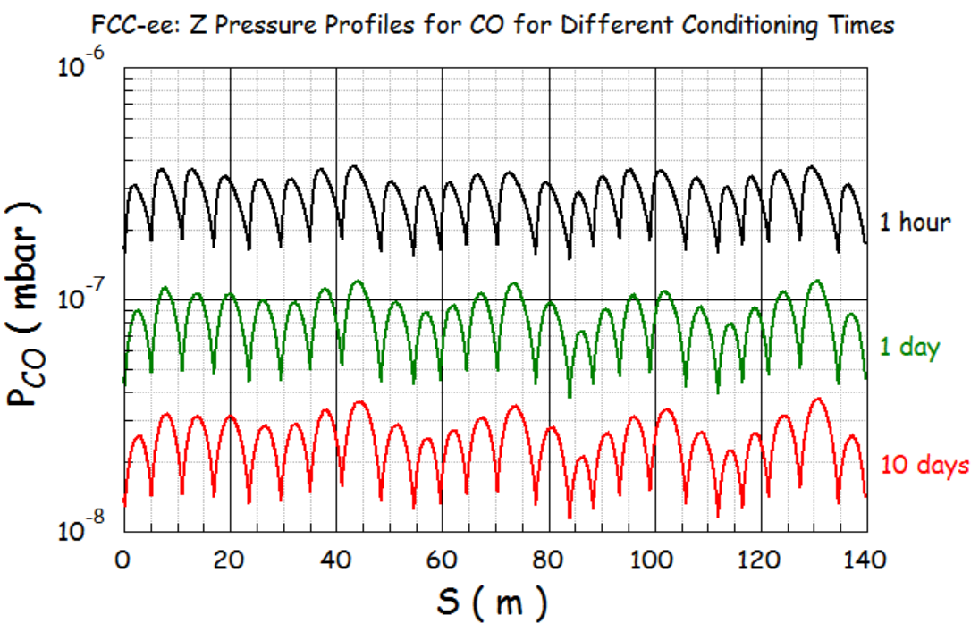
Expected performance,
pressure profiles in the arcs
The SYNRAD+ MC ray-tracing code has been run with energy- and angle-dependent reflectivity curves, in order to get a surface mapping of the SR photon distribution
The photon map has been used as an input to the MC code Molflow+, which calculates the corresponding pressure and density profiles; Molflow+ requires a “conditioning time” and the definition of the pumping speeds as an input
The pressure curves on the right assume 100% CO gas (real case probably ~80% H₂, ~20% CO and CO₂, and traces of CH₄)
It is assumed here that one NEG pumps is installed upstream of each absorber

Slide 15
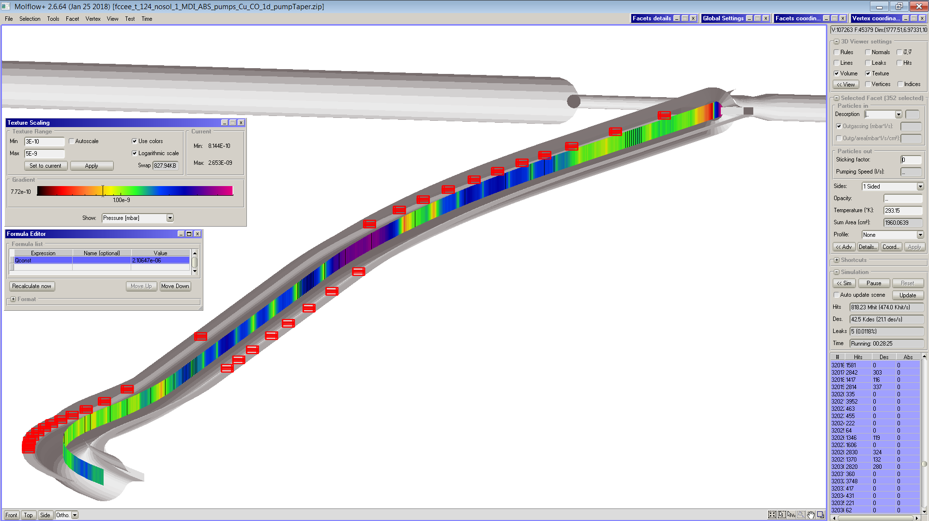
Machine Detector Interface areas
Modelling work has also been carried out for the MDI areas of FCC-ee, see relevant MDI meeting, study group, and workshop pages on indico
A 3D model of the vacuum chamber geometry ~ 660 m upstream of the IP has been created; it implements the SUPERKEKB-type cross-section with lumped absorbers and NEG pumps already described for the arc chambers
SYNRAD+ and Molflow+ have been run, coupled for the high-current Z-pole machine
The figure on the right shows the model with the colour-coded pressure along the beam path and the absorbers in red
e+
e-

Slide 16
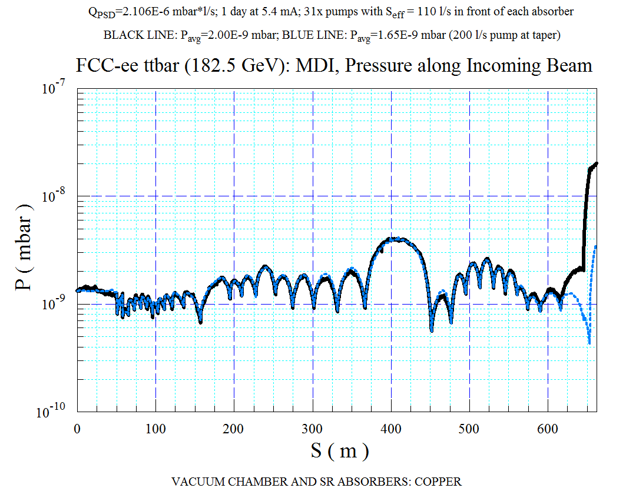
Machine Detector Interface areas
The figure on the right shows the pressure profile for the T-pole at 182.5 GeV, after a vacuum conditioning of 1 day at full current (5.4 mA)
The blue curve assumes a higher pumping speed at the taper placed immediately before the QC2L2 final-focus quadrupole: it helps decrease the pressure bump near the IP
See also:
  A. Kolano, “Mitigation of synchrotron radiation from IR”, this conf.
  F. Collamati et al., “Beam-gas background characterization in the FCC-ee IR”, this conf.
  M. Boscolo, “MDI status and overview”, this conf.

Slide 17
Summary and conclusions
Following the developments on the design of the arc magnets and optics, a vacuum chamber cross-section has been chosen
It is derived from that successfully implemented in the two rings of SUPERKEKB, with reduced dimensions (70 mm ID circular tube with two small “winglets” in the plane of the orbit)
Careful ray-tracing and vacuum considerations have convinced us that a lumped absorber design would improve the vacuum performance and shorten the commissioning time
“Thin” NEG-coating is the baseline choice for e-cloud mitigation and in order to shorten the vacuum conditioning due to SR photon irradiation
Plan-B e-cloud mitigation options are being considered too: TiN, amorphous carbon, LASE texturing, and clearing electrodes
Implementation of the same concept in the MDI areas has also been studied: it would generate a low-background at the IP
Work to do for the CDR:
  Cost estimate for vacuum chambers, pumping system, NEG-coating (or other technology)
  Full arc model to pass on to FLUKA team for R2E and tunnel activation studies
Many thanks to M. Ady, CERN, for support with lattice file conversion and integration into SYNRAD+ code

