Slide 1
Outline
List of systems with block diagram
Calibration system
Results with DAB system
  SFTPRO beam
  LHC25ns beam
  LHCPILOT beam
Results with TRIC system
  LHC

Slide 2
SPS Transfer-line BCTs
Where | Location | INJ/EXT
TT2 | 212 | INJ
TT10 | 102834 | INJ
TT40 | 400344 | EXT (AWAKE/TI8)
TT60 | 610225 | EXT (HiRadMat/TI2)
TT66 | 660516 | EXT (HiRadMat)
TI2 | 29125 | TI2
TI8 | 87750 | TI8
BCT
Calibrator
(tunnel)
Signal
Calib. trigger
FE electronics
(surface)
Scope, TRIC or VFC output
Gain
control
Calib
control
High BW (~70MHz) for BxB
Low BW (~MHz) for total intensity
C
P
U
D
A
B
B
O
B
R
Use-case for SPS TL BCTs
For all beam injections (max = 13) and fast extracted per cycle:
Total intensity (charges)
Intensity profile (at least relative)
Capture start trigger (PP)
BST timing (SPS)

Slide 3
Specifications (never released) https://edms.cern.ch/document/1233006/1.0
Beam Intensity in Transfer Lines: Total and bunch-by-bunch intensity (25nsec slots)
Parameter | PSB/PS/SPS
Absolute Accuracy (RMS) | 2% + 5e8 charges
Resolution = detectable differences between transfers or consecutive shots (RMS) | 2e8 charges
Total beam intensity evolution in the rings over the cycle
Parameter | PSB/PS/SPS
Absolute Accuracy (RMS) | 1% + 5e8 charges
Resolution = detectable differences between transfers or consecutive shots (RMS) | 2e8 charges
Bunch by Bunch Intensity in the Rings (at 40MHz)
Parameter | PSB/PS/SPS
Absolute Accuracy (RMS) | 2% + 5e8 charges
Resolution = detectable differences between transfers or consecutive shots (RMS) | 2e8 charges

Slide 4
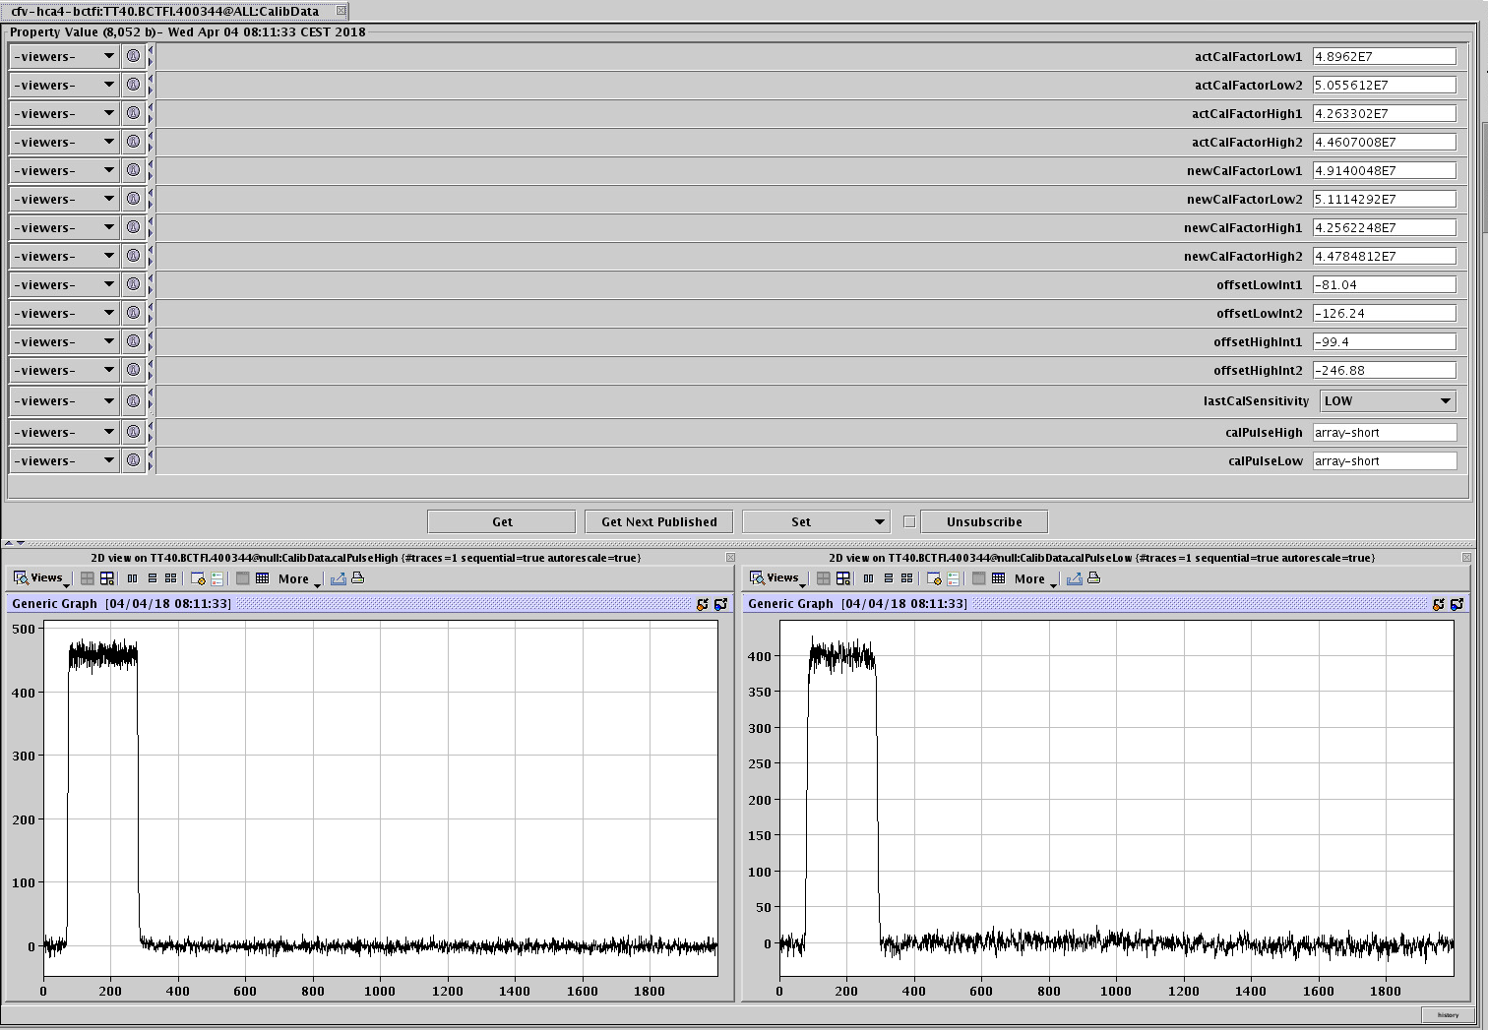
Calibration pulse
(pulse = 2E10 charges)
Quite often not working (SEU latch-up)

Slide 5
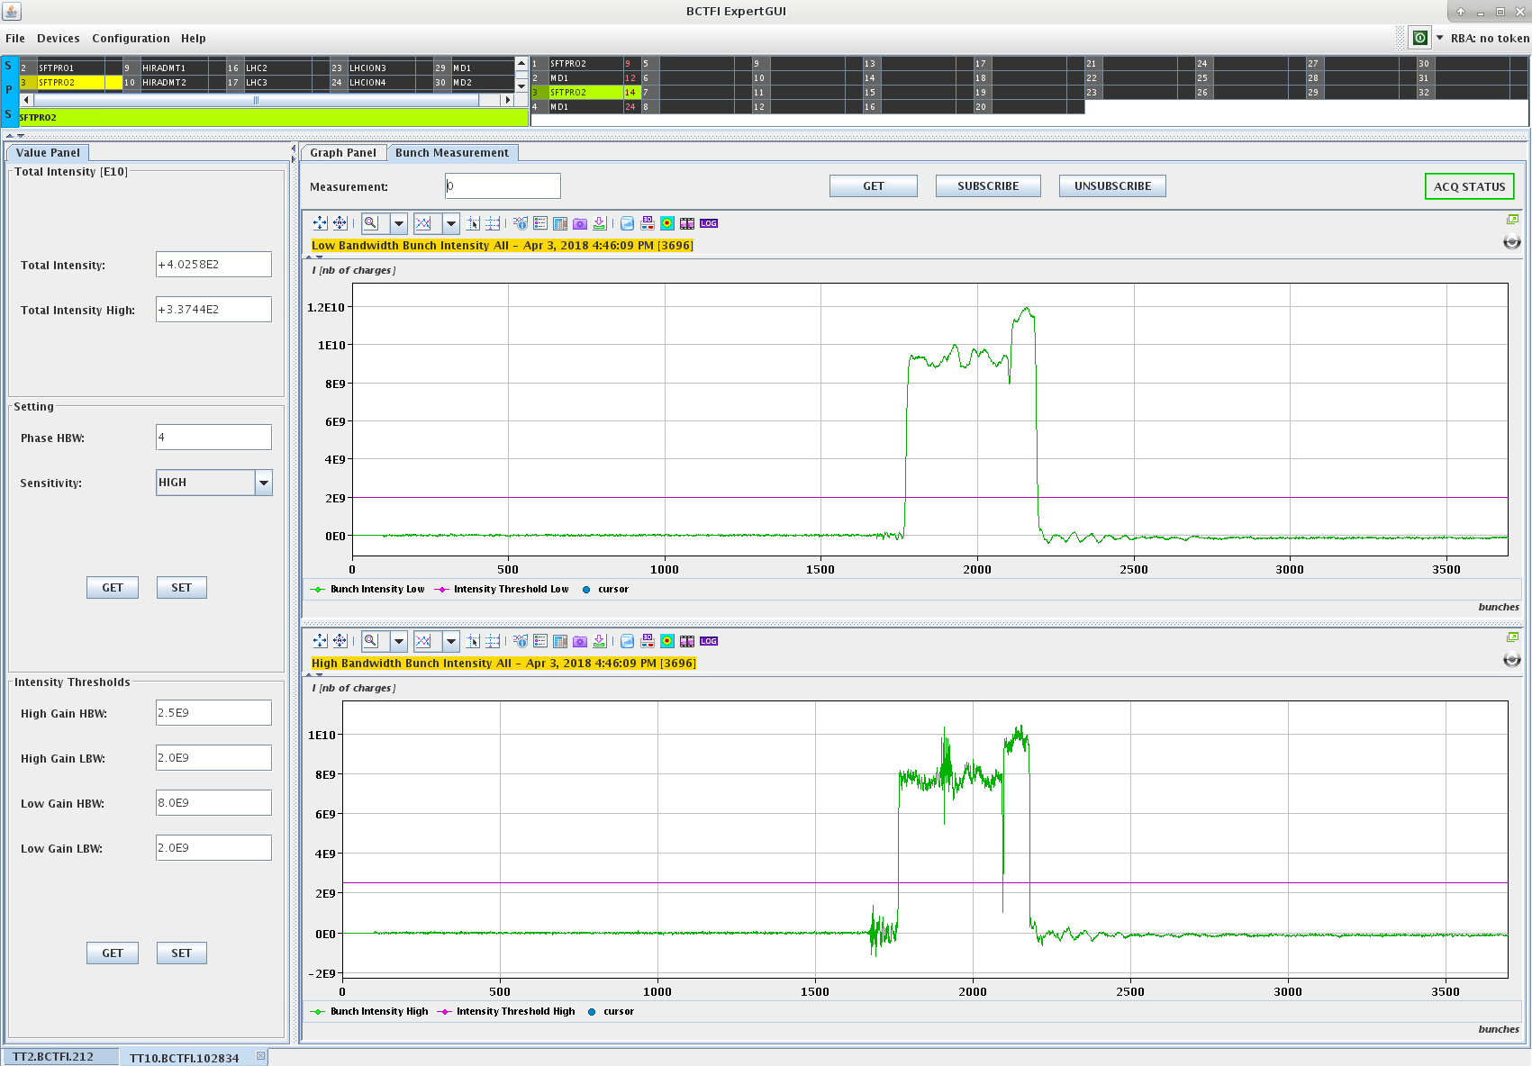
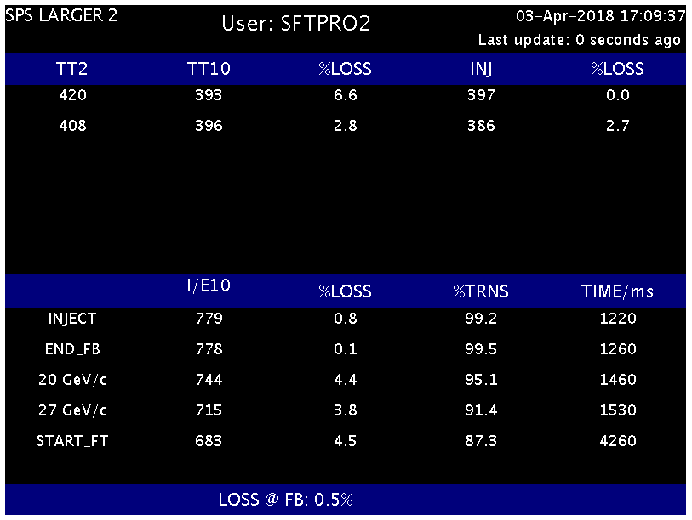
Settings and acquisitions (SFTPRO)
Phase (0-15)
Gain
Low BW for DC beams
MTE beam 5th turn too high (profile)
Noise threshold (~2E9 charges)
Find and apply DC offsets (dynamic)
Apply calibration factors
Effective integration time (21nsec) applied for HBW
Calculate total intensity by integrating all bunches above threshold
Noise threshold (~2E9 charges)
High BW for LHC-type beams
Capture acquisition two channels @40Mhz covers 4 SPS turns, first ‘valid’ bunch varies for each injection (=> need access to raw-data buffers)

Slide 6
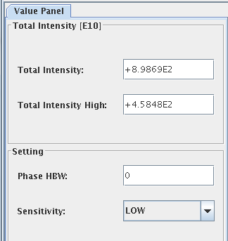
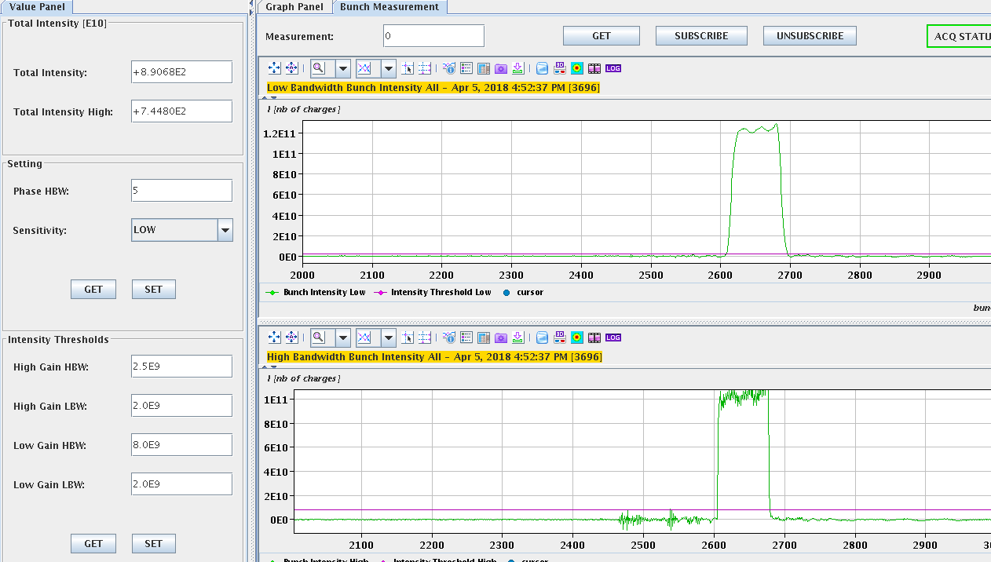
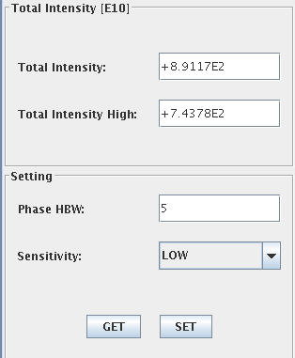
Settings and acquisitions (LHC25NS) – TT10
Dependency of 25 nsec phase
Phase (0-15)
Gain
Low BW for DC beams
Noise threshold (8E9 charges)
High BW for LHC-type beams
Acquisition covers 4 SPS turns, first valid bunch varies for each injection

Slide 7
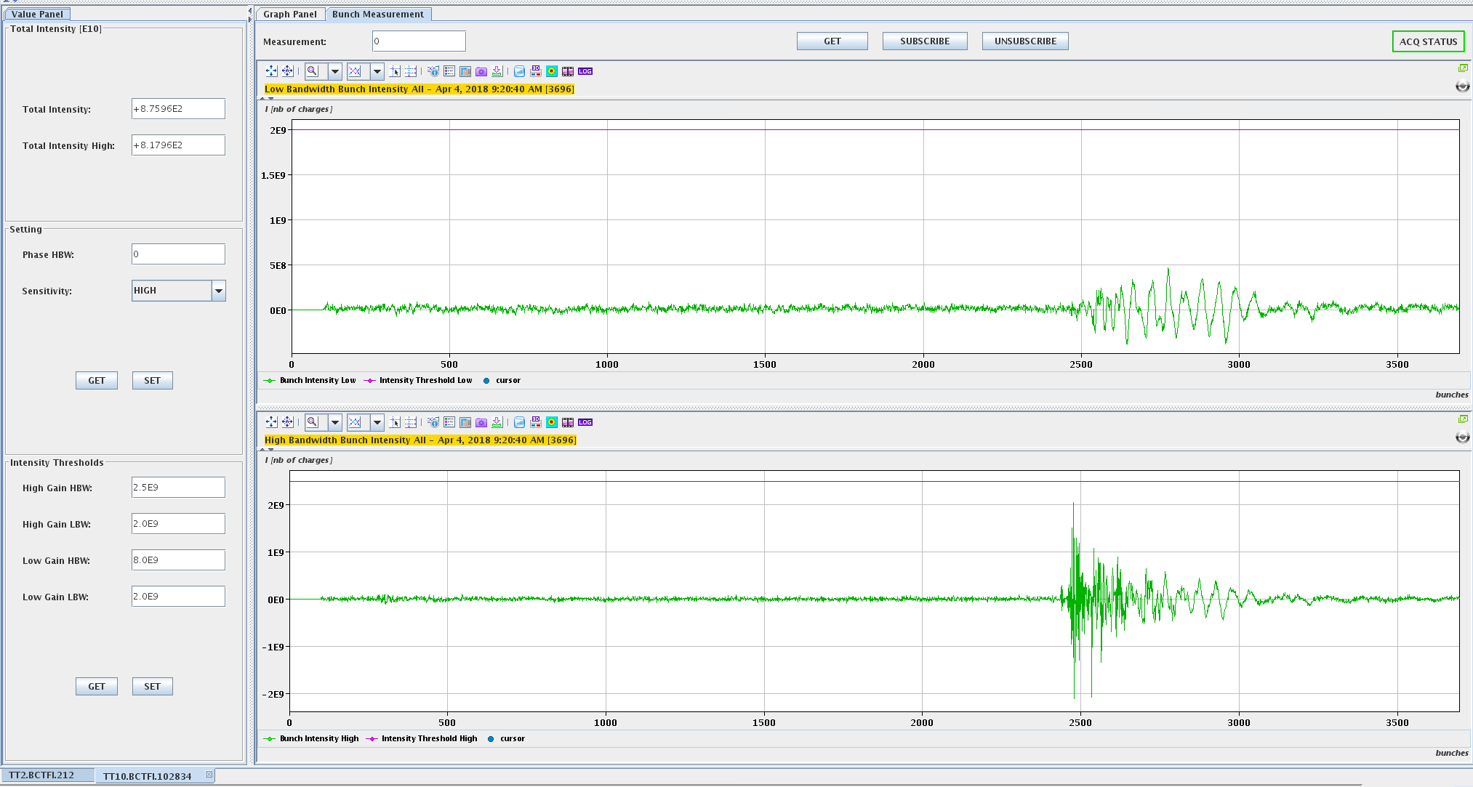
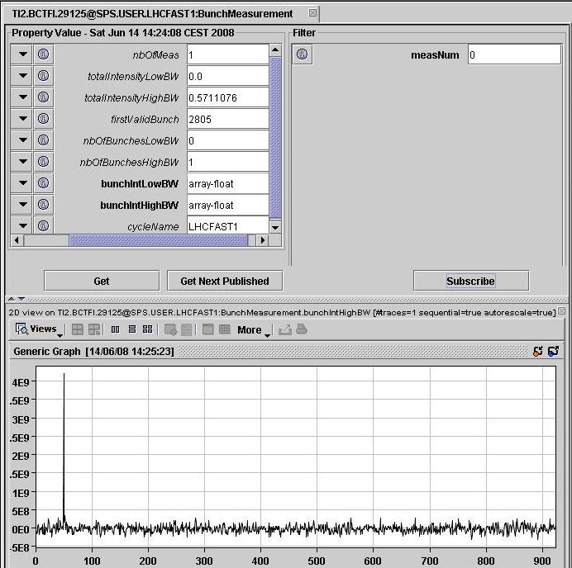
Settings and acquisitions (LHC pilot) – TT10 and TI2
High gain
No beam – noise ~= signal
Injection kicker noise
Very clean signal in TI2

Slide 8
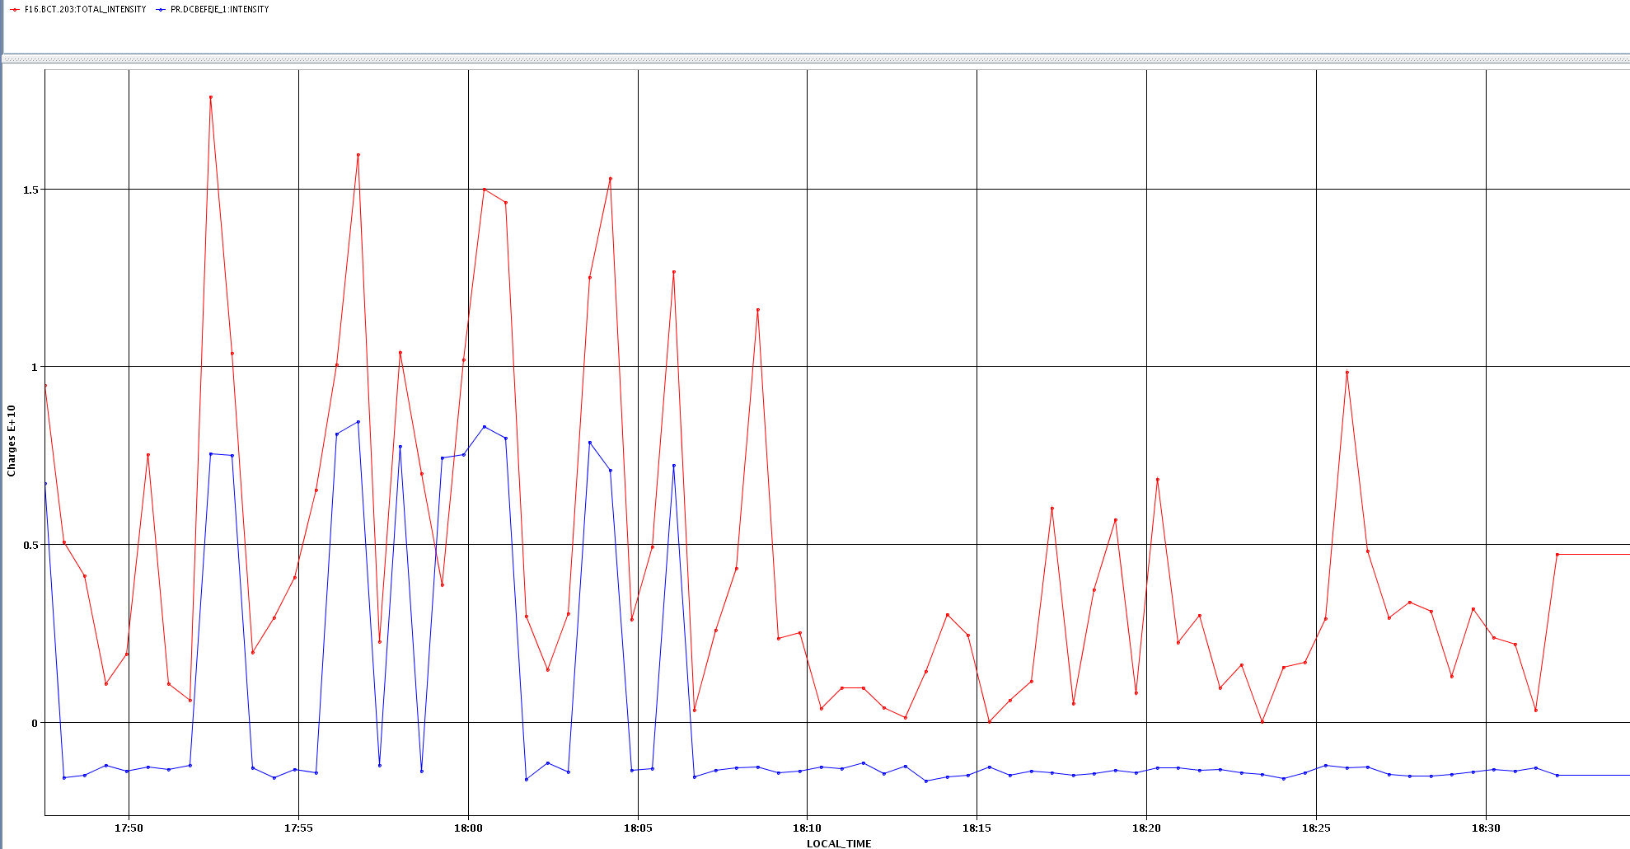
LHCPROBE: PS ring (blue=DC) + TT2 Fast BCT (TRIC) (red=BCT203)
We measure double in TT2 than in PS ring

Slide 9
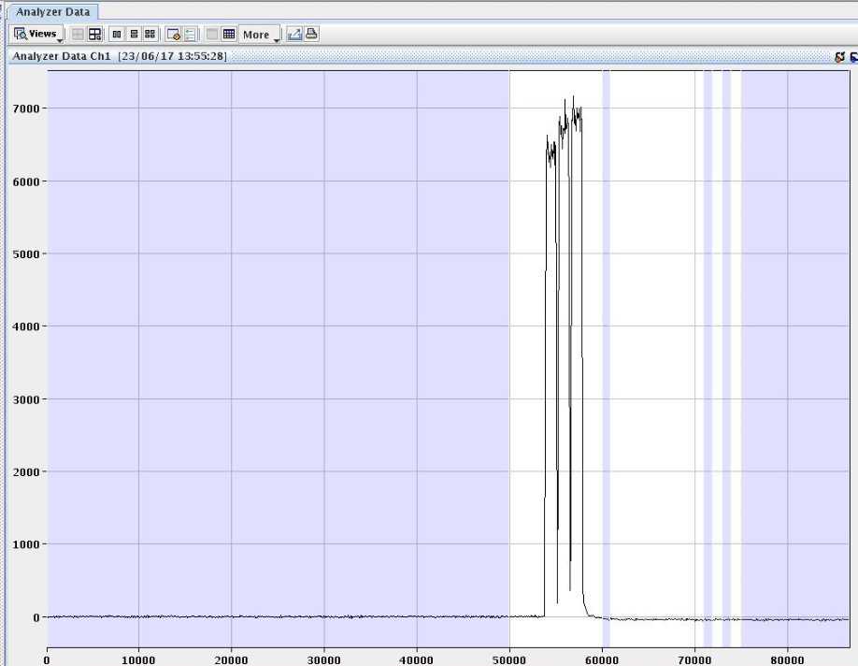
DAB and TRIC in TT60
Compared transmission from SPS DC BCT (BA3) to TT60 for 200 extractions to LHC (fixed calibration)
  STDEV:
    TRIC: 1.0% (electronics noise?)
    DAB: 0.6%
Propose to replace the TRIC with a VFC+1GS as soon as possible
Internal analyser on the TRIC

Slide 10
VFC for single-pass
Principle used in LHC dump lines
  Kicker signal used to freeze buffers
  RF pre-pulse with freeze delay over SPS BST
Digital data available (used for BCTFD)
  Raw-data traces (~1.5 nsec between samples) over ~10 turns
  Bunch (25 nsec slots) (limited to ~10 turns)
  BxB data at 25 nsec (over N turns)
Analogue signal:
  Bandwidth full and limited? (ch1 / ch2)
  How about the dynamic range? (gain)

Slide 11
Final remarks
Low intensity beams (pilots) remain very difficult to measure in transfer-lines (S/N ~ 1) – need high values for noise rejection
DAB-based system robust with few settings for medium to high intensity beams
  Infrequent data corruption on DAB memory -> reboot
  Suffers with low intensity and dependency of 40MHz phase (effective integration) for FBW (BxB) values
VFC is believed to cover requirements but the large number of settings per beam type and no easy way to calibrate is a worry (for me!)
  Need to start testing – where?
Any chance to reduce the kicker noise in TT10?

