Slide 1
DAB-based Ring fast BCTs – BA3
2 integrators (21ns effective integration time) in tandem
2 acquisition modes:
  REPETETIVE:
  Total Intensity averaged @ 20 Hz – published at the end of the cycle
  Bunch-by-bunch intensity averaged @ 20 Hz – published at the end of the cycle
  TURN_BY_TURN:
  Turn-by-turn (max 500) intensity for tracking instabilities at injection – published at the end of the cycle
Calibration a la BCTFI
Settings a la BCTFI
Expert settings to treat undershoots in SW

Slide 2
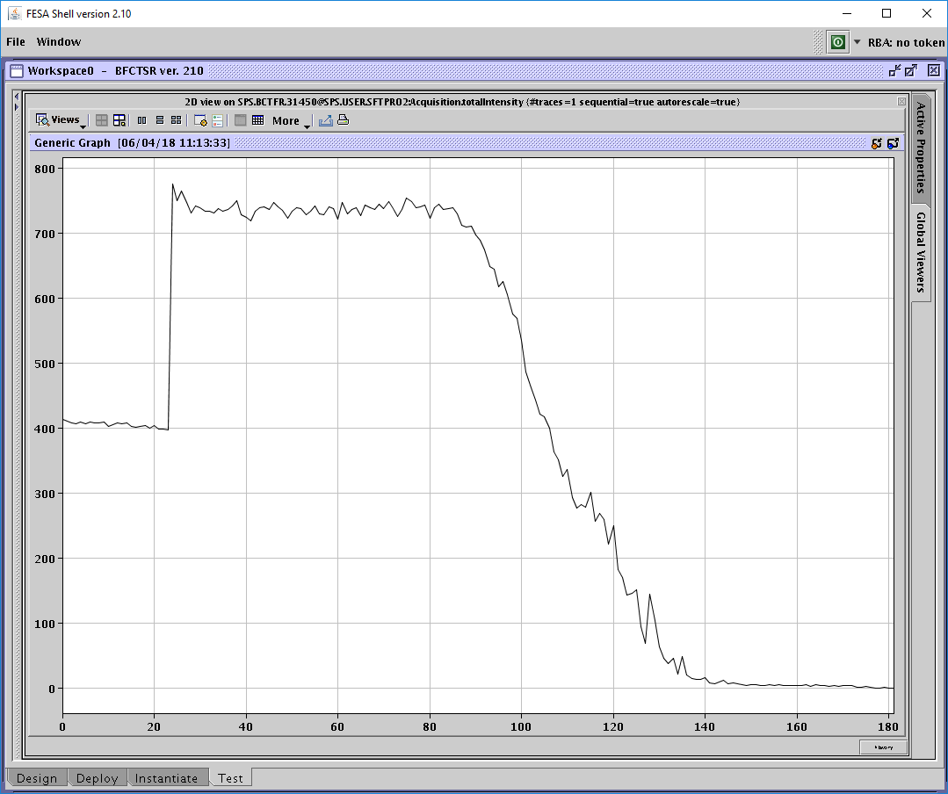
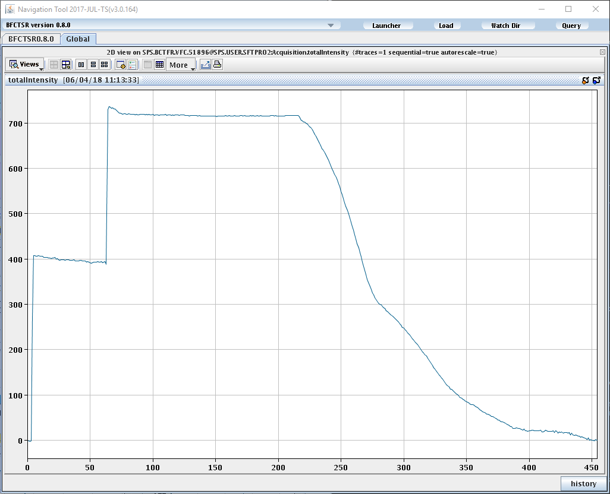
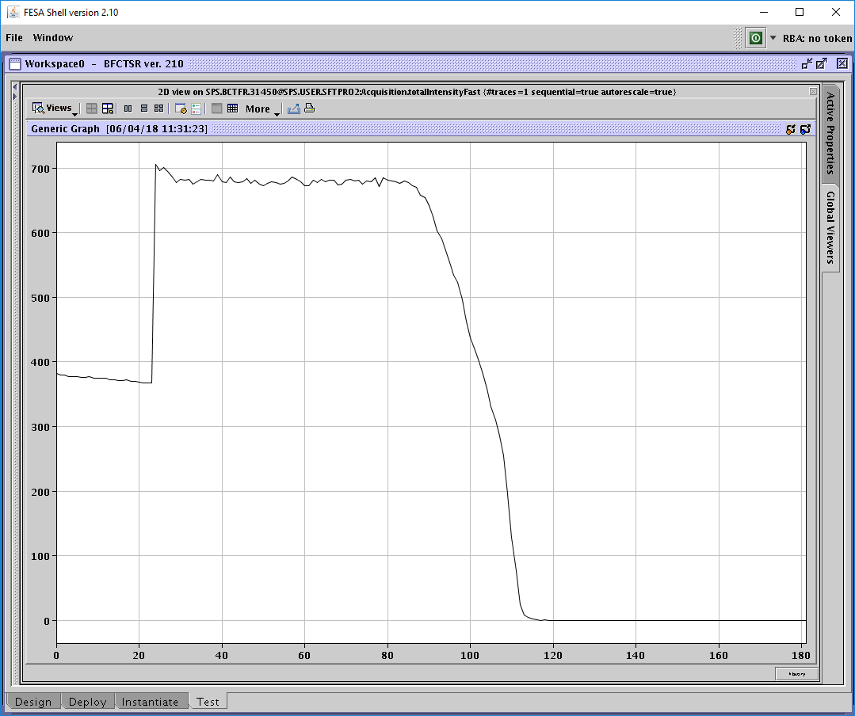
SFTPRO cycle with DAB (BA3) and VFC (ECA5)
DAB - LBW
VFC
DAB - HBW

Slide 3
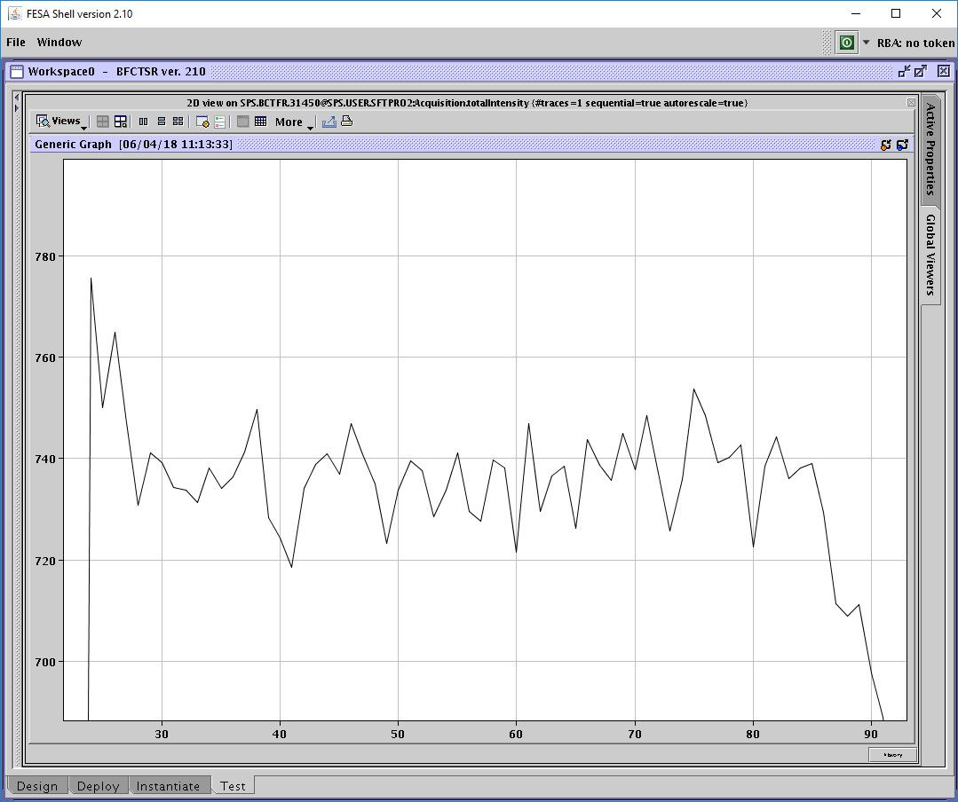
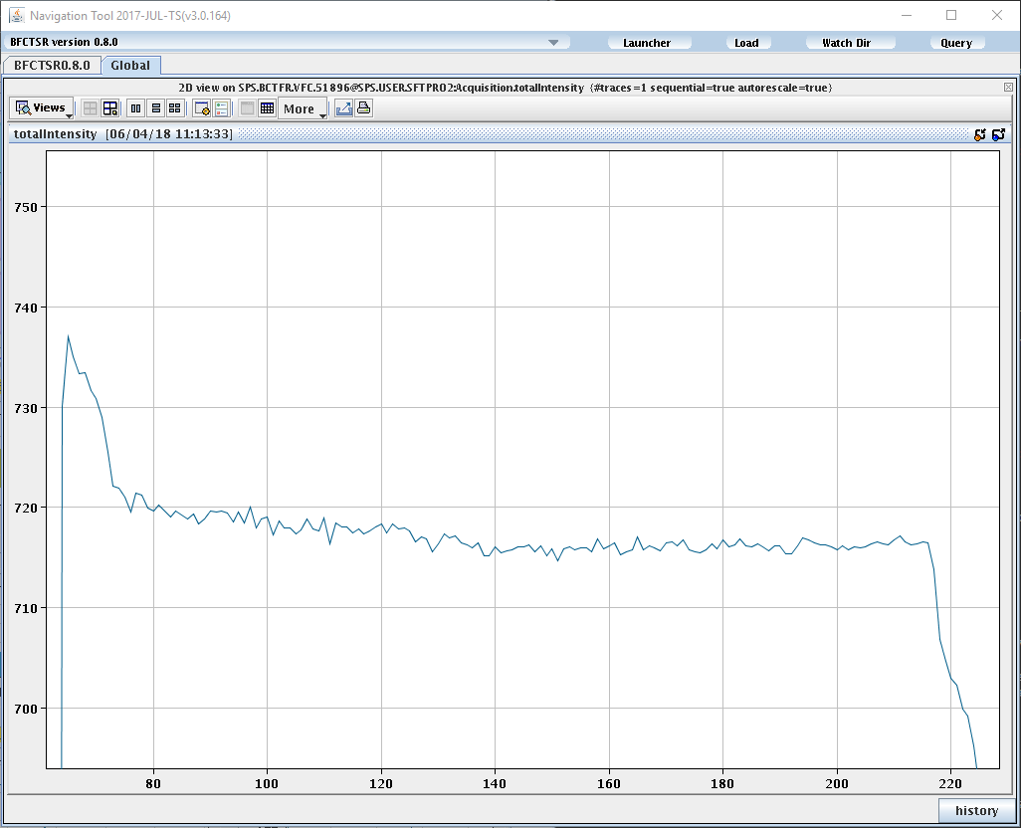

SFTPRO cycle with DAB (BA3) and VFC (ECA5) - Zoom
OP never trusted the measurement in BA3
DAB - LBW
VFC
DAB - HBW

Slide 4
VFC-based Ring fast BCTs – ECA5
Automatic gain selection – possibility to lock to a specific one
Numerous algorithms implemented in firmware for:
  Zero-suppression
  Baseline
    Minimum
    Abort gap
    Variable
  Peak finding
  …

Slide 5
VFC-based Ring fast BCTs – ECA5
Total Intensity averaged @ 50 Hz – published at the end of the cycle
Bunch-by-bunch intensity averaged @ 50 Hz – published at the end of the cycle
Beam filling pattern @ 50 Hz – published at the end of the cycle
Turn-by-turn (max 1023) intensity for tracking instabilities at injection – published when data ready
Total Intensity @ the basic period
Total Intensity @ the flat-top (not available for every cycle due to missing timings) – published at the end of the cycle
Bunch-by-bunch Intensity @ the flat-top (not available for every cycle due to missing timings) – published at the end of the cycle
Down sampled bunch intensities for logging (@ the basic period)

Slide 6
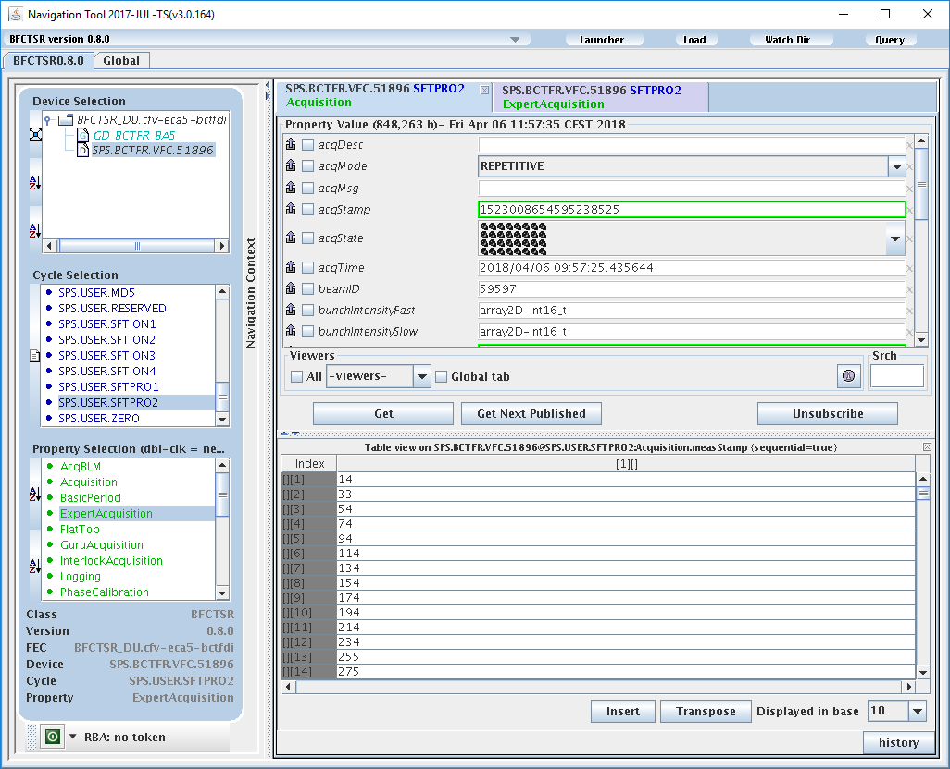

Total Intensity averaged at 50 Hz
Free running buffers cause misalignment (1st IRQ never at the same time)
This is an issue for MDs (reported by Simone)

Slide 7
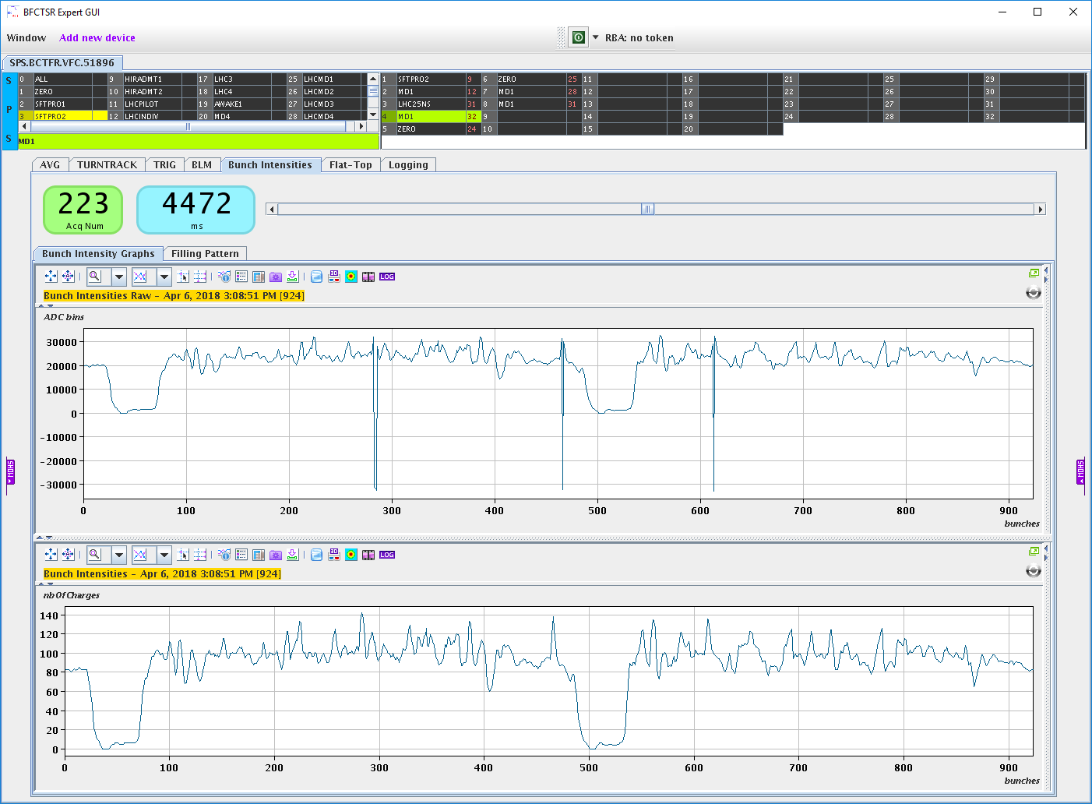
Bunch Intensity averaged at 50 Hz
Raw ADC in 16 bits otherwise too big
Rarely overflows
adc
# of charges

Slide 8
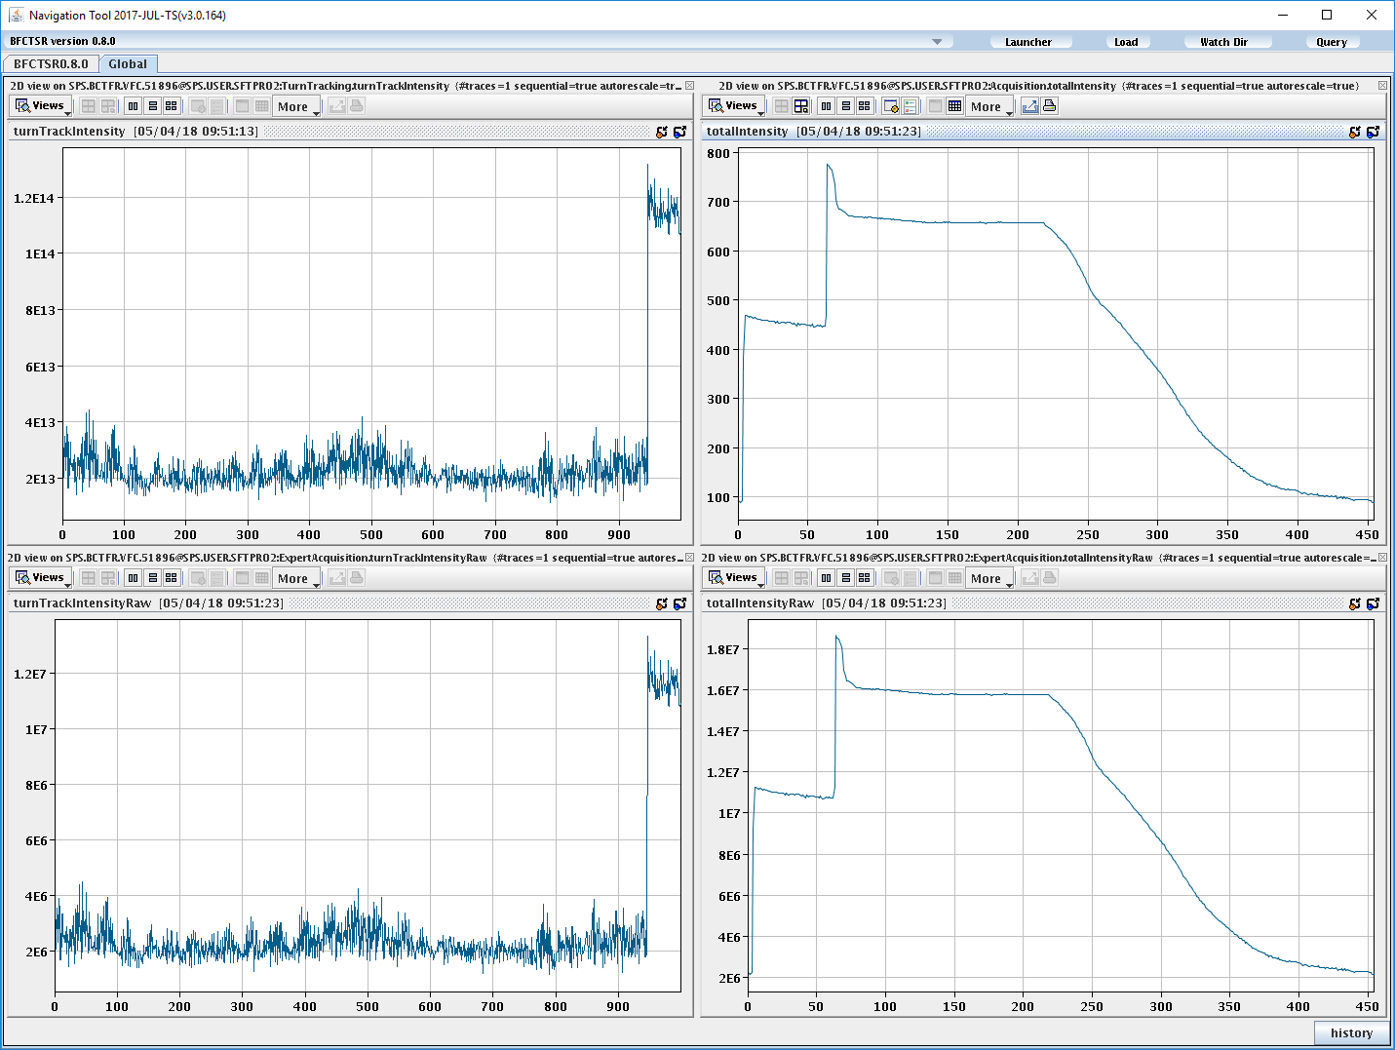
Turn-by-turn Intensity
1023 Turn-by-turn measurement
Total intensity measurement
20 ms
Injection Warning
Unfreeze buffers
Configurable delay in ms
Injection
# of turns
time
IRQ
adc
adc

Slide 9
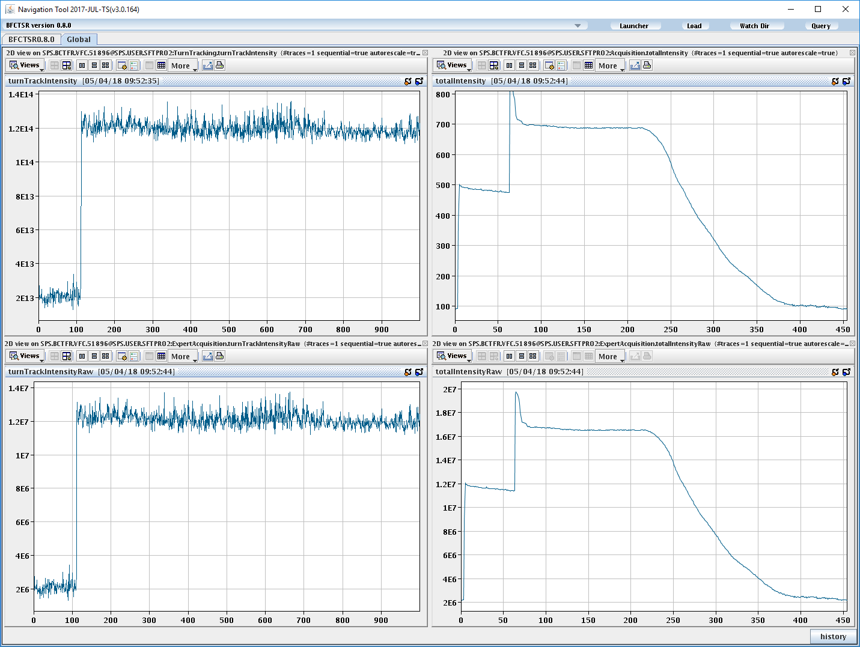
Turn-by-turn Intensity
1023 Turn-by-turn measurement
Total intensity measurement
20 ms
Injection Warning
Unfreeze buffers
Configurable delay in ms
Injection
# of turns
time
IRQ
adc
adc
Due to the free running nature of the acquisition, injection is moving around!

Slide 10
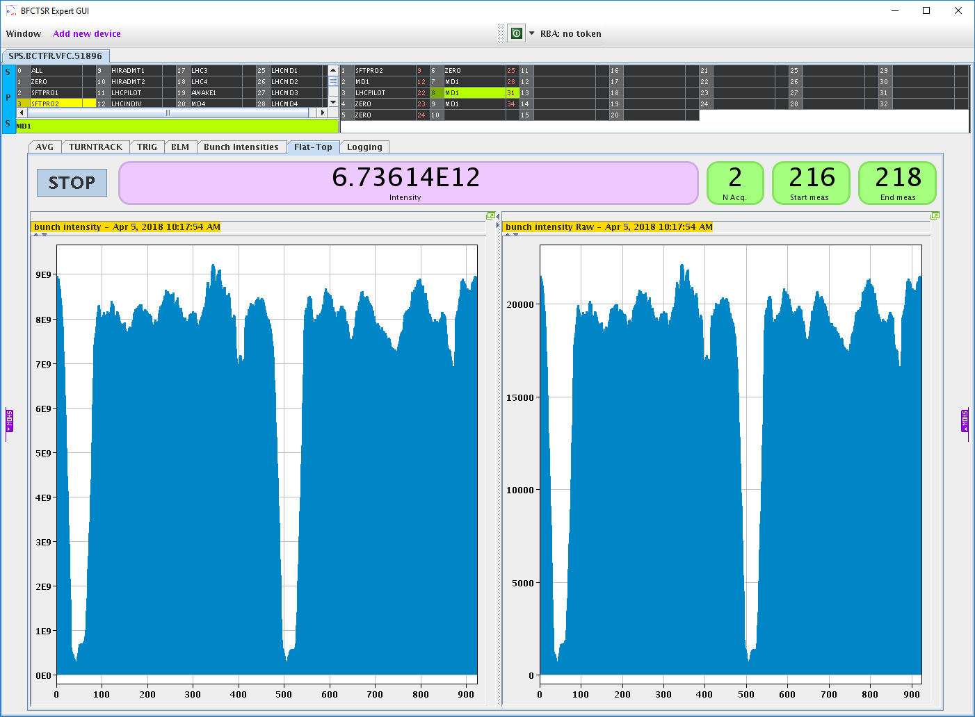
Flat-Top total and bunch-by-bunch Intensity
Average of the 50 Hz measurements
Not available for every cycle

Slide 11
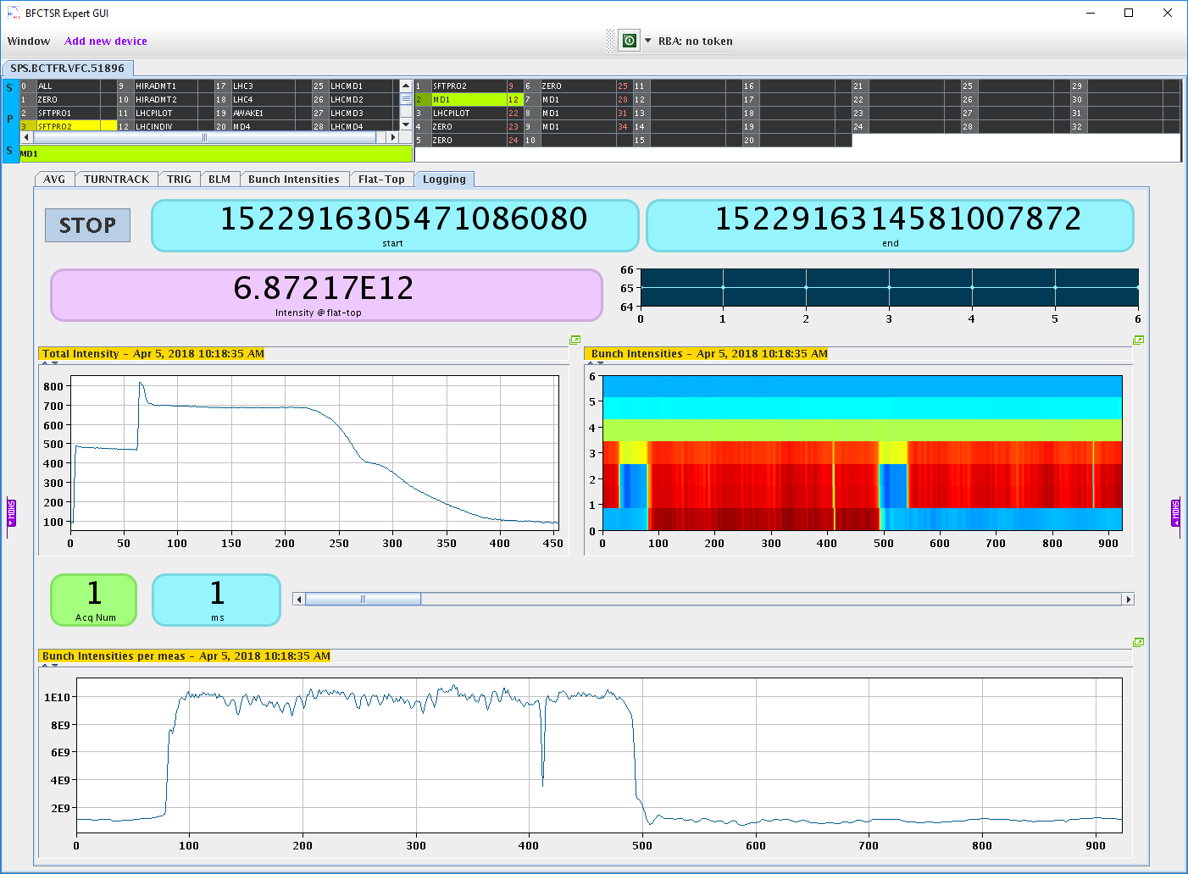
Logging
Total Intensity averaged @ 50 Hz
Bunch-by-bunch intensities averaged @50 Hz – averaged @ basic period
Intensity @ flat-top

Slide 12
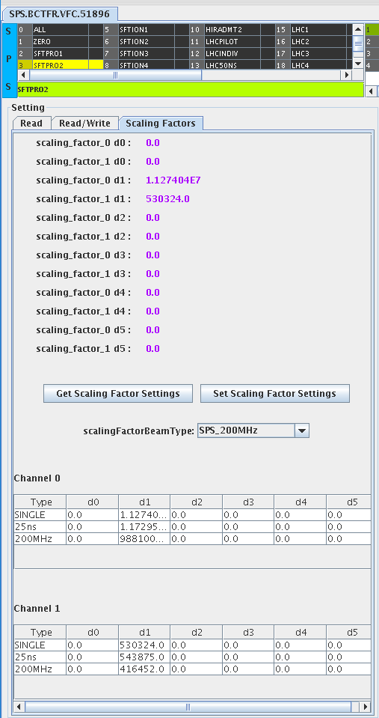
Scaling Factors
5th degree polynomial while we use linear correction
3 types of factors per beam type – non PPM
  Single bunch
  25 ns
  200MHz
Setting to choose which type to use PPM

Slide 13
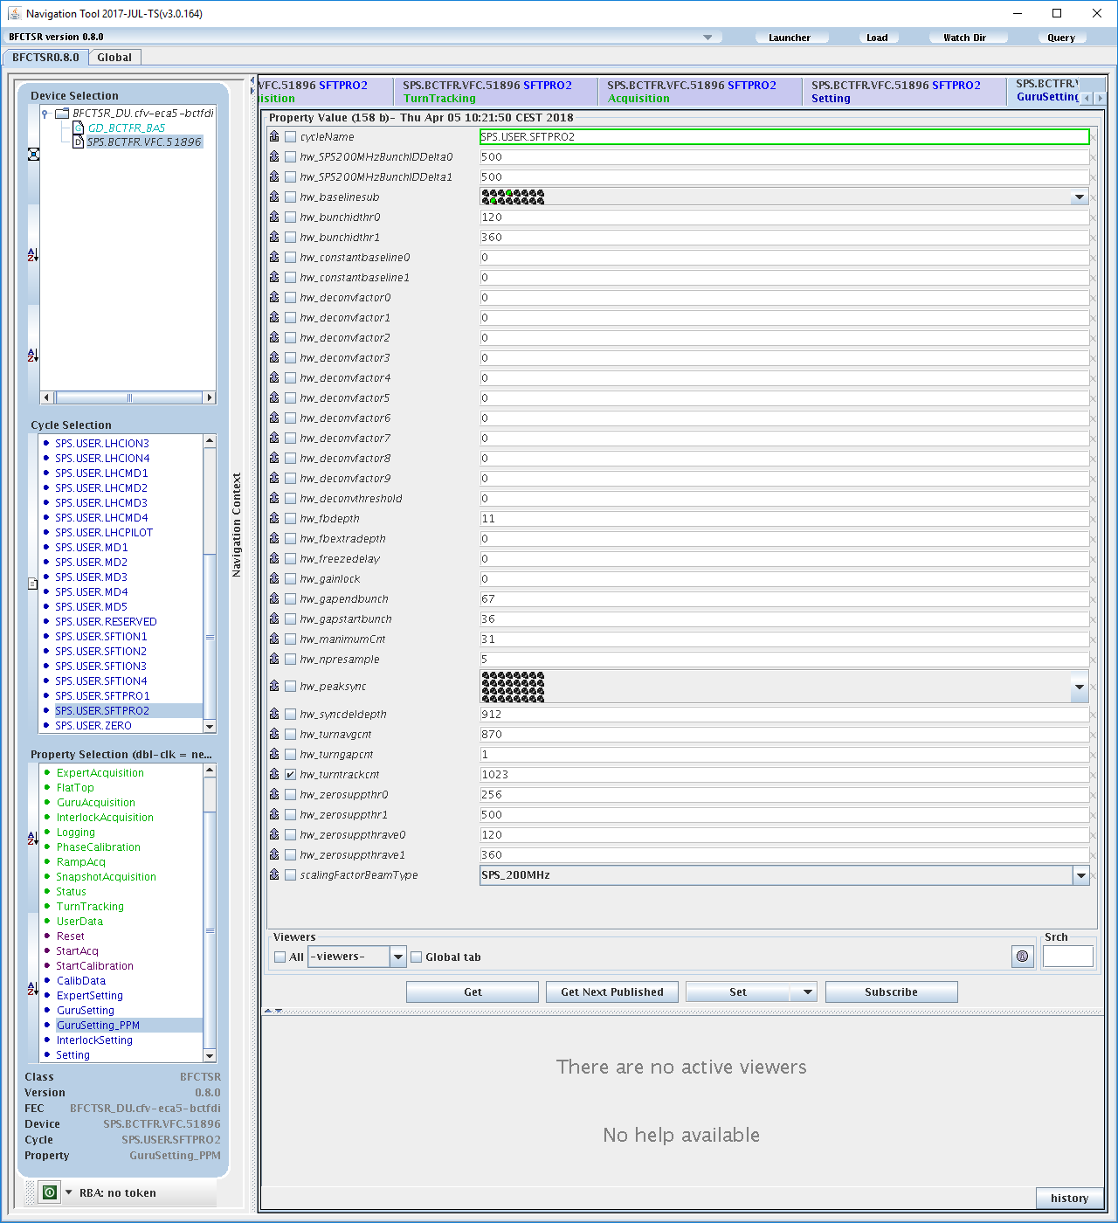
Guru Settings PPM
36 PPM Settings!
Difficult names as kept register names
Description available for most of them…

Slide 14
Conclusions
VFC gives very nice results
Free-running nature of acquisition is an issue for SPS measurements
Too many capabilities… Too many settings!
No calibration (yet)

