Slide 1



n_TOF: Facility status report and Future Perspectives
E.Chiaveri
CERN EN-STI-EET
INTC Meeting 16/17 November 2009

Slide 2
Milestones towards of nTOF Facility
14.07.2007 Presentation to the First External Panel Review
27.09.2007 Old Target removal
Study of possible solutions
14.02.2008 Presentation to the Second External Panel Review
14.03.2008 Decision to build the New Target
Target Design and Construction
Preparation of the Safety File
12.11.2008 Short commissioning of new target
15.04.2009 Installation of the new cooling system
Ventilation of primary area
Air-tight technical gallery
Alignment of FTN line and last collimator
18.05.2009 Commissioning of the new Target
15.8.2009 End of Commissioning /Start Physics

Slide 3
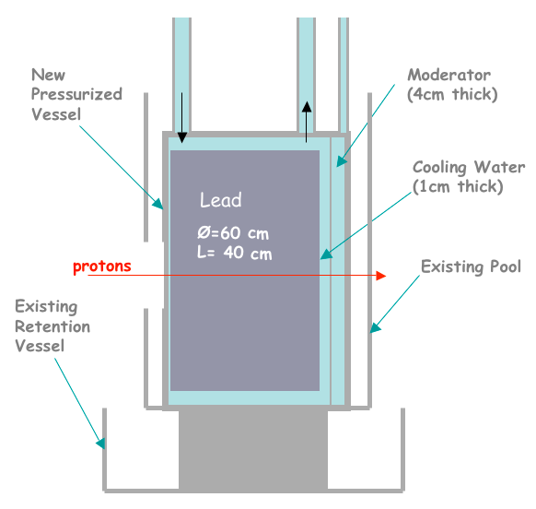
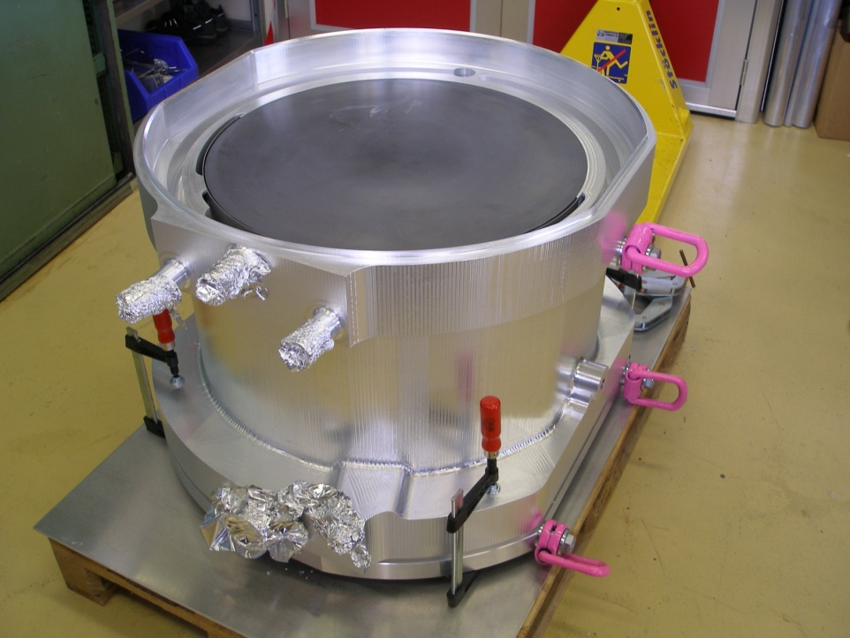
New Target: Conceptual Design
New target:
  1 cm H₂O cooling + 4 cm moderator (H₂O) (old target @ 5.8 cm H₂O)
  2.8 cm air between moderation and TOF tube
  more aluminum windows (+6 mm wrt old target)

Slide 4
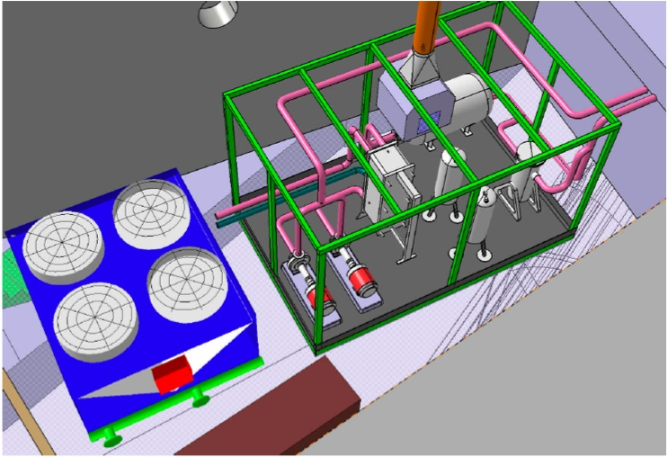
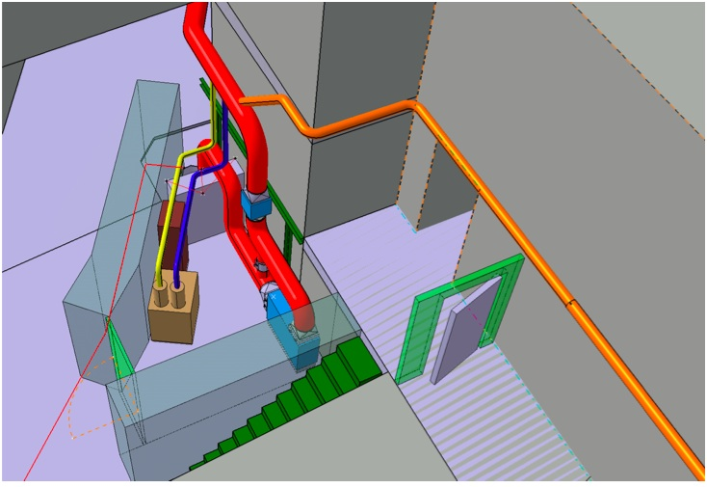
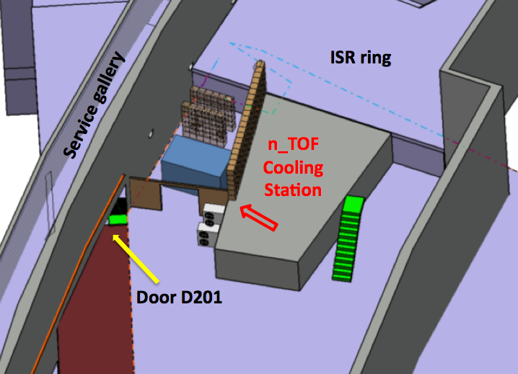
Station layout
Target cooling station
Ventilation station
From degassing station
From target area
Located in the ISR (public) area, b. 375
Appropriate shielding installed to comply with RP rules

Slide 5
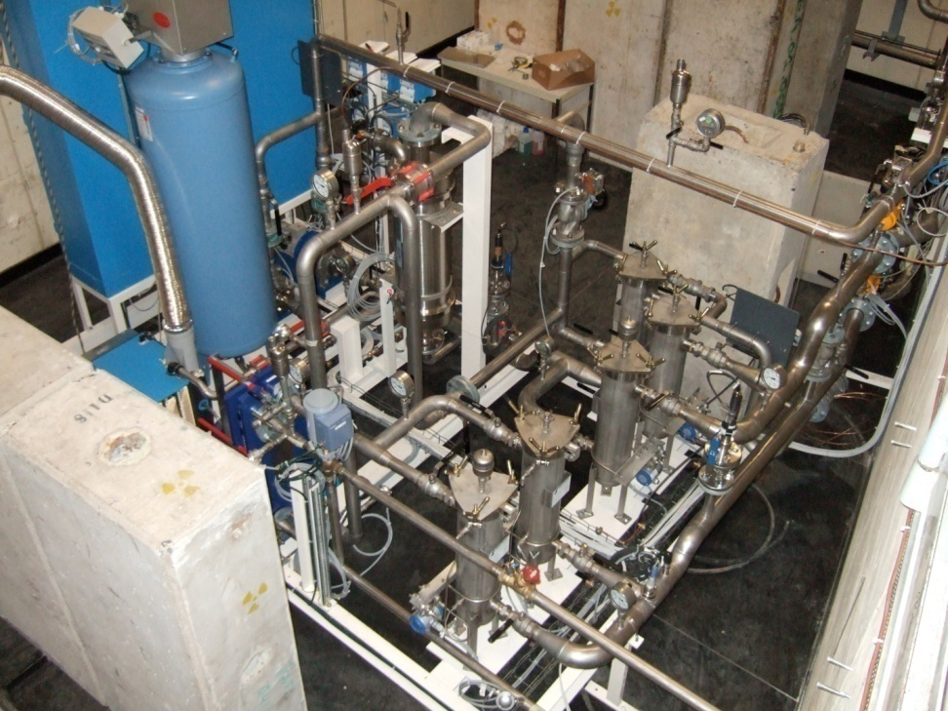
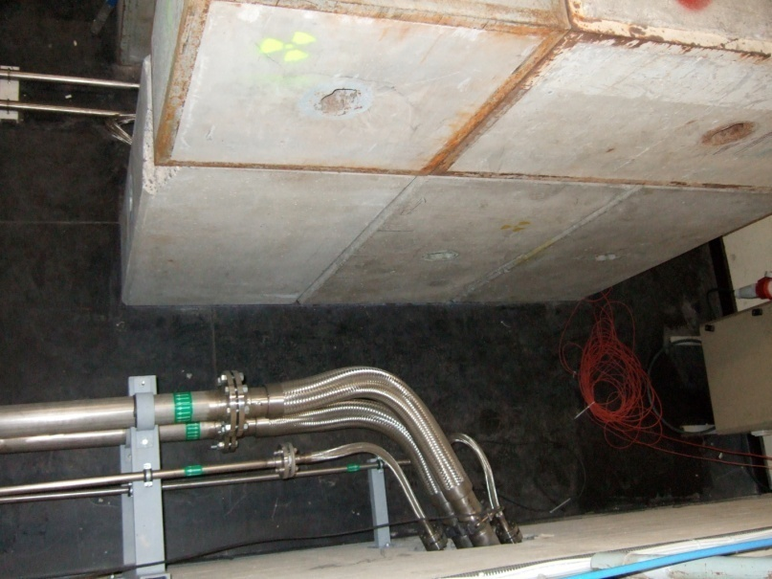
New Cooling station
During May ‘09 the new permanent station was installed
  several mechanical filters (protection)
  2 ion-exchanger cartdridges (resins) (remove “solids”)
  degassing device (remove oxygen and other “gases” from water) (O₂ level < 80 ppb)
  water flow ~5.2 m³/h (cooling circuit), 0.5 m³/h (moderator circuit)
    the two circuits are physically separated in the pit, but together (now) in the circuit
  temperature ~ 18 C
  cooling capacity ~ 7 kW
To and from cooling station
To and from target

Slide 6
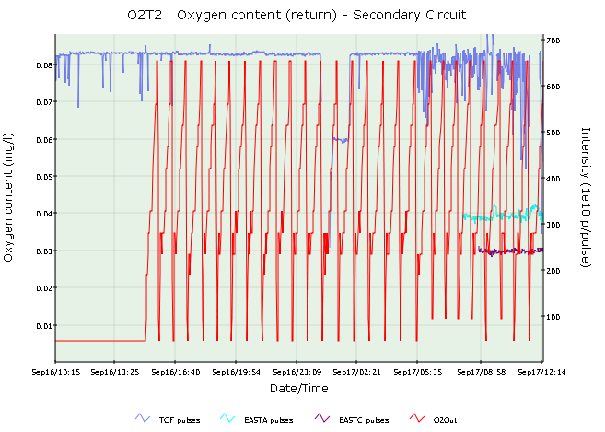
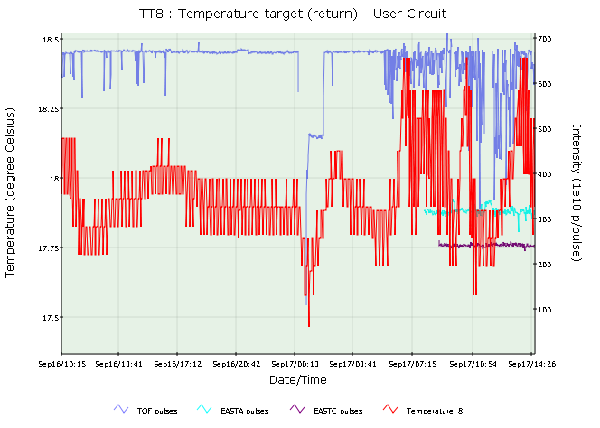
Cooling station parameters monitoring
All station parameters are monitored online (oxygen content, pH, conductivity, water fall and Δp) through interface with the TIM network
Data available online on ntofdaq.cern.ch
  correlation with proton intensity is possible
M.Calviani

Slide 7
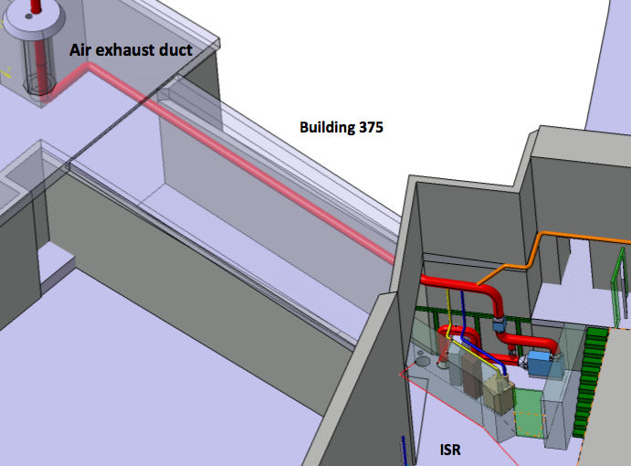
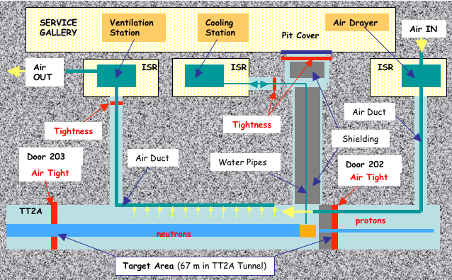
Ventilation station
By request of RP, the target area is continuously flushed out and air is released in the atmosphere:
Filter: ⁷Be, not efficient for noble gases
Flush: 500 m³/h (design)
  (40 Pa depressure – industrial standards ;ISO17873)
  Volume: 1200 m³
Dose to public: < 1μSv for 1.6*10¹⁹ p (safety file)
  RP assumption release
  of ¹¹C (t_{1/2}=1h)
  reality ⁴¹Ar (t_{1/2}=2h)

Slide 8
Protons for n_TOF and Pb target acceptable values
Nominal proton intensity on the target (for small beam spot):
thermal calculation: 4 dedicated every 16.8 s → 1.66*10¹² p/s
  average power ~2.7 kW
nominal cooling capabilities (1.66*10¹² p/s) → 200 days == 2.86*10¹⁹ p/run
Typically n_TOF is requesting 1.6*10¹⁹ p/run
→ Since the beam is 9 x larger, even higher values could be feasible
n_TOF required integrated intensity ~2*10¹⁹ p/y, PS will deliver 7.1*10¹⁸ p/y in 2009
nominal conditions: 2 TOF (7*10¹² p/pulse) + 3 EASTA/C (3.5*10¹² p/pulse) every 48 s.
“extra” conditions with more pulses/supercycle if DIRAC or EAST area not running
more “extra” during SPS MDs → maximum reached was 2.2*10¹² p/sec

Slide 9
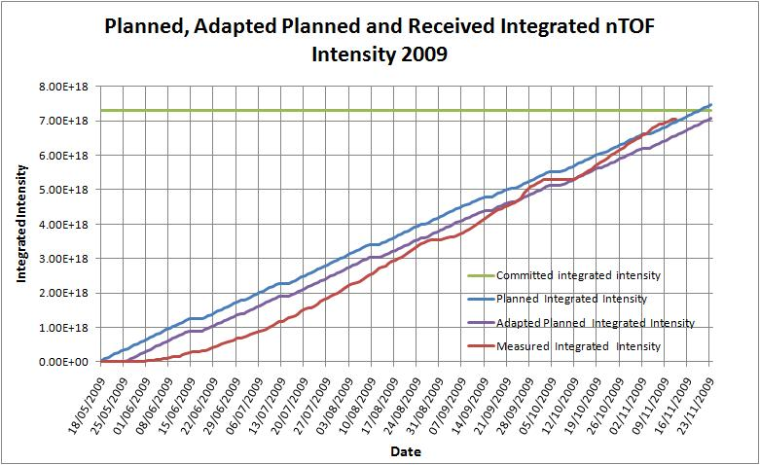
2009 beam for n_TOF
Start of beam for n_TOF 2009 run: 26th of May
Expected end 2009 run (23rd November)
nTOF received 6.97E18 protons for 7.06E18 planned, which corresponds to nearly 101% up to now and with 97% of the total committed intensity for 2009.

Slide 10
Work Sector of Type A
Fire proof
    Walls doors F90 and T60
    Fire detection
    “Continous and impermeable wall coating”
    Fire retention system (“clapet anti-feu)
Ventilation
    Depression shall be more than 60 Pa (ISO 17873)
    Guaranteed ventilation in case of power cut (UPS and CERN backup)
    Isolation of work sectors in case of fire
    Must be monitored and connected to an alarm
Access
    Material and personnel
    Hand foot monitors, complete clothing change
Decontamination area
    Hands free wash basins
    Shower can be used in Bat 179 (ISOLDE area)
Notes:
10

Slide 11
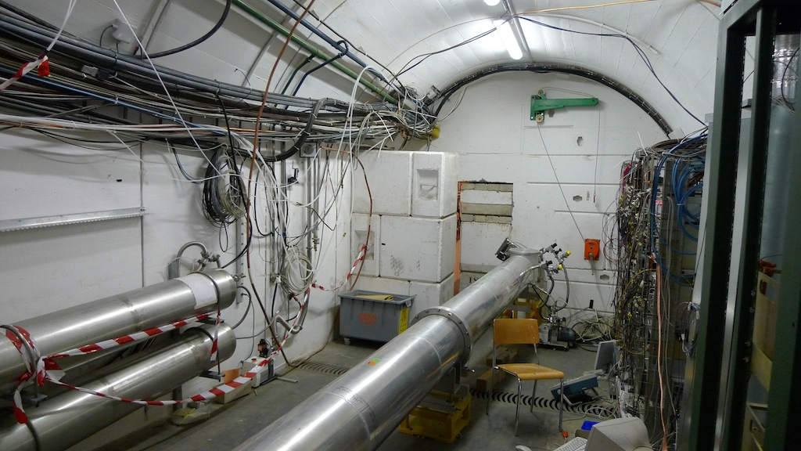
n_TOF Escape Lane, DAQ and access to Experimental Area

Slide 12
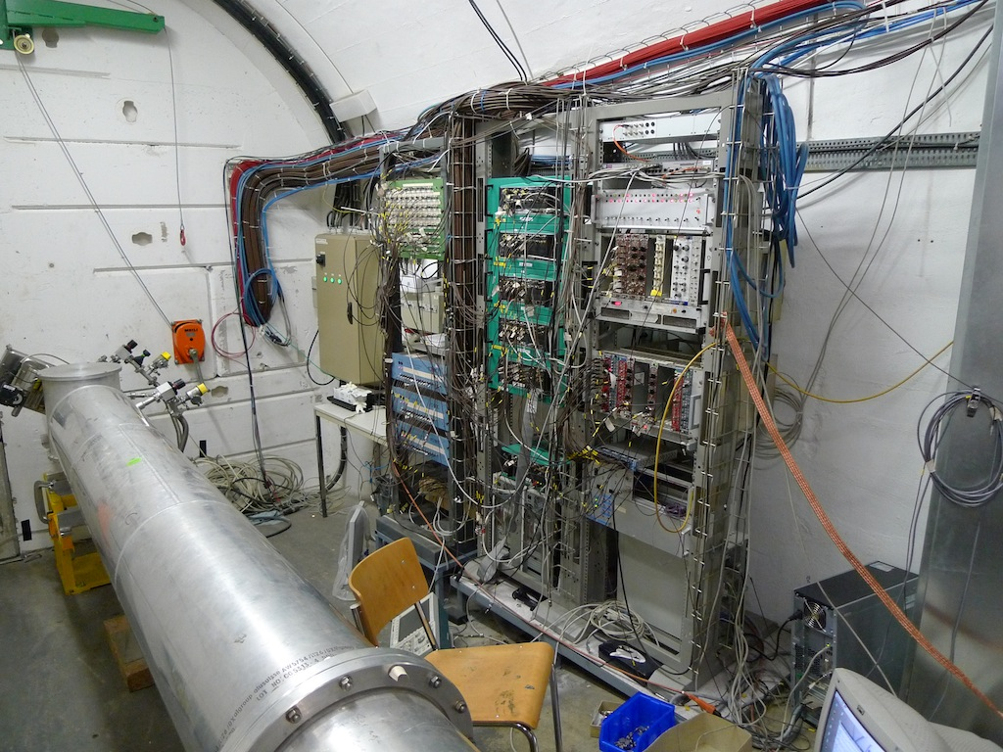
n_TOF DAQ + cablings to Experimental Area

Slide 13
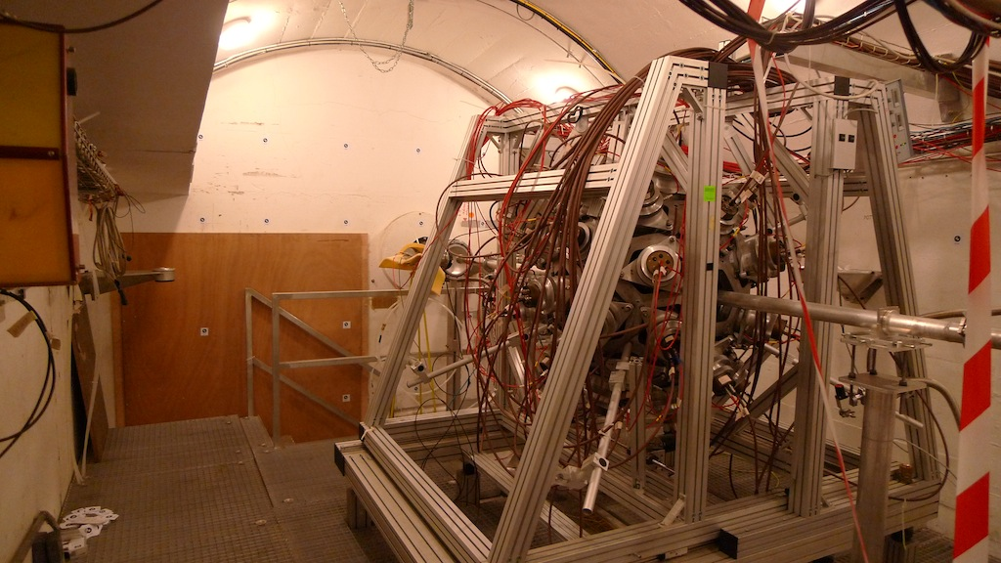

Slide 14
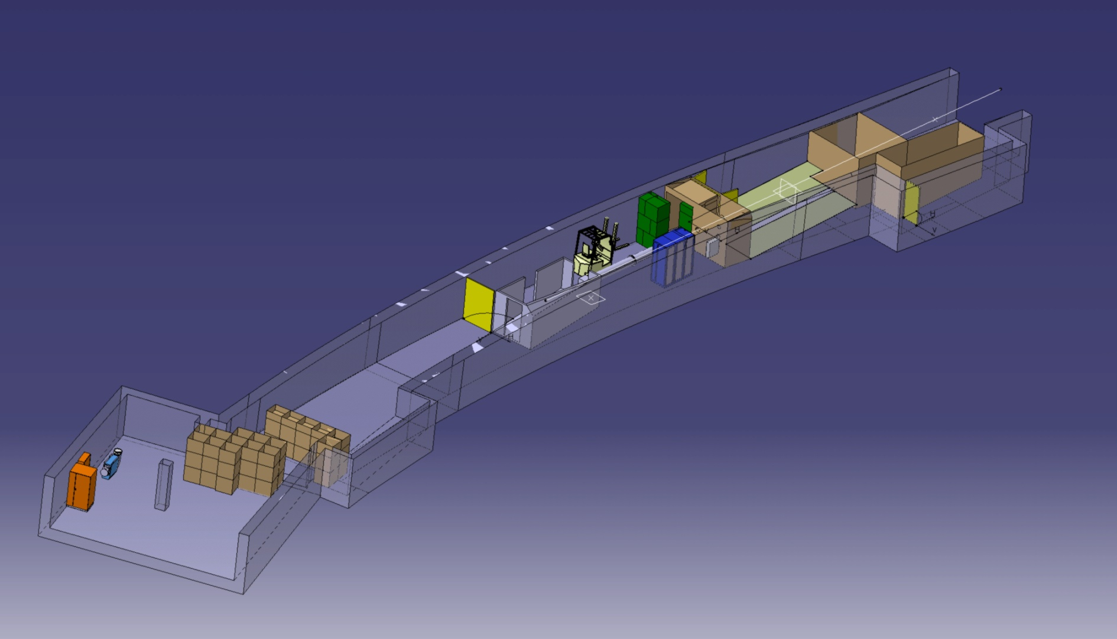
New layout proposal
SG - EN-MEF-SBA

Slide 15
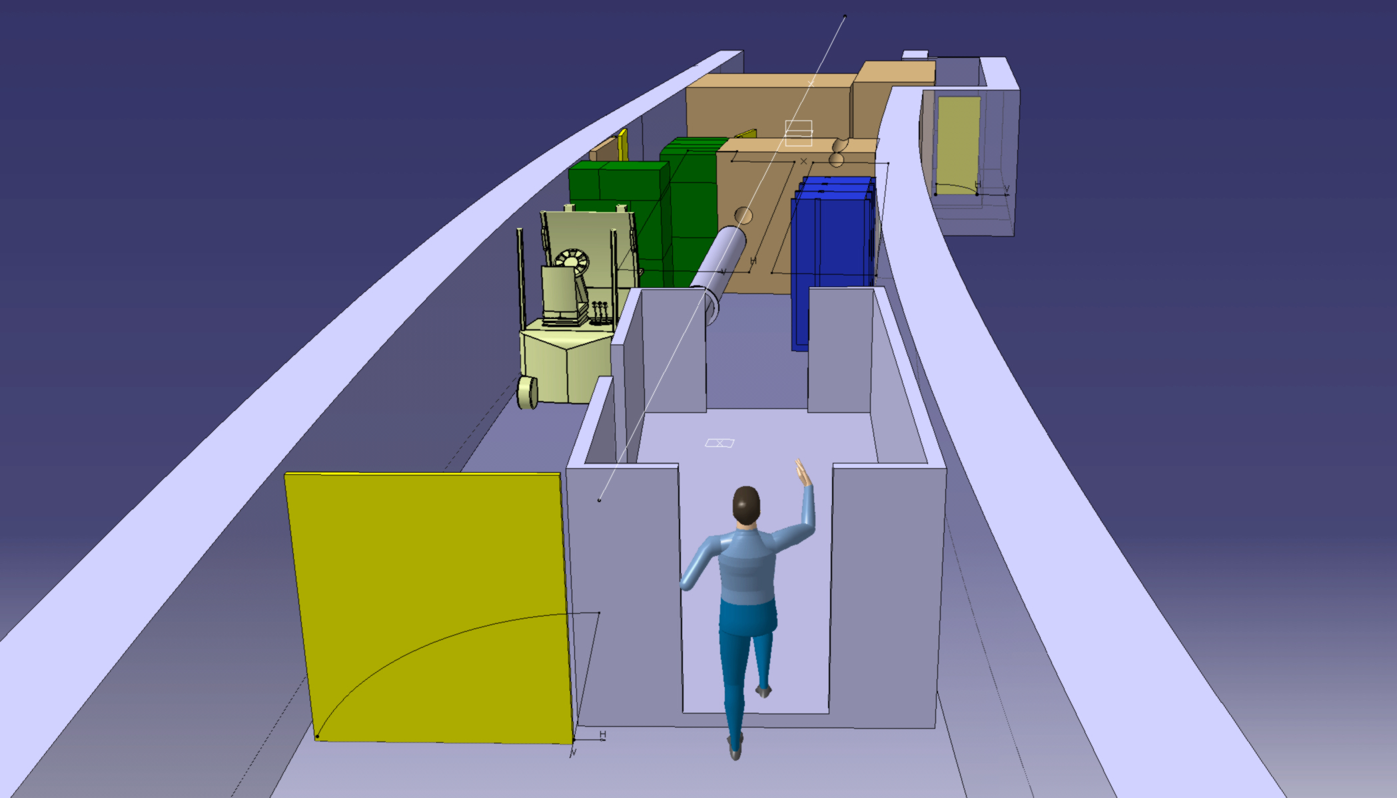
Changing Room
fire doors
(Not shown)
SG - EN-MEF-SBA
15
Notes:
15

Slide 16
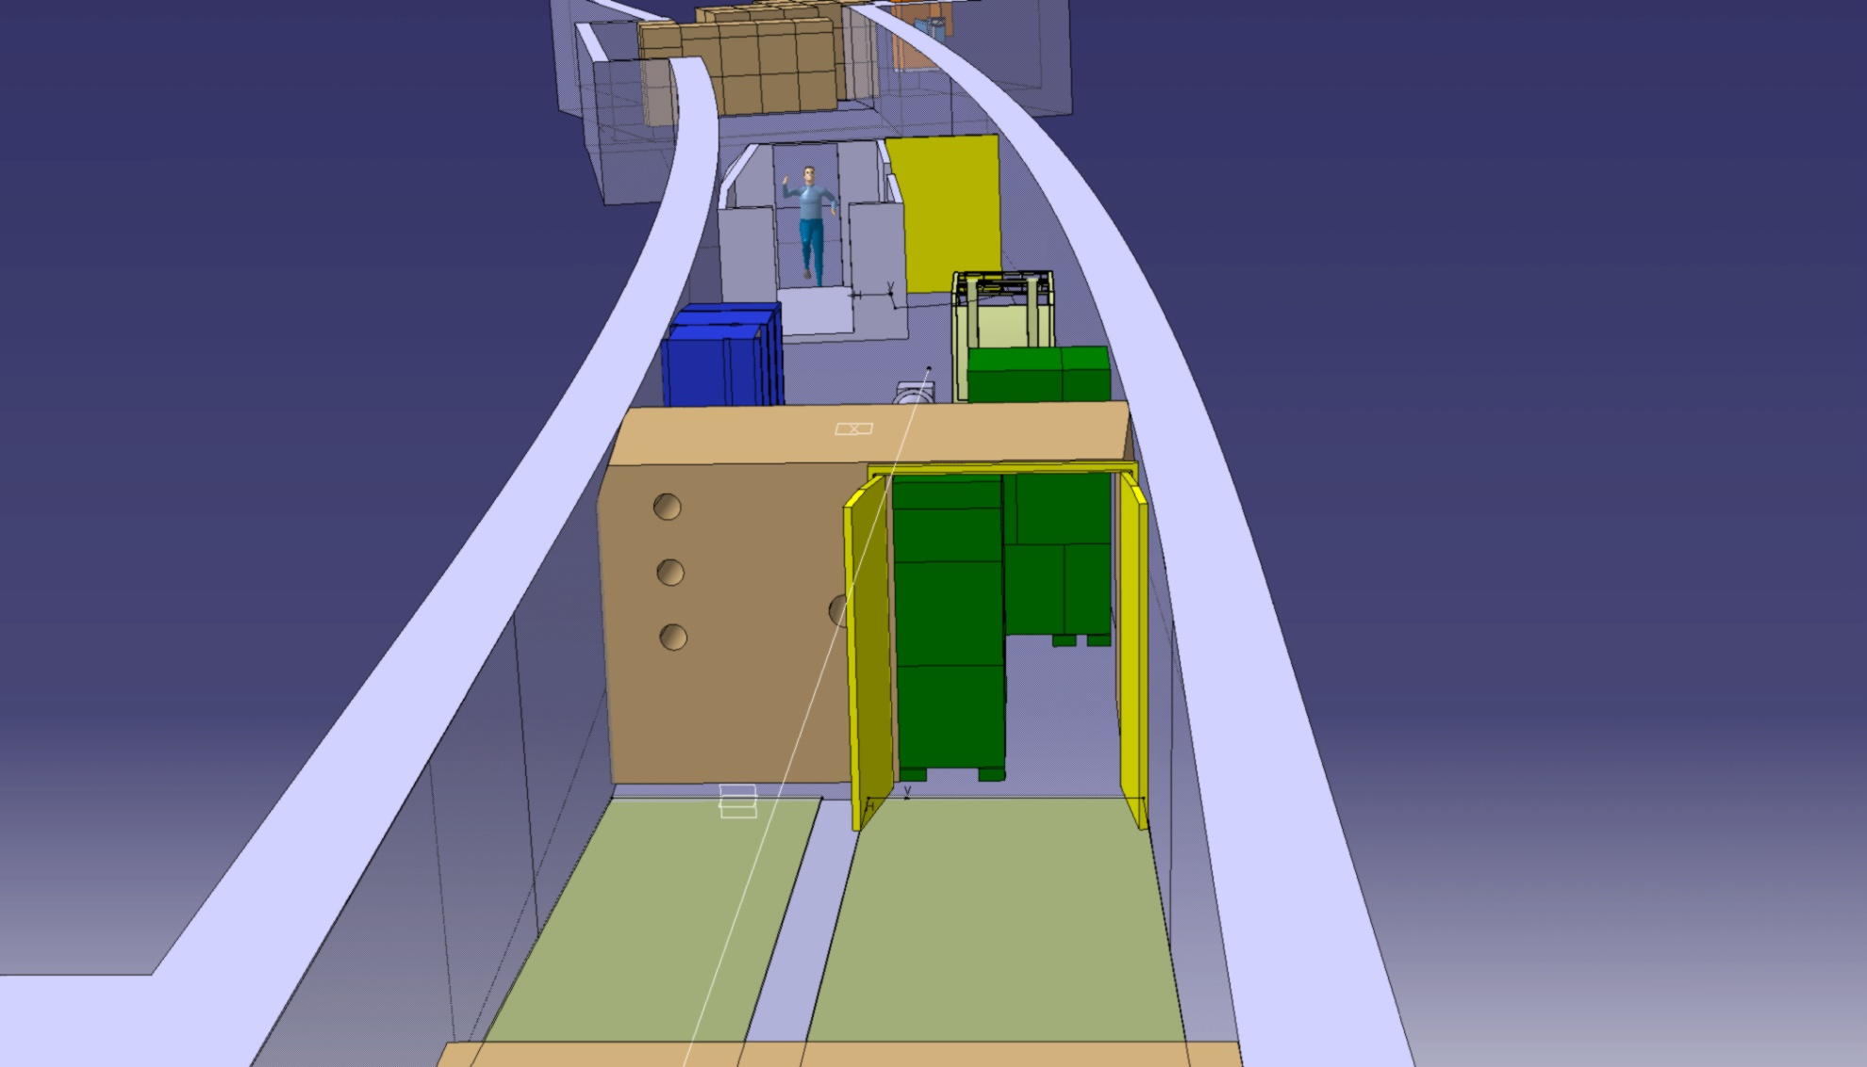
Experimental Area

Slide 17
Borated water
H₂O + 1.28% ¹⁰B 99%
  Neutrons:
    removal of thermal neutrons
    flux unchanged > 1 eV
  Photons:
    7.5 MeV, 2.5 times lower
    2.2 MeV, 12.5 times lower
    480 keV ~60 times higher
Circuit is in the engineering phase
  capable of running with and without boric acid in the water within reasonable time (needs flushing)
  possible precipitation of B salt
Cooling is of the solution is performed through contact at target station level (contact surface big compared to volume)
Two operational modes 0% boron content, and fully saturated

Slide 18
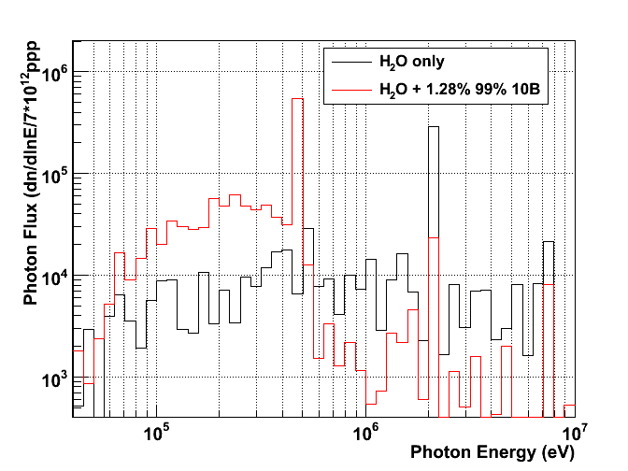
Borated water studies –
Photon Energy distribution
Effect of boric acid: → appearance of the 470 keV line + reduction of the 2.2 MeV
470 keV from ¹⁰B(n,α)⁷Li
2.2 MeV ¹H(n,γ)
7 – 7.5 MeV prompt γ on Fe, Al, Pb
511 keV e+e-
M.Calviani

Slide 19
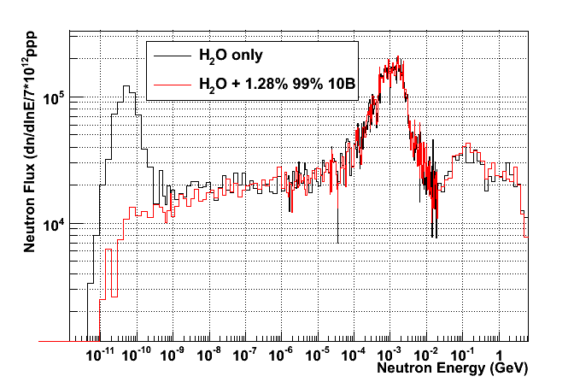
Borated water studies – neutron fluence
Effect of ¹⁰B presence is essentially in the region < 1-10 eV and specifically at thermal
Almost removal of the “thermal” peak
M.Calviani

Slide 20
Phase II experimental program
Capture measurements
Mo, Ru, Pd stable isotopes Fe, Ni, (*)Zn, and Se (stable isotopes) ⁷⁹Se A≈150 (isotopes varii) ^{234,236}U, ^{231,233}Pa ^{235,238}U ^{239,240,242}Pu, ^{241,243}Am(*), ²⁴⁵Cm | r-process residuals calculation isotopic patterns in SiC grains s-process nucleosynthesis in massive stars accurate nuclear data needs for structural materials s-process branching points long-lived fission products Th/U nuclear fuel cycle standards, conventional U/Pu fuel cycle incineration of minor actinides
(*) approved by CERN Scientific Committee (planned for execution in 2009/2010)

Slide 21
Phase II experimental program
Fission measurements
MA ²³⁵U(n,f) with p(n,p’) ²³⁴U(n,f) ²³²Th,²³³U, ²³⁴U^{,237}Np | ADS, high-burnup, GEN-IV reactors new ²³⁵U(n,f) cross section standard study of vibrational resonances at the fission barrier Angular distribution for fission products
Other measurements
¹⁴⁷Sm(n,α), ⁶⁷Zn(n,α), ⁹⁹Ru(n,α) ⁵⁸Ni(n,p), other (n,lcp) Al, V, Cr, Zr, Th, ²³⁸U(n,lcp) He, Ne, Ar, Xe n+D₂ | p-process studies gas production in structural materials structural and fuel material for ADS and other advanced nuclear reactors low-energy nuclear recoils (development of gas detectors) neutron-neutron scattering length

Slide 22
Summary
Facility status
Implementation New Cooling and moderator systems of the target
Implementation of primary area Ventilation
Work sector type A ready May 2010
2009 run
New spallation target commissioning finished the 15th August
  Performances as expected
  New and multiple detectors used for evaluating beam characteristics
Physics measurements: of the 2009 run:
  ⁵⁶Fe(n,γ) (C₆D₆) with 2.37x10¹⁸ POT
  ⁶²Ni(n,γ) (C₆D₆) with 1.79x10¹⁸ POT
Next years
2010 experimental campaign ready:
  Angular distribution of fission fragments with PPACs (TOF14)
  Capture measurements with C₆D₆ (TOF13)
  Capture measurements on actinides with TAC
  Commissioning with borated water moderator (TOF12)
New proposals under preparation for the next INTC meeting

