Slide 1

n_TOF commissioning
INTC-P-249
Spokespersons: J.L.Tain, V.Vlachoudis
Contactperson: V.Vlachoudis
16-17th Nov 2009
for the n_TOF collaboration

Slide 2
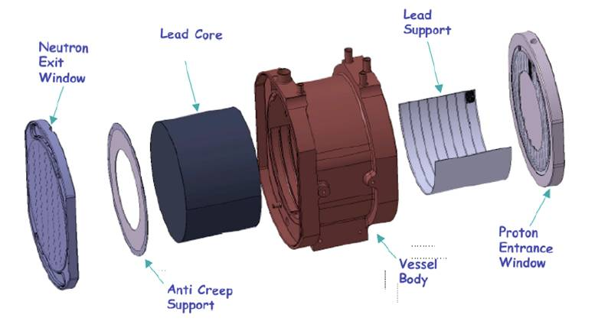
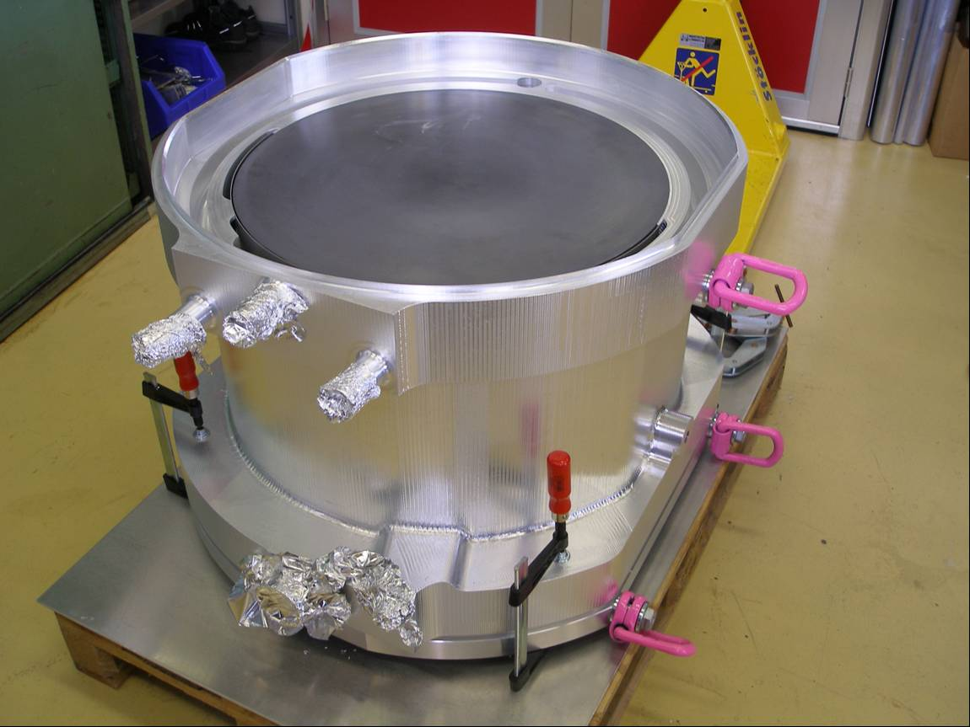
New Target – Refurbished Facility
Pb mono-block (∅60cm L40cm)
Forced water cooling
Chemically controlled water
Oxygen/Corrosion control
Separate moderator from cooling
  Al container
  3 Al-windows with air-gap
Defocused proton beam
New Ventilation system
Air-tight primary zone with a
40Pa depression

Slide 3
Proposed measurements
The neutronics of the new target is different, therefore there is a need to characterize carefully the beam and backgrounds in order to fulfill our goal of obtaining accurate data:
Neutron fluence
Neutron beam profile
Neutron energy resolution function
Neutron energy versus time-of-flight relation
Scattered in-beam γ-ray background
Scattered neutron background
Off-beam background
Needed to obtain cross sections
Needed to control systematic errors
Detected counts as a function of ToF
Cross section as a function of energy

Slide 4
Requested beam time
General start-up: 1.0×10¹⁷ p
Neutron fluence: (*) 1.6×10¹⁸ p
Beam profile: -
Resolution Function: (*) 5.0×10¹⁷ p
In-beam γ-ray background: (*) 4.0×10¹⁶ p
Scattered n background: 2.1×10¹⁷ p
Off-beam background: -
Total: 2.45×10¹⁸ p
(*) assuming: normal water / borated water

Slide 5
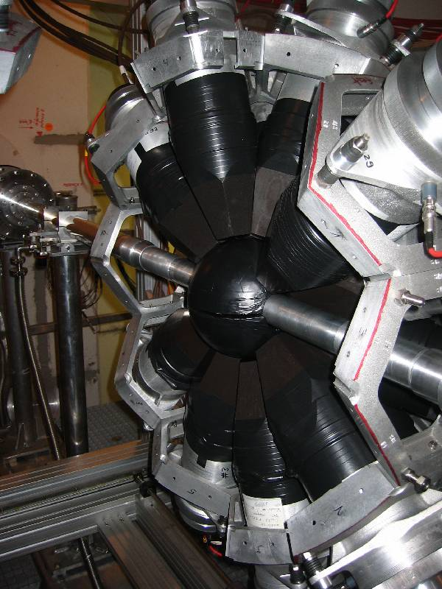
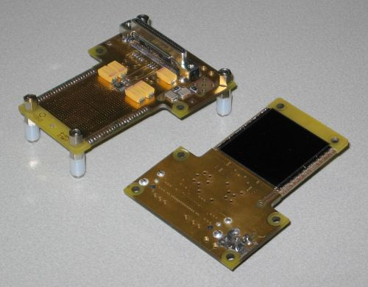
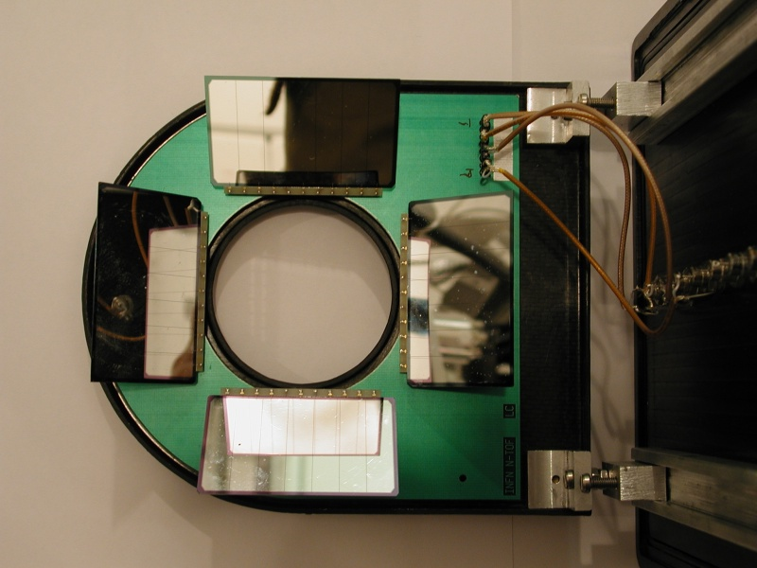
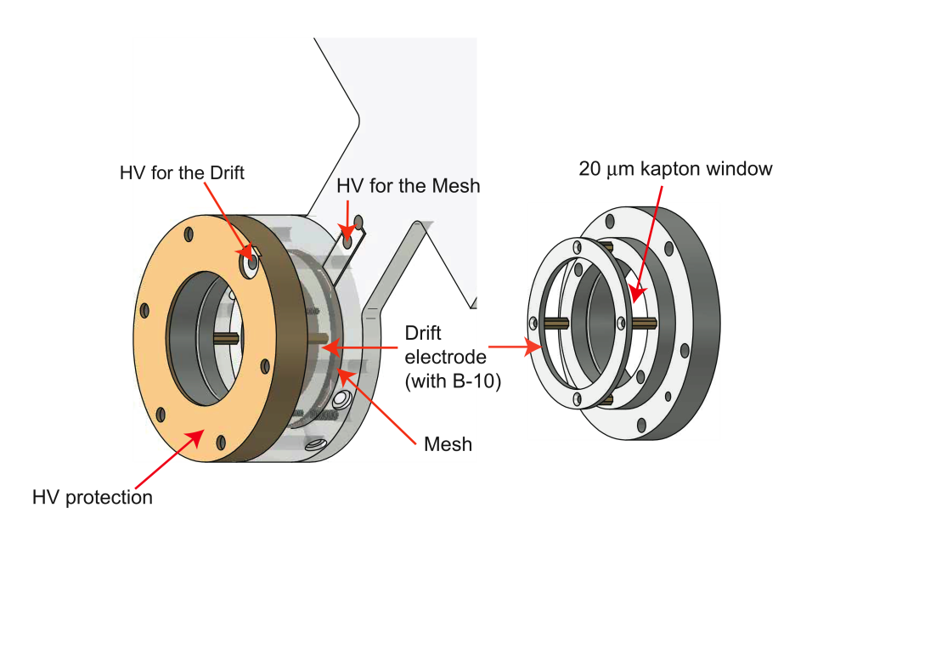
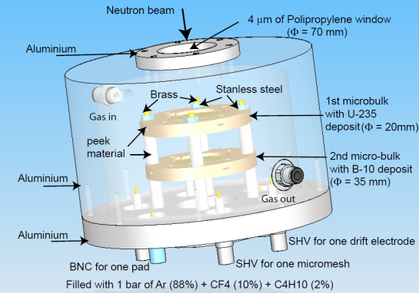

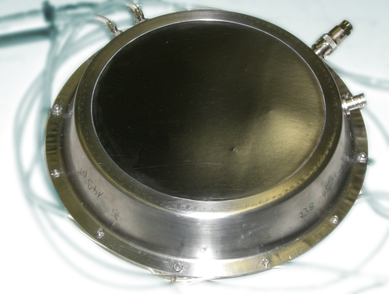
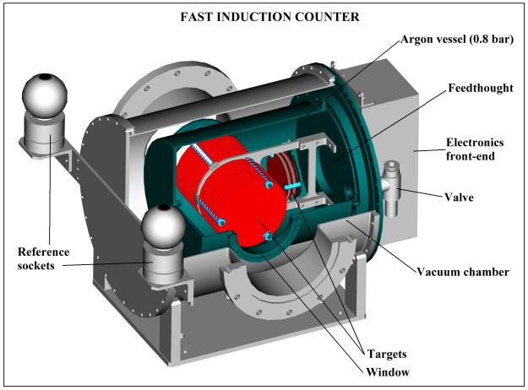
Proposed Experimental Apparatus
X
Beam characteristics:
Neutron fluence:
PTB Fission Chamber ²³⁵U, ²³⁸U
FIC ²³⁵U, ²³⁸U
uMegas: ²³⁵U & ¹⁰B
SiLi, Gold foils
Spatial distribution:
Medipix with LiF & polyethylene
X-Y μMegas with ¹⁰B
Resolution function:
C6D6 with ^{54,56}Fe, ³²S
Background:
CR-39, TLD, BaF₂ and C6D6
Cooling station:
Monitor Performance
Control O₂ level
C6D6
PTB FC
Quad Medipix
uMegas
TAC

Slide 6
Commissioning Diary
18.05.2009 Scheduled beam on n_TOF target
Delayed due to PS problems
26.05.2009 Medipix run.
Problem on readout of the beam transformer.
No reliable proton information.
01.06.2009 X-Y μMegas Beam profile measurements
Alignment issues with the detectors
Possible alignment problem on 2nd collimator
09.06.2009 Beam transformer readout problem solved
15.06.2009 Resolution function
22.07.2009 Fluence measurements with PTB chamber
13.08.2009 Fe/Ni proposal
…
09.11.2009 Scattered neutron background in TAC
16.11.2009 Experimental alignment of the second collimator

Slide 7
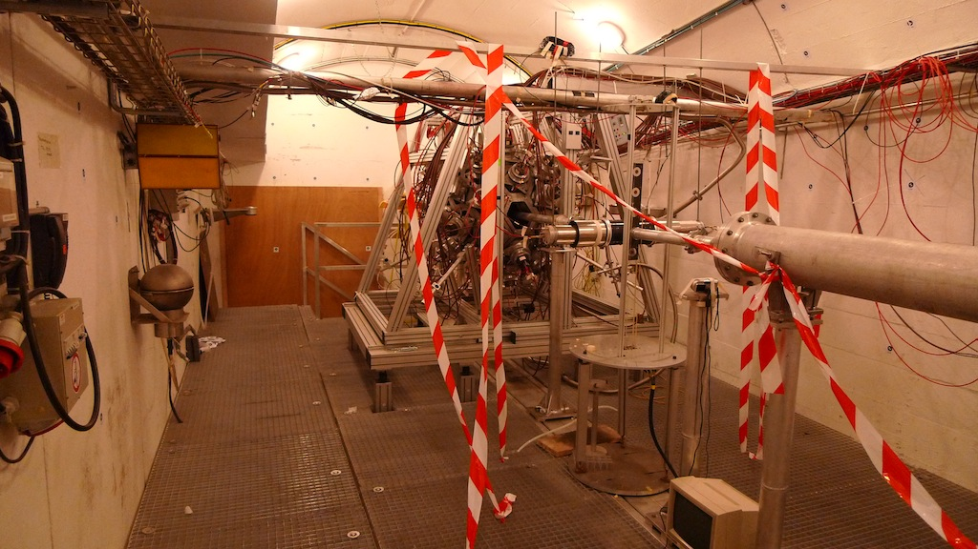
Experimental Area

Slide 8
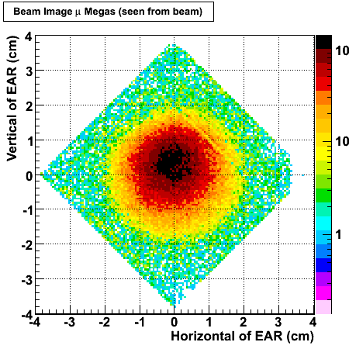
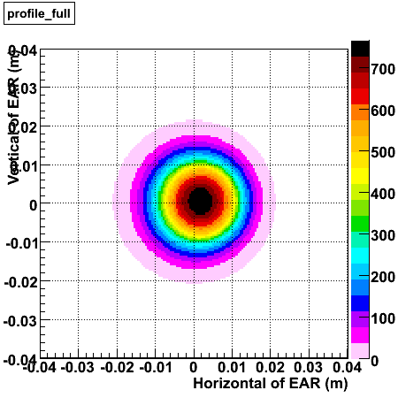
Beam profile results
Comparison X-Y Micromegas data vs. simulation for the New Target
Projection of a cut around the mean value of the 2D distribution of X and Y
  +/- 2.5 mm in simulated data
  +/- 2.8 mm for X-Y Micromegas data
Full coverage from thermal to 1 MeV
Experimental @ S-Ex position
Simulated @ 184.5 m

Slide 9
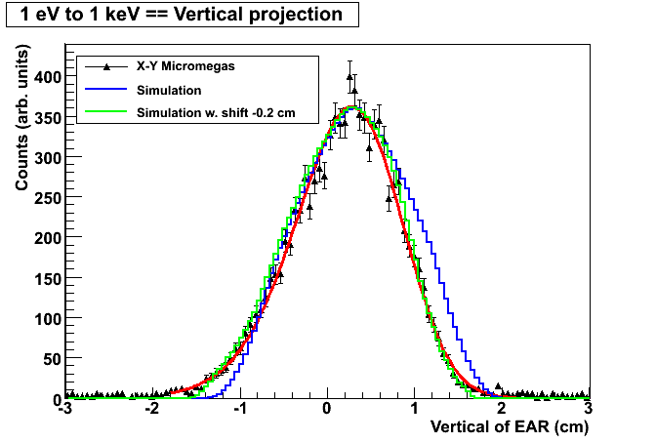

Slide 10
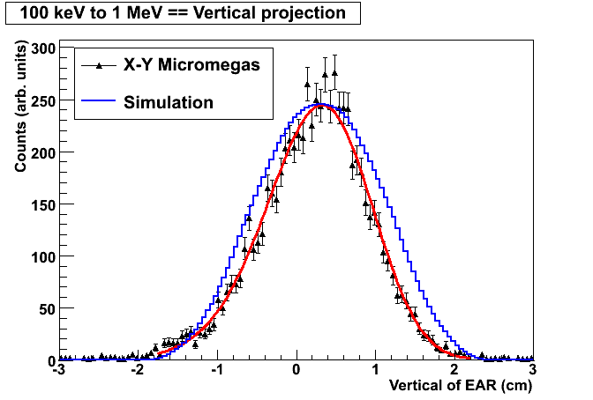

Slide 11
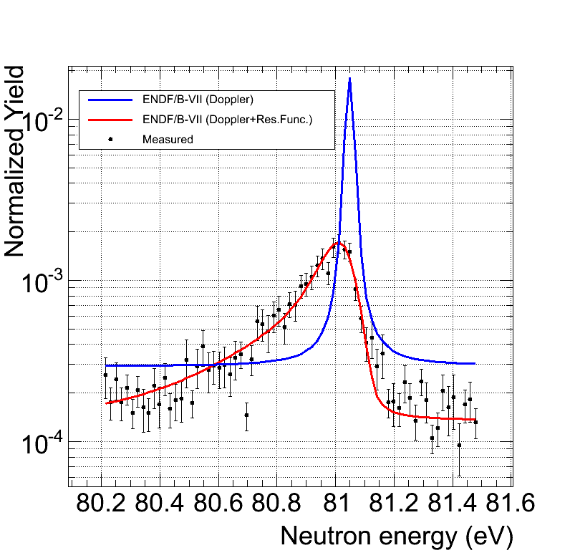
Resolution Function
The direct comparison with data from 2002 do not indicate a significant change in the Resolution Function. The detailed analysis from high energy ⁵⁶Fe resonances and simulations remains to be done.
Use 2 C6D6 detectors
2g samples enriched ⁵⁴Fe, ⁵⁶Fe
Also ³²S (513, 819keV)
Expected:
10³ counts in weakest resonance
25% worsen on the tail.
Effect to be seen after resonance
analysis with SAMMY
The C6D6 were placed upstream
to reduce the in-beam gamma
background → Statistics were lower
PRELIMINARY

Slide 12
Neutron Fluence measurements
The shape and intensity of the neutron fluence at n_TOF has been characterized by means of five different measurements:
 | Reaction | Shape | Intensity
PTB | ²³⁵U(n,f) | Yes | Yes
μMegas | ²³⁵U(n,f) & ¹⁰B(n,α) | Yes | ~
SiMon | ⁶Li(n,t) | Yes (E_{n}<keV) | ~
TAC | ¹⁹⁷Au(n,γ) | No | Yes (@4.9 eV)
Activation | ¹⁹⁷Au(n,γ)¹⁹⁸Au(β) | No | Yes (@4.9 eV)
The shape of the neutron fluence is crucial for all capture measurements, which are normalized to a saturated resonance at a given energy.

Slide 13
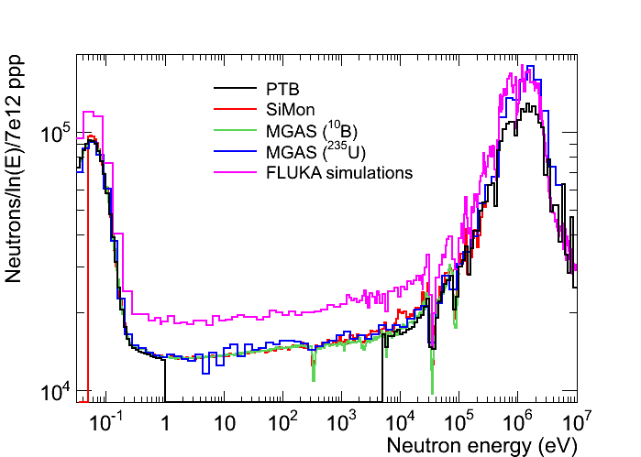
Neutron fluence
A combination of all detectors provided the neutron fluence spectrum&intensity
All detectors agree within 4-5%
Neutron fluence is lower by 20-28% than expectations
→ Consistent with a possible 2nd collimator tilt by -2mm.
PRELIMINARY

Slide 14
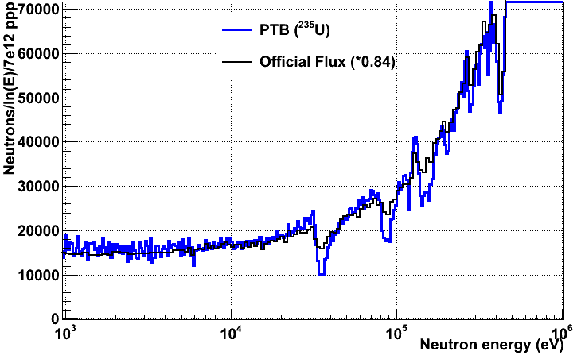
Comparison with old target
Neutron fluence is comparable with the previous target apart from more pronounced the aluminum resonances
Deeper Al dips (E_{n}>30 keV)
PRELIMINARY

Slide 15
Summary
Setup
Problems in reading the transformers
Problems in alignment of detectors
Beam Profile
Protons: uMegas 1×10¹⁸ + Medipix 6×10¹⁶ p
Horizontal plane: Very good agreement with the expectations
Vertical plane: Agreement assuming a tilted second collimator by -2mm
Neutron fluence
Protons: PTB 1×10¹⁸ p
20-25% lower than the expectations → collimator misalignment/tilt
Resolution function + Energy-Time relation
Protons: 4×10¹⁷p (+exploiting the statistics from Fe/Ni proposal)
No significant change with the past
Analysis still on progress

Slide 16
On-going / future measurements
2009: ongoing
Sample scattered neutron background in TAC
Cross-check 2nd collimator alignment experimentally
2010: planned
Borated water circuit
operating in two modes 0% ¹⁰B-content or fully saturated ~1% ¹⁰B
Measure:
  Neutron fluence
  Resolution
  Reduction effect of in-beam γ-rays

